Slide 1
Storyboarding and Paper Prototyping
CPSC 481 Week 3 Tutorial
Anthony Tang, with acknowledgements to Julie Kientz, Saul Greenberg, Ehud Sharlin, Sheelagh Carpendale, Nicolai Marquardt
Notes:
Preparation:
Take the templates Tony has made for Storyboarding, and make sure you have enough copies for everyone
Watch the videos over so you know what the storyboards are about
Bring post-it notes of various sizes to the lab, as well as markers

Slide 2
Storyboards
A storyboard is a sequence of images where each image shows an element in time. The space between the frames show the transitions between states.

Slide 3
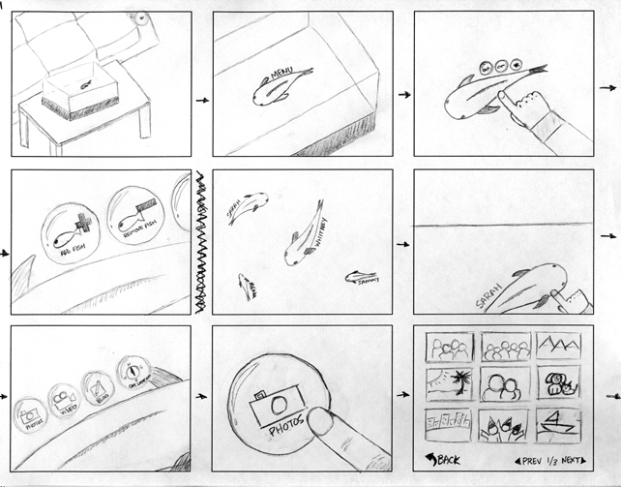
Example
Notes:
http://www.wesmichaels.com/projects/fishtank.php
This shows a concept for viewing photos, organized by people. They are represented by fish in a holographic fishtank. Clicking on fish allows you to view photos associated with the person, etc.
Make note of the role of each frame, and what it is doing:
Frame 1: it is in a living room
Frame 2: there are fish in here
Frame 3: you can touch the fish
Frame 4: zoomed in. when you touch the fish, you see this stuff
Frame 5: there are lots of fish in here
Etc…
This one shows how the interface looks as someone uses it

Slide 4
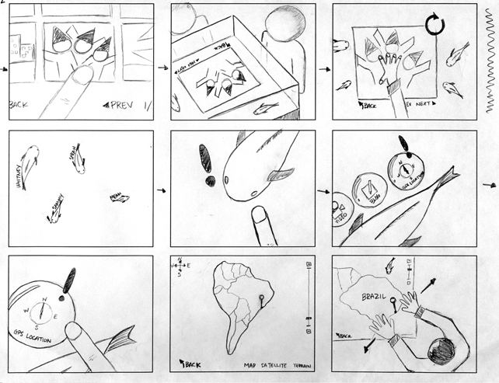

Slide 5
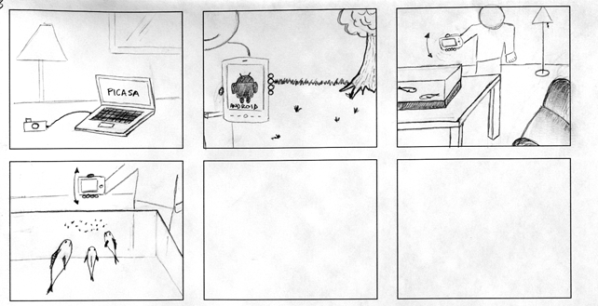
Notes:
This one shows you both user interaction, and the nature of the interface

Slide 6
Cleaning Robot
Notes:
This is an example, where the focus is mainly on user interaction (as there is no “screen” to speak of)
The main idea is to make “cleaning” more of an experience that people can enjoy, mainly through the use of a robot dog cleaner

Slide 7

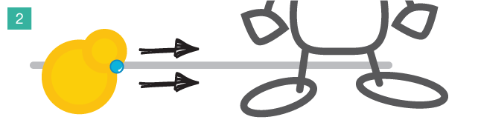
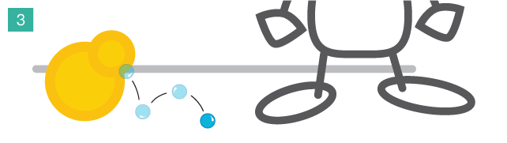

Slide 8
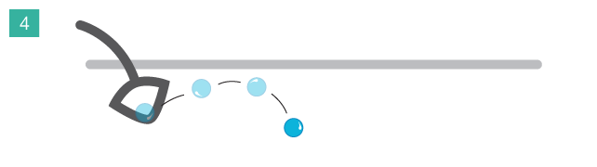
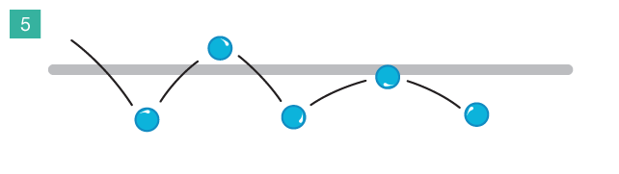
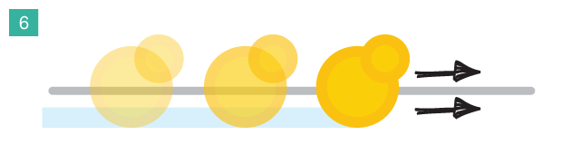

Slide 9
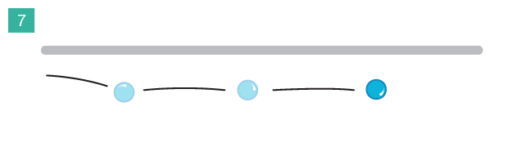
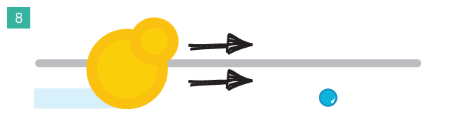
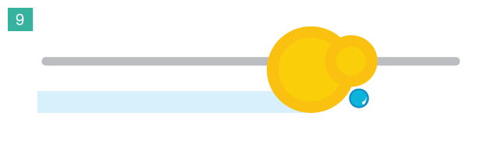

Slide 10
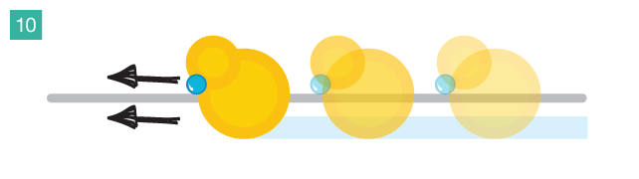

Slide 11
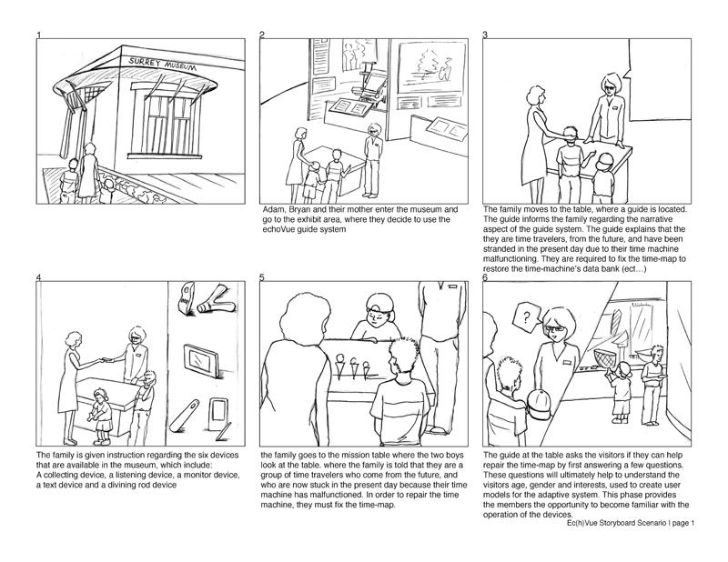
Notes:
http://www.kmuise.com/design/portfolio/kurio.php
This example is describing how a hot new museum exploration tool is to be used, and the kind of scenario that occurs to get there.

Slide 12
Storyboards in Design
For the purpose of design, storyboards can be used for a few things:
Exploring how a tool is used
Illustrating an interface
Showing a narrative
Storyboards are flexible tools, and can of course be used to map out “shots” to be used for video.

Slide 13
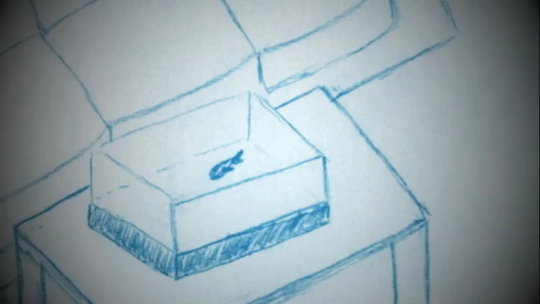
Notes:
Use VLC to play if it doesn’t work. 4-fishtank.mp4
http://www.wesmichaels.com/projects/fishtank.php

Slide 14
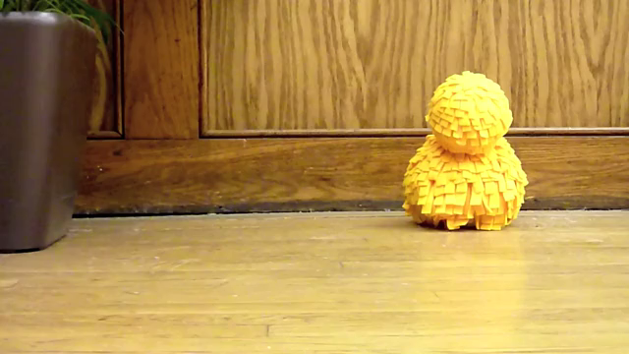
Notes:
http://www.wesmichaels.com/projects/robot.php

Slide 15
Storyboarding Exercise (20 mins)
Take a cell phone of your choice, and sketch a sequence of images that capture, over time, how the phone’s interaction unfolds over time as you enter a new name and number into the phone’s contact list. (10 mins)
If multiple pairs are working on the same phone “type”, then each should start in a different “logical” place for doing this task. (e.g. from the home screen through the “Contacts” app, or from an existing email, or perhaps by dialing and hitting “Save to Contacts”)
Tape this sequence of sketches in a row on the whiteboard, labeling the transitions between each sketch (what happens to get from one sketch to another) with a whiteboard marker. Put your storyboard near other storyboards of people doing the same phone as you. (5 mins)
Take a look at how it is done from across phones. You should see that for some phones, it does not require that many “screens” to get through, while others require a lot more. (5 mins)
Notes:
This activity can be done in pairs.
For each major phone type that is being attempted, please try to ensure that there are at least two or three teams working on this, and make sure that they start from different “starting points”. The idea is to show them that these can be combined into a state transition diagram

Slide 16
State Transition Diagram
State transition diagrams are a related idea to storyboards. Whereas storyboards are used to illustrate a particular interaction scenario, state transition diagrams are used to of map out an entire space of interaction possibilities.
They are commonly used to show the possible states of the application, and the major decision paths that occur to move through the interface.

Slide 17
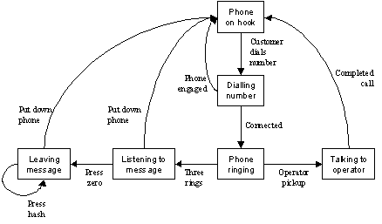
Simple state transition diagram (you’ve seen these)
Notes:
http://syque.com/articles/state-transition/state-transition.htm

Slide 18
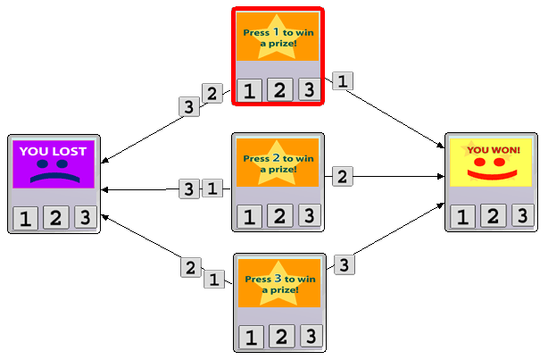
Can be used for mapping out an application, or awesome games
Notes:
http://hci.stanford.edu/research/dtools/guide_design_patterns.html

Slide 19
State Transition Diagram Exercise (15 mins)
Combine your team with the forces of other teams that are working on the same phone, and construct a state transition diagram showing all the possible ways (that you’ve storyboarded) to add a new contact plus phone number. Mainly, this means moving around some of the storyboards, and adding transition lines and annotations between them. (10 mins)
Where there are possible interactions unaccounted for, just notate these with an arrow to an ellipse labeled with whatever function is missing.
Admire the cool state transition diagrams. (5 mins)
Notes:
Take photos of the transition diagrams, if you can, TAs!

Slide 20
Exploring Interaction w/ Paper Prototyping
Given a sufficiently developed set sketches for an interface/interaction flow, you can use it to understand an interaction experience.
You saw this in class, with a paper prototype for an email client as a video. In that video, parts of the interface were replaced with, for example, sticky notes, or transparent overlays, etc. This is a totally acceptable strategy.

Slide 21
Why paper prototypes?
You can already see that it’s way faster to develop a paper prototype to explore designs for interaction scenarios (compared to writing actual working code).
Taking a look at your state transition diagrams, you’ve probably already imagined other possible ways of adding a person+phone number. It would, of course, be way faster to mock this up as a paper prototype to test whether people like it better (faster with, etc.) than the existing methods.

Slide 22
Exploring a Paper Prototype (10 mins/group)
For this activity, you will use the state transition diagrams and operate them as a paper prototype with “phone noobies” from another team. That is, the operator will manipulate/show various states depending on the interaction of a phone noobie.
This will happen on the document projector, so everyone can see what is happening.
The phone noobie is required to “think aloud” and articulate everything that s/he sees, and is thinking as s/he operates the interface.
Notes:
TA: if you can do some videography to capture this, it’d be totally awesome
TA: you may need to prod the noobie to be more vocal if they are being quiet

Slide 23
Exploring a paper prototype
Each “phone team”, select four representatives:
two noobies
two operators
Operators manage the paper prototype, while a noobie representative from two other teams plays (in succession) with the prototype
Task: add a new person and a new phone number.
Operators, you can select a starting state.
*Note: in real life, don’t call them noobies
Notes:
TA: you will probably run out of time. If it makes sense to only get through one run per phone type, then so be it.

