Slide 1
Sketching
CPSC 481 Week 3 Tutorial
Anthony Tang, with acknowledgements to Julie Kientz, Saul Greenberg, Ehud Sharlin, Sheelagh Carpendale, Nicolai Marquardt
Notes:
Preparation:
Bring LOTS of scrap paper – i.e. from a recycling bin. Look for paper that has printing on one side, but is empty on the other
--Each person should have about 10-15 quarter sheets of paper. We can cut these in advance to prep them
Bring enough pencils for everyone in the class – probably around 20. Make sure these are sharp
Bring tape
Bring a watch so you can time for 30s
Partition the class into three sort of “groups”. Make sure that they are mixing beyond their deep dive group. Force it to happen, if needed. The purpose here is to make them work with others

Slide 2
What is sketching for?

Slide 3
Sketches are…
quick, freehand drawings
can include labels or captions
don’t need to be pretty*
goal:
for communication
for brainstorming
try to communicate ideas with as few lines (as little “ink”) as possible!
Notes:
Emphasize speed and effectiveness of communication over prettiness
Brainstorming: that is, generating through new ideas in a design cycle quickly

Slide 4
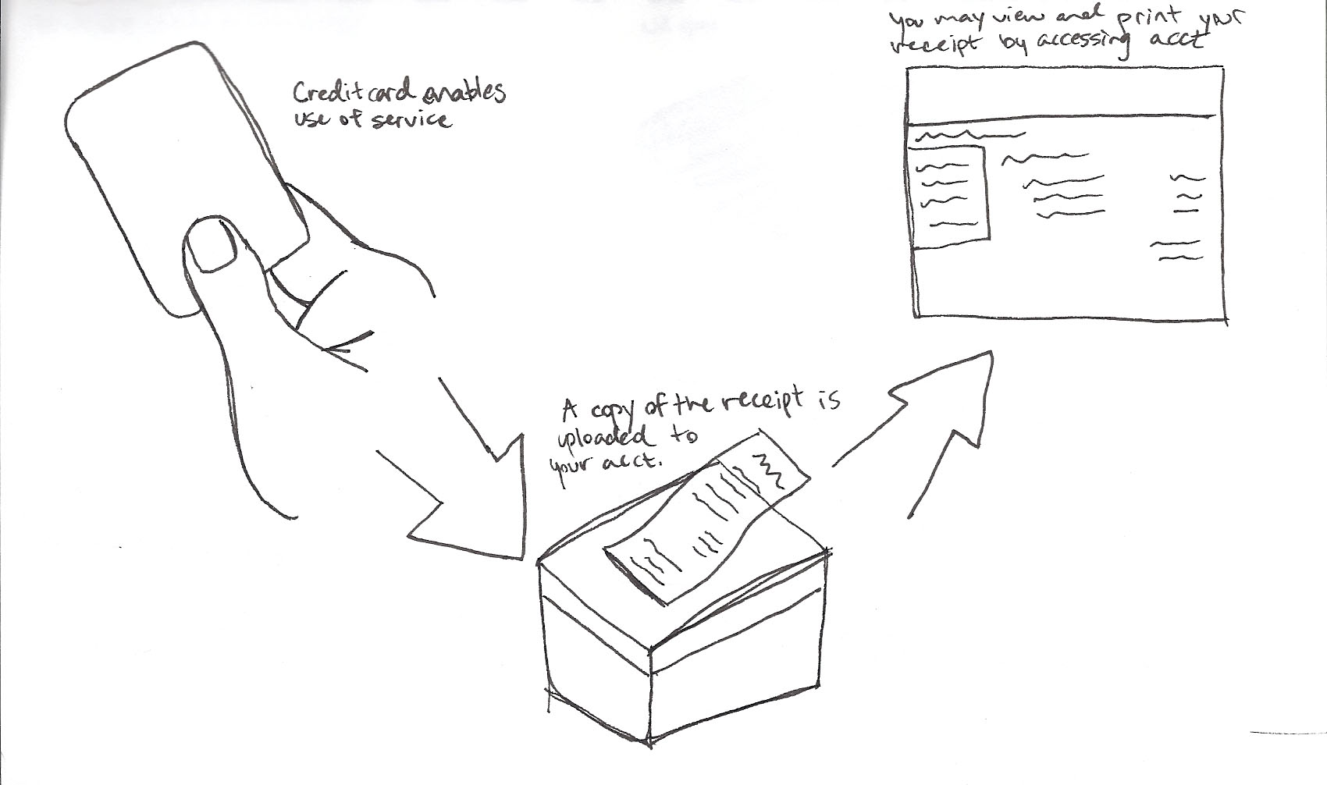
Example sketches
Notes:
Discuss qualities of each sketch, and point out thigns that are worth noting
Here, for example:
-- creditcard, and the fact that it is the size of something that fits in your hand – no details
-- receipt – no details on receipt, mainly through caption– note also that the box and the receipt overlap. Big deal
-- account thing: just some notion of a webpage with “things you can do”

Slide 5
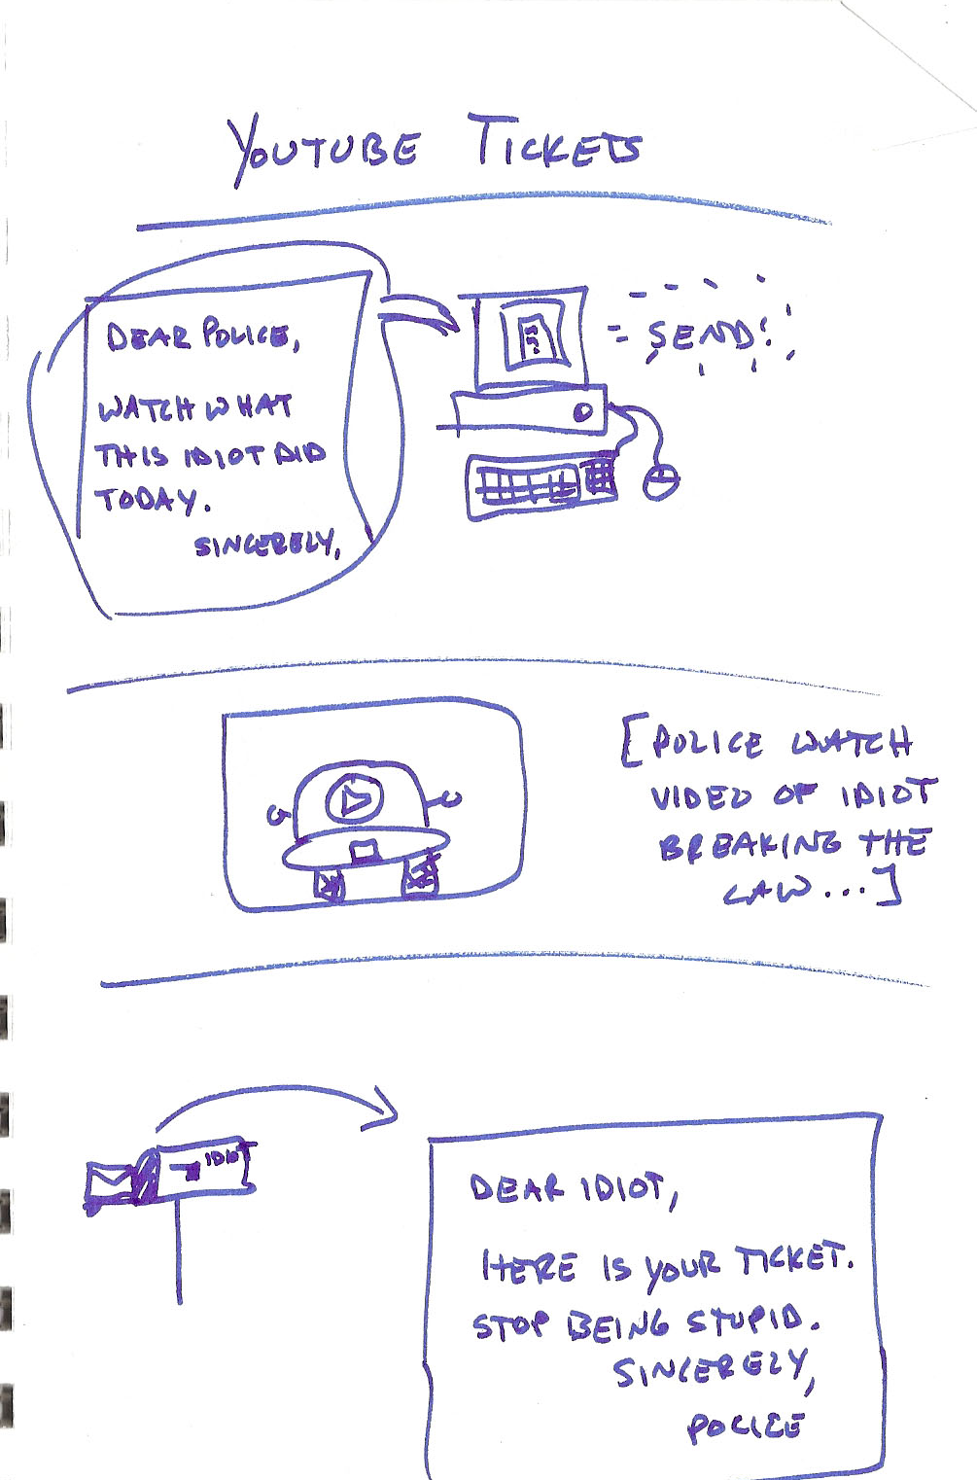
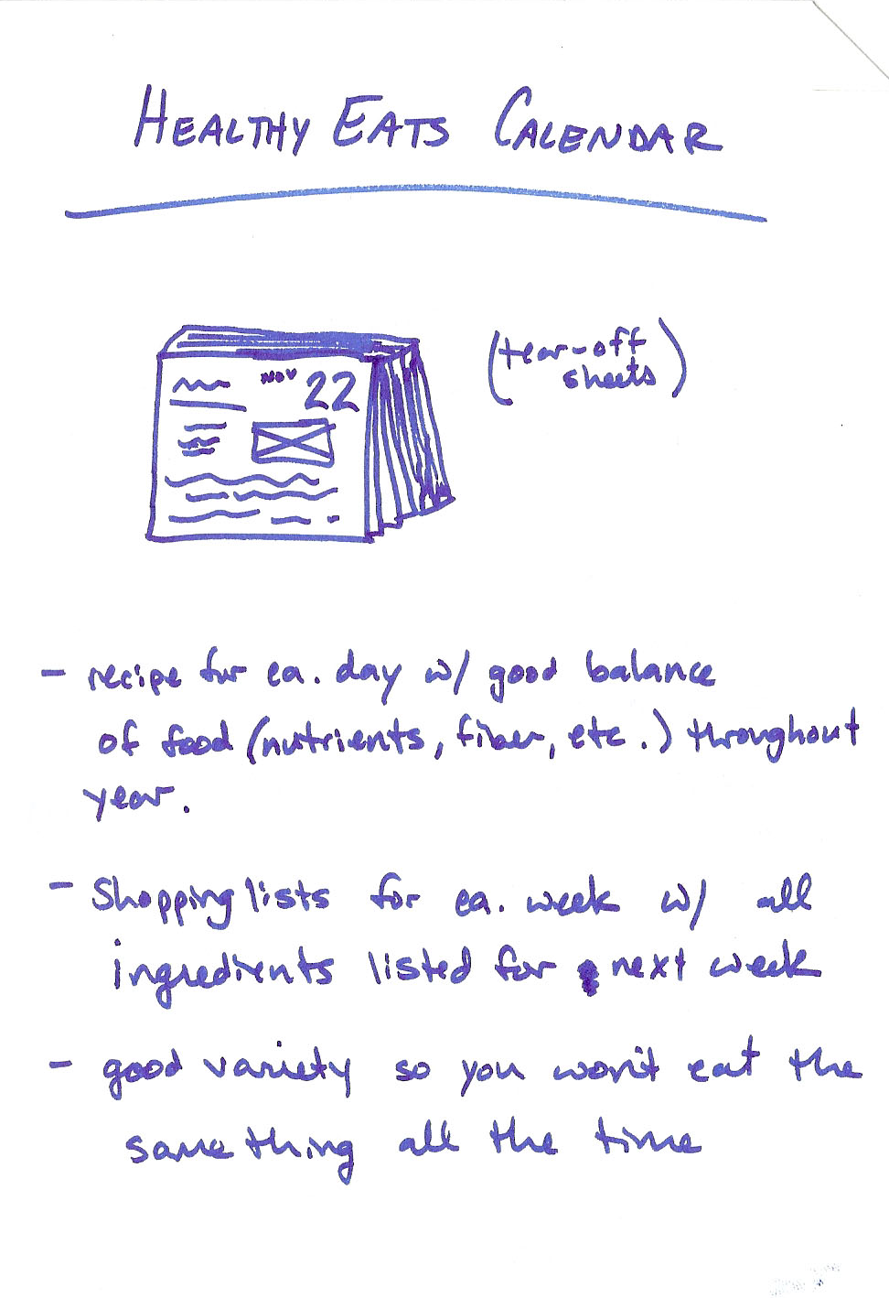
Example sketches
Notes:
Again, take the time to explain what is there, and what /isn’t/ there
Note that in both cases, the idea is to communicate an idea. The one on the right I don’t really like as much, as it’s not showing that much pictorially, but I suppose you can say that it’s because sometimes, it’s easier to write in text

Slide 6
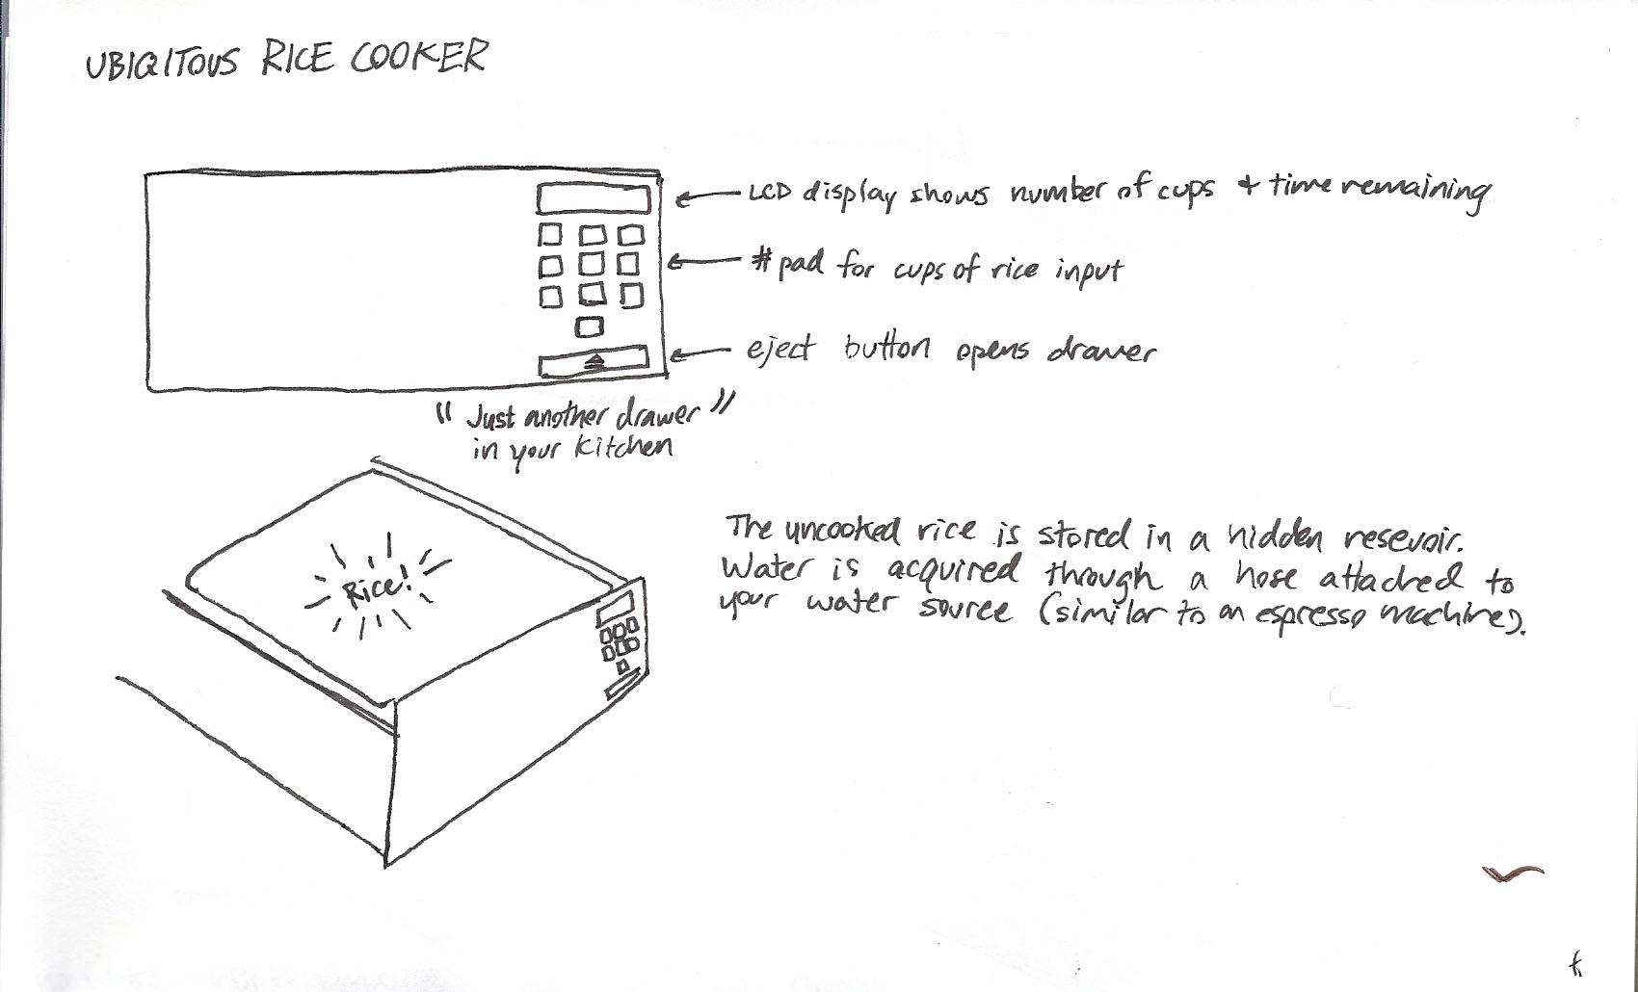
Example sketches

Slide 7
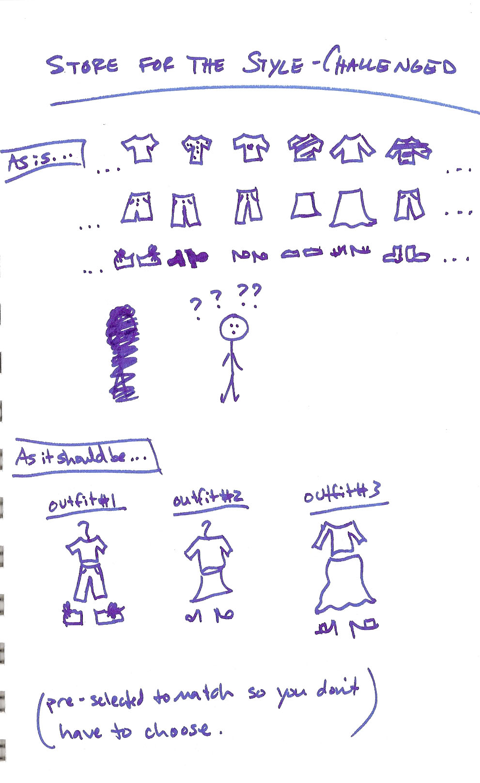
Example sketches

Slide 8
Sketching Practice Activity (20 mins)
Sketch a number of different things (TA will tell you) rapidly
DO NOT put your name on your sketches
One page per sketch
We will then tape these sketches up together
Explore them, and discuss

Slide 9
Some principles for sketching
Use as few lines as you can
Communicate the essence of the idea
Details only if they are important
Choose the detail you put in deliberately
One piece of paper per sketch!!!!!
Notes:
All of these sketches have been for the purpose of communicating an idea
We will come back to the idea of using sketching for brainstorming in a moment
Sketching exercise: warming up.
Your goal here is to work them through sketching for the first time. Each of the exercise is 30seconds long. NOTE: THEY MUST USE A DIFFERENT PIECE OF PAPER PER SKETCH
They are to use pencils
Emphasize:
-- quickness
-- conservation of lines
-- for the purpose of communication
Each of the next four slides is a sketching exercise. Show, and then time for 30s, and then stop.

Slide 10
Sketching
Principles
Exercise
Use as few lines as you can
Communicate the essence of the idea
Details only if they are important
Choose the detail you put in deliberately
One piece of paper per sketch!!!!!
Sketch a cellphone (30s)
Notes:
All of these sketches have been for the purpose of communicating an idea
We will come back to the idea of using sketching for brainstorming in a moment
Sketching exercise: warming up.
Your goal here is to work them through sketching for the first time. Each of the exercise is 30seconds long. NOTE: THEY MUST USE A DIFFERENT PIECE OF PAPER PER SKETCH
They are to use pencils
Emphasize:
-- quickness
-- conservation of lines
-- for the purpose of communication
Each of the next four slides is a sketching exercise. Show, and then time for 30s, and then stop.

Slide 11
Sketching
Principles
Exercise
Use as few lines as you can
Communicate the essence of the idea
Details only if they are important
Choose the detail you put in deliberately
One piece of paper per sketch!!!!!
Snow tires (30s)
Notes:
All of these sketches have been for the purpose of communicating an idea
We will come back to the idea of using sketching for brainstorming in a moment
Sketching exercise: warming up.
Your goal here is to work them through sketching for the first time. Each of the exercise is 30seconds long. NOTE: THEY MUST USE A DIFFERENT PIECE OF PAPER PER SKETCH
They are to use pencils
Emphasize:
-- quickness
-- conservation of lines
-- for the purpose of communication
Each of the next four slides is a sketching exercise. Show, and then time for 30s, and then stop.

Slide 12
Sketching
Principles
Exercise
Use as few lines as you can
Communicate the essence of the idea
Details only if they are important
Choose the detail you put in deliberately
One piece of paper per sketch!!!!!
Computer(30s)
Notes:
All of these sketches have been for the purpose of communicating an idea
We will come back to the idea of using sketching for brainstorming in a moment
Sketching exercise: warming up.
Your goal here is to work them through sketching for the first time. Each of the exercise is 30seconds long. NOTE: THEY MUST USE A DIFFERENT PIECE OF PAPER PER SKETCH
They are to use pencils
Emphasize:
-- quickness
-- conservation of lines
-- for the purpose of communication
Each of the next four slides is a sketching exercise. Show, and then time for 30s, and then stop.

Slide 13
Sketching
Principles
Exercise
Use as few lines as you can
Communicate the essence of the idea
Details only if they are important
Choose the detail you put in deliberately
One piece of paper per sketch!!!!!
Gas station (30s)
Notes:
All of these sketches have been for the purpose of communicating an idea
We will come back to the idea of using sketching for brainstorming in a moment
Sketching exercise: warming up.
Your goal here is to work them through sketching for the first time. Each of the exercise is 30seconds long. NOTE: THEY MUST USE A DIFFERENT PIECE OF PAPER PER SKETCH
They are to use pencils
Emphasize:
-- quickness
-- conservation of lines
-- for the purpose of communication
Each of the next four slides is a sketching exercise. Show, and then time for 30s, and then stop.

Slide 14
Discussion (10-15 mins)
Use tape to post up your sketches
Discuss the sketches on a per-exercise basis
What worked well? What didn’t work well? What things were important to communicate the idea? What wasn’t important to communicate the idea?
Note: DO NOT “defend” your sketch (better yet: don’t identify it is yours). Remember that your peers are the “users” of your sketch. If they find something incomprehensible, this is telling you something.
Notes:
Discussion points
Which sketches have used the least amount of pencil, but managed to communicate the most?
How have they done that?
How have they used detail?
What about the use of lines? Are there different places where there is emphasis (shape of line, thickness of line, texture of the line, etc.)?
How about the use of stereotypical shapes, or known shapes, or symbols? That is, making use of conventions as they exist in our everyday world?

Slide 15
Sketching for Brainstorming
To this point, we have mainly talked about the use of sketching for communication
But, sketching can also be used for brainstorming (and commonly is)

Slide 16
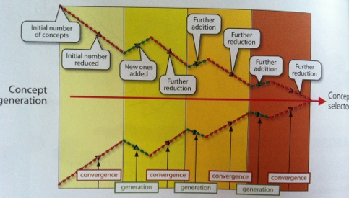
You’ve seen this in class…
Notes:
Describe the design process as a funnel that moves toward the selection of one idea, but to get it right, you need to do the following:
Iterate through phases, where each phase involves:
-- idea generation PLUS refinement
The initial set of ideas may come from some of the work that you’ve done by understanding users (e.g. interviews), and based on that, you refine your ideas to a small set.
From there, you brainstorm ideas. Then, you take those ideas, and refine them—what’s good, what’s bad, what do we still not know?
And continue.

Slide 17
10 Plus 10 Technique
The 10 plus 10 technique is a great way to generate ideas, PLUS refine those ideas
We will actually use the 10 plus 10 technique today to explore/study two design problems
This is a technique that you can use in generating ideas/refining them for the purpose of your project

Slide 18
10 Plus 10 Technique
Generate 10 sketches individually that relate to the design problem (individually) (10 mins)
These sketches must be meaningfully different (i.e. avoid variations on the same idea)
Take risks: do not limit yourself to the realities of “today”
Avoid judging the quality of these ideas now; the point is to get diversity
Discuss within your group each of the design ideas represented in the sketches, then select the most promising 3 design ideas (10 mins)
Using these promising design ideas, generate an additional 10 sketches that are variations of these 3 design ideas (10 mins)
Discuss within your group each of these variations, and select the 2 best variations for each design idea (5 mins)
Present these best ideas to the class and discuss (5 mins for each presentation, plus 5 mins of discussion)
Notes:
This is a heavy duty slide. You can split it into two or three slides if that helps

Slide 19
Three Design Challenges
Connect two smartphones together (so they know to “talk” to each other)
Activate/deactivate the “power save” mode on a computer/tablet/phone
Technology that promotes healthy sleeping habits
Notes:
You provide these design challenges verbally per group
They don’t get to pick (sorry)

Slide 20
Phase 1: Make 10 sketches (10 mins)
Generate 10 sketches individually that relate to the design problem (individually)
These sketches must be meaningfully different (i.e. avoid variations on the same idea)
Take risks: do not limit yourself to the realities of “today”
Avoid judging the quality of these ideas now; the point is to get diversity

Slide 21
Phase 2: Internal Discussion
Discuss within your group each of the design ideas represented in the sketches
Select the most promising 3 design ideas

Slide 22
Phase 3: “Plus 10” (10 mins)
Using the 3 promising design ideas, generate an additional 10 sketches that are variations of these 3 design ideas
On a per-person basis, it might be best to stick to one of the design ideas

Slide 23
Phase 4: Internal Dicussion 2
Discuss within your group each of these variations
Select the 2 best variations for each design idea

Slide 24
Phase 5: Present (5 mins/group)
Present these best ideas to the class and discuss (5 mins for each presentation, plus 5 mins of discussion)
Notes:
Allow the questions/discussion phases to go long if time allows, allow it to go short if time is tight

Slide 25
Lessons from 10 Plus 10
10+10 is a great technique for brainstorming
This is a great way to “unstick” yourself if you feel stuck on a design problem.
Note: there are phases where you discuss with others—in principle, you can do this on your own.
But, one thing to remember is that it is always valuable to discuss the sketches with others—forces you to communicate something, and forces you to be concrete.

