Slide 1
Observing and Interviewing
CPSC 481 Tutorial 2
Anthony Tang, with acknowledgements to Julie Kientz

Slide 2
Agenda
Concepts
  Observation
  Interviewing
Class Exercise
Group Exercise
  Complete interview guide
  Plan observations
Observation and interview practice
Discussion
Lab Deliverable

Slide 3
Observations
Recording methods
  Notes
    At time of observation
  Video/Photographs
  Audio
Choose the methods that best fit the environment
When taking notes, have a plan for what you will record
If multiple people will be taking notes, agree on conventions
Decide where you will observe from
  Where will you get the best view of what you want to see?

Slide 4
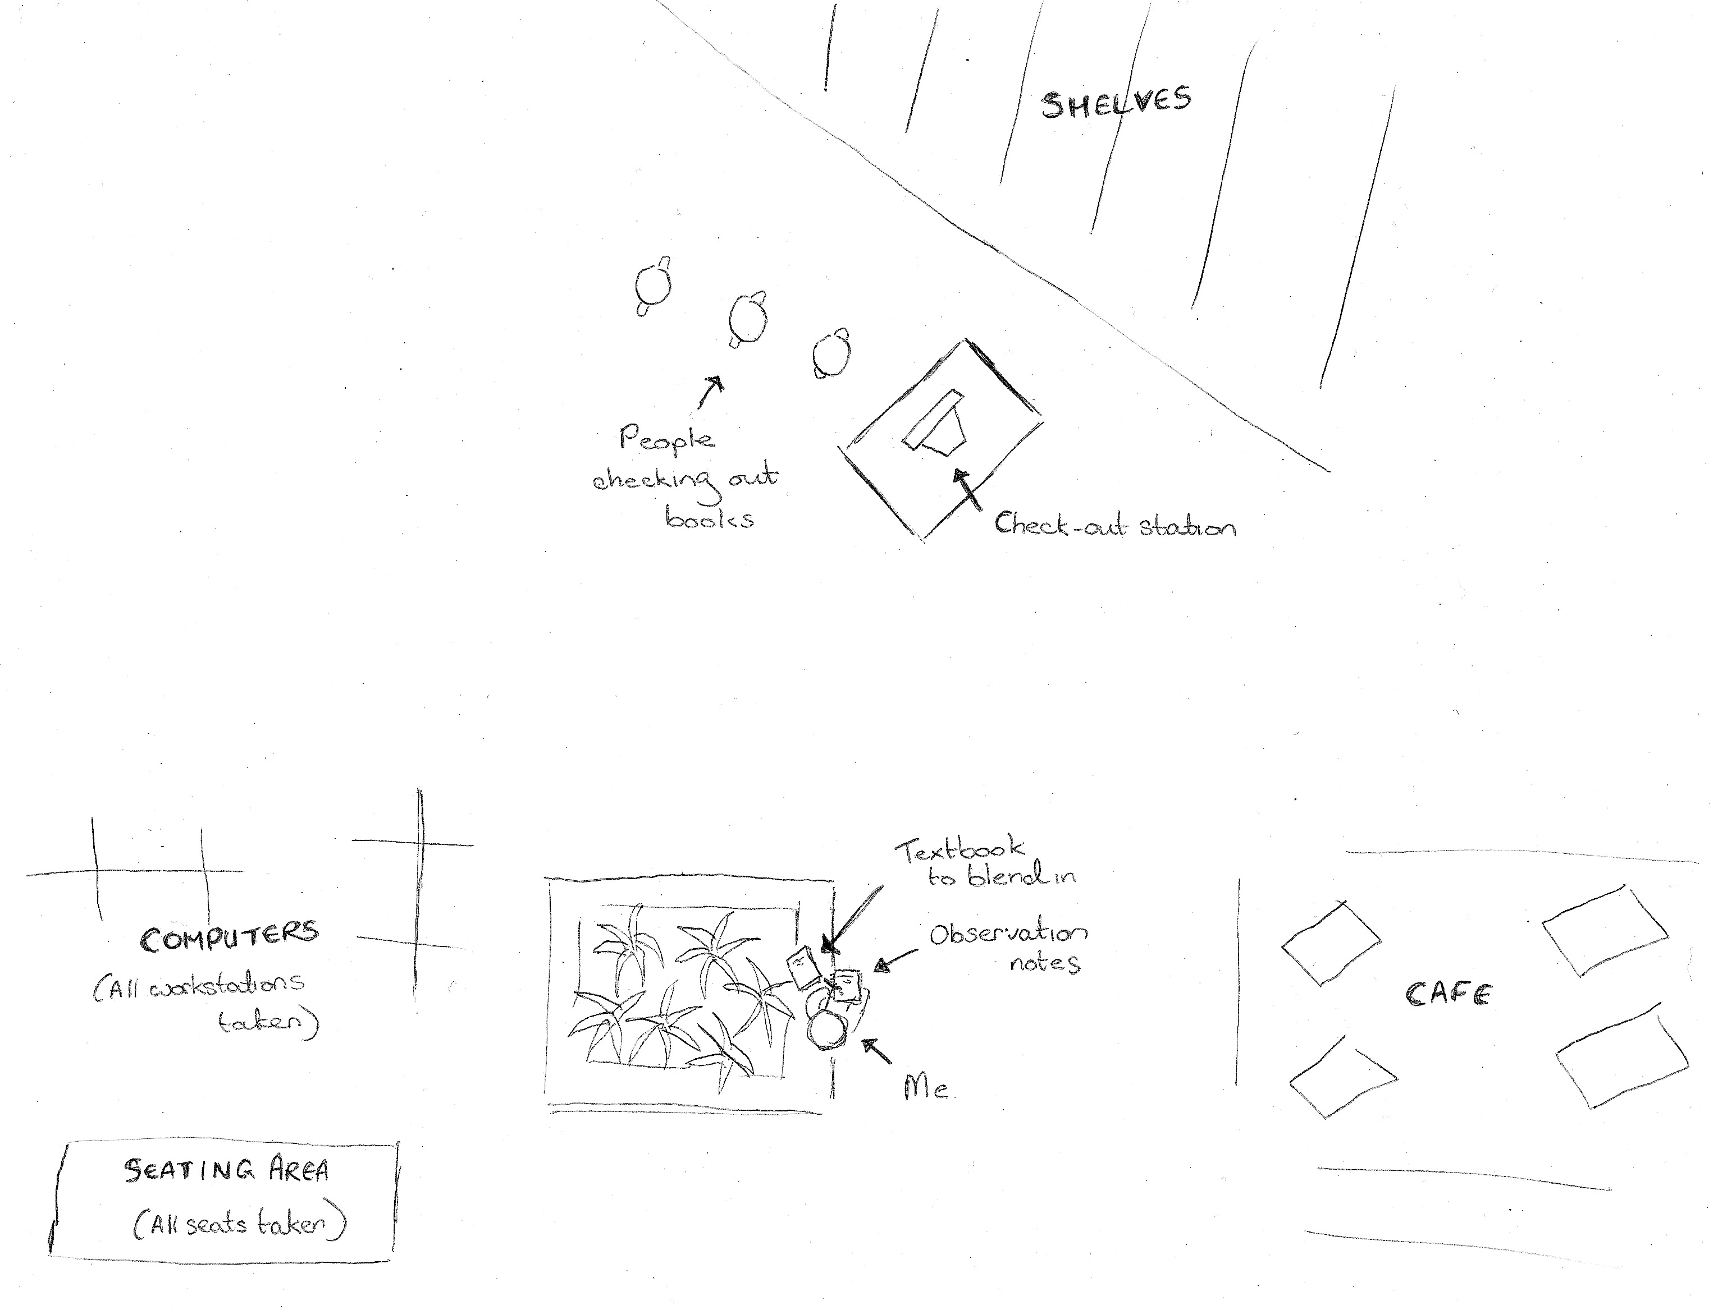
Observation Example
Notes:
Discuss what’s drawn
Also, consider what you might be trying to observe here (e.g. a checkout system?)
What would try to record?
Where would you try to be? Move/sit?
What might you take a photo of?
Consider the Deep Dive video from last week, what did they take photos of?

Slide 5
Interviews
Who should you interview?
  Users
  Experts
  Stakeholders
How long should you interview?
  As long as it takes to get the info you need
  Or until your interviewee loses interest
What should you do if your interviewee doesn’t say much?
  Prepare prompts (e.g. could you say more about X?)
How should you capture responses?
  Take notes during or soon after the interview; record audio or video
Notes:
Note: users are not stakeholders

Slide 6
Interview Questions
Open vs. closed questions
  Closed questions produce short answers
  Open questions produce longer answers (harder to analyze/compare, but more interesting)
Avoid leading questions
  e.g. “What do you think about X” vs. “Do you think that X is awesome?”
Only ask one question at a time
  “Do you agree that X is awesome and everyone should be using it?” is two questions
Depending on what you’re looking for:
  Make your questions clear and specific, or
  Make your questions vague
Start with easy questions
  Give your interviewee time to warm up
Notes:
Re: point 4… Imagine trying to design a fitness tracker. “What do you think about fitness” is pretty vague, so you may not get a useful answer; on the other hand, it helps you get a sense for what the person thinks of as being “fitness.” That is, people have different definitions of what “art” is. When having a conversation, a vague question like this can get things moving, and you onto the same page as them. Specific questions allow you to get right at what you want. The trick is to balance specific vs. leading in terms of a question.

Slide 7
Redesign these…
What do you think about shopping?
Are you a good student or a bad student?
How long have you been stressed out?
How often do you relax and what do you do when you relax?
Notes:
Show one at a time. Why is each of these bad? What could you do to revise it? (Lots of possibilities, use your instincts)

Slide 8
Class Exercise: Interview Guide – 10-15min
Imagine you are trying to build a good commuter bicycle.
Who should you talk to?
Where should you talk to them? Why?
What do you want to find out?
Notes:
Point here is not to focus too much on wrong things they say, but to get them to explain/justify their choices. Encourage broadness rather than focusing them
Who to talk to: think broadly about who is impacted (rider, buses, pedestrians, maybe even co-workers [they may have to deal with stinky/late cyclists, or bicycles in the workplace], bosses, bicycle enthusiasts? Bicycle shop people? Bicycle manufacturers? Maybe fabric people—think about having to wear pants on bikes, kinesiology people? etc.) – where should these people come from? Oil patch workers? Downtown people? Office workers? Outdoorsy people? Etc.
Where: that is, you might be able to ask them about their environment/ideas they have
Find out: again, be broad about this, but make sure that it’s semi focused. Allow them to pose questions that they could ask, but make sure that the questions are framed around something that is important for /design/. Do I need to know this from the perspective of a designer for a commuter bike?
Have responses to these things written up either as a powerpoint deck (you can make it available to them), or you can use flip-chart paper if it’s easier

Slide 9
Team Exercise: Planning – 10 mins
Get into your project groups
Create an interview guide (~10 mins)
  Five questions that are relevant to your project – think carefully about these given all the things we discussed earlier
  Later, you will use these to interview someone

Slide 10
Interview Practice – 20 mins
Get into groups of three—each person should be from different group.
Take turns in different roles: interviewer, interviewee, observer.
  Interviewer: use your questions to interview the person
  Interviewee: answer them to the best of your ability—take mental note of when things are weird
  Observer: take notes of the interview, particularly when a question is not getting the interviewer what s/he wants. Provide suggestions on how to revise the question.

Slide 11
Discussion: Interviews – 10mins
What did you find out (about your topic)?
What was your experience of interviewing?
What was your experience of being interviewed?
Notes and thoughts from observers? (without embarrassing one another)

Slide 12
Class Exercise: Planning an Observation – 10 mins
Returning to the commuter bike design example, plan an observation.
What are you interested in understanding or learning?
What is a good site? What would you take notes on?
Notes:
Come up with a whole space of stuff. You can use whiteboards

Slide 13
Deliverable
Provide a sheet of paper that has a revised list of questions that you think will work well for your project.

Slide 14
Extra time…
Construct an observation plan for your project
You will likely need to do this at a later time anyway. If you have time right now, this would be a good time to do it.

