Slide 1
A3 Redux

Slide 2
Learning Objectives
By now, you should be able to:
Conceptually group tests into set.
Design automated unit tests for those tests
Learn how to operate automated unit testing machinery within an IDE (Visual Studio)

Slide 3
Learning Objectives
By now, you should be able to:
Conceptually group tests into set.
Design automated unit tests for those tests
Learn how to operate automated unit testing machinery within an IDE (Visual Studio)

Slide 4
Automated Unit/Integration Testing
What constitutes a “unit”? Depends a bit on your perspective. In some ways, this assignment is about integration testing (do all these pieces fit together and work?); however, in the real world, the VendingMachine might frequently be considered a “unit.”
Regardless, the testing proceeds similarly:
[define preconditions]
[execute some behaviours]
[check if expected values match actual values]

Slide 5
What was annoying
Extracting (and comparing) things from delivery chute
Extracting (and comparing) things from the vending machine
A lot of code/repetition

Slide 6
Extracting and Checking
A3 solution was a bit dumb
A4 shell is a bit more elegant
public static Tuple<int, string[]> ExtractDelivery(HardwareFacade hardware) {
var items = hardware.DeliveryChute.RemoveItems();
var cents = items.OfType<Coin>().Sum(coin => coin.Value.Value);
var products = items.OfType<Product>().Select(product => product.Name).ToArray();
return new Tuple<int, string[]>(cents, products);
}
public static void CheckDelivery(Tuple<int, string[]> delivery, int cents, string[] productNames) {
Assert.AreEqual(cents, delivery.Item1);
Assert.IsTrue(productNames.SequenceEqual(delivery.Item2));
}
var delivery = VMUtility.ExtractDelivery(this.hardware);
VMUtility.CheckDelivery(delivery, 0, new string[] { "Coke" });
or
CheckDelivery(ExtractDelivery(this.hardware), 0, new string[] { "Coke" });

Slide 7
Aside: API Usability
Think about how you want someone to be using your code (or, how you want to use your code):
What is the “language” you want them to use?
What are the verbs/nouns that should be here?
What is the language that the “user” of your API is thinking of?
How much should they need to know to use this?
Do they need to know about the abstractions you’re using?
Could someone reading the code understand what was going on (without digging into the code)?
What is the order they will be thinking of things in?
CheckDelivery(ExtractDelivery(this.hardware), 0, new string[] { "Coke" });

Slide 8
Lots of Code
Writing unit tests is a way of expressing how you think the system ought to work (it’s actually a lot like a spec in this sense!)
Remember: when we were in the midst of doing A2, someone in the class asked, “Can we just have the scripts you’ll be testing our code on?”
Test-driven development: Writing the test cases first(!), and then moving towards writing the code that you need (to make the code work)

Slide 9
“Modularizing” Test Code
[define preconditions]
[execute some behaviours]
[check if expected values match actual values]
The preconditions were often similar/common across multiple tests. In the VS Testing framework, you could have used the [TestInitialize] attribute to say, “Execute this each time before each test”

Slide 10
“Modularizing” Test Code
You can also group by “related” tests:
T08-good-approximate-change
T09-good-hard-for-change
All the U*tests

Slide 11
Unit Testing Frameworks are Similar
VS Unit Testing == NUnit (C#) == JUnit (Java) == Python unit test
Syntax is slightly different, but the core flow is basically the same (spec preconditions, do stuff, compare expected to actual values)
Running also sometimes differ: through IDE, command line, separate GUI

Slide 12
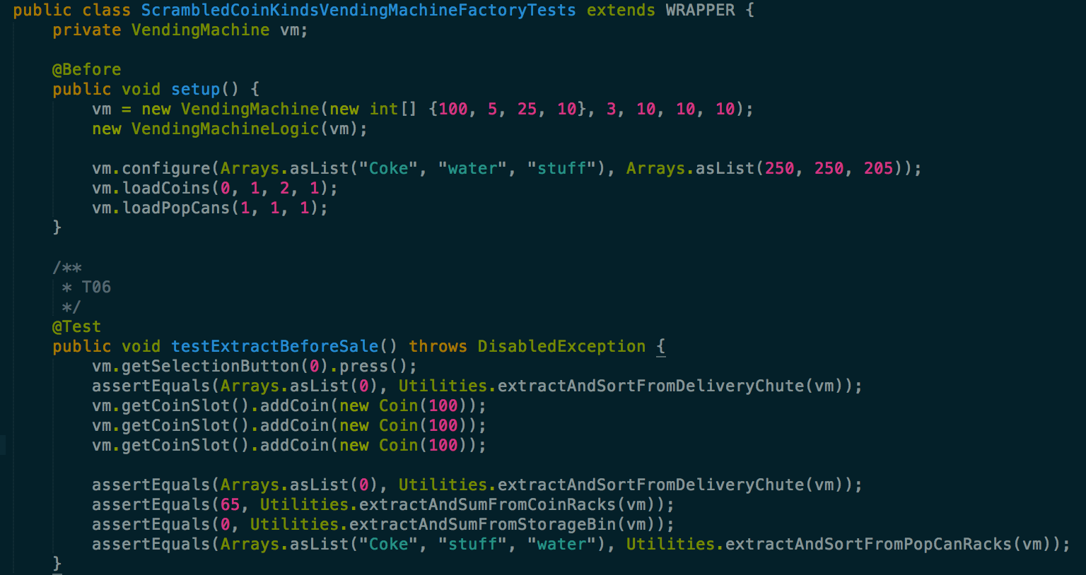
JUnit

Slide 13
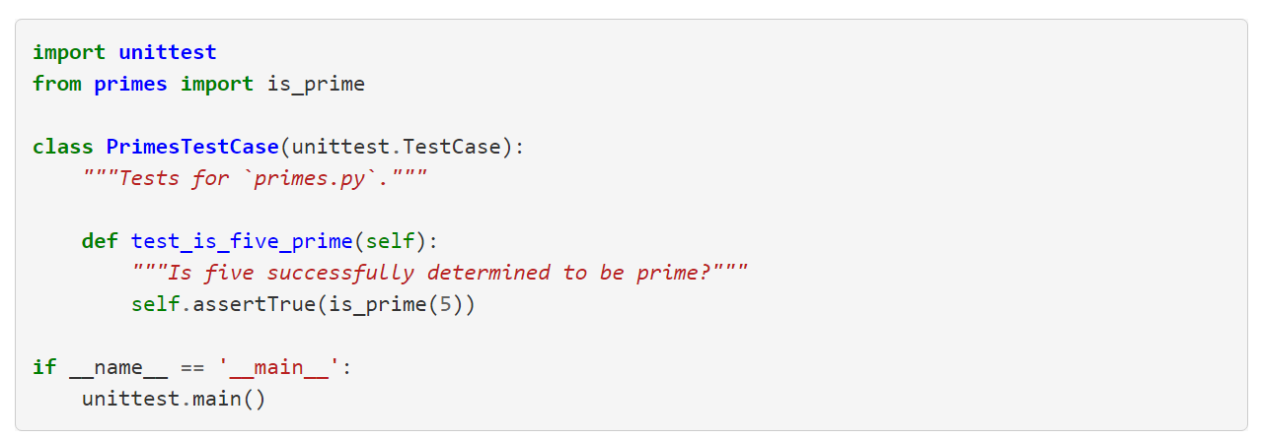
Python Unit Testing
Notes:
https://jeffknupp.com/blog/2013/12/09/improve-your-python-understanding-unit-testing/
https://docs.python.org/2/library/unittest.html

Slide 14
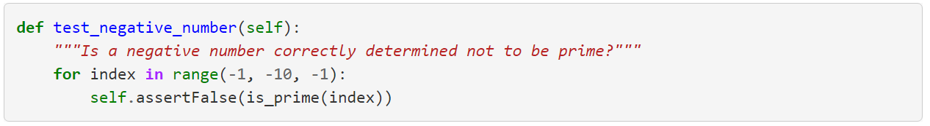

Python Unit Testing

Slide 15
GUI vs. Command Line

Slide 16
GUI vs. Command Line

Slide 17
A3 Learning
You now know how to do simple unit testing
Remember to use these powers for the forces of good

