Slide 1
#in-class
Take a look at A3 assignment description
Respond to the poll on #in-class
Post questions you have about A3 on #in-class, or emoji a question you like

Slide 2
A2 Post-Mortem
SENG 301

Slide 3
A2: Notes on grading
Grades should be in by Monday of next week
I’ve posted a solution to A2 on the #A2 channel
-- it includes the test scripts that your code will be graded against

Slide 4
A2: Learning Objectives
Learn how to think about and use Events and EventHandlers as a mechanism for inter-component communication
Overcome (again) the fear of opening up a massive code base
Develop UML diagrams based on code that you know

Slide 5
A2: How does the A2 solution work
Each time a VendingMachine is created, it creates an instance of a Logic class ➔ new VendingMachineLogic(vm);
The Logic class really only does three things:
listens for when a customer puts in money;
listens for when someone presses a button, and
calculates how much change should be dispensed.

Slide 6
A2 Solution Functionality
Listens for when a customer puts in money
vm.CoinSlot.CoinAccepted += new EventHandler<CoinEventArgs>(CoinSlot_CoinAccepted);
void CoinSlot_CoinAccepted(object sender, CoinEventArgs e) { this.availableFunds += e.Coin.Value;
}

Slide 7
A2 Solution Functionality (cont.)
2) Listens for when someone presses a button
Registers for the ButtonPressed event from each of the selection buttons in that vending machine
Uses sender parameter to figure out which SelectionButton was pressed
Determines the cost of the corresponding pop, and determines whether there’s enough credit in the machine to dispense the pop

Slide 8
A2: What’s the point?
In large systems, components talk to one another in a lot of different ways:
Explicit function calls on other objects POS calls Kitchen.OrderFood(order)
Manipulating properties on other objects Kitchen.Open = false
Sending messages over a wire (e.g. internet) new HttpRequest(”http://google.com”)
Events and EventHandling Kitchen.FoodDone += new EventHandler(kitchen_FoodDone);

Slide 9
A2: What’s the point? (cont.)
Many architectures publish tons of events; usually for most of the code you will write, you only need to listen/subscribe to a small subset of these
The tricky thing is figuring out _which_ events are meaningful
This is where UML diagrams come in handy: they provide a concrete visualization of how the different components are associated with one another

Slide 10
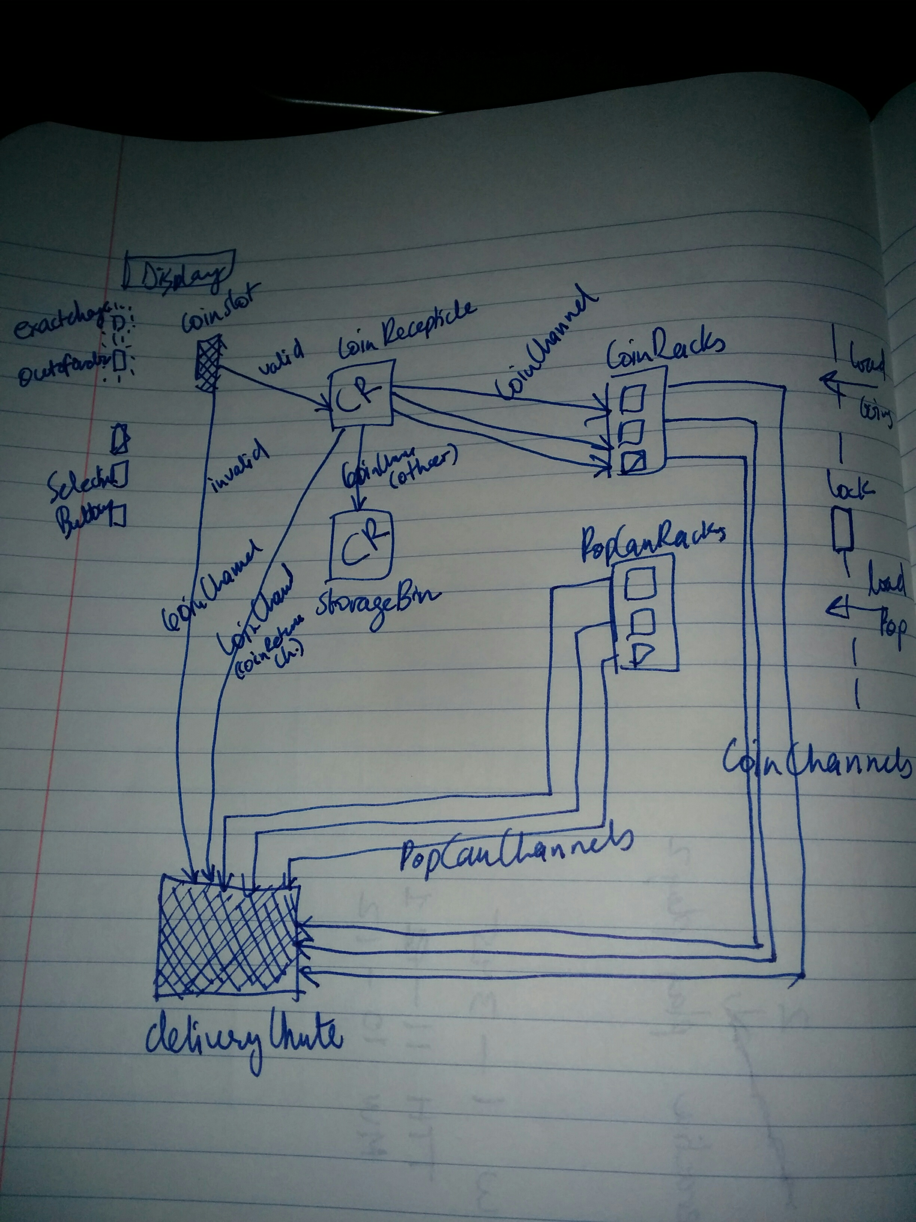
A2: Even “Chicken Scratches” are great..

Slide 11
A2: Some Remarks
It is possible to complete A2 without using events, but generally, this required using more knowledge than you normally would have (i.e. the ScriptProcessor fires events into the VendingMachineFactory, and you can use this information to do the logic)
Given how I promised grading would be done (i.e. black box), this is fine in terms of your grade
HOWEVER, if you took this approach, I strongly urge you to take a careful look at A2, and see if you could re-create it in a “whiteroom” context (i.e. close the book and then try re-implementing it yourself). No honour lost if this is you!

