Slide 1
Requirements Modeling
SENG 301

Slide 2
Learning Objectives
By the end of this lecture, you should be able to:
Discuss trade-offs between different representations of requirements
Understand and be able to apply Use Case modeling to model requirements (and reason about requirements of a system)
Read and generate Use Case Diagrams
Analyze a Use Case Model

Slide 3
Requirements Representations
Lots of different ways to represent requirements, all with various trade-offs:
» natural language text
» structured natural language
» formal specification
» user stories*
» scenarios
» use cases*

Slide 4
Vending Machine: Natural language…
Our vending machines let customers buy pop by entering Canadian coins and selecting the pop of their choice from a set of options. The total value of all coins entered in the machine and not used in a previous purchase shall be displayed to the customer. When the customer selects a pop and sufficient funds are available, the total will be reduced by the amount of the cost of that pop, the pop will be vended, and the change returned to the customer. If insufficient funds are present, a message will be displayed to that effect. If no pops remain for the selection, a message will be displayed to that effect. A technician will be able to set the price of each available pop, load pops into the machine, and load/empty coins to serve as change. When the machine is open for servicing, other functionality must be disabled, for safety. We are also interested in some sort of “customer loyalty card”, whereby customers can prepay amounts and receive discounts on products. And we are also considering having the machines communicating directly with the central office, to tell us when they are full of coins, out of product, etc.
Notes:
“Easy” to read
Potentially lots of ambiguities
No guarantee of ... – completeness – consistency
Potential admixture of important points and trivial details
Hard to analyze

Slide 5
Vending Machine: Structured NL
1. Coin entry
Vending machine: Structured requirements
Vending machines shall accept Canadian coins
Vending machines shall track the total value of all coins entered in the machine not used in a purchase
2. Pop selection
Customers shall select the pop of their choice from the available kinds
A pop shall be vended when it is selected and its cost is less than the current total available
The current total available will be reduced by the amount of the cost of the selected pop
The remainder shall be returned to the customer
The pop shall be delivered via the delivery chute
When the cost of a selected pop is greater than the current total available, it shall not be vended
An error message will be displayed
The total available will not change
When a pop is selected which is currently out of stock, no pop shall be vended
An error message will be displayed
The total available will not change
Notes:
“unit of analysis isn’t clear…”
• Is this really any clearer? – True, it is formatted a little more nicely
What is the user experience like?
What unusual conditions can arise that have been overlooked
and how should these be handled?
Are there any self-contradictions?
Are all terms clear and unambiguous?
– After all, this is still natural language!
• Structured requirements often don’t abstract well into useful views

Slide 6
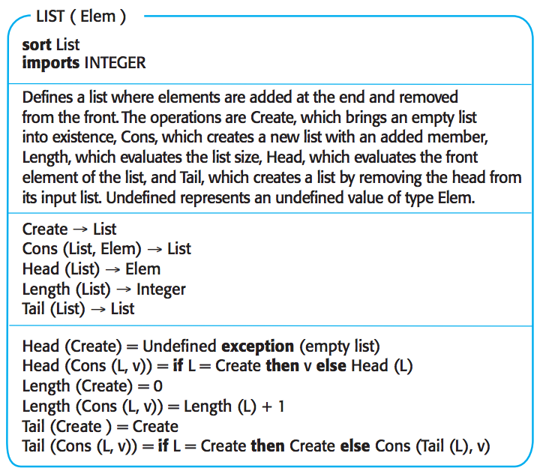
Formal Specification
These look like either pseudo-code or formal algebras. While these are easier to code against and are unambiguous, they are not useful for discussions with clients (generally).

Slide 7
User Stories
Focused on users’ desires and goals
As a <role>, I want to <desire> so that <benefit>.
As a customer, I want to insert coins to be able to pay for my item.
As a customer, I want to select my item.
As a customer, I want to know the cost of an item.
As a technician, I want to set the prices of items.
As a technician, I want to open the machine to service it, without injuring anyone.

Slide 8
Scenarios
A simple means of describing desired specific interaction sequences
“Ming inserts $2 in Canadian coins in the vending machine. He decides which of the available kinds of pop he would like, and selects it. The pop costs less than $2, so the pop is dropped into the delivery chute, and his change is returned through the coin return.”
Multiple scenarios needed for other possibilities
- Ming changes his mind altogether and wants his money back
- Ming realizes that he doesn’t have enough change, and wants his money back
Notes:
• Positive:
– Non-technical people can read and write them
– Easy to see whether there are problems with individual scenarios
• Negative: – Voluminous, hence, a lot of work to write down
carefully – Difficult to analyze as a whole
• Complete? overlap? contradictions?

Slide 9
Use Cases
A use case is an abstraction of one or more scenarios
A use case does not mention specific individuals
A scenario is an instance of a use case, as an object is an instance of a class
Each use case describes a set of scenarios, in terms of externally visible behaviour
Basically, information going into the system and information coming out
Use cases model the functional requirements of the system: diagram and descriptions

Slide 10
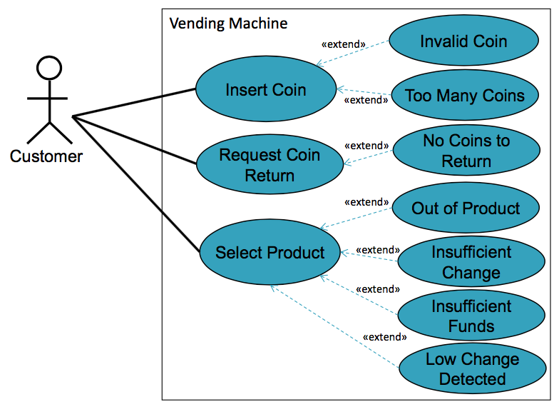
Use Case Diagram (Vending Machine)

Slide 11
Why so many different kinds of representations?
Depends a lot on the nature of the system that you are building (e.g. Is a simple content website? Is it part of a spaceship? Is it mission critical—e.g. AHS?)
Depends also on who your clients are (e.g. scientists, business analysts, university, elementary school teachers, mathematicians)
Depends on your team

Slide 12
Use Cases
Idea: we should organize our understanding of requirements around what the system is supposed to do
Use case: sequence of actions describing a task (one objective per use case) from the perspective of a class of users

Slide 13
Good Use Cases
Cover a full sequence of steps from beginning to end of task
Describe a user’s actions
Describes the systems’ responses (not the internal actions)
Describes this independently of the UI
Only includes interactions with the software

Slide 14
Parts of a Use Case
Name (what is this use case about – should have a verb)
Actor (who is going to use this?)
Goals (what are they trying to do)
Precondition (what is the state of the system)
Steps (two columns: left-actor, right-system)
Postconditions (what is accomplished)

Slide 15
Add announcement to a single course
Actor: Instructors, TAs
Goal: Distribute information to students of a specific course
Precondition: Actor has navigated browser to main D2L page for institution
Steps: Actor System
1. Add title
2. Add description
3. Submit 4. Creates announcement
5. Sends announcement to students
Postcondition: New announcement is added to main D2L page for all users. New announcement is emailed to student users.

Slide 16
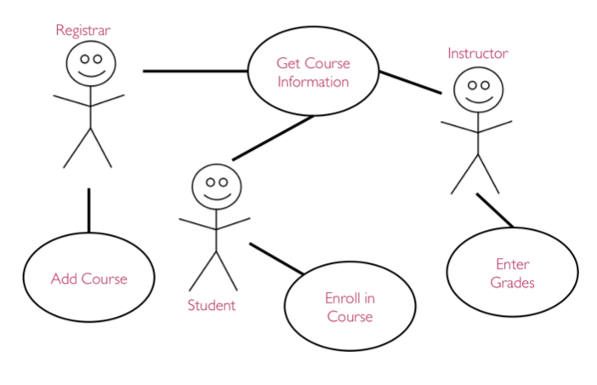
Use Case Diagrams
We can relate actors with Use Cases they are involved in with a Use Case Diagram
Notes:
© Lethbridge/Laganière 2005

Slide 17
Use Case Diagrams
Inheritance: We can represent generalization/specializations much in the same way as you would with class diagrams
Extension (special cases): We can model optional interactions or exceptional cases
Inclusion: We can re-use parts of other use cases

Slide 18
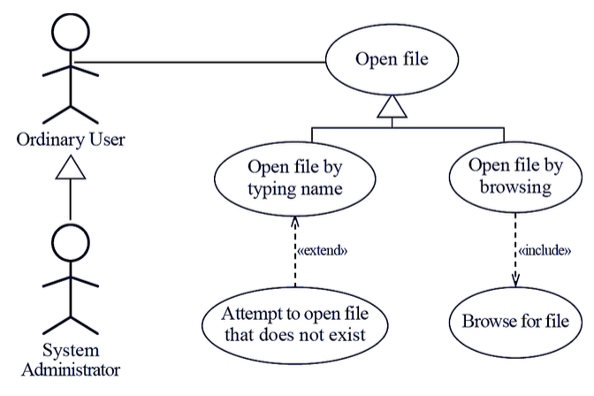

Slide 19
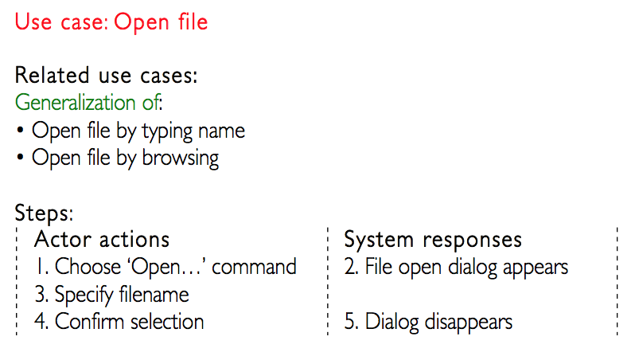

Slide 20
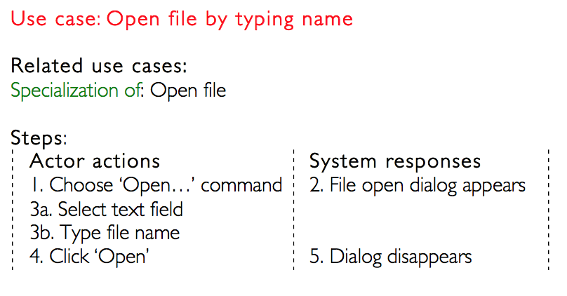

Slide 21
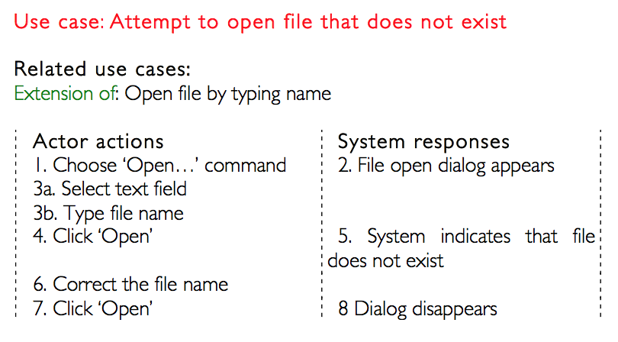

Slide 22
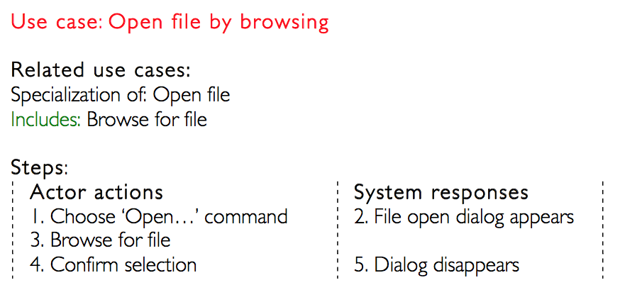

Slide 23
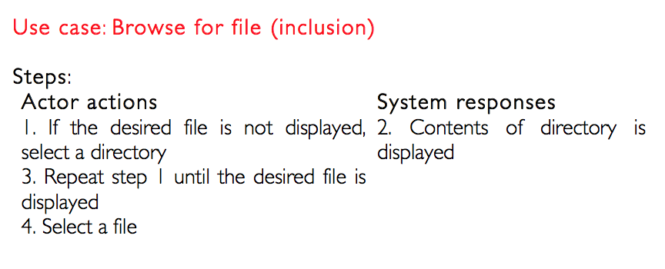

Slide 24
Use Case Model
A set of use cases along with a description or use case diagrams
Generally, only a handful of use cases are central (i.e. 90% of usage)
These should be the focus of the system
These should be the focus of development

Slide 25
Requirements Analysis
Correctness: Are we trying to do the right thing?
Completeness: What is missing?
Consistency: Do any details conflict?
Reality: Are any details unattainable?
Verifiability: Are any details impossible to check for?
Cost: How hard will a detail be to attain?
Priority: What matters the most?
Risk: Where are the unknowns?

Slide 26
Risk and Value

