Slide 1
Requirements Gathering and Capturing
SENG 301

Slide 2
Learning Objectives
By the end of this lecture, you should be able to:
Discuss several techniques for gathering requirements
Identify functional vs. non-functional requirements
Discuss the distinction between functional vs. non-functional requirements
Explain why we need techniques to capture requirements
Understand how User Stories and Story Mapping works (you will practice this in tutorial)

Slide 3
Gathering Requirements
You and the two people sitting next to you are on a team to develop a tool for post-secondary education that allows students in a class to ask and discuss questions about assignments with the professor. What methods would you employ to gather requirements for this system?

Slide 4
Techniques for Gathering Requirements
Your goal is to understand the domain as best you can, typically with respect to the particular (focused) context.
Interviews with stakeholders
Analysis of competing products (or previous versions)
Observation of stakeholders at work (e.g. POS systems)
Questionnaires and surveys
Collection of process/procedure documents
Notes:
Who are stakeholders?

Slide 5
Wait, what are requirements?
Things your system should do
Things your system should not do
Features your system must provide
Things your users will expect

Slide 6
Functional Requirements
Inputs the system should accept
Outputs the system should produce
Data the system should store that other systems might use
Computations the system should perform
Timing and synchronization of the above (i.e. ordering of events)
Notes:
Inputs and outputs can be people, or other systems! (e.g. internet)
Computations => how does the system actually do X?

Slide 7
Functional vs. Non-functional Requirements
Functional requirements: “What should the system do” (independent of the implementation)
Non-functional requirements: How does the system do the thing? E.g. quality attributes, or quality characteristics
Example:
Functional requirement: A user should be able to scroll through the chat history to examine the chat history.
Functional requirement: A user should be able to enter in query terms to search the chat history.
Non-functional requirement: Scrolling through the chat history should be smooth.
Non-functional requirement: A user should be able to find pertinent search terms within 1s.
Notes:
Note that NFR tend to be difficult to maintain, and to enforce during development. They tend to be experience qualities of the system

Slide 8
Functional or non-functional?
A user should be able to request from the ATM withdrawals where the cash provides denominations of $10, $20, $50 or $100.
A withdrawal transaction from the ATM should last no longer than 2 minutes.
The system should ensure that clients do not forget their debit cards.
A card and PIN must be entered before the user is able to withdraw cash from the ATM.

Slide 9
Non-functional requirements
Response Time
Throughput
Resource usage
Reliability
Availability
Failure recovery
Maintainability
Notes:
Web servers
Cloud systems
Reliability - The extent to which it works as it is expected to when needed
Uptime
Autosave / backups
Timely and helpful assistance

Slide 10
More non-functional requirements
Modularity
Testability
Security
Learnability
Usability
Price
Extensibility
Reusability
Notes:
Ability to create tests to check implemented design works
Roles and what people can do
Can intermediate or end products be reused rather than rebuilt

Slide 11
Just because non-functional requirements are hard to model, it does not mean they are not important.
Consider the transit ticket machine on the left—it likely fulfills all the major functional requirements, but is a usability nightmare!

Slide 12
Eliciting Non-Functional Requirements
Performance Characteristics
  Are there any speed, throughput, or response time constraints on the system?
  Are there size or capacity constraints on the data to be processed by the system?
Security Issues
  Must access to any data or the system itself be controlled?
  Is physical security an issue?
User Interface and Human Factors
  What type of user will be using the system?
  Will more than one type of user be using the system?
  Is it particularly important that the system be easy to learn?

Slide 13
How can these requirements be improved?
Work with a neighbour: (a) What’s wrong with each, and (b) How can it be improved?
The system shall validate and accept credit cards and cashier’s checks. (High priority)
The system shall process all mouse clicks quickly to ensure users do not have to wait.
The user must have Adobe Acrobat installed.

Slide 14
Some notes about Requirements
Functional requirements specify what the system should do, but these are (generally) independent of the implementation
We retain requirements because they tell us when we’re “done” in some sense—they can also be used as part of contracts
Note: requirements can and do change—sometimes, this is because the stakeholders change. Other times, it is because the stakeholders didn’t know what they wanted until they saw something.

Slide 16
Why do we need requirements capture techniques?
Notes:
Credit: User Story Mapping, by Jeff Patton (O’Reilly, 2014).

Slide 17
Notes:
http://www.cakewrecks.com/home/2017/1/18/literally-literally.html

Slide 19
Notes:
House -> Horse

Slide 21
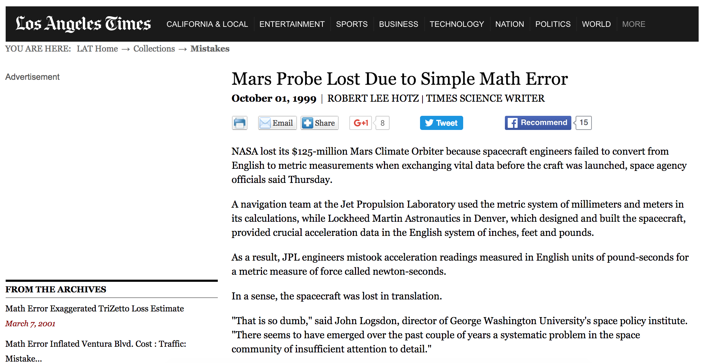

Slide 22
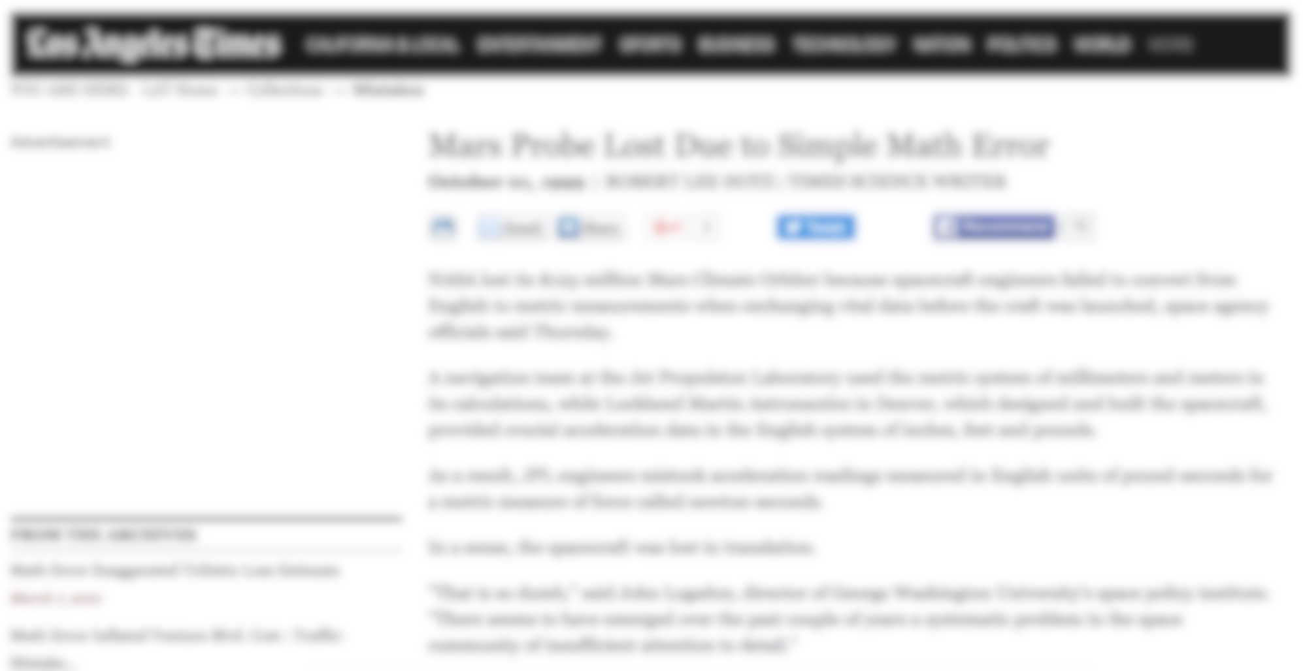

Slide 23
Shared Understanding >> Documentation
Notes:
Credit: User Story Mapping, by Jeff Patton (O’Reilly, 2014).

Slide 24
User Stories & Story Mapping
Invented and popularized by Jeff Patton (look for his webcasts!)
Basic idea: externalize understanding of system in digestible bits
Develop a story about how the system is used
Drill down into elements of this story to understand what different ways different parts of the story can be accomplished
Consider user “journeys” to understand what ought to be prioritized
Use the physicality of the story map to facilitate conversation and understanding

Slide 25
Story cards
Story cards capture user goals
Title should be a verb description
Goal is written as “As a {type of user}, I want to {perform some action} so I can {achieve a goal}”

Slide 26
Examples of User Stories (for Vending Machine)
As a customer, I want to insert coins to be able to pay for my item.
As a customer, I want to select my item.
As a customer, I want to know the cost of an item.
As a technician, I want to set the prices of items.
As a technician, I want to open the machine to service it, without injuring anyone.

Slide 27
Story Cards & Backlog
User stories are arranged into a Backlog
» set of all stories for a product
» sorted with highest-priority tasks at top
Value

Slide 28
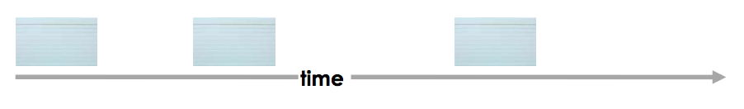
Story mapping
Story maps add narrative structure to a backlog
» top-level: main features (high level goals) “project backbone”

Slide 29
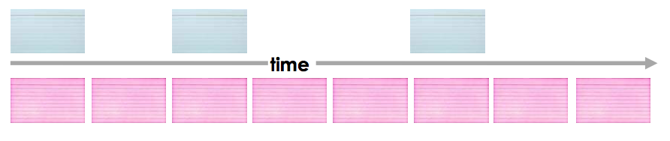
Story Maps
Second level: activities or stories that are ordered to complete the higher level goal
» This is known as a “walking skeleton”
Notes:
Note some texts describe Goals > Activities > Tasks or Activities > Tasks > Sub-tasks
The labeling is not too important, the point is that there are “sub-” things that need to be accomplished

Slide 30
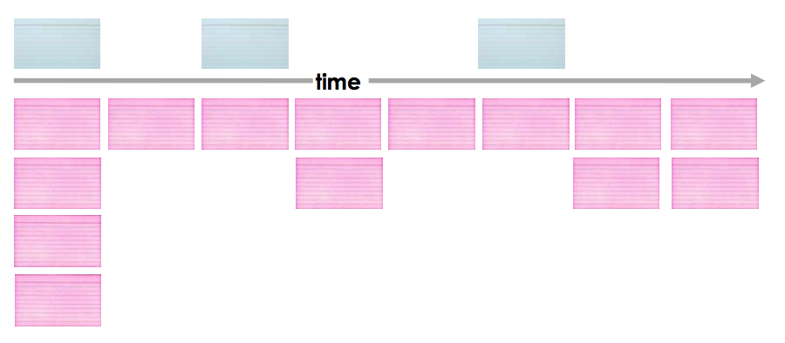
Story Maps
The next layer down fleshes out different ways the same task can be accomplished, and these are ordered in priority from top to bottom
» Release planning

Slide 31
Learning Objectives
By the end of this lecture, you should be able to:
Discuss several techniques for gathering requirements
Identify functional vs. non-functional requirements
Discuss the distinction between functional vs. non-functional requirements
Explain why we need techniques to capture requirements
Understand how User Stories and Story Mapping works (you will practice this in tutorial)

