Slide 1
State Diagrams
SENG 301

Slide 2
Learning Objectives
By the end of this lecture, you should be able to:
Read and interpret a state diagram
Analyze and debug a system based on a state diagram
Create a state diagram that models a system’s behaviour

Slide 3
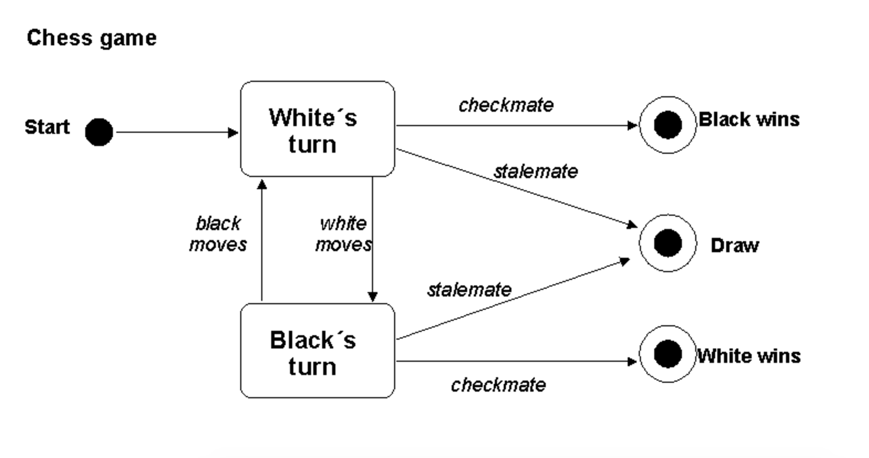
Notes:
http://users.csc.calpoly.edu/~jdalbey/SWE/Design/STDexamples.html

Slide 4
State Diagrams
A system’s state is the value of all the instance variables at a given moment. At any one moment, a system can only be in one state.
A system stays in that state until an event occurs to change that state
In reality, the entire state of the system is usually kind of crazy to think about (because there are usually so many variables), so we do some abstraction.

Slide 5
In real life, transitions between states sometimes take time
We consider state transitions in computer systems to happen instantaneously
» States are represented by rounded rectangles
» Transitions are represented by directed edges (that are labeled)
Notes:
http://www.uml-diagrams.org/examples/state-machine-example-water.png

Slide 6
You can model at different levels
» Start points are a black disc
» States are labeled
» Transitions can be labeled with a {event} / {result} – event must be there; result is optional
» Note here that it explicitly includes another diagram
Notes:
http://www.math-cs.gordon.edu/courses/cs211/ATMExample/Statecharts.html#ATM

Slide 7
Last Bits
» End state is a black disc with a circle around it—a system can have multiple end states
» You can model actual code calls, or you can model operations/state at a higher level
» Modeling at the lowest level is usually not useful

Slide 8
» Certain transitions only happen in certain situations
» Here, they are marked by “guards” that are in [square brackets]

Slide 9
Notes:
http://www.btutor.com/uml/States.html

Slide 10
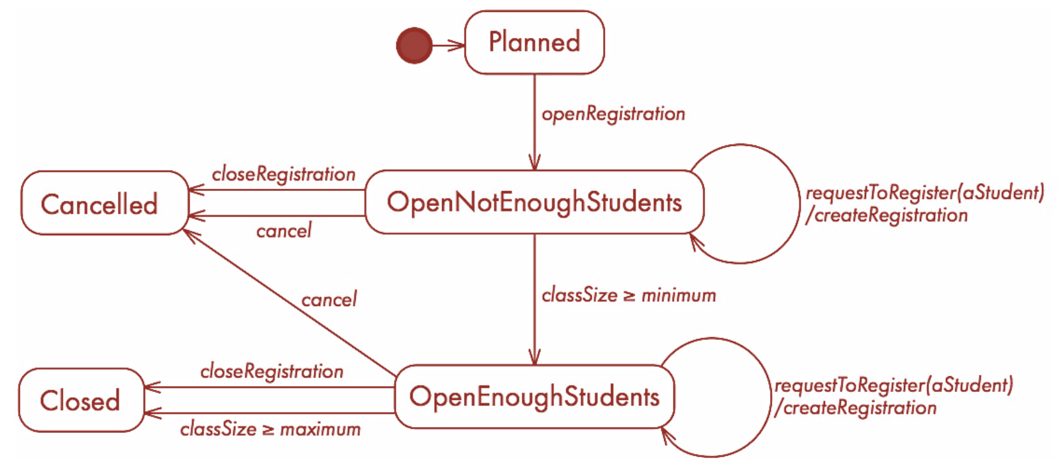
Conditional Logic
Notes:
© Lethbridge/Laganière 2005

Slide 11
State Diagrams
The trick is getting the right level of abstraction for the system states—what are meaningful states for the system to be in?
Remember the lesson on the first day: what is the purpose of the diagram? Who is reading this diagram?
Examples: non-technical stakeholder; the intern who needs to know how a specific component works (e.g. A1); your boss who wants to understand how the whole system works, etc.

Slide 12
Exercise
Pull out a piece of paper. If you don’t have it, sketch on your computer, but this will be harder.
Develop a state diagram that captures one-button mouse operation.
Once you’re done, take a photo and post it to #in-class.
» Hint: 1. What are the possible states? 2. How do we move between those states?
Notes:
http://i.amz.mshcdn.com/DSrzhDM_NlEcv0K0balgoLNpqZ4=/fit-in/850x850/http%3A%2F%2Fmashable.com%2Fwp-content%2Fgallery%2Fapple-mouse%2Fadb4206895378_53575bddff_z.jpg

Slide 13
One-Button Mouse – Two state model by Buxton

Slide 14
Three state GUI interaction by Buxton

Slide 15
Exercise
Take the three-state model, and extend it for a two button mouse.

Slide 16
Summary of Modeling
Structural modeling: how are the different components of the system organized, how are they related to one another? (class diagrams)
Behavioural modeling: at runtime, how does the system behave—specifically, how do they communicate with one another, in what order (sequence diagrams, communication diagrams), and how does the system move through different states, and in response to what (state diagrams)?

Slide 17
Summary of Modeling
We use modeling as a way to abstract from the complexity of the system in its entirety. Modeling diagrams allow us the analyze the structure or behaviour of a system—incredibly, we can do this w/o even having any code! This allows us to make decisions about how a system should be organized/how it should be have. The modeling diagrams allow us to understand what is going on without having to read the code.
These diagrams and models can be created and used in a number of ways: e.g. before code is written to consider/analyze different structural/behavioural possibilities; after some code is written to understand how the system works, or even as a way to document how the system works for future developers/stakeholders.

Slide 18
Summary of Modeling
While there is syntax that needs to be followed, there are many aspects of the diagrams that are optional. Deciding when (and when not) to use these optional components depends on who the audience is, and the purpose of the diagram.
Remember that the purpose of building a diagram is almost always to communicate something to someone else, so be cognizant of what they are interested in knowing, and their level of sophistication.

Slide 19
Learning Objectives
You now know how to:
Read and interpret a state diagram
Analyze and debug a system based on a state diagram
Create a state diagram that models a system’s behaviour

