Slide 1
On #in-class
Please respond to the poll
If you have a question about A1, post it to #in-class, and we will discuss it together as a group.
If someone else has already posted a question that you want to ask, then give it an interesting emoji reaction.
Notes:
/poll “How I’m feeling about A1 right now:” “Haven’t started” “FREAKING OUT” “?!?!?!?!?!” “Almost done” “Basically done” “Other"

Slide 2
Behavioural Modeling:
Sequence Diagrams
SENG 301

Slide 3
Learning Objectives
By the end of this lecture, you should be able to:
Contrast the purpose of behavioural modeling from structural modeling
Understand how to read sequence diagrams as a model of inter-component communication
Understand how to read communication diagrams
Model real-life process using both sequence and communication diagrams

Slide 4
Notes:
http://cse.stfx.ca/~mlin/cs485/lectures/Ch5Sysmodel.ppt

Slide 5
Sequence Diagrams
Help us to visualize how a system operates at runtime
Answers: how, and in what order to objects send messages to one another to get something done

Slide 6
What’s in a sequence diagram
Objects: the runtime instantiations of the classes that comprise the system
Messages: communication between the objects, e.g. method call, network messages, etc.
Actors: peeps

Slide 7
What’s in a sequence diagram
Objects: the runtime instantiations of the classes that comprise the system
Messages: communication between the objects, e.g. method call, network messages, etc.
Actors: peeps
myFoo : Foo
: Foo

Slide 8
What’s in a sequence diagram
Objects: the runtime instantiations of the classes that comprise the system
Messages: communication between the objects, e.g. method call, network messages, etc.
Actors: peeps
myFoo : Foo
Underlined to indicate “an instantance of”
Foo is the type (class)
myFoo is a named object (usually will be referred to later)
: Foo

Slide 9
What’s in a sequence diagram
Objects: the runtime instantiations of the classes that comprise the system
Messages: communication between the objects, e.g. method call, network messages, etc.
Actors: peeps

Slide 10
What’s in a sequence diagram
Objects: the runtime instantiations of the classes that comprise the system
Messages: communication between the objects, e.g. method call, network messages, etc.
Actors: peeps
process()
price := getPrice(book)
«create»

Slide 11
What’s in a sequence diagram
Some diagrams choose to include/exclude the parameters; others choose to include/exclude the return (though this is implied)
You can name return values or even arguments for clarity
We can also indicate if we create an object
Objects: the runtime instantiations of the classes that comprise the system
Messages: communication between the objects, e.g. method call, network messages, etc.
Actors: peeps
process()
price = getPrice(book)
«create»

Slide 12
What’s in a sequence diagram
Objects: the runtime instantiations of the classes that comprise the system
Messages: communication between the objects, e.g. method call, network messages, etc.
Actors: peeps

Slide 13
What’s in a sequence diagram
Objects: the runtime instantiations of the classes that comprise the system
Messages: communication between the objects, e.g. method call, network messages, etc.
Actors: peeps

Slide 14
Other notes
Objects are arranged horizontally
Action starts on the left
Vertical axis represents time (in terms of ordering, not in terms of how long things will take), and moves top to bottom
“Lifeline” represents each object → is broad when it is “activated”

Slide 15
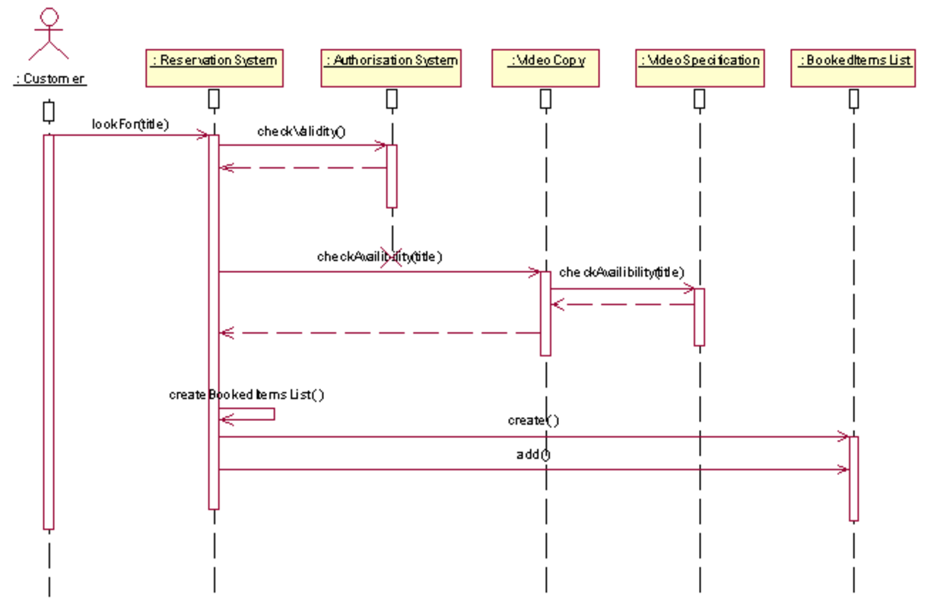
Notes:
http://slideplayer.com/slide/7117097/

Slide 16
Notes:
Named instances
http://www.btutor.com/uml/States.html

Slide 17
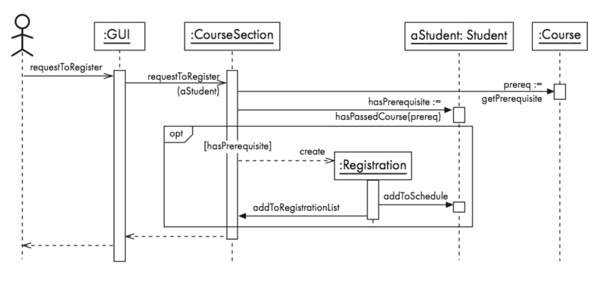
If/else, or optional structures

Slide 18
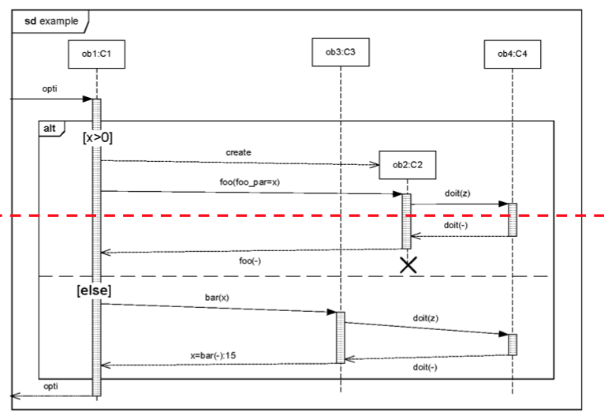

Slide 19
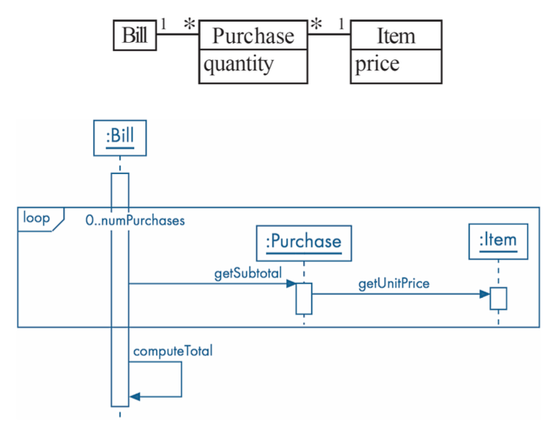
Loops

Slide 20
Examples
Model the interaction between a customer at McDonalds and their touch-screen ordering system. Note that the customer can order multiple items, and there is interaction with the kitchen system, as well as the bank.
Notes:
http://i3.liverpoolecho.co.uk/incoming/article10291392.ece/ALTERNATES/s615b/JS74771331.jpg

Slide 23
Examples
Model the interaction between a customer, an online bookstore, a bank and the shipping company when a customer hits “Buy the items in my shopping cart”
Notes:
http://central.com.ph/iv2-css/centralbooks/images/bookstore-ad-small.jpg

Slide 24
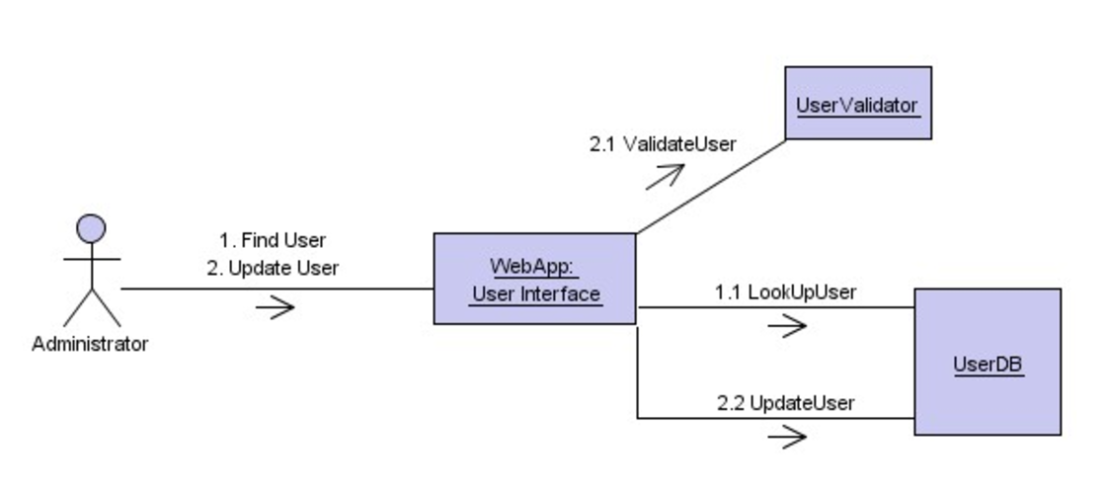
Communication Diagrams
Decimalized numbering to indicate flow
Different “big” number indicates a different major task
[guard] (like a condition)
Notes:
http://slideplayer.com/slide/7117097/

Slide 25
Communication Diagrams
Decimalized numbering to indicate flow
Different “big” number indicates a different major task
[guard] (like a condition)

Slide 26
Communication Diagrams
No strict horizontal/vertical flow
Objects that communicate with one another are connected by a link
Annotated arrows (with number and function) indicate the message call direction
[Guards] are used to indicate condition that must be met before the call

Slide 27


Slide 28
Why do we use sequence diagrams and communication diagrams?
Even medium-sized systems are complex because of the interdependencies between different objects. While you can model this with a class diagram, they do not capture the dynamics of the system at runtime. So, for example, certain kinds of class-level interdependencies don’t matter for certain operations. (e.g. Bookstore example from lecture 4: when we are dealing with search results, we don’t care about other parts of the system – e.g. shopping cart, customer addresses etc.)
Sequence diagrams and communication diagrams help us to understand how different objects (i.e. instances of classes) communicate with one another during runtime (i.e. when the system is running, how do they talk to one another) for short, specific interactions.
Sequence diagrams help us untangle the “rat hole” of interactions between components (i.e. they can get pretty nested). They help us untangle what the “high level” calls are vs. what the “low level” calls are. (high level ones are the ones that end up relying on the low level ones at the end of the chain)
Communication diagrams focus on the different interacting components at a slightly higher level. The numbering scheme allows us to see a little more clearly multiple interactions; however, the nestedness of the communication is sometimes less clear.

Slide 29
Meta: Why does A1 feel so hard?
There are a few reasons why:
It is probably the largest codebase you’ve worked with so far (don’t hold your breath for A2!)
There’s a lot of documentation and specs to get through before you can figure out how to begin
Growth opportunity: You need to get over the hump of “I don’t know how to do the whole thing,” before beginning. With this kind of thing—just do something so you can learn from it. Accept that you might make a mistake, and accept that you may need to throw away some code and re-write it. Just go for it.
But here’s the real lesson: One of the reasons this assignment feels hard is that the flow of execution does not feel like it’s in your hands. It starts and ends somewhere else. <-- this should tell you why Sequence and Communication Diagrams are useful (i.e. they help you untangle this)

Slide 30
Learning Objectives
You now know how to:
Contrast the purpose of behavioural modeling from structural modeling
Understand how to read sequence diagrams as a model of inter-component communication
Understand how to read communication diagrams
Model real-life process using both sequence and communication diagrams

Slide 31
A1
Due on Friday at noon on D2L via the Dropbox
You can submit multiple times – the last one is what will be evaluated
If you freaked out when you saw the assignment the first time, then the assignment did its job
Remember that the right way to approach this is to read through the documentation carefully to understand what is being asked of you ➔ Your principal job is to build VendingMachineFactory from the stubs such that it passes the test scripts

Slide 32
A1
Test scripts: scripts that tell the system what to do – ones that should pass begin with “T”; ones that should fail begin with a “U”.
If it is a script that should pass, then nothing should happen (aside from it saying PASS a bunch).
If it is a script that should fail, then somewhere along the line, some part of the code should throw an exception. This is caught by ScriptProcessor, where it says, “FAIL… but that’s good!”

Slide 33
A1
#A1 slack channel has been very active
Some really active contributors helping one another out: thank you
But: remember that you only have so much social capital in Slack, just as in real life. Remember to try /something/ before reaching out for help.
I do not like repeating myself: make sure that your question has not already been asked/responded to. I don’t enjoy the cursory, “Sorry if this has already been asked,” – that really just means you didn’t try looking. ;-)
I will not be online past Thursday evening into Friday. My intention is not to make it hard on you; rather, I’m trying to force you not to wait until the last minute.

