Slide 1
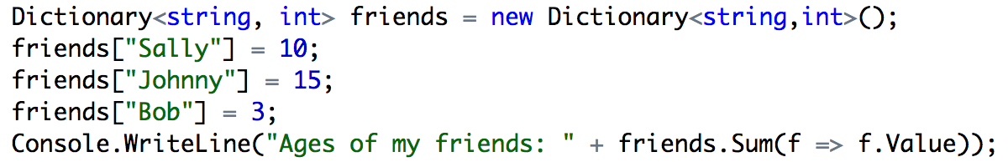
#in-class (link is there)
Go to: https://repl.it/languages/csharp
Add two usings: “using System.Collections.Generic; using System.Linq”
Add the following code into Main:
Then, try this: http://www.kongregate.com/games/moly/gorillas-bas

Slide 2
Recap of Object-Oriented Programming
SENG 301

Slide 3
Learning Objectives
By the end of this lecture, you will be able to:
Provide a rationale for using object-oriented design
Explain the distinction between traditional procedural designs and object-oriented design
Define and explain core OO terms: encapsulation, state retention, inheritance, polymorphism
Understand the principles of how OO ideas are realized in C#
Applied: using generic collections in C#/.NET, using exceptions

Slide 4
Need two volunteers
http://www.kongregate.com/games/moly/gorillas-bas
Notes:
http://www.kongregate.com/games/moly/gorillas-bas
Post to slack: http://www.jefflewis.net/archive/programming/gorilla.bas

Slide 5
Gorillas.bas
Take a look at the source code
Consider these questions:
How is state of the system represented?
How does the system know “how” to run?
How does the system interact with the data?
Notes:
Classic Qbasic game that was released alongside MS-DOS – copyrighted by Microsoft

Slide 6
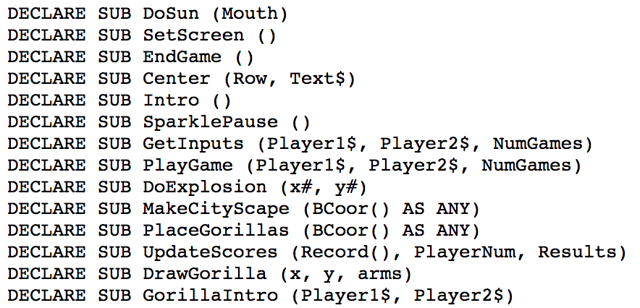
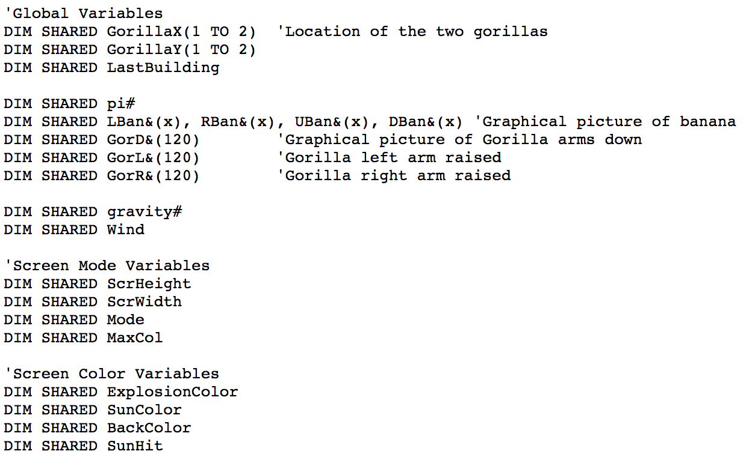
Ol’ school codin’
Data and procedures are separated – each is modeled separately (e.g. by naming convention)
Scaling this approach is hard

Slide 7
Object-Oriented Approach
Idea 1. Group together related pieces of data and methods together into “things” that we can manipulate
Idea 2. “Things” can have relationships with one another, and these relationships inform how a system operates
In the context of the Gorillas game, what kinds of objects might we use to represent things in the game? [take 1 minute]
Arena
Gorillas
Obstacles -> Sun, Building
Notes:
The idea is that OO reduces complexity, because it models things in the same way we think about things, people and processes in the real world – this is debatable, perhaps, but is the argument that is usually used.

Slide 8
Object-oriented paradigm
The object-oriented paradigm: organizes procedural abstractions in the context of data abstractions
The object-oriented paradigm is an approach to the solution of problems in which all computations are performed in the context of objects. The objects are instances of programming constructs, normally called classes, which are data abstractions and which contain procedural abstractions that operate on the objects.

Slide 9
What’s an ‘object’ in OOD terms?
Objects are conceptual entities that are a metaphor for something in the real world, but this breaks down when you push hard
Objects are discrete things (as opposed to continuous things)
In code, we model these real-world objects with structured data running inside a system—it is structured in the following ways: it has a state, and a set of operations that you use to manipulate its state

Slide 10
OO Concepts
Encapsulation
State
Operations
(aside: objects vs. classes)
Inheritance
Polymorphism

Slide 11
Encapsulation
Grouping related things together—specifically, state and operations
Hides information from the outside world, and exposes specific mechanism for outside world to interact
In OOD, we rely on objects as the primary mechanism to do encapsulation

Slide 12
Encapsulation » State
State is represented in an object by the value of its instance variables (sometimes known as “fields”, or the data in the object)
What might be state of this object:

Slide 13
Encapsulation » Operations
Methods (or sloppily, “functions”) on an object result in behaviours. These behaviours are generally a function of this object’s state.
Based on visibility, some methods allow other objects to operate on this object.
banker.withdraw(tony.chequing, 10) ➔ success (tony has $10)
banker.withdraw(tony.chequing, 10) ➔ could fail (tony is broke)
badguy.withdraw(tony.chequing, 10) ➔ fails (badguy cannot see tony’s chequing account)

Slide 14
Aside: objects vs. classes
Classes are labels that we give to objects that are similar
For example, Ralph and Spot are both dogs. Ralph is an object, and Spot is an object, and they belong the class of “Dog”. This is reflected in code like this:
Dog ralph = new Dog(“Ralph”, 10);
Dog spot = new Dog(“Spot”, 1);
Note that ralph and spot have different “instance variables”. Each of ralph and spot are instances of a Dog. Dog is a type – kind of like an integer (but a bit more complicated).

Slide 15
Inheritance
Inheritance is unique to OO
When class B inherits from class A, it implicitly takes on methods, fields, etc. from class A
Some phrases that describe this relationship: “B is a subclass of A”; “A is a superclass of B”; “B is a child of A”; “A is a parent class of B”; “B extends A”; “B is derived from A”; “B is a specialization of A”; “A is a generalization of B”

Slide 16
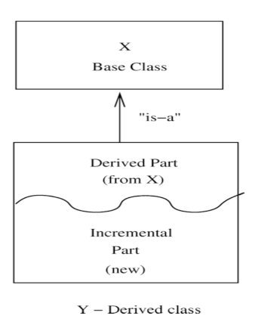
Inheritance
For instance, let’s imagine a simple class system in a first person shooter game: Player. What constitutes a set of operations a player can do?
(Shoot, run, duck, jump)
Now let’s suppose there are sub-classes: Medic, Spy. What are the “incremental parts” that each of these classes provide?
(heal, revive; switch clothes, back-stab)

Slide 17
Polymorphism
Polymorphism is a property of object-oriented software by which an abstract operation may be performed in different ways, typically in different classes.
Inheritance enables some kinds of polymorphism. (i.e. an object can be several different types)
Open up the C# REPL: https://repl.it/languages/csharp
Notes:
https://repl.it/languages/csharp

Slide 18
Polymorphism - Peeing
All humans pee, but males and females pee differently
abstract class Human {
public abstract void Pee();
}
class Male : Human {
public override void Pee() { Console.WriteLine(“Stand up, fool!”); }
}
class Female : Human {
public override void Pee() { Console.WriteLine(“Sit down”); }
}
Notes:
Example from: http://stackoverflow.com/questions/154577/polymorphism-vs-overriding-vs-overloading
https://gist.github.com/hcitang/6d128851a08da15a82b7cc0adce30cc3

Slide 19
Polymorphism - Peeing
var humans = new List<Human>() { new Female(), new Female(), new Male() };
foreach (var human in humans) {
human.Pee();
}
➔
Sit down!
Sit down!
Stand up, foo!
Notes:
Example from: http://stackoverflow.com/questions/154577/polymorphism-vs-overriding-vs-overloading

Slide 20
OO in C#
Terms: fields (instance variables), properties, methods (functions)
Encapsulation
Inheritance
Polymorphism
Interfaces

Slide 21
C# Terms
member variables == fields == instance variables
(e.g. class Player { int hitPoints; int ammoRemaining } )
properties – explicit mechanisms to get/set fields
These look a lot like accessing the internal fields directly, but have additional semantics (e.g. different visibility – public get; protected set)
methods == functions

Slide 22
Inheritance in C#
https://gist.github.com/hcitang/6fbb1d71e9356b3afd68d6e6a2ffc7ab
Notice the use of a property that the compiler uses to generate a field
Respond to the poll first
Try the code.
Note that we can change what “r” is interpreted at at run-time (think of it as a “Shape” right now; think of it as a “Rectangle” now)
4. Changing the “override” term to “new”, then re-run
Notes:
https://gist.github.com/hcitang/6fbb1d71e9356b3afd68d6e6a2ffc7ab
/poll “What will it run?” “Shape.Draw(), then Rectangle.Draw()” “Rectangle.Draw(), then Rectangle.Draw()"

Slide 23
Applied: Generic Collections in C#
Common data structures?
-- List of numbers
-- Mappings between names and ages
Trying to operate on collections
-- Sum
-- Max? Min?
Notes:
https://repl.it/languages/csharp
https://gist.github.com/hcitang/4b68ddf75808d180de809d64c0854cf2

Slide 24
Applied: Generic Collections in C#
Using generic collections mean that the collections are “typed” – operations like insertions are type checked (i.e. made sure to conform to what is expected).
using System.Collections.Generic;
…
List<int> numbers = new List<int>();
numbers.Add(2); // okay
numbers.Add(“two”); // this will break

Slide 25
Applied: LINQ Magic
LINQ (“Language Integrated Queries”) operate on generic collections for unbelievable magic
Mind blown
.Count, .Sum, .Min, .Max
.Where, .OrderBy, .First, …

Slide 26
Applied: Using Exceptions
Exceptions are a way to signal to the caller that something really seriously went wrong with the code.
void ReadFile(string name) {
if (name == null) {
throw new Exception(“Filename was null”);
}
…
}
Note that the exception text is (hopefully) useful for the component that called this code.

Slide 27
Questions about #A1?
A quick reminder:
If asking a question on Slack, please use the #A1 channel
Writing your own test scripts is fun, and you can see how your system behaves with slight

