Slide 1
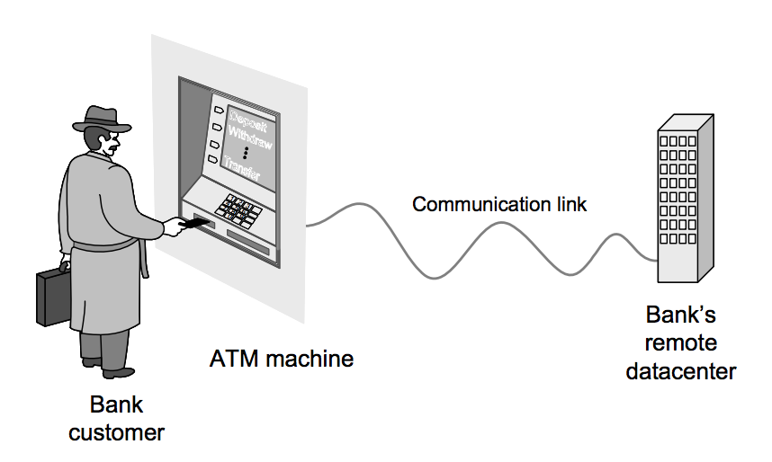
On #in-class today
Imagine that there are little gremlins inside of the ATM that make everything work.
Post on #in-class: how many gremlins are there, and what are their job titles?
Note: this is actually a serious exercise

Slide 2
Administrative
Course communication: http://seng301.slack.com
Course site: http://hcitang.github.io/seng301
Assignment 1 is now posted (due 1/27). Please review this so we can discuss later today.
Regular office hours: TR 10:45-11:50; today’s office hours are canceled

Slide 3
Software Process Models
SENG 301

Slide 4
Learning Objectives
By the end of this lecture, you will be able to:
Define and understand the role of a domain model
Discuss different software development process models: specifically to compare and contrast different approaches (strengths and weaknesses)
Articulate the conditions under which different software development process models are more effective

Slide 5
On #in-class today
Imagine that there are little gremlins inside of the ATM that make everything work.
Post on #in-class: how many gremlins are there, and what are their job titles?
Note: this is actually a serious exercise

Slide 6
Notes:
http://www.ece.rutgers.edu/~marsic/books/SE/book-SE_marsic.pdf

Slide 7
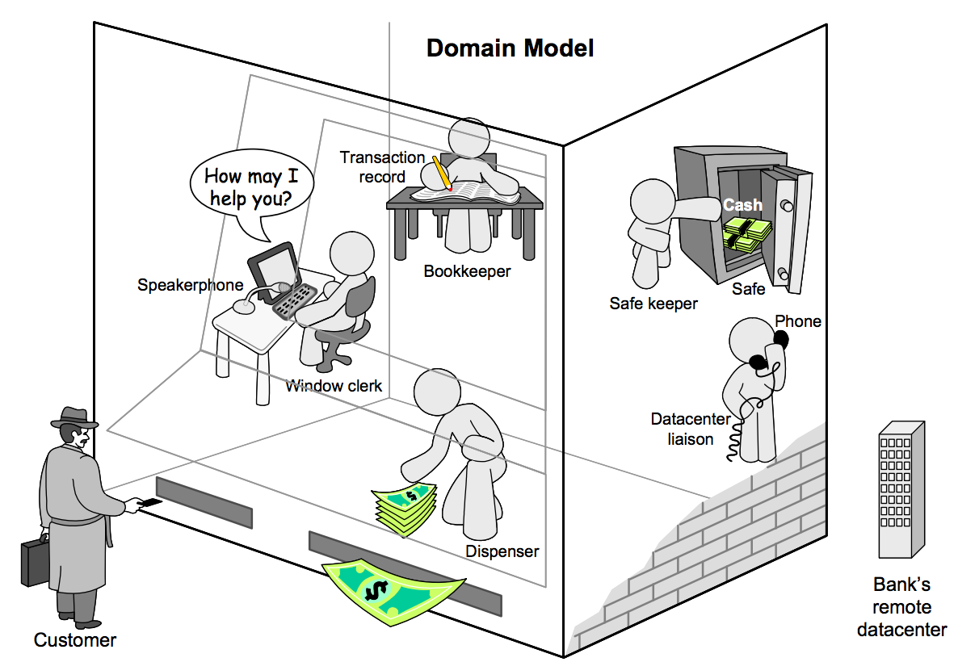
Notes:
Static: what the components are

Slide 8
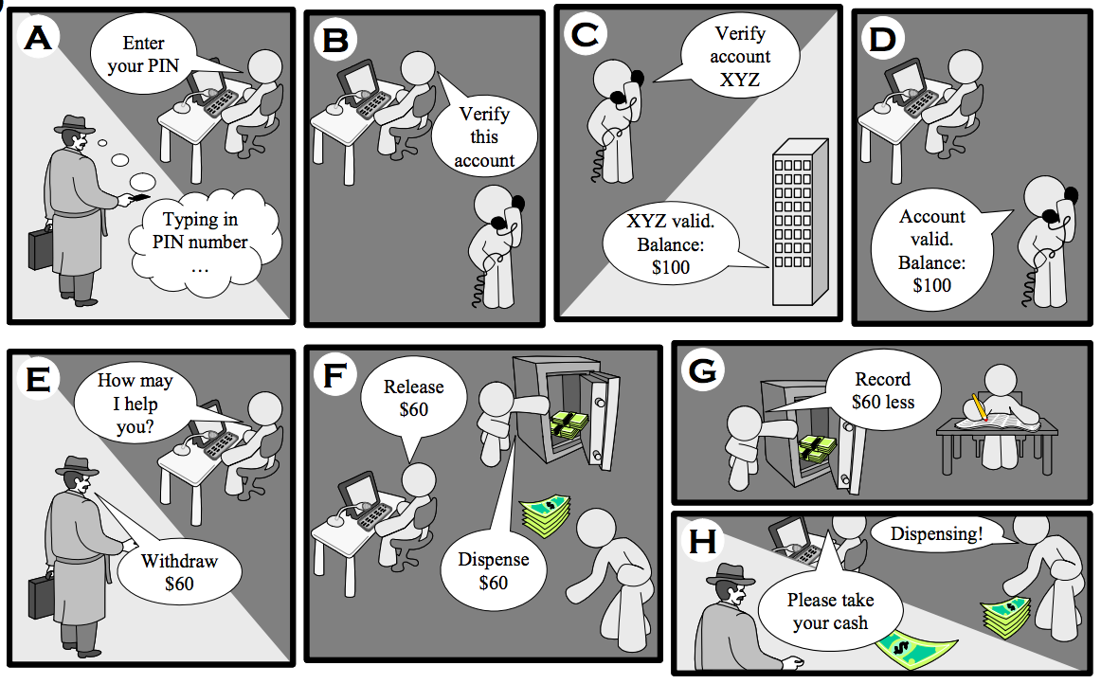
Notes:
Dynamic: how the pieces communicate with one another – i.e. the processes

Slide 9
Domain Model
A system of abstractions used to describe a domain
Captures real-world concepts, rules, components and processes
Uses the vocabulary of the domain, so that the representation can be reviewed and used to communicate with stakeholders
The model can be used to help us (software engineers) understand that domain, and it can be used to help us figure out what needs to be built

Slide 12
Variation in Target Domain
Memory Game for iPhone
Street Fighter
Microsoft Word
Electronic health records for Alberta Health
WestJet website
Flight control system
Most clients are non-technical stakeholders, and think in terms of “business needs”/language
Similarly, we are rarely (if ever) experts in the target domain
Building the domain model provides a “boundary object” that we can both talk about and reason about

Slide 13
Variation in Target Domain
Memory Game for iPhone
Street Fighter
Microsoft Word
Electronic health records for Alberta Health
WestJet website
Flight control system
Some projects have well-defined parameters up front
Most do not, where requirements change
Stakeholder client organizations are not always stable either
Some projects have stakeholders who are more readily available for feedback than others
Notes:
Okay, so how do we get there?

Slide 14
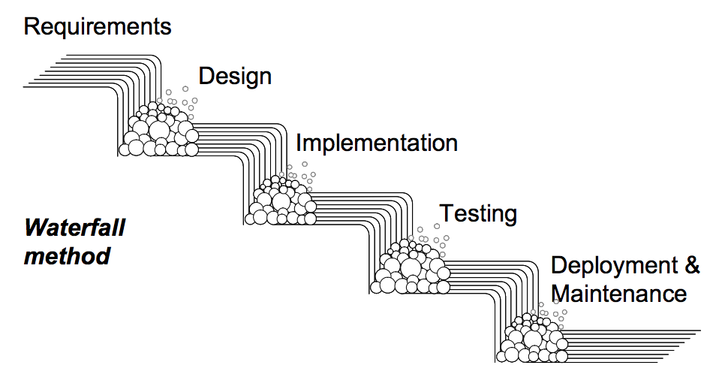
Waterfall model: a first approximation
Notes:
Requirements Specification - Understanding the usage scenarios and deriving the static domain model 2. Design - Assigning responsibilities to objects and specifying detailed dynamics of their interactions under different usage scenarios 3. Implementation - Encoding the design in a programming language 4. Testing - Individual classes/components (unit testing) and the entire system (integration testing) 5. Operation and Maintenance - Running the system; Fixing bugs and adding new features
http://www.ece.rutgers.edu/~marsic/books/SE/book-SE_marsic.pdf
Structured moves from phase to phase
Relies heavily on documentation, and sign off is crucial

Slide 15
Software Development Process Models
Process models describe strategies for teams, outlining:
activities that will need to be done
when they ought to be done (in relation to one another)
how team interacts with itself and outside world
work products that will be produced
As with the domain model, they’re a simplification/abstraction
Purpose: help us to get things done on time, on budget, “correctly” (from a software perspective, and a client perspective) and gives us an understanding of what we all ought to be doing
Notes:
Legal issues, too

Slide 16
Waterfall model: a first approximation
→ Product requirements doc
→ Software architecture doc
→ Software!
→ Unit/Acceptance tests
Manuals / service agreement
Notes:
Requirements Specification - Understanding the usage scenarios and deriving the static domain model 2. Design - Assigning responsibilities to objects and specifying detailed dynamics of their interactions under different usage scenarios 3. Implementation - Encoding the design in a programming language 4. Testing - Individual classes/components (unit testing) and the entire system (integration testing) 5. Operation and Maintenance - Running the system; Fixing bugs and adding new features
http://www.ece.rutgers.edu/~marsic/books/SE/book-SE_marsic.pdf
Structured moves from phase to phase
Relies heavily on documentation, and sign off is crucial

Slide 17
Waterfall model: challenges
No feedback mechanism
Requirements are rarely possible to state in entirety up front; requirements rarely do not change
Customer needs to be patient
Works when domain is very well-understood/well-specified

Slide 18
So how can we do better?
Projects: (1) self-driving nav system for Tonyota cars; (2) Gmail; (3) westjet.ca flight booking system; (4) eBay “automobiles” sub-site; (5) electronic health record system for Alberta Health; (6) accounting software for UCalgary
Consider the following questions:
How big is my target audience? How easily accessible are they? How homogeneous are they? How frequently do I need feedback?
How robust does the system need to be?
How much ambiguity is there in designing the system?
How should we change the development process?

Slide 19
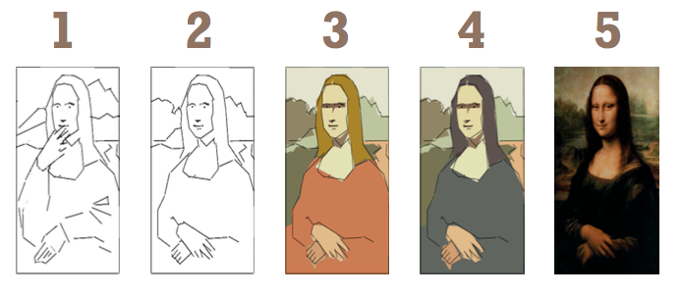
Term: Iterative approaches
Iterative: successive approximations to the right solution
Idea: encourage feedback frequently
Challenge: not always the case that things can be used in successive iterations (may need to be scrapped or re-done b/c not appropriately engineered)
Notes:
Jeff Pa8on: www.AgileProductDesign.com

Slide 20
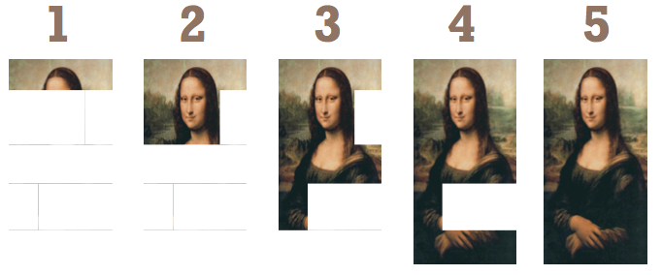
Term: Incremental approaches
Incremental: work on portions of the system at a time
Idea: get units working right before worrying about integration
Challenge: don’t get to see something until the end—the “TADA” moment
Note: Wikipedia gets this wrong, and confuses this with iterative approaches

Slide 21
Term: Prototype
A (hopefully quickly-made) system that mimics or approximates the final system
Idea: use a prototype to get feedback without the expectation that it will be used later; great for making mistakes!
Challenge: done usually in “cowboy”-style, so usually fairly difficult to extend or evolve

Slide 22
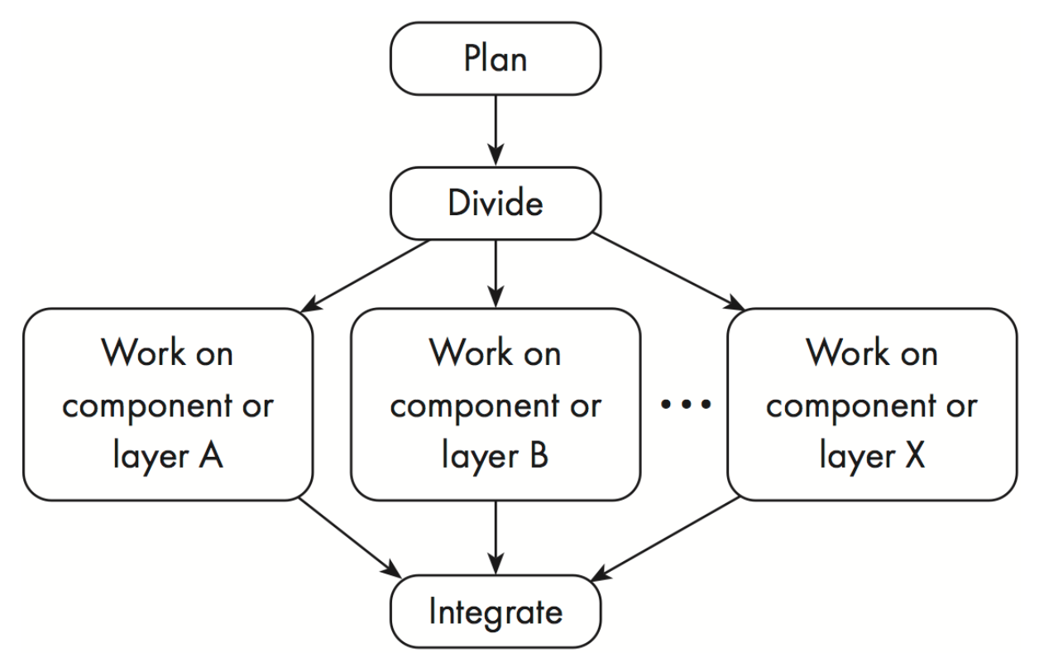
Term: Concurrent Engineering
Project is divided into components; integration is an explicit (painful) step
Common undergrad approach
Not always this way though! Some approaches rely on cross-functional people (everyone owns everything)

Slide 23
V-Model
Notes:
http://mickey-cheatham.blogspot.ca/2014_06_01_archive.html
More explicitly recognizes the importance of testing across the axis of the V
So, for example, how the system is used is compared against the problem description/concept of operations
Acceptance testing happens against the requirements
System verification and validation happens against the architecture
Detailed design leads to tests that comparea against those

Slide 24
V-Model: Challenges
Main critique of V-Model is that it, too tends to advocate a fairly static model of development
While the advocacy on testing is nice, it is also kind of an incomplete model of how things actually work in practice
Notes:
More explicitly recognizes the importance of testing across the axis of the V
So, for example, how the system is used is compared against the problem description/concept of operations
Acceptance testing happens against the requirements
System verification and validation happens against the architecture
Detailed design leads to tests that comparea against those

Slide 25
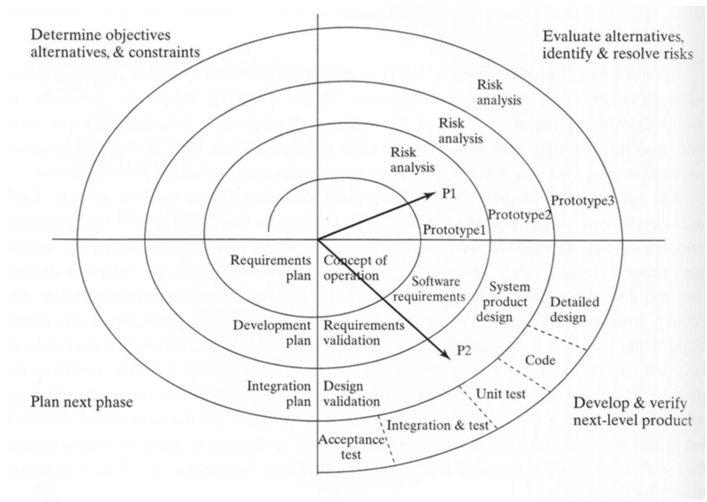
Spiral Model
Spiral model is an iterative model where the focus is identifying and addressing risks
Each spiral (called a “round”) is comprised of four phases:
Exploring alternatives, identifying objectives
Risk analysis
Development and verification
Planning of next phase
Notes:
Basically, this recognizes that risk is something that is something frequently introduced and is out of our control, and the model accounts for this by allowing us to deal with it when it comes up
e.g. over-scheduled/over-budget; exit/entry of personnel; dependncies on other products
e.g. poor design choices, poor performance; usability, change

Slide 26
Rapid Application Development
Derisively: “build-and-fix”
Iteratively develop prototypes, fixing them as problems arise ➔ most of the smaller tools that we get from IT
Best example is: “submit”
Challenge: no focus on quality, leading to poor changeability over time (as requirements change)

Slide 27
Agile Processes
“New hotness” (as of 2005)
Idea: frequently delivering working software (as opposed to documentation) to get feedback from customers
Requires: close communication with stakeholders and negotiability of everything (things change!)
Work is organized as a set of “sprints” rather than being planned out long in advance
Notes:
Came out of web consulting, where prototypes can be developed quickly

Slide 28
Agile Processes
“New hotness” (as of 2005)
Idea: frequently delivering working software (as opposed to documentation) to get feedback from customers
Requires: close communication with stakeholders and negotiability of everything (things change!)
Work is organized as a set of “sprints” rather than being planned out long in advance
Challenge: same with prototype/iterative approaches
Notes:
http://pragma.team/blog-list/2016/2/19/agile-the-why-the-how-the-who

Slide 29
What’s best?
Answer: it totally depends on the project and the team culture
Predictive approaches (emphasis on plans)
System correctness is critical
Junior developers
Requirements are stable
Large team
Adaptive (“agile”) approaches
System correctness is not as critical
Senior developers
Requirements are in flux
Small team

Slide 30
Learning Objectives
You should now be able to:
Define and understand the role of a domain model
Discuss different software development process models: specifically to compare and contrast different approaches (strengths and weaknesses)
Articulate the conditions under which different software development process models are more effective

Slide 31
Next time
Recap of object-oriented design (good times!)
Tutorials next week: C# primer, OO design, and debugging

Slide 35
Assignment 1: Vending Machine
You are given a specification for a vending machine. It mostly works the way you’d expect (except that we’re doing it all in software).
You’re responsible for implementing the VendingMachineFactory class, which creates new (virtual) vending machines. You will submit this as a .zip of the code in D2L’s dropbox.
Your boss has created a small test script system that checks whether your implementation is working right.

Slide 36
Front-end
Front-end
Your code
Your code
Your code
Test scripts
VendingMachineFactory
PASS!
FAIL!
Parser

Slide 37
Your code
Your code
Your code
Test scripts
VendingMachineFactory
PASS!
FAIL!
CREATE (5, 10, 25; 2)
CONFIGURE ([0] “Coke”, 10; “Pepsi”, 50)
INSERT ([0] 25)
PRESS ([0] 0)
EXTRACT ([0])
CHECK_DELIVERY (15, “Coke”)
Parser

Slide 38
Your code
Your code
Your code
Test scripts
VendingMachineFactory
PASS!
FAIL!
CREATE (5, 10, 25; 2)
CONFIGURE ([0] “Coke”, 10; “Pepsi”, 50)
INSERT ([0] 25)
PRESS ([0] 0)
EXTRACT ([0])
CHECK_DELIVERY (15, “Coke”)
Parser
SHOULD FAIL!

Slide 39
Your code
Your code
Your code
Test scripts
VendingMachineFactory
PASS!
FAIL!
CREATE (5, 10, 25; 2)
CONFIGURE ([0] “Coke”, 10; “Pepsi”, 50)
POP_LOAD ([0] 0, “Coke”, 1)
INSERT ([0] 25)
PRESS ([0] 0)
EXTRACT ([0])
CHECK_DELIVERY (15, “Coke”)
Parser

Slide 40
Your code
Your code
Your code
Test scripts
VendingMachineFactory
PASS!
FAIL!
CREATE (5, 10, 25; 2)
CONFIGURE ([0] “Coke”, 10; “Pepsi”, 50)
POP_LOAD ([0] 0, “Coke”, 1)
INSERT ([0] 25)
PRESS ([0] 0)
EXTRACT ([0])
CHECK_DELIVERY (15, “Coke”)
Parser
SHOULD FAIL!

Slide 41
Your code
Your code
Your code
Test scripts
VendingMachineFactory
PASS!
FAIL!
CREATE (5, 10, 25; 2)
CONFIGURE ([0] “Coke”, 10; “Pepsi”, 50)
POP_LOAD ([0] 0; “Coke”, 1)
COIN_LOAD ([0] 0; 5, 1)
COIN_LOAD ([0] 0; 10, 1)
INSERT ([0] 25)
PRESS ([0] 0)
EXTRACT ([0])
CHECK_DELIVERY (15, “Coke”)
Parser

Slide 42
Assignment 1: Heavy Duty
Relies on C#. You’ll do it in Visual Studio
Visual Studio 2015 is free to download
I expect that you will spend 4-8 hours of time on this assignment (but YMMV)
Read through the specification carefully (and think about what’s been written—is it clear? Are there ambiguities?)

Slide 44
Assignment 1: Heavy Duty
When you first see the code, there’ll be a lot of “WTF!”, fear and anxiety—this is the point.
Notes:
Better to do it now than at your first job.
Get over it now. Get the anxiety, the heeby jeebies, etc.
This class is about strategies to overcome it.
But for now, it’s all about exposure therapy

Slide 45
Assignment 1: Heavy Duty
When you first see the code, there’ll be a lot of “WTF!”, fear and anxiety—this is the point
Don’t sweat it though: you don’t need to understand all the code (heck, I don’t even understand all of it). THAT’s the point. You just need a working “model” of what’s going on.
Notes:
Better to do it now than at your first job.
Get over it now. Get the anxiety, the heeby jeebies, etc.
This class is about strategies to overcome it.
But for now, it’s all about exposure therapy

Slide 46
Assignment 1: Questions?
More questions: ask on #a1

Slide 47
Next time
Structural modelling
Tutorials next week: C# primer, OO design, and debugging

Slide 49
Death March Projects
A death march project is one where the “project parameters” exceed the norm by 50% through one or more of:
schedule compression
staff compression
budget compression
functionality inflation
You will be asked to work longer hours (e.g. 14-hour days, 6 days a week) → yo, bad for your health!
Surprisingly common (not frequently talked about)

Slide 50
Why Death Marches?
Politics
Promises / bad estimates / bad management
Intense competition
Pressure caused by unexpected constraints (e.g. regulations)
Unexpected/unplanned crises

Slide 51
Why do people stay in it?
Optimism (“it’ll get better soon!”)
Perceived reward for risk (“risks are high but so are rewards!”)
Alternative is frequently unemployment
Kind of fun ;-)

Slide 52
What can you do?
Be aware when it’s happening
Do your best to survive (focus on things that emphasize your contributions; lie to superiors; protect your teammates)
Negotiate (time off; flexibility in scope; flexibility in deadlines)
Get out!

