Slide 1
Prototyping
SENG 301

Slide 2
Learning Objectives
By the end of this lecture, you should be able to:
Describe different techniques to prototype software
Understand how prototypes can be used in a software engineering process to gather feedback from stakeholders
Discuss the tradeoffs between low-fidelity and high-fidelity prototypes

Slide 3
How can we gather stakeholder feedback?

Slide 4
Paper Prototypes
Hanmail: what are they able to simulate well; what are they unable to simulate well?
Login: what does the voice-over add; what does he do beyond what Hanmail does?
Notes:
https://www.youtube.com/watch?v=GrV2SZuRPv0
https://www.dropbox.com/s/ljagp0ukhyd0iur/481-8-user-registration.mp4?dl=0

Slide 5
Prototypes
Prototypes are approximations of the final product
Prototypes vary on two dimensions: fidelity and depth
Fidelity refers to the medium with which a prototype is constructed (hi vs. lo)
Depth refers to the range of capabilities expressed by the prototype (horizontal vs. vertical)

Slide 6
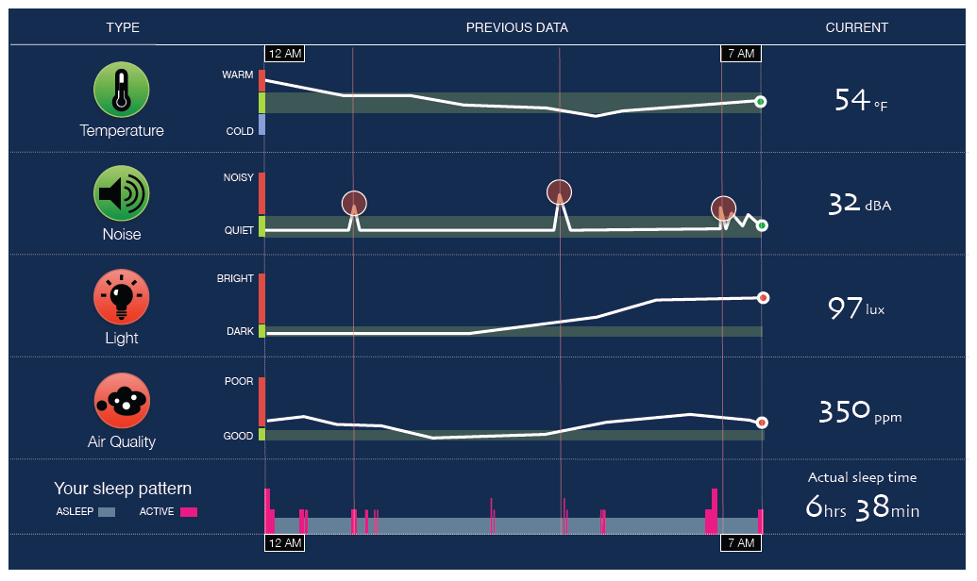
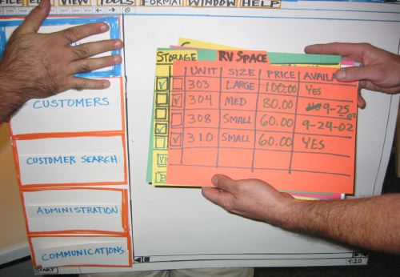
Hi vs. Lo Fidelity Prototypes
Distinction: is the choice of medium close or far from that of final design? (e.g., high = software; low = paper prototype)
Hi fidelity
Lo fidelity

Slide 7
Prototype “Types”: Two Dimension Classification Scheme
High --- Low Fidelity
  » Choice of medium is close to or far from that of the final design
  » e.g. high = software; low = paper prototype
Horizontal vs. Vertical (generally for software prototypes)
  » Range of capabilities in the prototype
  » horizontal = wide range of features without full “implementation” of any
  » vertical = select features are “implemented” all the way through
Notes:
-=-=
Horizontal prototypes are appropriate for understanding relationships across a broad system and for showing the range of abilities of a system.
Vertical prototypes are most appropriate when a certain complex feature of a system is poorly-understood and needs to be explored, e.g. as a proof-of-concept.

Slide 8
Hi-fi vs. Lo-fi: “From the experts…”
 | Lo-Fi | Hi-Fi
Advantages | » ***fast*** » cheap » easy – kindergarten skills! » can simulate actual product » great way to get feedback from stakeholders | » better sense of finished product » can judge aesthetic appeal » more realistic experience » can evaluate the experience better » probably more convincing for stakeholders
Disadvantages | » slow response time » can’t get feedback about aesthetics » user may question design quality | » users may focus on unnecessary details » takes a lot of time to make » users may lose track of big picture

Slide 9
Vertical vs. Horizontal Prototypes
Different Features
Horizontal prototype
Scenario
Functionality
Full
interface
Vertical prototype
Notes:
Arrow on functionality
Take out the paper prototype/ photoshop mock up thing
• Two common types of compromise
- horizontal prototype: provide a wide range of
functions but with little detail
- vertical prototype: provide a lot of detail for only a
few functions

Slide 10
Prototyping Techniques
Paper prototyping
Video prototyping
Storyboarding
Prototyping tools (e.g. https://proto.io/)
Interactive Powerpoint!
Wizard of Oz!!

Slide 11
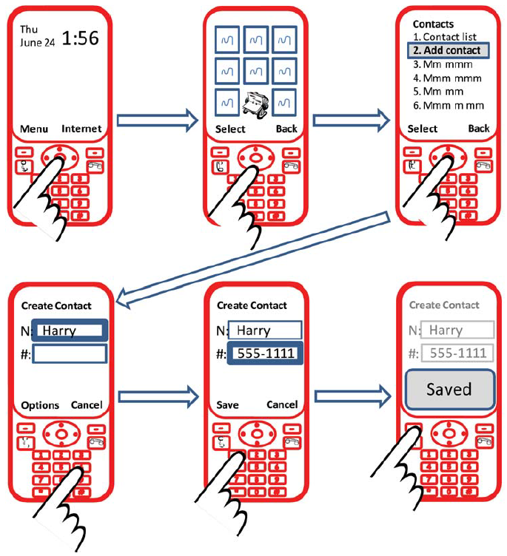

Slide 12
Wizard of Oz
Notes:
https://ghh-trikrollc.netdna-ssl.com/wp-content/uploads/2015/09/Wizard-of-Oz-test-Pay-no-attention-to-the-man-behind-the-curtain.png

Slide 13
Wizard of Oz
Mimicking hard-to-develop functionality to elicit responses from potential users (i.e. they do not know it is faked)
Elicited responses are approximations of what real reactions would be

Slide 14
Notes:
https://310valeo.files.wordpress.com/2013/12/20131120_172808.jpg
Voice recognition, pen/gesture recognition

Slide 15
Learning Objectives
By the end of this lecture, you should be able to:
Describe different techniques to prototype software
Understand how prototypes can be used in a software engineering process to gather feedback from stakeholders
Discuss the tradeoffs between low-fidelity and high-fidelity prototypes

