Slide 1
Refactoring
SENG 301
Notes:
© Refactoring: Improving the Design of Existing Code, Martin Fowler, Kent Beck Source: https://sourcemaking.com/

Slide 2
Learning Objectives
By the end of this lecture, you should be able to
Define code smell and refactoring
Understand why refactoring is used
Identify common “basic” code smells
Identify or suggest situations where simple refactoring strategies can be used

Slide 3
Technical Debt
“Building it this way is stupid, but we did it that way because it was faster”
“Ugh, I’ll come back to this later and fix it up”
“We should have done X”
Technical debt: “the extra development work that arises when code that is easy to implement in the short run is used instead of applying the best overall solution”

Slide 4
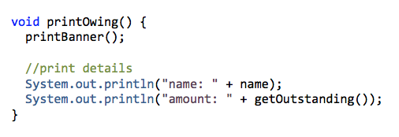
Copy and paste
Generally in coding, copying and pasting is your enemy
» introduction of bugs
» introduction of code that you may not understand
» introduction of some small technical debt ➔ duplicated code
Notes:
If you must copy and paste, do it manually: have it open on the right side, and then type it out manually – this forces you to go through the processof thinking about what is going on as you’re typing

Slide 5
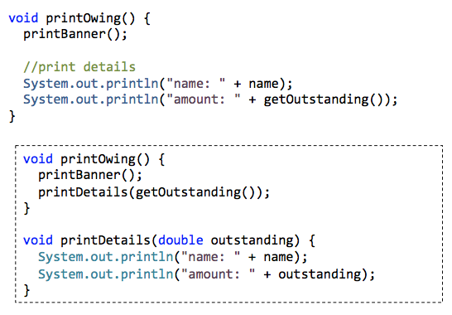
Refactoring Technique: “Extract Method”
If you have a code fragment that can be grouped together, and is frequently used/repeated, move this code into a separate new method, and replace the old code with a call to the method.

Slide 6
Refactoring
Refactoring is changing a software system in such a way that it addresses non-functional requirements (e.g. comprehensibility, extensibility, usability, etc.) without alter external behaviour of the code.
» Cleaning up code so that it minimizes chances of bugs
» Improving design of code after it is written

Slide 7
Problems and Techniques
“Code smells” are surface indications that there are deeper problems in the system
Most refactoring techniques are fairly straightforward, and there is often really good tool support for these (now)
In both the case of code smells and refactoring techniques, there are new ones being “discovered” all the time, so the list of names is fairly long: we’ll look at a small subset of each

Slide 8
Code smell: Duplicated code
If you see the same code structure in more than one place, unifying them is a good idea (e.g. propogating bug fixes)
» same expression in methods of the same class
» same expression in sibling subclasses
» code is similar but not the same (are there opportunities here?)
» methods do the same thing with a different algorithm

Slide 9
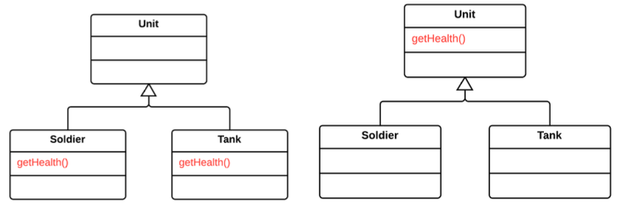
Refactoring Technique: “Pull Up Method”
Problem: Your subclasses have methods that perform similar work
Solution: Make methods identical, then move to relevant superclass

Slide 10
Refactoring Technique: “Extract Method”
If you have a code fragment that can be grouped together, and is frequently used/repeated, move this code into a separate new method, and replace the old code with a call to the method.

Slide 11
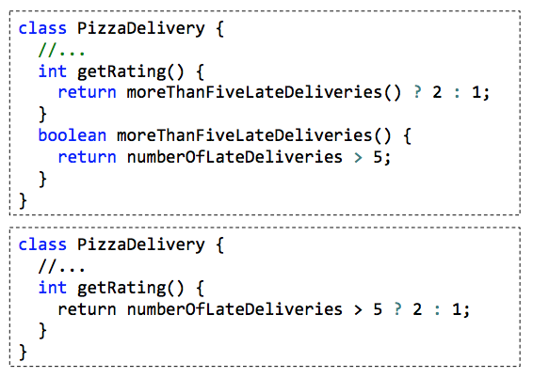
Refactoring Technique: Inline Method
Situation: Method’s body is as clear as its name
Solution: Put method body in the body of its caller and remove method
Notes:
Why does this happen??

Slide 12
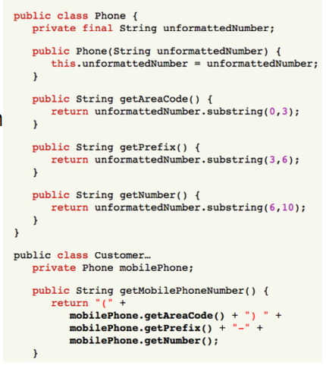
Code smell: Feature Envy
Situation: A method that seems more interested in a class other than the one it is actually in (i.e. overly coupled)
Why: Adds unnecessary complexity to code
Notes:
Notice how getMobilePhoneNumber touches Phone a bunch of times. Can we make this better?

Slide 13
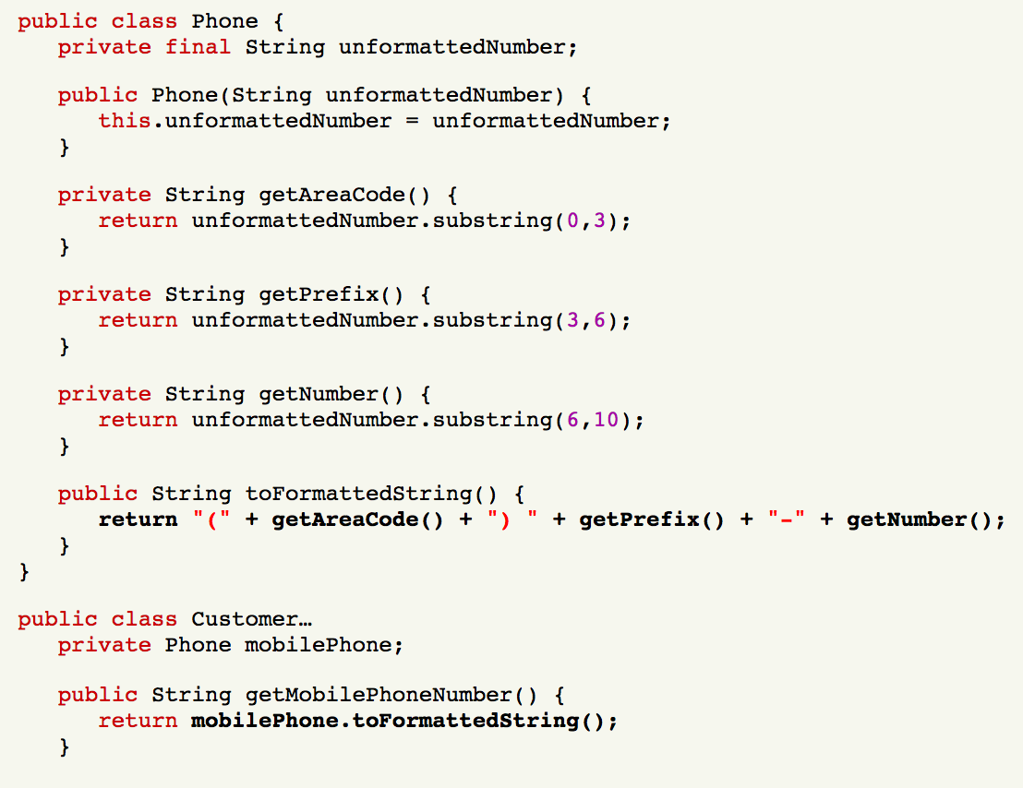
Redesigned Customer and Phone
Notes:
One way to think about this:
In the first case, there are three possible points of failure if getMobilePhoneNumber isn’t right
In the latter case, there is one point of failure

Slide 14
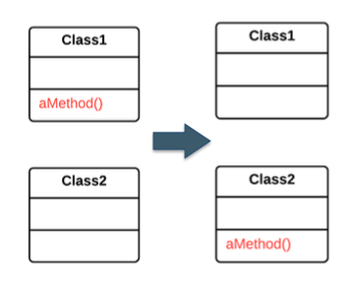
Refactoring Technique: Move Method
Problem: Classes have too much behaviour, or are collaborating too much (i.e. too coupled)
Solution: Create a new method with a similar body in the class it uses most; turn the old method into a delegation, or remove it

Slide 15
Code Smell: Middle Man
One class delegates many of its requests to another class
Beware classes that are merely wrappers over other classes or existing functionality in the framework

Slide 16
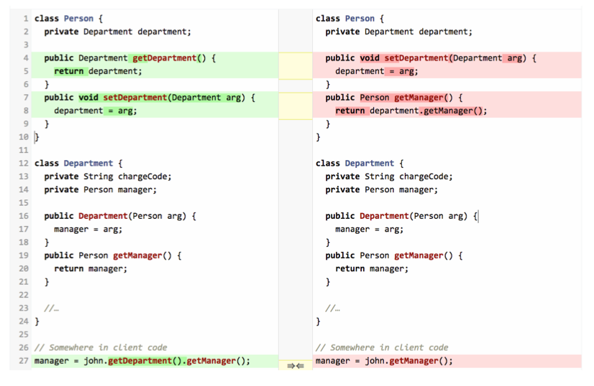
“Remove middle man”
Notes:
What’s happened here (for the client code):
To get the manager, we can just ask the person object (i.e. John) rather than asking for John’s department, and then the manager for the department

Slide 17
Code Smell: Uncommunicative Name
Problem: Name of the method or class does not succinctly describe what the class is for, or what the method does
(e.g. When someone other than the developer looks at the code, they don’t know what is going on)
Solution: rename or rewrite it!

Slide 18
Refactoring Technique: “Rename”
Obvious, but bears repeating: names are one of the most important “signals” in code for comprehension
“Sink” was meaningless for most of you
Names are super important—methods, fields, local variables, types, etc.!!
Avoid name collisions (sometimes happens), and make sure you have consistent ones: e.g. Open & Close vs. Open & Dispose
We need to usually worry about subclasses and superclasses when we do this type of refactoring technique

Slide 19
Other Code Smells
Long Method: All else equal, shorter methods are generally easier to read, to understand and to troubleshoot
Long Parameter List: The more parameters a method has, the more complex it is. Limit parameters to a method, or use an object to combine parameters
Dead Code: Ruthlessly delete code that isn't being used.
Indecent Exposure: Beware of classes that unnecessarily expose their internals. Aggressively refactor classes to minimize their public surface. You should have a compelling reason for every item you make public. If you don't, hide it.
Notes:
https://blog.codinghorror.com/code-smells/

Slide 20
Tool Support for Refactoring
Many IDEs and software tools can help automate some refactoring
It’s worthwhile understanding (roughly) how this works, so when the tool messes up, you can figure out why it messed up
Notes:
You will not be examined on this

Slide 21
Consider
Suppose I wanted to rename a method “Add” to “Increment”. Assuming that there was a good reason to do this, and the semantics made sense, why would it be a bad idea to simply do a Find+Replace across all the files in my code base for Add to Increment?

Slide 22
while b ≠ 0
if a > b
a := a − b
else
b := b − a
return a

Slide 23
Abstract Syntax Trees
[code] => Lexer => Parser => Abstract Syntax Tree
Abstract Syntax Tree: a tree representation of the abstract syntactic structure of source code written in a programming language. Each node of the tree denotes a construct occurring in the source code. The syntax is "abstract" in not representing every detail appearing in the real syntax.
Lexer: takes a stream of characters and identifies “important” chunks of text (usually: eliminates whitespace, comments, etc.) and understands those as “tokens”
Parser: identifies patterns in the sequences of tokens, and groups them into programmatic constructs (i.e. “This is a method declaration”, “This is a parameter name”, and so forth) ➔ produces an abstract syntax tree
Notes:
https://en.wikipedia.org/wiki/Abstract_syntax_tree

Slide 24
Code Model
Internal representation of the code that (usually) allows programmatic manipulation
e.g.
var method = project.GetClass(“VendingMachine”).GetMethod(“Dispose”);
method.Name = “Close”;
method.AddParameter(“int”, “Foobar”);
Notes:
Observe: this really only “works” if the code is complete and compiles.

Slide 25
Tool Support: Analyzing your code as you write
Notes:
Visual Studio and Eclipse are constantly analyzing the code you’re writing (it’s kind of weird)
On the VS team, they are very aware of how fast a editor feels, and so performance is paramount
Regardless, the output/benefit of this work is the pane on the right side
A good one can infer what is intended, even if the code is temporarily “broken” (e.g. missing brace, etc.)

Slide 26
Learning Objectives
By the end of this lecture, you should be able to
Define code smell and refactoring
Understand why refactoring is used
Identify common “basic” code smells
Identify or suggest situations where simple refactoring strategies can be used

