Slide 1
Evolvability
SENG 301

Slide 2
Learning Objectives
By the end of this lecture, you should be able to:
Discuss evolvability as a unifying concept in the long-term deployment of software, and how this impacts the design of software
Understand the vocabulary and concepts around evolvability
Understand how OO languages are designed for evolvability

Slide 3
#in-class
What year did you join Facebook? (How old were you?)
What do you remember as being the most major change that Facebook went through since then?

Slide 4
Facebook’s Vision and Mission
People use Facebook to stay connected with friends and family, to discover what’s going on in the world, and to share and express what matters to them.
Facebook’s mission statement is “to give people the power to share and make the world more open and connected
Notes:
http://panmore.com/facebook-inc-vision-statement-mission-statement
Global market
Facilitation of communication among friends and family
Tool for discovery
Tool for self-expression
Empowering people
Enabling sharing
Connecting the world

Slide 5
Facebook for Individuals
Communication
Impression management
Self-expression
“Friend discovery”/“Acquaintence maintenance”

Slide 6
Facebook for Companies
Lightweight “fan” management
Marketing/Tracking
Campaigns
Identity
Small companies—e.g. books

Slide 7
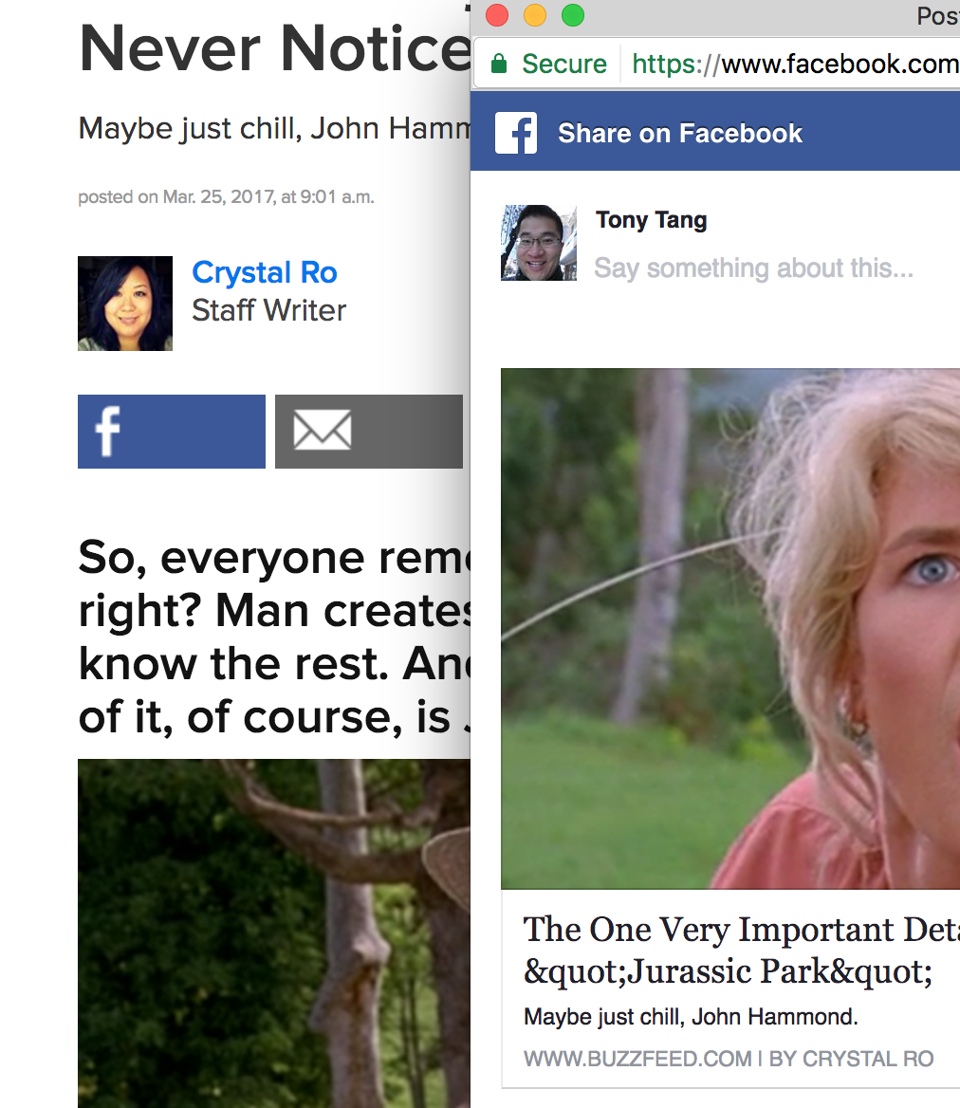
Facebook Today

Slide 8
Facebook in 2004

Slide 9
Facebook: Points of Evolution
2004: Harvard -> other schools
2005: Photos
2006: Mini-feed
2007: Platform
2008: Chat
2009: Mobile, Realtime newsfeed, and Deluge of users
2011: Cover photo, The Timeline
2012: Instagram
…
2015: Curated news
Notes:
http://www.eonline.com/ca/news/736976/this-is-how-facebook-has-changed-over-the-past-12-years
http://www.knowyourmobile.com/apps/facebook/21807/history-facebook-all-major-updates-changes-2004-2016

Slide 10
Facebook Example: What’s the point?
Facebook is an example of a company whose software offering has needed to evolve drastically as:
Its users changed
Its users’ needs/wants changed
Its users’ “access platforms” changed
Its users started sharing different/new kinds of things → advertisers/companies wanted the ability to share different kinds of things
…

Slide 11
Designing Facebook
What needs to be re-written to accommodate:
new UI designs?
“live” newsfeed?
external developers (Facebook as a platform)
new “content” for the newsfeed?
new/different access platforms?
“Like” button?
“Fan” pages, Company pages, …
…
To what extent could engineers/architects have anticipated these evolutionary needs, and designed the underlying platform such that these changes are easy to accommodate?

Slide 12
Evolvability
The ability of a software system to adapt in response to changes in its environment, requirements and technologies that may have impact on the software system in terms of software structural and/ or functional enhancements, while still taking the architectural integrity into consideration.
» bug fixes (maintenance)
» enhancements
» porting for platforms
» refactoring
Notes:
Most software is not built from scratch
Complexity increases unless work is done to manage or reduce it
Refactoring: restructuring code for addressing non-functional requirements (e.g. comprehensibility, usability, etc.) without changing its external behaviour

Slide 13
Evolvability Vocabulary
Maintainability: How easy is it to locate and fix a fault in the program?
Integrity: How easy is it for the system to maintain architectural coherence when accommodating changes?
Changeability: How easy is it to allow for modifications?
Extensibility: How easy it to extend, expand or enhance the system with minimal impact to the existing system?

Slide 14
Evolvability Vocabulary
Testability: How easy is it to test new modifications to the system?
Portability: How easy is it to transfer the software to a different environment?

Slide 15
Examples
C – “portable language”
Java – “write once, run anywhere” – UI challenges/semantics
Windows!
Rise of touch-screen devices: website semantics, interaction with small targets
Maps “use two fingers to move the map around”
Failure: Netscape’s Gecko (HTML renderer)
Acidtests.org – HTML5 – complaint browsers

Slide 16
Evolvability in OO
Given an existing subsystem written using an OO approach, how does a standard OO language support evolvability?
Subclassing
Superclassing
Moving methods up the class hierarchy
Addition of methods

Slide 17
Issues with OO Evolvability
Adding Subclasses
➔ e.g. Car ➔ SportsCar
Generally, not problematic
When methods are overrided, this can sometimes cause challenges for comprehensibility (e.g. when a method is overrided that doesn’t make sense for that subclass, or there may be variable interpretations about how that subclass could override the method)

Slide 18
Issues with OO Evolvability
Changes to method implementations
➔ void Car.StartRadio() ➔ void Car.StartRadio() // two times faster!
Not problematic so long as side effects are the same: encapsulation wins here – subclasses don’t even need to know what happened!

Slide 19
Issues with OO Evolvability
Superclassing
➔ e.g. SportsCar and MiniVan ➔ Car
The idea here is that some of the methods common to SportsCar and MiniVan now move up the class hierarchy
Usually, this is not a problem

Slide 20
Issues with OO Evolvability
Addition of concrete methods
➔ e.g. Car.AutomaticShift(int)
Usually not a problem—subclasses get it without having to do anything
If a class happened to have it first, this might cause problems (e.g. Minivan had .AutomaticShift already)

Slide 21
Issues with OO Evolvability
Addition of abstract methods / deletion of methods ➔ bad idea
➔ e.g. abstract Car.StartAutoDrive()
➔ e.g. remove Car.Unlock()
Adding abstract methods is problematic, because subclasses of this class now won’t compile (and will need to implement)
Deletion of methods is generally considered a really bad call – clients can be really negatively impacted

Slide 22
Evolvability example: MVC
Model-View-Controller style is one that essentially accommodates evolvability in several ways: (1) each component can be subclassed, (2) each component is essentailly decoupled from one another aside from the notification interface
➔ specifically, consider that we could make the controller and views interfaces or abstract classes, which would enhance the evolvability here.

Slide 23
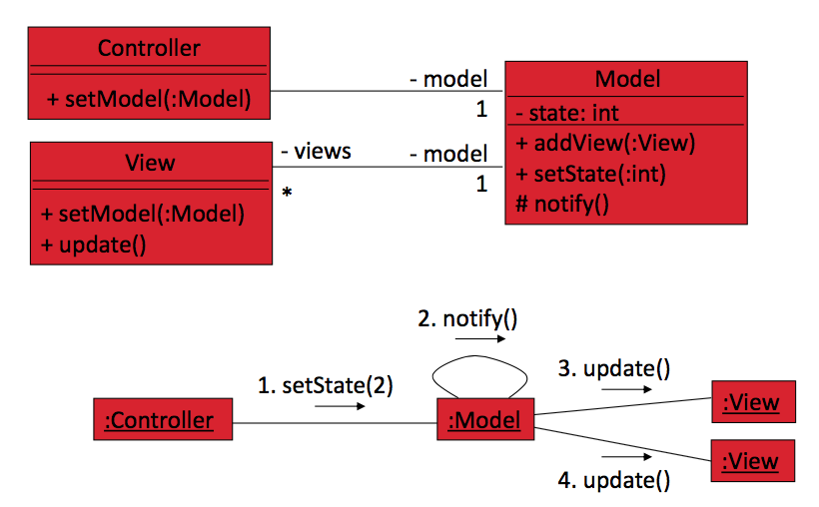
Evolvability in MVC

Slide 24
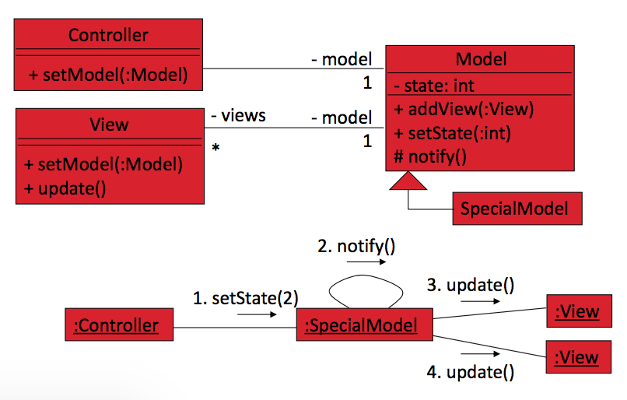
Evolvability in MVC

Slide 25
Learning Objectives
You should now be able to:
Discuss evolvability as a unifying concept in the long-term deployment of software, and how this impacts the design of software
Understand the vocabulary and concepts around evolvability
Understand how OO languages are designed for evolvability

