Slide 1
Introduction to Software Architecture
SENG 301

Slide 2
Learning Objectives
By the end of this lecture, you should be able to:
Understand the distinction between software architecture and design patterns
Identify the three major questions that a software architecture answers
Recognize common architectural styles
Understand why these common architectural styles are used

Slide 3
Software Architecture
Software architecture is the process of designing the global organization of the system, specifically:
Dividing the system into subsystems
Determining how subsystems interact with one another (when and with whom)
Identifying how the subsystems are deployed (e.g. into same/different processes or machines altogether!)
Software architecture is high-level design:
Abstract away details of individual classes
Subdividing system into manageable subsystems
Considering how these pieces fit together

Slide 4
Why is an architecture important?
Supports understanding of the system
Allows sub-teams or individuals to work on subsystems in isolation
Enables re-use and re-usability

Slide 5
Partitioning Considerations
Hardware constraints (e.g. external database server; scalability)
Computational cost (parallelizing expensive operations)
Logical divisions (e.g. UI, business logic, database, etc.)
Communication
Intraprocess (same method, same thread, different threads)
Interprocess (same node)
Interprocess (different nodes)

Slide 6
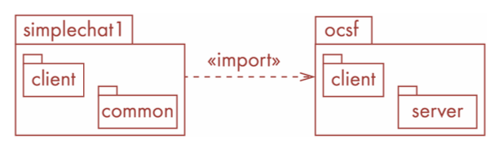

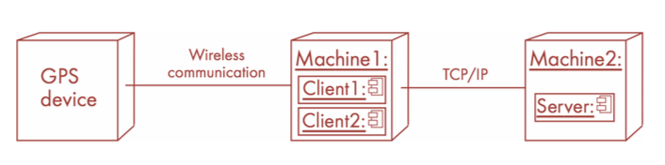
Some UML for describing architecture too!
Package diagram
(emphasizes logical structure)
Component diagram
(emphasizes interfaces/communication between components)
Deployment diagram
(emphasizes deployment model)

Slide 7
Architectural Models are judged on Stability
Stable: new features can be easily added with no or small changes to the architecture
So: an architectural model ought to be designed to be stable—this aids maintainability, extensibility, and reliability of the system in the long term

Slide 8
ICQ

Slide 9
Common Architectural Styles
Client/server
Pipes-and-filters
Repository
Model-view-controller
Layered (three-tier, four-tier)
Peer-to-peer
Interpreter
Plugin
Component-based
Event-based
…

Slide 10
Common Architectural Styles
Client/server
Pipes-and-filters
Repository
Model-view-controller
Layered (three-tier, four-tier)
Peer-to-peer
Interpreter
Plugin
Component-based
Event-based
…

Slide 11
Client-Server Style
Stand-alone servers
Stand-alone clients
Network connects them
…
Client 1
Client 2
Client n
Network
…
Server 1
Server 2
Server m

Slide 12
Client-Server Style
+ Common for distributed applications
+ Easy to add new servers
+ Server performance can be optimized
- Each server must manage its data by itself
- Communication overhead
- Security concerns

Slide 13
Examples
WWW: browser (clients) - servers
Email: IMAP, SMTP, email clients
Games: Quake (and most derivatives)

Slide 14
Aside: DooM Multiplayer
Instance 1
“Shared input” or “lockstep” model
→ No server
Essentially: send each piece of input that each instance gets to the other
Each game instance processes the input as it receives it
+ Simple (input is what drives the simulation)
- Synchronization as soon as some input is dropped
Instance 2
Notes:
http://gafferongames.com/networking-for-game-programmers/what-every-programmer-needs-to-know-about-game-networking/

Slide 15
Aside: Quake
Client n
Quake’s model: Client-Server
Server maintains “state of the world”
Clients get a version of the world as an update (e.g. where enemies are, if someone is shooting, etc.), and send input to the server (based on their version of the world)
+ “Ground truth” is relatively straightforward (what the server knows), so synchronization is easy
- Latency
…
Network
Client 2
Client 1
Server 1

Slide 16
Aside: Quake
Client n
Server (list)
Problem: finding the game servers
Solution: “three step” client-server approach:
Query special servers for game server IP list (via QuakeSpy → GameSpy)
Ping these servers in turn to find the one with quickest response time
Connect to the “fastest” server
…
Server 3
Network
Server 2
Client 2
Client 1
Server 1

Slide 17
Pipes and Filters
Pump = source
Filter = small, self-contained units that take input from a pipe, transform the input, and send it out to another pipe
Sink = something that
Notes:
http://www.dossier-andreas.net/software_architecture/pipe_and_filter.html
The filter transforms or filters the data it receives via the pipes with which it is connected. A filter can have any number of input pipes and any number of output pipes.
The pipe is the connector that passes data from one filter to the next. It is a directional stream of data, that is usually implemented by a data buffer to store all data, until the next filter has time to process it.
The pump or producer is the data source. It can be a static text file, or a keyboard input device, continously creating new data.
The sink or consumer is the data target. It can be a another file, a database, or a computer screen.

Slide 18
Pipes and Filters
+ robust: each filter can be designed, implemented and tested independently
+ filters can be on different threads or processes, or nodes
- introduces some additional complexity in building software to handle input from pipes
- if filter needs to wait (e.g. sort), it can overflow
- breakage in one filter can kaibosh everything (unclear what should happen)

Slide 19
Examples
Unix/GNU tools
Compiler: consecutive filters perform lexical analysis, parsing, semantic analysis, and code generation.

Slide 20
Example
Consider a dataset of World Cup players: https://gist.github.com/hcitang/4e1073dfc73417b669bc0eddf79019cd
How many players play for Russia?
Of Russia’s players, how many are midfielders?
Produce a list of Russia’s players: “<Last Name>, <First Name> - <Position>”
How many players have “Anthony” as a last name?
How many teams are represented at the World Cup?
Notes:
Post to #in-class: https://gist.github.com/hcitang/4e1073dfc73417b669bc0eddf79019cd

Slide 21
Unix Example
You could build a monolithic program that figures out the answers to these questions, or you could string together a set of Unix commands to do this for you
cat <file> ➔ displays the file line by line
grep <pattern> <file> ➔ lists the lines in the file that matches the pattern
sort ➔ sorts the lines in the file
uniq ➔ filters repeated lines in a file
awk ’{ print $2 }’ ➔ prints only the second column for each line

Slide 22
Unix Example
How many players play for Russia? grep Russia wcdata.tsv | wc | awk ’{ print $1 }’
Of Russia’s players, how many are midfielders? grep Russia wcdata.tsv | grep Mid | wc | awk ‘{print $1}’
Produce a list of Russia’s players: “<Last Name>, <First Name> - <Position>” grep Russia wcdata.tsv | awk ’{print $11 “, “ $10 “ – “ $2}’ | sort
How many players have “Anthony” as a last name? grep Anthony wcdata.tsv
How many teams are represented at the World Cup? cat wcdata.tsv | awk ‘{print $1}’ | uniq | wc
Notes:
Post to #in-class: https://gist.github.com/hcitang/4e1073dfc73417b669bc0eddf79019cd

Slide 23
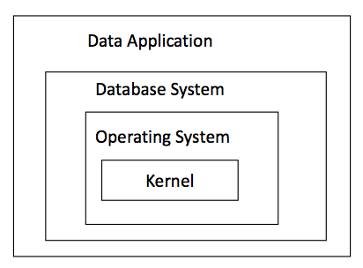
Layered Architecture
Sub-systems are organized into layers
Each layer:
– uses the services of the layer below
– provides services to layer above through well-defined interfaces
The terms “tier” and “layer” are interchangeable, for most people

Slide 24
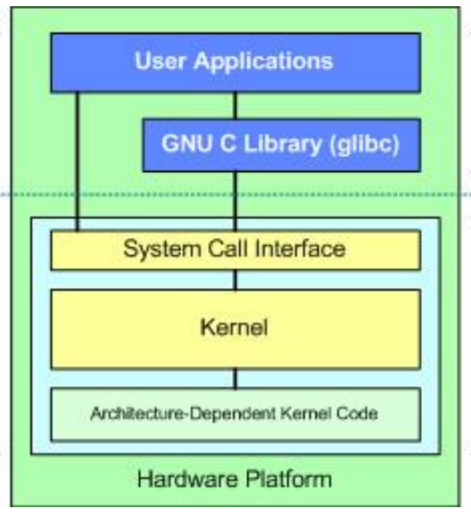
Layered Architecture Examples
?
Notes:
https://www.win.tue.nl/~aserebre/2IW80/2013-2014/A3%20-%20Arch%20Styles.pdf
http://www.winsocketdotnetworkprogramming.com/dotnetnetworkprogrammingver1_files/socketdotnetframework001.png

Slide 25
Layered Architecture
+ abstraction of concerns
+ isolation of lower and higher levels from one another (i.e. decoupled)
+ reusability
- overhead of going through different layers
- complexity

Slide 26
Model-View-Controller Architectural Style
Separation of M, V and C:
Model: manages behaviour of data; responds to requests about state (from View), responds to state change commands (Controller)
View: manages display of info
Controller: interprets user input, and updates model and view

Slide 27
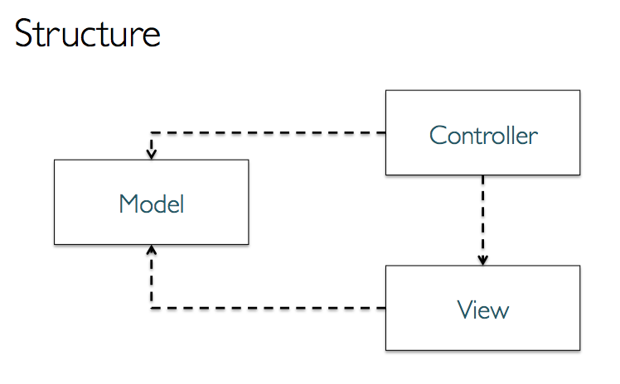
MVC

Slide 28
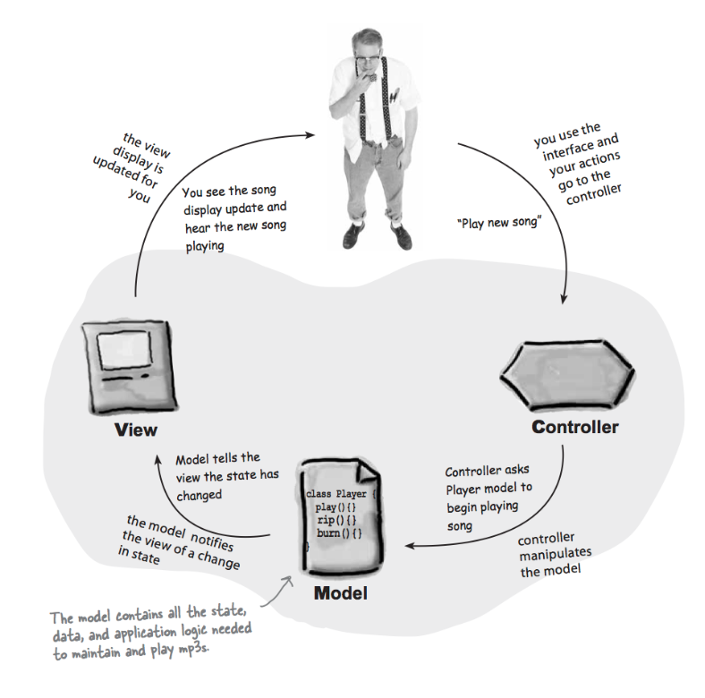
MVC - Variations

Slide 29
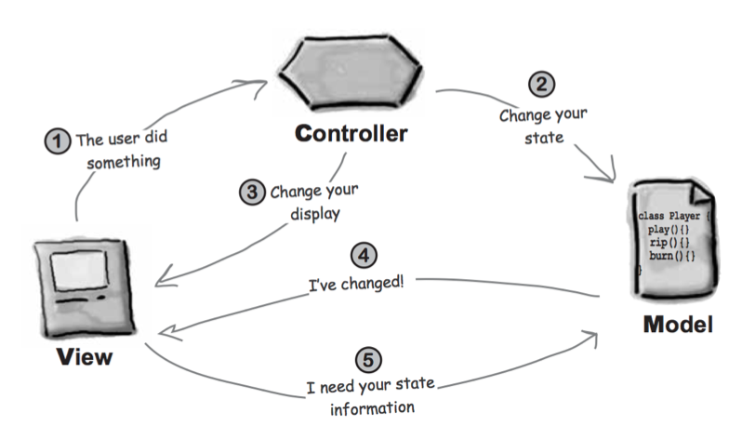
MVC - Variations

Slide 30
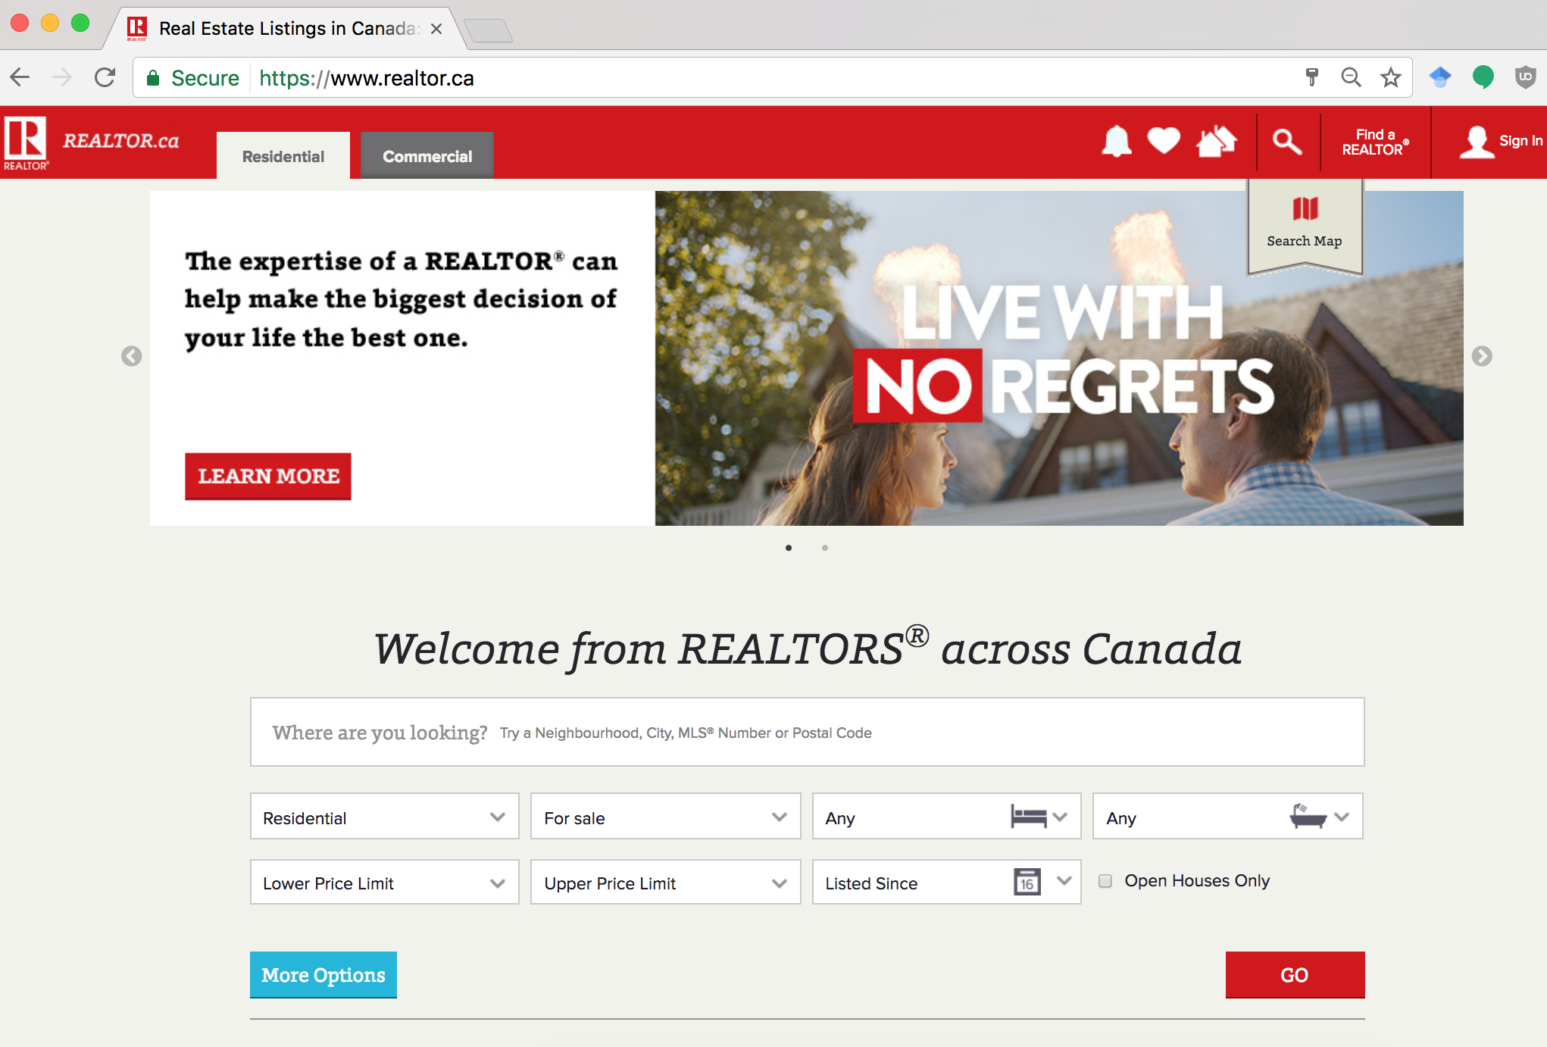
MVC Example

Slide 31
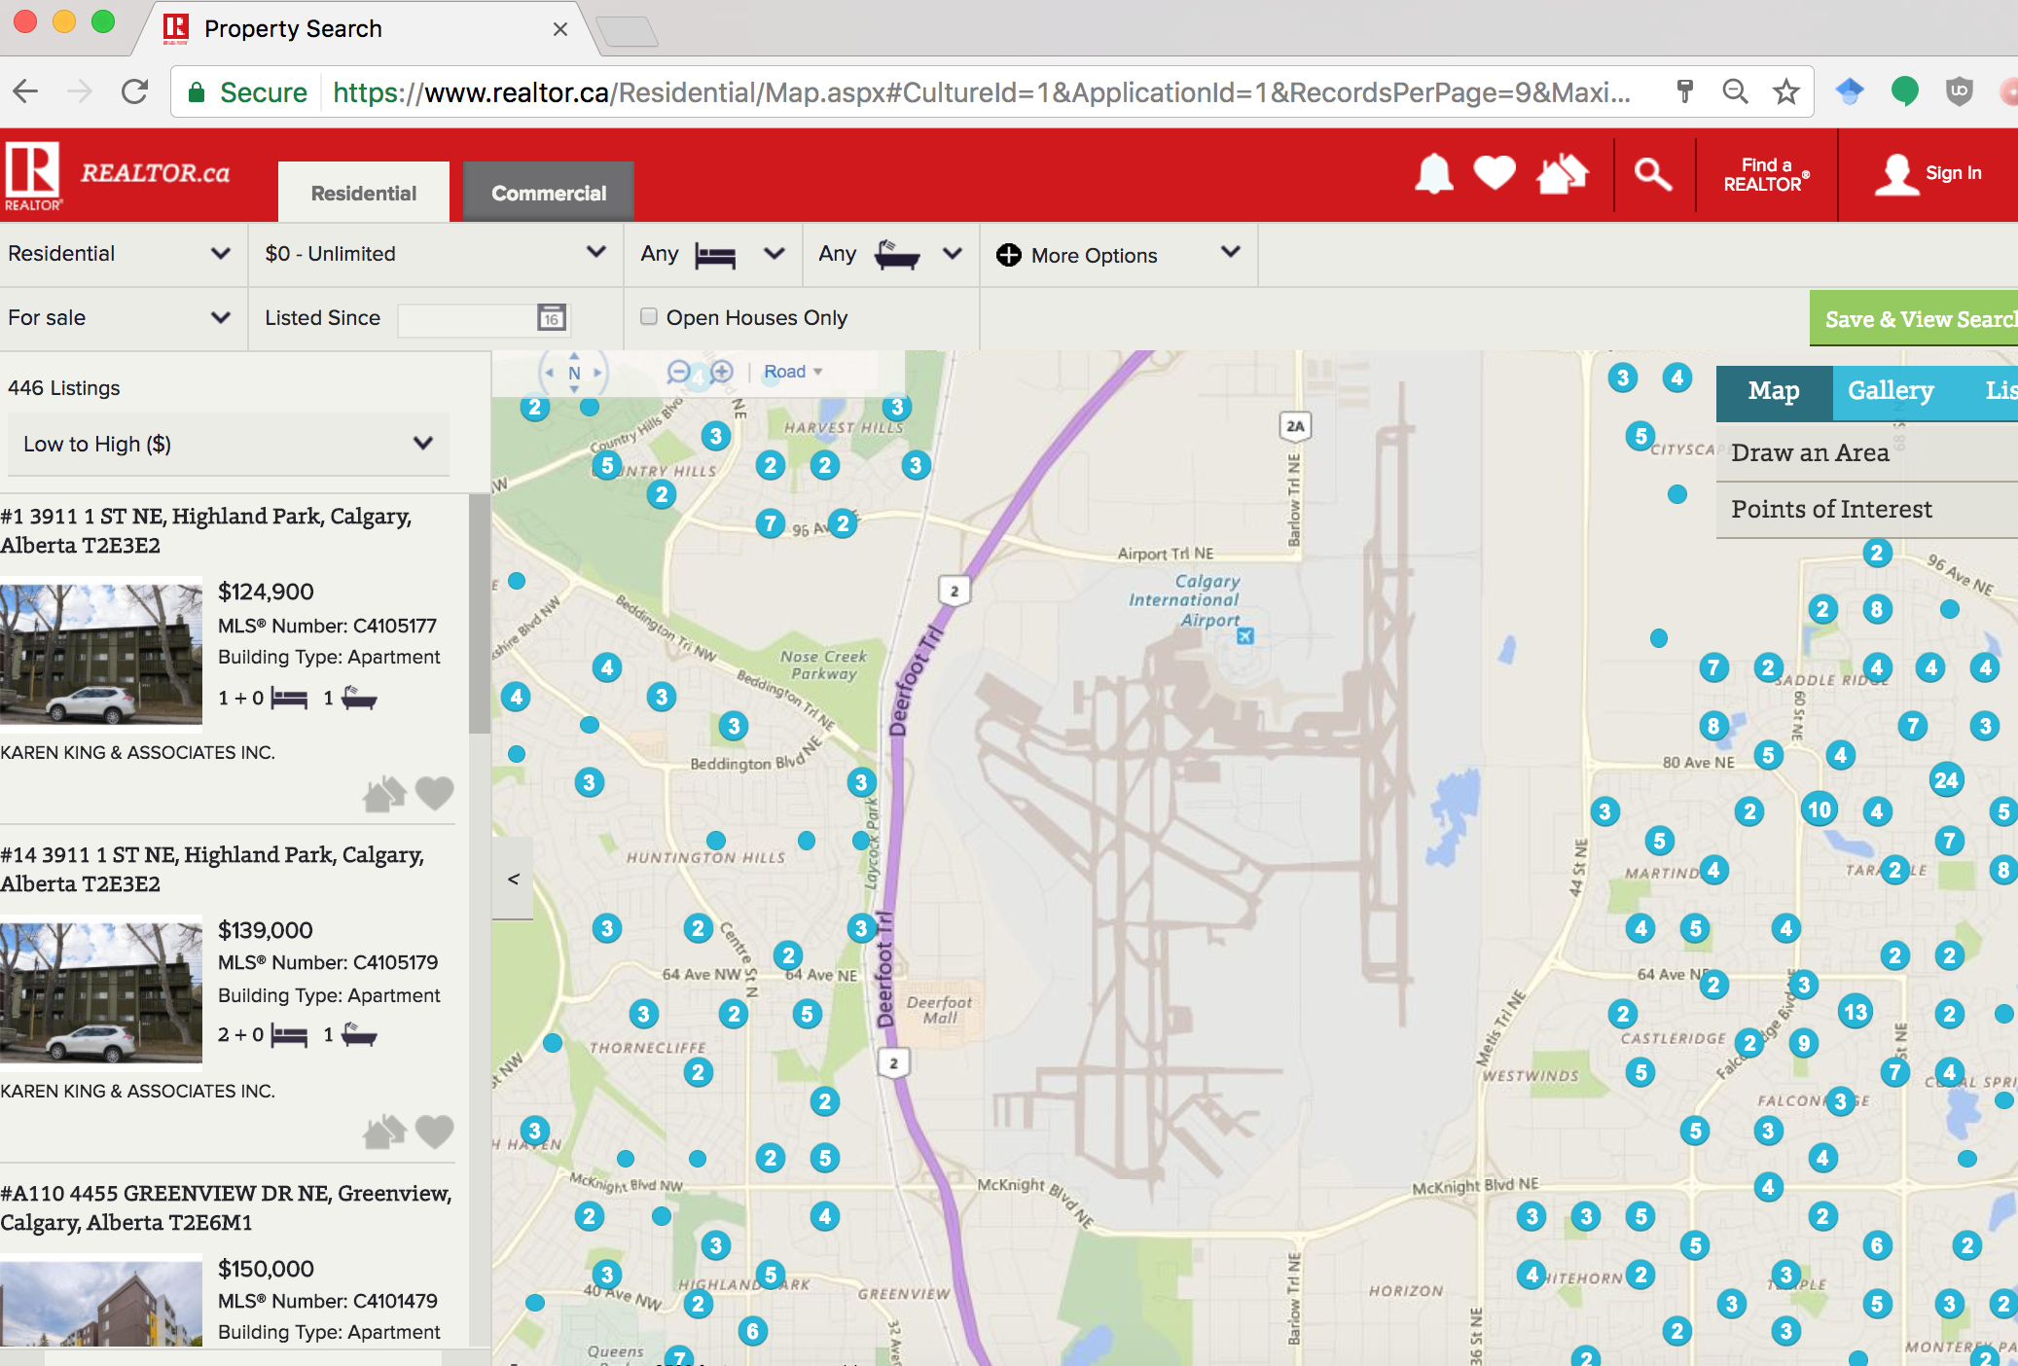
MVC Example
Notes:
Different view for mobile or desktop
Different view also for realtors, and their app can make changes to the model (i.e. mark as “sold”, etc.)
There are different models at work here too: the list of houses I’ve starred, or want to see – different views also can control and manipulate this

Slide 32
MVC
+ Separation of concerns
+ Increased usability, readability, reusability, ...
+ Increased TESTABILITY
- Complexity

Slide 33
Service Oriented Architectural Style
“New kid on the block”
Loosely-coupled, autonomous, distributed services
Close adherence to a schema and contract, not class (i.e. it’s usually about data)
Applications are then mostly about composing services together
Notes:
https://msdn.microsoft.com/en-us/library/bb833022.aspx?f=255&MSPPError=-2147217396
https://msdn.microsoft.com/en-us/library/aa480021.aspx?f=255&MSPPError=-2147217396

Slide 34
Notes:
http://www.logimethods.com/images/diagram-soa.gif

Slide 35
Services
http://www.webservicex.net/new/Home/Index
New challenge: registration and discovery

Slide 36
Architectural Style Overview
Client-server: Segregates the system into two applications, where the client makes requests to the server. In many cases, the server is a database with application logic represented as stored procedures.
Pipes and filters: Decompose a task that performs complex processing into a series of separate elements that can be reused
Layered architecture: Partitions the concerns of the application into stacked groups (layers).
Model-view-controller: The Model-View-Controller (MVC) pattern separates the modeling of the domain, the presentation, and the actions based on user input into three separate classes
Service-Oriented Architectural style: Refers to applications that expose and consume functionality as a service using contracts and messages.

Slide 37
Learning Objectives
You are now able to:
Understand the distinction between software architecture and design patterns
Identify the three major questions that a software architecture answers
Recognize common architectural styles
Understand why these common architectural styles are used

