Slide 1
Intro to Design Patterns
SENG 301

Slide 2
Learning Objectives
By the end of this lecture, you should be able to:
Describe the rationale for the use of design patterns in software engineering
Identify some common design patterns (all the ones we discuss today), both from a description or when instantiated in code
Articulate a rationale for the use of each of the design patterns, understanding the purpose and the circumstance under which they are applicable

Slide 3
Design Patterns in a Nutshell
Outline of a reusable solution to a general problem encountered in a particular context
[solution] – “structuring” of code
[general problem] – something we see over and over again
[particular context] – your situation
[outline] – is incomplete—needs you to fill in the details for your situation

Slide 4
History
“Pattern language” – Christpher Alexander (architect)
70’s: Describing general problems/solutions in architecture and environmental planning
“Gang of Four”: Design Patterns: Elements of Reusable Object-Oriented Software
90s: Four researchers describing 23 of the most common design solutions to common software architecting problems

Slide 5
Design Patterns
“A design pattern describes a problem which occurs over and over again in our environment, describes the core of the solution to that problem, in such a way that you can use this solution a million times over, without ever doing it the same way twice.”
Design patterns represent decades of software engineering experiences distilled into “templates” that you can use in architecting your systems.
Note: Just because a piece of code follows a design pattern doesn’t necessarily mean that it is designed well; rather, this depends a lot on the particular circumstance

Slide 6
Some Patterns
Façade*
Adapter
Observer*
Factory*
Singleton
This is a (really) short subset of the original 23 identified by GoF. More are getting discovered/invented over time (as languages evolve). Note that these patterns are descriptive of what is out there rather than prescriptive of what ought to be used.

Slide 7
Façade: Make it easier for a client to use a mess
Intent: Simplify interaction with several related classes
Motivation: Sub-systems are comprised of a large number of classes, is highly complex, or challenging to use in ways that are unnecessary.
Structure: Create a new class that wraps the interaction with sub-systems with a simplified set of calls
Consequences: Shields clients from internal classes; promotes weak coupling; doesn’t hide internal classes (both good and bad)
Commentary: I like this one because it speaks to thinking carefully about the usage of an API from the perspective of a programmer. Designing a good façade means carefully thinking about how a programmer is likely to use an API.

Slide 8
Façade Illustrated
Notes:
From wikipedia

Slide 9
HardwareFaçade for VendingMachine?
Consider the main interactions with the VendingMachine from the perspective of a user:
Customer – Insert Coin
Customer – Press Button
Customer – Extract Delivery
Technician – Reconfigure VM
Technician – Load Pop
Technician – Load Coins
Technician – Unload Vending Machine

Slide 10
HardwareFaçade for VendingMachine?
VendingMachine (from A2) forces a programmer to dive in to get access to each of the hardware components to do things:
Customer – Insert Coin
this.vm.CoinSlot.InsertCoin(coin);
Customer – Press Button
this.vm.SelectionButtons[selectedButton].Press();
Customer – Extract Delivery
vm.DeliveryChute.RemoveItems();

Slide 11
HardwareFaçade for VendingMachine
While the interaction here is fairly straightforward, with a more complex system, this could be cumbersome for the client (i.e. needs to know internals of system to do it right). Rather, what you want is a more simplified interaction:
Customer – Insert Coin
this.vm.CoinSlot.InsertCoin(coin); => façade.InsertCoin(coin)
Customer – Press Button
this.vm.SelectionButtons[selectedButton].Press(); => façade.Press(button)
Customer – Extract Delivery
vm.DeliveryChute.RemoveItems(); => façade.ExtractDelivery()
Notice: A4’s HardwareFacade is not very good

Slide 12
Façade: Real World Analogy
In principle: my.ucalgary.ca simplifies access to a lot of different student services
Airline customer service agents simplify access and interaction to services (e.g. flight bookings, special requests, cancellations, etc.)

Slide 13
Adapter: Glue-gunning semi-compatible interfaces
Intent: Convert the interface of a class to another interface that a client expects
Motivation: A component you’d like to use has a different “view of the world” compared to the one you’re working from
Structure: Create an adapter class that wraps the target adaptee class, with methods that appropriate “translate” parameters, etc.
Consequences: Decouples clients from internal structure of adaptee; overuse may introduce a large number of redundant classes
Commentary: In HCI prototyping work, we are often piecing together different libraries and APIs in unusual ways, and need to use this pattern to “glue” things together. You’ll frequently need this type of approach when communicating with legacy APIs.

Slide 14
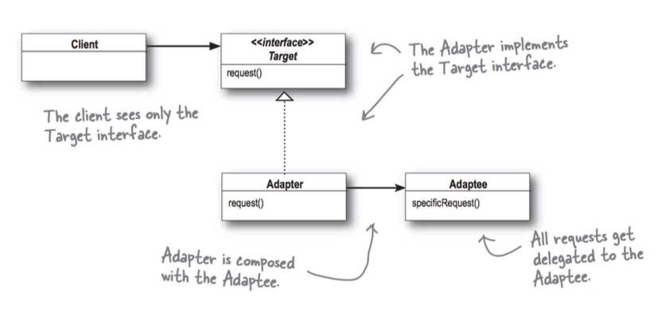
Adapter: Visually…
Notes:
Head First Design Patterns

Slide 15
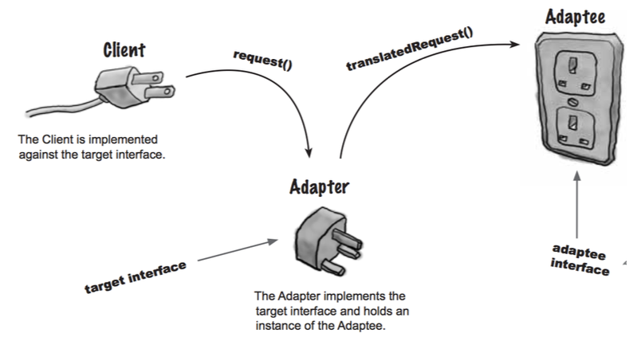
Adapter: By analogy

Slide 16
Adapter: Example
Imagine your graphics card uses an internal structure for drawing rectangles that is different from how the UI for a “rectangle drawer” application asks for coordinates
class GraphicsRectangle {
public GraphicsRectangle(int x1, int y1, int x2, int y2) …}
interface IRectangle {
IRectangle CreateRectangle (int x, int, y, int width, int height)
void Translate(int dx, int dy) …}

Slide 17
Adapter: Example
GraphicsRectangleWrapper wraps calls exposed by IRectangle:
class GraphicsRectangleWrapper : IRectangle {
private GraphicsRectangle gr;
IRectangle CreateRectangle(int x, int y, int width, int height) {
gr = new GraphicsRectangle(x, y, x+width, y+height);
return this; }
void Translate (int dx, int dy) {
gr.x1 += dx; gr.x2 += dx;
gr.y1 += dy; gr.y2 += dy; }

Slide 18
Categories for Design Patterns
Structural patterns: façade, adapter
» focused on how classes and objects are composed to form larger structures
Behavioural patterns: observer
» focused on simplifying interactions and communications between objects
Creational patterns: factory, singleton
» focused on how objects are instantiated

Slide 19
Observer: If you want to know, subscribe
Intent: Enable 1-to-many communication from a source without needing to know much about the listener
Motivation: Simplify interaction between sources and sinks for communicating about state changes
Structure: Source maintains a list of observers, and notifies them when state changes. Concrete observers inherit a simple interface, and register (and de-register) explicitly with the source
Consequences: Reduces the coupling between listeners and sources; enables broadcast communication; # of objects listening can be dynamically modified

Slide 20
Observer: Structure
Notes:
https://en.wikipedia.org/wiki/Observer_pattern

Slide 21
class Announcer {
List<IListener> listeners …
public AddListener(Listener l) {
listeners.Add(l); }
public void Say(string stuff) {
this.announceSaying(stuff); }
void announceSaying(string stuff) {
foreach(var l in this.listeners) {
l.SaidSomething(this, stuff); }
}
}
interface IListener {
void SaidSomething(Announcer, string); }
class Athlete : IListener {
public Athlete(Announcer a) {
a.AddListener(this); }
public void SaidSomething(Announcer, string) {
this.StartRunning(); // do something }
}
class Fan : IListener {
public Fan(Announcer a) {
a.AddListener(this); }
public void SaidSomething(Announcer, string) {
this.Cheer(string) }
}
Notice: Athletes and Fans can both listen in for announcements, and you can put in lots of listeners.
Most Sources will also have a RemoveListener method, and may actually fire a lot of different notifications.

Slide 22
Observer Pattern in C#
In C#, this is usually obviated with Events and EventListeners
You’ve seen this pattern a lot already (A2-A4), and when you begin programming UIs, you will see it again in most frameworks
For instance:
[C#]
this.button.Click += new EventHandler(this.button_Clicked);
[Java]
this.button.addActionListener(this);

Slide 23
Observer: Real World Analogy
Mailing list

Slide 24
Factory: Ask me to make the widget: I know who to delegate it to
Intent: Separate request from actual creation of object (client doesn’t need to know about implementation, dependencies, etc.)
Motivation: The client doesn’t know at compile time (or doesn’t care about) what the exact object will be (so long as it implements the right interface), or we need extensibility built-in
Structure: Factory class exposes a method that can Create a number of different objects depending on the parameters passed in
Consequences: Decouple client’s understanding from the actual implementation of resulting object; Allows for flexible instantiation

Slide 25
Factory Pattern

Slide 26
VendingMachineFactory: Factory?
Technically, VendingMachineFactory was designed in the Factory pattern; however, it was not a particularly interesting Factory
Imagine having: PopVendingMachine, ChipVendingMachine, ToiletryVendingMachine, FoodVendingMachine
VendingMachineFactory.Create(typeof(PopVendingMachine), …)

Slide 27
Factory Pattern in .NET
Very common creational pattern: takes the complexity of creating an object away from a client
Object Convert.ChangeType(obj, type)
^ You can specify whatever type you like, and this is the object that is returned

Slide 28
Factory Pattern in Real Life
You are a company that needs someone who: knows how to file things, knows how to organize things, <skill>, <skill>, … etc.
You go to a Hiring Agency, and put in this request
They go and find people (i.e. “create an object”), but these can come from a bunch of different base classes: Administrator, BusinessStudent, Scientist, …

Slide 29
Singleton: There can only be one
Intent: Resolve resource contention by allowing only one instance to be created
Motivation: Address resource contention (i.e. there is logically only one of these), or lazy instantiation is desirable
Structure: Private constructor, with a “GetInstance” method that provides access to a privately constructed instance
Consequences: Makes for tricky debugging
Commentary: This pattern is very popular in the Java libraries, but has fallen out of favour of late

Slide 30
Singleton
Notes:
https://i-msdn.sec.s-msft.com/dynimg/IC400943.png

Slide 31
Singleton Example: Logger
class Logger {
private static Logger instance = new Logger();
private Logger() { … }
public static Logger GetInstance() {
return instance;
}
public Log(string) …
}
Notice: GetInstance() method is a static one

Slide 32
Singleton Example: Lazy Instantiation
class Logger {
private static Logger instance;
private Logger() { … }
public static Logger GetInstance() {
if (instance == null) {
instance = new Logger(); }
return instance;
}
public Log(string) …
}
Notice: instance is null until actually needed. Why do it this way?

Slide 33
Categories for Design Patterns
Structural patterns: façade, adapter
» focused on how classes and objects are composed to form larger structures
Behavioural patterns: observer
» focused on simplifying interactions and communications between objects
Creational patterns: factory, singleton
» focused on how objects are instantiated

Slide 34
Commentary
When raising a child, you often say something like, “You’ll understand when you’re older.” My take on design patterns is something similar—while understanding the basic ideas for these patterns is not hard, it is not until one day, one, two, maybe five years from now, after you’ve written some substantial amount of code, that you’ll suddenly say, “AAAH! THAT’S what Tony was talking about.” The so-called “genius” of this only shows a bit later.
For now, I have two main goals here: (1) provide you with terminology so that when someone says these words, you have some understanding what they’re getting at, and (2) provide you with some basic tools to understand what you’re seeing when you look at code/APIs that have already been written.

Slide 35
Learning Objectives
You can now:
Describe the rationale for the use of design patterns in software engineering
Identify some common design patterns (all the ones we discuss today), both from a description or when instantiated in code
Articulate a rationale for the use of each of the design patterns, understanding the purpose and the circumstance under which they are applicable

