Slide 1
Design: an introduction
SENG 301
Notes:
At least four lectures, maybe more.
Design – Introduction
Design Principles & Evolveability
Design Patterns
Software Architecture

Slide 2
Learning Objectives
By the end of this lecture, you should be able to:
Describe why software engineering is a practice of software design
Discuss why design should be a core focus of software engineering work (i.e. rather than just cowboy coding)
Think about design as an iterative process of refinement
Understand how tradeoffs are a fundamental part of design

Slide 3
What’s design?
Software engineering: building structures and code to address functional requirements while respecting constraints of non-functional requirements (e.g. budget, deadlines), and trying to ensure good quality.
At each step, you are faced with options in how to build or organize things—e.g. the structure of components, the calling sequence of components, and so forth.
The choices we make with respect to these options and decision points define the design of our system.
How we go about making those choices is the design process.

Slide 5
Design in SE
Design in SE is about making choices about what to keep, what to get rid of, and how these things are organized
In the past, these decisions were driven mainly by machine optimization—i.e. making the system run quickly somehow
Increasingly though (and rightfully so as machines get faster), these decisions are now driven by human issues—i.e. maintainability, modifiability, extensibility, usability, and so forth

Slide 6
Moore’s Law – System Complexity
Computer
abilities
transistors
speed
discs
cost
1950
1990
2030
Slide idea by Bill Buxton
Notes:
So why does this happen?
The observation made in 1965 by Gordon Moore, co-founder of Intel, that the number of transistors per square inch on integrated circuits had doubled every year since the integrated circuit was invented. Moore predicted that this trend would continue for the foreseeable future.
If you don’t believe this, you can trade it for “complexity of software” or “interconnectivity of things”

Slide 7
Human Capacity
Memory (working memory)
Errors
Fatigue
Temporary / Ongoing
human
abilities
2000BC
1950
1990
2030
Slide idea by Bill Buxton
Notes:
The reality though, is that as users of these systems, we basically have stayed static as users over several millenia.
We do not process information faster than we used to
Our short term working memory (7 +/- 2) has stayed the same
We can only move so fast
We can only see so much (our eyes aren’t better than they used to be)
In fact, you might argue that because we live longer, the “average” or “middle” user is older than s/he used to be, is slower than s/he used to be

Slide 8
Where is the bottleneck?
system
performance
Slide idea by Bill Buxton
Notes:
As a system, the human and the computer work together to get stuff done
It’s the interface to the system that we are concerned about, and it is hampered by our (human) ability to interpet, think, and understand things
Consequently, we frequently end up with systems – be they systems for your desktop, websites or webpages, tools, apps, whatever it may be, that are challenging to use

Slide 9
Thought Experiment
Imagine the VendingMachine assignment was distributed in one big .cs file
Hard to find things (landmarks)
Hard to remember
Hard to understand

Slide 10
Strategies to Manage Complexity
Abstraction: simplification by hiding information
Structure: clarifying interactions between components
Layers: repeat this process upwards and downwards
Consistency: follow simple rules so people know what to expect

Slide 11
On #in-class (10 mins)
Review the code for the VendingMachine from A2, and the comments on the #A2 slack channel.
From the perspective of improving the VendingMachine assignment for the next student:
  (1) Based on how things worked for how A2 was done, what could have been REMOVED from what was handed out? (Briefly, why?)
  (2) Based on how things worked, what could have been ADDED or CHANGED? (Briefly, why?)
In a team of three, identify at least one thing for each of the two above points. Discuss amongst yourselves.

Slide 12
What could have been designed differently?

Slide 13
Activity: What you should take away
It’s easy to critique a system design/architecture once you’ve actually gotten a chance to play with it for a while (i.e. usability, modifiability, extensibility); harder to do it without actually interacting with it
Lesson: Usually, design relies on an iterative process to “get it right” – i.e. incremental improvements over time
Terminology: API = application programming interface
An API abstracts the implementation of software; sometimes known as “entry points”; provided by one piece of software to another as a contract
Examples: OpenGL, .NET Framework, Java Standard Libraries, Microsoft Foundation Classes, Unity API, etc.
Tech companies often build example code (i.e. that exercise the API, or test the API) alongside the code under the API at the same time

Slide 14
Why is design important?
Other people are involved in the lifecycle of your system—not just you, not just your team, but also people that maintain, extend or modify the system long after you are done. These people (and maybe even you!) will forget how things were put together.
“submit” on csl.cpsc.ucalgary.ca
PeopleSoft at UCalgary
plug-ins for Unity
plug-ins for Photoshop
New requirements! (e.g. McDonalds’ kitchen system now needs to account for customer-facing POS systems)
Notes:
We will return to the notion of modifiability and extensibility next time

Slide 15
Challenge: design is about making tradeoffs
It is unlikely that you can optimize everything (e.g. usability, extensibility, cost, speed, etc.)
Design choices usually rely on making informed choices about the possible trade-offs

Slide 16
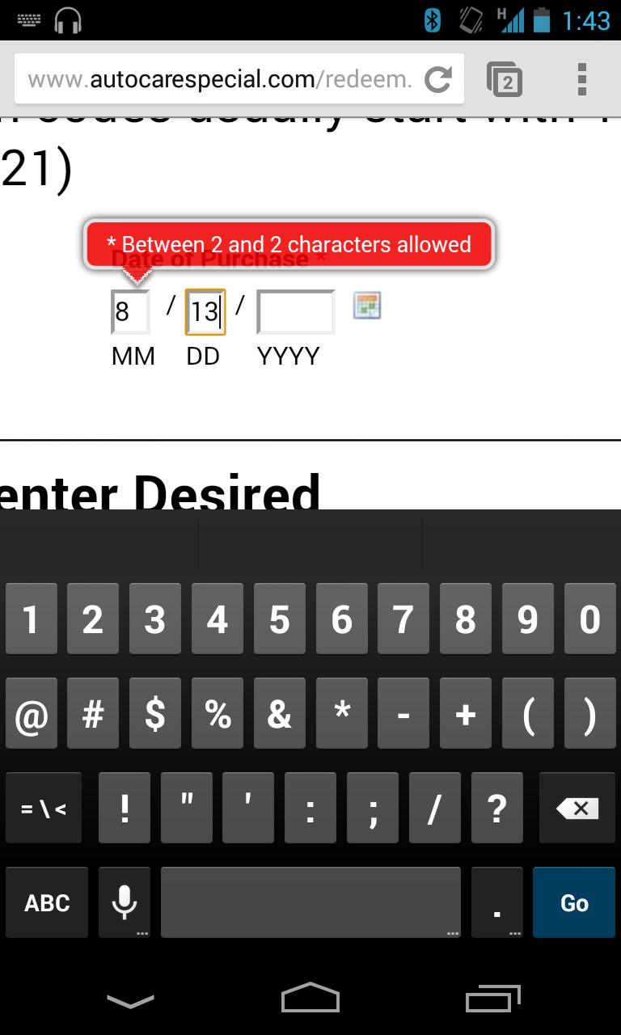
What happened here?
What is stupid?
How might you fix it?

Slide 17
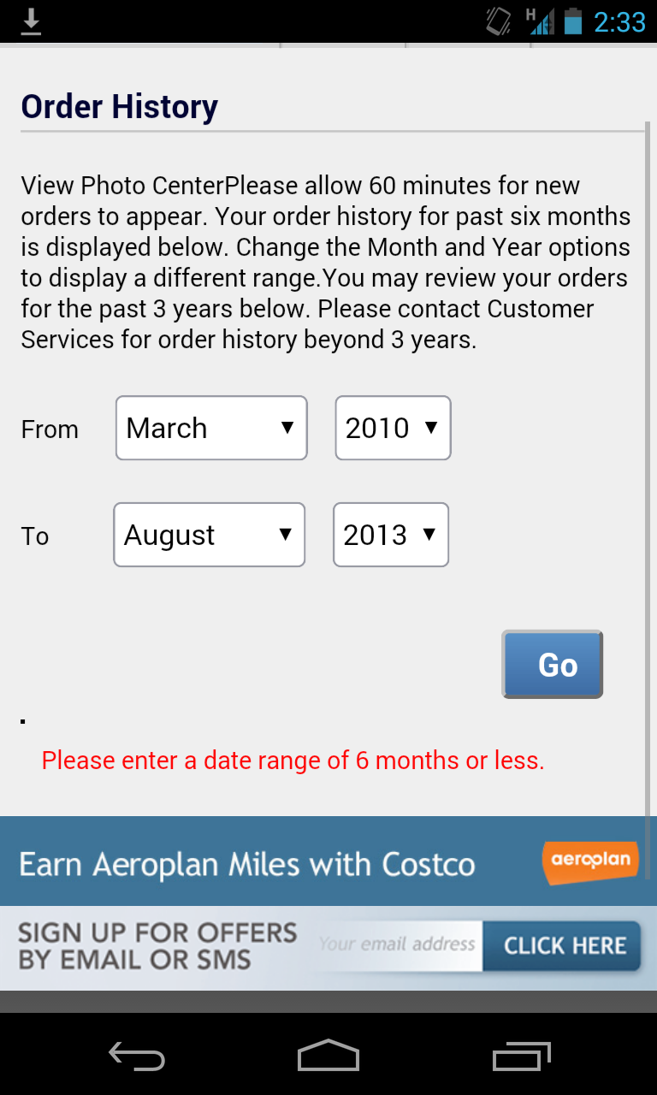
What happened here?
What is stupid?
How might you fix it?
Notes:
Notice: lots of possible solutions – how do you know what the “right one” is??

Slide 18
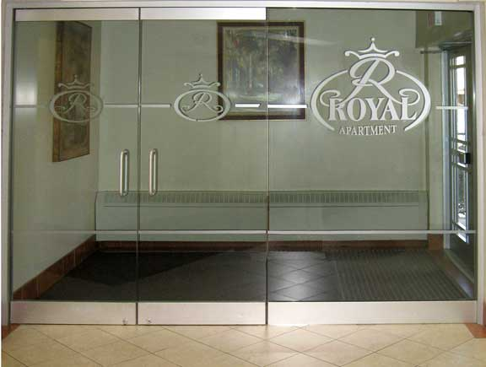

Slide 19
Design Trade-offs: C# Example
Context: We go through collections a lot to do stupid stuff. E.g.:
  for (…) { if (list[i] > max) max = list[i]; }
  for (…) { if (list[i] > threshold) Console.WriteLine(list[i]); }
  for (…) { sum += list[i]; }
Idea: What if we could simplify these things:
  list.Max();
  list.Where(i > threshold).ForEach(Console.WriteLine);
  list.Sum();

Slide 20
How could we make this happen?
For each Collection type, add methods like Sum(), Max(), Min()…
Consequence: a lot of additional code for each of the Collection types (Dictionary, List, …)
Make every collection inherit from an ICollection interface
Create “extension methods” that allow us to add functions post-hoc to any class
Consequence: changing the C# language

Slide 21
Thoughts
Software systems are a result of design decisions (intentional or accidental)
Often, these seem to add additional complexity, but often, the purpose is for extensibility (e.g. interfaces)
Some of these design decisions are lessons based on use of previous iterations or related systems (e.g. consider mobile phone interfaces); others are logical consequences of the underlying structure of the system/assumptions being made by developers ➔ OpenGL

Slide 22
Learning Objectives
You should now be able to:
Describe why software engineering is a practice of software design
Discuss why design should be a core focus of software engineering work (i.e. rather than just cowboy coding)
Think about design as an iterative process of refinement
Understand how tradeoffs are a fundamental part of design

