Slide 1
Test Granularities Unit Testing and Automation
SENG 301

Slide 2
Learning Objectives
By the end of this lecture, you should be able to:
Identify several different scales of testing, and the goals of testing at each scale
Describe and apply test doubles for unit testing
Understand and execute unit testing
Provide rationale for automated testing

Slide 3
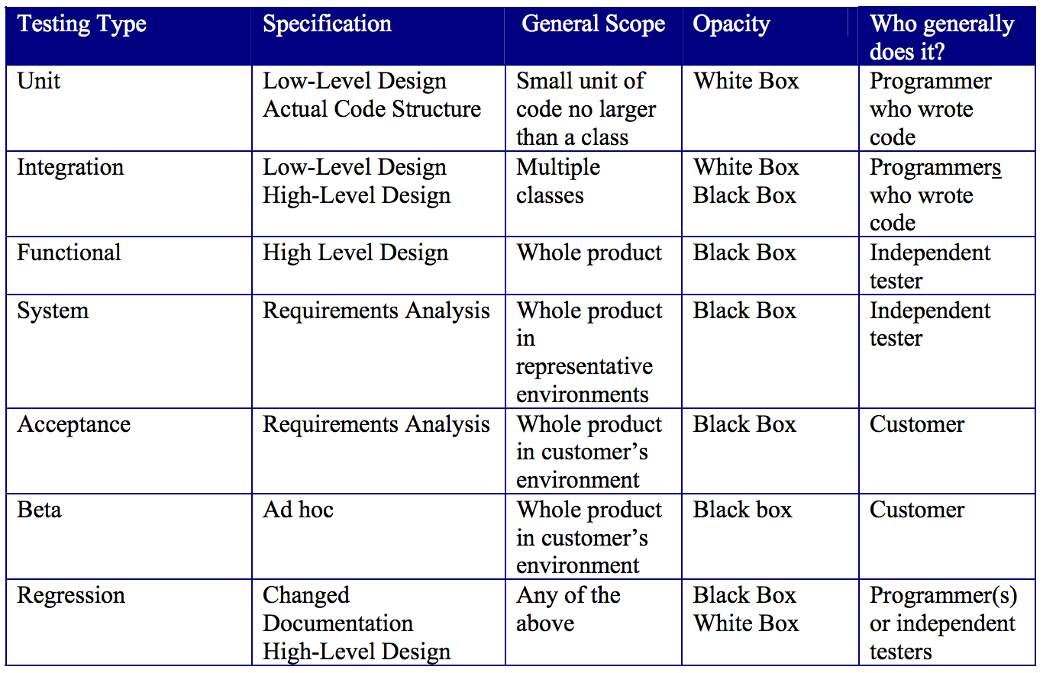
Testing at Different Scales
Scale/scope of test increases
Notes:
http://agile.csc.ncsu.edu/SEMaterials/BlackBox.pdf

Slide 4
Scale: Unit Testing
Defn: Testing individual hardware or software units or groups of related units.
Spec: Low-level design and/or code structure
Who: Usually developer
Scale: A class or a component
e.g. Does my abs() function work?

Slide 5
Scale: Integration Testing
Defn: software components, hardware components, or both are combined and tested to evaluate the interaction between them
Spec: Low and high-level design
Who: Developers
Scale: Ensuring the interfaces between classes work
e.g. Mars lander (metric vs. English measurements); messages/function calls between components

Slide 6
Scale: Functional and System Testing
Defn: Functional testing ensures that the functionality meets that which is specified in the requirement spec. System testing ensures that the system works in the larger integrated environment.
Spec: High-level design, requirements spec
Who: Testers (independent)
Scale: entire system!
e.g. stress testing, performance testing
e.g. POS cash registers running in a room to stress hardware and server (e.g. price lookups)
Ideally: working from a use case model

Slide 7
Scale: Acceptance Testing
Defn: Formal testing with client to see if system satisfies acceptance criteria
Spec: Requirements spec
Who: Client
Scale: Whole system
e.g. Telephone booking system for cab company – doing this AT the cab company

Slide 8
Scale: Beta Testing
Defn: Release of “draft” software to wide population outside of dev organization
Who: “Wider” population
Scale: Whole system (incl installer!)
e.g. beta-tests of games
Notes:
Low cost
Unexpected errors
Lack of systematic testing
Low quality error reports

Slide 9
(Not Scale): Regression Testing
Defn: Retesting system/components to ensure modifications have not introduced unintended negative effects, and still comply with requirements
Note: Not a scale thing

Slide 10
Terminology: Test Doubles
Tests often make use of drivers, which is testing code that “drives” the test on a certain module.
At the outset of A1, ScriptProcessor was a driver of the VendingMachineFactory module (which made use of other functions and modules).
At the outset of A1, VendingMachineFactory was a stub--a simple implementation of the IVendingMachineFactory interface, and had hardcoded, meaningless values.

Slide 11
Terminology: Test Doubles
In the “hints” section of A1, I suggested making a DummyVendingMachineFactory that would simply indicate when functions were called by the driver. This kind of implementation is called a fake or a test spy.
When testing code, you can develop drivers that test smaller units of functionality (e.g. to ensure that the PopCan implementation is correct). When pieces of code aren’t ready, you can write stubs to help.

Slide 12
Unit Testing
Lots of packages to help you with this (e.g. jUnit, nUnit, xUnit, blah blah blah)
For this class, we will use Visual Studio’s integrated unit testing
The TA will walk you through doing this in tutorial
You’ll be doing this for A3! (woohoo!)

Slide 13
Unit Testing (briefly)
Write a “test class” that drives methods on module being tested
Give it “expected values”, and see whether things check out
[TestClass]
public class CoinRackTester {
[TestMethod]
public void TestInsertTwoValidCoins() {
CoinRack cr = new CoinRack(new int[] { 0.25, 0.10 });
cr.Insert(new Coin(0.25));
cr.Insert(new Coin(0.10));
double expectedValue = 0.35;
Assert.Equals(expectedValue, cr.TotalCoinValue, 0.001, “Coin rack not totalling properly”);
}
}

Slide 14
Unit Testing (briefly)
Write a “test class” that drives methods on module being tested
Give it “expected values”, and see whether things check out
[TestClass]
public class CoinRackTester {
[TestMethod]
public void TestInsertTwoValidCoins() {
CoinRack cr = new CoinRack(new int[] { 0.25, 0.10 });
cr.Insert(new Coin(0.25));
cr.Insert(new Coin(0.10));
double expectedValue = 0.32;
Assert.Equals(expectedValue, cr.TotalCoinValue, 0.001, “Coin rack not totalling properly”);
}
}
Sometimes a test fails. This will be either because: (1) the code is broken, (2) your test is broken!!

Slide 15
Unit Testing (briefly)
You can also make it expect Exceptions
[TestClass]
public class CoinRackTester {
[TestMethod]
public void TestInsertInvalidCoin() {
CoinRack cr = new CoinRack(new int[] { 0.25, 0.10 });
try {
cr.Insert(new Coin(0.30));
}
catch (Exception e) {
StringAssert.Contains(e.Message, “Invalid coin type”);
return;
}
Assert.Fail(“No exception thrown.”);
}
}

Slide 16
Automated Testing
During and after bug fixing, tests must be run repeatedly
After a modification, previously passing test cases may now fail (called a regression)
Manual tests are tedious, and not likely to be performed consistently
Mozilla’s test suite: https://developer.mozilla.org/en-US/docs/Mozilla/QA/Automated_testing
Challenge: Not all tests can be automated (e.g. tests requiring physical interactions)

Slide 17
Learning Objectives
By the end of this lecture, you should be able to:
Identify several different scales of testing, and the goals of testing at each scale
Describe and apply test doubles for unit testing
Understand and execute unit testing
Provide rationale for automated testing

