Slide 1
The Joy of Breaking Code
Testing Logic and Case Selection
SENG 301

Slide 2
Learning Objectives
By the end of this lecture, you should be able to identify, understand and use:
Equivalence-based strategies for selecting test cases
Boundary-based strategies for selecting test cases
Path-based strategies for selecting test cases
State-based strategies for selecting test cases

Slide 3
On #in-class
Imagine you were trying to test this function signature. Post a test case (or a set of test cases) along with the expected result, and explain why you would test what you would.
/** Returns the string for the date: e.g. Monday, 18 Oct
* @param month 1-12
* @param dayOfWeek 1-7
* @param day 1-31
* @throws OutOfRangeException */
string dateString(int dayOfWeek, int day, int month) {…}

Slide 4
Some Test Cases

Slide 5
Recall
Exhaustive (or brute force) testing is likely infeasible
We need to select a practical handful of tests to run, because some of these take a lot of time!

Slide 6
Testing Strategies (a subset)
Black-box
  Equivalence-based selection
  Boundary-based selection
White-box
  Path-based selection
  State-based selection

Slide 7
Strategy: Equivalence-based Selection
Insight: While functions may accept a wide range of inputs, it will treat “groups” of inputs in similar ways
Idea: Test only one member of each of these groups
Group all possible inputs into sets for which the output is identical or “similar” → i.e. partition input into “equivalence classes”
For each equivalence class, test one representative member (and we assume that behaviour of other members is identical)
NB: Sometimes, it’s tricky to figure out what the “right” equivalence classes are

Slide 8
Example
/** Returns the “school type” (e.g. pre-school, primary school, elementary school, secondary school) depending on student’s age at the beginning of the school year */
string SchoolTypeForAge(double age);
Five equivalence classes:
  pre-school kids (2-4y)
  primary-school age (5-8y)
  elementary-school age (9-14y)
  secondary-school age (15-17y)
  outside-of-range (<2, >18)

Slide 9
#in-class
How many equivalence classes for each of the following functions?
double abs(double num) {…} // returns absolute val of num
int sign(double num) {…} // 1 if positive, -1 if negative, 0 if 0
string monthName(int month) {…} // month numbered 1-12
string dateString(int dayOfWeek, int day, int month) {…}
Notes:
2 (maybe unexexpected numbers? E.g. Double.NaN, or Double.Infinity?)
3
13? (12 mos + invalid), 2? (1-12 and any other int?), maybe 4 classes? (30 days, 31 days, 28 or 29, invalid?)
Combinations start to get kind crazy

Slide 10
Strategy: Boundary-based Selection
Situation: We have all probably written code that looks like this—and not been 100% sure exactly how many times the loop will execute:
  for(i = 0; i <= 10; i++) { j++; }
  for(i = 0; i < 10; i++) { j++; }
  for(i = 1; i < 10; i++) { j++; }
  for(i = 1; i <= 10; i++) { j++; }
Insight: Developers tend to make errors at “boundaries” of equivalence classes (e.g. using “<“ instead of “<=“)
Idea: At each boundary, test value on either side of that boundary

Slide 11
Example
/** Returns the “school type” (e.g. pre-school, primary school, elementary school, secondary school) depending on student’s age at the beginning of the school year */
string SchoolTypeForAge(double age);
Five equivalence classes:
  pre-school kids (2-4y)
  primary-school age (5-8y)
  elementary-school age (9-14y)
  secondary-school age (15-17y)
  outside-of-range (<2, >18)
We should definitely test 1, 2, 17, 18
We should probably test at each of these boundaries, too:
Pre-school: 1,2, 4,5
Primary: 4,5, 8,9
…

Slide 12
#in-class
What kinds of boundary conditions should we check for each of:
string monthName(int mont) { … } // month is 1-12
int sign(double num) { … } // 1 if positive, -1 if negative, 0 if 0
bool CheckUsername(string name) { … } // false if null, empty, or over 12 chars long

Slide 13
Strategy: Path-based Selection
Observation: Logical errors and incorrect assumptions are inversely proportional to a path’s execution probability.
Idea: Design tests such that each of the execution paths will be covered by at least one test.
Requires: Access to the source!

Slide 14
Idea: construct a graph that illustrates each possible path of control
Starting the car
0. Start
1. Enter car
2. Do you have the key in your hand?
3. Check your pocket
4. Is it a physical key, or a FOB?
5. Press button on car
6. Insert key, and turn
7. Is the car started?
8. End
0
1
2
3
4
5
6
7
8
Notes:
These courseware materials are to be used in conjunction with Software Engineering: A Practitioner’s Approach, 6/e and are provided with permission by R.S. Pressman & Associates, Inc., copyright © 1996, 2001, 2005

Slide 15
Starting the car
0. Start
1. Enter car
2. Do you have the key in your hand?
3. Check your pocket
4. Is it a physical key, or a FOB?
5. Press button on car
6. Insert key, and turn
7. Is the car started?
8. End
0
1
2
3
4
5
6
7
8
#in-class: How many paths through this code?
Notes:
These courseware materials are to be used in conjunction with Software Engineering: A Practitioner’s Approach, 6/e and are provided with permission by R.S. Pressman & Associates, Inc., copyright © 1996, 2001, 2005

Slide 16
0
Exhaustively, there are 6 paths through the code
But you would (probably) only need/want to test 4 paths:
0, 1, 2, 4, 6, 7, 8
0, 1, 2, 4, 5, 7, 8
0, 1, 2, 3, 7, 8
0, 1, 2, 3, 7, 2, …, 7, 8
Exercise: Figure out how this works with loops
1
2
3
4
5
6
7
8
Notes:
These courseware materials are to be used in conjunction with Software Engineering: A Practitioner’s Approach, 6/e and are provided with permission by R.S. Pressman & Associates, Inc., copyright © 1996, 2001, 2005

Slide 17
Strategy: State-Based Testing
Observation: What we care about most of the time is whether our system is moving correctly from one state into the next
Idea: Select tests that cover those transitions between states to ensure that we are correctly moving from one state to another
Notes:
http://www.desaware.com/img/articles/State1.jpg

Slide 18
Challenge: observing states?
Recall: a state is comprised of all the values of the internal variables
How do we observe what “state” we are in?
Directly: through getters, or public states; we can insert “probes” or debug to determine what the private values are
Indirectly: by observing the outputs

Slide 19
Example: File Transfer Protocol
FTP: client-server protocol for transferring files
Commands include: USER, PASS, STOR, RETR, QUIT, ...
Server sends back responses
There are ordering constraints on some commands:
  e.g. to login, USER must be immediately followed by PASS
  e.g. STOR can only succeed if logged in

Slide 20
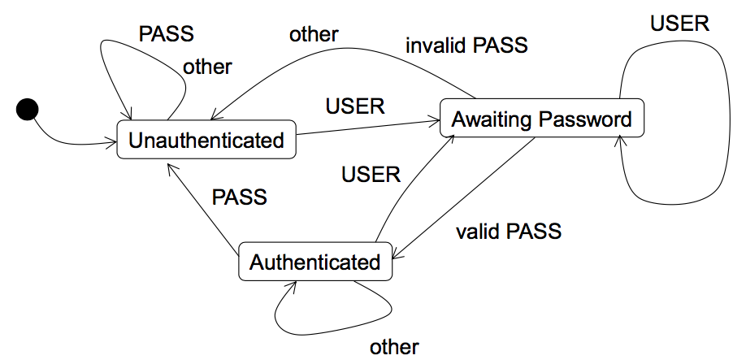
Recall: STOR only works if authenticated

Slide 21
Identify the test cases we should explore for transition coverage to test an FTP server on its handling of authentication.
Recall: STOR only works if authenticated

Slide 22
Observations
Bugs “lurk in the corners” where the test suite isn’t exercising the program
The strategies that we have explored focus on trying to increase the “code coverage” of the test (or ”test coverage”)

Slide 23
Learning Objectives
You should now be able to identify, understand and use:
Equivalence-based strategies for selecting test cases
Boundary-based strategies for selecting test cases
Path-based strategies for selecting test cases
State-based strategies for selecting test cases

