Slide 1
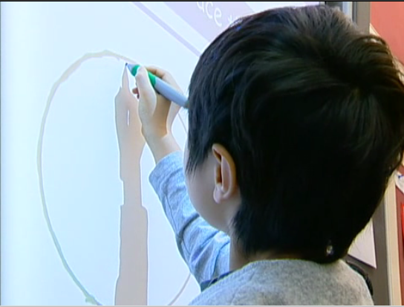
UX @ SMART
Kathryn Rounding and Michael Rounding
Sr. User Experience Designers
SMART Technologies

Slide 2
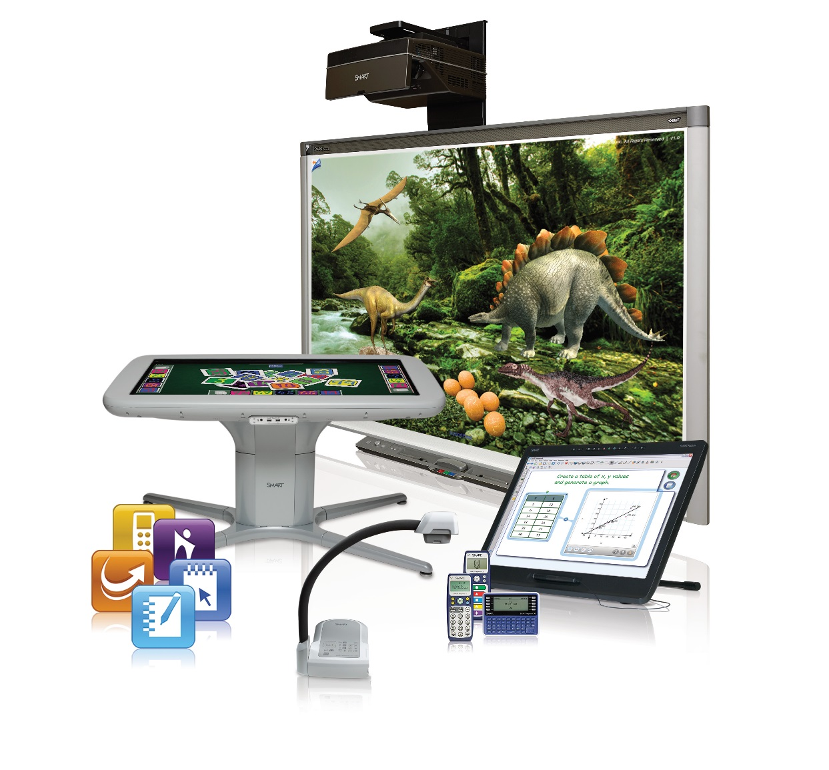
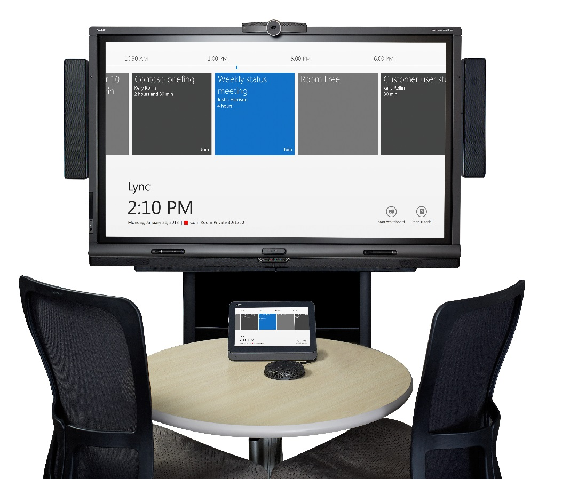
SMART Technologies
Notes:
First, a little bit about SMART... is there anyone who isnʼt familiar with SMART and what we make?
- touch sensitive - SBiw
- other hardware products: Table, clickers, slates, podiums...
- software products: NB, response, classroom monitoring, table apps...
- primarily focused on two specific markets: K-12 education and corporate meeting rooms, but also reaching out into higher ed, military, government, etc.

Slide 3

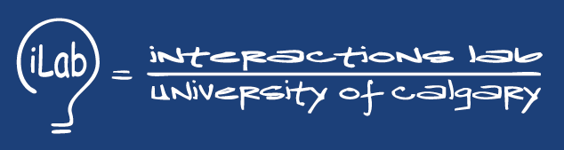
Us
Notes:
Computer science undergrad, took either this exact course (kathryn) or a very similar one (Kim), then did MSc’s here at UofC, we were students in the lab at the same time as Tony. Been at SMART 6 years (kathryn) and 5 years (Kim).
The UX group at SMART has 11 members: 5 usability folks, 1 graphic designer, 4 industrial designers, plus our manager. Iʼm going to talk today a little bit about what we do to support all these products. Have people in our group with diverse backgrounds: industrial design, graphic design and psychology.

Slide 4
9 Real World UX Lessons from SMART
1. know your users
2. really know your users
3. know all your users
4. REALLY know your users
5. form factor is a really big deal
6. history is valuable
7. it’s always quick and dirty (and that’s okay)
8. UX needs to be sold
9. UX is bigger than usability
Notes:
So what we would like to do today is talk about 9 real world UX (aka. User Experience) lessons weʼve learned working at SMART. We donʼt think any of these rules are ground breaking, especially for people who work in UX or HCI, We’re mostly just using them as an excuse to talk about what we do at SMART, what we know about our users, and how we found those things out!

Slide 5
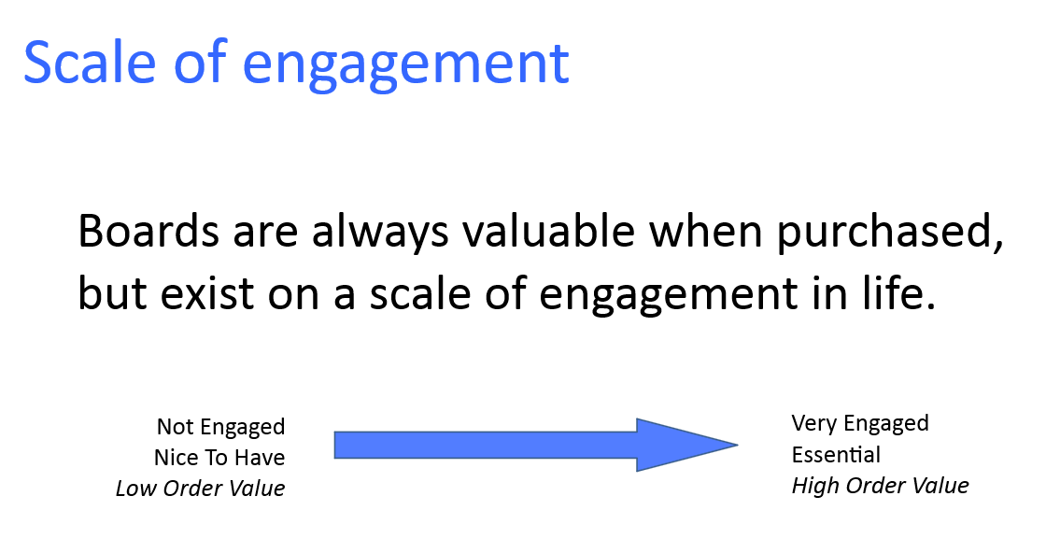

Slide 6
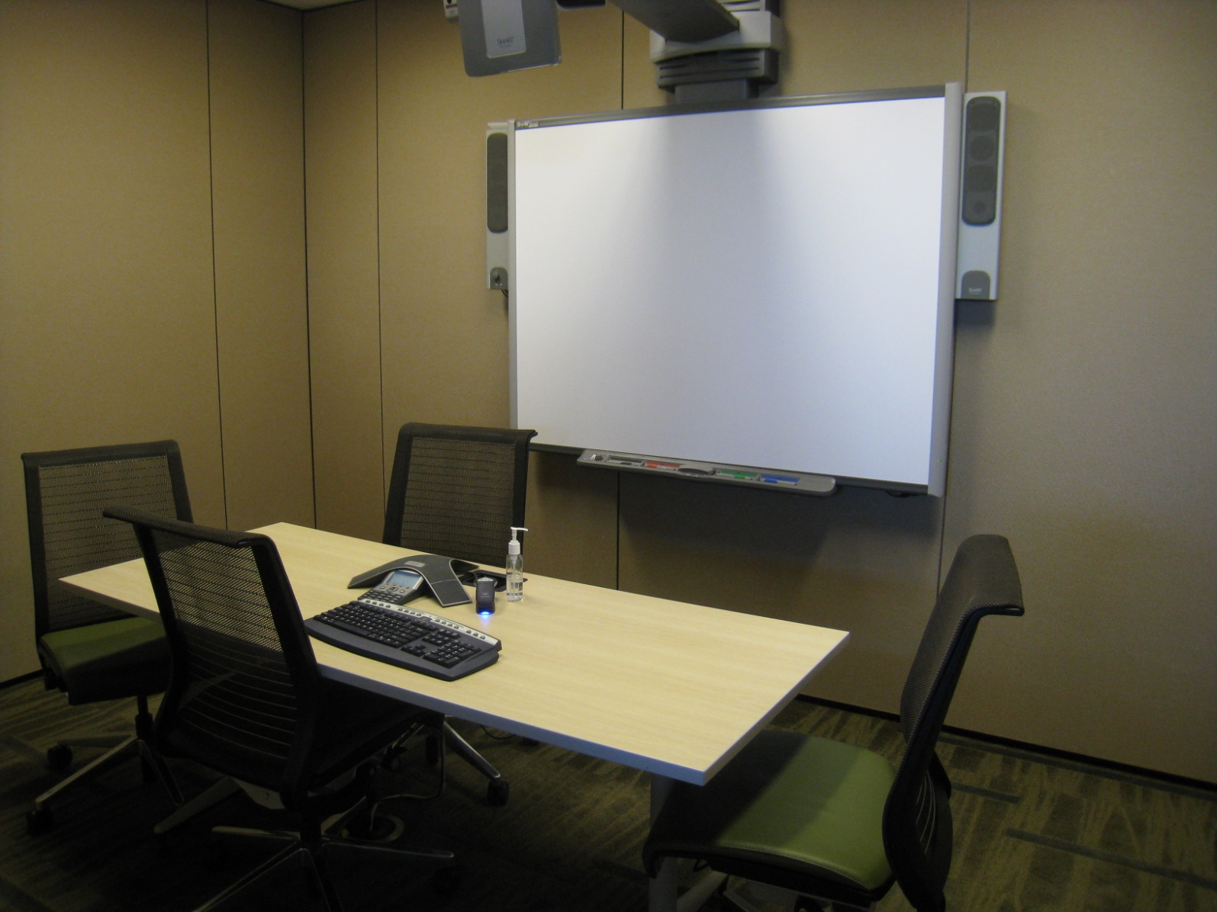
know your users
Notes:
Obviously, the first rule of UX is that you need to know your users. At SMART, we use our own boards a lot - thereʼs one in every single meeting room. I know that you guys have some boards here as well, also in meeting rooms. So hereʼs what a SMART Board looks like in one of our meeting rooms - the way we personally experience our boards every day

Slide 7
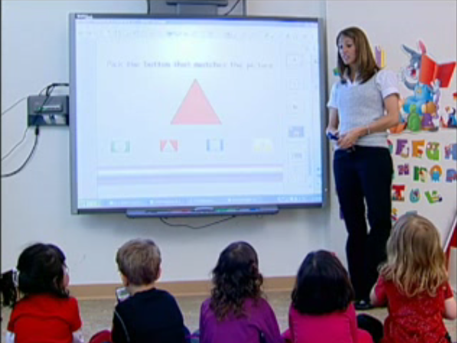
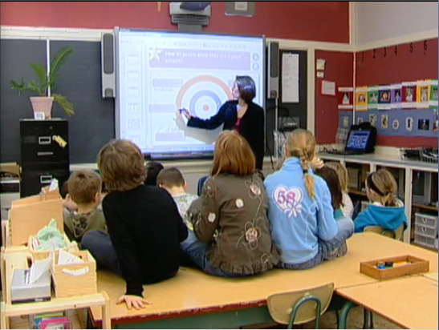
know your users
Notes:
..however, the primary use case for our education boards is a teacher in an elementary school classroom. Elementary school classrooms are pretty different from meeting rooms - for example, do you remember the carpet in your grade 2 class? The carpet is the centre of every elementary school classroom - itʼs where most full group activities happen.
The classroom carpet is a little different from a meeting room. When the teacher asks the kids to go to the carpet, they go there as fast as possible so they can get the best seat. Once theyʼre there, they all sit knee to knee, as close as possible, and when asked to volunteer to go up to the board all their hands shoot into the air, and the lucky chosen one climbs right over everyone else to get up there.
This is obviously not the same in a meeting room - can you imagine sitting on the floor for a meeting, right next to your coworkers, and being so excited to go up and contribute that you were jumping up and down? Getting out and watching kids and teachers use our boards in classrooms gives us some much needed perspective on what our real use cases are.

Slide 8
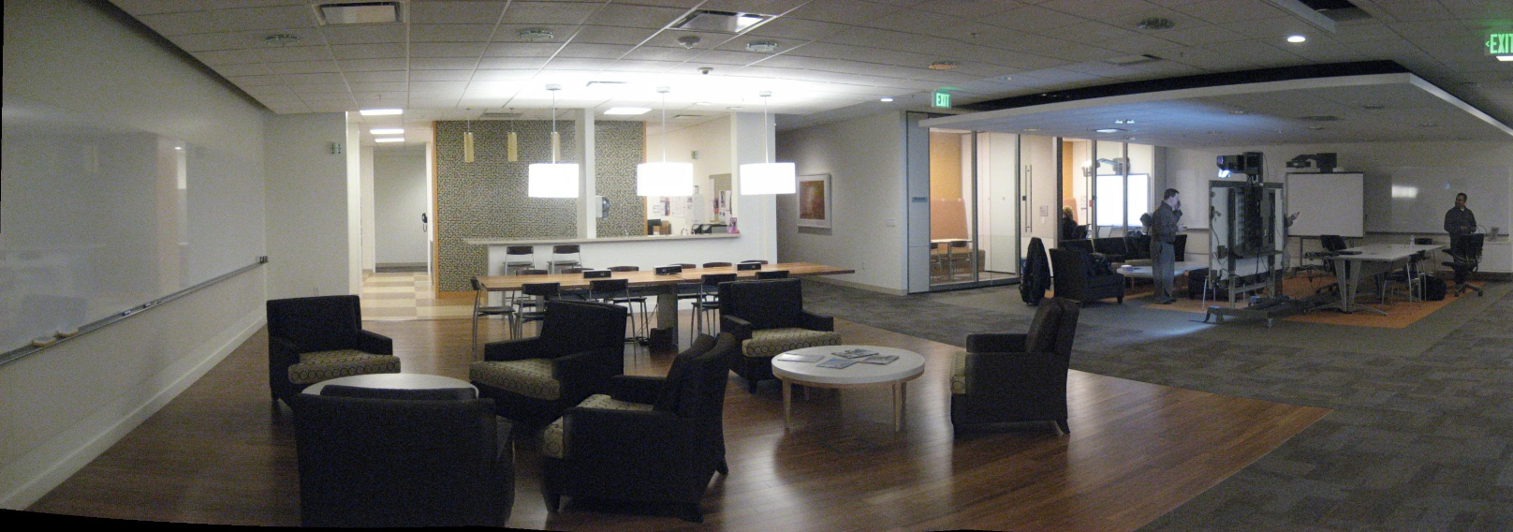

Slide 9
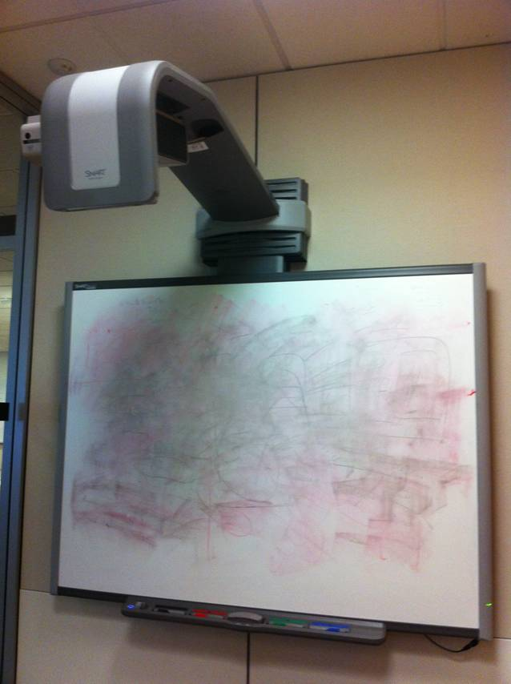
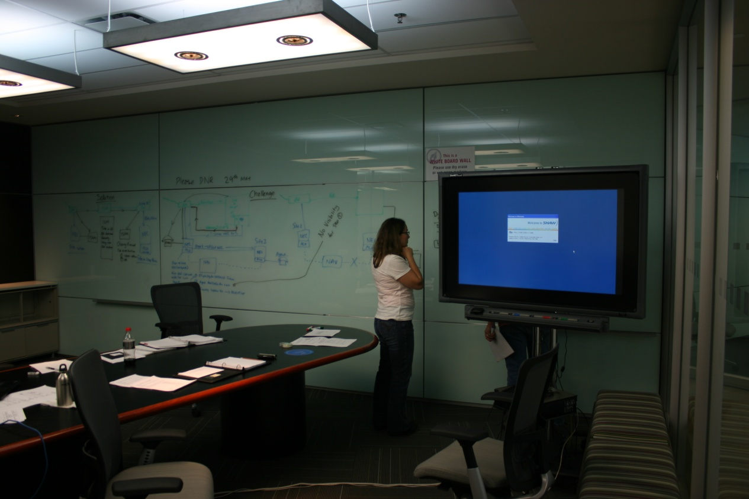
know your users
Notes:
Weʼre lucky if our corporate users know that the board is touch sensitive - weʼve been in situations more than once where weʼve gone to help users with our boards, and theyʼve said “wait, donʼt tell me you can touch this thing!”. Even if they know the board is touch sensitive, corporate users are extremely hesitant to be embarrassed - the last thing you want to do is get up there in front of your boss and look like you donʼt know what youʼre doing. Corporate users have no time or patience for exploring, and they donʼt live in meeting rooms - they only visit for an hour at a time. This is the complete opposite of the teacher who basically lives in her classroom. In a corporate environment, every use is first use, and if itʼs not completely obvious - first use wonʼt happen either. Weʼre still working on how to work with this, but itʼs a really interesting and challenging
group of users.

Slide 10
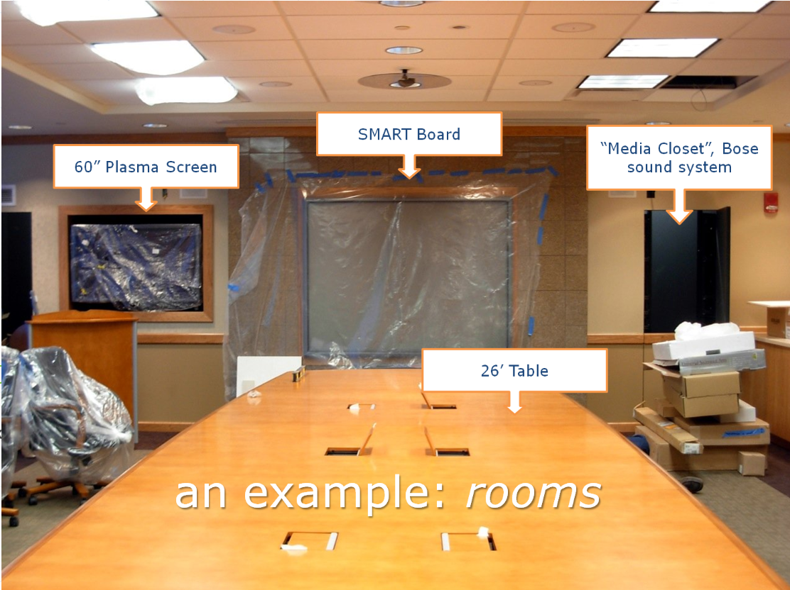
Notes:
Is this a room that’s really about collaboration? Human factors analysis:
Is it inviting?
Would you be comfortable booking and running a meeting here?
Can you even get to the SMART Board?
$15000 table, Bose sound system, separate VC system
$30000 board, room behind it to make it a rear-projection SMART Board. Most expensive product we sold at the time.
Way table is oriented – physically uncomfortable to turn your head and watch what’s going on at the board.
What’s at the other end of the table?

Slide 11
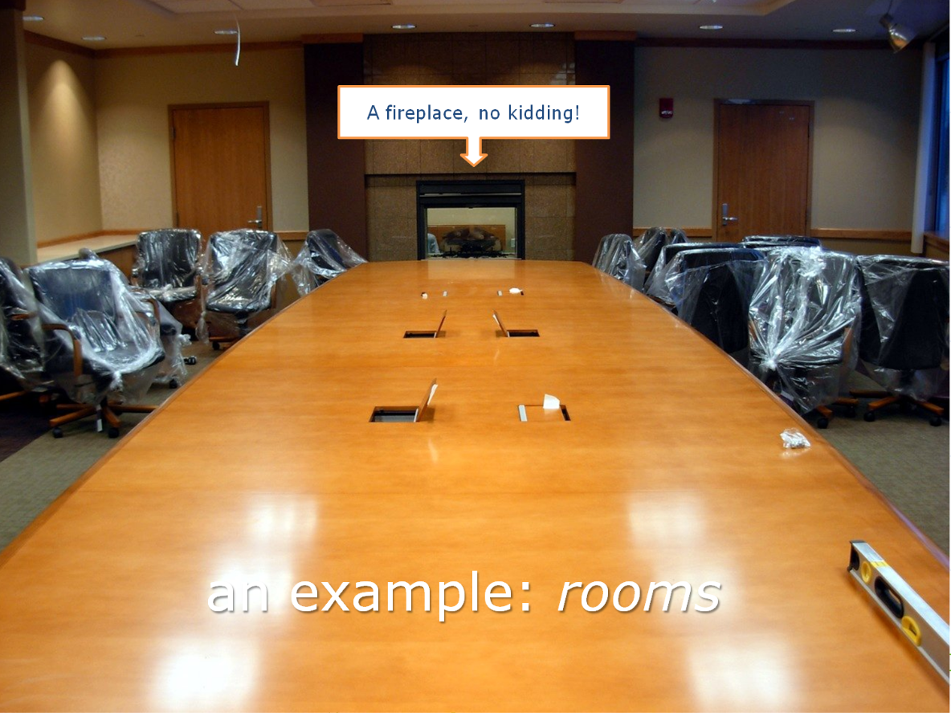
Notes:
Is this a room about collaborating and getting work done, or is it a room about showing off?? Judgement call, a bit.

Slide 12
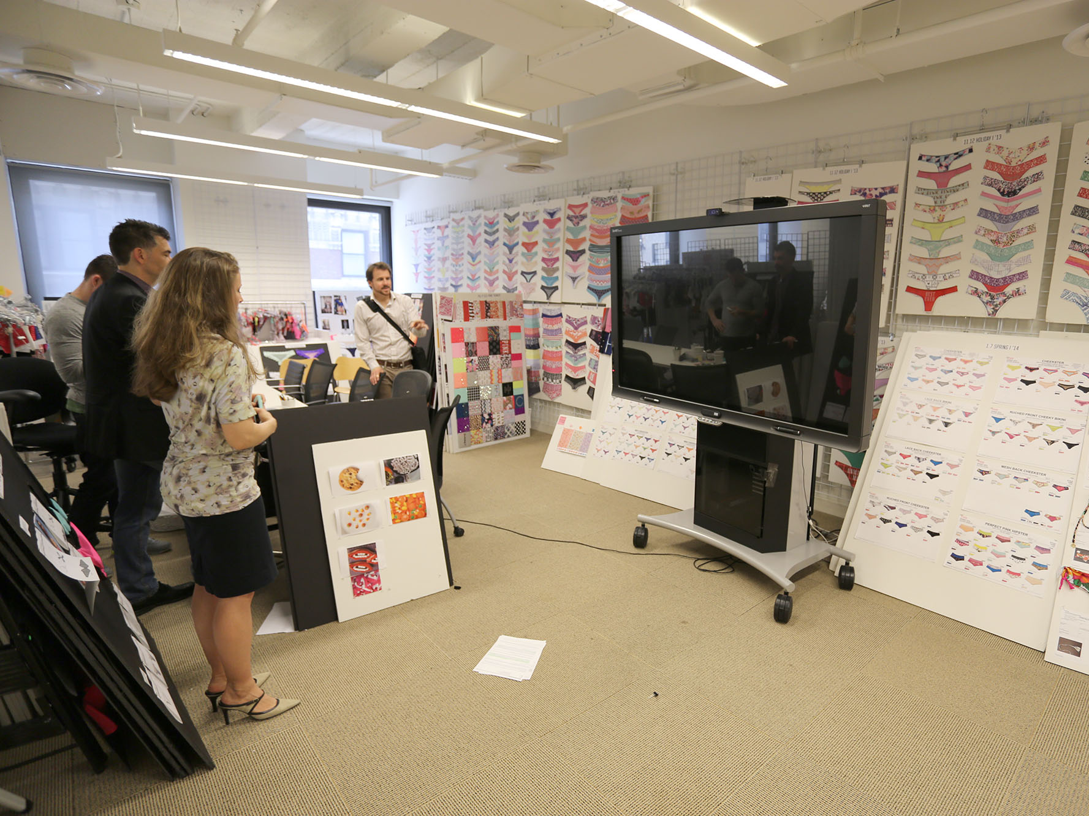
Notes:
Effective collaborative use – garment design review over distance.

Slide 13
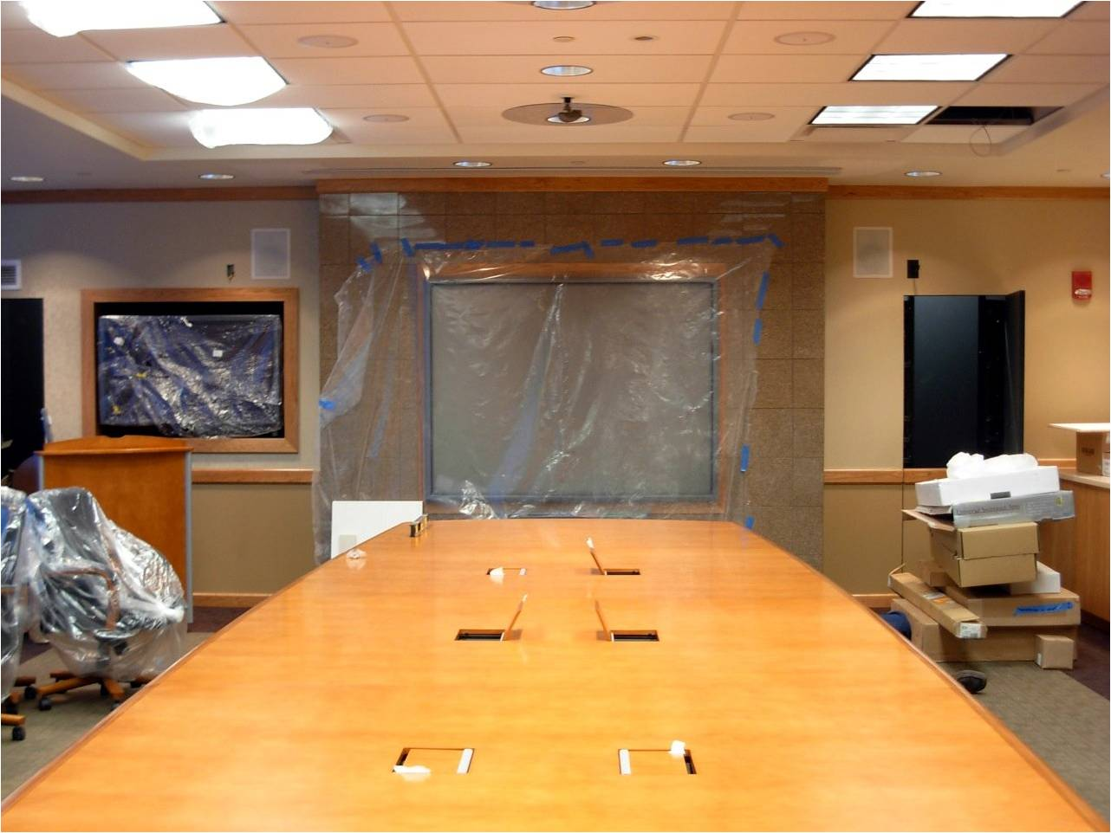
really know your users
cool factor
enables work
Image from flickr
Notes:
…of course, knowing these basics isnʼt enough. We really need to know our users. If we were to generalize what weʼve learned about how boards are used, we would say that board use for most people falls somewhere on this continuum. On the left you have the “typical” corporate case, and on the right you have the “typical” education case.
On the left, we have people who buy the board because itʼs the best technology or because itʼs “cool”: this includes situations like this under-construction boardroom - the best table, the best AV, the best sound system, and the best SMART board – this room even has a stone fireplace at the other end of this table. This is a showpiece - the chances of anyone actually touching this board are slim to none. It happens in schools as well - the principal hears at a conference that SBs are the hot new thing, buys a couple to try and puts them on mobile carts. Teachers donʼt use them because theyʼre not installed in the class and therefore take too much time to set up - they end up being a nifty toy, pulled out a couple times a year.
On the right, we have the situation where the board becomes so integrated itʼs a key tool - this most often happens when the board makes what you were doing before the board so much better, you canʼt imagine going back. This most often happens in education, but does occasionally happen in corporate.

Slide 14
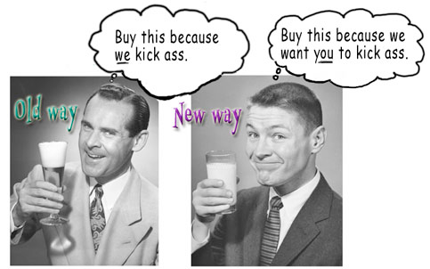
really know your users
cool factor
enables work
Image from Kathy Sierra: Creating Passionate Users
Notes:
We are obviously thrilled if you buy a board no matter where you fall on this continuum - board sales pay our salaries - however, the users on the right are the ones more likely to want accessories, to buy new boards, and to tell all their friends about the board. Theyʼre our evangelists. The better we understand our users, the more likely we are to be able to help people move from the left to the right - we want all of our users to be completely in love with their SMART Boards because of how much more awesome their SMART Boards make whatever it is that they do. The better the experience that we provide, the more the SB improves what you do already, the more likely it is that the SB becomes a critical tool that youʼre passionate about and canʼt live without.

Slide 15

know all your users
Notes:
Knowing our users is so important, that we’ve put it in here yet again. Seriously, know your users. While we understand education and corporate in big picture terms, there are different user groups within each that have their own unique needs. One of these groups for SMART is kids! I think it’s pretty obvious that kids are not adults. For one thing, they’re a lot shorter. But kids aren’t just little adults either - they have fundamentally different approaches to technology, and even this varies from one age group to another, and from one child to another.

Slide 16
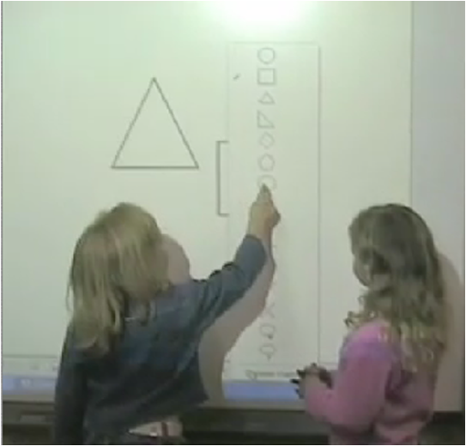
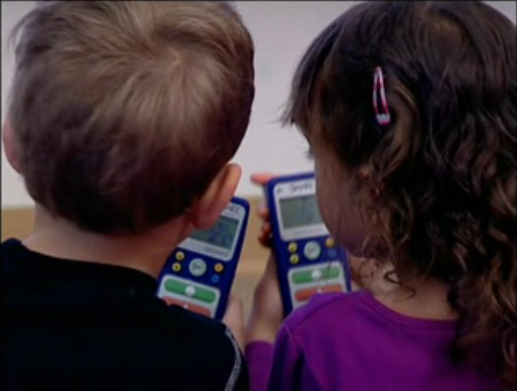
know all your users
Notes:
At SMART, we try to do usability testing with kids as much as possible. Testing with kids is in itself, pretty challenging - little kids have equally little attention spans and are pretty shy, and big kids are WAY too cool to be enthusiastic around adults, so we’ve had to develop techniques to put kids at ease, help them communicate, and find out where they struggle. I don’t have time to get into too much detail here, but we’ve had a lot of success testing children in pairs - they might be too shy/too cool to talk to an adult, but they’re more than happy to talk to each other and we learn a lot that way about how they’re understanding the products. We also usually test multiple products at once in short stations that the kids rotate through - having lots of other kids there puts them at ease, and the frequent task changes and movement keep their attention.

Slide 17
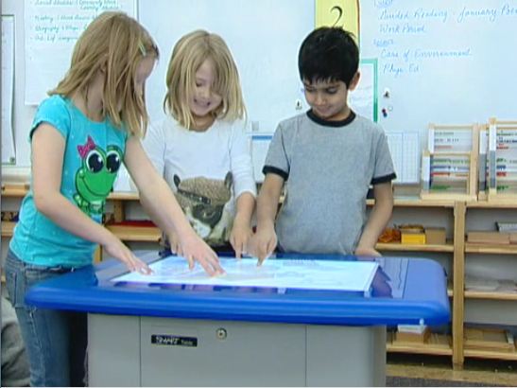
know all your users
Notes:
From these test sessions, we’ve learned a lot about how kids are different from adults in their approach to technology. As an example, we brought a bunch of kids in to try out the SMART Table very early on. Although the sessions were very non-traditional - we had no tasks, we just let the kids try things and watched them play – we learned some really valuable lessons.

Slide 18

know all your users
Notes:
The biggest thing we learned was that little kids do not approach touch surfaces the same way adults do. Adults, who have spent a lot of time with the mouse, tend to approach with one finger, touch an object and then move it. You have to practically force them to use both hands.

Slide 19

know all your users
Notes:
Kids approach with all their fingers, their hands, their arms and anything else. They reach across, over and under each other. And they don’t follow the typical computer drag action of touching an object and then moving it – they want to push things and pull things and fully expect the computer to respond like the real world. This seems like something small, but it’s actually a huge factor in the usability of the Table - one afternoon of testing taught us something we would never have found out otherwise.

Slide 20
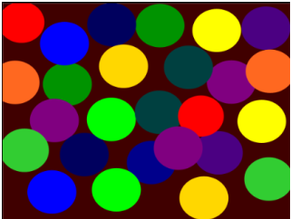
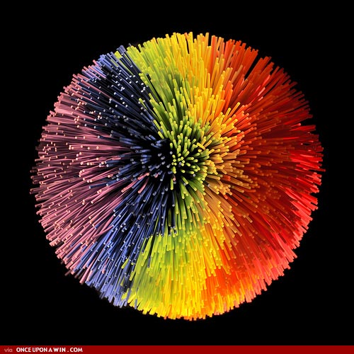
know all your users
Notes:
And we don’t just learn these lessons from testing. Going out into the real world to visit our users and see what they’re doing with our stuff in their worlds opens our eyes to a huge range of issues and surprise successes. For example, a side effect of the way we do touch in our hardware – a pressure based system that didn’t require special pens or conductivity or anything else, led to teachers coming up with a whole category of lessons that are now really, really popular. What they do is they set up a page with a bunch of shapes or pictures that link to other pages with review questions. They give a student a soft koosh ball, and have them throw it at the board to pick a review question the student then has to answer. This is a really cool, really innovative use of our product that we would never have known about. Even worse, when we changed our touch technology with the latest iteration of our boards, we would have lost this ability had we not specifically worked to continue supporting it.

Slide 21
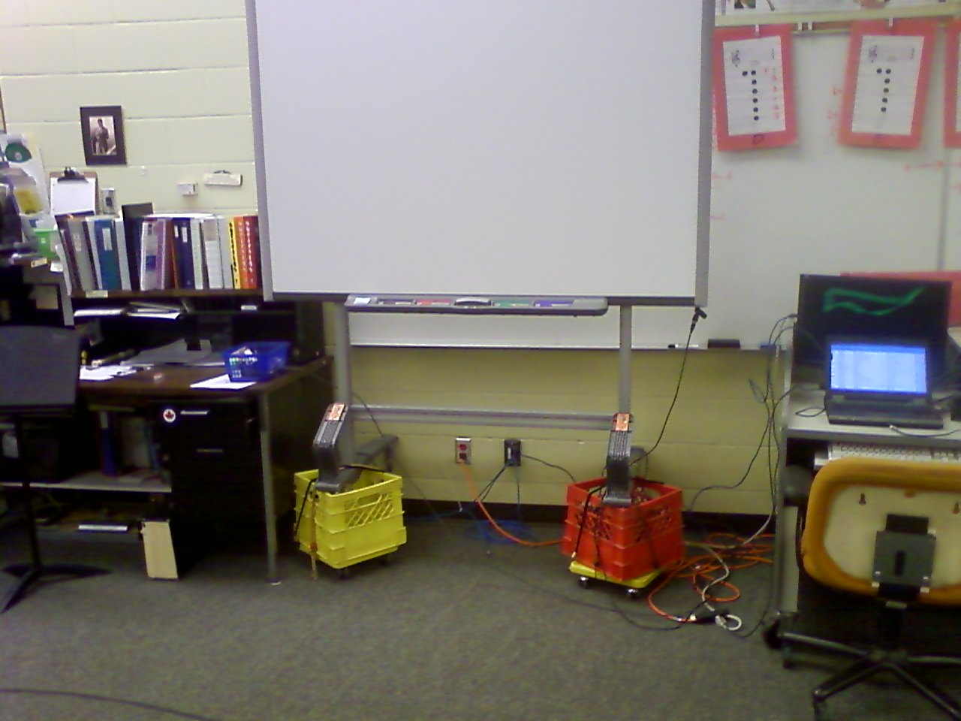
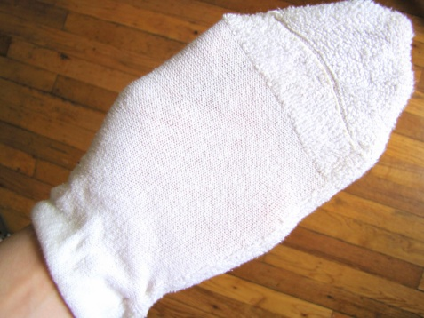
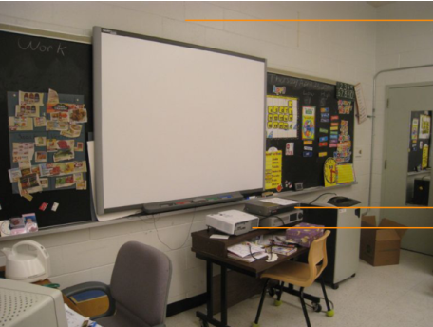
know all your users
Notes:
We have tons of other examples where going out and visiting our users or bringing users in to participate in testing have taught us things we would never have thought about otherwise. From little kids using the board with socks on their hands to make dragging easier, to SMART Board installers not reading a single page of the install guide we so carefully provide, to music teachers putting their SMART Board on milk cartons so that their students can see them over their music stands, to UIs that look messy but work flawlessly – there are a million little things we need to know about to design better solutions, that we would never find out without constantly working to better understand out users.

Slide 22
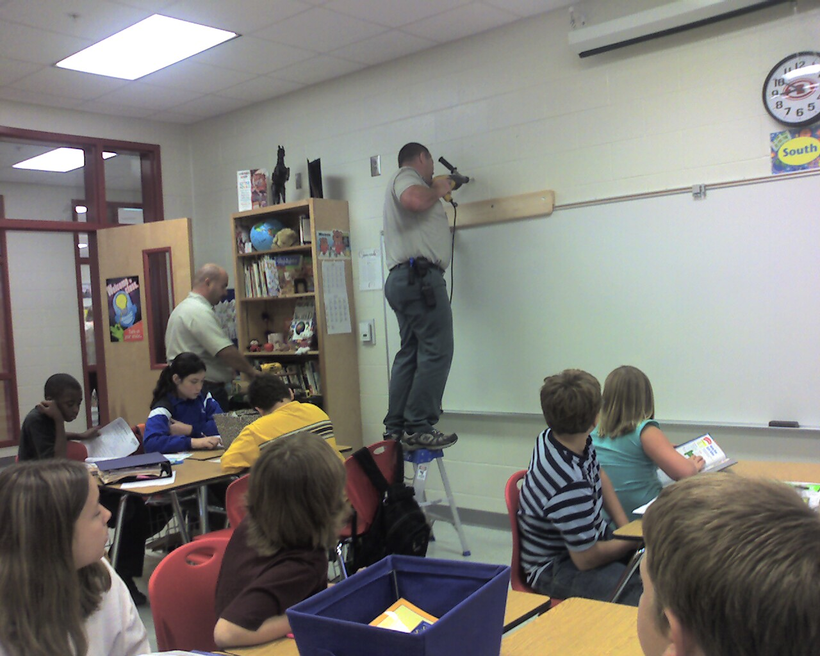
know all your users
Notes:
Users also include
IT support professionals who support/deploy our software.
Installers who bang with tools to put our products on the wall.

Slide 23

REALLY know your users
Notes:
So our fourth UX lesson...I think we’ve made our point - As a UX person, you are the voice of your users in the design
process. The more information you have about your users, the better you can advocate for them. As developers,
as UI designers, as product owners, we’re asked to make decisions every day about the design of our products. All
these teenie little decisions add up to create a bigger experience. Without as much knowledge as you can possibly
gather, you’re making these decisions based on guesswork and assumptions, and I think we all know how well that
can work out.

Slide 24
REALLY know your users
site visits
observations
usability testing
feature requests
feedback
user forums
interviews
focus groups
expert interviews
customer tracking
web tracking
surveys
...
Notes:
At SMART, we try to gather as much information as we can, in as many formats as we can - quantitative,
qualitative, anecdotal... anything we can get, we can use. We visit our users in their worlds as often as we can, we
bring them in for usability testing, we ask them about their work through surveys and interviews, we read their
feature requests and their feedback, we track their actions (anonymously) through customer tracking data and web
tracking, we interview experts in pedagogy, in technology, in system administration - in short, we do everything
we can to be able to paint a picture of who our users are and what they need.

Slide 25
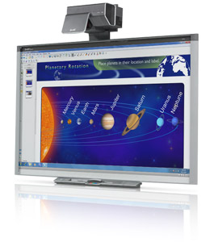
form factor is a really big deal
no hover
no edge visibility
stand at the side
accidental touches
palm reject
tall vs. short
hw + sw integration
Notes:
Lesson #5 - I’m sure again, this feels obvious to people who research tables, large displays or small displays – but the user experience is fundamentally different depending on your form factor. Our number one product is a large, touch sensitive display - we’ve had to learn a lot about how touch is different from a mouse, and how a wall is different from a monitor. Difficult keyboard and right click access along with losing hover as a feedback mechanism means that a lot of design patterns from traditional displays don’t work. Losing the bottom third of your display for notifications (people don’t see what’s below their belly button) means status bars and tray bubbles no longer work. Having users that can’t reach across the whole board vertically or horizontally means that a lot of tricks have to be developed - scrollbars and toolbars need to be movable. And the hardware has it’s own capabilities (e.g. a pen tray) which need to be smoothly integrated into the software. We’ve solved some of these problems, but there are still a ton that we’re working on.
And the table is yet another surface - it may be another large, touch sensitive display, but its interactions are fundamentally different - it’s a challenge to make software that can go from one to the other, and works on a traditional laptop.

Slide 26
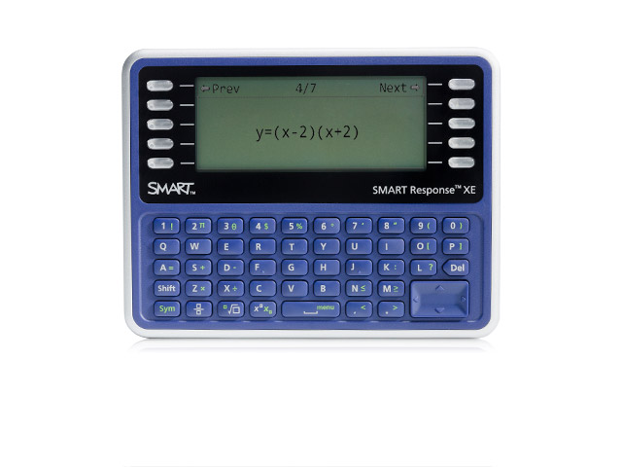
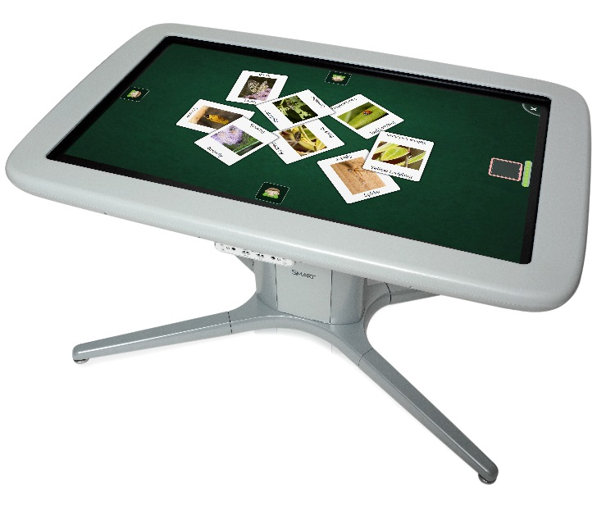
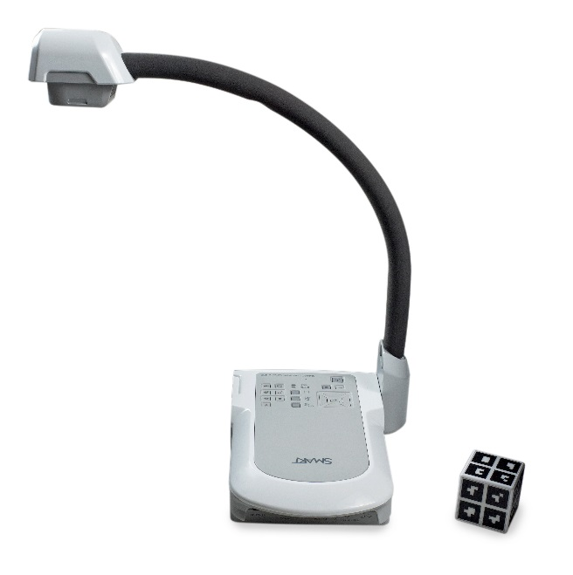
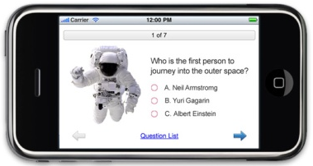
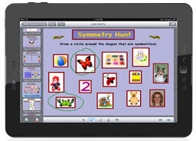
form factor is a really big deal
horizontal/vertical
multi/single user
multi/single touch
text only
touch/camera/mouse
…
Notes:
And the SMART table is yet another surface - it may be another large, touch sensitive display, but its interactions are fundamentally different – now it’s horizontal, it’s multi-user, it’s multi-touch, people sit on all sides and can lean on it, etc. And we build software for the iPad – single user, but still multi-touch. We build Response clickers with only a few lines of text for a UI, we build mixed reality systems that use a document camera to manipulate 3D content…. Obviously each one of these has hugely different capabilities, limitations and ways of communicating with a user. If we designed in the same way for each one, our experience would be pretty rough. Form factor matters a lot and understanding it completely is critical to the user experience.

Slide 27
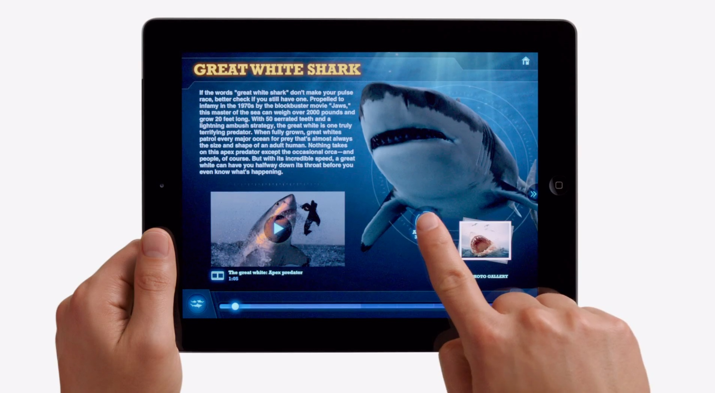
make it work like an iPad!
Notes:
Our least favourite corporate directive: “Make it as simple as an iPad!” The problem is we’re solving a lot more difficult/complicated problems than that.

Slide 28
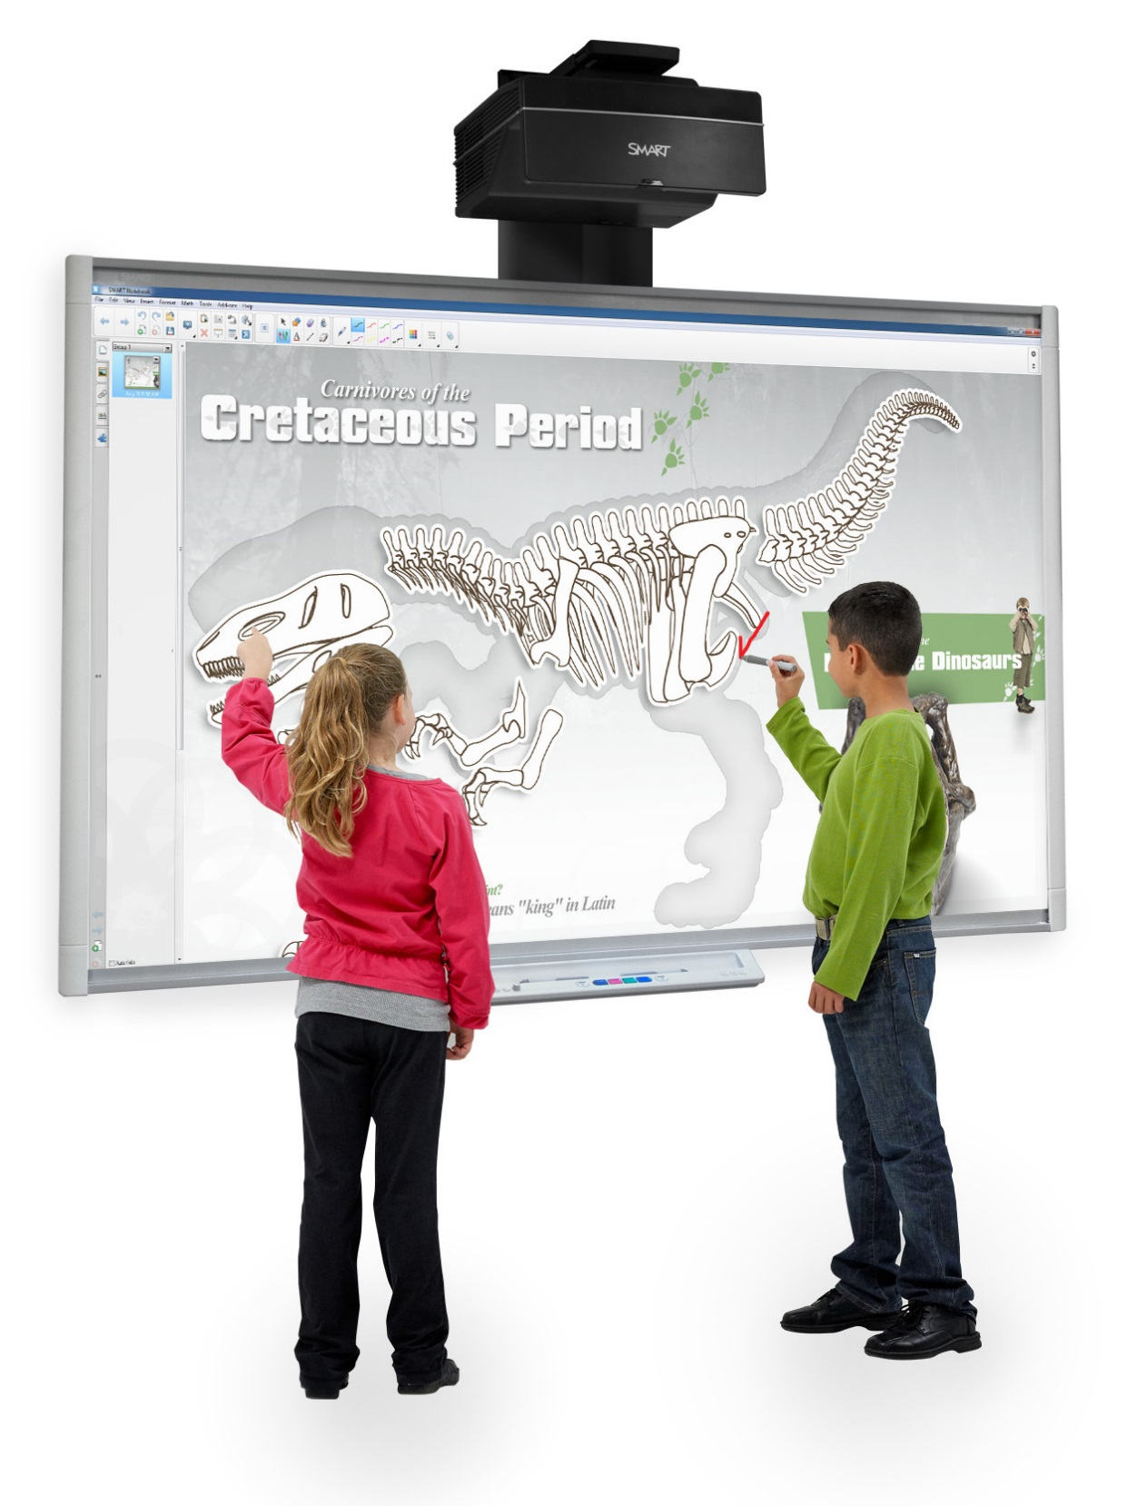
reality
iPad: Single user, single tool, multi-touch
SMART: Multi-tool, multi-user, multi-touch
  Migration from 2 to 4 touch – why??!
  We demand more information, you don’t know we need it, or what benefit it is to you.
Notes:
Migration from 2 to 4 touch – market mistake. “we have a dual user product” “it supports gestures” - these two statements put together read as “two people can do gestures at once!” you can’t do that with two touches.
With more tools and more capabilities comes more complexity, and we demand user input that users may have no idea they need to give.

Slide 29
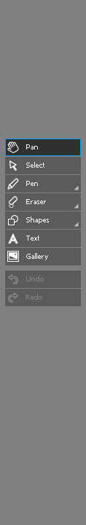
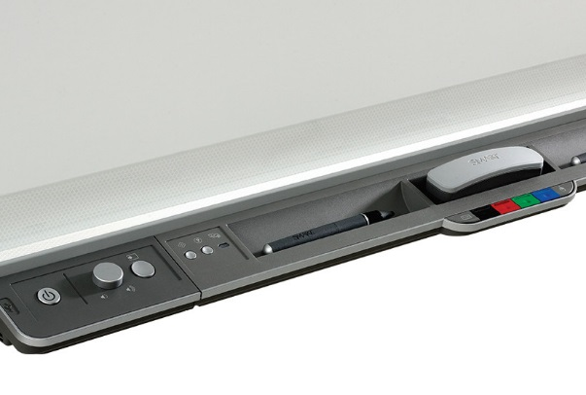
On-screen interface
Hardware interface
Notes:
Inkwell – the tool you touch the tool UI with gets the assignment. E.g., if pen touches green ink, pen gets green ink. If finger touches red ink, finger gets red ink.
Sounds powerful, but:
People pick up a pen, change the colour with their finger, draw with the pen and don’t get what they expected. Highlights the importance of design and testing your design. Also highlights the danger of designing quickly on paper only when the problems are complex.

Slide 30
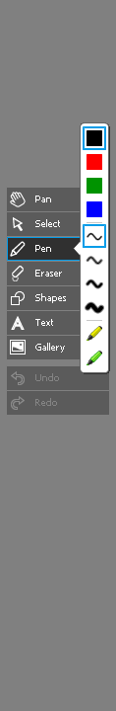
On-screen interface
Hardware interface

Slide 31

On-screen interface
Hardware interface

Slide 32
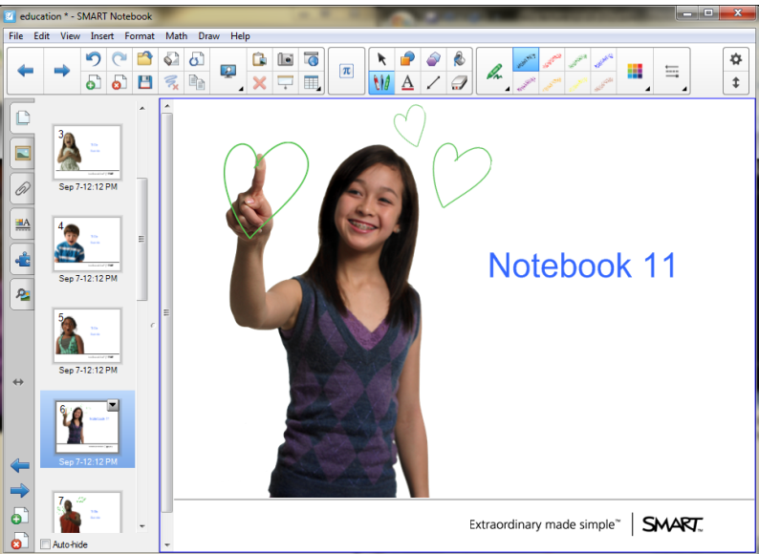
history is valuable
Notes:
Lesson #6 - the history of your products is really valuable. For example, here’s a screenshot of Notebook – our biggest education software product, with somewhere in the neighborhood of 1-2 million users. Notebook is designed to help teachers create and present interactive lessons. We use Notebook a lot internally too - we use it for prototyping, for presentations, for requirements documents... everything.
Every single new UX person over the last three years comes to SMART, spends about two weeks with NB and then wants to “fix” it. Notebook has a lot of quirks, especially if you’re a usability person used to looking for consistency and commonalities between software programs - the way you choose tool settings is a bit odd, the scrollbar is on the wrong side, the resize handles for objects are not like any other graphics program, it has all these tiny places where it’s just not like any other software most people have used. However, if you know the history of Notebook, each of these quirks and inconsistencies comes from a user need. Our unusual tool settings come from teachers’ need to be able to quickly access the tools they use most often, the scrollbar is about classroom managment at a large display, and the weird resize handle is actually much easier to
use on a board than a regular one. But until you know the history, NB just seems weird. But if those quirks were removed, our users would be furious - each one of those “weird behaviours” actually supports something critical to what they do, and they love it. Knowing the history of existing products is critical in making informed design decisions.

Slide 33

it’s always quick and dirty (and that’s okay)
image courtesy: http://www.flickr.com/photos/meanestindian/221581067/
Notes:
Lesson #7 - As a UX professional, one of the biggest adjustments from school to “reality” is how FAST everything moves, and how quickly you have to be able to provide answers. When I was in grad school, if someone was able to design a study, run it, analyze and report on the feedback in a month, that was AMAZINGLY fast. In industry, that’s way too slow. You need to provide answers yesterday, or decisions will be made without critical user feedback. There is rarely, if ever, the luxury to do a full study with statistical validity. 5-7 users is more than enough. Sometimes the three people you happen to find in the cafeteria one afternoon are enough.
But this is okay - quick and dirty is usually enough to answer the question and move forward. We’re not publishing, no one is reproducing our results - we just need to provide support to decision makers. And as long as we understand our users well enough from other sources (as mentioned earlier) we have enough of a body of data to be able to make decisions about how good is good enough: we know enough about our users to know how important a feature is and whether it should be given more testing time and effort or whether asking a few people in the cafeteria is enough - it all comes back to knowing your user.
This also means that if you’re interested in being a UX professional, you need to develop the ability to quickly figure out what the question is, pick a tool to explore it, figure out the answer and communicate it to the team. Being able to rapidly solve problems and answer questions is huge. This is even more important if you’re working with development teams that use an agile development process and are on 2 or 3 week sprints.

Slide 34
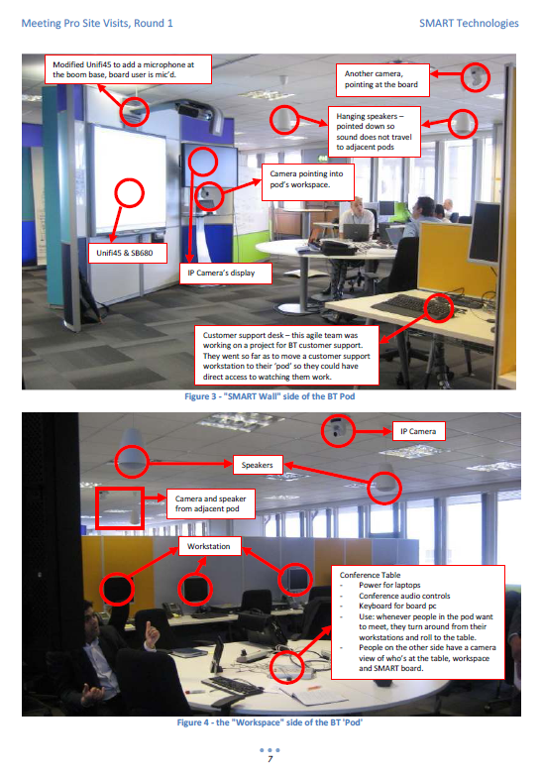
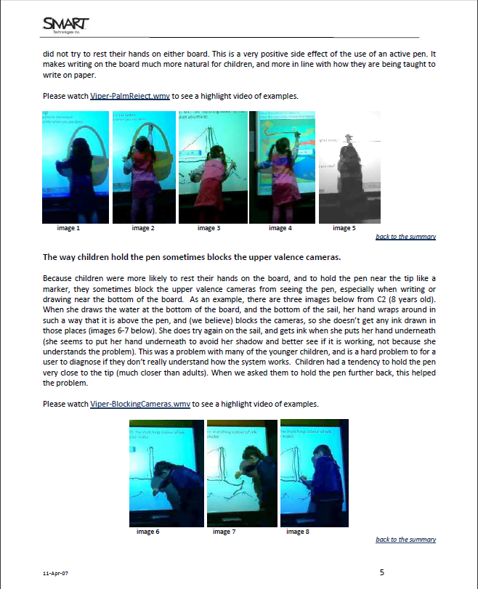
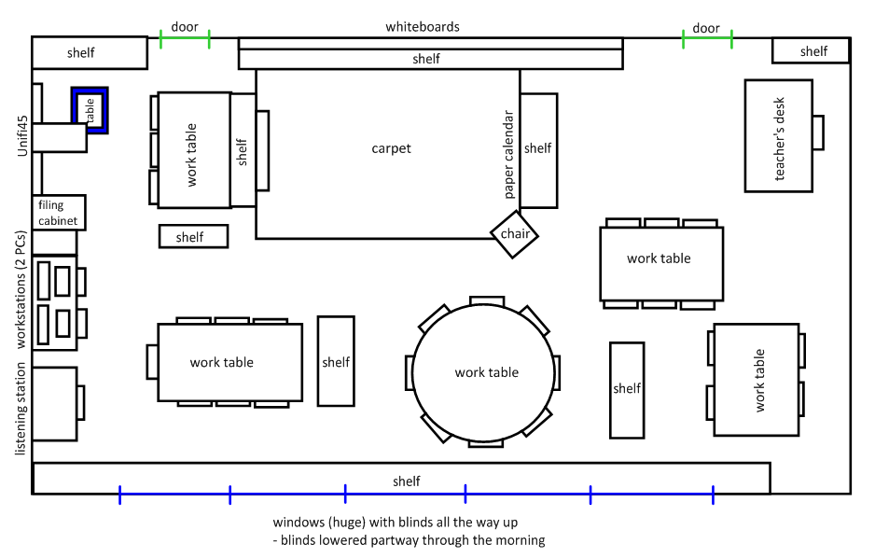
UX always needs to be sold
Notes:
Lesson #8 - This is again for anyone looking at a career in UX - SMART is an awesome company to work for as a UX professional - the entire company has a strong policy around putting the user first that comes right from the top down. It’s even our slogan: “Extraordinary made simple” - SMART is willing to put in the time, money and energy to support Usability and UX, which is awesome.
However, even with all that support, the UX team still needs to evangelize: we need to make sure the whole company has a single user vision, we need to convince those that are new to UX and are skeptical of the value, and we need to demonstrate the value of the additional development time we’re requesting to do a feature right.

Slide 35
UX always needs to be sold
Scope
Time
Cost
Notes:
Product development is always a trade off between the amount of time it takes to build & ship a product, the scope of the product or how many features it has, and the cost of building the product. While user needs are important and are our focus as UX professionals, there are also business needs to consider as well as technical concerns. For every usability improvement that gets included, it means that a bug isn’t fixed or a new feature isn’t added. There is a cost to everything, and part of what we do is help the teams prioritize issues. Definitely you want to be able to advocate for an ideal design, but you also have to be realistic about what can be done within the time and constraints of your development team. The computer science background that you have will help you with this – it’s important to understand at some level what the costs are of what you want to get done, so you can bring that to the discussion.
The analytical research skills you’re learning here are important, but the writing and speaking skills you also acquire will be critical as a UX professional – without being able to communicate your results or your value, it’ll be a constant struggle to get changes made. You are the voice of the user - so be prepared to be their constant advocate.

Slide 36
UX is bigger than usability
usability
Notes:
Finally, our last lesson is that UX is bigger than just usability. Usability tends to focus on the product itself, and how to make it the best it can be. This is awesome for obvious reasons - great products are the basis of great experiences.

Slide 37
UX is bigger than usability
branding
support
usability
human
factors
content
Notes:
However, to really create a good experience, we also have to be interested in everything we provide around the product: the out of box experience, tech support, websites, documentation, visual design etc.
When it comes to a user interface, a particular form or screen can be laid out in a perfectly usable way. But depending on the visual look of it, people can find it more or less appealing.
With the SMART Table, we went to our first four or five schools and watched them unbox and use the Table for the first time - was our documentation clear? Did they know how to connect the power cord? Could they get the Table out of the packaging? Did little pieces get lost?
When a teacher gets a SMART Board, how do they learn how to use it? How can we help them get started quickly? How can we make the SMART Board more approachable and less intimidating?
These are all questions that our group is interested in that go beyond the usability of the product and whether it’s easy to use or not.

Slide 38
UX is bigger than usability
UX
branding
support
usability
human
factors
content
…
Notes:
Going beyond that, UX is also interested in the things around the product that we can’t always control, because even those things are part of the experience people have with our stuff. A teacher doesn’t understand that her SB doesn’t work because it was installed incorrectly or because her school’s network is too restrictive or one of her students tripped over a cable and it got unplugged - all she knows is “the SB doesn’t work”.
One of the biggest complaints we hear is that teachers hate the shadows you get on the board when using it with a projector on a cart - there is really very little we can do about those shadows other than sell you a short throw projector. Yet they’re a huge part of the experience, so we have to think about them and see if there’s any way we can improve the experience of the teacher dealing with them every day.
So keep in mind that while usability is a big part of the user experience, there is more to user experience than that. As a UX professional, you may either specialize in a particular aspect of UX, or you may end up having to do a little bit of each.

Slide 39
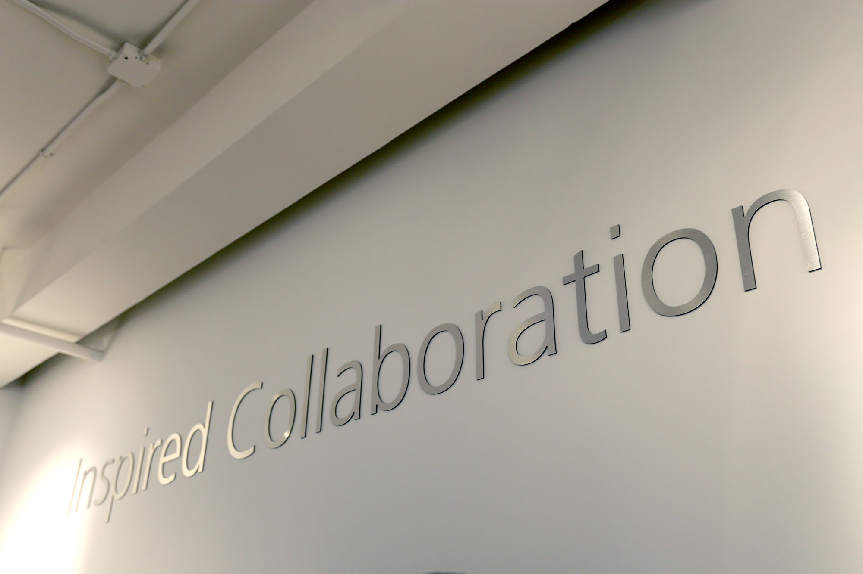
Notes:
Photos from a design open house we held in our New York sales office. (Some removed for confidentiality)
- Bring a whole bunch of people in to look at future designs and workflow storyboards – get buy-in before we start building.

Slide 40
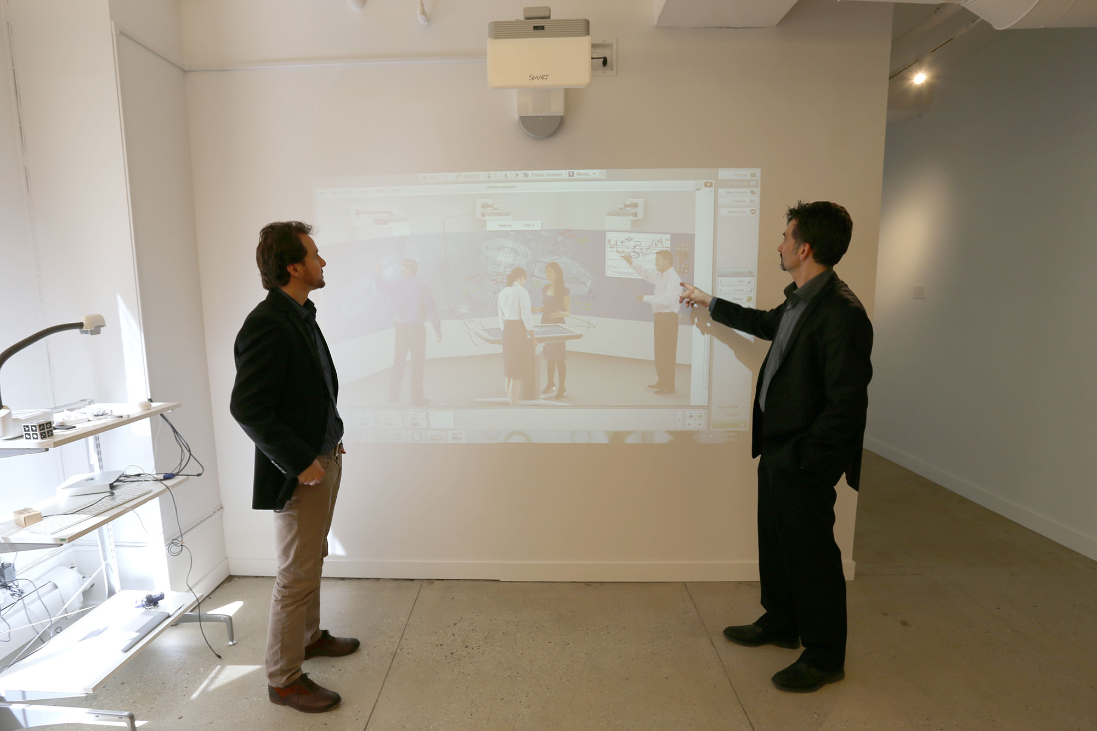
Notes:
Now shipping – interactive projector. Self-contained, no longer requires a separate board (sensor) on the wall.

Slide 41
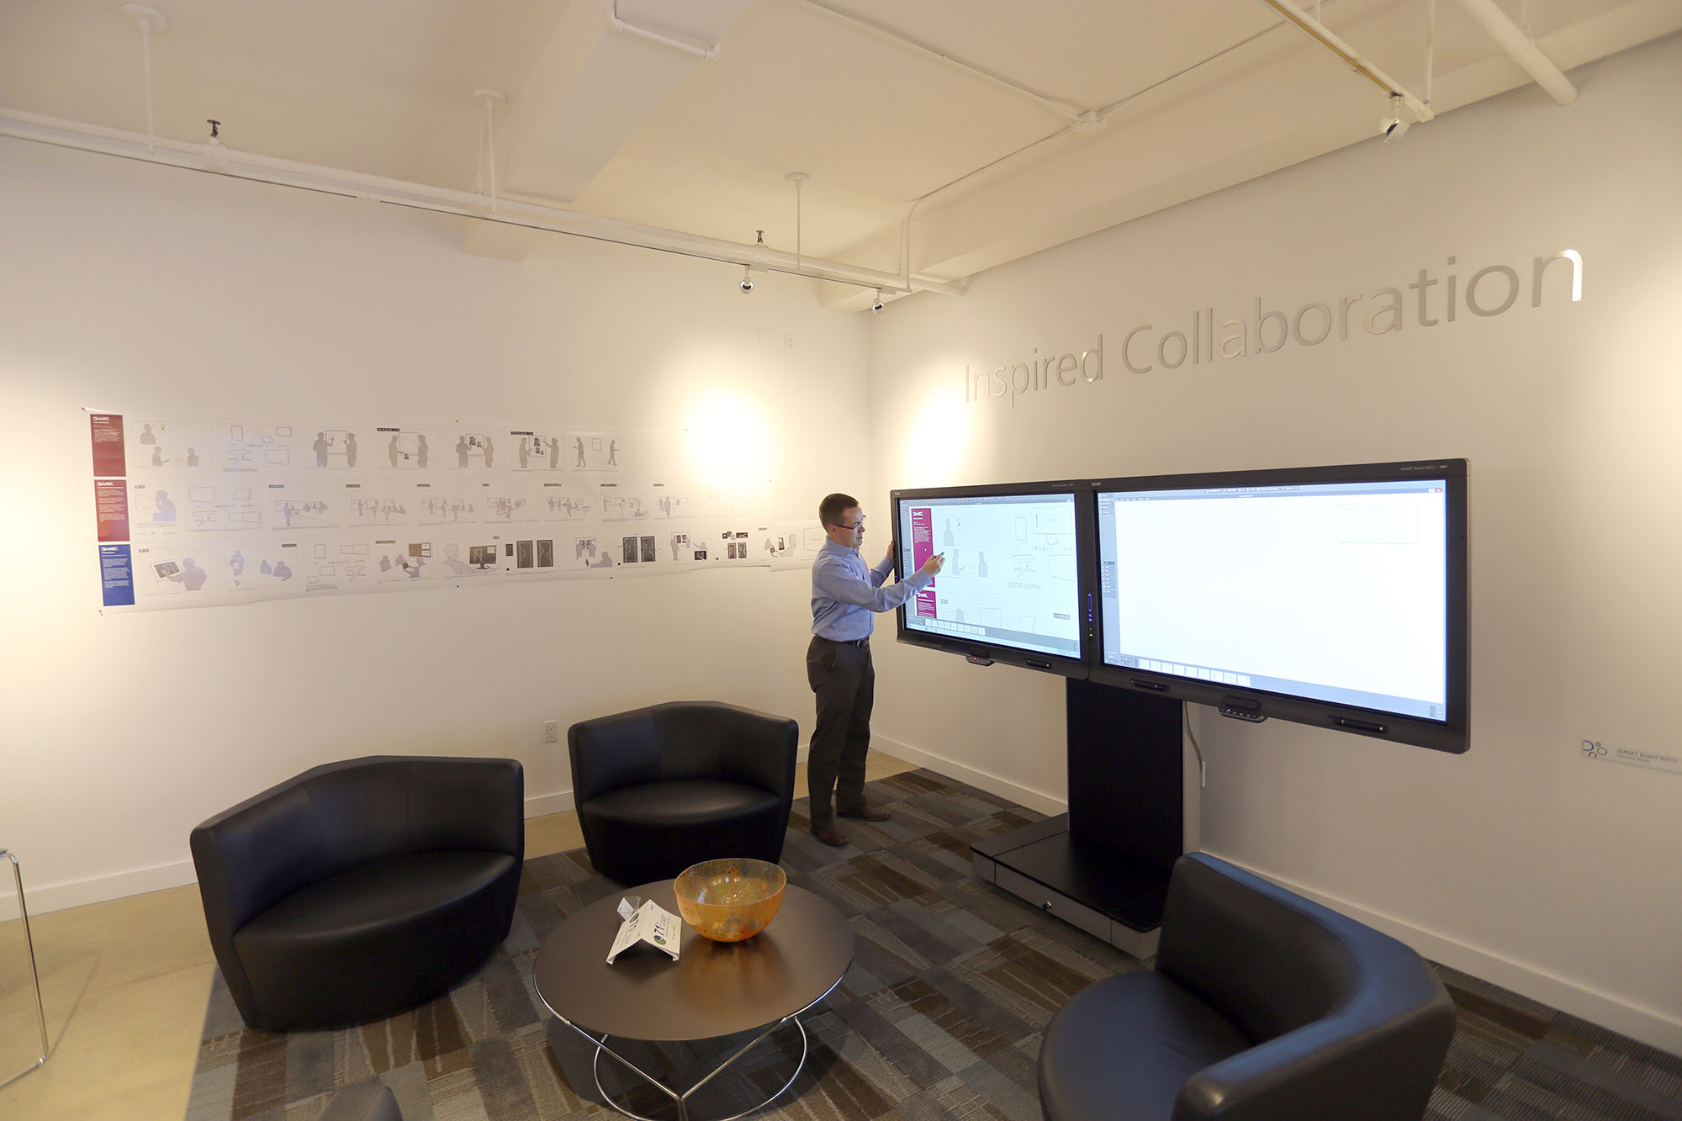
Notes:
Paper and digital workflow review – here are our storyboarded interactions. We had everyone from garment designers to workflow consultants take a look at these workflows and critique/corroborate them.

Slide 42
9 Real World UX Lessons from SMART
1. know your users
2. really know your users
3. know all your users
4. REALLY know your users
5. form factor is a really big deal
6. history is valuable
7. it’s always quick and dirty (and that’s okay)
8. UX needs to be sold
9. UX is bigger than usability
Notes:
So there we go! Those are our real world UX lessons. Questions?

Slide 43
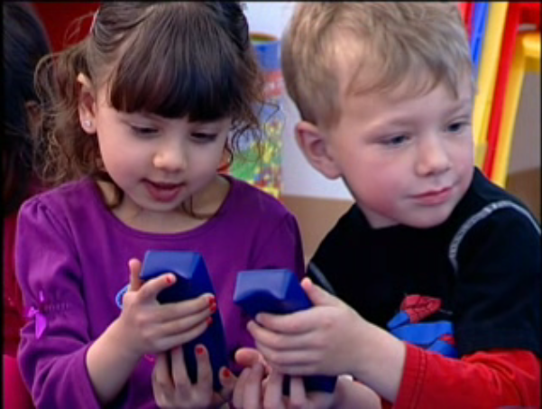
thank you!

