Slide 1
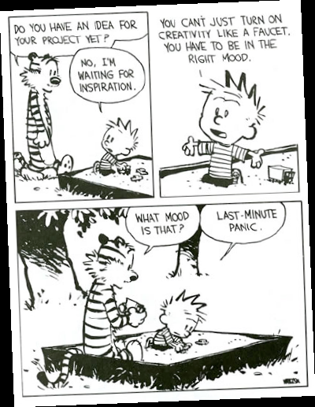

Slide 2
WHY THE IDEO METHODS (80% good for your project)

Slide 3
Bold the due dates
Send out a reminder on piazza when things are about to be due
Show where the calendar due dates are

Slide 4
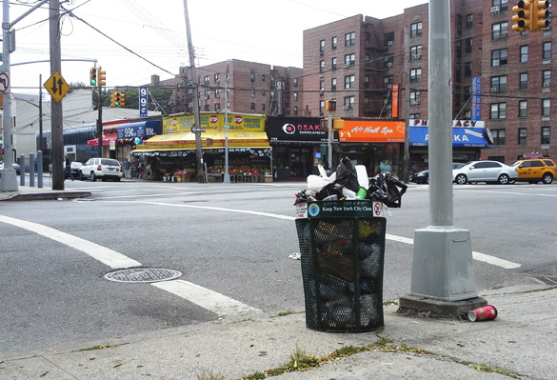

Slide 5
Activity (5 mins)
Scenario: City of Calgary is going to put a bin on every street corner in the city. Design the bin. What do you do to support this design?
Break into groups of 3-4 for this. Select an interesting idea and be prepared to discuss aloud with the class.
Consider:
  Who are the users? Who are the stakeholders?
  What are their needs?
  What are important design considerations?
  What IDEO methods would you use to understand this design problem?

Slide 6
Ideation
CPSC 481: HCI I
Fall 2012
Anthony Tang, with acknowledgements to Julie Kientz, Jake Wobbrock, Dave Hendry, Andy Ko, Jennifer Turns, and Mark Zachry

Slide 7
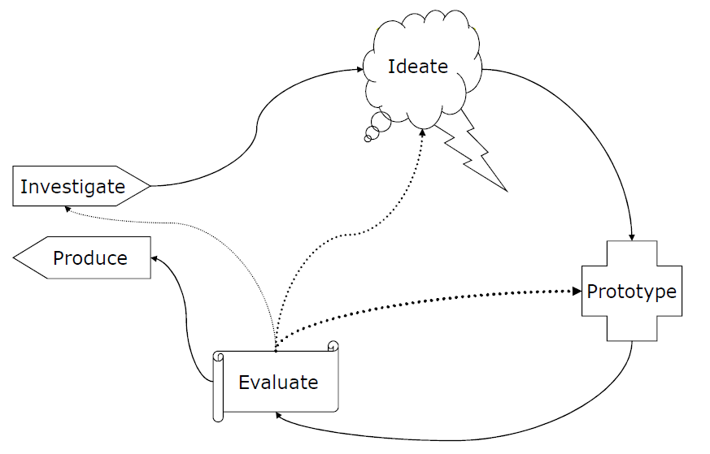
User Centered Design Process
Generate lots of ideas
Grasp issues and
potential solutions

Slide 8
Problem
“I’m not creative!”
Today: techniques that will help you (and your team) be creative together.

Slide 9
Ideation
How do we come up with great ideas?
How do we come up with lots of ideas?
How do we come up with big ideas?
How do we refine ideas?
How do we organize ideas?
Notes:
Tutorial 10+10 techniques

Slide 10
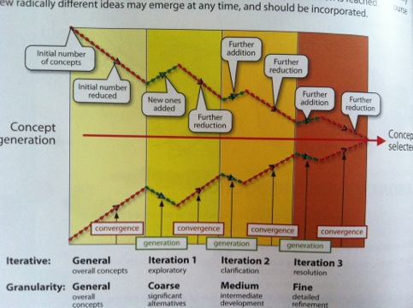
Design Funnel

Slide 11
Role of Creativity in Design
Design is about making choices, and compromises
There are three places where there is room for creativity in design:
  determining the methods you choose to investigate a problem
  enumerating distinct options from which to choose
  defining the criteria, or heuristics, according to which you make your choices

Slide 12
Inspiring Creativity (2 mins)
Write down, on a piece of paper:
How can we inspire creativity?
In pairs, discuss this idea

Slide 13
Creativity as a Designer
Immerse yourself in the world you are designing for (gathering inspiration)
  Collect examples from existing systems
  Collect things that irritate you
  Collect things that seem really good
  Sample things that inspire you

Slide 14
Existing Systems
What’s so good about this? (Why is it good?)
What is the general problem that this solves?
Where else could I use it?
Practice articulating what makes something good.

Slide 15
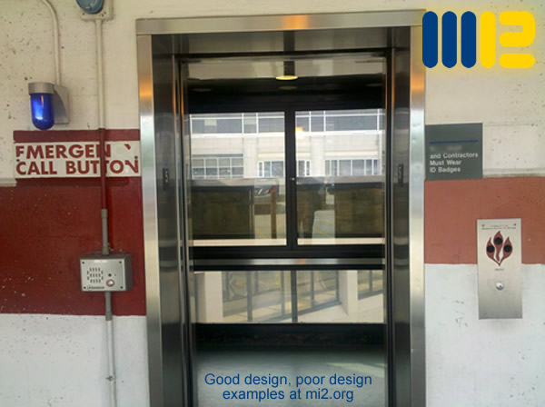
Things that irritate
Articulate and understand what makes something irritating.
Why are mistakes happening?
How can it be done better?
Notes:
http://mi2.org/building-science-healthcare/good-design-poor-design-we-see-examples-every-day

Slide 16
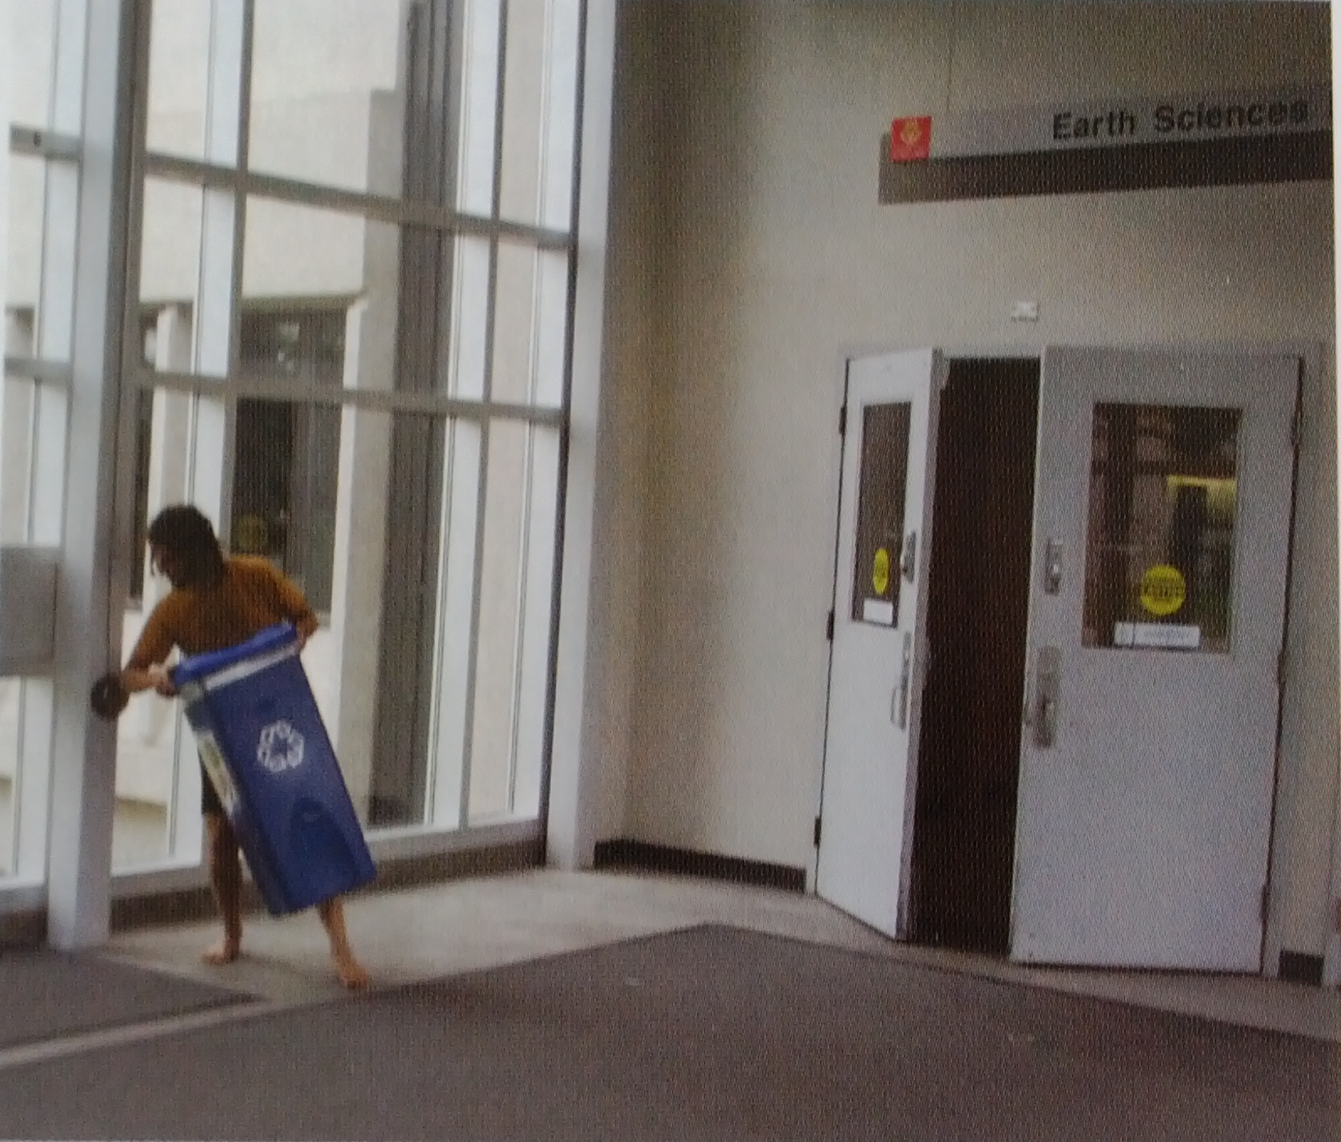
Things that irritate

Slide 17

Things that seem really good
Real life things too!
What are the principles that drive this design?

Slide 18

Sample the inspiring
How has the world solved these problems?
How have others solved these problems?
What is nice to look at?

Slide 19
Creativity as a Designer
Explain ideas to others
Take an outsider’s perspective on something you know well
  Helps to simplify your language/understanding
Take an insider’s perspective you don’t know well
  Helps you to identify your assumptions

Slide 20
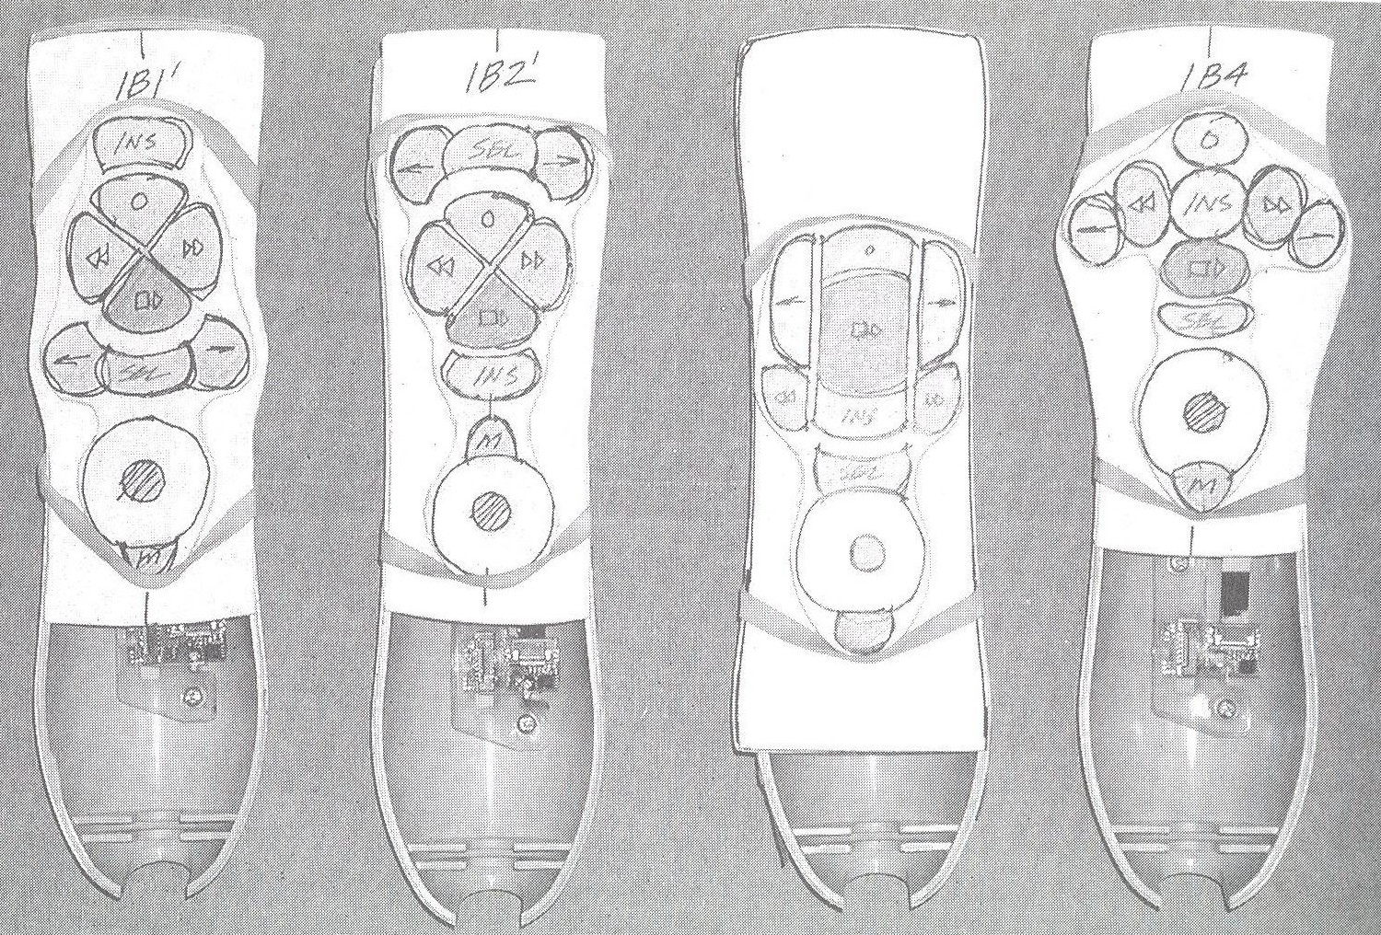
Sketch constantly
Generate ideas constantly (keep a sketchbook)
Sketch vague ideas to help think more clearly
From Carloyn Snyder’s Book: Paper Prototyping (2003) Morgan Kaufmann, p350

Slide 21

Creativity as a Designer
Take risks (early on, it doesn’t hurt!)
Notes:
http://tobiasmastgrave.wordpress.com/tag/throw-off-cliff/

Slide 22

Kids and creativity
Kids are creative because they don’t know the rules, so they feel free to break them
Kids don’t know the consequences, so they take risks

Slide 23
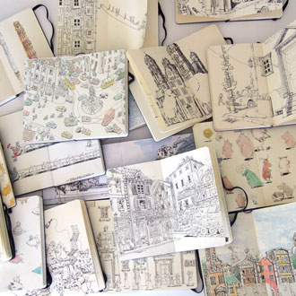
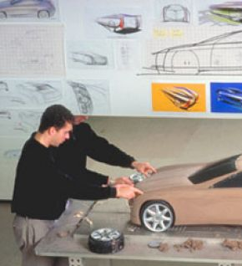
What to do with your collection
Keep a sketchbook
Wallpaper it
Notes:
http://luciano63.hubpages.com/hub/Car-designers-at-work-how-is-it

Slide 24
Brainstorming
Works best in groups
Can be useful and fun
Keep the results of user research handy during the process (e.g. scenarios, lists of design requirements, etc.)

Slide 25
Brainstorming for Design
be visual
defer judgment
encourage wild ideas
build on others
go for quantity
one conversation at a time
stay focused on topic
Notes:
Brainstorming Dos
1. Sharpen the focus
2. Write playful rules
3. Number your ideas
4. Build and jump
5. Make the space remember
6. Stretch your mental muscles
7. Get physical
Brainstorming Don'ts
1. Let the boss speak first
2. Give everybody a turn
3. Ask the experts only
4. Go off-site
5. No silly stuff
6. Write down everything

Slide 26
Summary
Find things that x you
  where x = { inspire, interest, irritate, amuse }
Find things that you y
  where y = { can improve, relate to }
Break the rules, and think freely

Slide 27
What you now know
The role of creativity in design
Techniques to inspire creativity—point: apply these lessons as you engage with your project work.

Slide 28
Next Few Tutorials…
Last week: interviewing
This week: sketching
Next week: storyboarding/prototyping

Slide 29
P1: User Research
Identify your project idea
Identify stakeholders and users
Conduct three user research methods
Define design requirements

