Slide 1
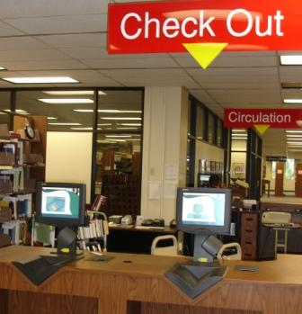
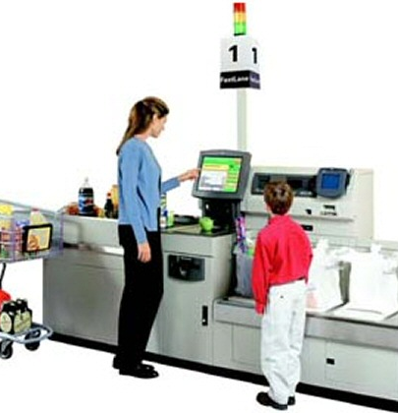
Why did they install these?
Notes:
Ostensibly, solving same problem
Actually, solving different ones
Library – frees librarian to do what they’ve been trained to do
Self-checkout – cheaper than having an actual person; makes you feel like you’re going faster
→ Trick is that you’re not

Slide 2
Design Methods: ASK
CPSC 481: HCI I
Fall 2012
Anthony Tang, with acknowledgements to Julie Kientz, Saul Greenberg, Ehud Sharlin, Jake Wobbrock, Dave Hendry, Andy Ko, Jennifer Turns, & Mark Zachry

Slide 3
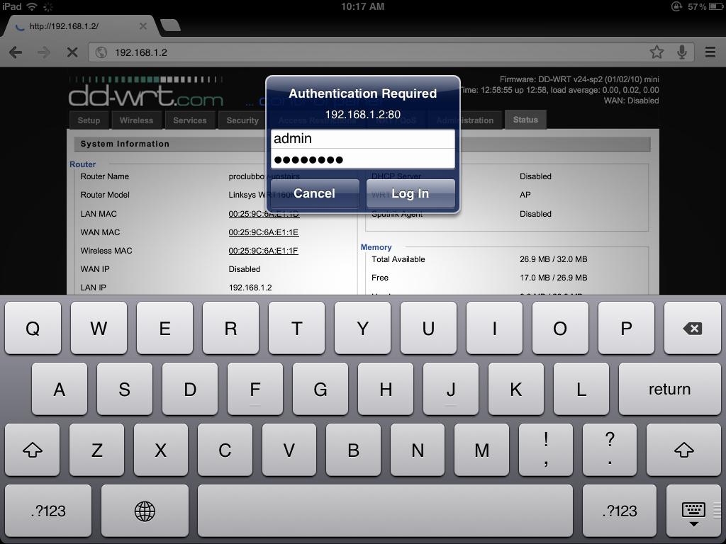
Notes:
I watched someone try to log into his router once from his ipad
He kept staring at this and said, “This is taking longer than usual”
Why?
Turns out that pressing “RETURN” just toggles between the two fields
Slip or mistake?
Whose fault?

Slide 4
When LOOKing is not enough…
LOOKing gives you great insight into the state of the world
But it doesn’t tell you why people are acting the way they do, or what their goals, needs, or feelings are

Slide 5
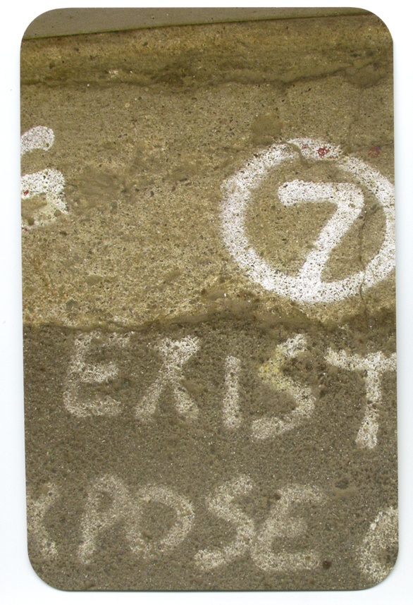
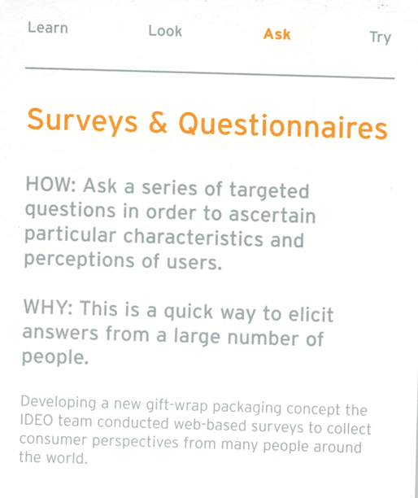

Slide 6
Questionnaires
Be clear on the goal
Open and closed questions
  What do you think about X?
  Which of the following are things you might use?
    a, b, c, d, e
Rating scales
  I think X is a good idea
    1 strongly disagree to 5 strongly agree
Be sure to pilot your questionnaire

Slide 7
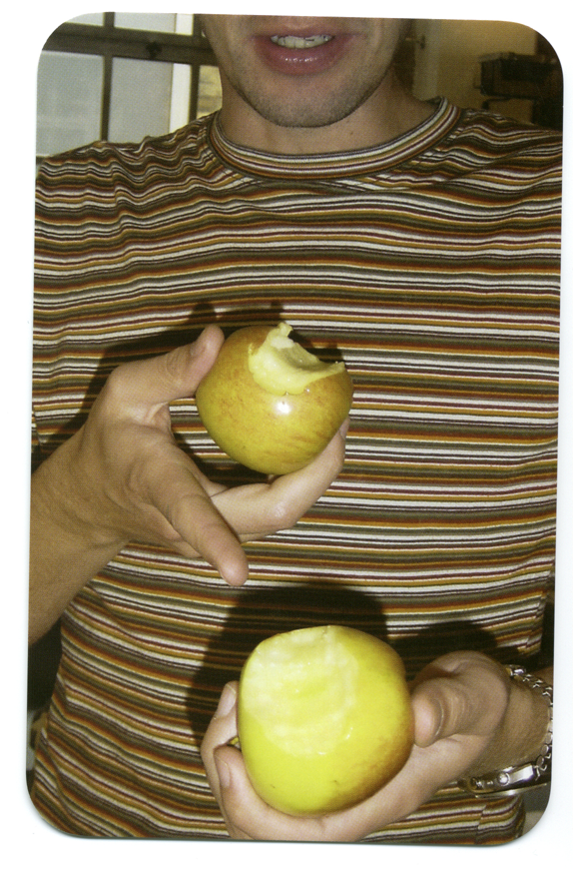
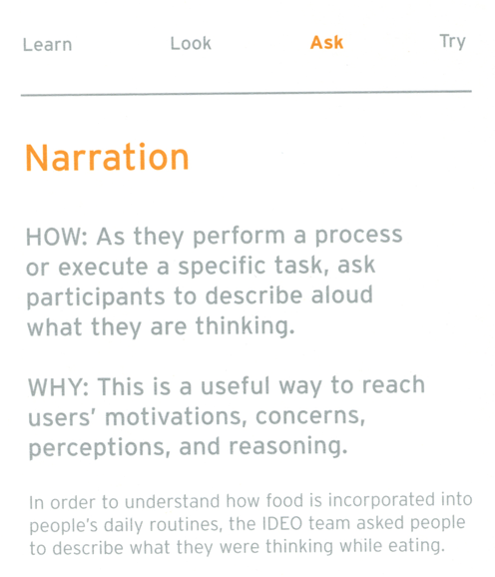

Slide 8
Volunteer
Requirements
  Basic computing skills
  Internet skills

Slide 9
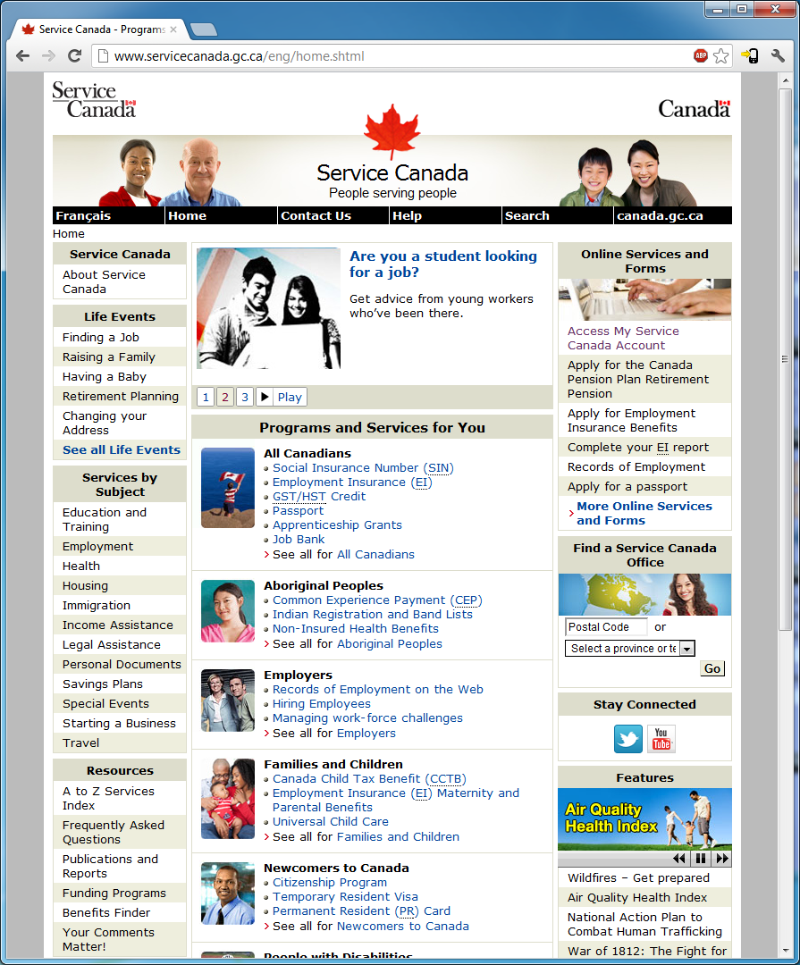
Notes:
http://www.servicecanada.gc.ca/eng/home.shtml
How do I demonstrate residency for the purpose of Old Age Security?
What percentage of my salary is covered by employment insurance when I go on maternity leave?
Old Age Security… what do you do here?
What are you looking for?
What words are you looking at?
“I want to do…”
“I’m looking at the UI, and I think it does…”
‘Hmm, that’s not what I expected; I thought it was going to…”
“That took longer than I expected.”
In this case, I’ve given you a specific thing someone is looking for. In real life, they’re often doing multi-step things, and what you want to do is understand what they think those intermediary steps are.

Slide 10

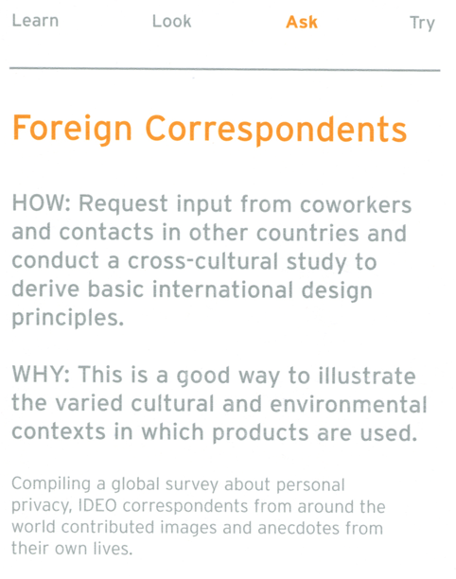
Notes:
Essentially, an outside view of things, of culture, of the way in which we do things , our routines, and our patterns, our values

Slide 11
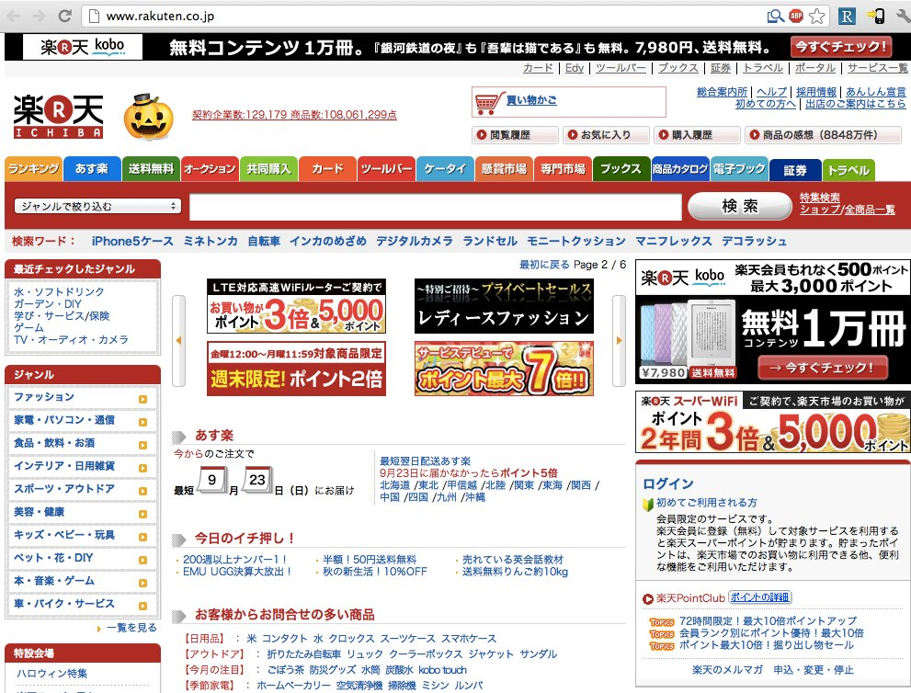
Notes:
Rakuten.co.jp
This is a shopping website
Note the use of the colours, the icons, etc.
The business is
http://www.quora.com/Why-are-popular-Japanese-websites-visually-busy
Conclusion vs. story

Slide 12

Online shopping experiences

Slide 13
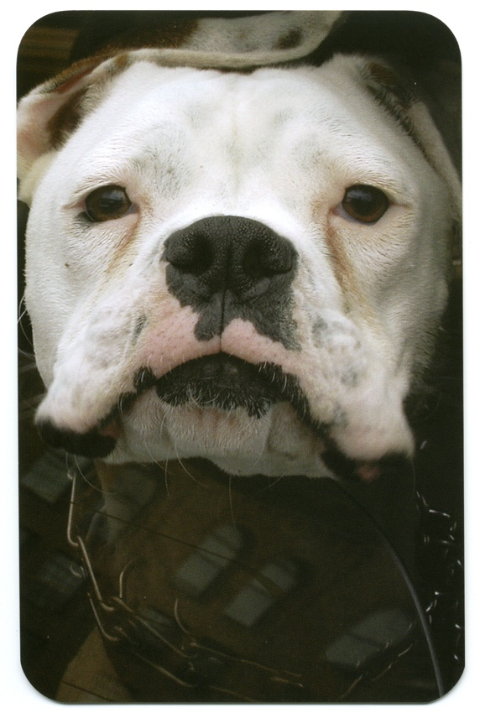
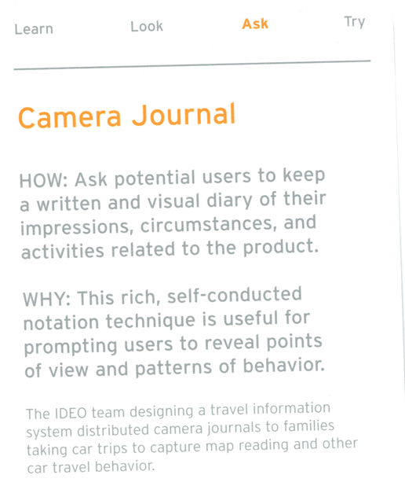
Notes:
You can’t always be there
Rich understanding of context and environment
Difficult to observe situations

Slide 14
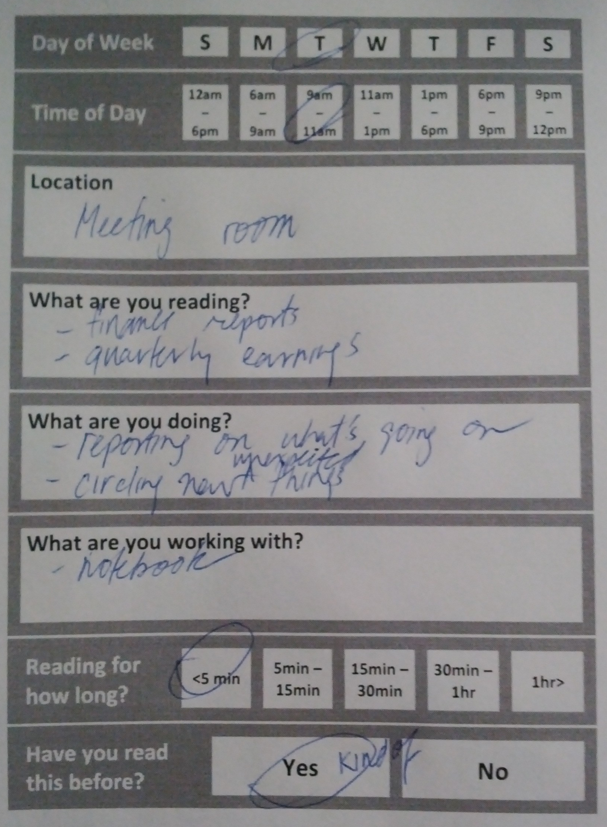
Diary Studies
Are Kindles/Nooks good for work-related reading?
Paper logs – fit in a pocket
  Log reading activity
  What else is going on
Findings
  People write while reading
  Searching/finding is frequent
  Annotations are common
  Single displays may be inadequate
Notes:
Annette Adler, Anuj Gujar, Beverly L. Harrison, Kenton O'Hara, Abigail Sellen: A Diary Study of Work-Related Reading: Design Implications for Digital Reading Devices. CHI 1998: 241-248
http://www.slideshare.net/qt1p/mobile-video-user-study-hp-labs
http://research.microsoft.com/en-us/um/people/horvitz/taskdiary.pdf
http://www.slideshare.net/leemcivor/diary-studies-for-ux
http://www.slideshare.net/UPABoston/diary-studies-in-hci-psychology

Slide 15
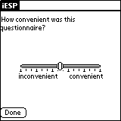
Experience Sampling
Have users carry around a
device that has them answer
questions at given intervals
  Cell phone, PDA, Pager
Example: page user once every 3 hours and ask them to fill out a short survey on their current activity and rate sleepiness level on a scale from 1 to 7

Slide 16
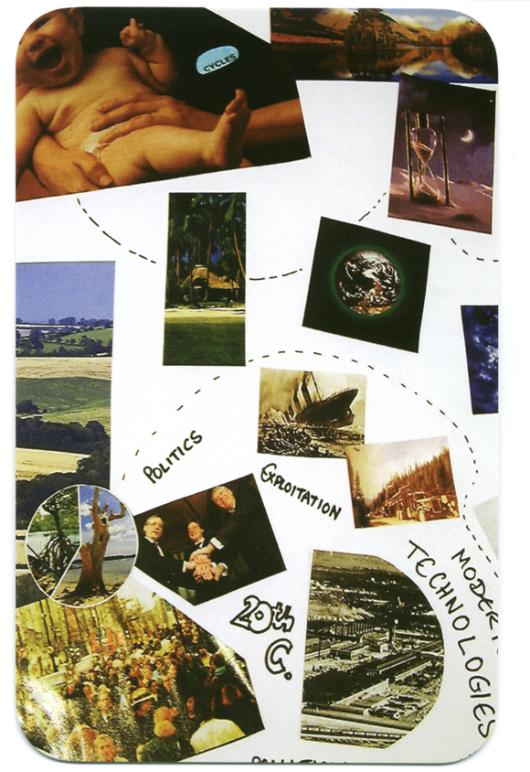
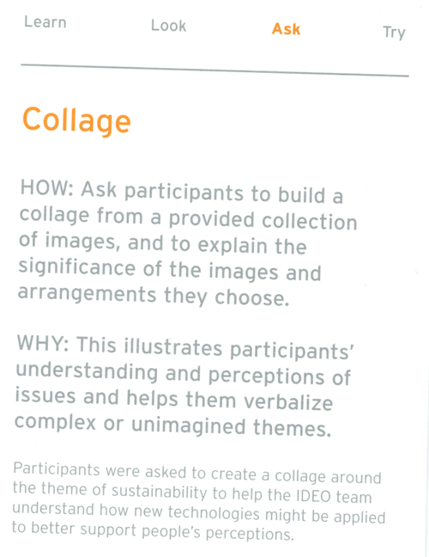
Notes:
Mental picture of how things are organized in their heads

Slide 17
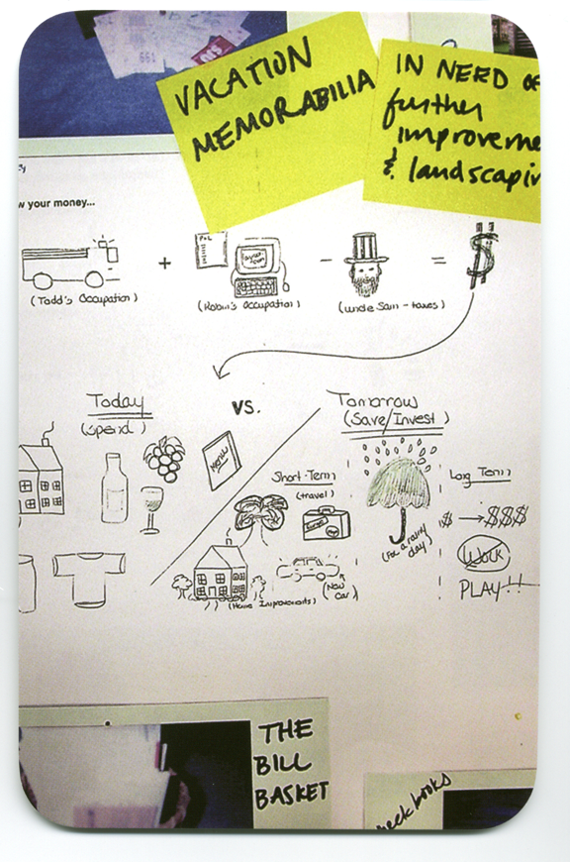
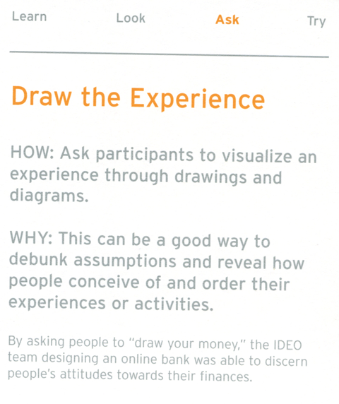

Slide 18
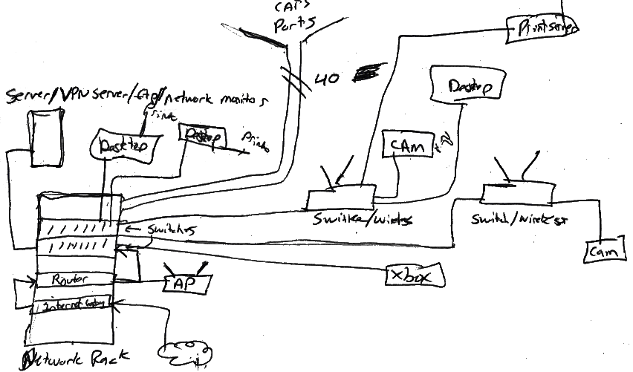
Poole, et al., DIS 2008

Slide 19
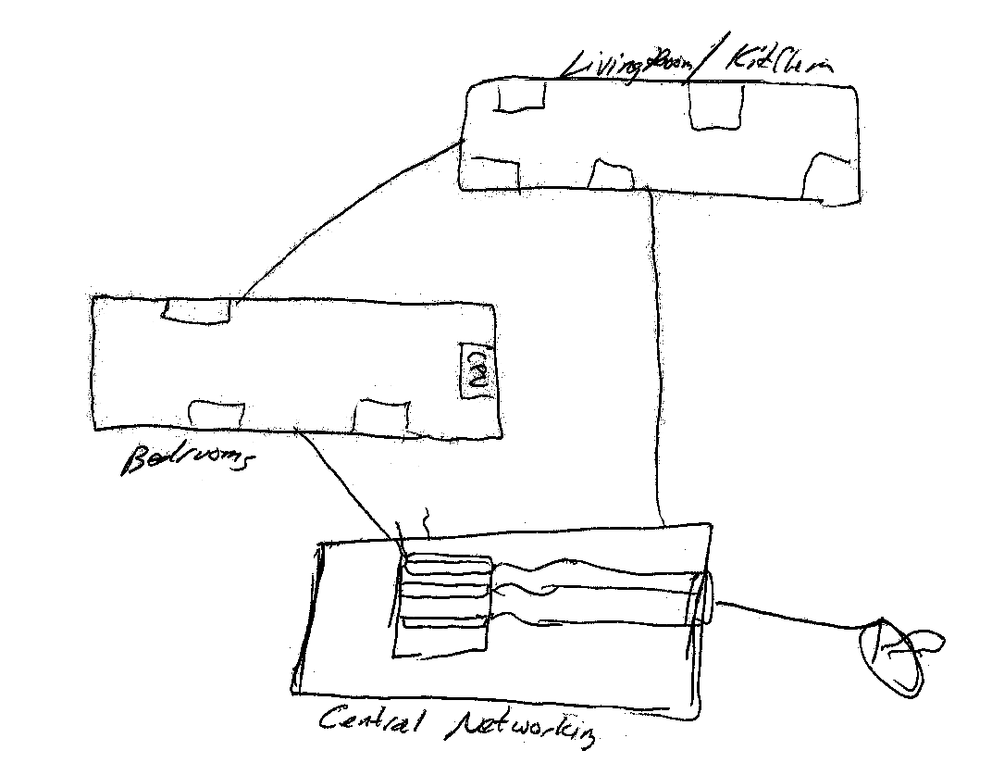
Poole, et al., DIS 2008

Slide 20
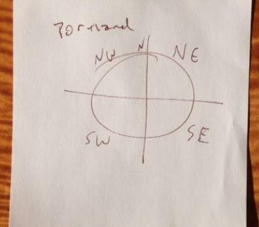
Archie Archambault: “Maps that help you navigate better than Google Maps”
Notes:
http://www.slate.com/blogs/the_eye/2013/12/02/circular_city_maps_archie_archambault_designs_minimalist_city_maps_printed.html – next four slides have images from this page

Slide 21
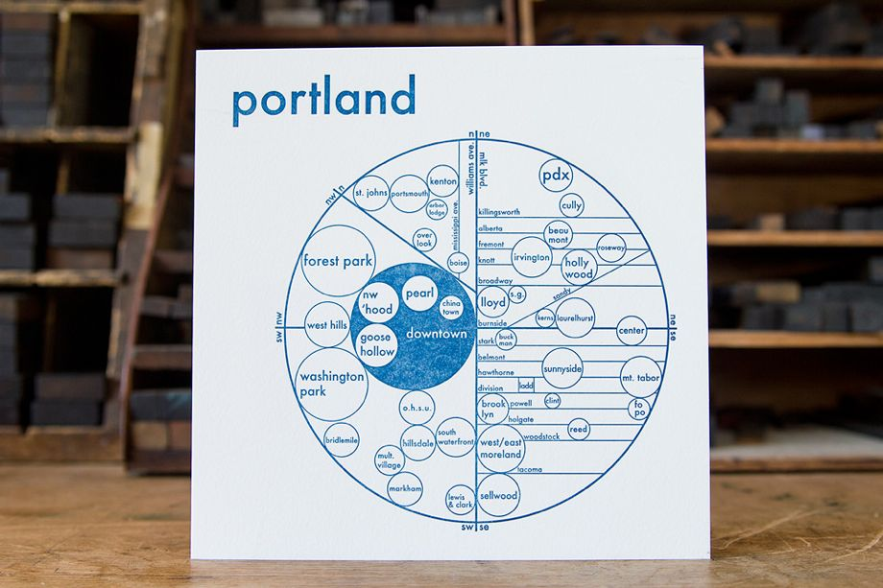

Slide 22
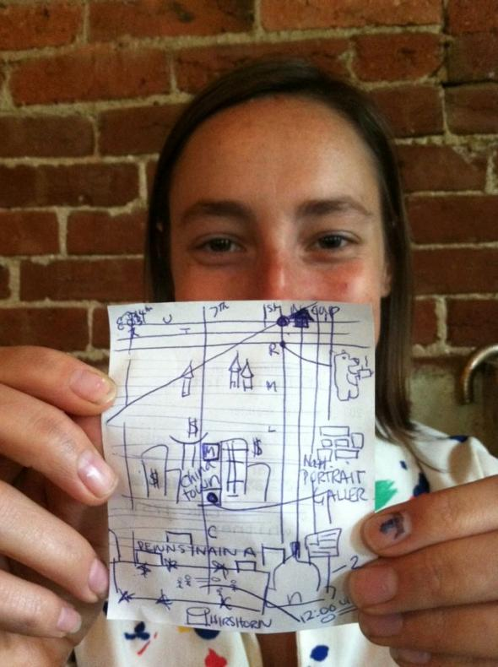

Slide 23
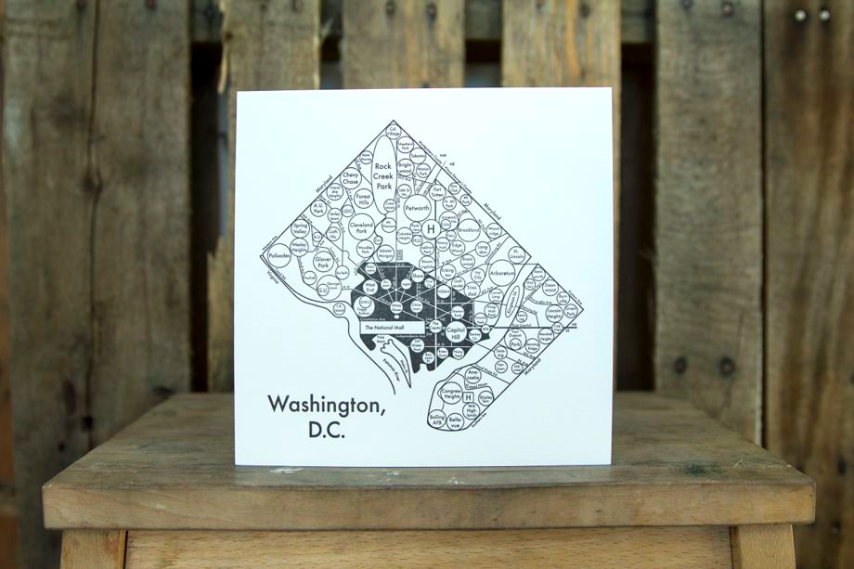

Slide 24
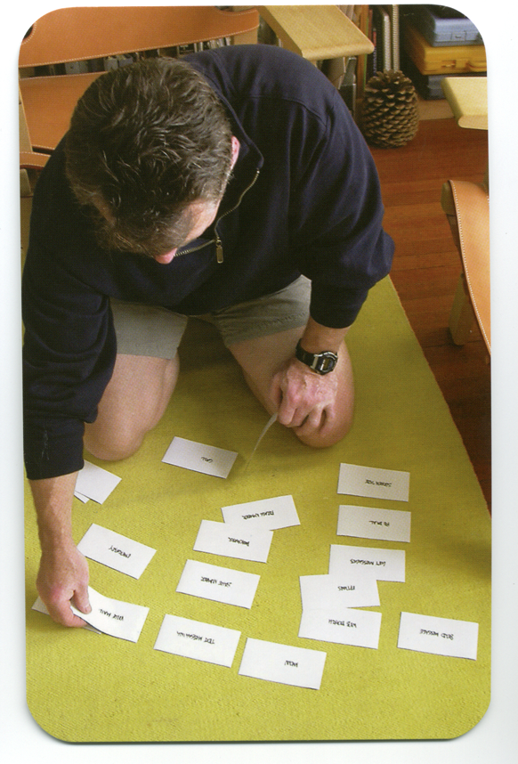
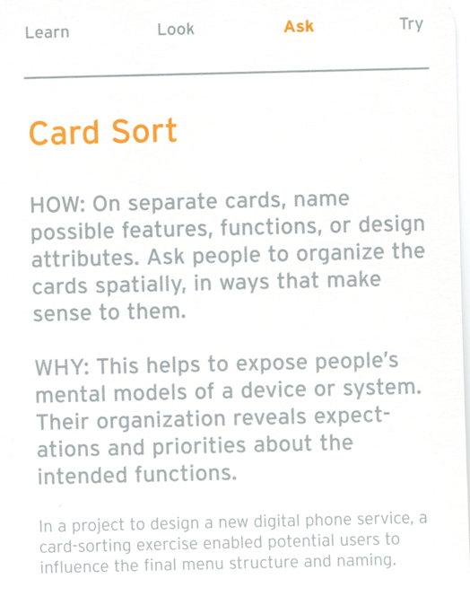

Slide 25
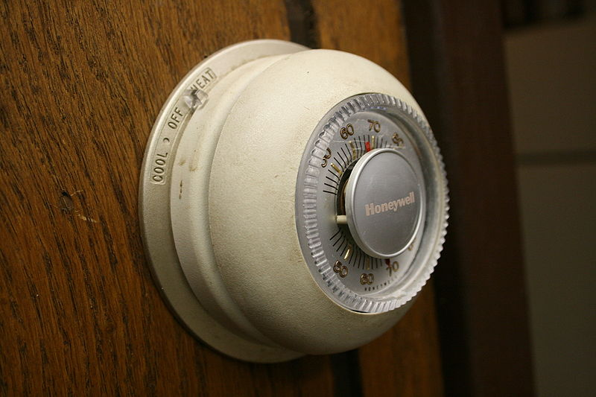
Some Concepts…
mental model
  thought process or understanding of how something works

Slide 26
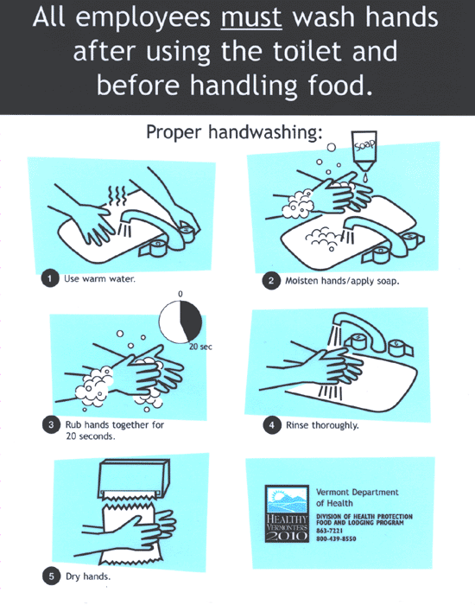
Some Concepts…
work processes
  formal articulation of how to get something done
work practices
  informal ways in which people get something done in the context

Slide 27
Contextual Inquiry
Combining “looking” and “asking” by immersing oneself into a particular context/culture: understand mental models and work practices
“The core premise of Contextual Inquiry is very simple: go where the customer works, observe the customer as he or she works, and talk to the customer about the work. Do that, and you can’t help but gain a better understanding of your customer.”

Slide 28
Contextual Inquiry: Principles
Context: in the setting of the participant
Relationship: you are the apprentice, participant is the expert
Interpretation: observed facts must be considered for design implications
Focus: lots of themes will emerge, but this helps to orient the team

Slide 29
Expert/Apprentice
You are the noob
What does this mean?
  Be a keen observer
  Ask questions
  Be eager to learn
  Admire the master
  Aspire to see the world as the expert does

Slide 30
Interviewing
Summaries vs. ongoing experience
  “I got to work, checked my email and had a cup of coffee” [abstract summary]
  “I got to work, looked over my email, answered messages from my boss, decided to have some coffee, walked to the coffee machine, found there was no coffee, so I made coffee…” [concrete detail]

Slide 31
Summary
Broad assumption in user-centered design: as designers, we know very little
ASK methods complement LOOK methods to help us discover what is happening and why
Survey & questionnaire; interview; narration; camera journal; experience sampling; diary studies; collage; draw the experience; card sort
Concepts: mental model; work processes; work practices
Contextual Inquiry combines these ideas into one technique

Slide 32
Expectations
Assignments
  You may talk to other people, you may look stuff up on the web; however CITE (indicate) who you talked to, and where you found material on the web (or in a paper/book)
Projects
  You are to work with your teammates, and you may look stuff up on the web; however CITE (indicate) who you talked to (outside of the group), and where you found the material on the web (or in a paper/book)
Forbidden
  You are NOT allowed to copy and paste
  If you use an idea that you found online, then you must cite it—that is, indicate that it is from an online source as a footnote, and include a link to it (still no copy and paste)

Slide 33
Randy Pausch’s Tips for Working in a Group
Meet people properly.
Find things you have in common.
Make meeting conditions good.
Let everyone talk.
Check your egos at the door.
Praise each other.
Put it in writing. Remember that “politics is when you have more than 2 people” – with that in mind, always CC (carbon copy) any piece of email within the group, or to me, to all members of the group. This rule should never be violated; don’t try to guess what your group mates might or might not want to hear about.
Be open and honest.
Avoid conflict at all costs.
Phrase alternatives as questions.
http://www.cs.cmu.edu/~pausch/Randy/tipoForGroups.html
Notes:
It all starts with the introduction. Then, exchange contact information, and make sure you know how to pronounce everyone’s names. Exchange phone #s, and find out what hours are acceptable to call during.
You can almost always find something in common with another person, and starting from that baseline, it’s much easier to then address issues where you have differences. This is why cities like professional sports teams, which are socially galvanizing forces that cut across boundaries of race and wealth. If nothing else, you probably have in common things like the weather.
Have a large surface to write on, make sure the room is quiet and warm enough, and that there aren’t lots of distractions. Make sure no one is hungry, cold, or tired. Meet over a meal if you can; food softens a meeting. That’s why they “do lunch” in Hollywood.
Even if you think what they’re saying is stupid. Cutting someone off is rude, and not worth whatever small time gain you might make. Don’t finish someone’s sentences for him or her; they can do it for themselves. And remember: talking louder or faster doesn’t make your idea any better.
When you discuss ideas, immediately label them and write them down. The labels should be descriptive of the idea, not the originator: “the troll bridge story,” not “Jane’s story.”
Find something nice to say, even if it’s a stretch. Even the worst of ideas has a silver lining inside it, if you just look hard enough. Focus on the good, praise it, and then raise any objections or concerns you have about the rest of it.
Talk with your group members if there’s a problem, and talk with me if you think you need help. The whole point of this course is that it’s tough to work across cultures. If we all go into it knowing that’s an issue, we should be comfortable discussing problems when they arise -- after all, that’s what this course is really about. Be forgiving when people make mistakes, but don’t be afraid to raise the issues when they come up,
When stress occurs and tempers flare, take a short break. Clear your heads, apologize, and take another stab at it. Apologize for upsetting your peers, even if you think someone else was primarily at fault; the goal is to work together, not start a legal battle over whose transgressions were worse. It takes two to have an argument, so be the peacemaker.
Instead of “I think we should do A, not B,” try “What if we did A, instead of B?” That allows people to offer comments, rather than defend one choice.

