Slide 1
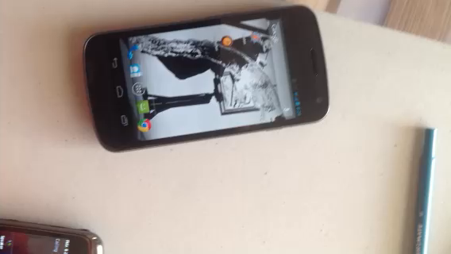

Slide 2
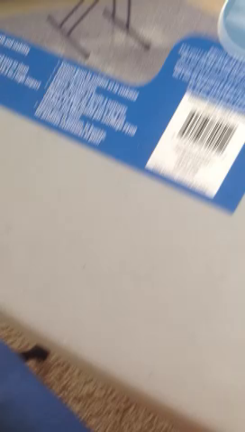

Slide 3
Thumb-meat example on phone
Main message: you don’t know who your users are, and often, you need to test your interface in the field to see if it’s going to work

Slide 4
Investigation…
CPSC 481: HCI I
Fall 2012
Anthony Tang, with acknowledgements to Julie Kientz, Saul Greenberg, Ehud Sharlin, Jake Wobbrock, Dave Hendry, Andy Ko, Jennifer Turns, & Mark Zachry

Slide 5
Think about my “thumb-meat” example…
What does it tell you?
Breakdowns
Opportunities for a new design
Workarounds
Mismatches between what users say and do
This is what observing people can help you discover

Slide 6
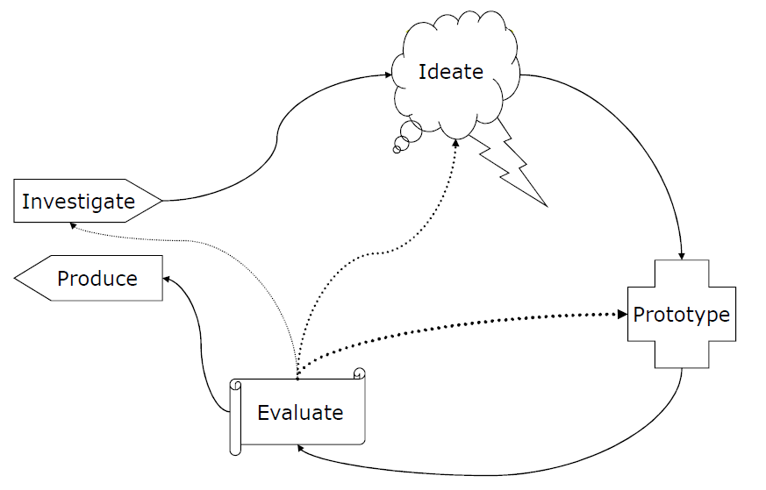
Notes:
Next few lectures, focus on the “investigate” thing

Slide 7
Investigate Phase Goals
Understand the state of the world, the state of our users, and what the problem is.
How can we go about doing this?

Slide 8
Imagine…
You are trying to design a better mop.
What do we need to find out?
How are we going to do that?
Notes:
How do people use mops?
What do they use them to clean up?
What is the purpose of mops?
When do they decide not to use them?
How big does the mess have to be before they use it?
What else do they use it with?
How often do they use them?
How do they use them?

Slide 9
What people say…
Can we rely on what people say about what they want in a new design?
Only kind of: people are really only good at framing their needs within the language of their current designs
Henry Ford: “If I had asked my customers what they wanted, they would have said a faster horse.”
Often, people can’t see past their immediate problems to the possibilities

Slide 10
What people say…
How many hours did you sleep last night?
How many hours did you sleep last Monday night?
People have a bad memory

Slide 11
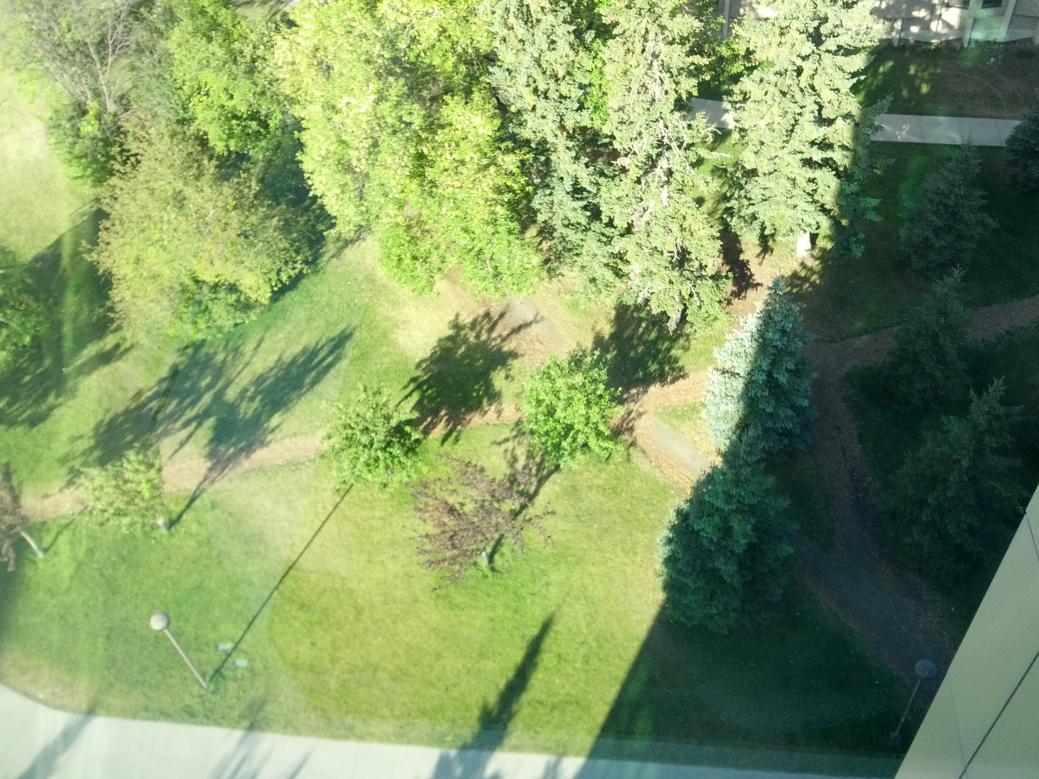
What people say…
Where do people need to walk around campus?

Slide 12
What people say…
12
Sometimes, people forget workarounds that they have already established to solve problems

Slide 13
What people say…
Where should we put the hand sanitizer?
On the way out the door, after we turn off the computer, after we turn off the printer, turn off the lights, etc., etc.

Slide 14
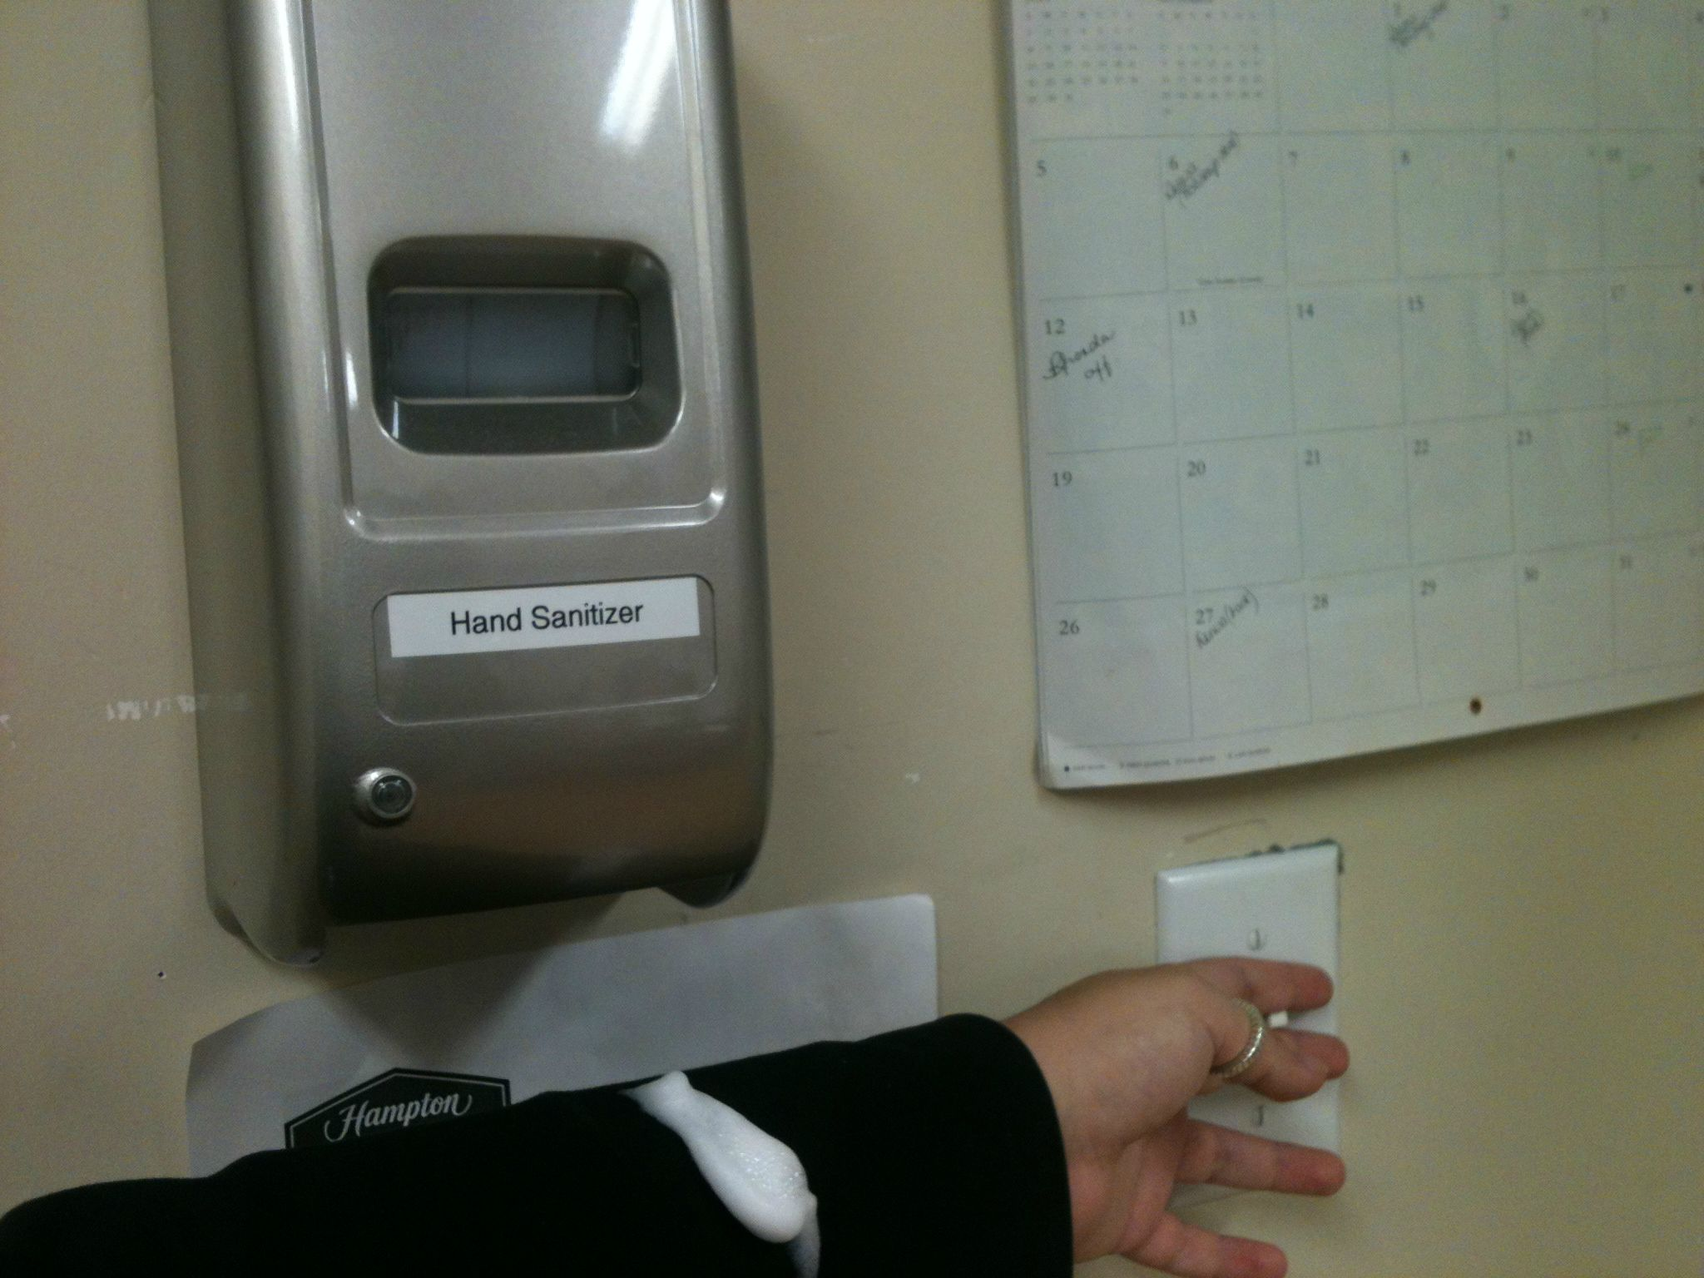
What people say…
People can be bad at predicting what they’d prefer if it is only hypothetical.

Slide 15
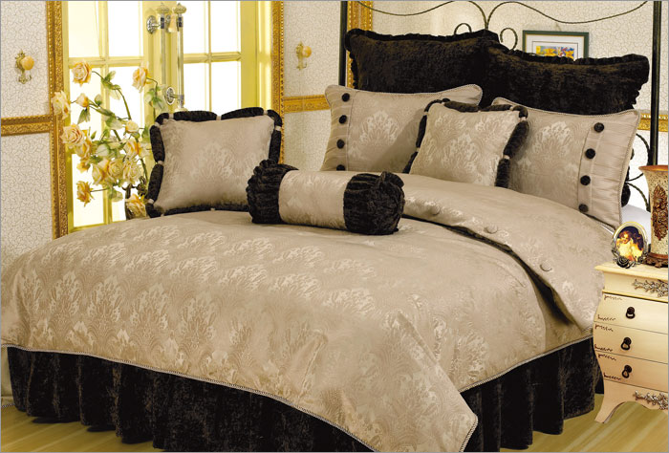
What people say…
Mismatches between what they say and do = GOLD
Notes:
Story about bloomingdales research
Trying to up the sales of bed sheets
Brought in focus groups, lined up a bunch of bed sheets: pick which ones you like the best
Only sold those for a while, but sales didn’t pick up
Brought them back in, and asked the same thing. At the end, they said to people, “So, we don’t need these any more, feel free to take one home with you.” They picked a different one.
Why?
Task asked: which do you like; task didn’t ask, “which would you use at home.”

Slide 16
Wait, are people completely useless?
People are really good at telling us a few things:
What they are doing right now.
How they are feeling right now.
What their goal is right now.

Slide 17
Combine Interview with Observation
Watch people in their own environment
Watch people do everyday tasks
Opportunities for new designs arise from:
Workarounds
Breakdowns
Unexpected uses of existing tools

Slide 18
Two Messages
Using a combination of what they are good at telling us, and observing them can tell us a lot → mismatches between what they say and what they do often lead keys to new designs
Your assumptions are likely to be wrong. To discover more, assume that your assumptions are always wrong.

Slide 19
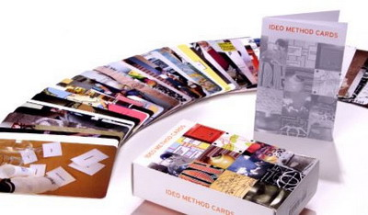
IDEO Method Cards: Course Site > Readings
Available from William Stout publishers ($49)

Slide 20
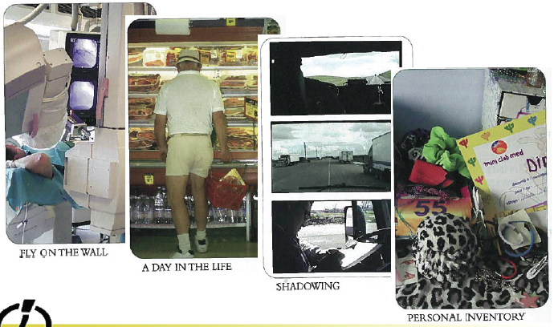
LOOK at what people really do

Slide 21
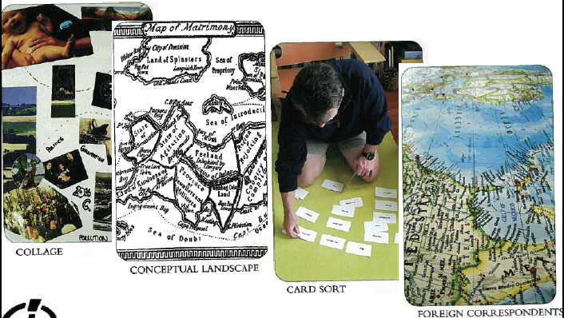
ASK users for help

Slide 22
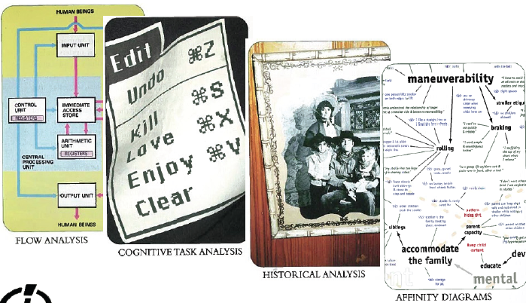
LEARN from the facts you gather

Slide 23
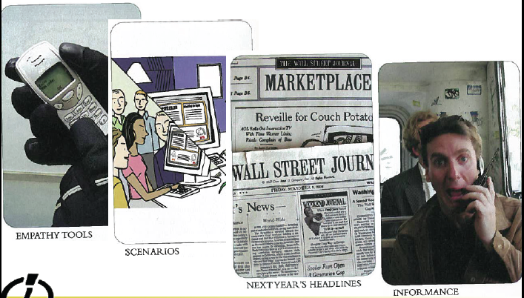
TRY it yourself

Slide 24
Assume you are wrong.

