Slide 1


Slide 2
Why is design hard?
People make errors
slips: unintended action [motor action]
mistakes: incorrect action [cognitive goal]
Key: mistakes typically occur when a person misunderstands something in the system; a slip you could imagine to be a lapse in attention, or due to a change in typical circumstance
The distinction matters because as designers, we want to help users avoid mistakes. With careful design, we can help avoid slips, too.
Notes:
http://www.measuringusability.com/blog/errors-ux.php

Slide 3

Slip vs. Mistake
Imagine you are using a mapping application wanted to find something, and clicked this icon.
Let’s pretend that in the application, the icon meant to magnify.
Is this a slip or a mistake?
Notes:
http://en.wikipedia.org/wiki/File:Magnifying_glass_Icon.png

Slide 5
Is the error you’d make a slip or a mistake?
How would you solve the problem?

Slide 6
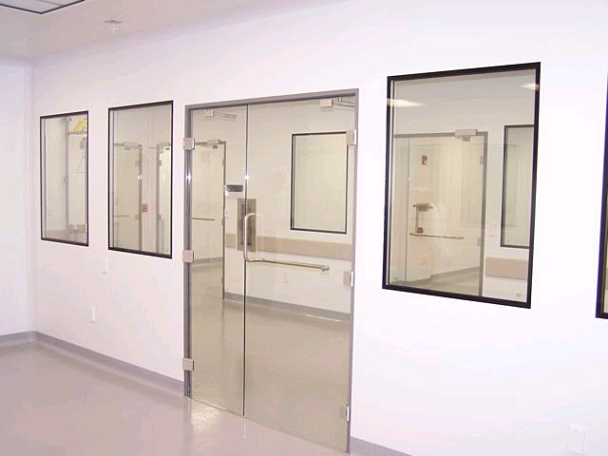

Slide 7
Slip or mistake?
Exercise: pull out a piece of paper… classify these
Mistyping an email address
Clicking on a heading that isn’t clickable
Clicking “Save” instead of “Open”
Sending an email without remembering to add the attachment
Typing both first and last name in the first name field
Notes:
http://www.measuringusability.com/blog/errors-ux.php
Slip
Mistake
Slip
Slip
Mistake

Slide 8
Core design skills
To synthesize a solution from all of the relevant constraints, understanding everything that will make a difference to the result
To frame, or reframe, the problem and objective
To create and envision alternatives.
To select from those alternatives, knowing intuitively how to choose the best approach.
To visualize and prototype the intended solution

Slide 9
“The user is not like me”
Familiarity with the interface problems being solved
Confidence
Designer’s setting vs. user’s setting
Designers have different skills (perceptual, cognitive, or domain)

Slide 10
A1 Posted: Thinking about design
http://bit.do/CPSC481 -> Assignments -> A1
Due: Jan 22, beginning of class
Print out grading rubric, and use it as your cover sheet
Roughly 3~4 pages

Slide 11
Designing for people
CPSC 481: HCI I
Fall 2012
Anthony Tang, with acknowledgements to Julie Kientz, Saul Greenberg, Ehud Sharlin, Jake Wobbrock, Dave Hendry, Andy Ko, Jennifer Turns, & Mark Zachry

Slide 12
Agenda
User is not like me → So… what should we do?
User-centred design process
Rationale
Major components: investigate, ideate, prototype, evaluate, produce
Role of iteration

Slide 13
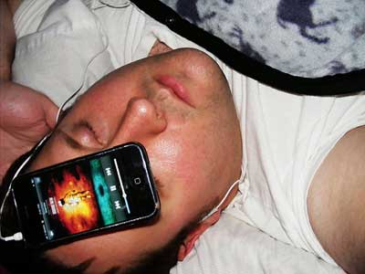
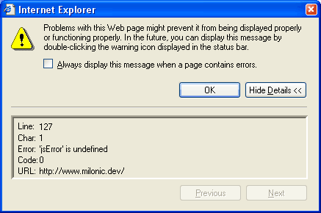
Last time… “User is not like me”
Perceptual capacity
Motor capacity
Cognitive capacity
Domain knowledge
Notes:
http://www.businessinsider.com/harvard-business-school-professor-heres-how-to-stop-sleeping-with-your-smartphone-2012-6

Slide 14
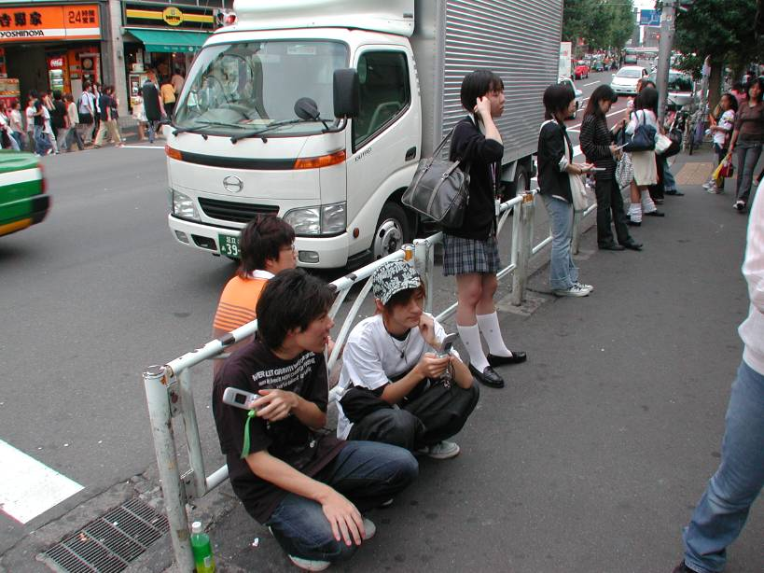
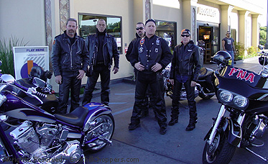
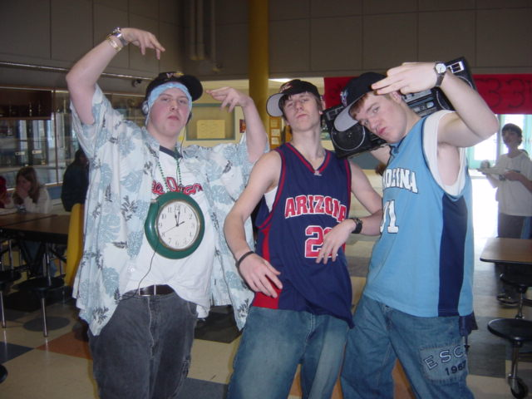
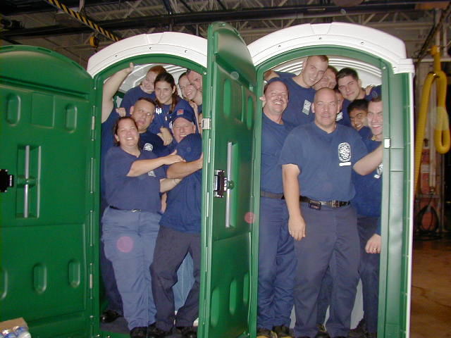

“Know your user!”
Notes:
What do we do when we aren't the ones using it?
o we find out about the people that will be using it!!
o user-centred design (generally)

Slide 15
“Know your user!”
You are not (usually) your user.
Notes:
What do we do when we aren't the ones using it?
o we find out about the people that will be using it!!
o user-centred design (generally)

Slide 16
User Centered Design Process
An iterative design process that makes use of knowledge through investigation of a domain of work/play to create ideas and prototypes.
Prototypes are used for evaluation, and to further stimulate investigation, and idea and prototype generation.
These prototypes and evaluations are used to aid in production.

Slide 17
Why a process?
Get started in a proven tack
Prevents “designer’s block”
Directs us toward final product
Helps us stay on schedule and on cost
Helps us to communicate with others
More reliable than intuition
Forces us to iterate
Helps to keep the users first

Slide 18
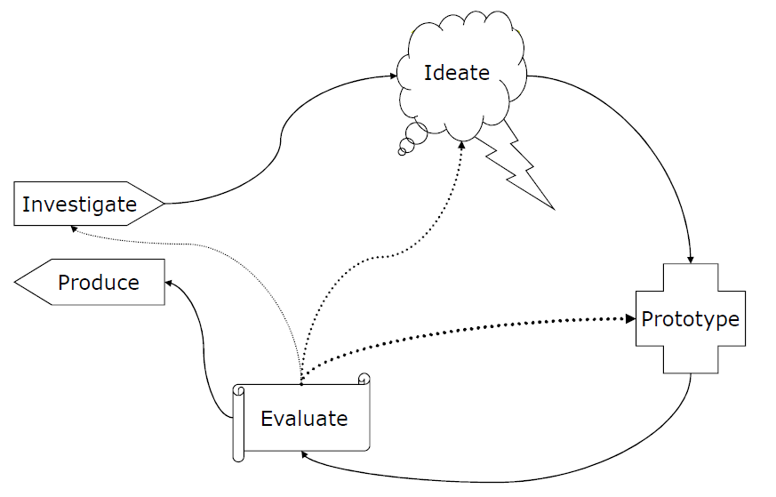
User Centered Design Process

Slide 19
Stage Goals
Generate lots of ideas
Grasp issues and
potential solutions
Learn about stakeholders
Discover goals and needs
How is it done now?
What is wanted?
What else has been tried?
Build final product
Ramp up marketing,
support, and
maintenance
Produce something tangible
Identify challenges
Uncover subtleties
Discover problems
Assess progress
Determine next steps

Slide 20
Investigate

Slide 21
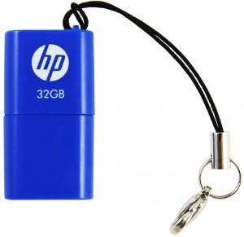
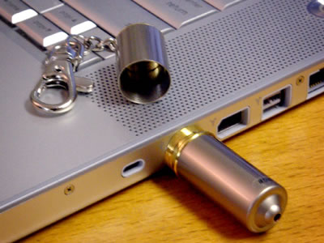
Why investigate?
You cannot design apart from the world where your users and design will live
Notes:
Real world is different than the world that you imagine
The only time I ever saw the cap on my USB key
On the right, better…
Is it the best design?

Slide 22
Investigation Questions
Identify users
Identify stakeholders
What are the requirements?
How do they do it now?
How long does it take?
What do they want?
What do they need?
What have they already tried?
Is there another solution?

Slide 23
Investigation Methods
Interviews
Focus groups
User surveys
…
[More on this on Wednesday]

Slide 24
Ideate

Slide 25
Ideation -> idea generation
“To get good ideas…
Get lots of ideas”

Slide 26
Ideation
One of the worst things: go with the first one you have
You can always come back to it later
Volume matters the most
Increase chance of success by considering a huge volume of ideas in a systematic way

Slide 27
Ideation
Structured brainstorming
Sketching
Affinity diagramming
Card sorting
Personas
Role-playing, play-acting
[More on Friday]

Slide 28
Prototype

Slide 29
Why prototype?
It’s cheap and fast
Easier for users to react to concrete things rather than abstract concepts
Prototyping brings subtleties and nuances to light
Working against some technical constraints is good

Slide 30
Prototyping Techniques
Paper prototypes
Screenshots
Flip books
Video mock-ups
Hyperlink prototypes
Functional prototypes
[More next week]

Slide 31
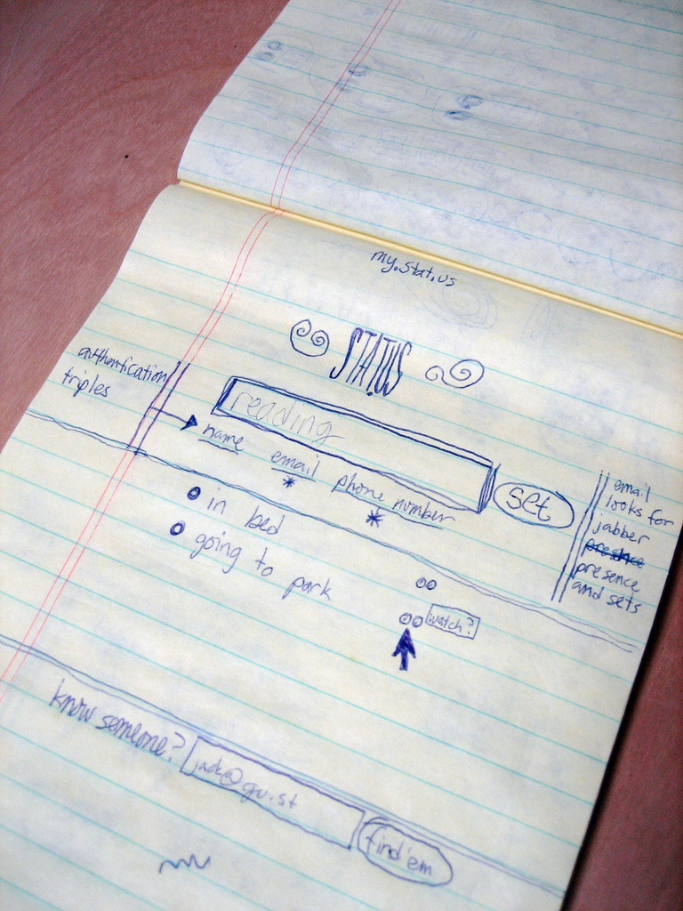
Notes:
http://www.flickr.com/photos/95728450@N00/182613360

Slide 32
Prototyping Fundamentals
Build it fast
Concentrate on unknowns
Don’t be attached to them
Build multiple concurrently
easier to compare pros/cons

Slide 33
Evaluate

Slide 34
Why evaluation?
Automated processes can find bugs, but not usability issues
Evaluation gives you a way to move forward
What needs to be fixed, added, removed?
Answers to two questions:
Did we build the right thing?
Did we build the thing right?

Slide 35
Evaluation Methods
Usability testing
Laboratory experiments
Real-world deployments
Heuristic evaluation
[More on this in the coming weeks]

Slide 36
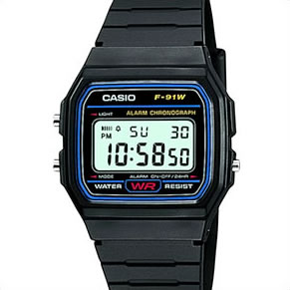
Notes:
How would you evaluate whether this watch worked well?
What are the primary tasks?
What are secondary tasks?

Slide 37
Evaluation Drives Iteration
Problem: usefulness/appropriateness
Return to investigation phase
Problem: users don’t understand
Return to ideation phase
Problem: user performance
Return to prototyping phase

Slide 38
Produce

Slide 39
Production
These are steps required to go from functional prototype to release candidate
Software architecture
Programming, building
Manufacturing
Help systems
Manuals
Training
Customer support
Marketing
Branding
Distribution

Slide 40
User Centered Design: Conclusions
Design starts with understanding your user, and should keep users’ interests central
Design is iterative -> trade-offs are difficult to see in advance
Designs are never “perfect” -> usually, they can be improved

Slide 41
You now know…
User is not like me → So… what should we do?
User-centred design process
Rationale
Major components: investigate, ideate, prototype, evaluate, produce
Role of iteration

Slide 42
Next time…
Strategies for investigating

