Slide 1
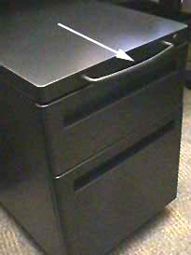
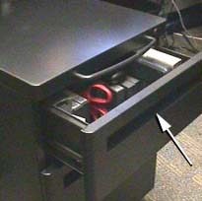
Open the top drawer…
Move cabinet
Photograph courtesy of www.baddesigns.com

Slide 2
P3 – High Fidelity Prototypes + Heuristic Evaluation
Learning Objectives
Understand how to use C#/Visual Studio/Blend to develop high-fidelity prototypes
Conducted a heuristic evaluation
Understand the challenges of live demos
Experience the challenges of probing questions
Activities
A hi-fidelity vertical prototype of “must have” requirements from P1
Heuristic evaluation
Deliverables
In-tutorial live demonstration (week of Mar 24)
Portfolio write-up (due Mar 24)

Slide 3
P3 – High Fidelity Prototypes + Heuristic Evaluation
Hi-Fidelity Vertical Prototypes
Addresses “must have” functionality as identified from P1 & addresses the walkthrough you constructed in P2
Illustrates the interaction flow through the system (i.e. a customer could try the system and understand how it would work)
Core interaction functionality should “work” – you should be able to conduct a usability evaluation on the prototype
Demonstration
You have 10 minutes to demonstrate that the “must have” functionality describe in your P1 is addressed. Think carefully about how to do this.
You need to answer questions from me, the TA and your classmates for 5 minutes (we are your customers).
**Zip your code up and post onto Piazza by EOD Mon Mar 24** This will be what you demo from.
Arrive early to tutorial make sure your code works on the demo machine. (1024 x 768 resolution)

Slide 4
P3 – High Fidelity Prototypes + Heuristic Evaluation
Heuristic Evaluation
As we discussed in class.
Ensure there is an individual component PLUS a group component.
Attach the raw materials as an appendix to demonstrate your efforts.
Next week tutorial: Heuristic evaluation. If your hi-fi prototype is ready, you can do your heuristic evaluation right in tutorial.

Slide 5
Lessons from the Design of Everyday Things
CPSC 481: HCI I
Winter 2014
Anthony Tang with acknowledgements to Saul Greenberg and Ehud Sharlin

Slide 6
Lessons from the Design of Everyday Things
We’ve seen that a lot of things are designed poorly, be it computer interfaces, or physical objects
Formally, there is a vocabulary around these concepts that we have discussed
  » perceived affordances
  » visible constraints
  » causality
  » mapping
  » transfer effects
  » idioms & population stereotypes
  » conceptual models
  » individual differences

Slide 7
Learning Objectives
By the end of the lecture, you should be able to:
» distinguish between perceived and actual affordances
» describe how visible constraints can help prevent errors in interfaces
» discuss the role of mappings in interface intelligibility
» describe ways in which causality plays an role in helping people understand interfaces

Slide 8
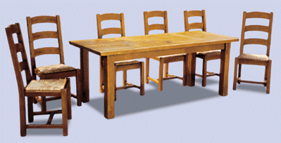
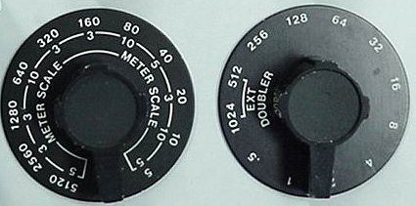
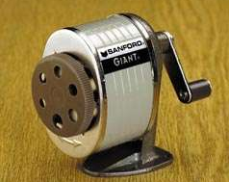
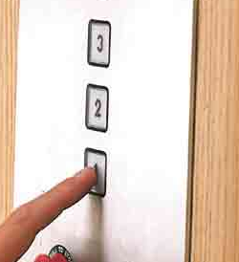
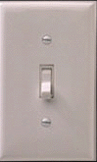

Perceived Affordance
The perceived properties of the object that suggest how one could use it
chairs are for sitting
table for placing things on
knobs are for turning
slots are for inserting
handles are for turning
switch for toggling
computer for…
buttons are for pressing

Slide 9
Perceived Affordances
Product design
  » perceived affordances: invitations for people to take possible actions
  » actual affordances: actual actionable properties of the product
Problems occur when
  » these are not the same
  » people’s perceptions are not what the designer expects

Slide 10
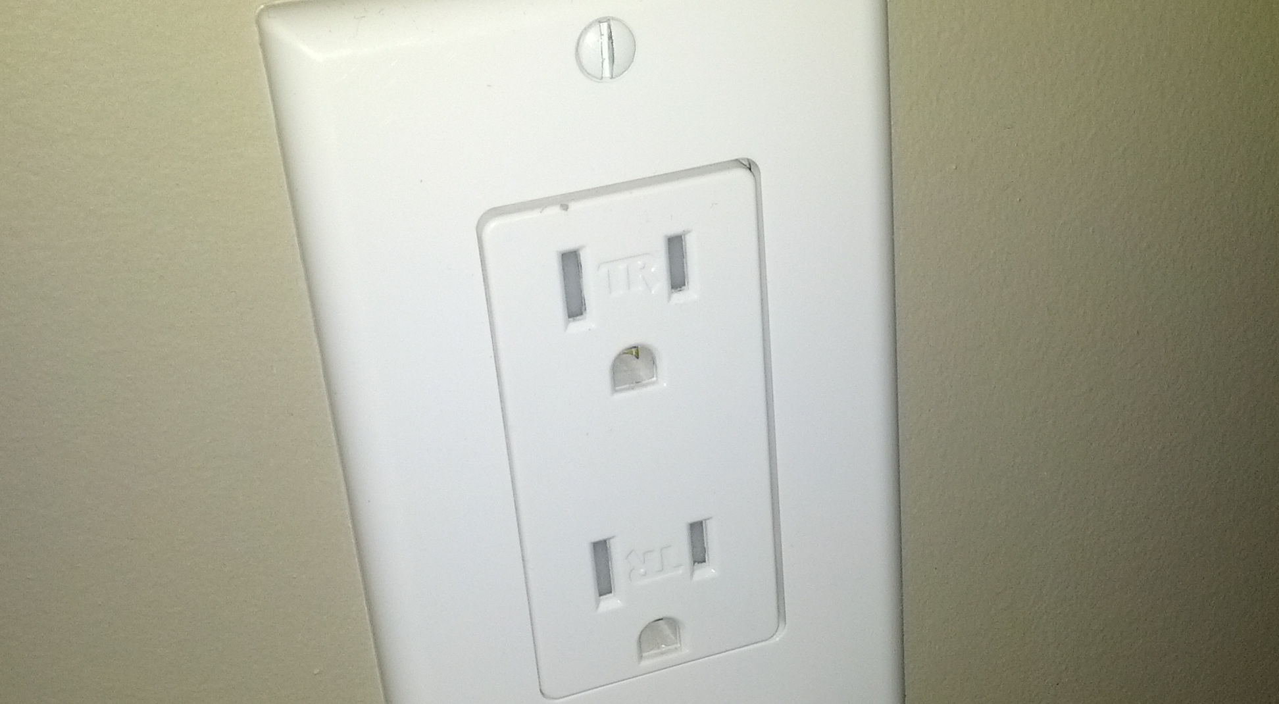
Quick example from my youth

Slide 11
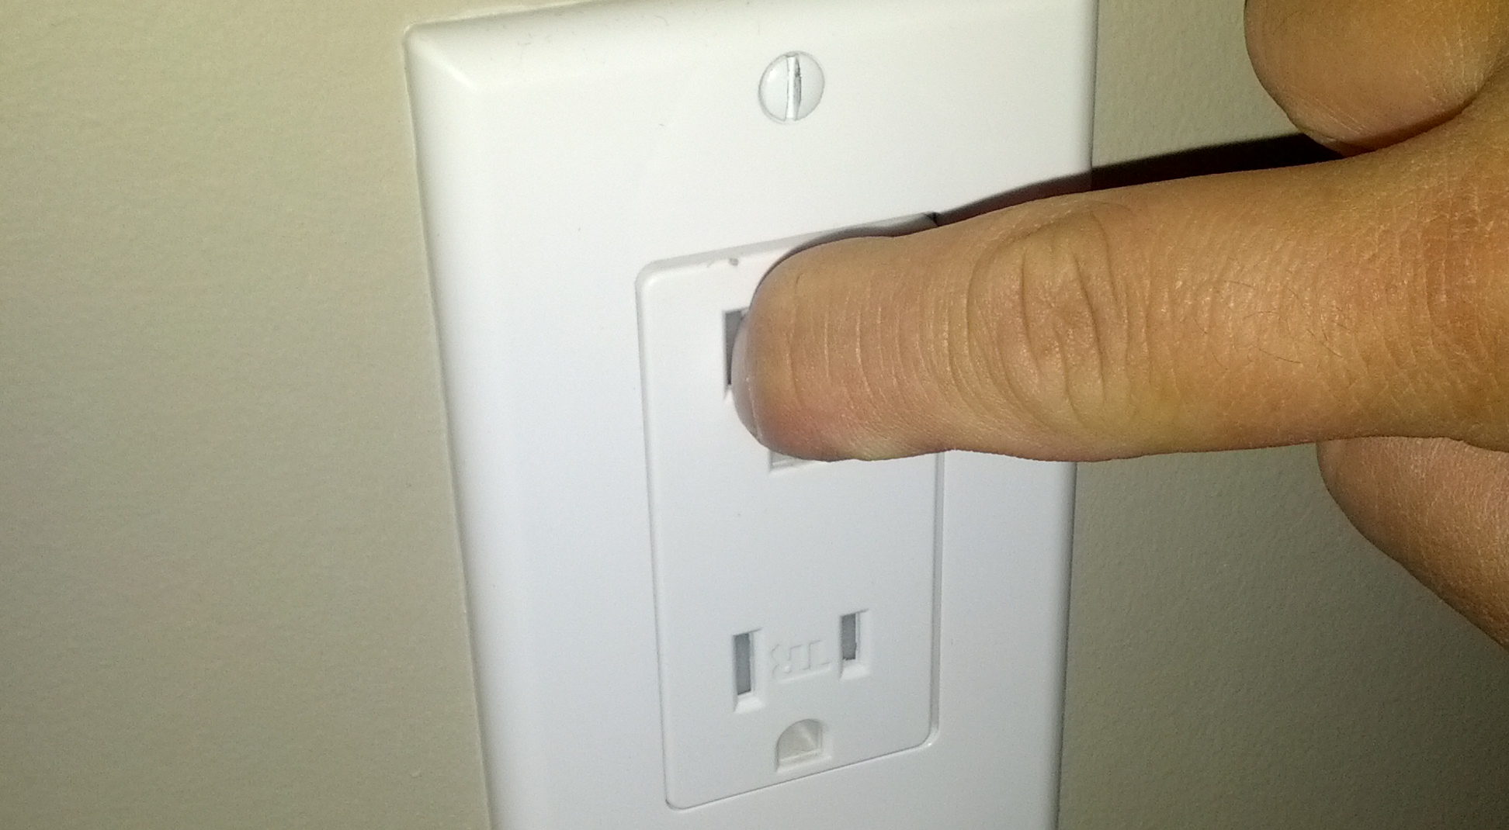
Quick example from my youth

Slide 12
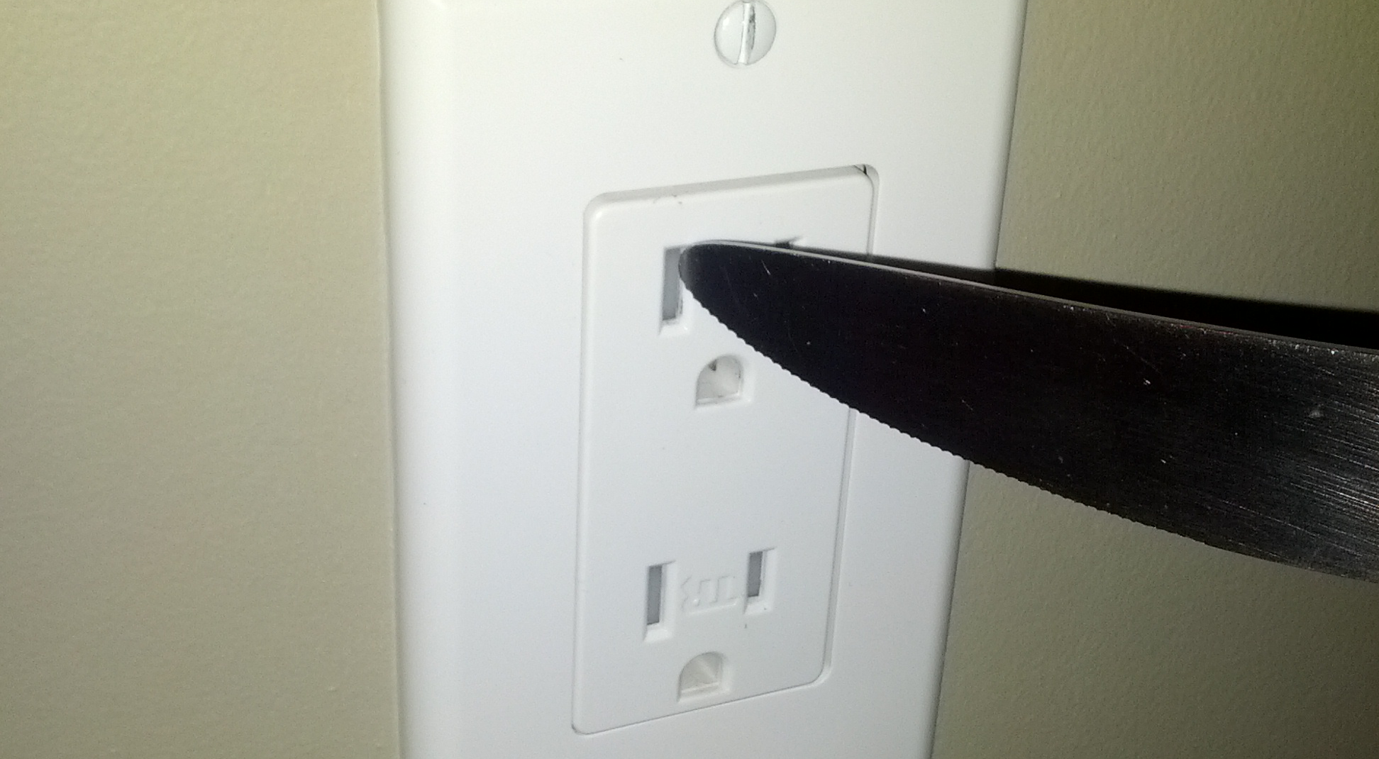
Quick example from my youth

Slide 13
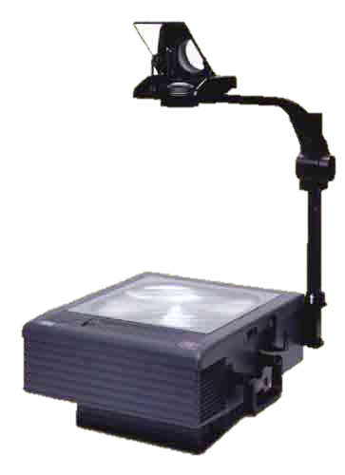
Perceived Affordances
    Mirrors for not touching
Knobs for turning
Handles for lifting
Surface for placing transparencies

Slide 14
Perceived Affordance Problems
    Mirrors for not touching
    people don’t reposition image
Knobs for turning
focus or image position?
Handles for lifting
bends frame, focus distorted
Surface for placing transparencies
which way is up?
what about this?

Slide 15
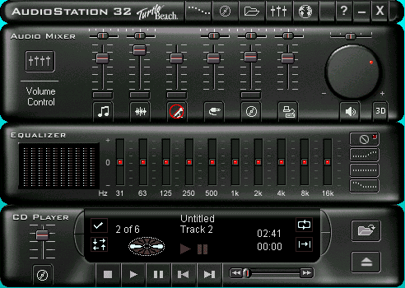
Perceived Affordances in GUI Design
Perception is only through visuals
Designer creates appropriate visual affordances via
  » familiar idioms
  » metaphors
Notes:
Skeumorphism: designing to retain ornamental elements of past iterations no longer necessary to current object’s function.
How it looks suggests a certain way to use things
But this has certain types of trade offs

Slide 16
Perceived Affordances in GUI Design
dials for turning
sliders for sliding
music console for controlling music

Slide 17
Perceived Affordances in GUI Design
is this equalizer control a toggle or button?
button for pressing,
but action unknown
are these buttons?

Slide 18
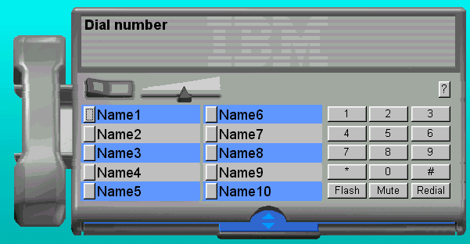
Perceived Affordances in GUI Design
Is this a graphic or a control?
A button is for pressing, but what does it do?
Visual affordances for window controls are missing!
text is for editing, but it doesn’t do it.

Slide 19
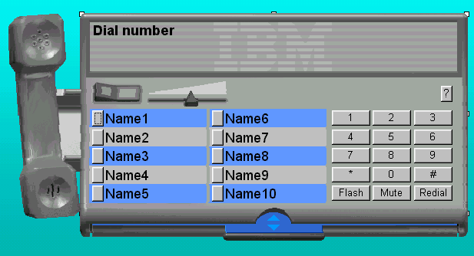
Skeumorphism in GUI Design

Slide 20
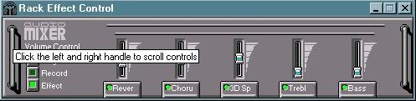
Perceived Affordances in GUI Design
Handles are for lifting,
but these are for scrolling!
Complex things may need explaining but
simple things should not
  when simple things need labels & instructions, then design has failed

Slide 21
Visible Constraints
Limiting the space of possible actions from an object’s appearance
  » provides people with a range of usage possibilities

Slide 22
Visible Constraints
Limiting the space of possible actions from an object’s appearance
  provides people with a range of usage possibilities
Push or pull?
Which side?
Can only push,
side to push clearly visible

Slide 23

Which side do you use for cutting?

Slide 24
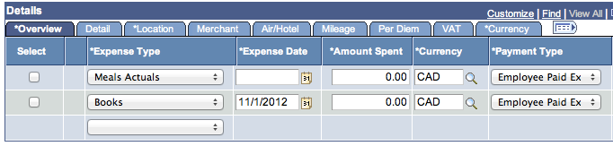
Visible Constraints
Notes:
System provides no meaningful constraint, so this suggests I can enter it however I like

Slide 25
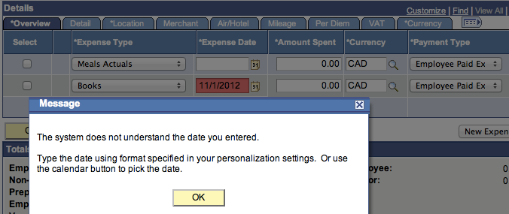
Visible Constraints
Notes:
Noooope…

Slide 26
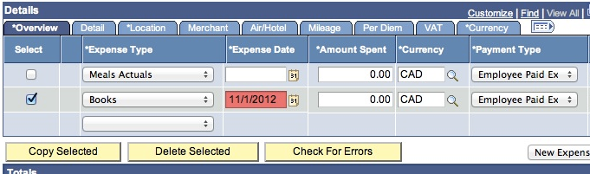
Visible Constraints
Notes:
Noooope…

Slide 27
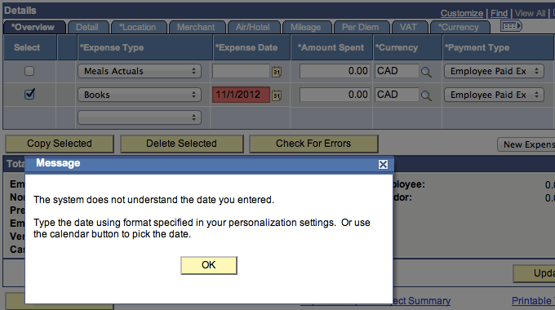
Visible Constraints
Notes:
Awesome

Slide 28
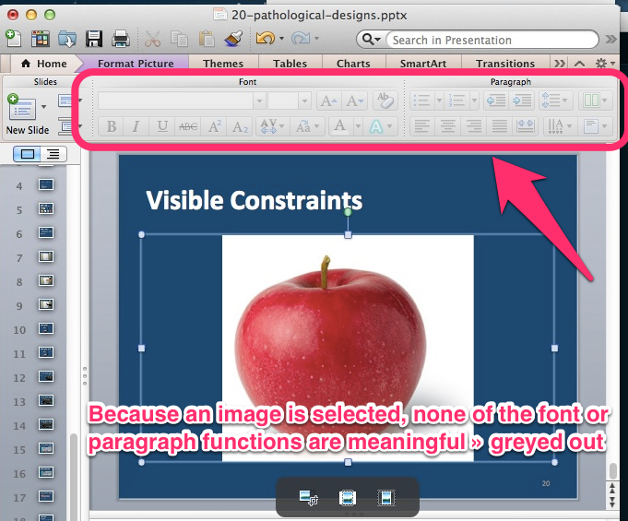

Slide 30
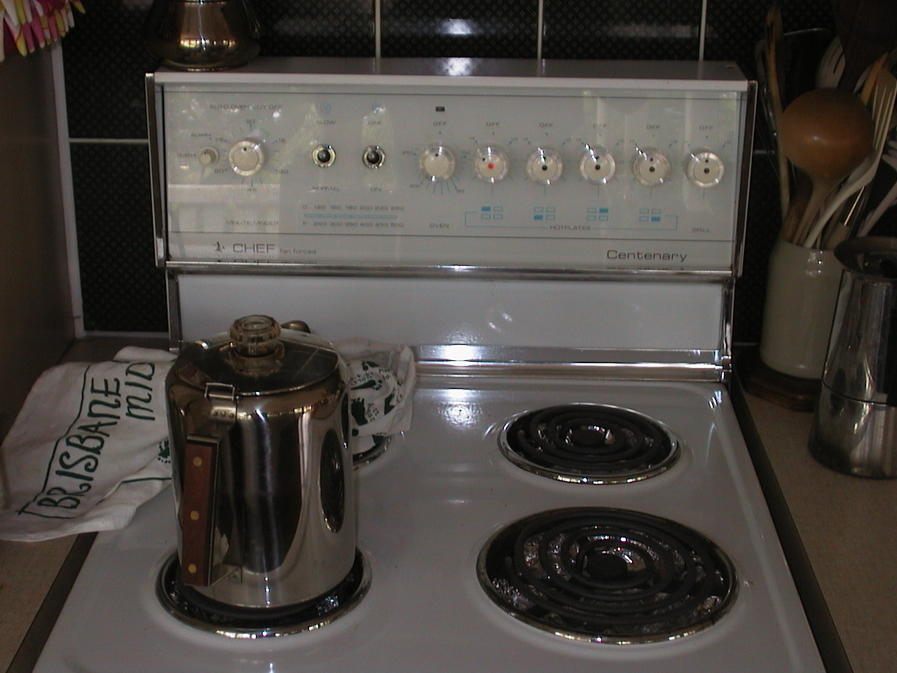

Slide 31
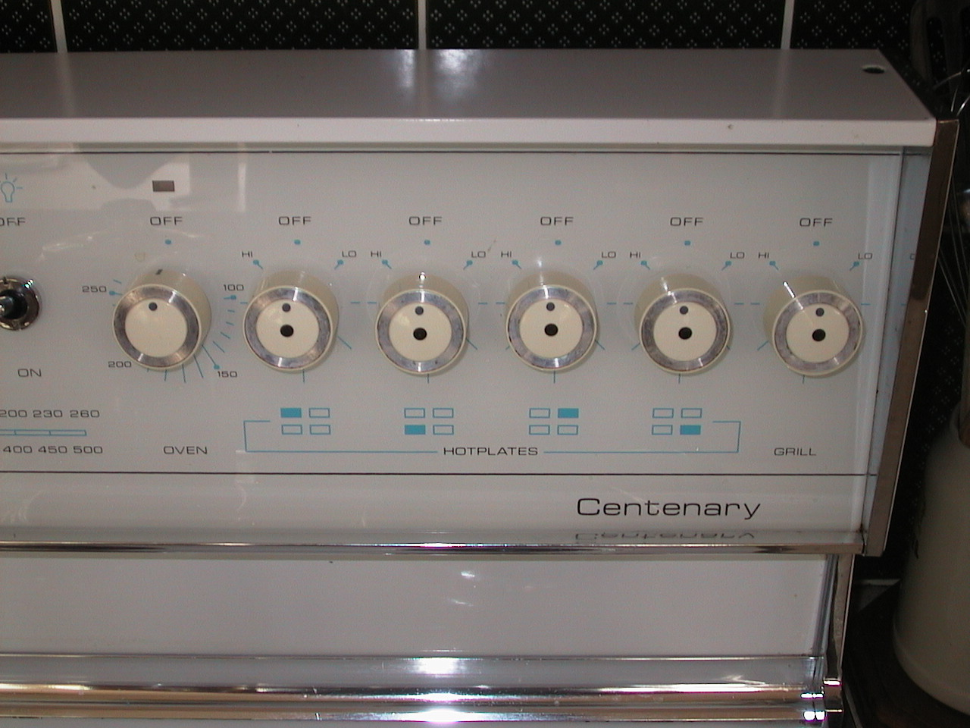

Slide 32
Mapping
The set of possible relations between objects
Control-display compatibility
  the natural relationship between controls and displays
  e.g., visual mapping of stove controls to elements
arbitrary
paired
full mapping
back
right
front
left
back
left
front
right
back
front
front
back
24 possibilities, requires:
-visible labels + memory
2 possibilities per side
=4 total possibilities

Slide 33
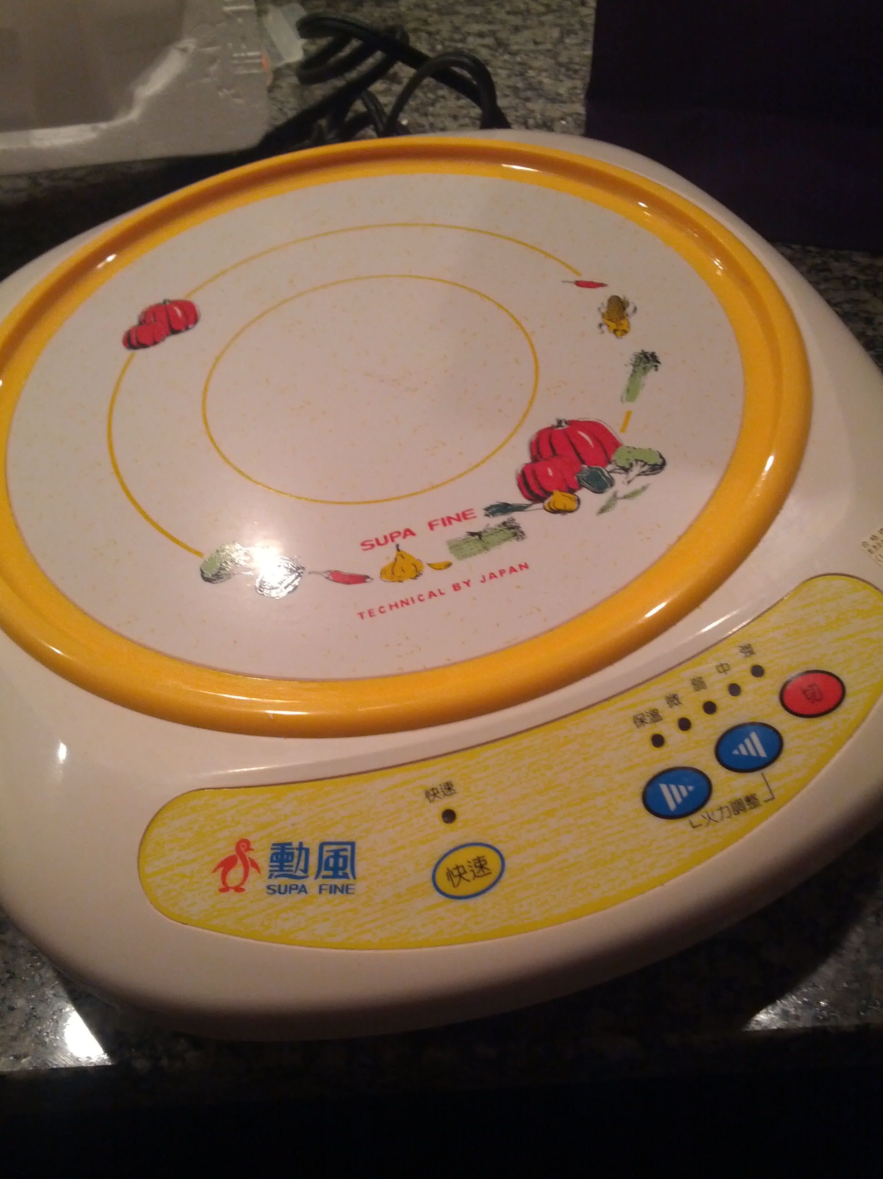
Hot Plate Example…

Slide 34
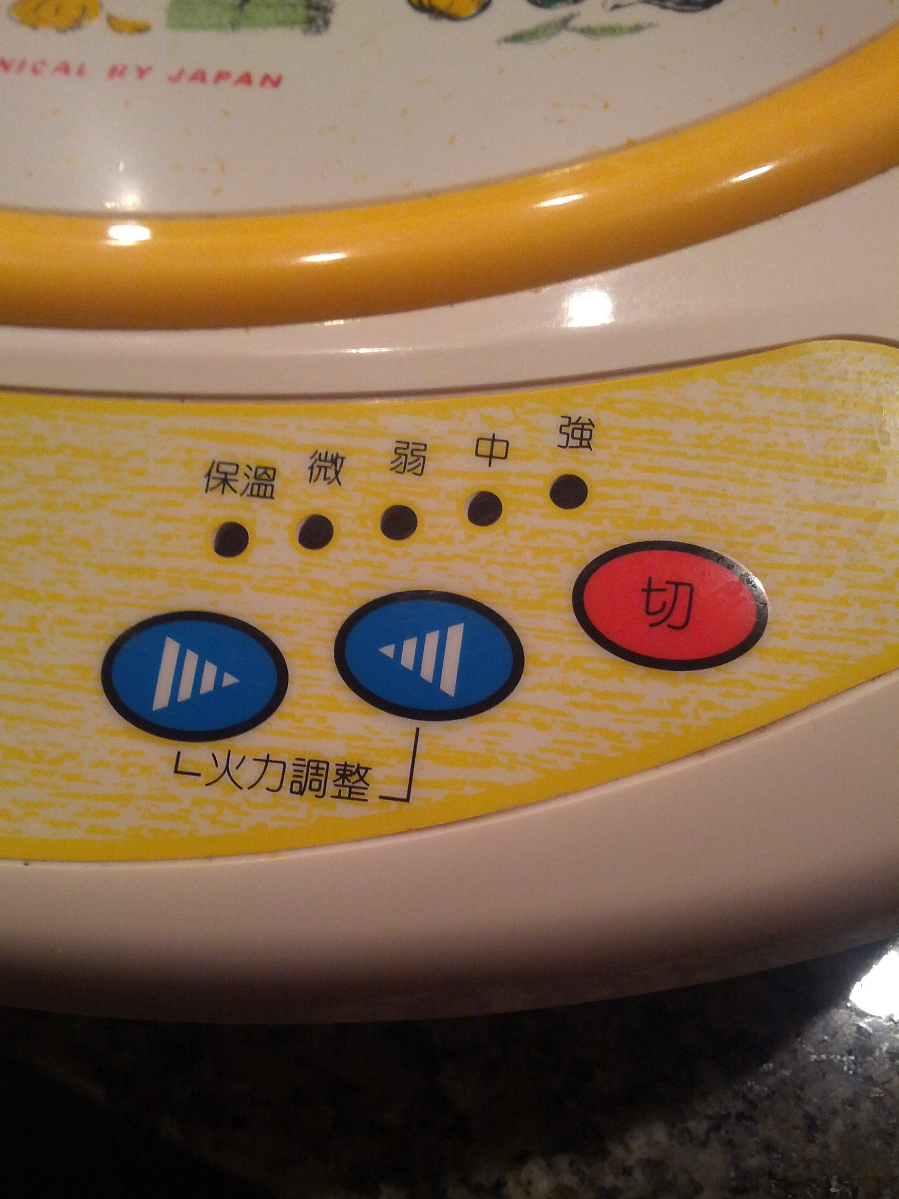
Insane Mapping Conflict…

Slide 35
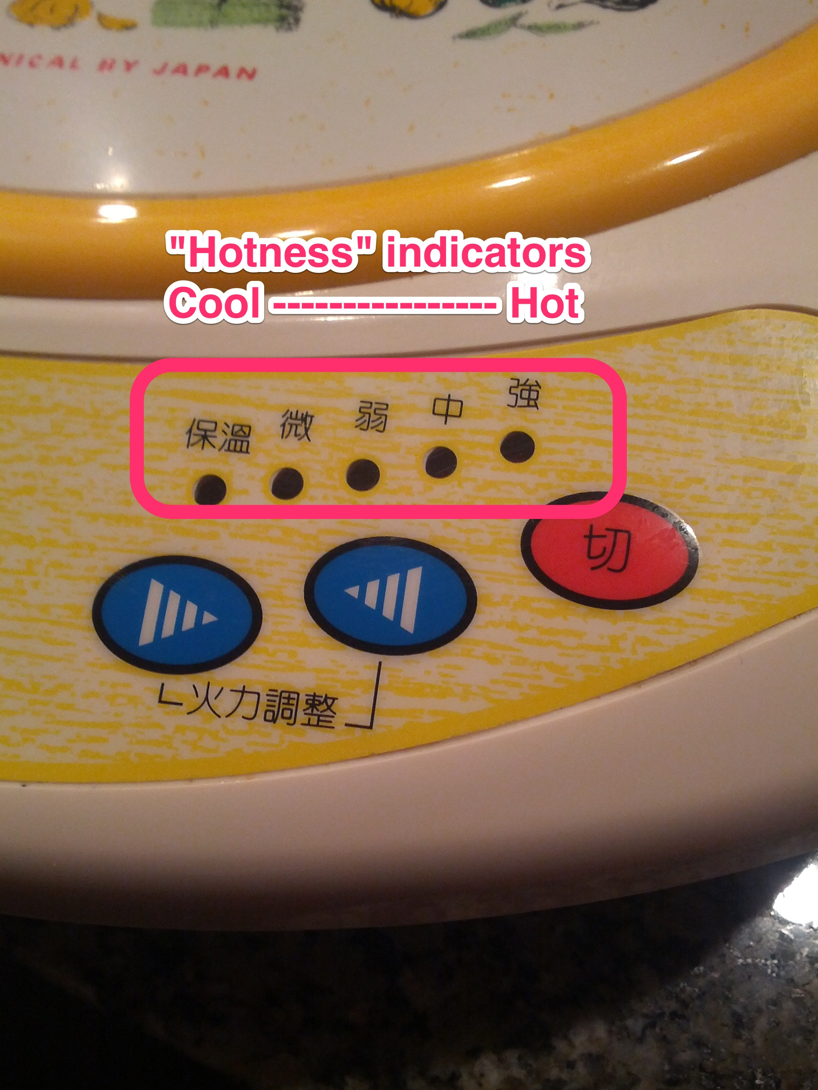
Insane Mapping Conflict…

Slide 36
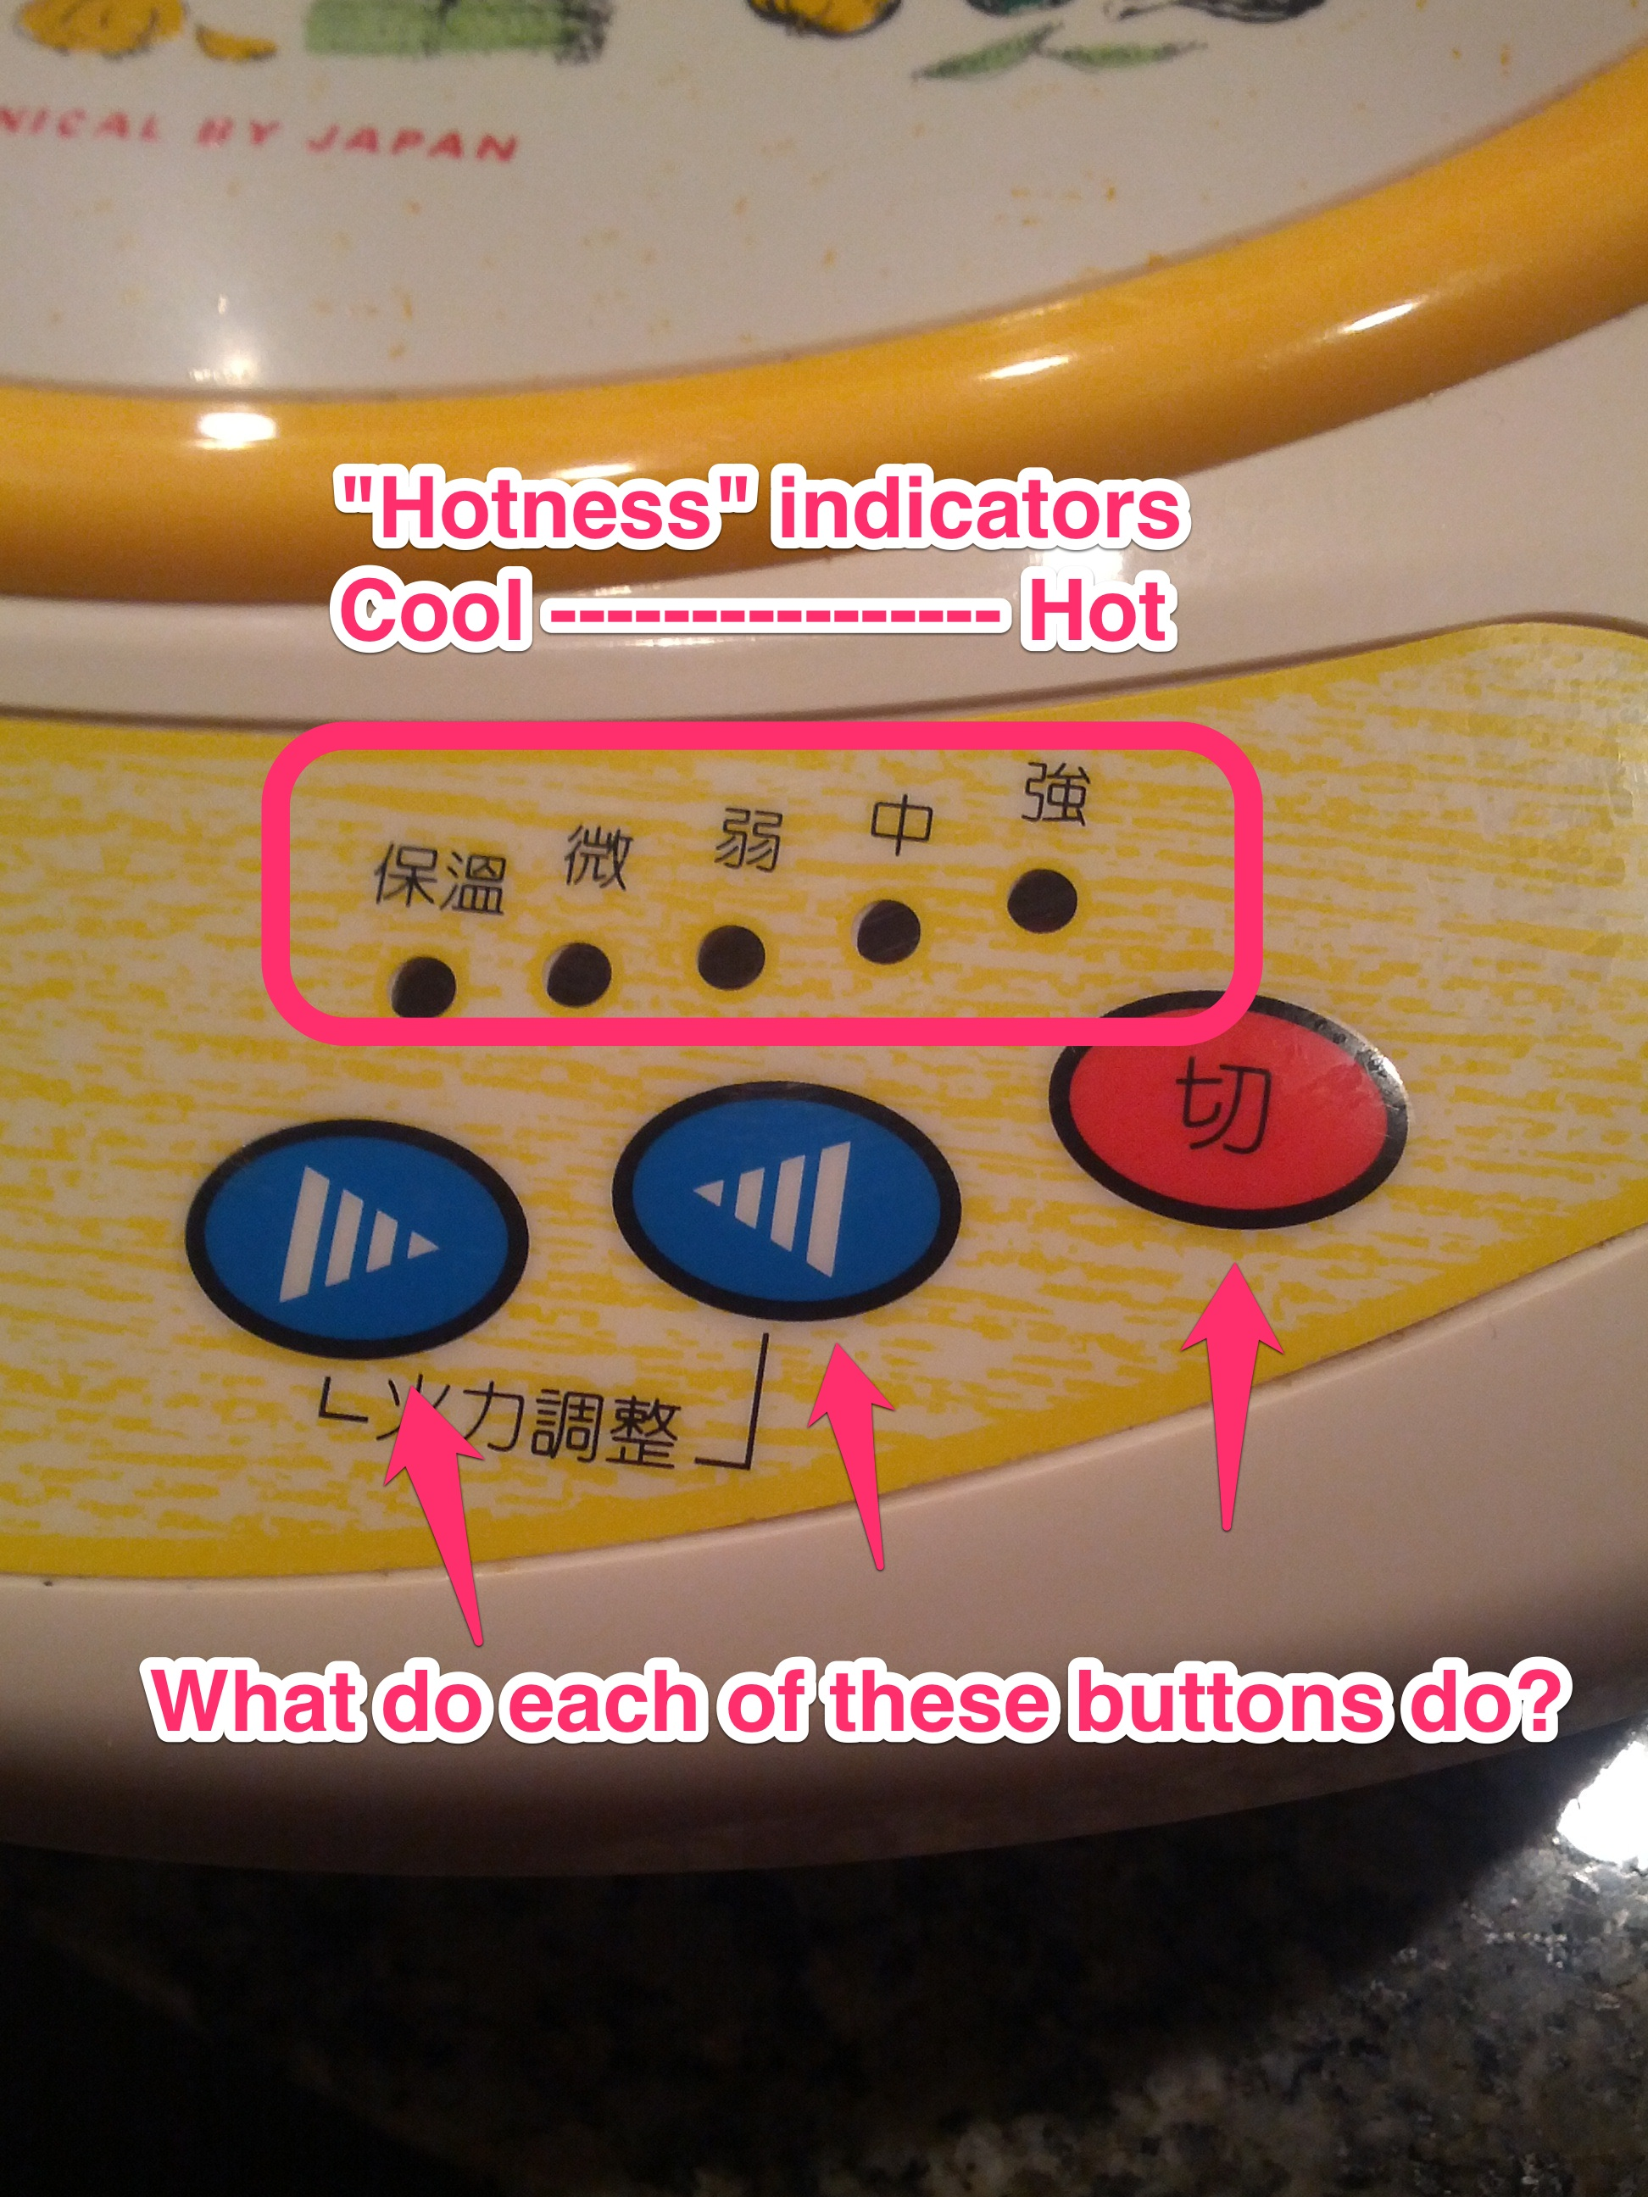
Insane Mapping Conflict…

Slide 37
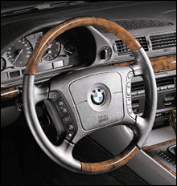
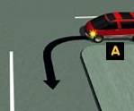
Mapping
Control-display compatibility » cause and effect
steering wheel-
turn left, front tires turn left, car turns left

Slide 38
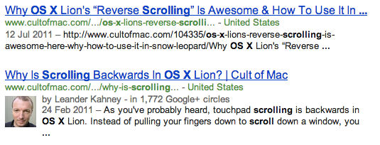
Mapping Scrolling in Apple Products…
In 2011, trackpad scrolling behaviour in OS X was reversed
  » swiping fingers downwards would scroll “upwards”, and vice versa

Slide 39
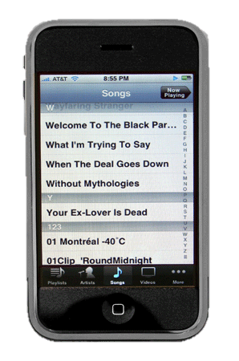
Why did Apple make this change?
Goal: unify the “model” of interaction that arises from touch devices
Model: touching something, and pushing it around

Slide 40
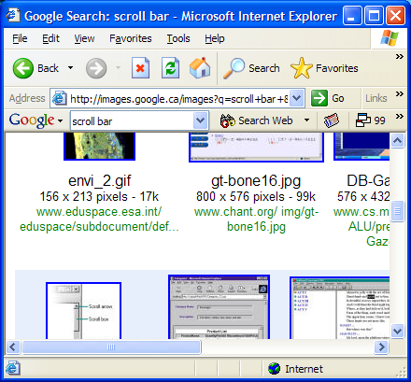
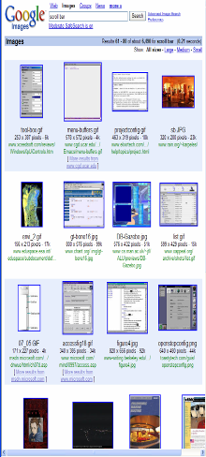
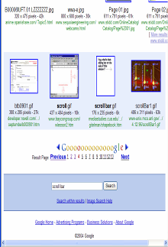
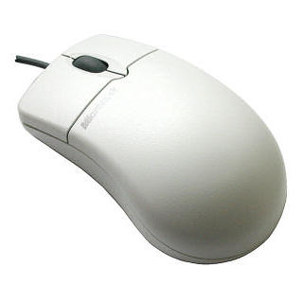
Wait, what did it change from?
scroll bar – scroll down viewport goes down
Model: turning the mouse wheel scrolls up and down
Trackpad model: your swipes are controlling the little scroll widget itself

Slide 41
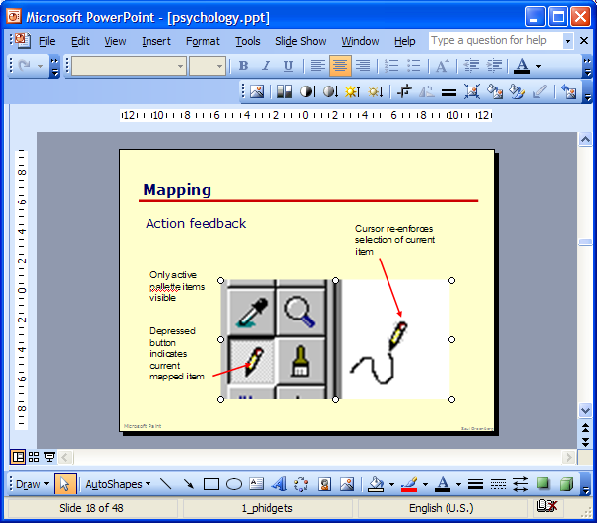
Mapping in GUIs
Palette controls and active objects
Only controls that can operate on a picture are fully visible
Others are grayed out
Selected picture

Slide 42
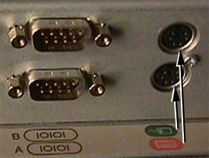
Mapping Problems
Ambiguous mappings in real life
Where do you plug in the mouse?

Slide 43

Causality
The thing that happens right after an action is assumed by people to be caused by that action
  » this is how simple machines work

Slide 44

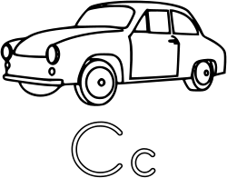
Causality: Impressing your friends, 1998 Edition
“Trunk activation area”

Slide 45
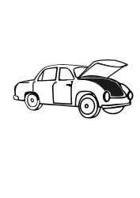
Causality: Impressing your friends, 1998 Edition
“Trunk activation area”

Slide 46
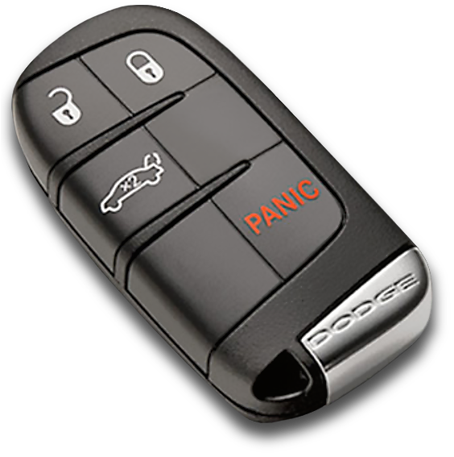
Causality: Impressing your friends, 1998 Edition
“Trunk activation area” » false causality

Slide 47
Causality » false causality
incorrect effect
  » invoking unfamiliar function just as computer hangs
  » causes “superstitious” behaviors
invisible effect
  » command with no apparent result often re-entered repeatedly
  » e.g., mouse click to raise menu on unresponsive system

Slide 48
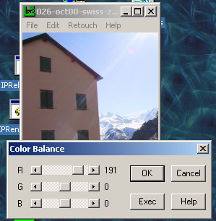
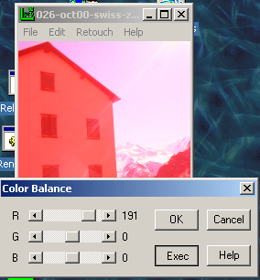
Causality Problems
Effects visible only after Exec button is pressed
  Ok does nothing!
  awkward to find appropriate color level

Slide 49
Lessons from the Design of Everyday Things
We’ve seen that a lot of things are designed poorly, be it computer interfaces, or physical objects
Formally, there is a vocabulary around these concepts that we have discussed
  » perceived affordances
  » visible constraints
  » causality
  » mapping
  » transfer effects
  » idioms & population stereotypes
  » conceptual models
  » individual differences

Slide 50
Learning Objectives
By the end of the lecture, you should be able to:
» distinguish between perceived and actual affordances
» describe how visible constraints can help prevent errors in interfaces
» discuss the role of mappings in interface intelligibility
» describe ways in which causality plays an role in helping people understand interfaces

