Slide 1


Personas
Making the user real Lecture /slide deck produced by Saul Greenberg and Anthony Tang, University of Calgary, Canada
vs
Image from http://3stepsbeyond.co.uk/2011/07/web-personas-this-is-what-weve-done/
Notice: some material in this deck is used from other sources without permission. Credit to the original source is given if it is known,

Slide 2
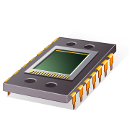
User Interface Design
User Centered Design
User Friendly
Human Computer Interaction…
focused on the user vs system

Slide 3
But who, exactly, is this user?
Image from http://3stepsbeyond.co.uk/2011/07/web-personas-this-is-what-weve-done/

Slide 4
Learning Objectives
By the end of this lecture, you should be able to:
-- understand the “design for everyone vs. design for one” argument
-- discuss the primary pitfalls of designing with engineers, and the nature of the “elastic user” and the “self-referential user”
-- describe the “persona” strategy (what is it comprised of), and argue for its utility and function
-- identify what constitutes a good persona

Slide 5
Design a car
Imagine you are designing an automobile to please a wide spectrum of people. You can easily identify at least three subgroups: the soccer mom, the carpenter, and the junior executive. Take one minute with a partner to articulate:
What is it that each subgroup wants?
How is this best achieved with a vehicle?
Notes:
Example from “Inmates Running the Asylum, p. 124”

Slide 6
What do they need?
Soccer Mom | Carpenter | Junior Exec
Space for storage or seating capacity Safety features – airbags side airbags Automated hands-free features (remote sliding doors) Durability easy to clean Visibility – larger mini-van (back up camera) In-car entertainment for the backseat Childsafe locks or windows | Functionality over how it looks – space for their tools and boxes -truckbed Don’t need lots of seats – just them and maybe an apprentice Durable and easy to clean (maybe) Powerful vehicle (lots of torque; all terrain) A GPS perhaps? | Hands-free stuff inside Sporty and expensive – to show off Tinted windows Coat-hangers for dry cleaning Removable seats (other clients or baggage) Classy interior (leather seats) – looks nice Gotta be fast Cushioned door handles; butt seat warmers

Slide 7
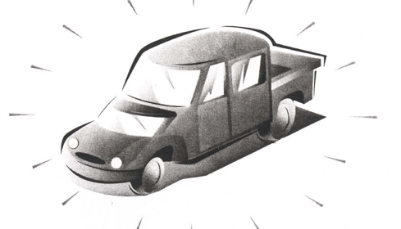
Design for everyone or design for one?
Notes:
When we design for everyone, we run into the problem that we annoy them a lot.
Now, a large population is 50% happy.
Whereas, if we took a different approach, where we came up with one car for one kind of user, then we would make them 100% happy, or even better 100% ecstatic.
So, it is often useful to think about designing “for one user”

Slide 8
Challenge of design with engineers
What is the nature of skill?
power users – computer-literate users – naïve users
➔ insufficiently nuanced
Rupak, network installer
Shannon, accountant
Dexter, VP of business development
Roberto, telemarketing rep
Notes:
Insufficiently nuanced.
Rupak – network installer who is very adept at getting things working, but has no real idea how things work. He relies on supersitition and lore
Shannon is accountant. Doesn’t know about web, email, networks, filesystem, but is a whiz at Excel.
Dexter VP of business development. Caries a pager, two cell phones, a computer, and wireless modem. Master of technology, but doesn’t have time to solve problems.
Roberto, telemarketing rep. Doesn’t know a thing about computers, but can follow complex instructions without difficulty. With a little bit of training, he can be a pro.
Example from Cooper, p131

Slide 9
Challenges of design with engineers
Feature debates
“What if the user wants to print this out?”
Programmers live and die by edge cases
Design is about the “center case”
Average person in Calgary has 2.3 kids
Who is the average?

Slide 10

The Elastic User
Can mean everyone and thus no one
vague audience means unfocused design
design defines user after the fact
lack of specifics means its easy to rationalize any design
image from p.127, The Inmates are Running the Asylum
Notes:
It is imprecise
It doesn’t allow us to make decisions
Talking about “the user” gives programmers license basically to do whatever they want
“The User” is almost the only thing people talk about in this way. Think about the games you play. – v specific about what h/w and o/s it can run on.

Slide 11
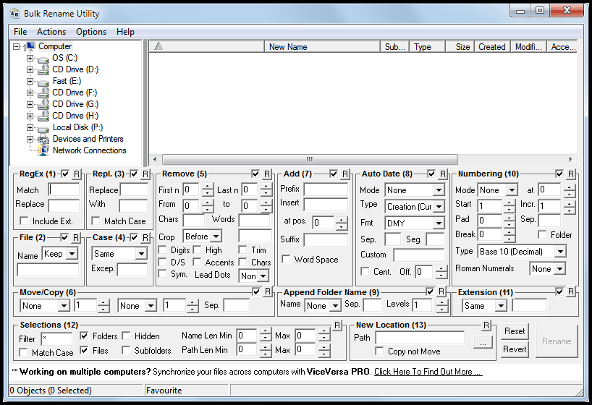
The Elastic User (defined after the fact)
An expert who wants plentiful renaming options
image from http://blog.ideaday.de/max/2010/11/example-for-a-bad-user-interface/

Slide 12
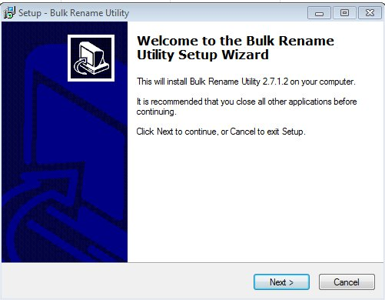
The Elastic User (defined after the fact)
Or a naïve user?
image from http://blog.ideaday.de/max/2010/11/example-for-a-bad-user-interface/

Slide 13
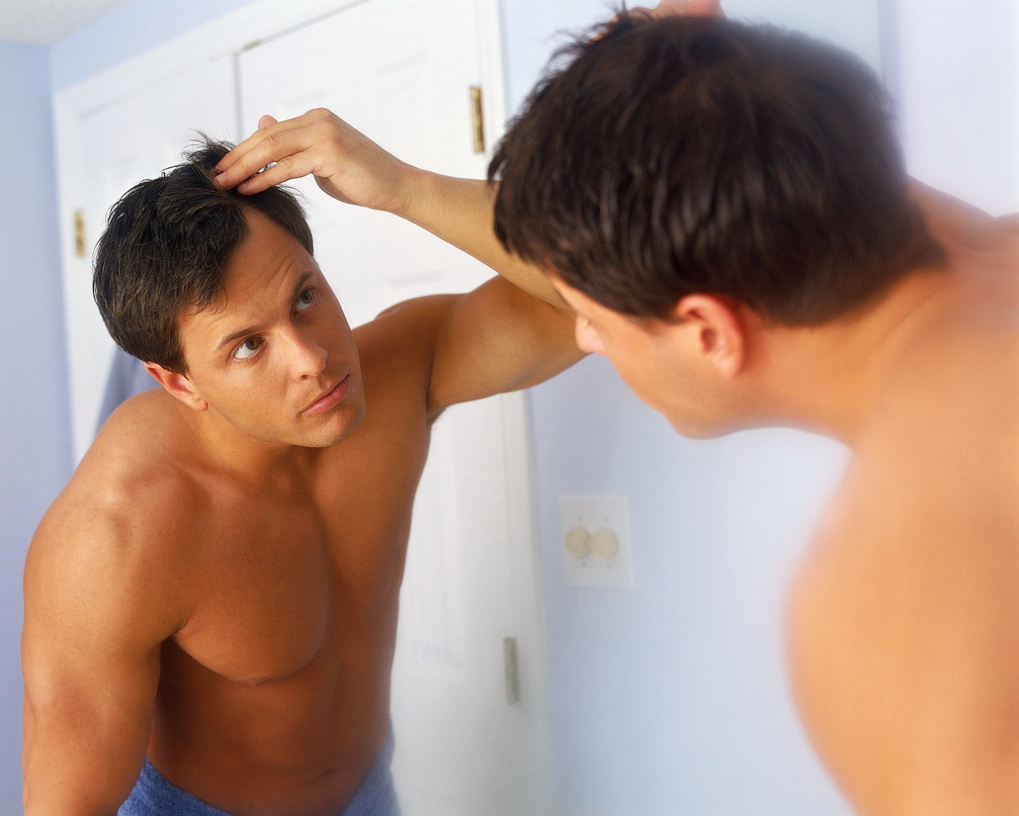
Self-Referential User
The user is me (even if he or she isn’t)
image from http://blog.ideaday.de/max/2010/11/example-for-a-bad-user-interface/

Slide 14
Personas: a Design Strategy
Focus on the specific needs and goals of a single, archetype individual based on user research. The archetype should be specific and precise so that it can be used to make decisions when with regard to scope and design.
Designing for such an archetype allows us to do really well at making this person happy. Often, it results in something that ends up working well for others, too.
e.g. bags with wheels (commercial airline pilots; Post-It notes for hymns)

Slide 15
Example
G4K Company
Produces children’s educational and game software
Goal: make a corporate destination site for kids
child-oriented entertainment
news
merchandise related to G4K software
This example and the following images are from: The Persona Lifecycle. John Pruitt and Tamara Adlin. Morgan Kaufmann (Elsevier), 2006

Slide 16
The Elastic User
I’ll gladly surf to your web site
I will love using it
I will buy your stuff
I’ll spend hours navigating your pages
I know how to download software
I have a credit card so I can pay
I am totally nto action games
I like dolls
Parents? What parents?
…

Slide 17
Making the User Real
do they have computers?
how do they use them?
what do they know?
what are their interests?
do they use the web?
what do they like doing online?
…
Captured as Personas
allows us to think about their goals
allows us to think about their usage contexts
allows us to think about their skills

Slide 18
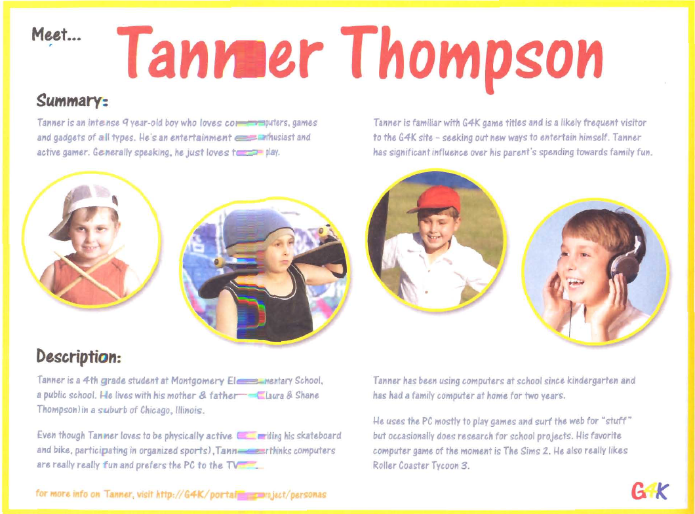

Slide 19
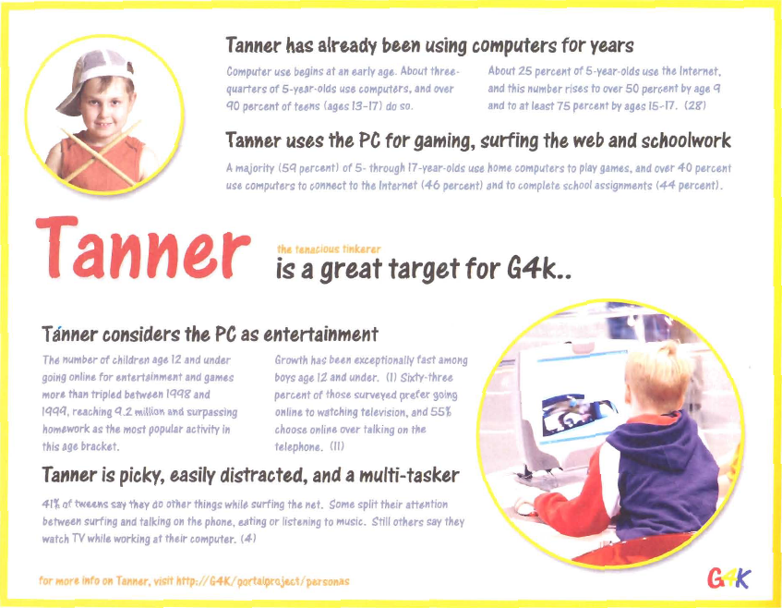

Slide 20
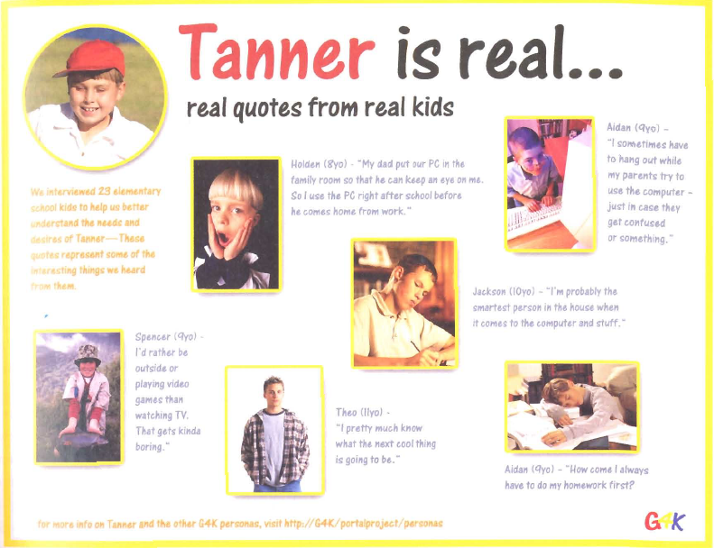

Slide 21
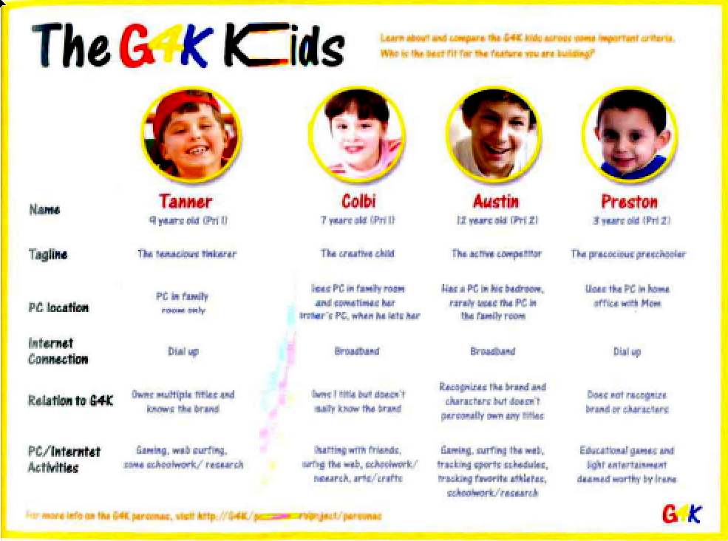

Slide 22
Making the User Real
User requirements analysis
Use Cases
Task centered system design
provide specifics about particular user’s needs and tasks
a good start, but can’t anticipate (nor inform) all design decisions

Slide 23
Making the User Real
User research
gather data about intended audience
How?
stakeholder interviews
business and technical context surrounding the product
preliminary product vision
budget and schedule
technical constraints and opportunities
business driers
stakeholders’ perception of the user
…

Slide 24
Making the User Real
User research
gather data about intended audience
How?
customer interviews (customer may not be the user!)
goals in purchasing the product
frustrations with current solutions
decision process for purchasing intended product
role in product installation, maintenance, and management
domain-related issues and vocabulary
…

Slide 25
Making the User Real
User research
gather data about intended audience
How?
user interviews
context of how product (or analogous system) fits in their lives or workflow
their domain knowledge for this activity
current tasks and activities: that the product is and isn’t supposed to support
goals and motivations for using this product
problems and frustrations with current products
…

Slide 26
Making the User Real
User research
gather data about intended audience
How?
user observations
non-obtrusive capture of specific activities
how they get things done
field studies
capture broader activities
how activities fit together in their ecosystem
contextual inquiry
master/apprentice model of learning
observing and asking questions
…

Slide 27
Making the User Real
User research
gather data about intended audience
Issues?
rich data, but
un-integrated
needs to be interpreted
high learning curve to assimilate
too much for ‘casual’ team members to use
easy to forget over long project
easy to forget big picture

Slide 28
Making the User Real
Personas
a surrogate
based on research
pseudo-fictional character representing a user archetype
a composite
concrete descriptive model of intended user
as a set, explores ranges of archetypes and behaviours

Slide 29
Personas
Why?
Precise way of thinking about
how users behave
their motivations
how they think
what they wish to accomplish (goals)
why they want to do what they do

Slide 30
Personas
Why?
Within the team
provides a shared understanding
engage in empathy of design towards a target user
helps communicate who you are building the product for
helps determines what the product should and shouldn’t do
serves as a stable reference point during the design process
provides focus
a stand-in for actual users
testable via walkthroughs

Slide 31
Personas
Characteristics
based on research
archetypes represented as individual people
not a real person, but a composite archetype
each represents groups of users
As a set
explores ranges of archetypes and behaviours

Slide 32
Persona
Basic structure
specific narrative
describes a specific usage pattern
embodied in a specific fictional user
by means of text and images
and based on data
Includes
name
photo
goals
and a mix of
key characteristics
motivations
context
activities
narrative story
representative quotes
pain points…

Slide 33
Example 1 (by Robert Barlow-Busch)
From:
http://chopsticker.com/2007/06/08/download-an-example-persona-used-in-the-design-of-a-web-application/
ClickDox had an idea that people would be willing to pay for a
web application that lets them
send and receive confidential documents online
as opposed to sending them by courier (too slow and expensive) or as email attachments (too insecure).

Slide 34
Example 1 (by Robert Barlow-Busch)
Data Collection: User interviews
What are people’s overall job goals?
By understanding what fundamentally motivates people in their jobs, we can design ClickDox’s web application so people feel it contributes to them achieving something important.
2. What’s the context in which they’d use ClickDox?
By understanding the many factors that influence people on the job, we can design ClickDox so it feels like it was made just for them.
3. What are their current behaviors around document exchange?
By understanding how people get things done today, we can design ClickDox to help them do it better.

Slide 35
Example 1 (by Robert Barlow-Busch)
Main Discoveries
Security was not as important as had been thought
2. People’s email client was a central tool in their jobs.
3. All struggled with large files that exceeded the mailer’s size limit
Result
Original strategy stressed security.
New result stressed ease of sending large files

Slide 36
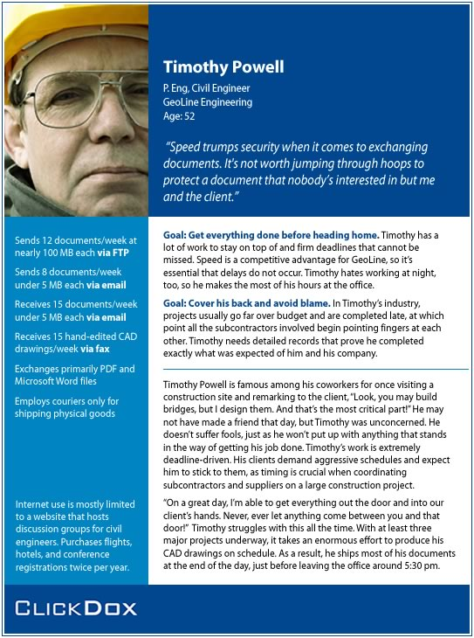

Slide 37
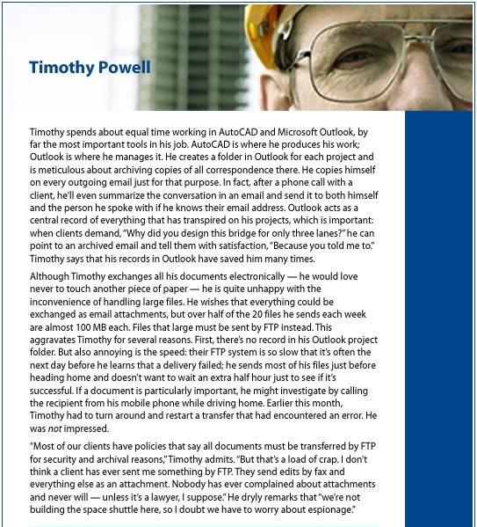

Slide 38
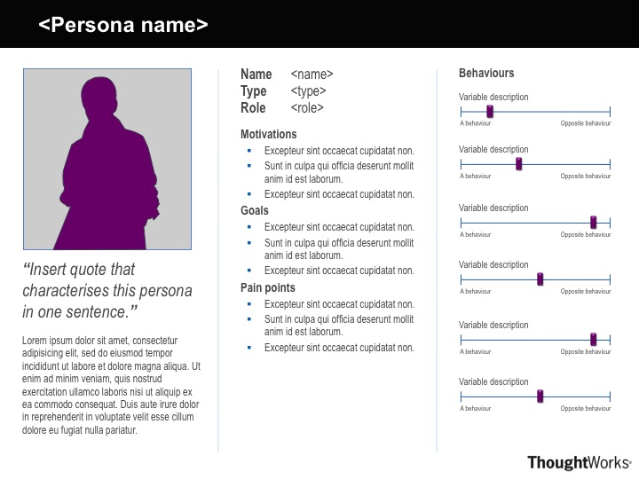
A Persona Template by Ben Melbourne from http://asinthecity.com/2011/05/13/explaining-personas-used-in-ux-design-%E2%80%93-part-2/

Slide 39
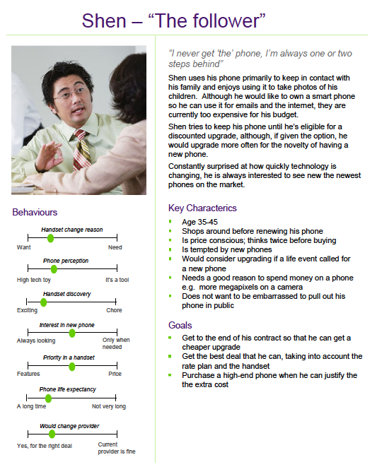
Handset upgrades
Persona Examples by Ben Melbourne
http://asinthecity.com/2011/05/13/explaining-personas-used-in-ux-design-%E2%80%93-part-2/

Slide 40
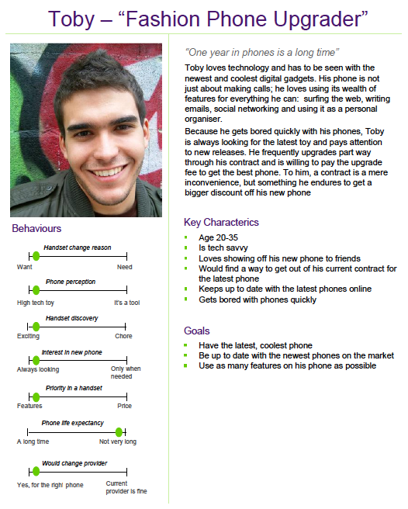
Handset upgrades
Persona Examples by Ben Melbourne
http://asinthecity.com/2011/05/13/explaining-personas-used-in-ux-design-%E2%80%93-part-2/

Slide 41
You now know
1. The Elastic User is problematic
2. Good Design requires Making the User Real
3. Personas define ‘real’ Archetype Users
4. Personas
use the design funnel to develop ideas with
the best ones considered for green/red light appraisal

Slide 42
Learning Objectives
You should now be able to:
-- understand the “design for everyone vs. design for one” argument
-- discuss the primary pitfalls of designing with engineers, and the nature of the “elastic user” and the “self-referential user”
-- describe the “persona” strategy (what is it comprised of), and argue for its utility and function
-- identify what constitutes a good persona

Slide 43
Liaison people!

Slide 44
Sources and Further References
The Inmates are Running the Asylum. Alan Cooper. Sams, 1999 (Chapter 9)
About Face 3. Alan Cooper, Robert Reimann & David Cronin. Wiley Publishing, 2007 (Chapters 4 & 5)
The Persona Lifecycle. John Pruitt and Tamara Adlin. Morgan Kaufmann (Elsevier), 2006
Using Personas. Slide deck by Andrea Resmini:
http://www.slideshare.net/resmini/personas-5431493?from=share_email

Slide 45



Permissions
You are free:
to Share — to copy, distribute and transmit the work
to Remix — to adapt the work
Under the following conditions:
Attribution — You must attribute the work in the manner specified by the author (but not in any way that suggests that they endorse you or your use of the work) by citing:
“Lecture materials by Saul Greenberg, University of Calgary, AB, Canada. http://saul.cpsc.ucalgary.ca/saul/pmwiki.php/HCIResources/HCILectures”
Noncommercial — You may not use this work for commercial purposes, except to assist one’s own teaching and training within commercial organizations.
Share Alike — If you alter, transform, or build upon this work, you may distribute the resulting work only under the same or similar license to this one.
With the understanding that:
Not all material have transferable rights — materials from other sources which are included here are cited
Waiver — Any of the above conditions can be waived if you get permission from the copyright holder.
Public Domain — Where the work or any of its elements is in the public domain under applicable law, that status is in no way affected by the license.
Other Rights — In no way are any of the following rights affected by the license:
Your fair dealing or fair use rights, or other applicable copyright exceptions and limitations;
The author's moral rights;
Rights other persons may have either in the work itself or in how the work is used, such as publicity or privacy rights.
Notice — For any reuse or distribution, you must make clear to others the license terms of this work. The best way to do this is with a link to this web page.

