Slide 1
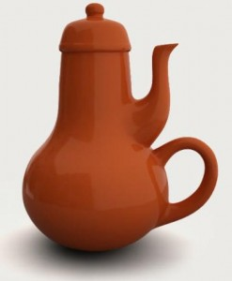
Awesome teapot for mother-in-law
Notes:
http://brazenthoughts.com/2012/06/the-tao-of-usefulness/

Slide 2
Midterm Questionnaire | Major Takeaways
7 responses out of 44 – 16%
Workload: Hours/week on class? Just right, or too much?
Seems fine: 5-10 hr
Tutorial: How is tutorial working out?
Ensure there is “project time”
Assignments/Project Components: Interesting? Too easy/hard? Is the content relevant?
Not complicated; just time consuming & tedious
Revisit page limits (or requirements)
Lectures: Useful? What would you change?
Conflicted: “good stuff” vs. “not concrete enough”
Maybe more notes in the comments for the slides → will probably visit this in the off-season
General: Other comments?
Concreteness vs common sense

Slide 3
Who do you get along with? (similarity)
Birds of a feather flock together
Opposites attract
Idea: Common sense is something that is “picked up” rather than something that is innate.
My goal: Impart upon you a way of thinking so that it becomes common sense to you.
My method: Mainly through practice (i.e. doing).
Notes:
Language, terms, concepts – these are all ways of providing a tiny bit of concreteness around it.

Slide 4
Pathological Designs
CPSC 481: HCI I
Winter 2014
Anthony Tang with acknowledgements to Saul Greenberg and Ehud Sharlin
Notes:
While computer design has its own idiosyncrasies, we can learn a tremendous amount by looking at the design of everyday things. We start with bad design, which make us realize that the problems and errors people face when dealing with even simple technology are usually a result of design failure. We then move to understanding visual design principles that help us analyze bad design and create good designs.

Slide 5
Learning Objectives
By the end of the lecture, you should be able to:
» Re-orient others into thinking about “human error” to “design errors” (and understand why the former is a common way of thinking)
» Understand the difference between functional testing and usability testing (and the value of each!)
» Understand the dangers of conditioned responses and negative transfer
» Argue why system designers/engineers should care about usability

Slide 6
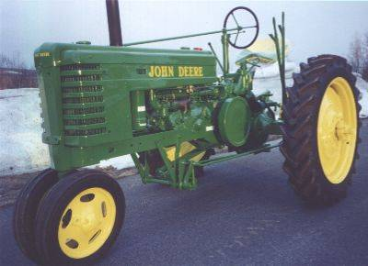
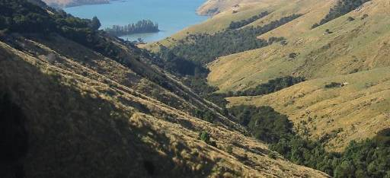

Slide 7
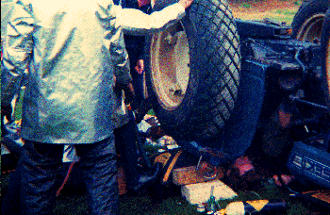
National AG Safety Database
“tractor upsets cause more fatalities than other farm accidents”
“injuries often include a broken or crushed pelvis”
“Human error”

Slide 8
Re-examination…
high center
of gravity
narrow front
wheel base
Terrain
» unsurfaced and rough
» hilly
Farmer
» works long hours
» works quickly

Slide 9
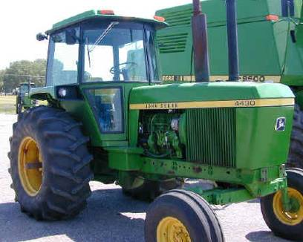
human error or design error?
accidents less frequent as modern designs have
roll cage
low center of gravity
wider wheel bases

Slide 10
So what does this tell us?
Lesson 1
» many failures of human-machine systems are the result of designs that don’t recognize people’s capabilities and fallibilities
» this leads to apparent machine misuse and human error
Lesson 2
» good design always accounts for human capabilities
So, consider the following:
» given examples of ‘human error’, critique them for possible ‘design errors’
» propose designs that limit/remove these errors
Notes:
There are a lot of reasons why we often blame human error.
It allows us to sleep better at night: “that wouldn’t happen to me”
It frees the company from blame
BUT THIS IS THE WRONG WAY TO THINK ABOUT THINGS!!

Slide 11
Motorway Communication System
Britain 1976
Motorway communication system operated 40% of its highways
police controlled it in real time to
change lane signs, direction signs, speed limits, etc
On December 10th, police failed to change the speed limit signs when fog descended
34 vehicles crashed
3 people killed
11 people injured and trapped in their vehicles
motorway closed for 6.5 hours
Slide ideas from David Hill

Slide 12
Some quotes
Police (at inquest)
“The system did not accept the instruction”
Dept of Transport (after examining computer logs)
“There is no evidence of technical failure”
System engineers
after emphasizing that they have no responsibility for the system
“We supplied it over 5 years ago and have never been called to look at that problem”
The Coroner’s court
judged it as "operator error"
the police operator:
“failed to follow written instructions for entering the relevant data”
Where have we heard this before?
Not me!

Slide 13
Example design problems
cryptic input codes
XR300/1: change (X) sign 300 on highway M5 (R) to code 1
i.e. change particular sign to indicate fog condition
no feedback
operator entered command, no visible effect of system response
cryptic error messages
“Error code 7”
teletype machine was old, text illegible
people could not see what they typed or system’s reply
operator overloaded with other chores
also handled radio and telephone traffic

Slide 14
Common frame of mind…
Blame the user – “operator error” – (frees everyone else from blame)
Belief in a just world – “Wouldn’t happen to me because I’m a good person”
Absolves everyone else from (legal) blame

Slide 15
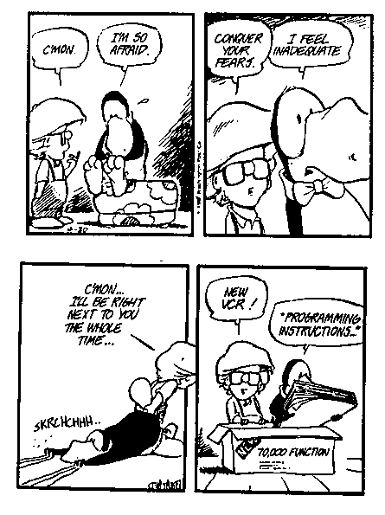
Psychopathology of Everyday Things
How many of you can program or use all aspects of your
» digital watch
» PVR
» sewing machine
» washer and dryer
» microwave
» home theatre
» cell phone
» …
Notes:
The engineer who founded DEC confessed at the annual meeting that he can’t figure out how to heat a cup of coffee in the company’s microwave oven

Slide 16
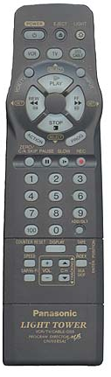

Phone rings… press pause
Big button
Visually distinct (colour)
Reasonably different from other buttons
Shape and central position make it easy to find in low light conditions
Notes:
You’ve seen this image before. I asked you to press the pause button quickly.
Just scanning these quickly, which could you find it on easiest?
What makes the TiVo one easy to find?
Big, distinct (CRAP), visually distinct.
Also, the WAY you hold it would lend itself to clicking there. Think about how the weight is distributed on these bad boys

Slide 17
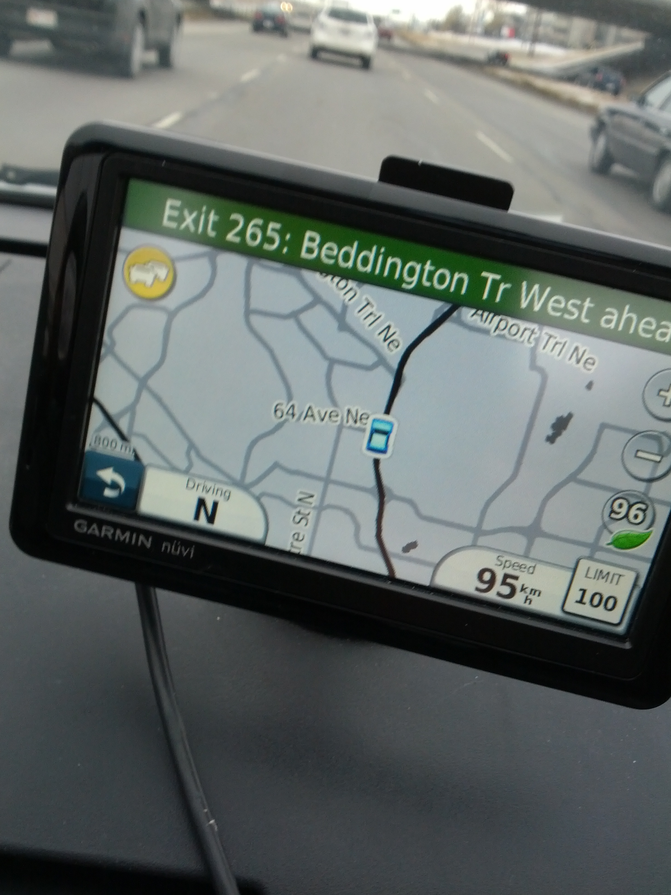
I hate my GPS
Notes:
So, suddenly, my device tells me there’s traffic ahead.
I glance over at my GPS, and suddenly, everything is ugly. It’s this grey nasty thing.
So, I click the yellow button (which is the traffic indicator)
Oops. It’s locked. Can’t be used while driving.

Slide 18
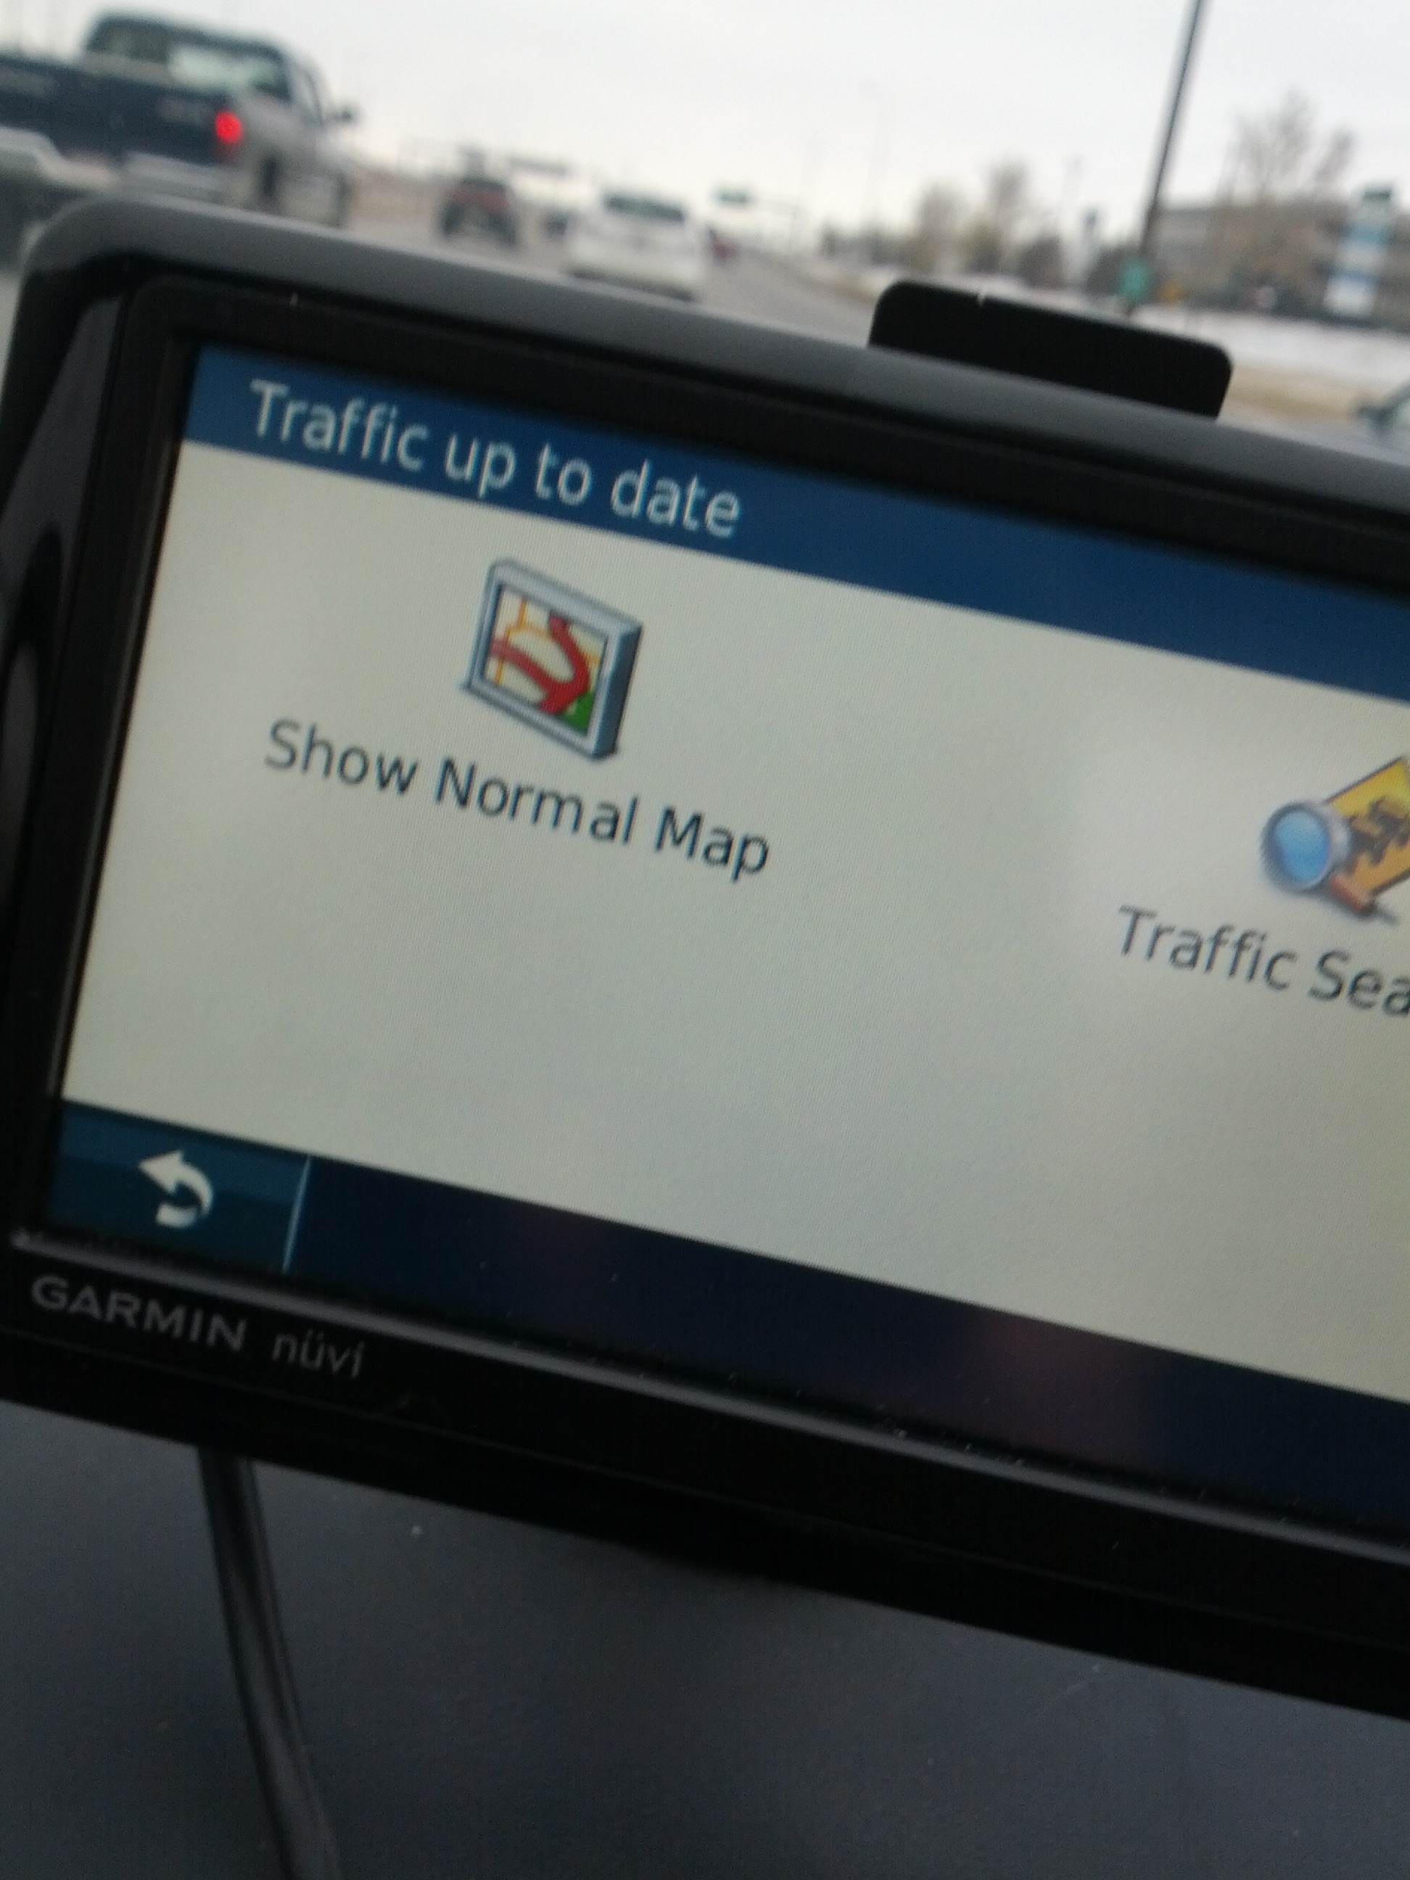
I hate my GPS
Notes:
What the… I was in the traffic mode already?

Slide 19
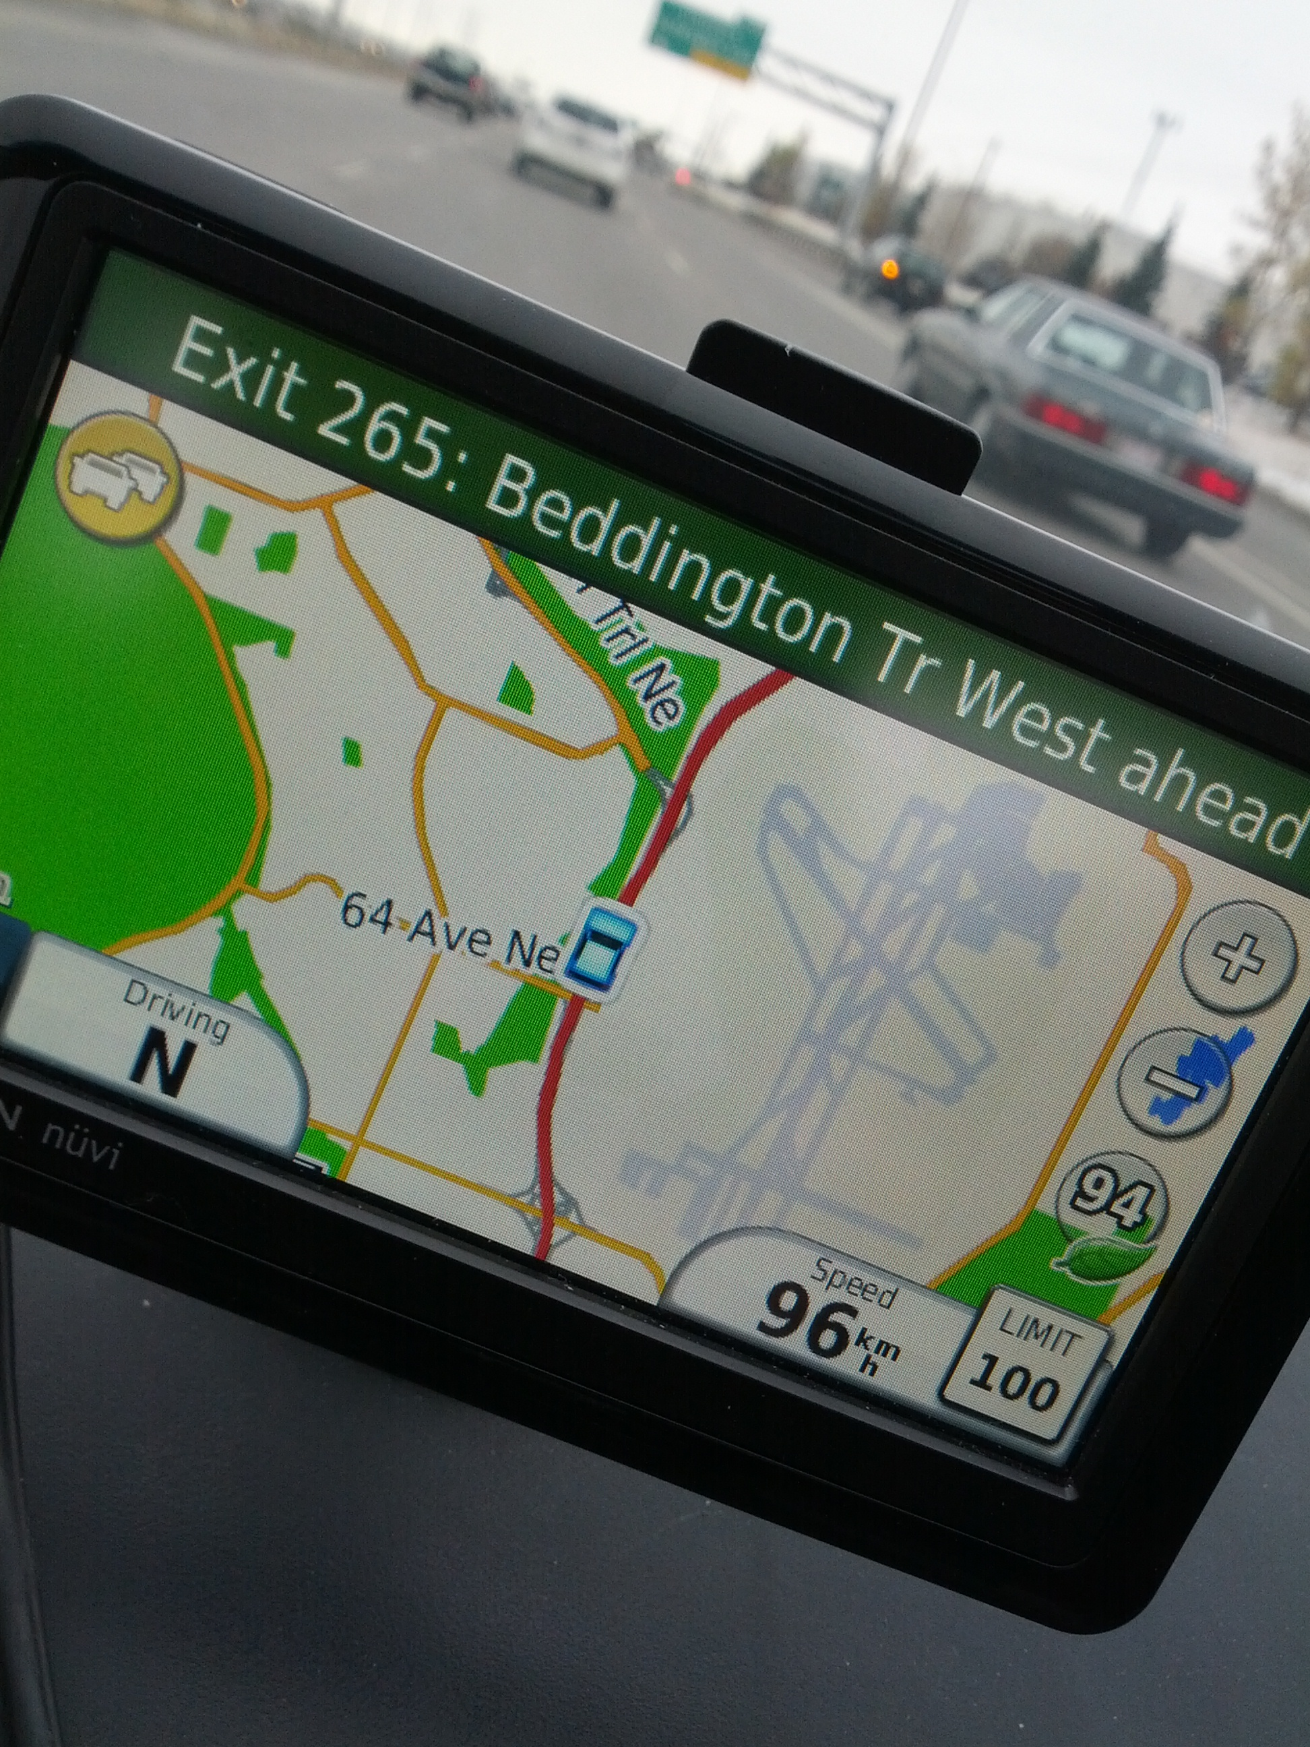
I hate my GPS
Notes:
Okay, whatever… here I am again.
Wait, where’s the traffic exactly?

Slide 20
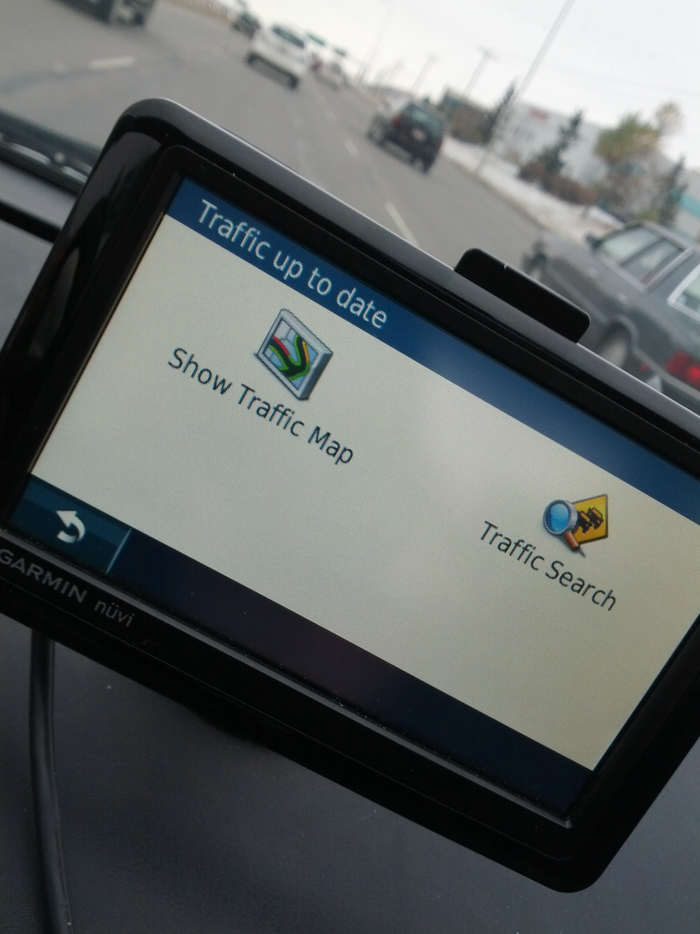
I hate my GPS
Notes:
Uh… those two screens look basically the exact same.
I’m DRIVING for goodness sake. I don’t have time to read a one word difference

Slide 21
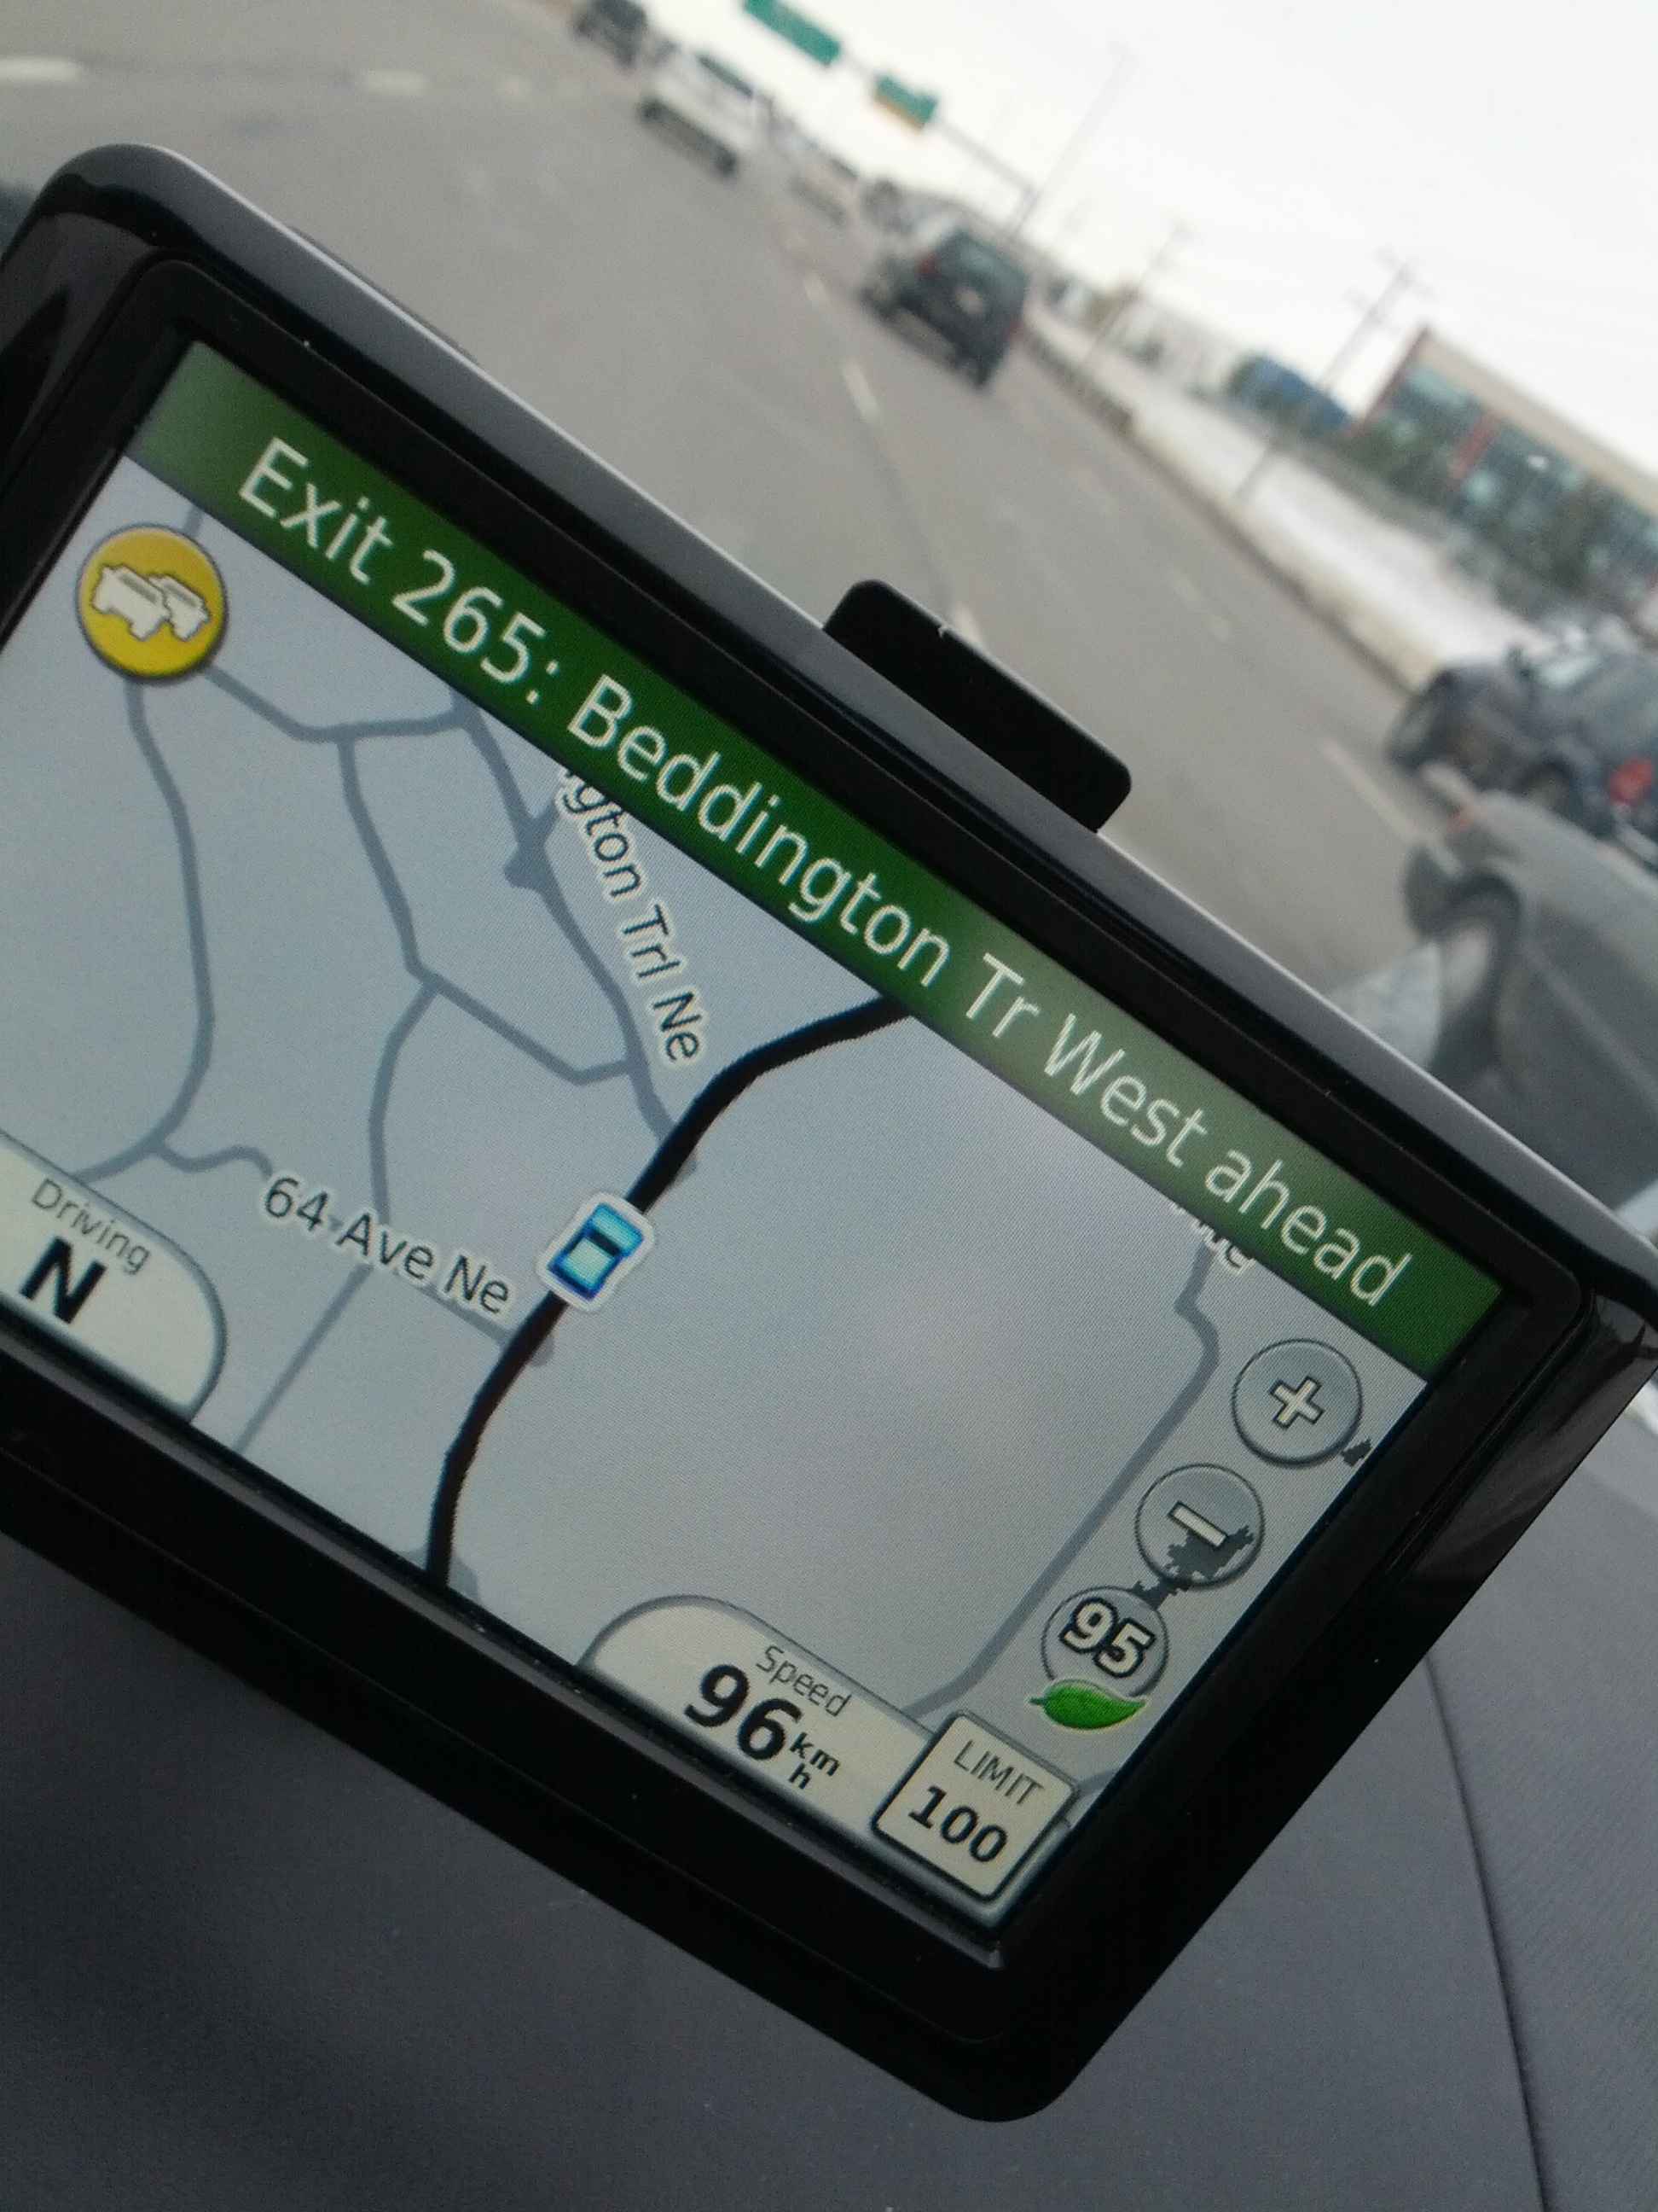
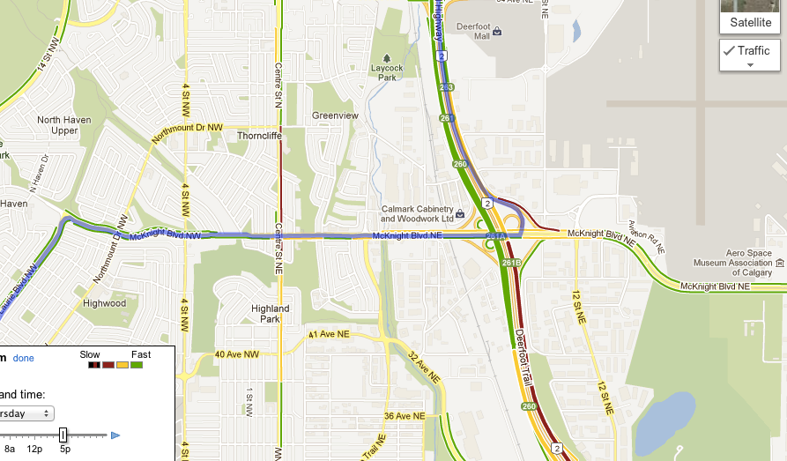
I hate my GPS
Notes:
Back at this useless screen.
WHERE IS MY TRAFFIC!?
I can see the traffic ahead – totally useless on the timing there
Why does it have to be a different mode? Lots of people have integrated maps already
If I have to switch, why does the screen not be more distinctive?
Finally, what the hell happens if I’m in a mode that doesn’t allow me to touch the screen?

Slide 22
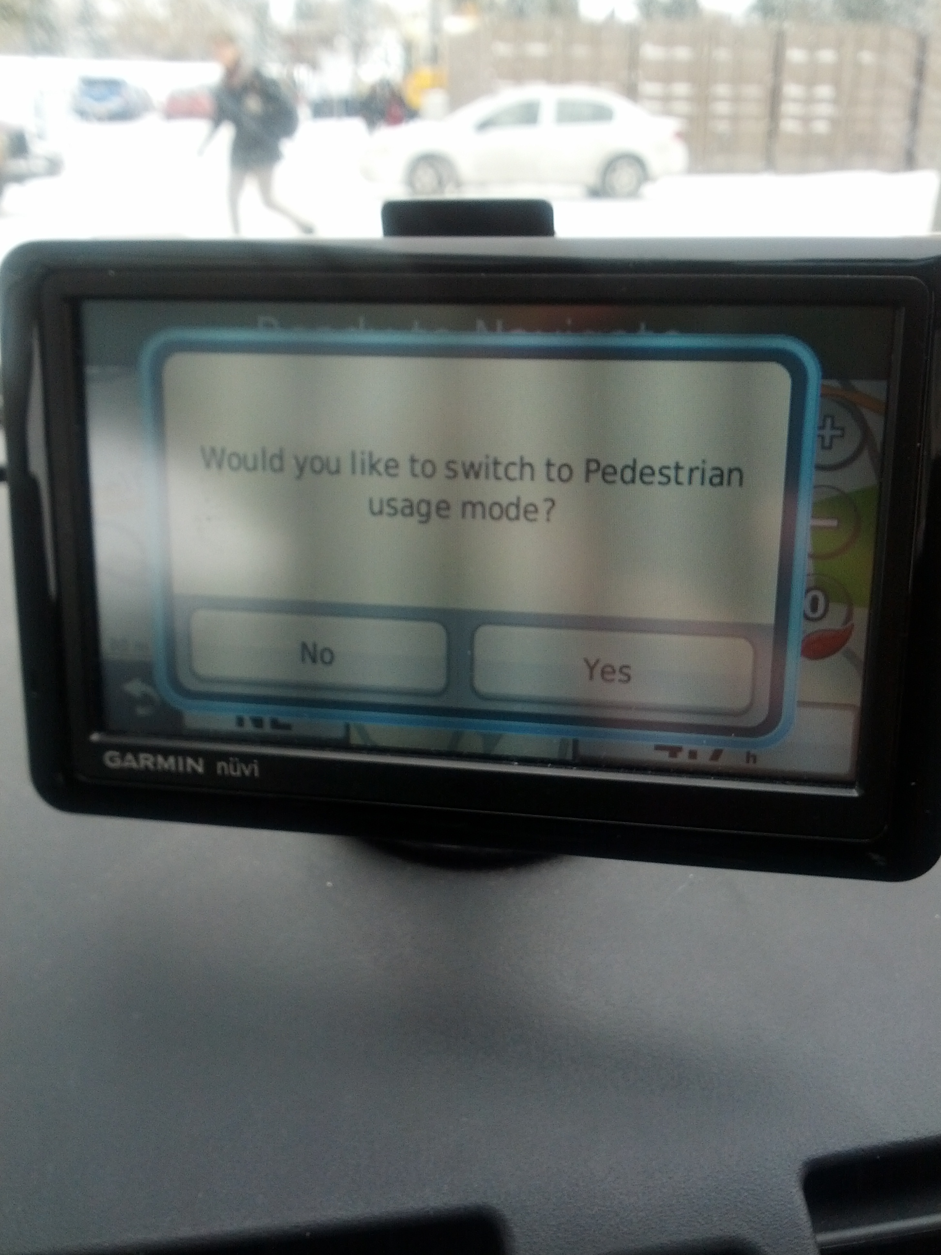
I hate my GPS
Notes:
Yes, there’s traffic, but seriously?!!

Slide 23
Problems with my GPS
Modes
Failure to recognize/address my (the operator’s) attention/capabilities in the moment
and more…

Slide 24
Pathological design: slide projector
Remote control from Leitz slide projector
How do you forward/reverse?
Instruction manual:
short press: slide change forward
long press: slide change backward

Slide 25
Pathological design: PHONES
Modern telephone systems
standard number pad
two additional buttons * and #
Problem
many hidden functions
operations and outcome completely invisible
*72+number = call forward
can I remember that combination?
if I enter it, how do I know it caught?
how can I remember if my phone is still forwarded?
Ok, I’ll read the manual
but what does call park mean? what's a link?
where is that manual anyway?

Slide 26
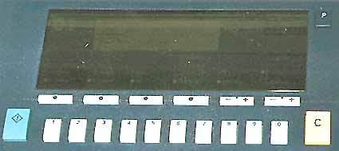
Pathological design: photocopiers
You want to make 15 copies, sorted and stapled.
You type in “1” then “5”, and then you press “C” to start the copying.
What happens next?
The photocopier makes the copies correctly
The copier settings are cleared, and no copies are made.
Notes:
http://www.baddesigns.com/copier.html

Slide 27
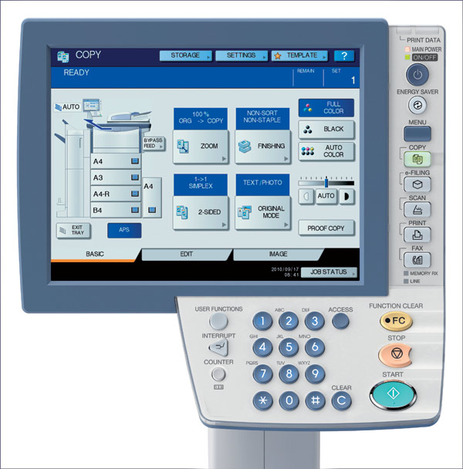
Pathological design: photocopiers
Better?
Safely:
» most functions never get used
» most buttons are never touched
Notes:
http://www.clubcopying.co.uk/toshiba-office/photocopiers/mfd-colourprinters/estudio5540c/

Slide 28
Lessons from these pathological designs…
Many problems can be identified by meaningfully considering the context of use and user (rather than considering “features”)
Evaluation! Usability + heuristic evaluations can play a huge role in helping to identify issues.

Slide 29
Getting serious about design
World War II
complex machines (airplanes, submarines...)
taxed people’s sensorimotor abilities to control them
frequent (often fatal) errors occurred even after high training
example airplane errors:
if booster pump fails, turn on fuel valve within 3 seconds
test shows it took ~five seconds to actually complete a fuel valve “turn on”
Spitfire: narrow wheel base
easy to do violent ground loops which breaks undercarriage
Altimeter gauges difficult to read
caused crashes when pilots believe they are at a certain altitude
Result
human factors became critically important
Slide ideas from David Hill

Slide 30
What’s the altitude?
Early days (< 1000’):
only one needle needed
0
9
1
As ceilings increased over 1000’
small needle added
8
2
As they increased beyond 10,000’
box indicated 10,000’ increment through color change
7
3
6
4
5
< 10,000’
> 10,000’
Slide ideas from David Hill

Slide 31
Tape altimeter
Human factors test showed:
eliminated reading errors
was faster to read
But not in standard use! Why?
14000
900
000
15000
100
200
16000
300
reference line
400
17000
500
18000
600
independent
movement
Slide ideas from David Hill

Slide 32
Harvard Airplane (World War II)
Undercarriage crashes
pilots landed without dropping undercarriage!
undercarriage warning horn
sounds if wheels up and power low (landing condition)
Stalls
plane airspeed drops too low to maintain lift
if occurs just before landing, will crash
Training
deliberately stall and recover
but sometimes similar to landing with undercarriage up
horn sounds, annoyance
installed “undercarriage horn cut-out button”
Oops! Now why did I do that?
Slide ideas from David Hill

Slide 33
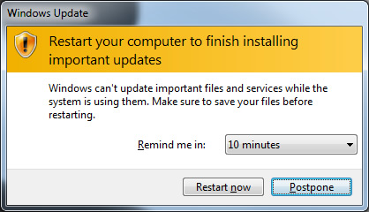
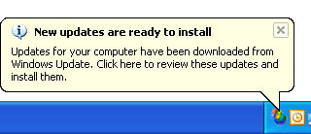
The Harvard Control Panel
U/C horn
cut-out
button
Problem #1: Conditioned response
stall -> push button; therefore stimulus nullified
Slide ideas from David Hill
Notes:
Where else do we see conditioned responses in our standard interfaces?
Why is this one so easy to ignore?

Slide 34
The Harvard Control Panel
The T-33 Control Panel
U/C horn
cut-out
button
Tip-tank jettison button
Problem #2: Negative transfer
T-33’s: tip-tank jettison button in same location
Slide ideas from David Hill
Notes:
Negative transfer…

Slide 35
Lessons
Dangers of conditioned responses (i.e. “confirmation dialogs”)
Dangers of negative transfer (i.e. importance of consistency)

Slide 36
The single key press
from InfoWorld, Dec ’86
“London— An inexperienced computer operator pressed the wrong key on a terminal in early December, causing chaos at the London Stock Exchange. The error at [the stockbrokers office] led to systems staff working through the night in an attempt to cure the problem”

Slide 37
More powerful key presses
from Science magazine
In 1988, the Soviet Union’s Phobos 1 satellite was lost on its way to Mars, when it went into a tumble from which it never recovered. “not long after the launch, a ground controller omitted a single letter in a series of digital commands sent to the spacecraft. And by malignant bad luck, that omission caused the code to be mistranslated in such a way as to trigger the [ROM] test sequence [that was intended to be used only during checkout of the spacecraft on the ground]”

Slide 38
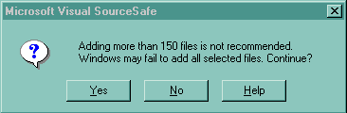
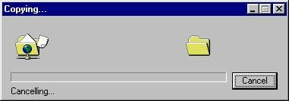
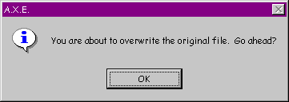

Inane Dialog Boxes
Umm, thanks for the warning,
but what should I do?
What happens when you cancel a cancelled operation?
Do I have any choice in this?
Uhhh… I give up on this one
Some of these interfaces were posted on Interface Hall of Shame

Slide 39
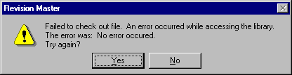
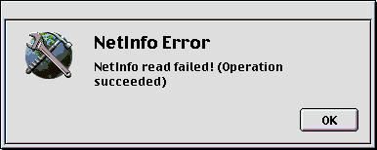
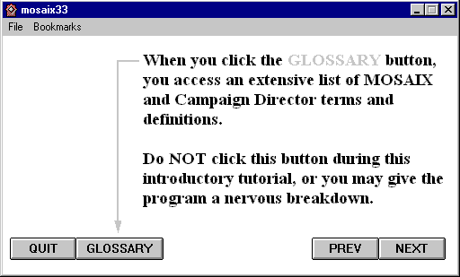
Inane Dialog Boxes
These are too good not to show
Some of these interfaces were posted on Interface Hall of Shame

Slide 40
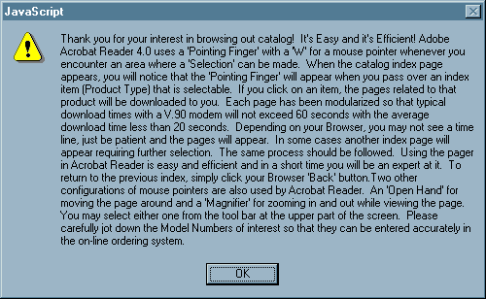
Inane Dialog Boxes
Midwest Microwave's online catalog
Some of these interfaces were posted on Interface Hall of Shame

Slide 41
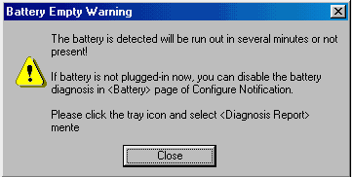
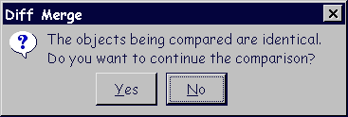
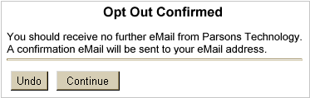
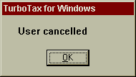
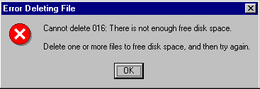
Inane Dialog Boxes
ClearCase, source-code control Rational Software
Some of these interfaces were posted on Interface Hall of Shame

Slide 42


Bad hosting company system

Slide 43
Why should you care?
Past
manufacturers had little incentive to emphasize usability
customers have no experience until after they buy the product
early technology adaptors were ‘resilient’
willing to put up with annoyances
consequences of bad design typically small (annoyances)
Slide idea from Jacob Nielsen Alertbox March 15, 2004

Slide 44
Why should you care?
Today: Usability sells
product reviews emphasize usability (e.g., Consumer Reports)
customers have used related products, and can often download trial versions (including competitors)
today’s users are impatient and intolerant of bad design
consequences of bad design now large
costly errors in serious systems (e.g., financial institutes)
widespread effects (e.g., incorrect billing, failures)
life-critical systems (medical, air traffic control)
safety (in-car navigation systems)

Slide 45
Why should you care?
Professionalism
software engineers are designers
we are ultimately responsible for the products we build
a history of ‘hack’ designs does not excuse our responsibilities
Compared to civil engineers
What would happen to an engineer who built a bridge where people fell off of it into the river (because the guard rails were too low), and where accidents were high (because the bridge was too narrow)?
We would call this incompetence.
The same standard should apply to software engineers.

Slide 46
Learning Objectives
You should now be able to:
» Re-orient others into thinking about “human error” to “design errors” (and understand why the former is a common way of thinking)
» Understand the difference between functional testing and usability testing (and the value of each!)
» Understand the dangers of conditioned responses and negative transfer
» Argue why system designers/engineers should care about usability

