Slide 1

What aspect of usability is this clip illustrating?
Notes:
http://images6.fanpop.com/image/photos/35600000/Agents-of-S-H-I-E-L-D-agents-of-shield-35640423-1920-1080.jpg
http://www.youtube.com/watch?v=SeiJ2jHyy7U
(Learnability/discoverability)
(Memorability)
(Errors)
(Satisfaction)

Slide 2
Usability Testing 2
CPSC 481: HCI I
Fall 2012
Anthony Tang

Slide 3
Learning Objectives
At the end of this lecture, you should be able to:
» Know how to select users for a usability test, and how many
» Be able to describe how to analyze data
» Describe three different usability test protocols, and their pros and cons
» Define external validity, and evaluate a usability test for external validity

Slide 4
Usability Testing: Users
Who?
Depends on your needs
Goal: get the people that will be using it, or people that represent those that will be using it
How many?
Considerable debate in the community. Rule of thumb: ~5

Slide 5
Usability Tests: How many users?
Main argument: If you have 15 people, it’s better to test three designs with 5 users each, rather than one design with 15 people. ➔ Pragmatics, bang for buck
Notes:
Nielsen & Landaurer (1993)
http://heb.freeshell.org/ie662/lecture7small.pdf
Only equation in the class
Rationale: you learn almost right away what is working well and what isn’t. if the first three people can’t login, you’re probably better off fixing the login page, rather than testing another 12 people on it
Most usability tests will help show you obvious problems, and those are the ones you want to get rid of right away

Slide 6
Making sense of your data
Look for:
Big obvious problems
Error trends
Trends in comments
Group issues in terms of severity/priority
1: must fix/brick wall
2: should fix/okay to wait
3: okay as is/could be improved
Notes:
http://www.how-to-kiss.us/get-to-know-someone.html

Slide 7
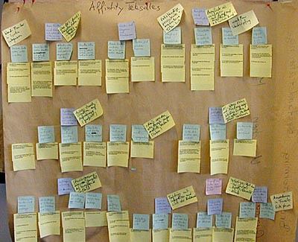
Making sense of your data
Affinity diagrams
Notes:
http://www.baran-systems.com/Products/Affinity%20Diagram%20for%20Excel/index_concept.htm
You’re doing this type of thing this week in tutorial. The main idea is to cluster ideas and observations so that you can make sense of what’s going on

Slide 8
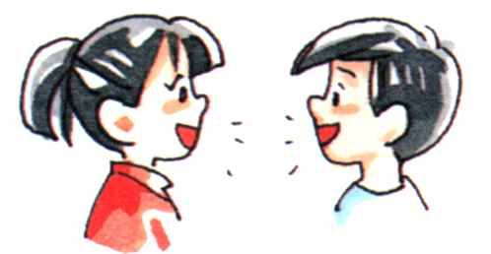
Making sense of your data
Discussion with others who watched with you
Notes:
http://www.how-to-kiss.us/get-to-know-someone.html
Part of affinity diagramming.

Slide 9
Making sense of your data
Look for:
Big obvious problems
Error trends
Trends in comments
Group issues in terms of severity/priority
1: must fix/brick wall
2: should fix/okay to wait
3: okay as is/could be improved
Notes:
http://www.how-to-kiss.us/get-to-know-someone.html

Slide 10
Usability Testing: Providing Feedback
Based on your list of issues, provide a small handful of suggestions on how to address the issue
Depending on the part of the design cycle you are in (early, middle, late), these should be bigger or smaller suggestions
Provide video “proof” of people encountering issues
ITERATE ON THE DESIGN!!?!?!?
Sample final report:
http://www.utexas.edu/learn/usability/report.html
Notes:
http://www.utexas.edu/learn/usability/report.html

Slide 11
What users do video-hotel
Design of a web-based interface for reserving a hotel room (under various circumstances)
Ran several users through tests of the interface
Did a screen capture of these test users as they went through the interface (asking users to speak aloud)
This is “video evidence” produced for the developers
Notes:
http://www.youtube.com/watch?v=HAiJCPWMGss

Slide 12
Notes:
Now we’ve talked about some of the practical details of the entire usability testing process, I want to get a bit into how it actually looks when you’re in a testing process.
To illustrate this idea, I need two volunteers.

Slide 13
Need two volunteers with high self-esteem
Notes:
Think-aloud protocol with the overhead projector

Slide 14
Think-aloud protocol
As participants complete a task, you ask them to report
» what they are thinking
» what they are feeling
» rationale for their actions and decisions
Idea: rather than interpret their actions/lack of action, you can actually understand why they are doing what they are doing

Slide 15
Think-aloud protocol
What’s weird:
People are not normally used to saying things out loud as they work.
They may also be embarassed to say things out loud.

Slide 16
Co-discovery Learning prototcol
Main idea: remove the awkwardness of think-aloud
Two people sit down to complete tasks
Only one person is allowed to touch the interface
Monitor their conversation
Variation: use a semi-knowledgable “coach” and a novice (only the novice gets to touch the design)

Slide 17
Conceptual Model Extraction
Show the design, but don’t say how it works
Ask the user to explain
» function of each element
» how they would perform a particular task

Slide 18
Conceptual Model Extraction
Initial conceptual model (before they use it)
Formative conceptual model (after they’ve used it)
Good for: eliciting a user’s understanding before and after use
Bad for: understanding exploration and learning

Slide 19
Three Basic Usability Test Protocols
Think-Aloud Protocol
Co-Discovery Protocol
Conceptual Model Extraction

Slide 20
Variations on Usability Tests
How well do people learn the interface?
Does the interface work with people’s actual real-life interactions?
How well does this interface work when people are busy with other things?
How well does this interface work with only a few seconds of interaction at a time?

Slide 21
Quick interlude with a snapshot from real life…

Slide 22
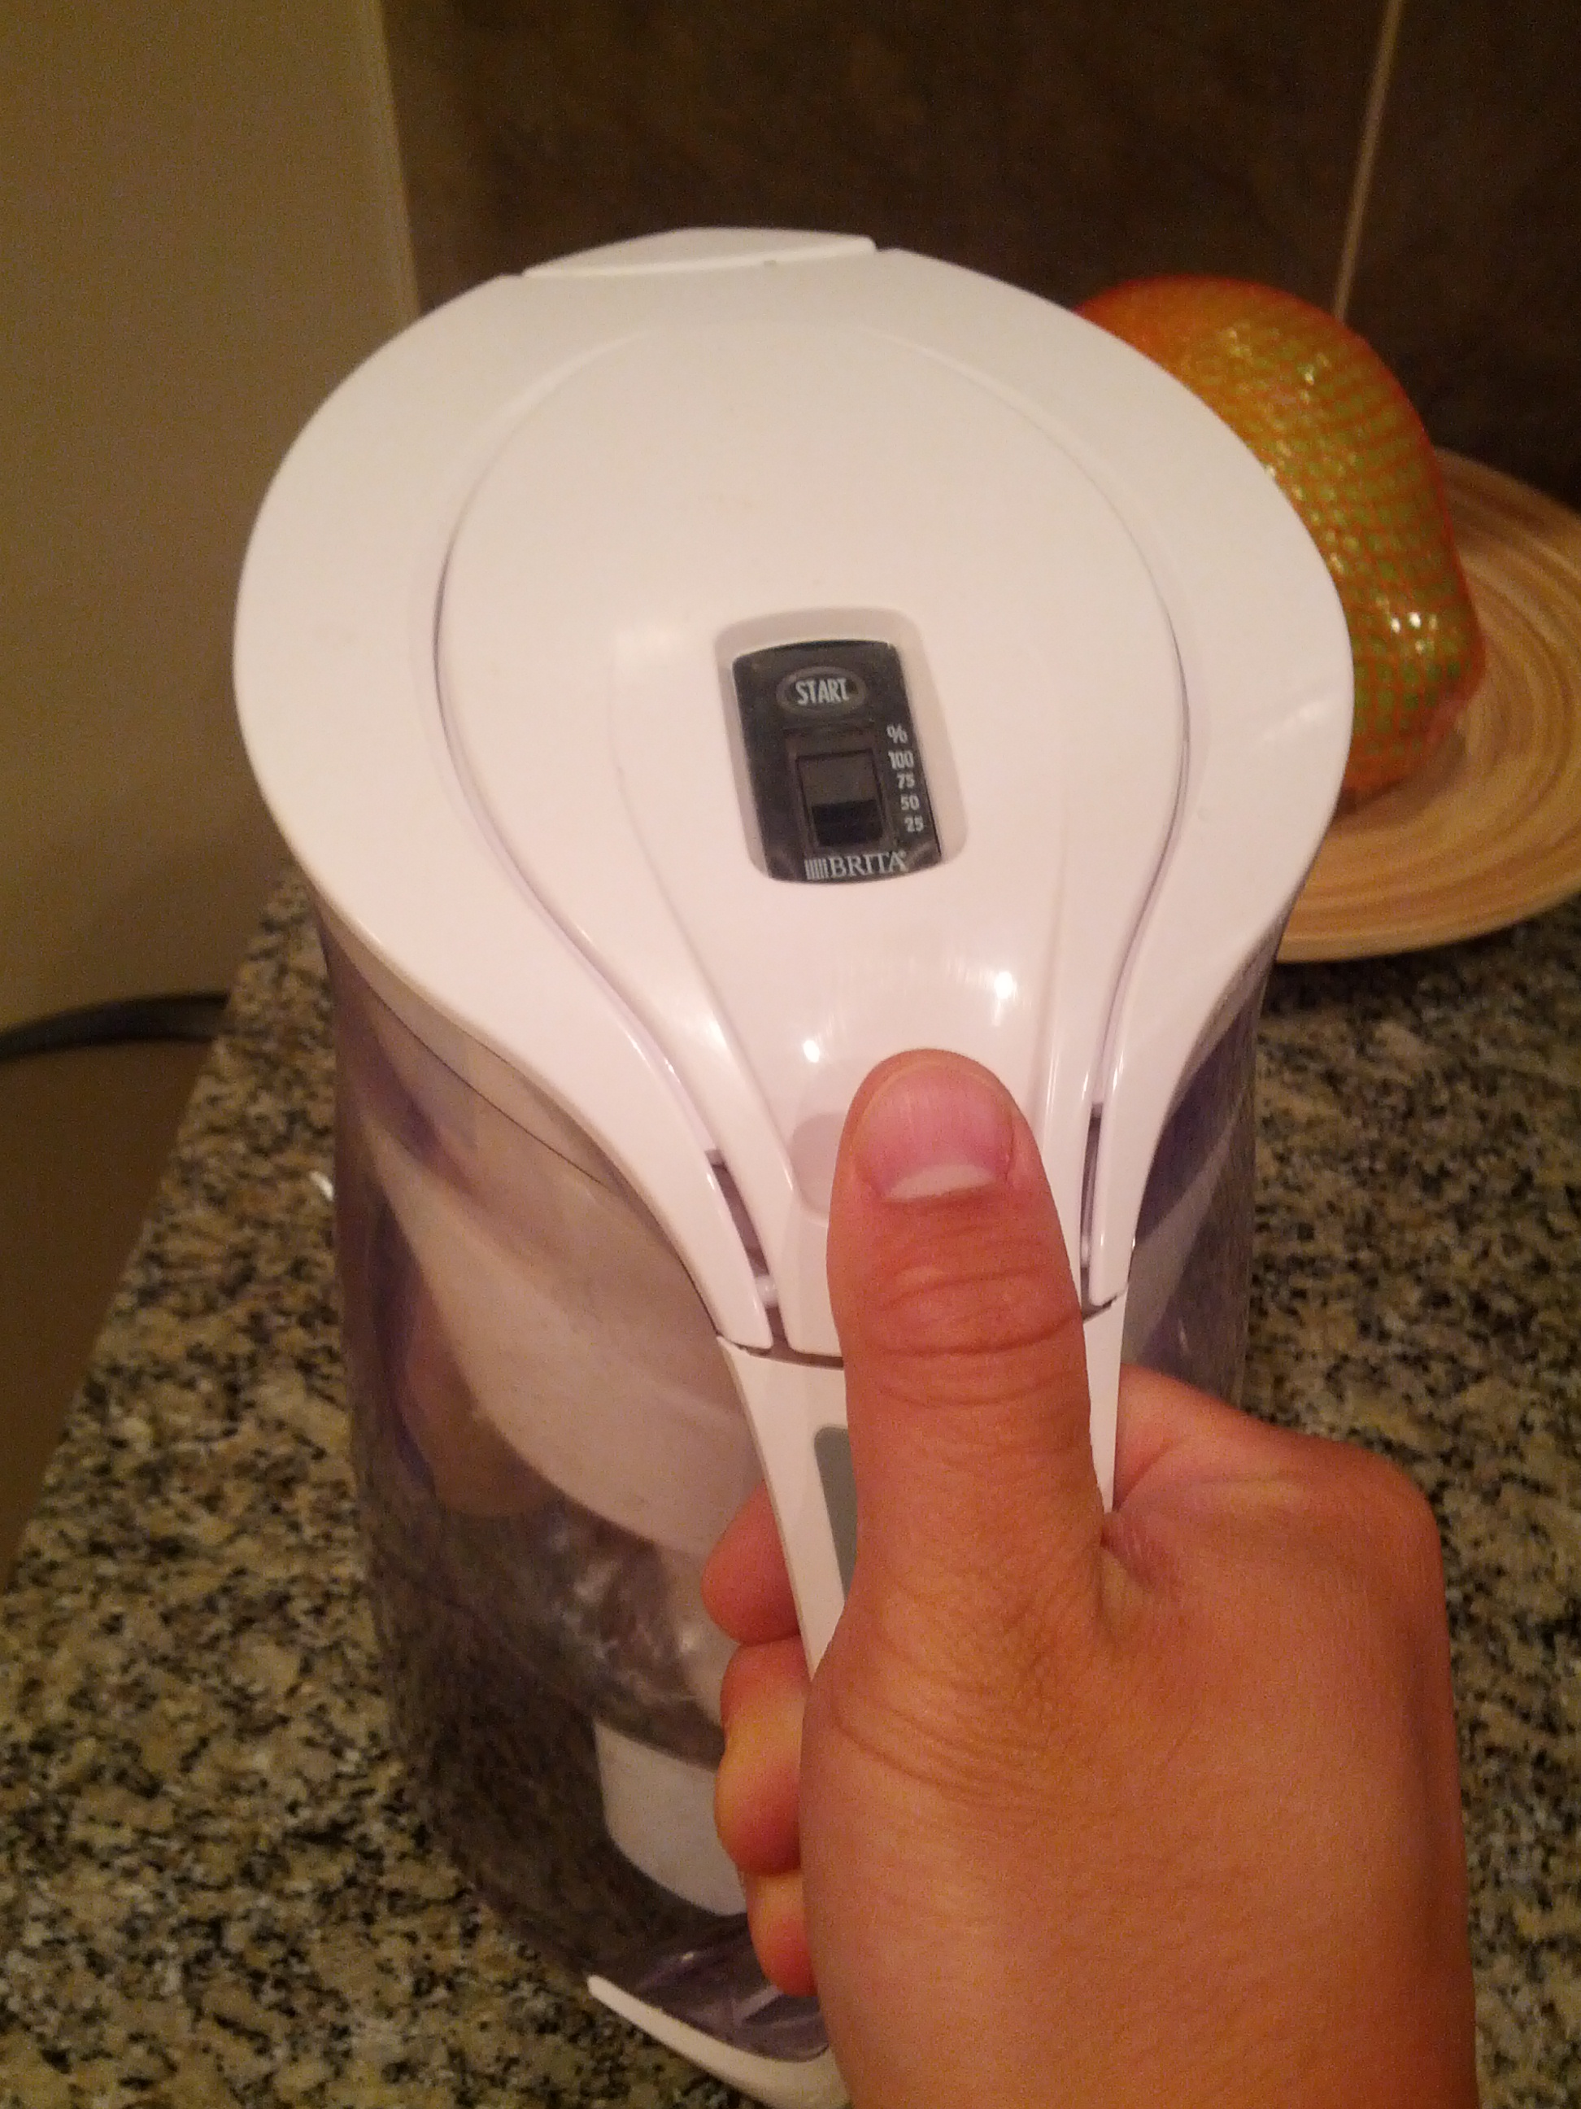

Slide 23
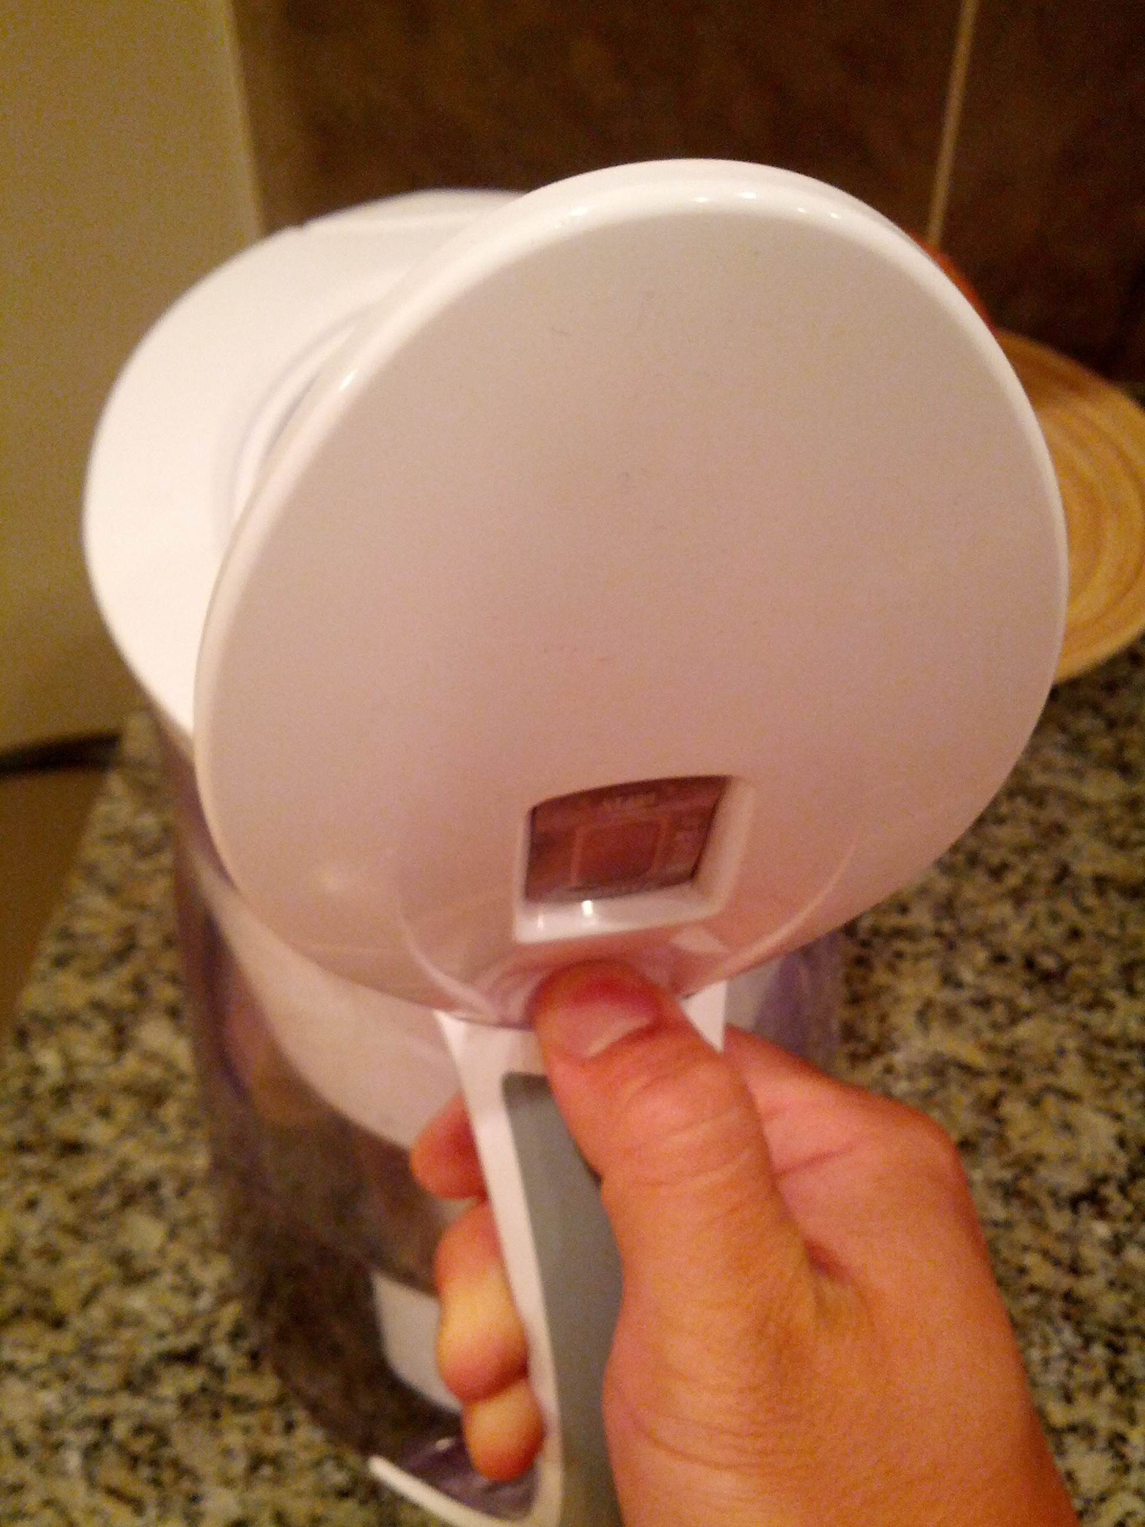

Slide 24
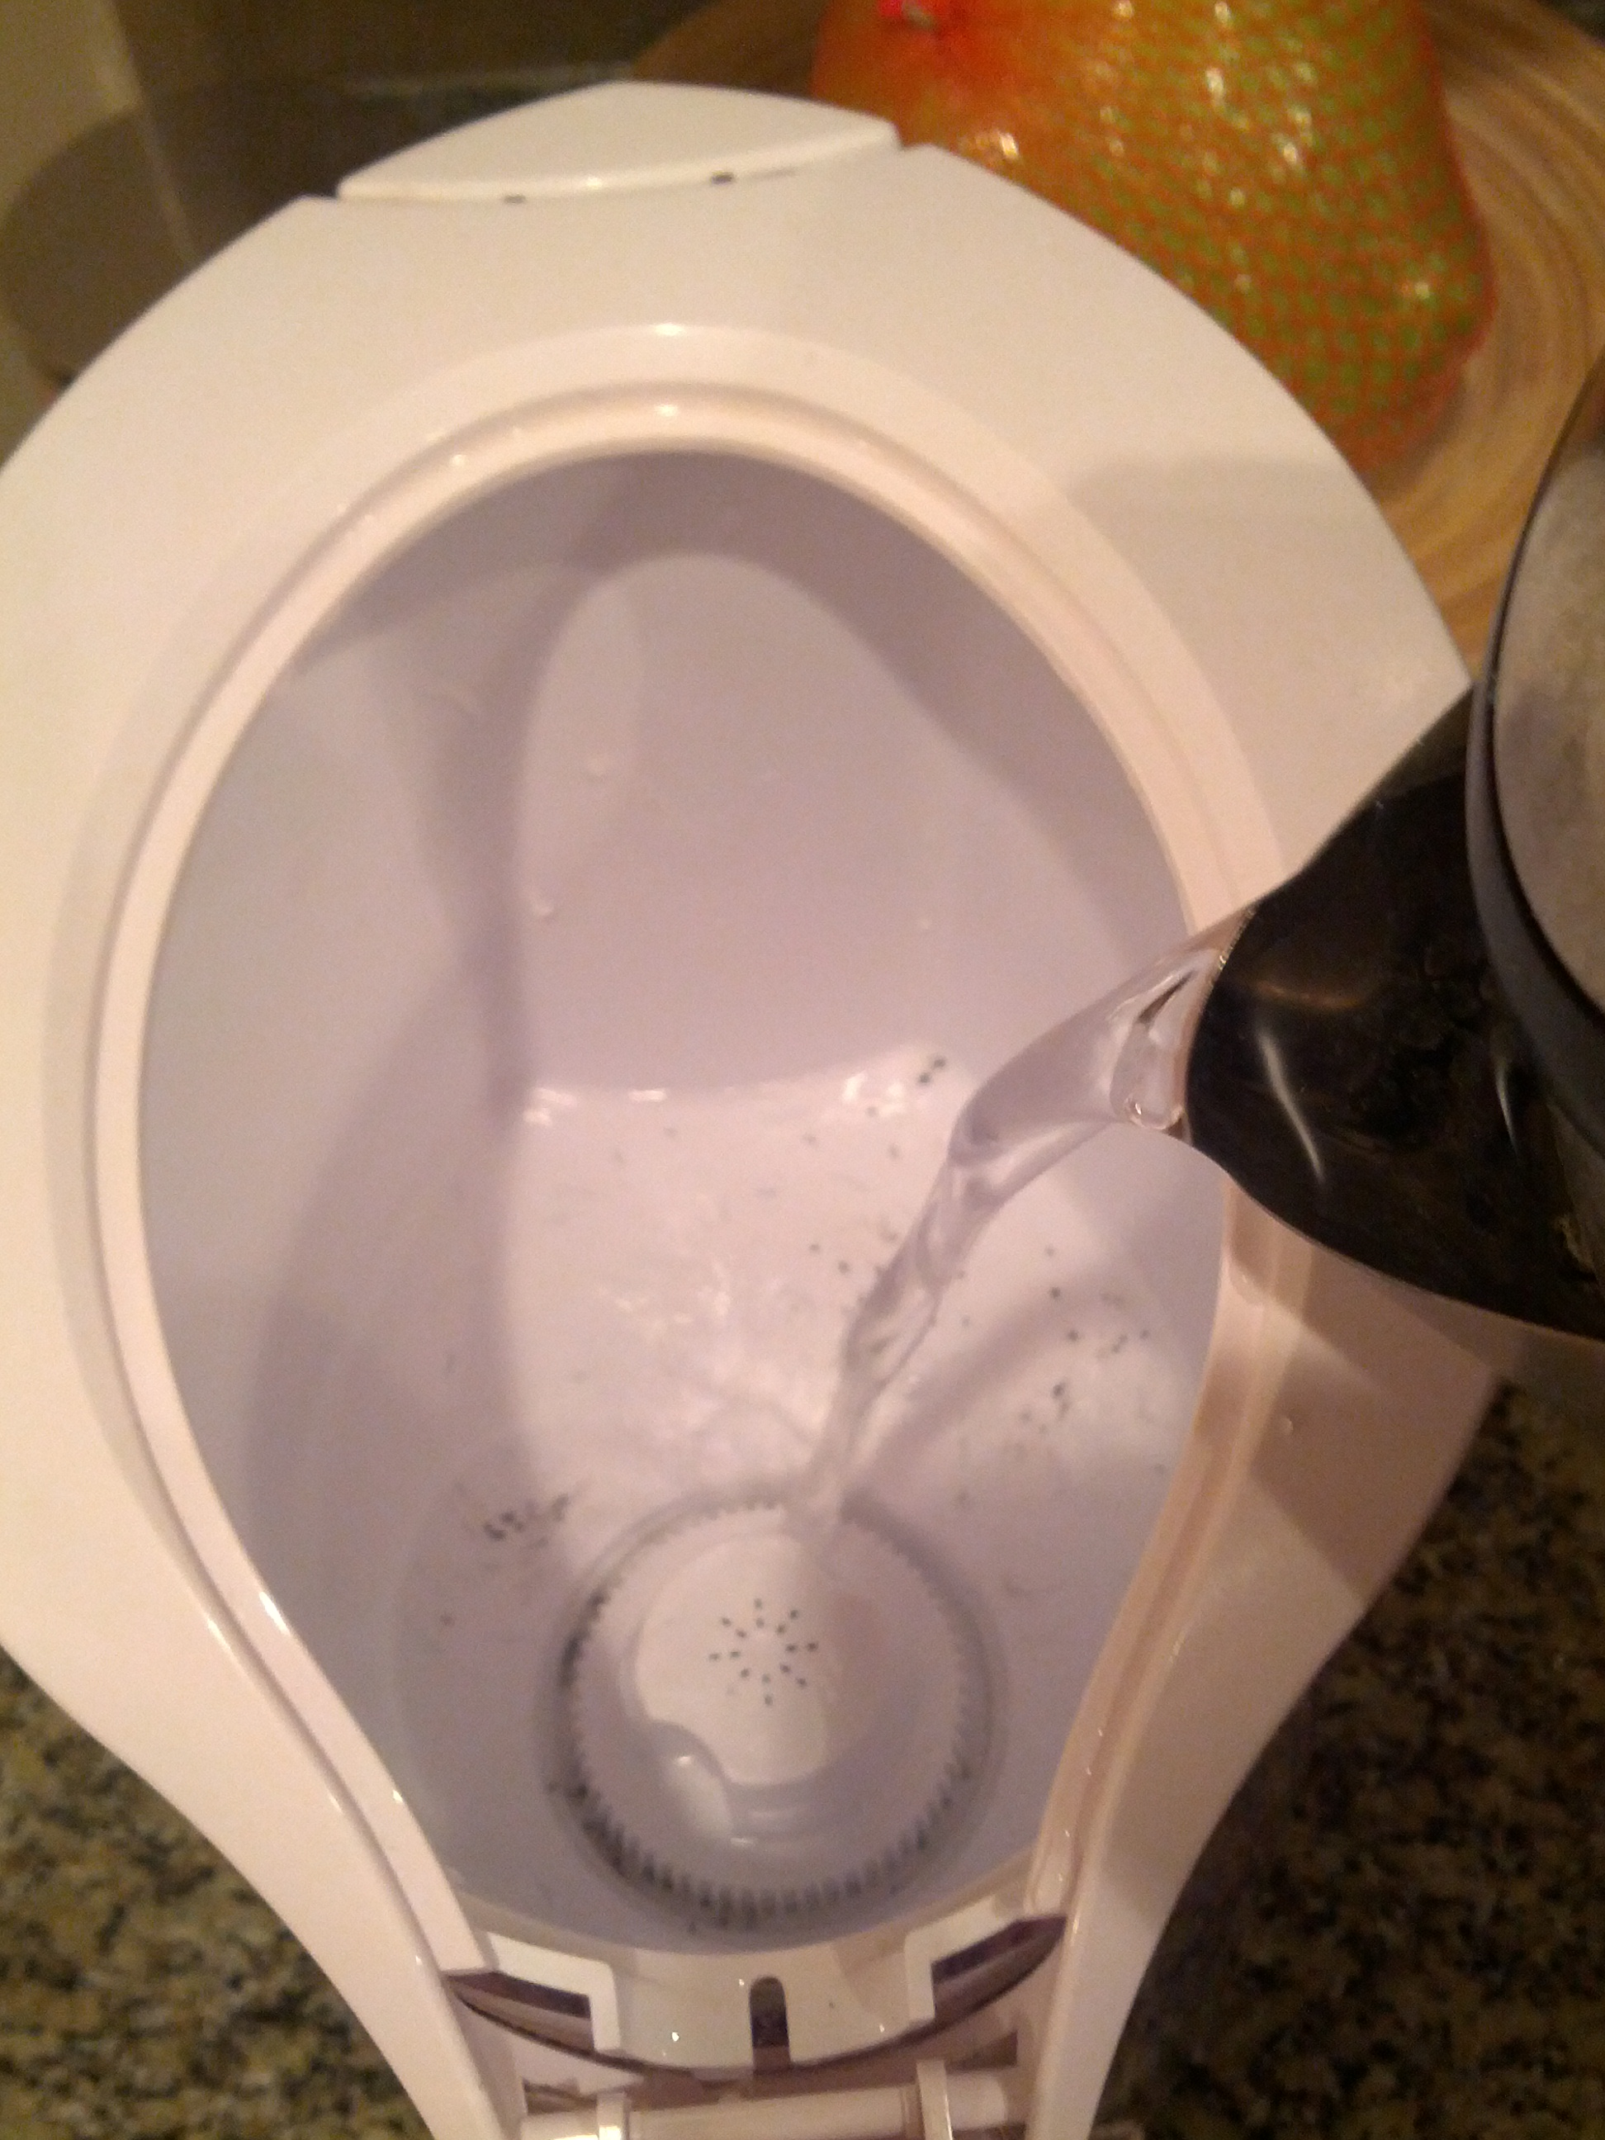

Slide 25
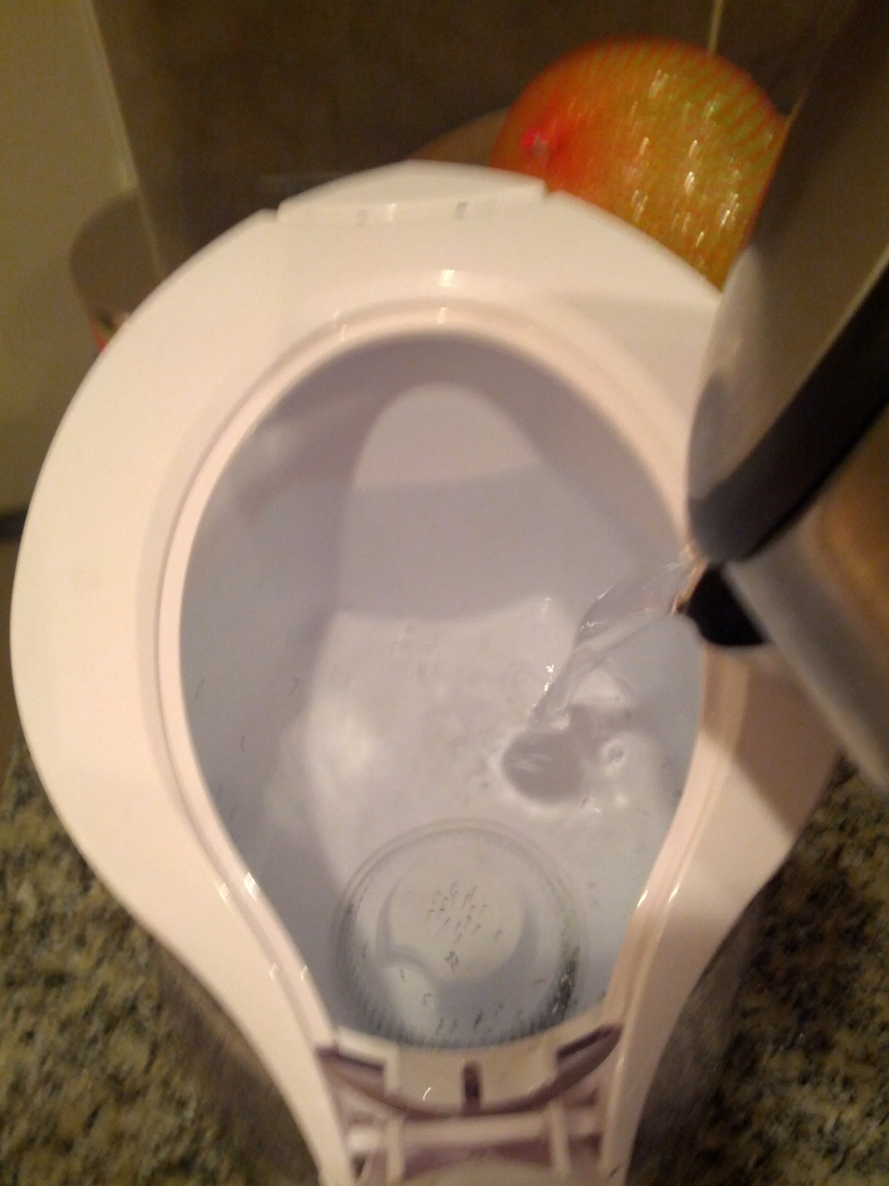

Slide 26
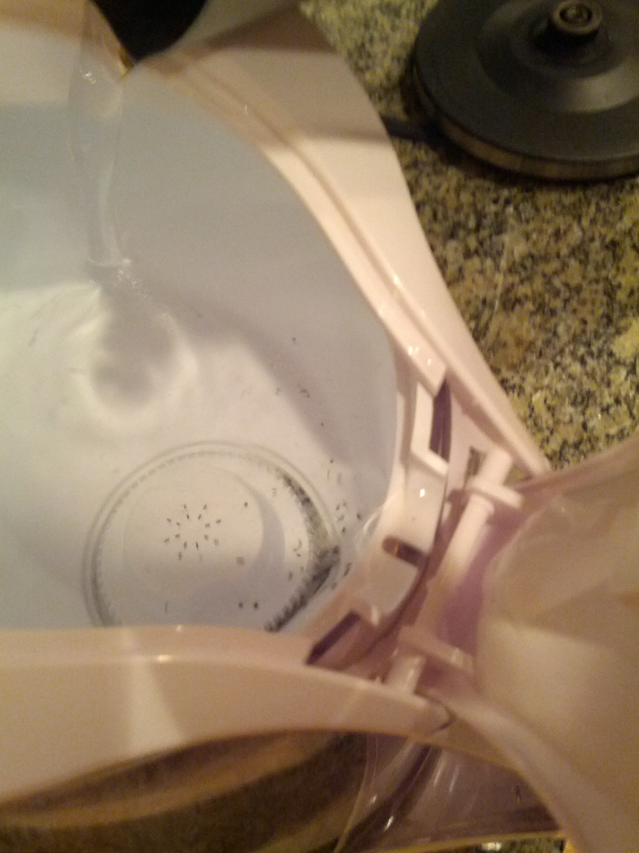
SPILLAGE!!!

Slide 27
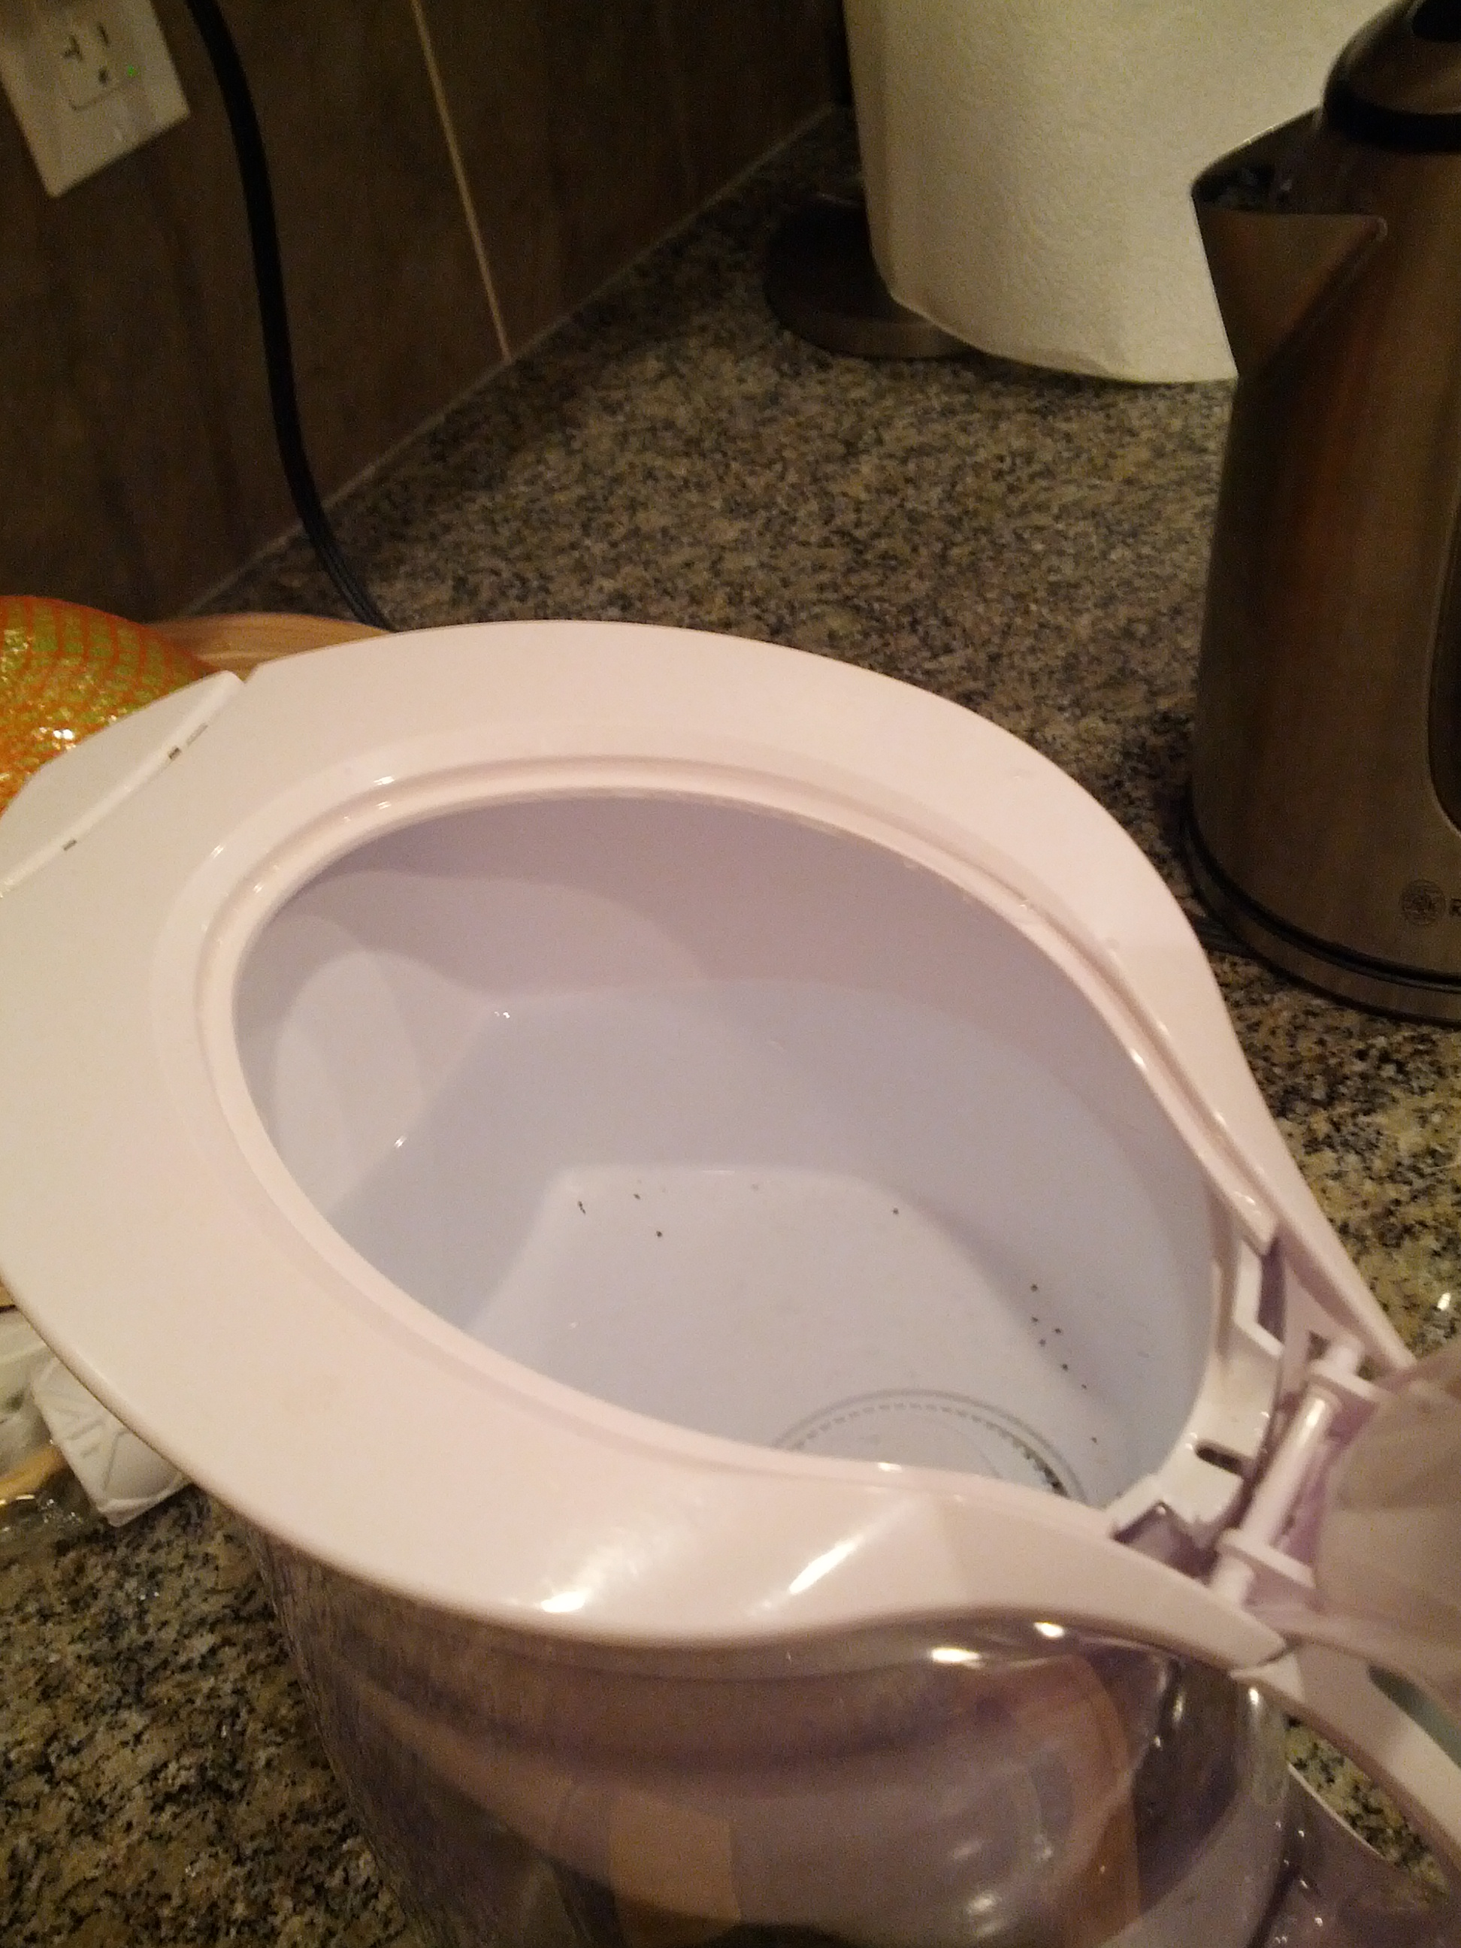
“Pour more!”
SPILLAGE!!!

Slide 29
Experimental Validity
External validity » realism
Across situations
Across people
Internal validity » integrity
Confound
Selection bias
Learning effects
Priming
Experimenter bias

Slide 30
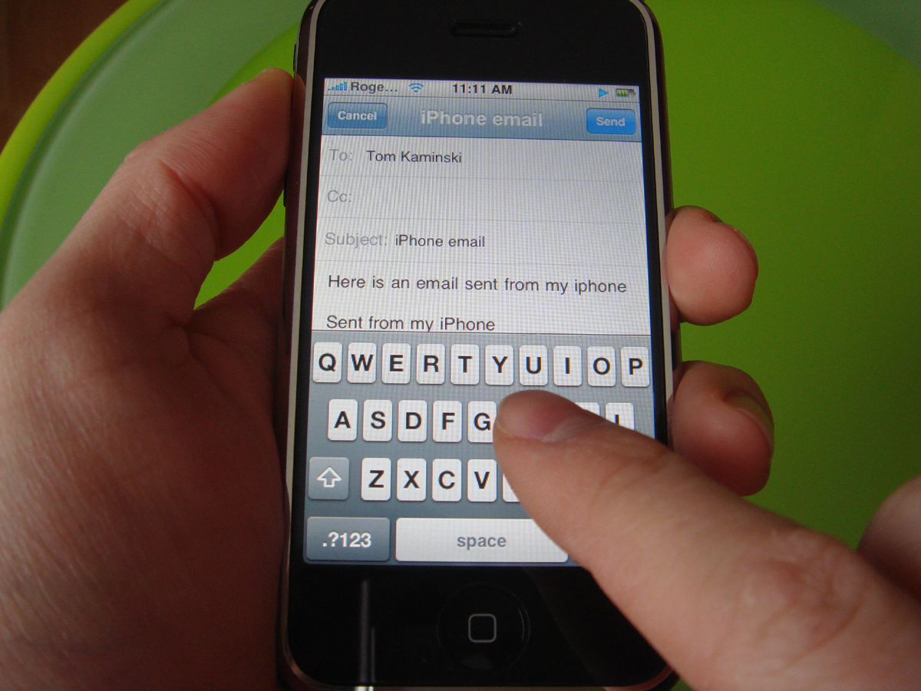
Imagine this test…
Design a typing interface for use while driving cars.
Bring people into the lab, put them at a desk.
Ask them to write an email, and time how long it takes.
Notes:
http://crackberry.com/files/u3/roundrobin/iphone/iphone6.jpg
At least one hand needed to drive!
What about attention and distractedness?
How will the device be held?

Slide 31
External Validity » Across Situations
Does the test situation match the situation that the design will be used in?
Does it match at least in critical ways?
What are aspects that are different?
Artificiality

Slide 32
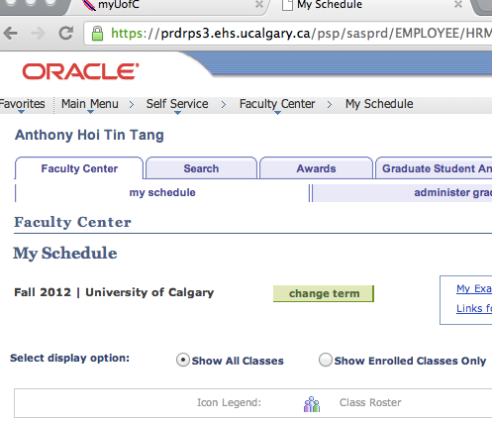
Imagine this test…
Recruiting developers of PeopleSoft, ask them to register for courses.
Because they can register for their courses within 5 minutes, the interface is deemed usable.

Slide 33
External Validity » Across People
Are test subjects representative of the target user population?
Is it a randomly selected group, or are there constraints on how the group is selected that may affect test results?
Generalizability across a population.

Slide 34
Learning Objectives
You should now be able to:
» Know how to select users for a usability test, and how many
» Be able to describe how to analyze data
» Describe three different usability test protocols, and their pros and cons
» Define external validity, and evaluate a usability test for external validity

