Slide 1
Usability Testing
CPSC 481: HCI I
Winter 2014
Anthony Tang

Slide 2
Learning Objectives
At the end of this lecture, you should be able to:
» Discuss the goals of the “evaluate” phase, and understand how this plays out in an organization
» Understand the role of a usability experiment
» Describe five testable aspects of interfaces in usability experiments
» Understand how to pick good usability tasks
» Describe five testable metrics in usability experiments

Slide 3
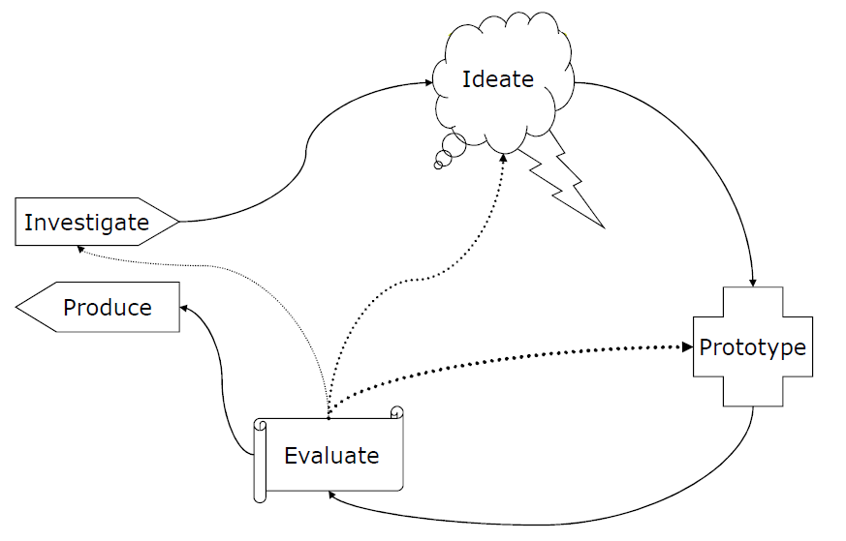
User Centered Design Cycle
Discover problems
Assess progress
Determine next steps

Slide 4
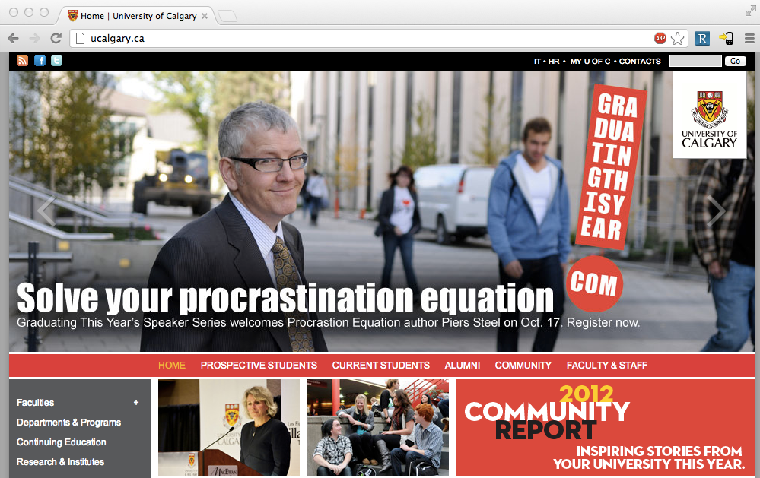
Notes:
Let’s suppose you were part of the design team for ucalgary.ca
What now? You have a design
What will you evaluate?
How will you evaluate this?

Slide 5
Within an organizational context
Reviews with stakeholders
Usually, fairly cursory as a presentation / part of a meeting
General flow, look/layout/feel
Useful for: getting people on board
Tests with users
See whether it actually works with real people
Looking for the problems that people encounter
In organizations w/ poor design: part of “quality assurance” (aka “testing”)
Reviews with stakeholders
Usually, fairly cursory as a presentation / part of a meeting
General flow, look/layout/feel
Useful for: getting people on board
Tests with users
See whether it actually works with real people
Looking for the problems that people encounter
In organizations w/ poor design culture: part of “quality assurance” (aka “testing”)

Slide 6
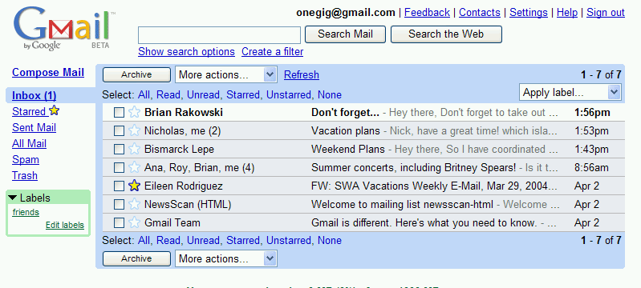
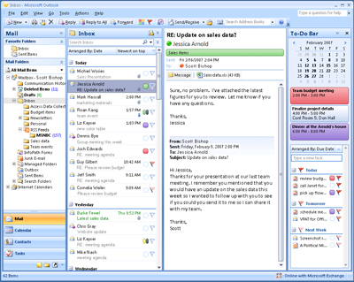
Which is better?
Notes:
Which of these would be easier to use?

Slide 7
Usability Test
A usability test is a “formal” method for evaluating whether a design is learnable, efficient, memorable, can reduce errors, and meets users’ expectations.
Users are not being evaluated
The design is being evaluated
Notes:
This is an important point—that users are not the ones being evaluated. Although we recruit them, and ask them to complete tasks for us, and we watch them fail, the key is that what we are evaluating Is whether the design is making it something that they can do

Slide 8

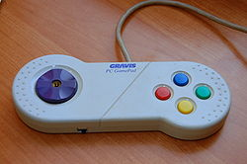
Learnable, memorable, but inefficient
Notes:
Next few sets of slides – imagine you were evaluating the interfaces, and what would you say about whether they were good or bad
Intuitively, these ideas are what we are trying to capture in a usability test… learnable? Efficient? Satisified? Reduces errors (playing errors)? Some of these ideas are obvious with interfaces that we know well, but they get really tricky when it’s interfaces that people DON’T know well.
Easy to learn, but less task coverage (and perhaps inefficient)

Slide 9
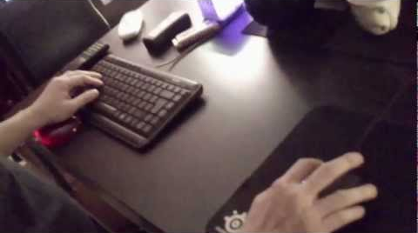
Difficult to learn, but efficient
Mouse left
Mouse right
W
A
D
S
Notes:
Difficult to learn, but efficient

Slide 10
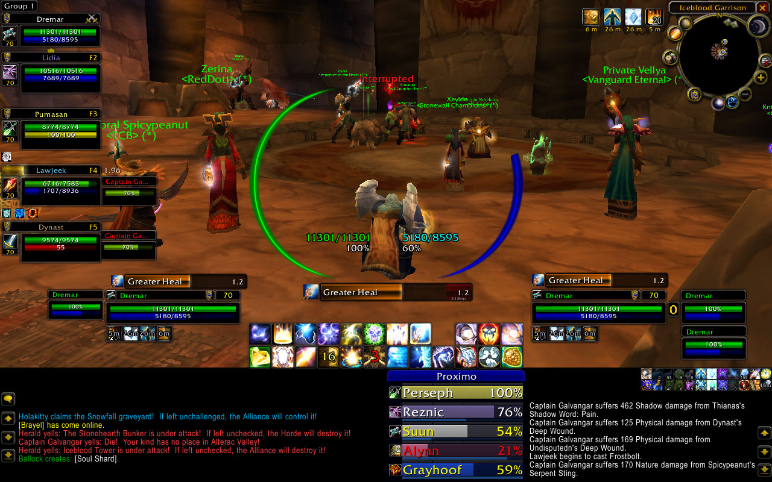
Difficult to learn, efficient? Reduces errors? Satisfaction?
Notes:
Crazy to look at, difficult to learn, but efficient

Slide 11
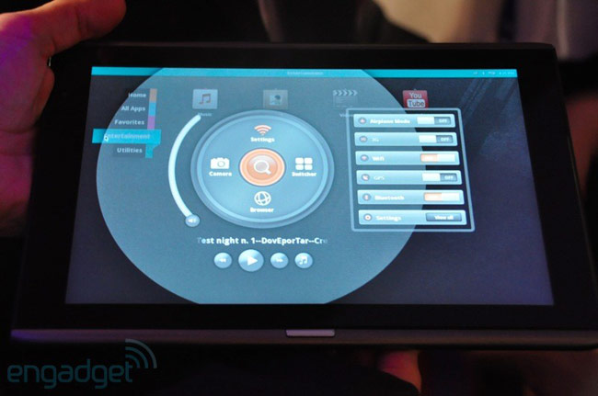
Interfaces with less well-known elements…
Notes:
http://droid-n.com/wp-content/uploads/2011/06/wpid-acer-m500-circular-ui.jpg
Can they learn this interface if they’ve never seen it before? Are there familiar elements? Is it using the language they expect?

Slide 12
Usability Test: Essentially…
Bring in real users
Have them complete tasks with your design, while you watch with your entire team
Use a think-aloud protocol, so you can “hear what they are thinking”
Measure
Task completion, task time
Satisfaction, problem points, etc.
Identify problems (major ones | minor ones)
Provide design suggestions to design/engineering team
Iterate on the design, repeat
Notes:
This is an “in English” variation of a slide that comes in slide deck 16 that talks about a “HOWTO”
They complement each other in that this talks about things in a grounded, “real life” way without any specialized terms, whereas the howto uses language and vocabulary that you will know by then.

Slide 13
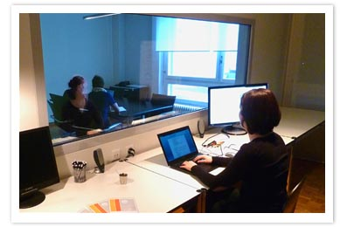
Testing Environments…
Notes:
http://lynnewatanabe.wordpress.com/2011/08/24/could-usability-testing-of-websites-help-non-profits-heck-yeah/
http://www.telono.com/en/lelab/fixed-lab
http://www.clockwork.net/blog/2009/11/04/291/our_usability_lab_keepin_it_simple
http://www.experiencelabstudios.com/studio_small.html

Slide 14
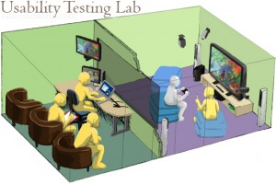
Testing Environments…
Notes:
http://lynnewatanabe.wordpress.com/2011/08/24/could-usability-testing-of-websites-help-non-profits-heck-yeah/

Slide 15
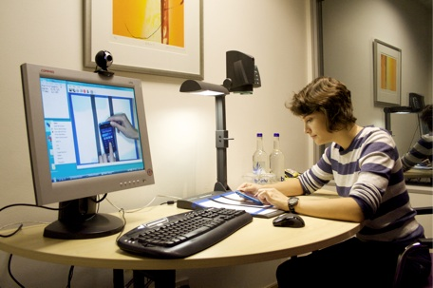
Testing Environments…
Notes:
http://lynnewatanabe.wordpress.com/2011/08/24/could-usability-testing-of-websites-help-non-profits-heck-yeah/

Slide 16
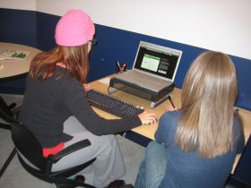
Testing Environments…
Notes:
http://lynnewatanabe.wordpress.com/2011/08/24/could-usability-testing-of-websites-help-non-profits-heck-yeah/

Slide 17
Testing Environments…
Best environment depends on pragmatic considerations, as well as what you’re looking for
Do you want your whole team to be able to view?
Do you want to be able to review a test?
Are interruptions important?
Repeat use systems, or one-time use systems?

Slide 18
Things you care about in a usability test
Learnability/Discoverability: How easy is it for users to accomplish basic tasks the first time they encounter the design?
Efficiency: Once users have learned the design, how quickly can they perform the tasks?
Memorability: When users return to a design after a period of not using it, how easily can they reestablish proficiency?
Errors: How many errors do users make, where are these errors occuring, and how easy is it to recover from these errors?
Satisfaction: How pleasant is it to use?
Notes:
http://www.useit.com/alertbox/20030825.html
Some of these require “repeat visits”, and so may not always be practical

Slide 19
Corel Paper Prototype Test
Notes:
Intro to video:
-- A system built by Corel to help web designers to structure websites
-- Evaluating a paper prototype to explore whether or not people can do basic tasks (e.g. “create a new page”)
-- What you will see is: you can use a paper prototype to do this; people have different language than what the designers expected
http://www.youtube.com/watch?v=ppnRQD06ggY
What is striking about this video?
Site settings -> use of terminology
Notions of mental models, and how design can push one or another
You can evaluate some things just with paper prototypes!
What are they evaluating here? (flow)
What can you not evaluate with a paper prototype?

Slide 20
Usability Tasks: IKEA Example
“Find a bookcase”
Search for “bookcase.”
“You have 200+ books in your fiction collection, currently strewn around your living room. Find a way to organize them.”
Clicking on catalogues looking for a storage solution
Searches (a few) were for “shelves” and “storage systems”
Notes:
http://www.uie.com/events/roadshow/know_your_users/articles/usability_testing_mistakes/

Slide 21
Usability Tasks
Again, depends a lot on what you’re looking for
Specific: does a task flow work?
Broad: does your language match the user’s mental model/language?
Consider “the context of use”
What would someone need to do with your tool?
Under what circumstances would they be in? (relaxed vs. under pressure; non-interrupted vs. interrupted constantly)
etc.

Slide 22
Usability Tasks: Netflix.com
“Rate a few movies”
“It’s a Friday night, and you’re looking for a movie to watch. What do you do?”
“You’re about to watch `Batman 3’, but want to watch the first two, first. How do you do this?”
“You want to watch Batman 1 through Netflix in your living room with your xbox. How do you set that up?”
“What do you think about the site?”

Slide 23
Usability Testing Metrics
Performance
Task success, time on task, errors, efficiency
Issue Metrics
Identify issue, issue severity
Behavioural
Observe verbal behaviour, issue severity
Self-reported
Ease, satisfaction, clarity, comprehension, etc.
Notes:
These are things you can really drill down on, and consider carefully

Slide 24
Learning Objectives
At the end of this lecture, you should be able to:
» Discuss the goals of the “evaluate” phase, and understand how this plays out in an organization
» Understand the role of a usability experiment
» Describe five testable aspects of interfaces in usability experiments
» Understand how to pick good usability tasks
» Describe five testable metrics in usability experiments

