Slide 1
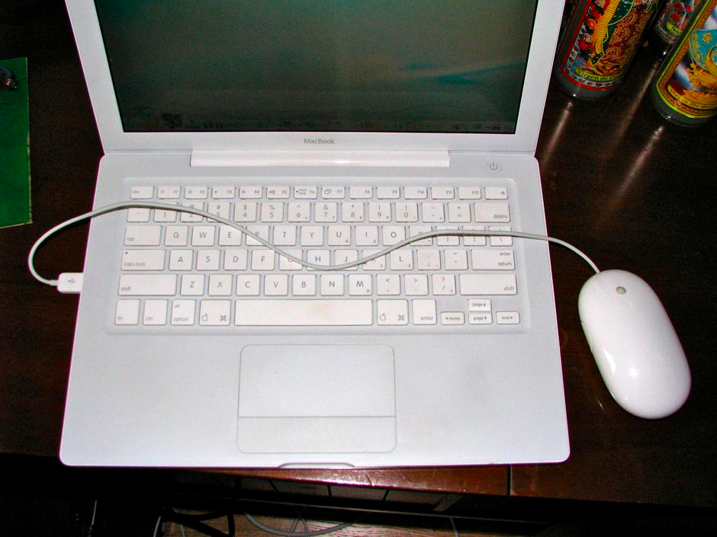
Excitedly go out to buy brand new Apple Super Mouse… Only USB port is on the left.
Notes:
http://nicolebarlaan.wordpress.com/2010/09/16/apples-terrible-design/

Slide 2
Midterm – Friday, Feb 7 @ 10am
Coverage: everything up to the end of Monday
Focus: I am mainly interested that you understand the concepts, and can apply them in a logical way. I am not concerned that you memorize everything, but you should be able to explain the main concepts and/or rationalize them.
How to study: review notes from lecture, the reading that I assigned you, as well as your assignments.
Exam: Closed book. Arrive early. Be concise. Mostly: short-answer questions.

Slide 3
Research Prototypes
CPSC 481: HCI I
Winter 2014

Slide 4
Learning Objectives
By the end of this lecture, you should be able to:
» Describe at least one of research prototypes that you’ve seen
» Discuss how prototypes are used in HCI research (i.e. describe their role/function in HCI research)

Slide 5
Fat-Thumb
High fidelity prototype, but very much a vertical one
Fat-Thumb video example w/ maps
Notes:
http://grouplab.cpsc.ucalgary.ca/grouplab/uploads/Publications/Publications/2012-FatThumb.MobileHCI.mp4

Slide 6
FatThumb Prototype: What for?
Designed and built to illustrate a design idea/concept
Used for evaluating the idea in a controlled laboratory study (i.e. to answer the question: is it faster)

Slide 7
More specific narrow scenarios as they relate to remote communication/collaboration
VideoDraw
http://dl.acm.org/citation.cfm?id=97302

Slide 8
VideoDraw Prototype: What for?
Illustrate a design concept
Used for observational studies of how the tool would be used

Slide 9
VideoWhiteboard Video
http://dl.acm.org/citation.cfm?id=108844.108932

Slide 10
ClearBoard
http://tangible.media.mit.edu/project/clearboard/

Slide 11
KinectArms
http://www.youtube.com/watch?v=Cz43UAr1nMY

Slide 12
KinectArms Prototype: What for?
A toolkit (code library) that others can build on to support the projection of hands/arms in remote tabletop workspaces.

Slide 13
ShareTable
http://home.cc.gatech.edu/lana/25
http://www.youtube.com/watch?v=8fupEOc4pYY

Slide 14
ShareTable Prototype: What for?
Realize a design idea.
Study its use in a field study (i.e. “real life deployment”): does it connect families?

Slide 15
MirageTable
http://research.microsoft.com/apps/video/default.aspx?id=163426

Slide 16
High Fidelity Prototypes in Communication Systems
Prototypes were built as a means to express an understanding of what was necessary in a communications system
  » hand gestures in design collaboration
  » role of eye contact in collaborative work
  » role of gesture height in tabletop collaboration
  » role of “real” artefacts | ease of use/establishing connection
  » potential role of virtual objects

Slide 17
High Fidelity Prototypes in Communication Systems
Different contexts → different needs
  » VideoDraw/ClearBoard: “design” scenarios, drawings/sketches
  » KinectArms: tabletop work/play scenarios
  » ShareTable: children, separated families
  » MirageTable: cool-dude virtual artefacts
Notice: each prototype serves to illustrate the particular idea

Slide 18
HRI Interruption
http://dl.acm.org/citation.cfm?id=1734504
http://dx.doi.org/10.1109/ROMAN.2011.6005257

Slide 19
HRI Interruption: What is the role of the human actor and prototype?

Slide 20
Learning Objectives
You should now be able to:
» Describe at least one of research prototypes that you’ve seen
» Discuss how prototypes are used in HCI research (i.e. describe their role/function in HCI research)

