Slide 1
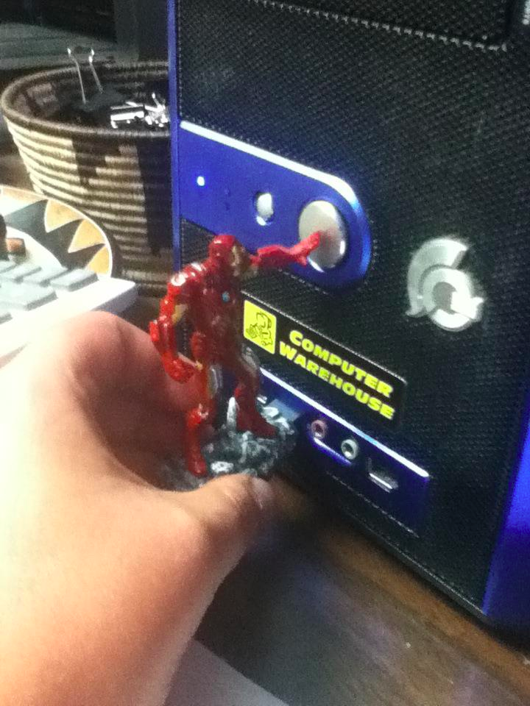
reddit.com
Notes:
http://www.reddit.com/r/funny/comments/10zcr2/i_just_got_trolled_by_the_iron_man_avengers_usb/

Slide 2
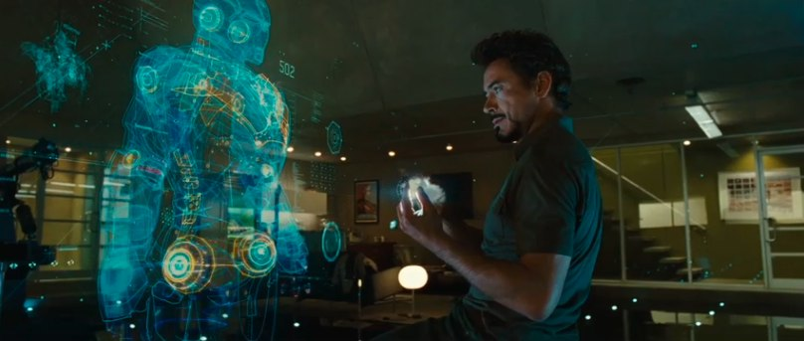
Cool video prototype
Notes:
Xkcd

Slide 3
Prototyping 2
CPSC 481: HCI I
Fall 2012
Anthony Tang, with acknowledgements to Julie Kientz, Saul Greenberg, Nicolai Marquardt, Ehud Sharlin

Slide 4
Learning Objectives
By the end of this lecture, you should be able to:
— articulate +’s and -’s of hi- vs. lo-fi prototypes
— describe the difference between horizontal and vertical prototypes
— contrast several methods for prototyping functionality (e.g. wizard-of-oz; video prototyping)
— contrast three ways of integrating prototyping into an organization’s software engineering process

Slide 5
Nordstrom Video…
What did you see?
Eye glasses, ipad
Developing prototypes on the spot
  There’s a paper prototype
  A working prototype
Brainstorming with the glass; people’s shopping process
Interaction with customers (shoppers; the people work in the sunglasses area) – evaluating as they went
Problem with the polarization – with the implementation
Fixed the problems/issues as they came up
Continual evaluation with protoypes – added new features/modified things as they went (two pictures/ adding the ability to do names, and so forth)
Notes:
What did you see?
What kinds of prototypes?
What kinds of methods?

Slide 6
Prototype “Types”: Two Dimension Classification Scheme
High --- . Low Fidelity
  » Choice of medium is close to or far from that of the final design
  » e.g. high = software; low = paper prototype
Horizontal vs. Vertical (generally for software prototypes)
  » Range of capabilities in the prototype
  » horizontal = wide range of features without full “implementation” of any
  » vertical = select features are “implemented” all the way through
Notes:
-=-=
Horizontal prototypes are appropriate for understanding relationships across a broad system and for showing the range of abilities of a system.
Vertical prototypes are most appropriate when a certain complex feature of a system is poorly-understood and needs to be explored, e.g. as a proof-of-concept.

Slide 7
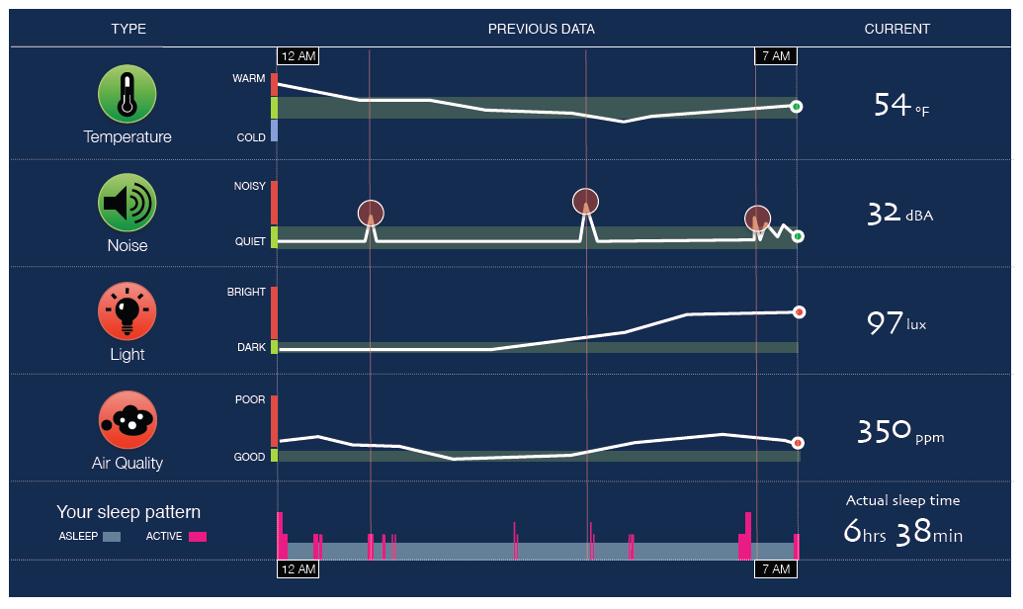
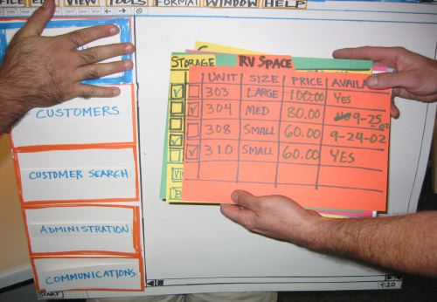
Hi vs. Lo Fidelity
Distinction: is the choice of medium close or far from that of final design? (high = software; low = paper prototype)
Hi fidelity
Lo fidelity

Slide 8
Pros and Cons (lo-fi vs. hi-fi)
 | Lo-Fi | Hi-Fi
Advantages | Quick to make and disposal Easy Cheap Easy to modify Users focus on the features more than the looks More likely to get major suggestions b/c the thing doesn’t finished | Get a strong sense of what the final product might look like Final feedback in terms of design Nuances of the implemention environment Could use parts of this for the ifnal product [Appearance of] professional/knowing what you’re doing
Disadvantages |  | When a customer sees something, they may assume it’s closer to being done than it really is Expensive – (time) They may on visual design rather than functionality Feel less inclined to make suggestions because the thing looks done Harder to change
Notes:
Fill it in!

Slide 9
Hi-fi vs. Lo-fi: “From the experts…”
 | Lo-Fi | Hi-Fi
Advantages | » ***fast*** » cheap » easy – kindergarten skills! » can simulate actual product » great way to get feedback from stakeholders | » better sense of finished product » can judge aesthetic appeal » more realistic experience » can evaluate the experience better » probably more convincing for stakeholders
Disadvantages | » slow response time » can’t get feedback about aesthetics » user may question design quality | » users may focus on unnecessary details » takes a lot of time to make » users may lose track of big picture

Slide 10
Hi Fidelity Prototypes: More
Big part: prototyping the visual design
With the right tools, hi-fi prototypes can be done very quickly
Requires very little client imagination
Communicates the form very well
Very effective in persuasion

Slide 11
Vertical vs. Horizontal Prototypes
Different Features
Horizontal prototype
Scenario
Functionality
Full
interface
Vertical prototype
Notes:
Arrow on functionality
Take out the paper prototype/ photoshop mock up thing
• Two common types of compromise
- horizontal prototype: provide a wide range of
functions but with little detail
- vertical prototype: provide a lot of detail for only a
few functions

Slide 12
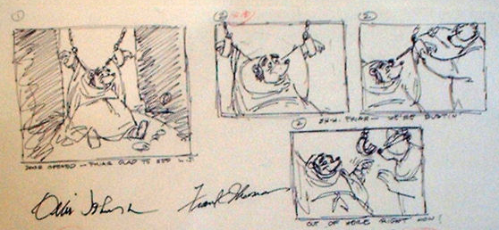
Prototyping through Storyboards
“comic book” approach, a series of keyframes as sketches—illustrates a sequence
  originally from film; used to get the idea of a scene
  snapshots of the interface at particular key points in the interaction
users can evaluate quickly the direction the interface is heading

Slide 13
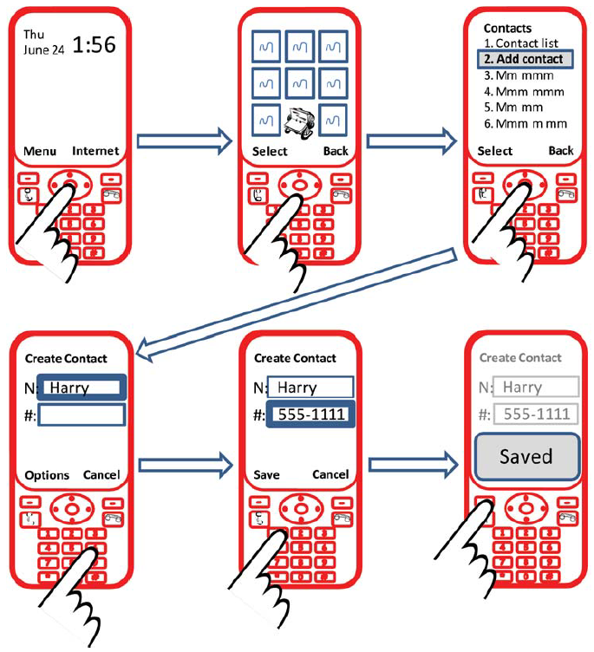

Slide 14
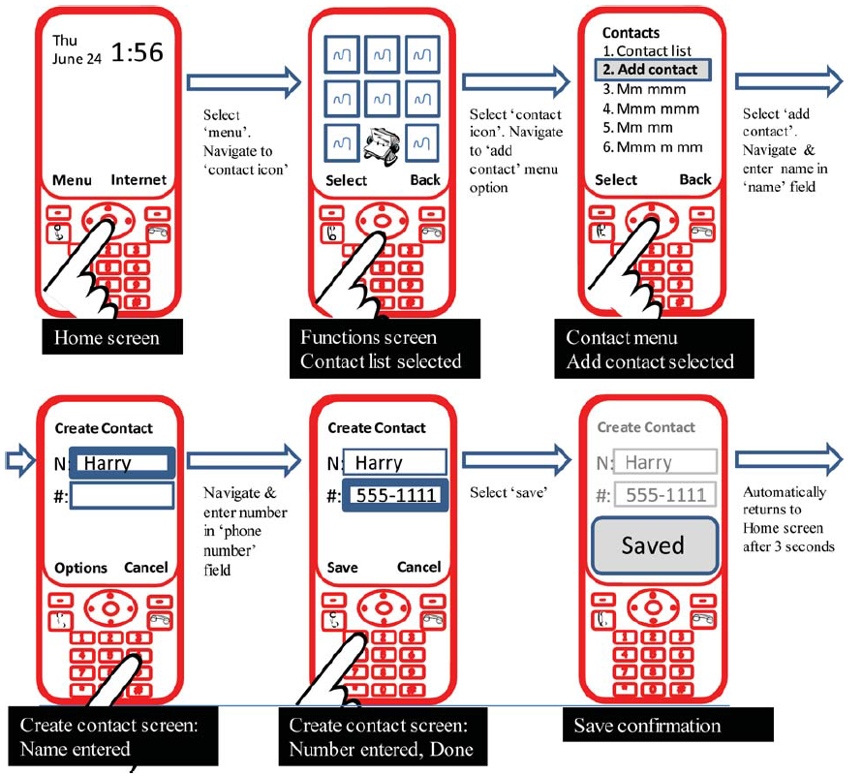

Slide 15
Prototyping with PICTIVE
PICTIVE: Plastic Interface for Collaborative Technology Initiatives through Video Exploration
Designing with customers using office supplies
  » multiple layers of sticky notes and plastic overlays
  » different sized stickies represent icons, menus, windows etc.
Interaction demonstrated by manipulating notes
  » new interfaces built on the fly
Session videotaped for later analysis
  » usually end up with mess of paper and plastic!

Slide 16
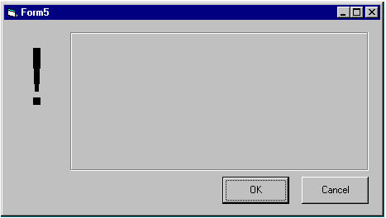

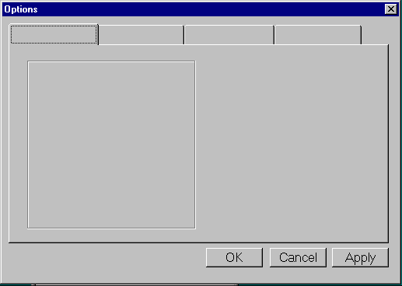
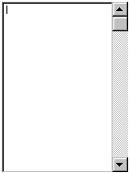
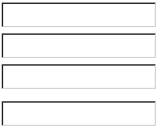
PICTIVE, designing with office supplies
Can pre-make paper interface components
buttons
menu
alert
box
combo box
tabs
list box
entries

Slide 17
Prototyping with PowerPoint
PowerPoint can also be used to simulate very specific interaction scenarios
Problem: People give me gifts I don’t want
Solution: Maybe a web-based gift-list social networking site could help
Notes:
http://www.boxesandarrows.com/files/banda/interactive/SamplePrototype.ppt

Slide 18
Powerpoint prototype here

Slide 19
Prototyping Functionality: Wizard-of-Oz
Common problem: it’s difficult to prototype some piece of functionality
Need: test whether it is actually good
Solution: fake it! Make the interaction as authentic as possible
Key: user has no idea that the interaction is being faked

Slide 20
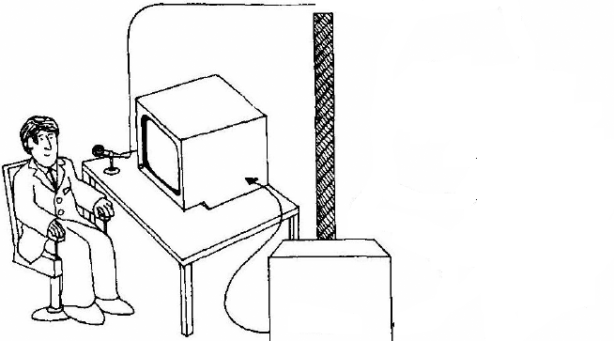
Wizard of Oz
A method of testing a system that does not exist
  the listening typewriter, IBM 1983
Dear Henry
Speech
Computer
What the user sees

Slide 21
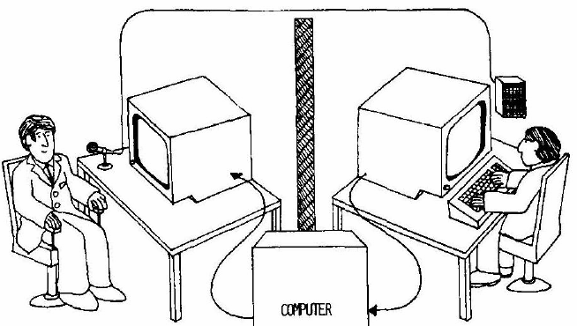
Wizard of Oz
A method of testing a system that does not exist
  the listening typewriter, IBM 1984
Dear Henry
Dear Henry
Speech
Computer
What the user sees
The wizard

Slide 22
Name Origin: Wizard-of-Oz
The Wizard of Oz: book and movie
clip

Slide 23
Wizard of Oz: The Point
Up until the point the wizard is discovered, the thoughts, feelings, and actions of Dorothy and the others were all genuine
They were genuinely experiencing what it would be like to talk to a powerful and terrible wizard

Slide 24
Wizard of Oz: Anti-Gravity Bar
  http://www.youtube.com/watch?v=DL9cAcQ-gKQd

Slide 25
Prototyping Functionality: Video Prototyping
Video prototyping allows you to prototype functionality without needing to be physically present.
Paper prototypes and wizard-of-oz require you to be around to simulate functionality.
A video prototype frees you from that, but constrains you to a limited scenario.
You can also simulate this through a stitched together set of images (slow-mation).

Slide 26
iPhone paper+video prototype
Notes:
http://www.youtube.com/watch?v=6TbyXq3XHSc

Slide 27
Body Centric Interaction
New design concept. Realized as a medium-fidelity prototype, and captured as a video prototype.
Notes:
http://grouplab.cpsc.ucalgary.ca/grouplab/uploads/Publications/Publications/2012-BodyCentricInteraction.TEI.mp4

Slide 28
Fat-Thumb
High fidelity prototype, but very much a vertical one
Fat-Thumb video example w/ maps
Notes:
http://grouplab.cpsc.ucalgary.ca/grouplab/uploads/Publications/Publications/2012-FatThumb.MobileHCI.mp4

Slide 29
More specific narrow scenarios
VideoDraw

Slide 30
Prototypes in an Organization
Question: How do we integrate the philosophy of prototyping into an organization?
Three methods for managing this integration:
  Evolutionary
  Modular (incremental)
  Throw-away

Slide 31
Evolutionary Approach to Prototype Integration
Iteratively change the prototype to incorporate changes
Eventually, the reworked prototype becomes the final system
Design prototype
Implement prototype
Test prototype
System

Slide 32
Modular (Incremental) Approach to Prototype Integration
Build the system as separate modules/components
Each module is designed, prototyped and build separately before being combined into a final system
Design component
Implement component
Test component
Design component
Implement component
Test component
Design component
Implement component
Test component
System

Slide 33
Throw-away Approach to Prototype Integration
Design prototype
Implement prototype
Test prototype
Prototype is used to get rapid feedback (i.e. to learn lessons)
Prototype is built, tested, and deployed (or discarded)
Design prototype
Implement prototype
Test prototype
Design prototype
Implement prototype
Test prototype

Slide 34
Integrating Prototypes in Organizations
evolutionary
  » prototype is altered to incorporate design changes
  » eventually becomes the final product
2. modular (incremental)
  » product is built as separate components (modules)
  » each component is prototyped and tested, then added to final system
3. throwaway
  » prototype serves to reveal user reach, then discarded
  » creating prototype should be rapid, otherwise can be expensive
Notes:
-- Many large systems (e.g. Twitter/Facebook) can be considered to be built with an evolutionary approach (timeline feed): modern SCRUM techniques
-- On the other hand, many of the feature areas are often designed somewhat independently of one another (Ebay: automobiles site is independent of rest of site; Yahoo: cars, mail, calendar, etc.):: traditional SENG
-- Modular is suitable for very large products with a lot of component pieces. The downside is trying to come up with a unifying interaction metaphor or theme. The U of Calgary website (as a whole) is a good example. There are published guidelines, etc., but these are rarely followed.
-- HCI research often gets to take a throw-away approach. This is more suitable for products where the main learnings are in the process of development, rather than being the end-goal itself

Slide 35
Learning Objectives
You now know how to :
— articulate +’s and -’s of hi- vs. lo-fi prototypes
— describe the difference between horizontal and vertical prototypes
— contrast several methods for prototyping functionality (e.g. wizard-of-oz; video prototyping)
— contrast three ways of integrating prototyping into an organization’s software engineering process

