Slide 1
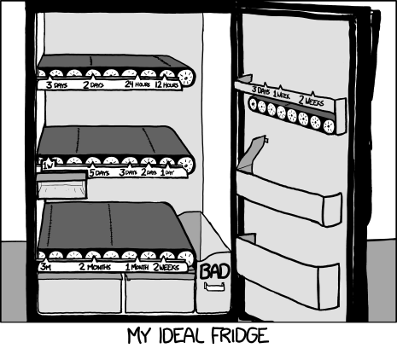
Source: xkcd.com
Notes:
Xkcd

Slide 2
Midterm – Friday, Feb 7 @ 10am
Coverage: everything up to the end of Monday
Focus: I am mainly interested that you understand the concepts, and can apply them in a logical way. I am not concerned that you memorize everything, but you should be able to explain the main concepts and/or rationalize them.
How to study: review notes from lecture, the reading that I assigned you, as well as your assignments.
Exam: Closed book. Arrive early. Be concise. Mostly: short-answer questions.

Slide 3
Prototyping
CPSC 481: HCI I
Fall 2012
Anthony Tang, with acknowledgements to Julie Kientz, Saul Greenberg, Nicolai Marquardt, Ehud Sharlin

Slide 4
Learning Objectives
By the end of this lecture, you should be able to:
— argue for the value of having prototypes
— identify the properties of a prototype
— describe different types of prototypes
— understand what should actually be prototyped

Slide 5
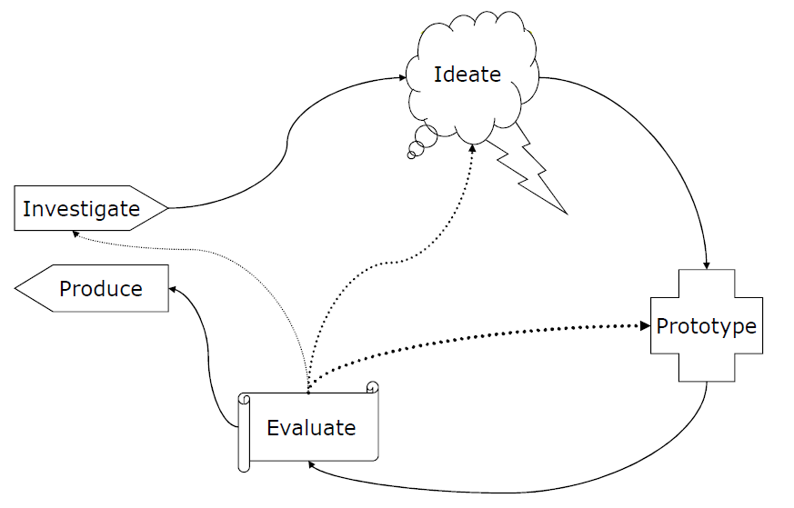
User Centered Design Process
Produce something tangible
Identify challenges
Uncover subtleties

Slide 6
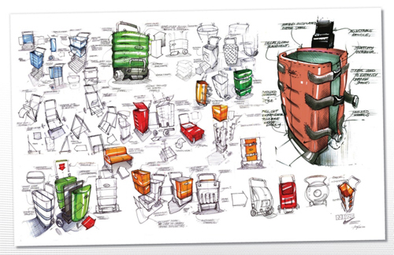
How to pick good ideas?
Notes:
http://www.idsketching.com/toolbox/toolbox-levels-of-sketching/
So, if you’ve been doing the ideate part right, then you should have a boatload of ideas and a ton of different design ideas.
Now, what? How do you select what to go with?

Slide 7
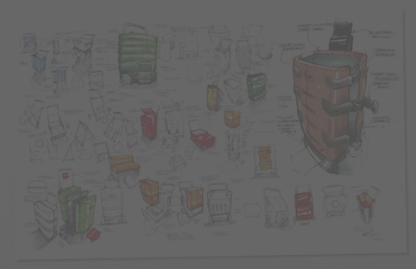
How to pick good ideas?
Try them out! Prototype multiple, and test them out with your users!
Quality metrics:
  Ease of use
  Utility vs. superfluous features
  Effectiveness (task coverage)
  Efficiency/performance
Notes:
http://www.idsketching.com/toolbox/toolbox-levels-of-sketching/
So, if you’ve been doing the ideate part right, then you should have a boatload of ideas and a ton of different design ideas.
Now, what? How do you select what to go with?
My suggestion: rather than choosing based on your gut, try it out! Your gut may be wrong, but you’d never know if you just went with your gut. If you can prototype several, then do it.

Slide 8
Why prototype?
Evaluation and user feedback is central in good design
  Stakeholders can see, hold and interact with a prototype
  Aids communication of an idea, and provides focus for a team
  You can test out your ideas
  Encourages reflection
  Answers questions, and helps you make choices between different alternatives

Slide 9
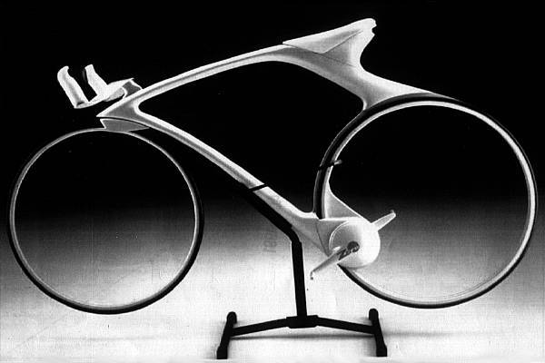
What is a prototype?
Notes:
http://www.csse.monash.edu.au/~aland/cycling.html
This is a concept bike. The idea is to have hubless, magnetically suspended wheels, and a magnetic drive.
Very cool idea, and this is perhaps a real prototype, or a vision prototype

Slide 10
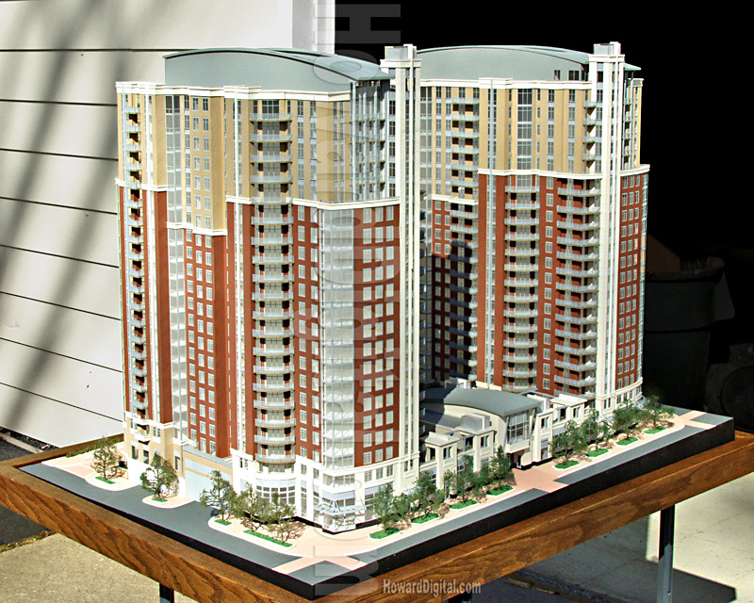
What is a prototype?
Notes:
http://www.howardmodels.com/architectural-models-07/reston/index.html
This is an architectural prototype. I used to love looking at these things.
Anyway, in it, you cansee to scale what things would look like – sidewalk to doors, windows to building height,

Slide 11
Prototype of a prototyping environment
Illuminating light video
Notes:
https://vimeo.com/48600709

Slide 12
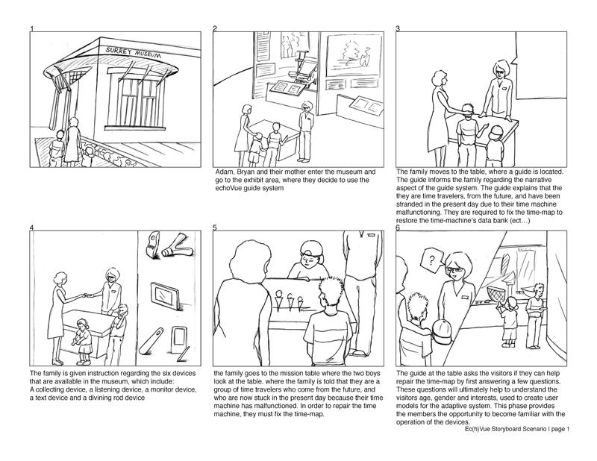
What is a prototype?
Notes:
http://www.kmuise.com/design/portfolio/kurio.php
This is a storyboard that expresses how people would interact in a new type of museum. IN it, what they do is to use these tangible objects that are like microphones, speakesr and cameras. There are digital tabletops and PDAs that work with these objects to help people better understand all the things that are going on in the museum

Slide 13
What is a prototype?
To me, a prototype is defined less by form, and more by its function:
  A prototype expresses and realizes a design concept for the purpose of communication.
Prototype qualities
  Fast
  Disposable
  Focused
Role of prototypes
  Test | Get feedback
  Communicate
  Persuade
Notes:
So, while sketches are used to provoke, and to express a general idea, or to elicit response, a prototype is used to actually depict what is going on as someone imagines it. In some sense, it is more or less concrete

Slide 14
Many different kinds of prototypes
Storyboards » museum example | your tutorial
PowerPoint slideshow » you’ll see one Monday
Video prototype » login page video
Paper prototype » email system video
Physical model » little apartment building
Software with limited functionality » your project
…

Slide 15
Video prototype
Login page video prototype
Notes:
http://e102.co.uk/?p=3
This is a paper prototype tat has been made into a video prototype.
As you will see in tutorial, the problem with paper prototypes is that you need someone there to “run it”
A video prototype, once you make it, can sort of “run itself.” Obviously, there’s only one user flow, but you get to see all the functionality that’s in it
A video prototype takes some time to develop, but it is actually often quite effective

Slide 16
“Tangible Prototypes”
URP video
Notes:
This is obviously a very very slick prototype, and it works
What did you see in there?
What does the video show?
What are the key ideas that are there?
Going beyond exactly the application they showed, what are they trying to tell us?

Slide 17
Nordstrom video
Prototyping and user feedback in a tight loop
Notes:
http://www.youtube.com/watch?v=szr0ezLyQHY

Slide 18
What should be prototyped?
Task design & user flow
  Based on expected tasks, what will the users see, what will they do?
Screen layouts and information display
  How should information be laid out to provide information as users need it? How can this be optimized?
Graphic design and look & feel
  What should it look like?
Technical aspects
  Can we actually make this go?!
* Start with controversial and critical areas (e.g. security)

Slide 19
Which prototyping method to choose?
Choose the method that works best for what you are trying to achieve (pragmatics).
For example:
  User flow » storyboard
  Screen layouts/page flow » paper prototypes
  Overall experience » video prototype
  Look and feel » PowerPoint or PSD
  Functionality » software
  … etc.
Alternately, maybe you are at different stages in the design. Early on, use techniques that are cheap and quick; later on, use techniques that give a stronger sense of finished idea.

Slide 20

Dose of reality
Choices here may not be just “what makes the best experience.” Remember that design is about trade-offs.
Some design trade-offs you will need to deal with:
  Technical constraints
  Commercial feasibility
  Resources (e.g. developer)
Notes:
http://en.wikipedia.org/wiki/Pointy-haired_Boss
BUT, prototypes still give us an opportunity to at least shape the direction of things, certainly if not for this iteration, then to at least shape mindshare moving forward (i.e. move resources to your project/design idea for the future)

Slide 21
Learning Objectives
You can now:
— argue for the value of having prototypes
— identify the properties of a prototype
— describe different types of prototypes
— understand what should actually be prototyped

