Slide 1
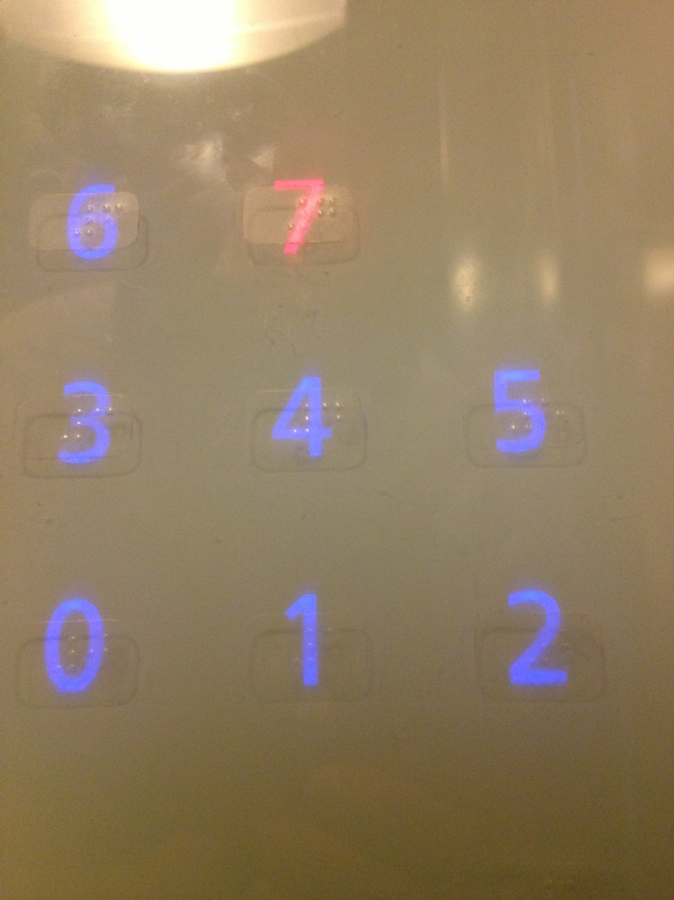

Slide 2
http://bit.do/CPSC481
Sign up at Piazza: http://piazza.com/
Look for our class: CPSC 481 at University of Calgary

Slide 3
Course Introduction
CPSC 481: HCI I
Winter 2014
Anthony Tang, with acknowledgements to Julie Kientz, Saul Greenberg, Ehud Sharlin, Jake Wobbrock, Dave Hendry, Andy Ko, Jennifer Turns, & Mark Zachry

Slide 4
Foundations of Human-Computer Interaction
Foundations of Human-X Interaction
Foundations of Design for Human-X Interaction

Slide 5
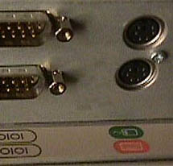

Slide 6


Notes:
www.baddesigns.com

Slide 7
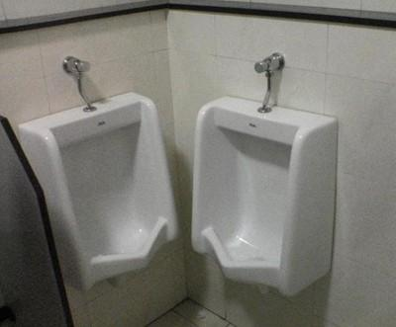
Bad Design is Everywhere

Slide 8
Bad Design Affects Us
Money
  A $200 withdrawal turns into $20000
  Bad font choice ➔ “,” looks like “.”
Lives: Therac-25 Radiation Machine
  Massive doses of radiation led to several deaths
  Cause: backing out and changing settings within 8s would not put the shield in place

Slide 9
Anticipated snarky response: “But, I wouldn’t make those mistakes!”
Maybe, but you’re not the only one working on most projects. Your team might still make that mistake.
Here’s the problem:
You are typically not the user.
You have your own biases.

Slide 10
What this course is about…
Understanding why bad design is so prevalent
Learning and practicing methods for “good” design
Hands-on experience with multiple design methods: involving users, prototyping, testing

Slide 11
Summary
Design is everywhere
Good design is hard
Poorly designed things have big consequences
Good design practices can help
You’re going to be a good designer

Slide 12
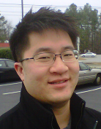
Introduction: Me
Instructor: Anthony Tang
  Call me Tony
Assistant Professor in the CS Department
  Ph.D. in Electrical and Computer Engineering from UBC
Research in Human-Computer Interaction
  Collaborative computing, personal informatics
Personal interests: Volleyball, Food, Video Games

Slide 13

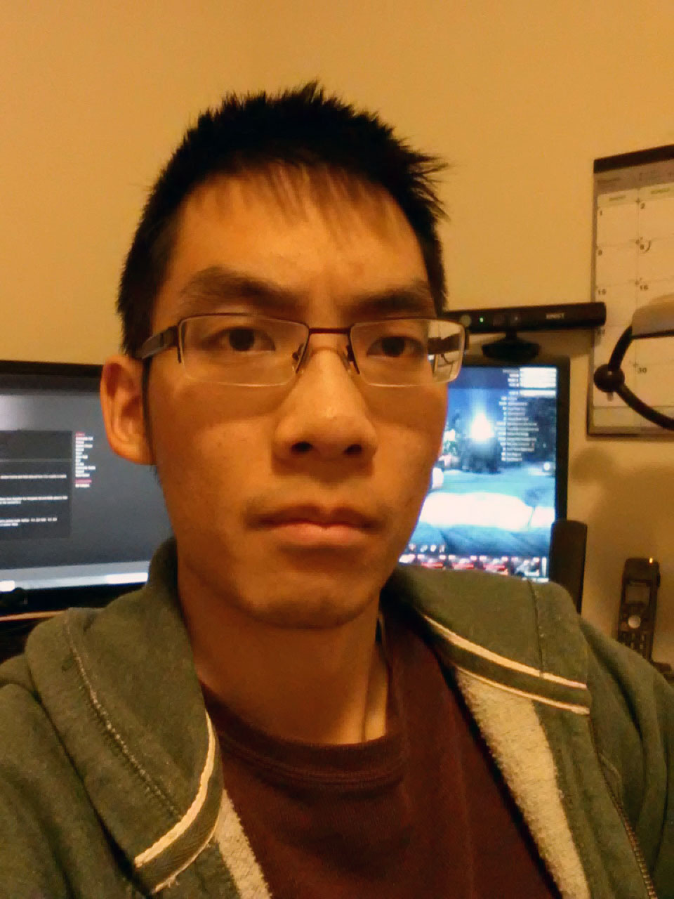
Introduction: Your TAs
Jonathan Haber
  PhD candidate
Richard Tang
  MSc student
» I twice competed at the Footbag / hacky sack world championships.
» I have been collecting coffee cup sleeves for the past year and the stack is now taller than me.

Slide 14
Syllabus
Basic information
Expectations
Assessment
Assignments
Project
Labs
Office hours/contact information

Slide 15
Basic Course Information
Website
  http://bit.do/CPSC481
  » password: hello481 (no spaces)
Q/A Forum
  http://piazza.com/
  » search CPSC 481 under University of Calgary
Readings
  Posted online at the main website
Slides
  Posted online at the main website within the week

Slide 16
What do you expect of me?
Well-defined timeline
Clear expectations
Reasonable turnaround on marking (for exams: 1 week, 1 ½ weeks; assignments/projects: 2 weeks)
Exams relating to course material
Clear marking schemes
Past exams

Slide 17
What You Can Expect of Me
I will be here on time
Your assignments will be graded in a timely manner
  Typically within 1-2 weeks
Piazza posts will be responded to in a timely manner
  Typically within 1-2 days
If I don't know the answer to your question, I will find out
I will treat you as professional colleagues
You will have several chances to evaluate the course

Slide 18
Feedback Mechanism
Three volunteers: act as liaisons between you (students) and me
Brief (weekly) meetings post-class on Wednesdays
Have I blown it on something?
Am I going to fast?
Am I going to slolwy?

Slide 19
What I expect of you
Come to class prepared – read carefully prior to class meetings
Be an active listener – be attentive, be engaged, use in-class technology with discretion
Treat all with respect – be constructive in all discussions
Tutorial materials are set up for you—I expect your best efforts on all components
Be here on time
Turn in everything on time

Slide 20
Assessment
Component | Worth
Class Participation | 5%
Assignments | 10%
Project | 40%
Mid-term | 15%
Final | 30%
Note: you must earn a passing grade on each component to pass the course.

Slide 21
Participation – 5%
Ask challenging questions
Comment, build on, or clarify others' contributions
Post useful or interesting information to the class discussion board
Visit the instructor during office hours to chat, to ask questions, or to give feedback.

Slide 22
Assignments – 10%
Assignment | Worth | Due
A0: Profile post | -% | Jan 10 EOD
A1: Thinking about design | 5%
A2: User-centered design | 5%

Slide 23
Project – 40%
Opportunity for you to engage in hands-on design with a real project
Groups of three (3) people; you will choose your groups in lab

Slide 24
Project – 40%
Project ideas:
  » System for people new to the city
  » Personal fitness tracker: able bodied or physiotherapy
  » Cross-family communication system
  » Communication system for video gamers
  » Ordering system at a restaurant/bar
  » Electronic course registration system

Slide 25
Project – 40%
Project Component | Worth | Due
P1: User research | 7.5%
P2: Sketching, ideation and lo-fi prototype | 10%
P3: Heuristic evaluation and hi-fi prototype | 15%
P4: Final report and presentation | 7.5%
Grading principle: BLOW MY SOCKS OFF.

Slide 26
Labs
Participation in these labs comprises part of your grade
Hands-on with specific skills and activities
  Design activities
  C#
  Presentations

Slide 27
Office Hours/Contact Information
Office hours: WF after class (11am) or by appointment
Questions: Use Piazza – http://piazza.com/
Do not email me or your TAs directly.

Slide 28
Handing In Assignments
Assignments are due at the beginning of lecture on the day specified
You have a 10 minute grace period from the start of class
After that, I will not accept assignments

Slide 29
Policies – See Syllabus
Academic integrity
Grading
Extensions
Late assignments
Accommodation
Quality of written assignments
Attendance

Slide 30
Questions, comments, queries?
…

Slide 31
Coming up…
Friday:
What is a good interface?

Slide 32
