Slide 1
cs 7460: collaborative computing introduction
anthony tang

Slide 2
what is this class about?
introduction
computer supported cooperative work
office/workplace systems for collaboration and coordination
everyday use of computation in collaboration, coordination and competition
What are some CSCW systems you used today?

Slide 3
groupware matrix
introduction
 |  | Time
 |  | Same | Different
Place | Same
 | Different
(Johansen 1988)

Slide 4
groupware matrix
introduction
 |  | Time
 |  | Same | Different
Place | Same | Face-to-Face Meetings (electronic whiteboards) | Ongoing Shift Work (e.g nursing station) (team room tools)
 | Different | Distance Meetings (teleconferencing tools) | Ongoing Coordination (voice mail, email, bulletin boards)
(Johansen 1988)

Slide 5
what is this class about?
introduction
How do people interact with and through computation?

Slide 6
course goals
introduction
understand and be conversant about core cscw issues (historical/practical)
implementation of simple cscw groupware systems

Slide 7
meetings
administrivia
class
tuesdays & thursdays
3:00-4:30
tsrb 222 (this may change)
office hours
mondays & wednesdays
12:30-3:00
near tsrb 345
or, by appointment (tonyt@cc.gatech.edu)

Slide 8
class (1/3)
administrivia
seminar style → you are expected to generate and contribute to discussion (10%)
weekly presenter responsible for summarizing two papers and leading discussion (10%)
assignment component → you will need to code (not a lot, but enough to get the gist) (15%)

Slide 9
class (2/3)
administrivia
project component → do some original work, get marks (65%)
build an original system, or
study a system, or
study a context where a system might help
➔ MEET AND TALK TO ME ABOUT THIS
presentation + paper

Slide 10
class (3/3)
administrivia
IRB certification → you need to complete this as a prerequisite for this course (not graded)
https://www.citiprogram.org/

Slide 12
who is tony?
about
systems for distributed/collocated collaboration
shared visual workspaces (e.g. large displays, tabletops)
games research (world of warcraft, geocaching)

Slide 13
B
C
A
Notes:
Build a cool system – describe the system
Unleash the beast
What is going on

Slide 14
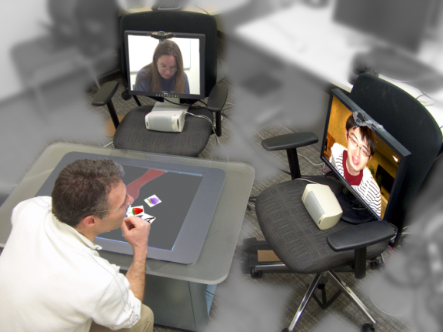
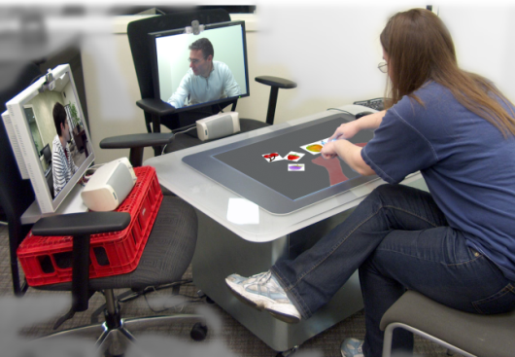
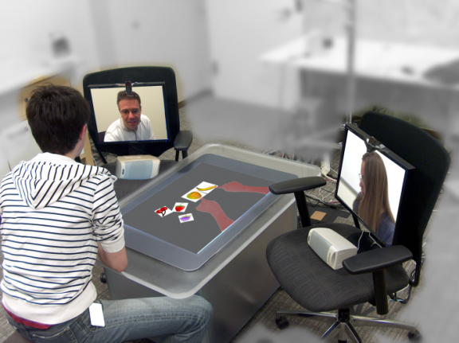
three channels of interaction
B
B
C
C
A
A
A
A
B
C
B
C
Notes:
Build a cool system – describe the system
Unleash the beast
What is going on

Slide 15
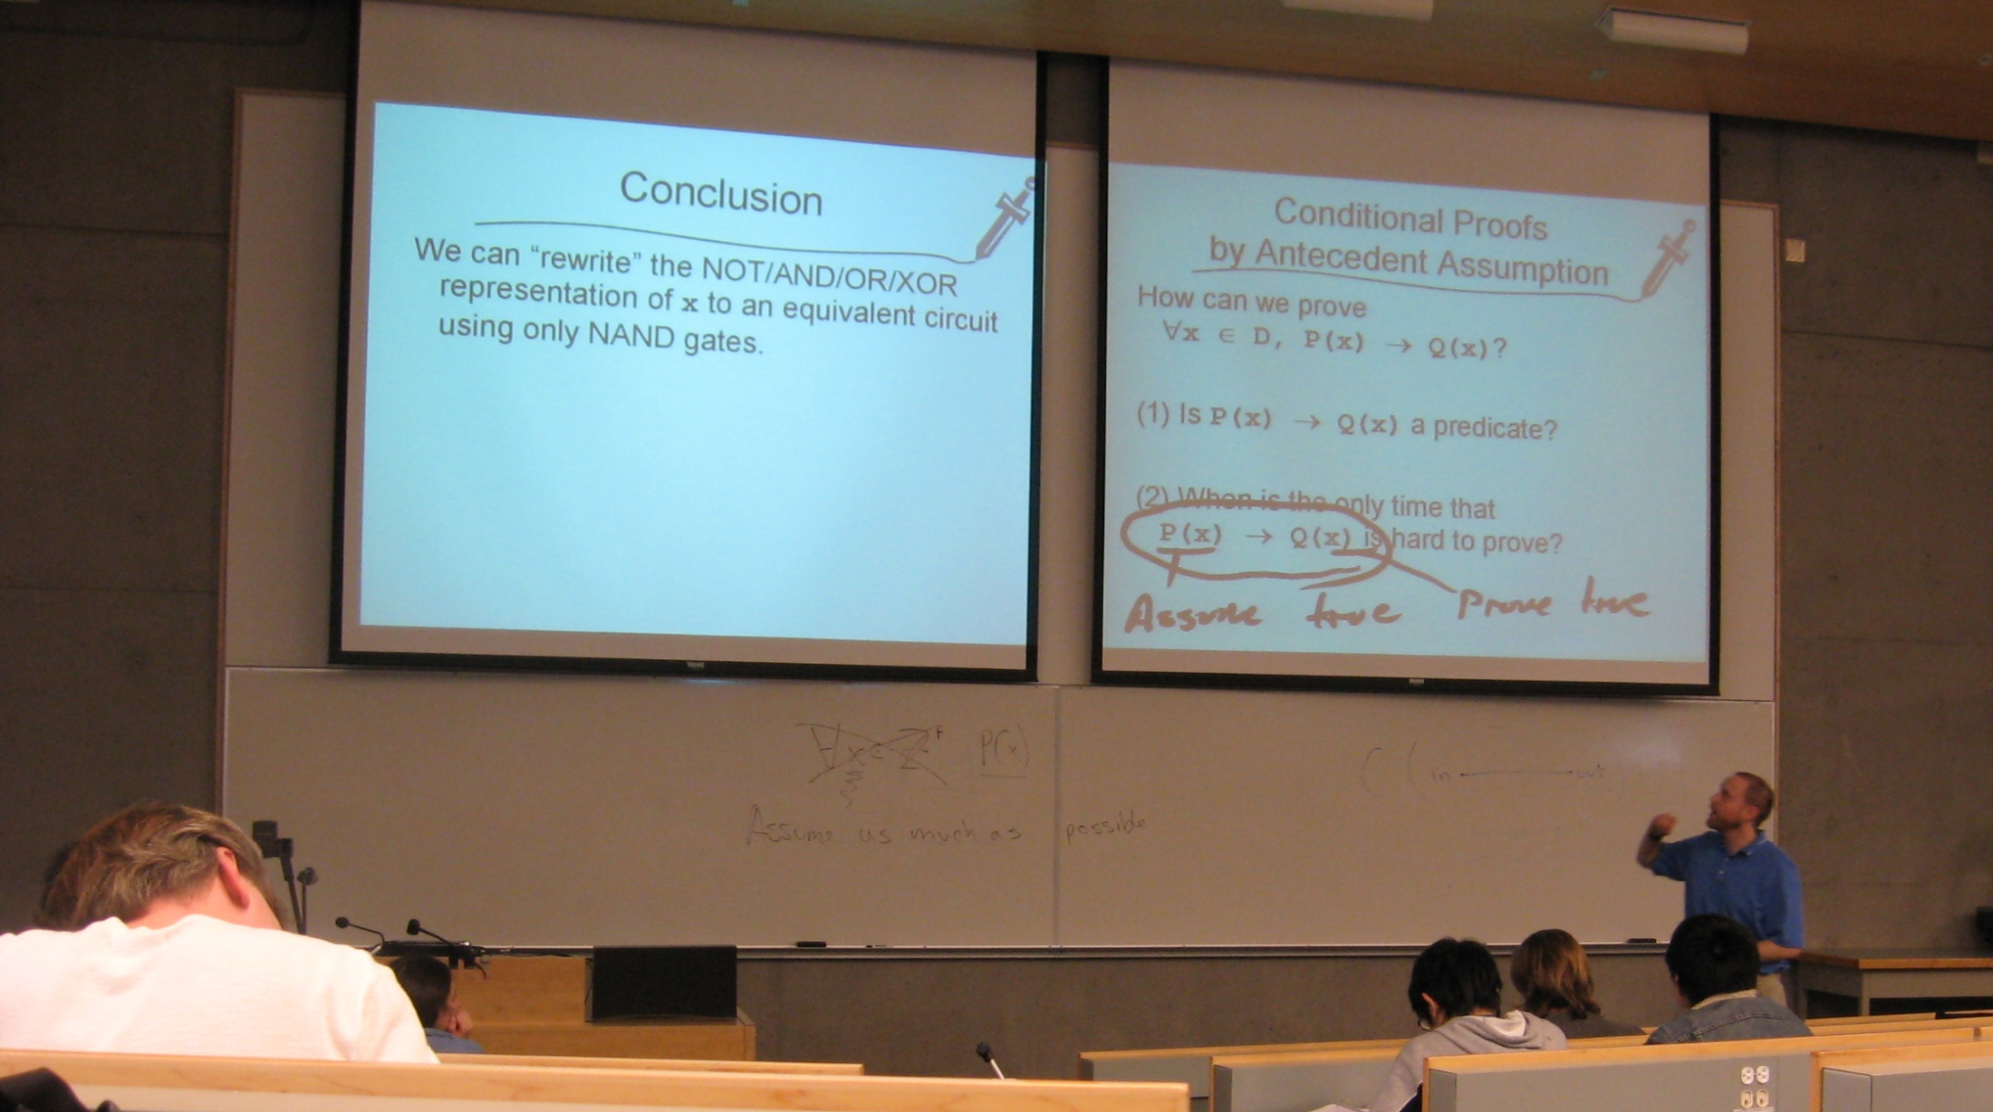
multi-presenter: multi-display presentation tool

Slide 16
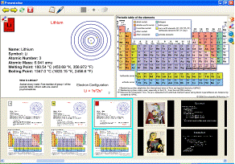
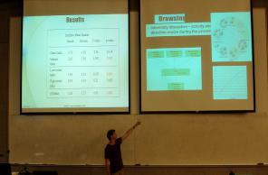
multi-presenter: multi-display presentation tool

Slide 18
how to prepare for seminar
read the papers
think about the papers
jot down some thoughts about the papers as you read them
write questions in the margins
prepare questions for discussion

Slide 19
how to present at the seminar
summarize the paper
what is the problem/context?
what is the research approach/solution?
what is the evaluation of the solution?
what is the contribution?
what are the research claims?
how claims supported?
lead a discussion about the paper
prepare questions to ask of the class
have an opinion

Slide 21
beyond the chalkboard: computer support for collaboration and problem solving in meetings
question: how can we support meeting room activity with computation?
problems:
production blocking (pp34, para 1)
range of meeting types (formality)

Slide 22
(cognoter/colab video)

Slide 23
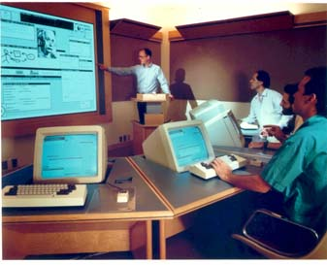
cognoter in colab
supporting presentation preparation
separation to 3 processes: brainstorming, organizing, evaluation

Slide 24
questions
how would you use cognoter?
how similar are your meetings with those in the video?
why don’t we see e-Whiteboards more often?

Slide 25
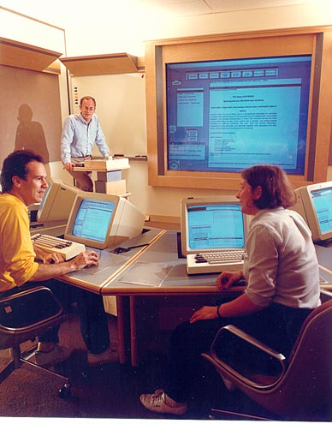
design for conversation: lessons from cognoter
models of conversation to explain what they saw: interactive vs. parcel-post
cognoter problems observed:
users wanted to see more
users couldn’t resolve deictic references

Slide 26
interactive model of conversation
“conversation is a highly coordinated activity in which meaning is attained and affirmed using a number of mechanisms that have context dependent functions” (pp192)
elementary: “the green thing on bookshelf”
try marker: “so when I’m talking about this thing (try marker), you know what I’m talking about”
mid-course corrections

Slide 27
some lessons from prior work
two types of actions involving whiteboards: those that involve production of objects, and those that involve use of (references to) those objects (Suchman 1988)
writing/recording takes time, so people manage that timing in the real world (Tang 1989)

Slide 28
some specific lessons from cognoter
separation b/n speech and text creation
loss of acknowledgements
unpredictable delay
relaxed-WYSIWIS causes problems
text & annotations inside are not reflected in the icon

Slide 29
questions

