Slide 1
HCI @ UCalgary
What we are doing in HCI, and how you can be a part of it

Slide 2
Outline
Courses – at UCalgary that relate to HCI
Team – faculty and students in CPSC and CMD doing HCI
Research – what we’re up to; how you can get involved
Grad School – what is it

Slide 3
Courses
Five undergrad courses
481 – HCI 1
581 – HCI 2
583 – Information Visualization
584 – Human-Robot Interaction
599.81 – Collaborative Computing
502/503 – Research project
Four graduate courses
681 – Research Methods in HCI
683 – Topics in Information Visualization
684 – Topics in Human-Robot Interaction
699.25 – Topics in Collaborative Computing and Personal Informatics

Slide 4
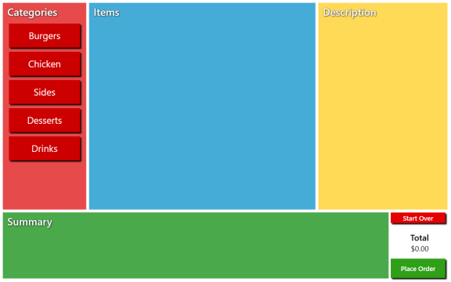
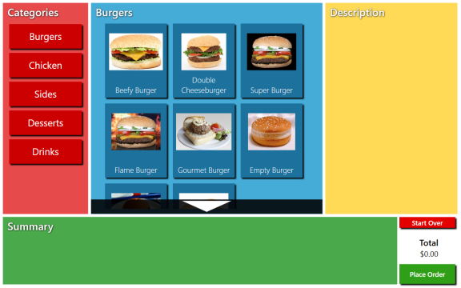
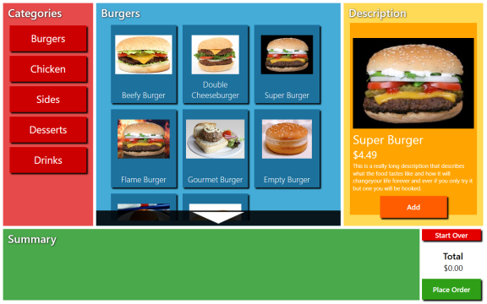
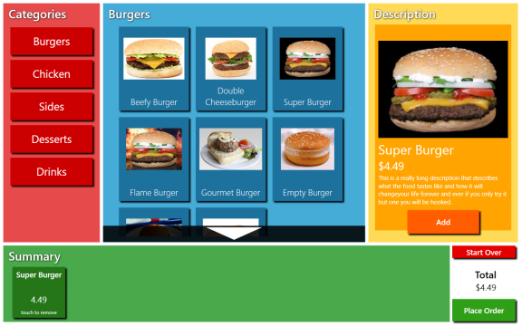
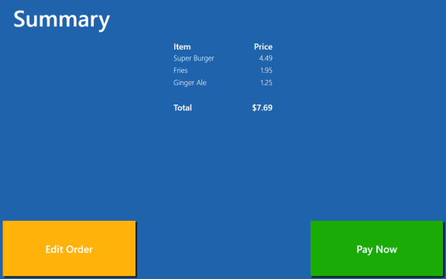
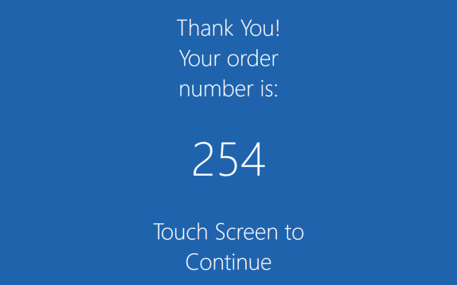
Courses – 481 HCI 1
Introduction to the processes and techniques involved for designing and creating tools or artifacts for direct human use.
Project team driven learning. (i.e. “learning through doing”)
Emphasis on communication.
Offered at least once a year (currently, once every term).
By: Kody Dillman,

Slide 5
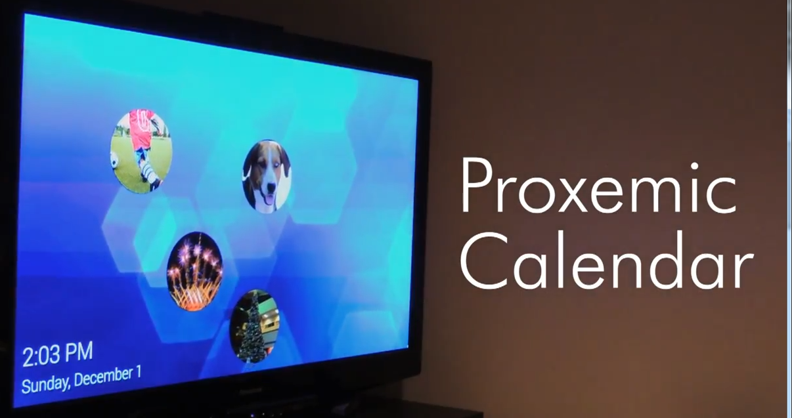
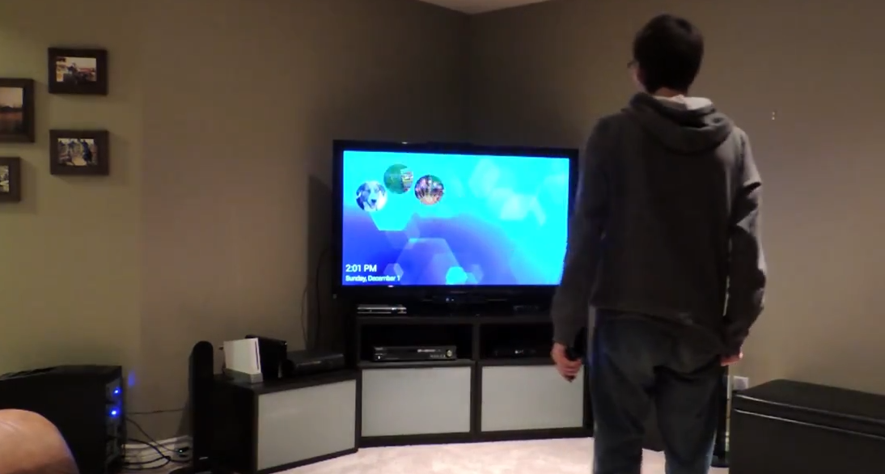
Courses – 581 HCI 2
Advanced topics and applications in human-computer interaction, emphasizing skills for designing highly interactive interfaces.
Multiple individual projects (4 or 5) through the term.
Frequent presentations and critiques.
Offered roughly once a year.
By: Daniel Sabourin

Slide 6
Courses – 583 Information Visualization
Designing, developing and investigating interactive visualizations specifically created to help people gain a better understanding of abstract data.
Multiple individual projects (4 or 5) through the term.
Frequent presentations and critiques.
Offered roughly once a year.

Slide 7
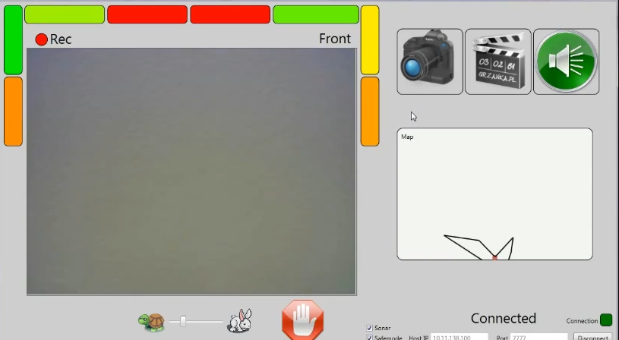
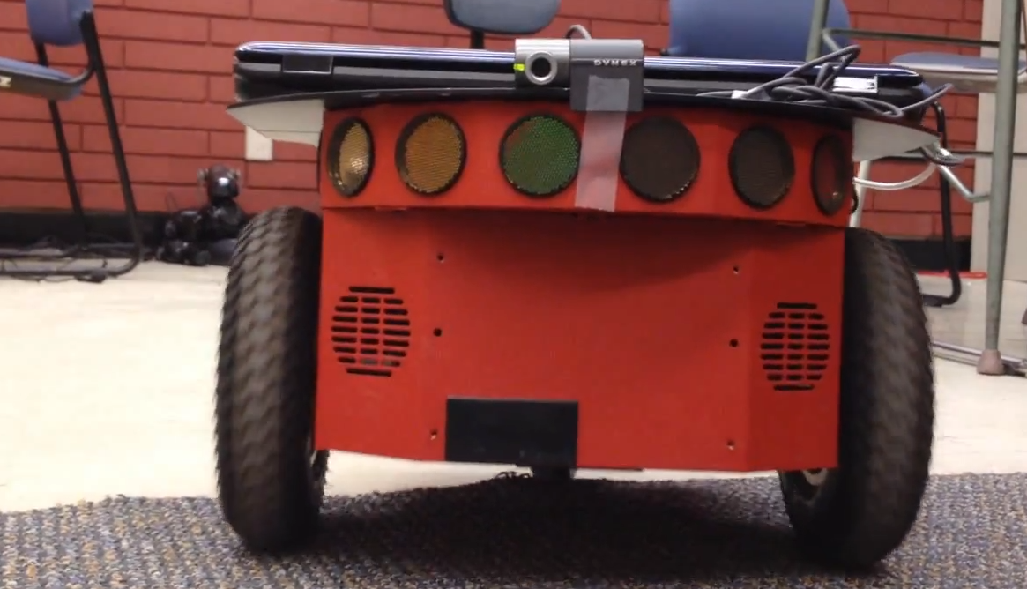
Courses – 584 Human-Robot Interaction
Introduction to the design, implementation and evaluation of human-robot interfaces. Topics include the evaluation of human-robot interaction (HRI), theoretical, philosophical and ethical issues, exploration of applications and tasks, prototyping HRI tools, and practical implementation and evaluation methods.
Offered roughly once a year.
By: Daniel Sabourin

Slide 8
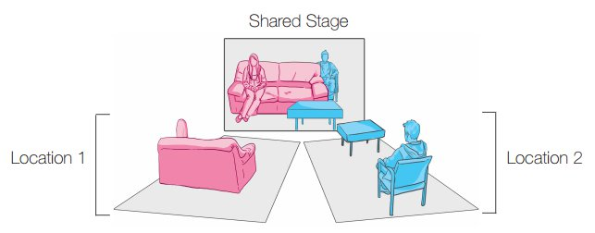
Courses – 599.81 Collaborative Computing
Design, implementation and evaluation of systems in specific settings (work, play and everyday life) with insight into social aspects of technology use, and how that affects the design of technologies that are used by multiple people.
Team or individual project driven.
Lots of reading and discussion.
Offered roughly once every two years.
By: David Ledo, Bon Adriel Aseniero, Kody Dillman, Haley MacLeod

Slide 9
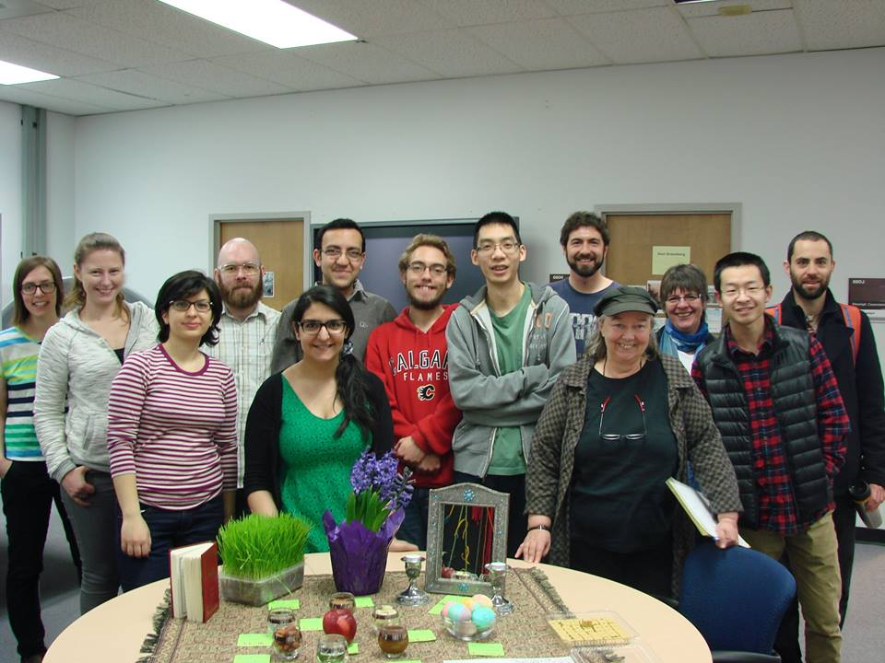
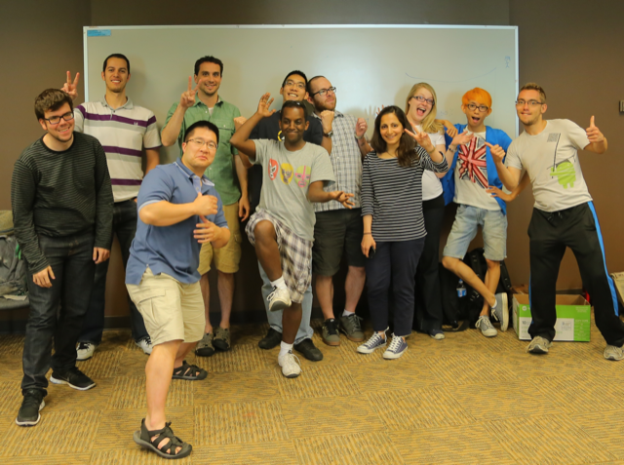
HCI Team at UCalgary
4 Professors + 2 Affiliates
3 Post-doctoral fellows
~25 Graduate students (MSc & PhD)
~5 Undergraduate students
Partridge in a pear tree
Canada is an HCI hotbed
UCalgary easily ranks in the top 3 (research productivity; students; research power; resources)

Slide 10

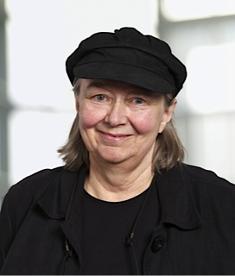
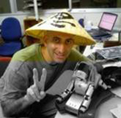
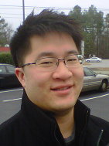
Interactions Lab – Faculty
Saul Greenberg (GroupLab) – Ubiquitous Computing, Physical Computing
Sheelagh Carpendale (InnoVis) – Information Visualization
Ehud Sharlin (uTouch) – Human-Robot Interaction
Tony Tang (RICELab) – Collaborative Computing

Slide 11
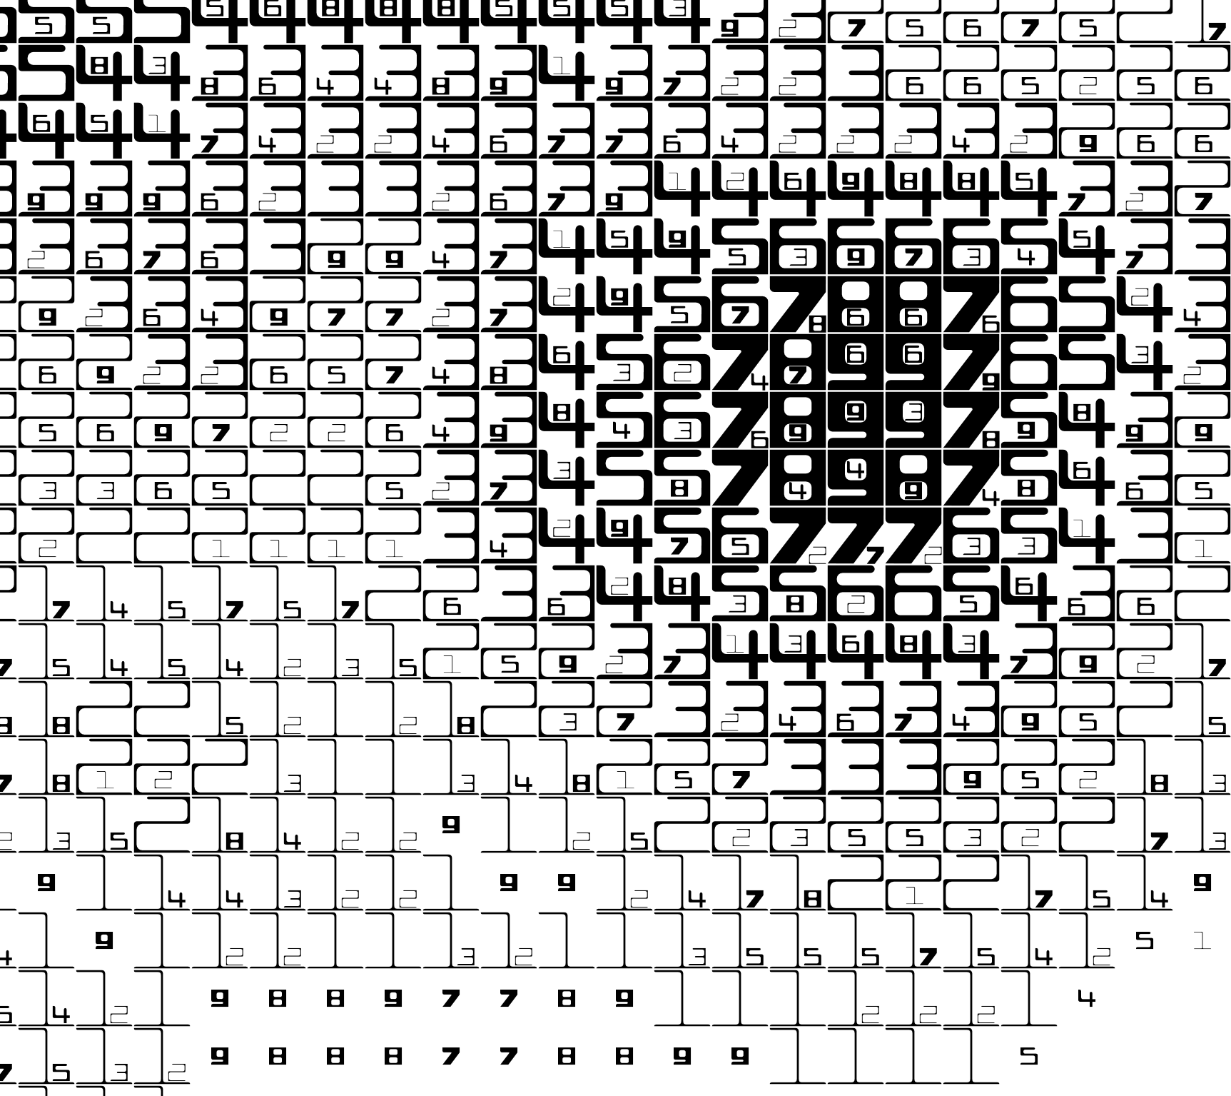

Computational Media Design (CMD)
Research-based graduate program that explores the relationships between art, music, design, science and technology.
By: Uta Hinrichs, Miguel Nacenta, Sheelagh Carpendale

Slide 12
HCI Research @ UCalgary
What
Requirements gathering
probes
interviews
Designing prototypes
Studies
How
CPSC 502/503
Summer RA
Grad school

Slide 13
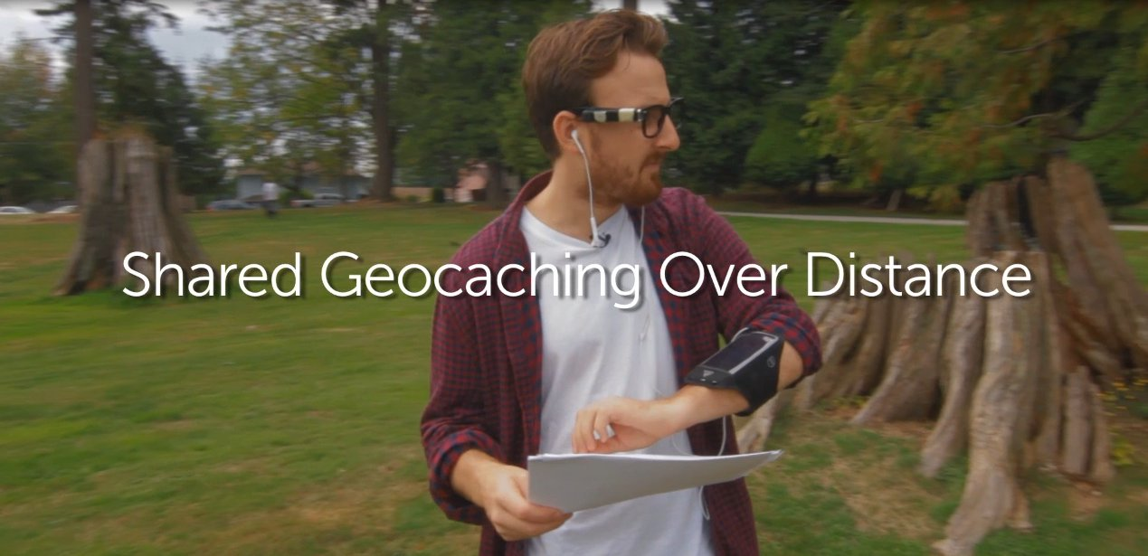
Requirements Gathering – Probes

Slide 14
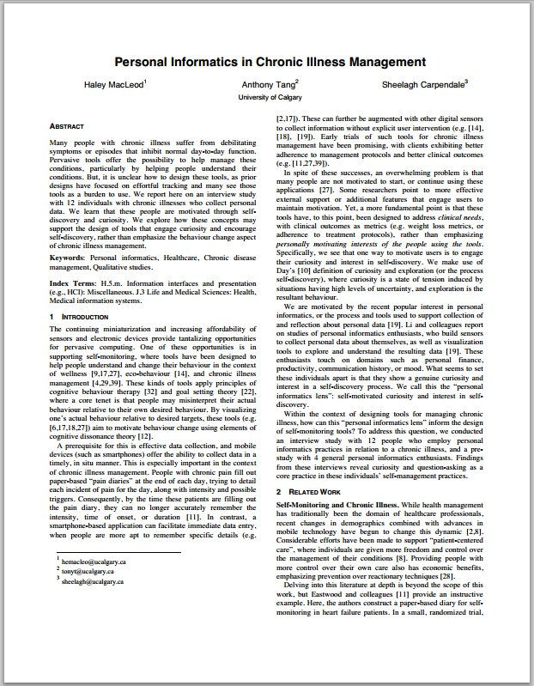
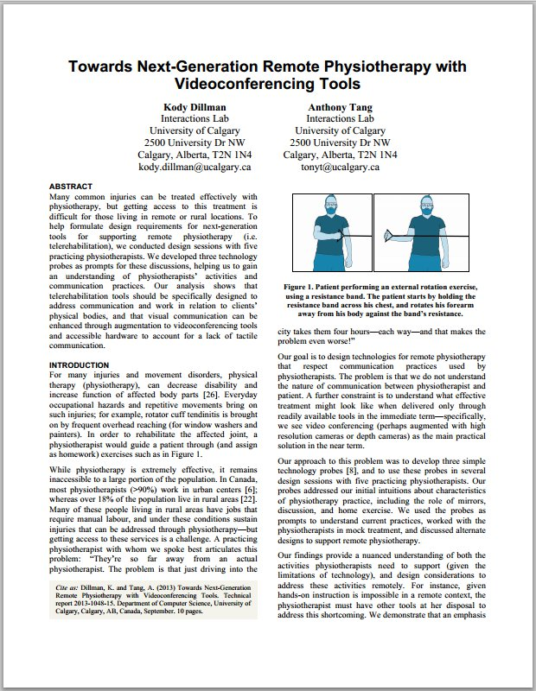
Requirements Gathering - Interviews

Slide 15
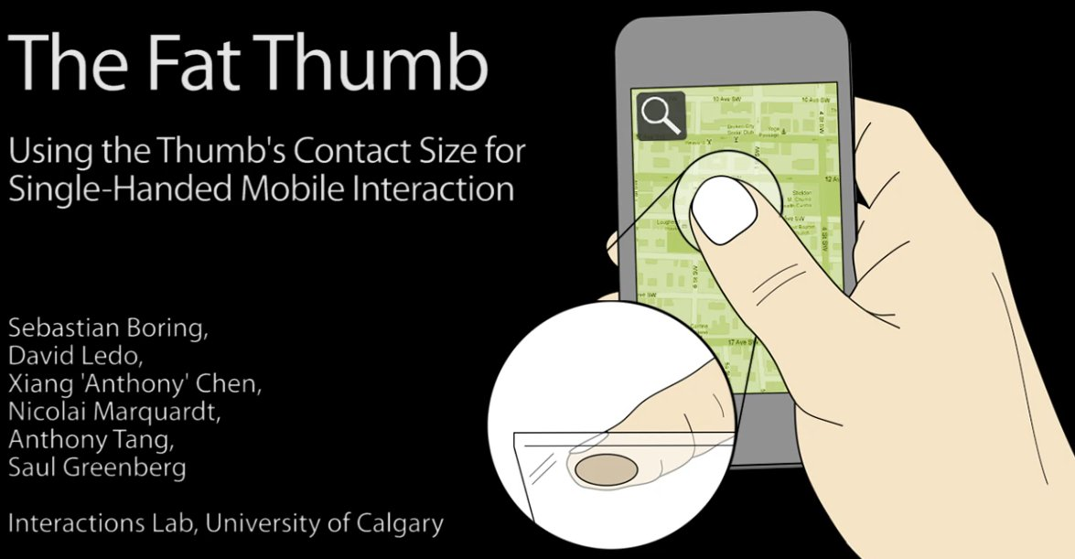
Designing Prototypes

Slide 16
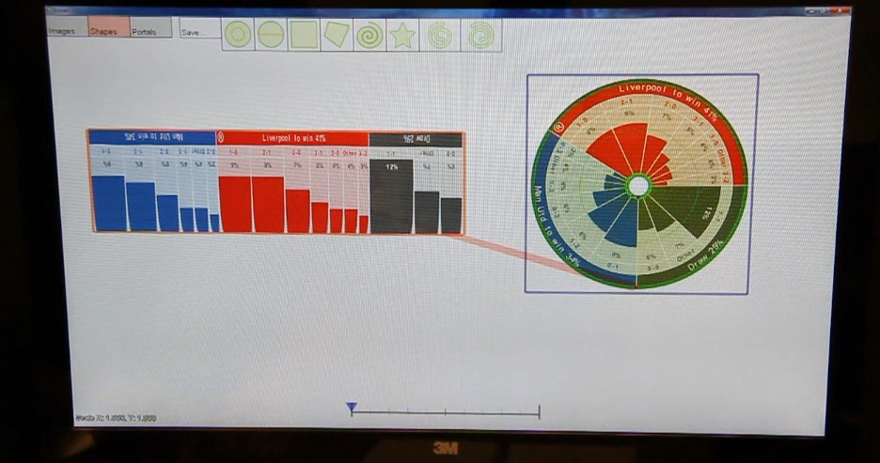
Designing Prototypes

Slide 17
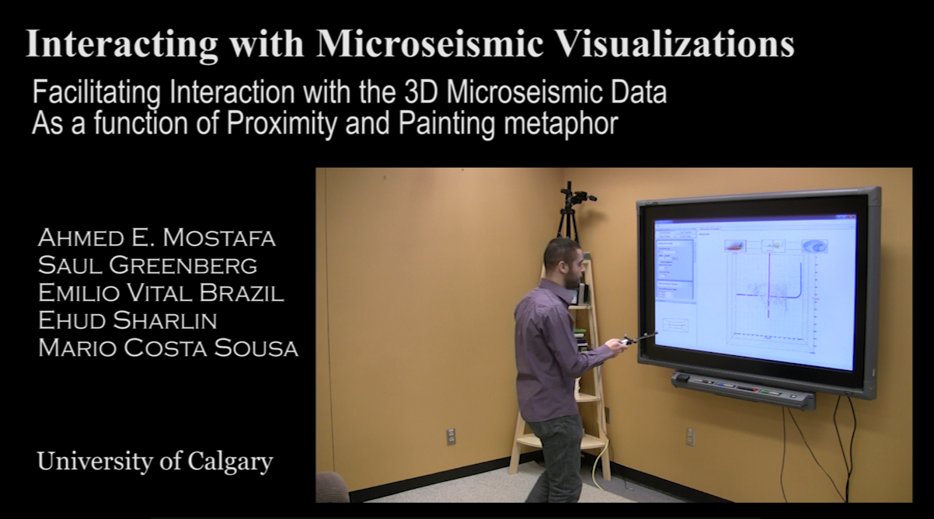
Designing Prototypes

Slide 18
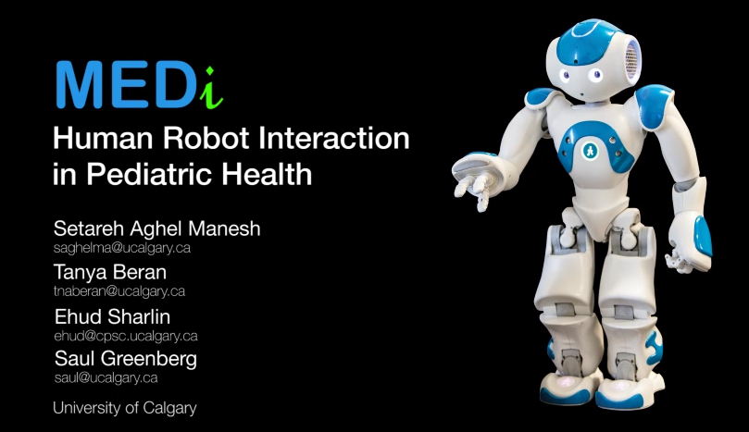
Studies

Slide 19
How
CPSC 502/503
Summer RA
Grad school

Slide 20
CPSC 502/503 – Research project
CPSC 502 – two term (for Honours students)
CPSC 503 – one term
Research project
Defined by you and your supervisor
You set the schedule
You are a researcher!
Assessed on: proposal, research paper, presentation

Slide 21
Summer RA
Usually through the summer
You get paid
Research project
Defined by you and your supervisor
You set the schedule
You are a researcher!
Assessed on: proposal, research paper, presentation

Slide 22
Grad school (MSc)
Two year program (5 courses total)
You get paid ($20k min - $56k w/ scholarships)
Research project
Defined by you and your supervisor
You set the schedule
You are a researcher!
Assessed on: proposal, research paper, presentation

Slide 23


Undergrad » how to solve a problem

Slide 24

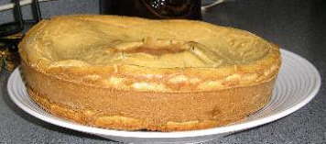


Undergrad » how to solve a problem
50%

Slide 25


Undergrad » how to solve a problem

Slide 26

Grad school
» figure out what problems are worth solving
» figure out how to solve problems
» solve problems
Notes:
Positions you to understand and consider bigger picture issues; understanding how things fit together, etc.
Sets you up for architect-like positions, where you’re not really working from ground up, because people understand your capacity to think about and address bigger issues

Slide 27
Outline
Courses – at UCalgary that relate to HCI
Team – faculty and students in CPSC and CMD doing HCI
Research – what we’re up to; how you can get involved
Grad School – what is it

