Slide 1
Skills for Success
CPSC 481
Michael Boyle, SMART Technologies
November 28, 2012

Slide 2

Empathy
© Nathan Y

Slide 3
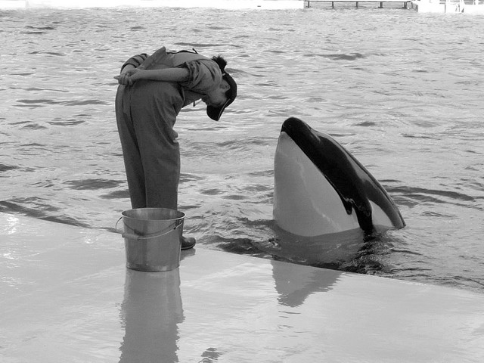
Humility
© gwaar

Slide 4

Awareness
© Battle Creek CVB

Slide 5

Wonder
© Emilio del Prada

Slide 6

Credit
© Jessie Pearl

Slide 7
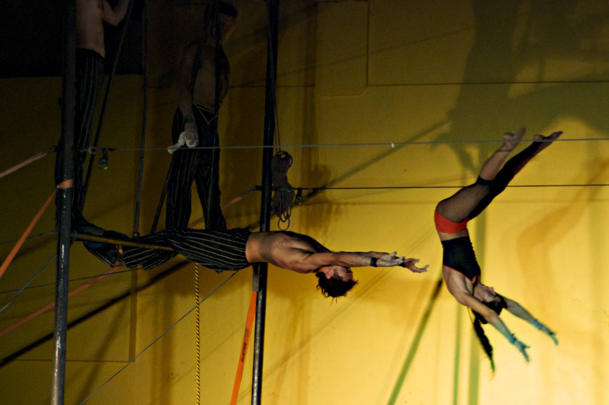
Faith
© kevin.j

Slide 8

Tenacity
© sarihuella

Slide 9

Accountability
© Nick Nguyen

Slide 10

Principles
© Catching.Light

Slide 11

Compromise
© Ed Yourdon

