Slide 1
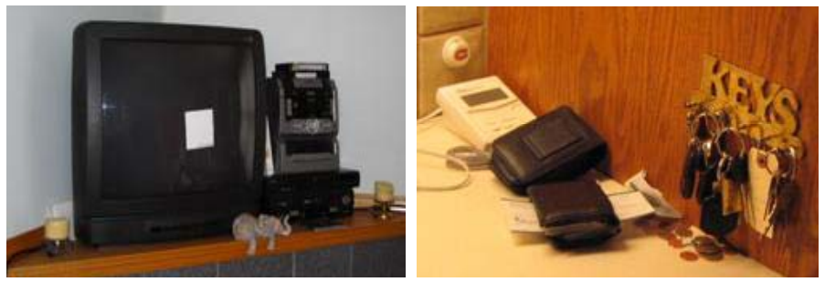
Notice the sticky note on the TV, and the mail stuck in the wallet. Why are they there?
Notes:
Kathryn Elliot, Carman Neustaedter, Saul Greenberg: Time, Ownership and Awareness: The Value of Contextual Locations in the Home. Ubicomp 2005: 251-268
Consider: who are the messages left for?
Do you have locations in your home that are like this? How do you send messages [explicit or otherwise] to other inhabitants of your home? What if it’s urgent?
Do certain locations have owners?
People are unlikely to /tell/ you about these. You have to go look, and discover them for yourself. The meaning and function are all embedded in how these things are used.

Slide 2
Wednesday Tutorial
Wednesday, 9/26 is canceled
Here are the alternate tutorial times:
-- Monday 5pm
-- Tuesday 5pm
-- Friday 12pm

Slide 3
Contextual Inquiry
Combining “looking” and “asking” by immersing oneself into a particular context/culture: understand mental models and work practices
“The core premise of Contextual Inquiry is very simple: go where the customer works, observe the customer as he or she works, and talk to the customer about the work. Do that, and you can’t help but gain a better understanding of your customer.”

Slide 4
Contextual Inquiry: Principles
Context: in the setting of the participant
Relationship: you are the apprentice, participant is the expert
Interpretation: observed facts must be considered for design implications
Focus: lots of themes will emerge, but this helps to orient the team

Slide 5
Expert/Apprentice
You are the noob
What does this mean?
  Be a keen observer
  Ask questions
  Be eager to learn
  Admire the master
  Aspire to see the world as the expert does

Slide 6
Interviewing
Summaries vs. ongoing experience
  “I got to work, checked my email and had a cup of coffee” [abstract summary]
  “I got to work, looked over my email, answered messages from my boss, decided to have some coffee, walked to the coffee machine, found there was no coffee, so I made coffee…” [concrete detail]

Slide 7
Design Methods: LEARN
CPSC 481: HCI I
Fall 2012
Anthony Tang, with acknowledgements to Julie Kientz, Saul Greenberg, Ehud Sharlin, Jake Wobbrock, Dave Hendry, Andy Ko, Jennifer Turns, & Mark Zachry

Slide 8

LEARN from your data
Now that you have a huge stack of notes and ideas from all of your LOOKing and ASKing, it’s time to make some sense of the data
Methods are intended to help you organize your thinking, and express it to help make it concrete and real

Slide 9
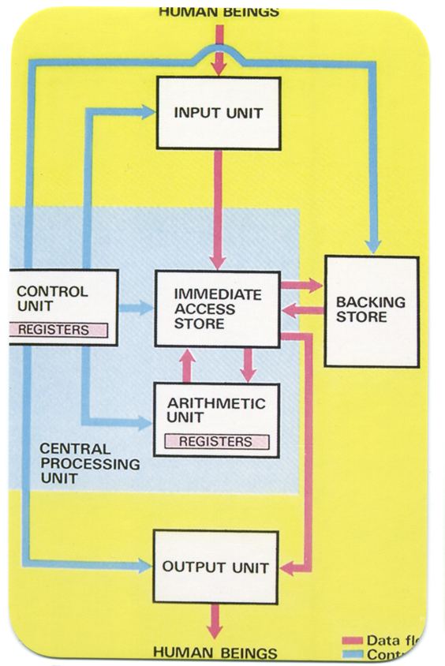
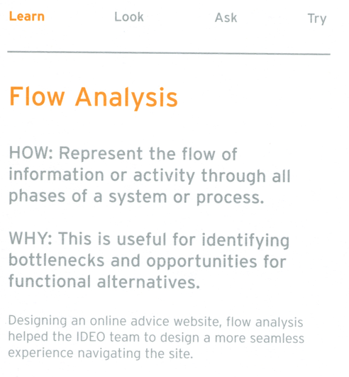

Slide 10

Notes:
http://www.zazzle.ca/thank_you_cards_red_daisy-137447214949027033

Slide 11
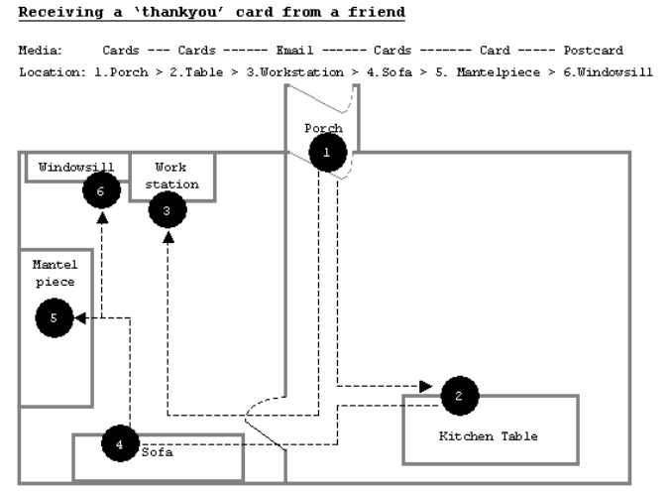
Notes:
Finding a Place for UbiComp in the Home *
Andy Crabtree, Tom Rodden, Terry Hemmings and Steve Benford
-- Ubicomp 2003

Slide 12
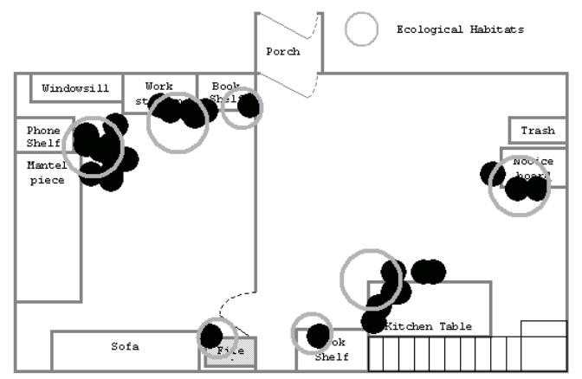
Notes:
Over time, can tell us where technology is used, and what it might be used for

Slide 13
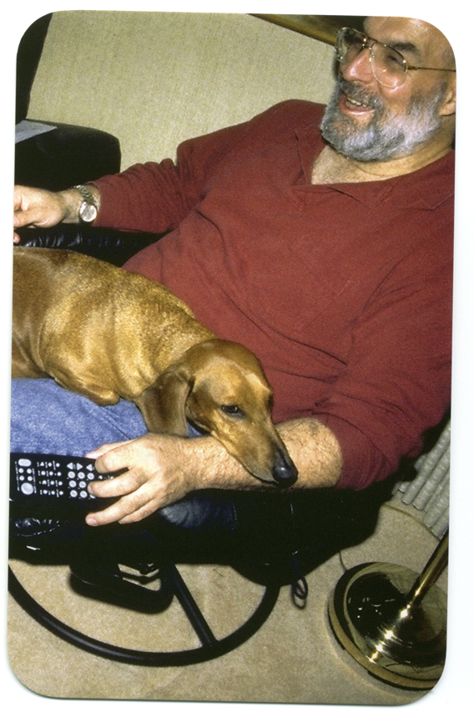
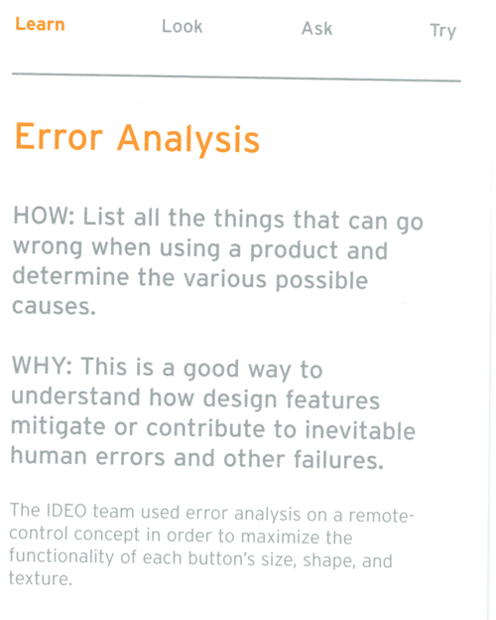

Slide 14
Error Analysis
Activity: List all of the errors that could happen when driving a car.
Activity 2: Why does that error occur?

Slide 15
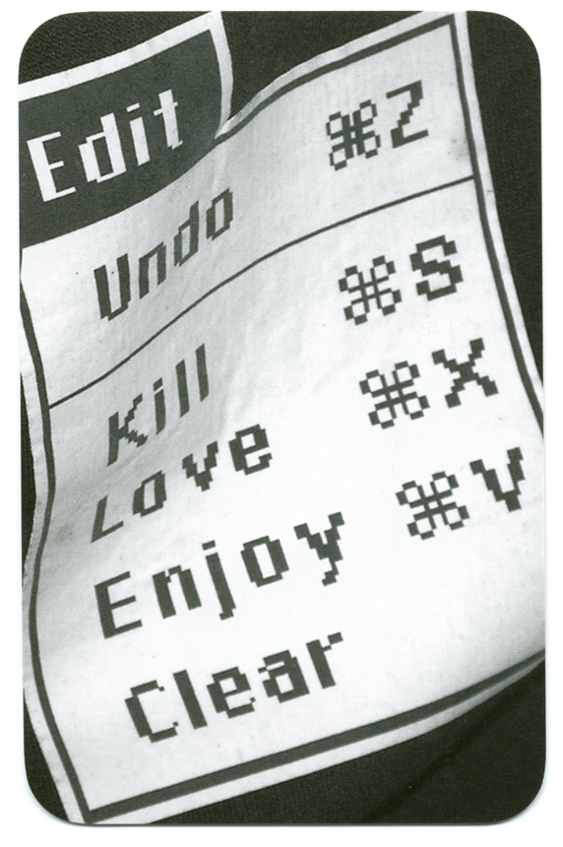
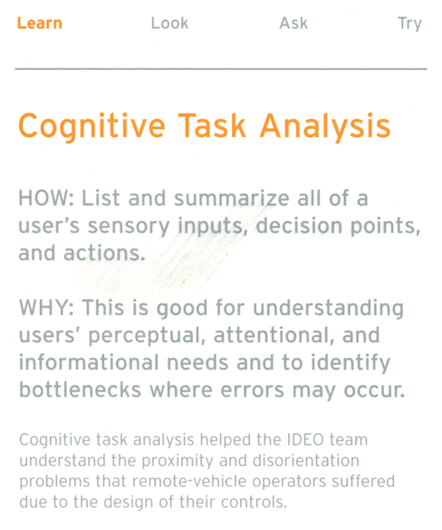

Slide 16

Notes:
Airbus A380 cockpit

Slide 17

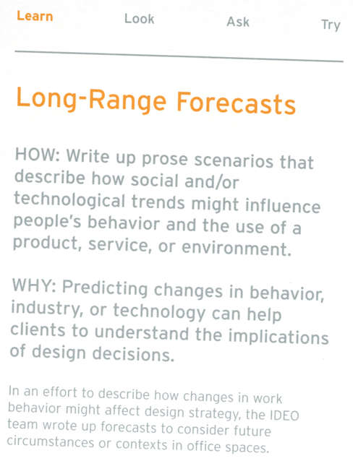

Slide 18
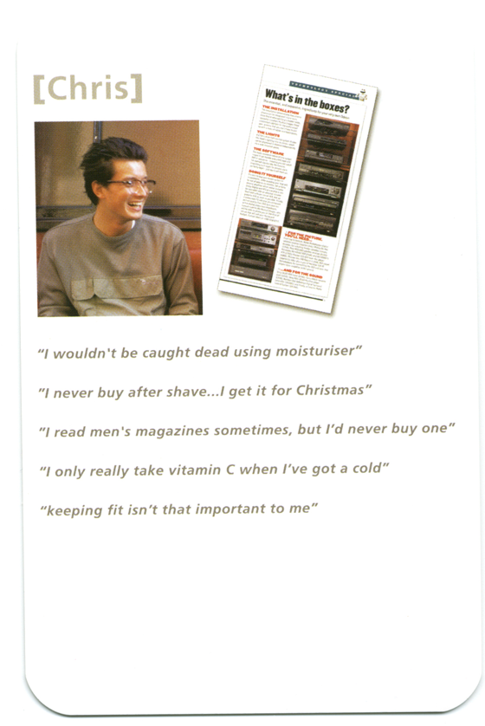
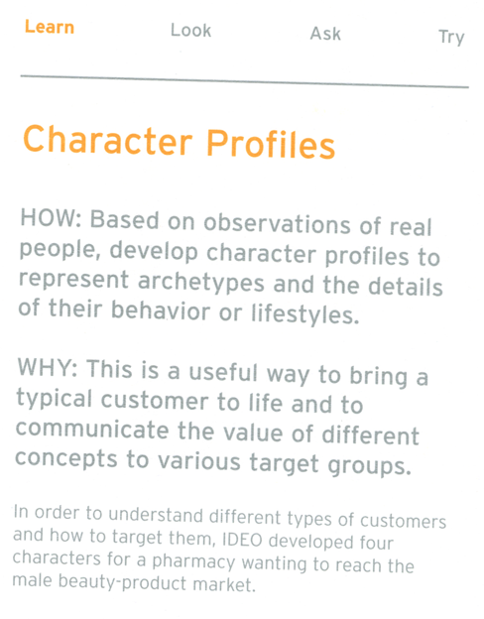

Slide 19
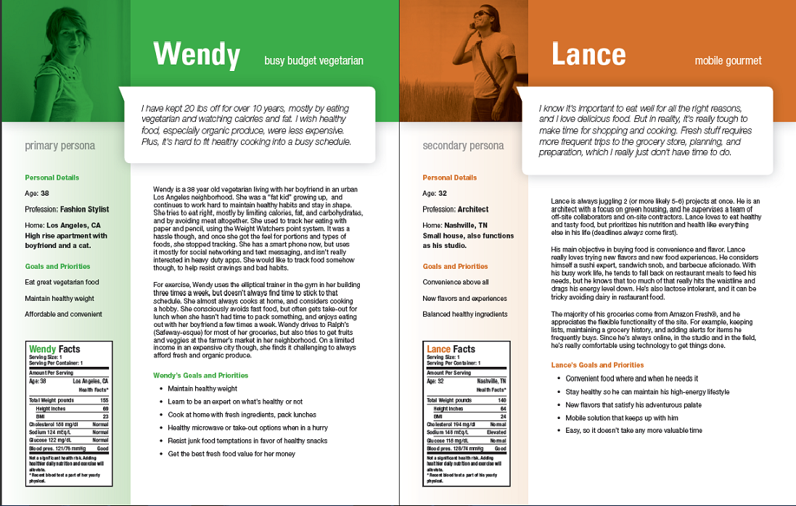

Slide 20
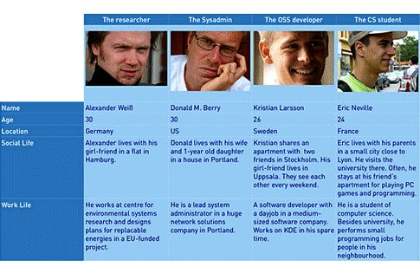

Slide 21
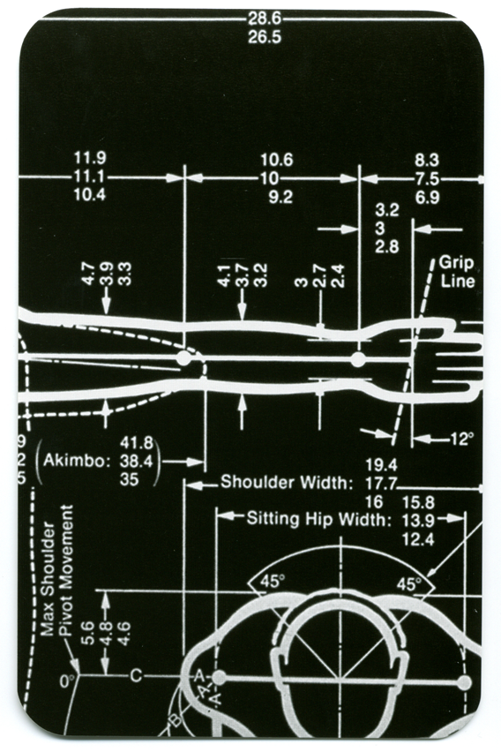
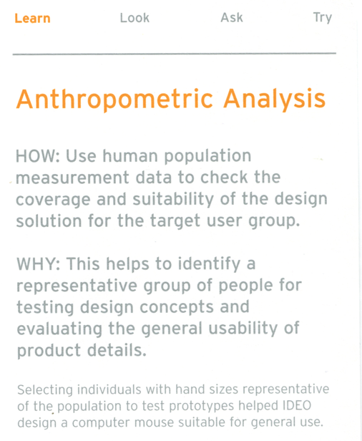

Slide 22
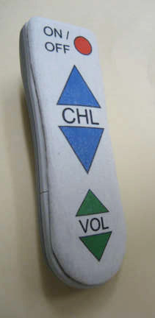
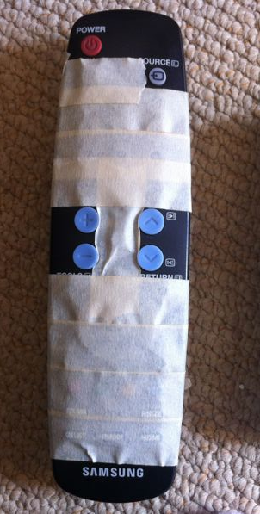
Notes:
http://theformer786.blogspot.ca/2010/05/life-is-so-hard-without-stuff.html
and
Reddit.com

Slide 23

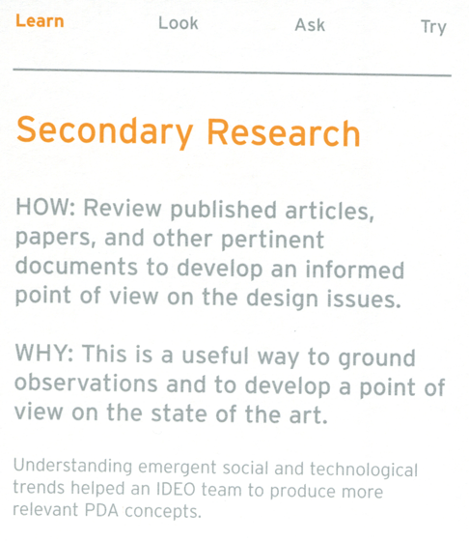

Slide 24
Secondary Research
Quick Activity: What are some sources you might look at for secondary research for your projects?

Slide 25
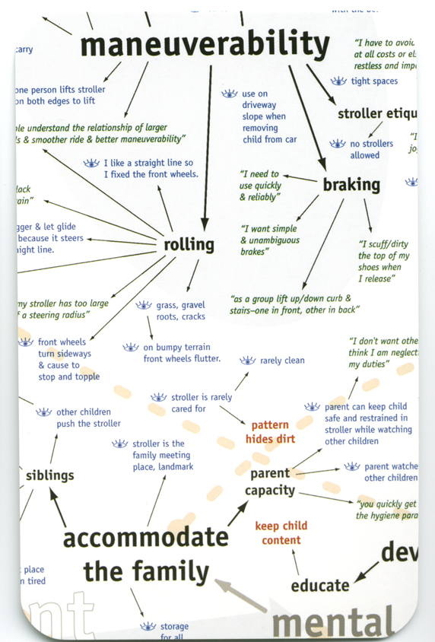
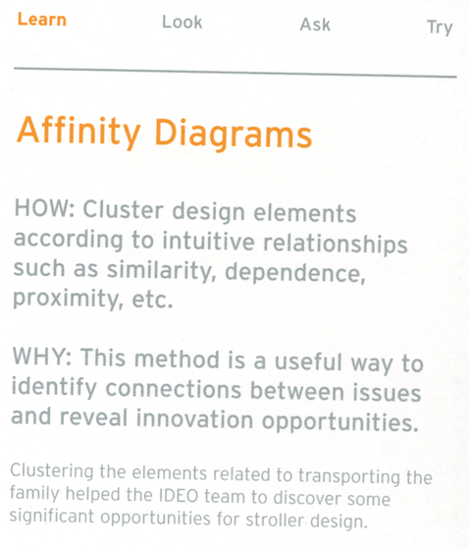

Slide 26
Summary
Apply “Learn” techniques as a way to process the data you gather from “Ask” and “Look”
Some learning tasks can help you figure out who to talk to for “Ask” and “Look”
  e.g., secondary research, cultural comparisons

Slide 27
Randy Pausch’s Tips for Working in a Group
Meet people properly.
Find things you have in common.
Make meeting conditions good.
Let everyone talk.
Check your egos at the door.
Praise each other.
Put it in writing. Remember that “politics is when you have more than 2 people” – with that in mind, always CC (carbon copy) any piece of email within the group, or to me, to all members of the group. This rule should never be violated; don’t try to guess what your group mates might or might not want to hear about.
Be open and honest.
Avoid conflict at all costs.
Phrase alternatives as questions.
http://www.cs.cmu.edu/~pausch/Randy/tipoForGroups.html
Notes:
It all starts with the introduction. Then, exchange contact information, and make sure you know how to pronounce everyone’s names. Exchange phone #s, and find out what hours are acceptable to call during.
You can almost always find something in common with another person, and starting from that baseline, it’s much easier to then address issues where you have differences. This is why cities like professional sports teams, which are socially galvanizing forces that cut across boundaries of race and wealth. If nothing else, you probably have in common things like the weather.
Have a large surface to write on, make sure the room is quiet and warm enough, and that there aren’t lots of distractions. Make sure no one is hungry, cold, or tired. Meet over a meal if you can; food softens a meeting. That’s why they “do lunch” in Hollywood.
Even if you think what they’re saying is stupid. Cutting someone off is rude, and not worth whatever small time gain you might make. Don’t finish someone’s sentences for him or her; they can do it for themselves. And remember: talking louder or faster doesn’t make your idea any better.
When you discuss ideas, immediately label them and write them down. The labels should be descriptive of the idea, not the originator: “the troll bridge story,” not “Jane’s story.”
Find something nice to say, even if it’s a stretch. Even the worst of ideas has a silver lining inside it, if you just look hard enough. Focus on the good, praise it, and then raise any objections or concerns you have about the rest of it.
Talk with your group members if there’s a problem, and talk with me if you think you need help. The whole point of this course is that it’s tough to work across cultures. If we all go into it knowing that’s an issue, we should be comfortable discussing problems when they arise -- after all, that’s what this course is really about. Be forgiving when people make mistakes, but don’t be afraid to raise the issues when they come up,
When stress occurs and tempers flare, take a short break. Clear your heads, apologize, and take another stab at it. Apologize for upsetting your peers, even if you think someone else was primarily at fault; the goal is to work together, not start a legal battle over whose transgressions were worse. It takes two to have an argument, so be the peacemaker.
Instead of “I think we should do A, not B,” try “What if we did A, instead of B?” That allows people to offer comments, rather than defend one choice.

