Slide 1
CPSC 601.25: Collaborative Computing & Personal Informatics
Day 1

Slide 2
What is this class about?
computer supported cooperative work
traditionally: systems for communication, collaboration and coordination
today: everyday use of computation in collaboration, coordination and competition
What are some CSCW systems you used today?

Slide 3
What is this class about?
personal informatics
collecting, analyzing and understanding personal data
behaviour change
What are some data stores you used today?
What about yourself would you like to understand?

Slide 4
Learning objectives
understand the unique challenges that exist for studying and designing collaborative technologies
identify various research areas within computer-supported cooperative work and understand the future directions in these areas
apply methodological tools used to study and evaluate collaborative technologies
analyze and critically reflect on the design and use of collaborative technologies
conduct informed presentations of collaborative technology design and use
document studies and designs of collaborative technology for conference or journal publication

Slide 5
Course Goals
Understand and be conversant about core CSCW issues (historical / practical)
Understand some of the central issues in Personal Informatics
Bleeding edge: be able to think / talk about the intersection
Notes:
This is an applied course: we use others’ bits and bytes. Here, it’s about the issues and ideas

Slide 6
Administrivia
Meetings
Mondays @ 2:00pm-4:45pm
MS680A (usually)
Office Hours
by appointment
Course Webpages:
http://hcitang.org/ -> follow link on left nav bar
password: hello601
http://piazza.com/

Slide 7
Class (1 / 3)
Seminar style class
Topic presentations (10%): each class, a student will present/summarize two papers (~15-20 mins), and lead a discussion about the papers
In-class participation (10%): your in-class participation matters—it shows you are thinking and reflecting on the material
Online participation (10%): you are to respond to the papers prior to class on Piazza

Slide 8
A note about online responses
I am looking for a single response to both papers—address themes that are common (or contrasting) in the two papers assigned each week
I am not looking for (just) a summary, but instead a critical response: e.g.,
What makes sense, what does not?
What arguments are the authors making, and how do they support those arguments?
What are the methods they choose to use, and are these appropriate?
What question would you ask the authors if you had the chance?
How do the findings square with your own understanding?

Slide 9
Class (2 / 3)
Assignments (10%)
Throughout the term, I will ask you to perform small assignments—you will typically have a week to perform the task (or at least until Friday). They are used to demonstrate competency and thinking in the CSCW & PI space.

Slide 10
Class (3 / 3)
Project (60%)
Do some original work: get marks.
You can work with a partner, or by yourself.
Design problem from CHI 2014 Student Design Competition
Ask an interesting question, build a system
Study a context where a system might help / understand needs
Study a system
Work & meet with me to discuss this project

Slide 11
Project: BodyData – Designing for Qualities of the Quantified Self
Lots of self-tracking technologies now available
How can we this incoming bodydata into self-knowledge?
Mood, Emotion, and Meaning
Sleep, Habits and Health
Movement, Mindfulness and Listening
Personal Analytics, Data Visualization
Design an object, interface, system, or service intended to help us to develop and share self-awareness, understanding or appreciation for our BodyData, exploring how we can Design Qualities for the Quantified Self, our personal experience as it relates to our knowledge in the world.

Slide 12
Project: Major Activities
Project Specification (Brainstorming)
Project Proposal
Final Presentation
Final Paper
Early Reviews
Program Committee Review

Slide 13
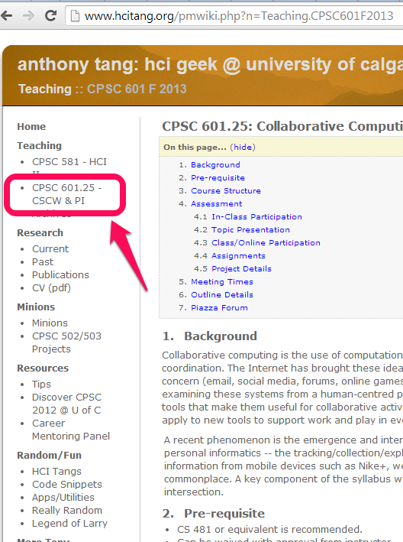
Resources
Course site
http://piazza.com/
Email: tonyt@ucalgary.ca

Slide 14
Preparing for class…
read the papers
think about the papers
jot down some thoughts about the papers as you read them
write questions in the margins
prepare questions for discussion

Slide 15
Online Responses
response: a few paragraphs about the papers – summarize briefly, then give your thoughts on the ideas presented in the papers. (no real formula)
» what did it make you think about?
» can you relate to the ideas in the papers?
» in ways are they right / in what ways are they wrong?
» what was interesting?
» what are some weaknesses / strengths?
» how can you extend the work / what would you do differently?
Graded on: no check, check minus, check, check plus
Notes:
Mulligan

Slide 16
For next class
Complete the TCPS 2 Tutorial Course on Research Ethics (CORE)
Sketch a plan for six different project ideas (three sentences each), and post on Piazza
Comment on two people’s project ideas (alpha up, alpha down)
Prepare online responses to readings for next week

Slide 18
Topic Presentation
summarize the paper
what is the problem/context?
what is the research approach/solution?
what is the evaluation of the solution?
what is the contribution?
what are the research claims?
how claims supported?
lead a discussion about the paper
prepare questions to ask of the class
have an opinion

