Slide 1
CPSC 601.25 – Oct 7, 2013

Slide 2
Agenda
Project proposals
Grading rubric activity
Pervasive games paper discussion
Trying Geocaching
Pervasive game design activity
HW: Proposal self-assessment & revisions posted to Piazza (Wed)
HW: Proposal feedback for others (Mon) – same assignments as for mini-proposals

Slide 3
Proposals

Slide 4
Grading Rubric
 | Poor | Satisfactory | Good | Outstanding
Articulation of problem & motivation
Treatment of prior work (scope)
Approach (appropriateness) / Solution / Timetable
Evaluation Method/Metric (rationale)
Novelty / value of proposed research
Structure / Style

Slide 5
Some Terms
Location-based experiences: games/things that you experience when you are out in the world (perhaps through technology)
Geocaching: location-based game where people go out in the world to hide (and find) little boxes (caches). These caches are documented on a website, where people also post their experiences finding (or not finding) the caches themselves.
Community: a social group bound by a common cultural heritage
Groupware: software that allows people to work (communicate / coordinate their activities) together

Slide 6
Location-based experiences
Location-sensing
Mobile devices – GPS, wifi sensing
Content
Issue 1: How do we keep content fresh, interesting, useful?
Issue 2: Who is going to create this content? How do we maintain this content?

Slide 7



Content Creation Possibilities
Designer-generated
Expensive, time-consuming
Automatically-generated
Low variance/novelty
Player-generated
Need for maintenance, vetting, etc.

Slide 8
Punchlines
Question: What factors make location-based experiences/games successful?
Approach: Study Geocaching through two means: (1) self-activities (experience of three researchers), (2) survey (185 people)
Findings: Participants help to create experiences (flexibility helps), and maintenance of these experiences occurs as side-effect of interaction w/ game system
Beyond this paper: Location-based games / experiences can be successful, but how they are constructed is tricky. We can learn from other successful systems in how they set up interactions.

Slide 9
Case study: geocaching
Geocaching is a successful location-based experience/game
It relies on largely user-generated content
How can it do this??
Questions:
How do people construct these experiences?
Why do they find it enjoyable?
What mechanisms support maintenance?

Slide 10
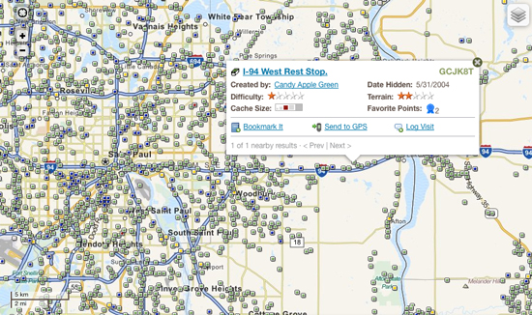
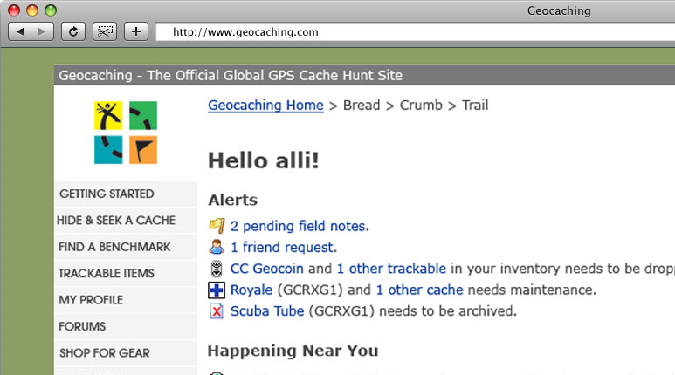
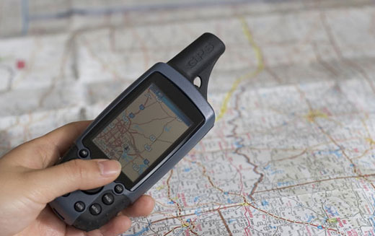
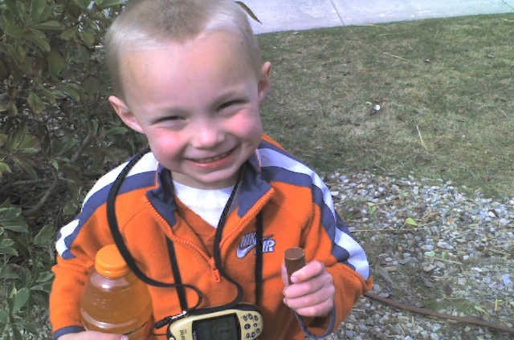
What is geocaching?
1
2
3
4

Slide 11
Method
Geocaching participation (self-experience of 3 researchers):
Play the game. Lots (on some measure). Find 315 geocaches, hide 12.
Survey of geocaching participants (185 completed):
Questions about: geocache creation, interesting geocaches
Recruitment: snowball sampling, forums

Slide 12
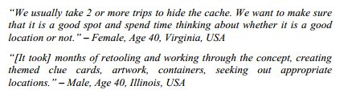
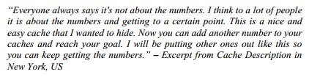
Findings: Cache Creation
Flexibility in what constitutes a geocache
Complex and well-thought out
Simple and ad hoc

Slide 13
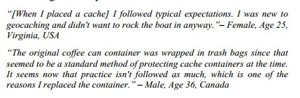
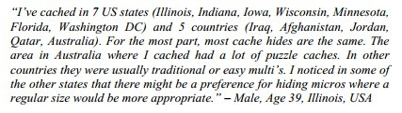

Findings: Norms
There are a set of customs and norms around cache creation
These differ a bit based on where one is

Slide 14
A bit about the webpages…
http://www.geocaching.com/seek/cache_details.aspx?wp=GC1JQZK
Notes:
Note Difficulty, Terrain, Size, Description, and Logs

Slide 15
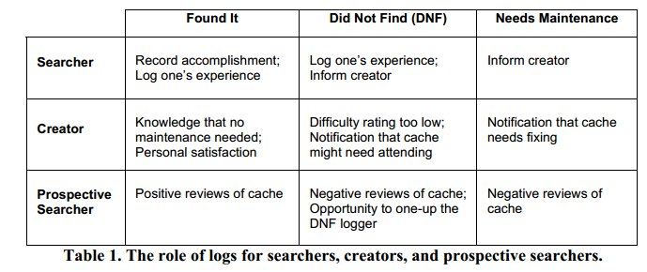
Findings: Maintenance

Slide 16
Points of Discussion
So, if you have a community, it works. How do you start that community?
How can a community pass on a set of customs/ideas to newcomers?
How does this work in Wikipedia?

