Slide 1
The Role of Community and Groupware in Geocache Creation and Maintenance

Slide 2
Some Terms
Location-based experiences: games/things that you experience when you are out in the world (perhaps through technology)
Geocaching: location-based game where people go out in the world to hide (and find) little boxes (caches). These caches are documented on a website, where people also post their experiences finding (or not finding) the caches themselves.
Community: a social group bound by a common cultural heritage
Groupware: software that allows people to work (communicate / coordinate their activities) together

Slide 3
Punchlines
Question: What factors make location-based experiences/games successful?
Approach: Study Geocaching through two means: (1) self-activities (experience of three researchers), (2) survey (185 people)
Findings: Participants help to create experiences (flexibility helps), and maintenance of these experiences occurs as side-effect of interaction w/ game system
Beyond this paper: Location-based games / experiences can be successful, but how they are constructed is tricky. We can learn from other successful systems in how they set up interactions.

Slide 4
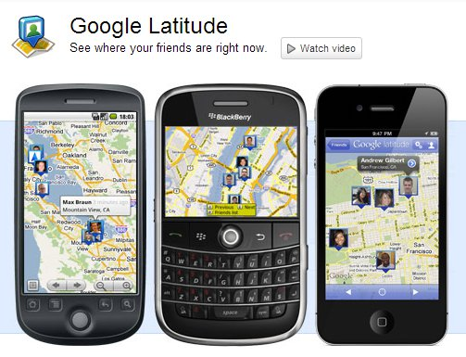
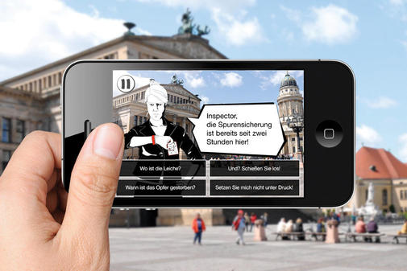
Context: location-based experiences
Location-based social networking
Location-based augmented reality

Slide 5
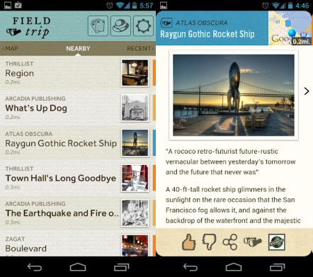

Context: location-based experiences
Location-based discovery/learning
Location-based games
Notes:
Location-sensing + content

Slide 6
Location-based experiences
Location-sensing
Mobile devices – GPS, wifi sensing
Content
Issue 1: How do we keep content fresh, interesting, useful?
Issue 2: Who is going to create this content? How do we maintain this content?

Slide 7



Content Creation Possibilities
Designer-generated
Expensive, time-consuming
Automatically-generated
Low variance/novelty
Player-generated
Need for maintenance, vetting, etc.

Slide 8
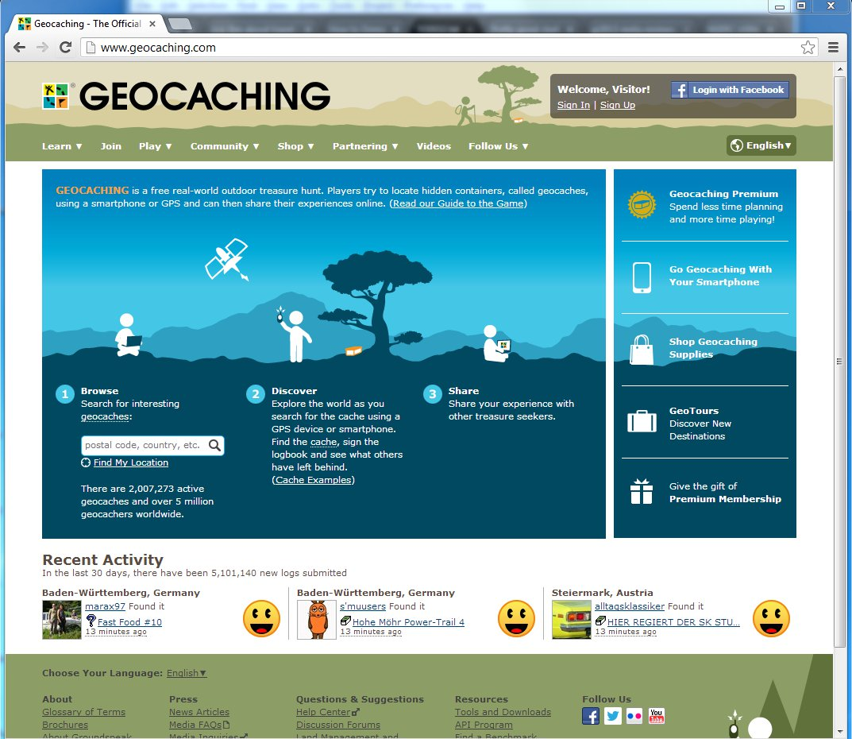
Geocaching
Notes:
Geocaching:
2 million geocaches
5 million geocachers
World-wide

Slide 9
Case study: geocaching
Geocaching is a successful location-based experience/game
It relies on largely user-generated content
How can it do this??
Questions:
How do people construct these experiences?
Why do they find it enjoyable?
What mechanisms support maintenance?

Slide 10
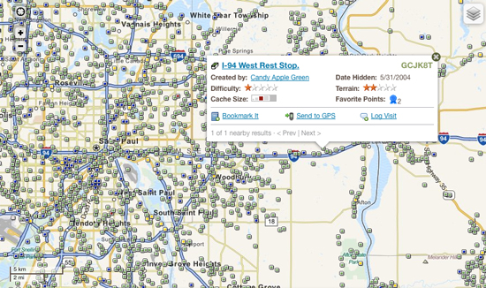
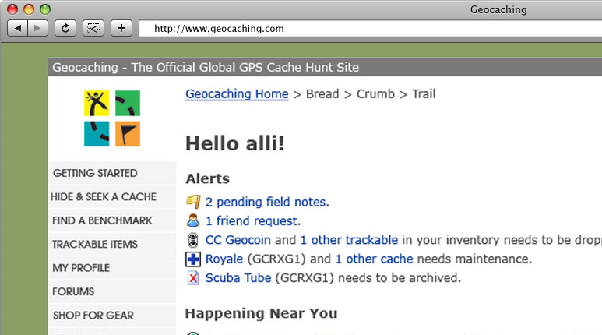
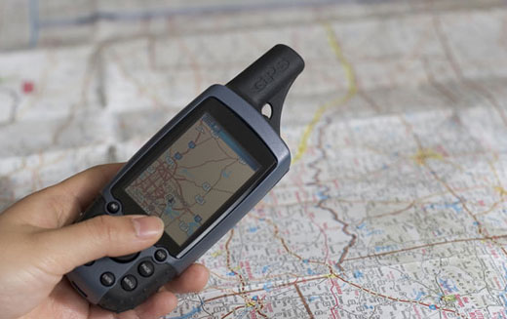
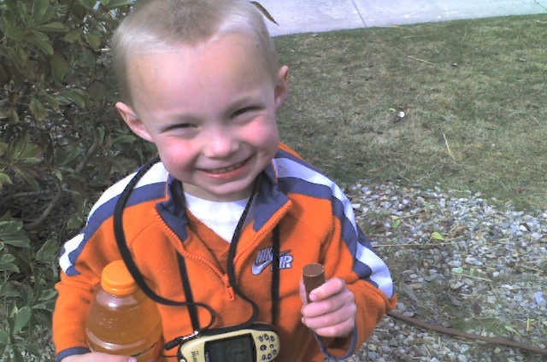
What is geocaching?
1
2
3
4

Slide 11
Method
Geocaching participation (self-experience of 3 researchers):
Play the game. Lots (on some measure). Find 315 geocaches, hide 12.
Survey of geocaching participants (185 completed):
Questions about: geocache creation, interesting geocaches
Recruitment: snowball sampling, forums

Slide 12
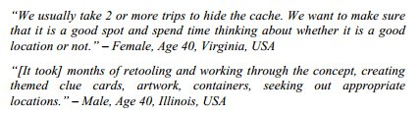
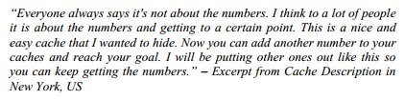
Findings: Cache Creation
Flexibility in what constitutes a geocache
Complex and well-thought out
Simple and ad hoc

Slide 13
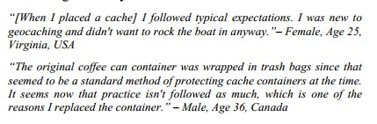
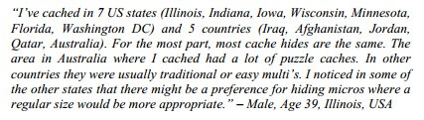

Findings: Norms
There are a set of customs and norms around cache creation
These differ a bit based on where one is

Slide 14
A bit about the webpages…
http://www.geocaching.com/seek/cache_details.aspx?wp=GC1JQZK
Notes:
Note Difficulty, Terrain, Size, Description, and Logs

Slide 15
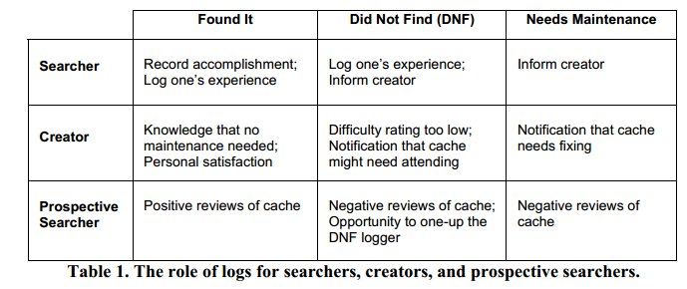
Findings: Maintenance

Slide 16
Points of Discussion
So, if you have a community, it works. How do you start that community?
How can a community pass on a set of customs/ideas to newcomers?
How does this work in Wikipedia?

Slide 17
Questions from Piazza
How does age influence hiding/seeking practices?
How do you encourage adoption?
When do people geocache? What is the role of geocaching in traveling?
What are people’s motivations in playing and creating geocaches?
How could we use geocaching for an MMORPG?
How does policing work in other games?
How do we make sure a community stays closely knit?
What is the role of trust in maintaining a system like this? How does this relate to stackoverflow?
How does geocaching relate to shared histories?
What mechanisms are there to generate a strong and reliable community of users?

