Slide 1
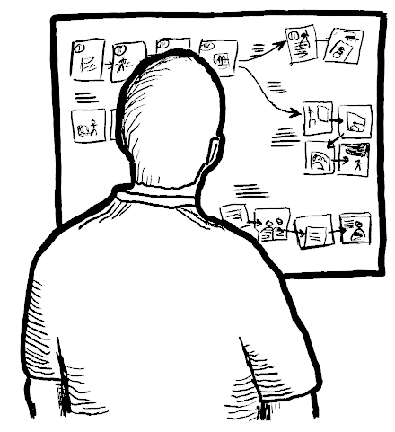
Sequential Storyboards
Chapter 4.1 in Sketching the User Interface: The Workbook
Image from:

Slide 2
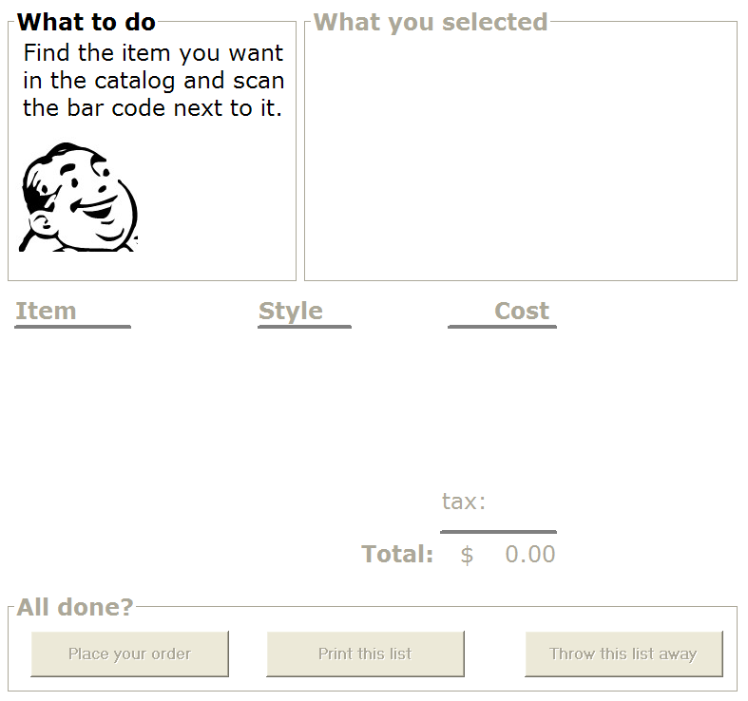
Single sketch
The interface at a single moment in time

Slide 3
Single sketch
captures user interface, but not user behaviour
excludes dynamics of interaction over time
user actions
system responses
context
doesn’t tell a story

Slide 4
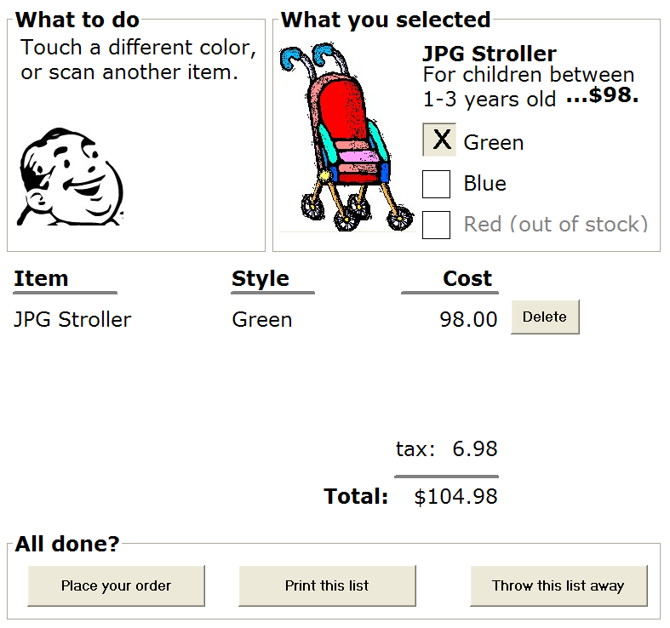

Sequential Storyboard
A visual narrative
series of key frames as sketches
interface snapshots at points in the interaction
portrays
key scenes in the interface
transitions that caused the changes

Slide 5
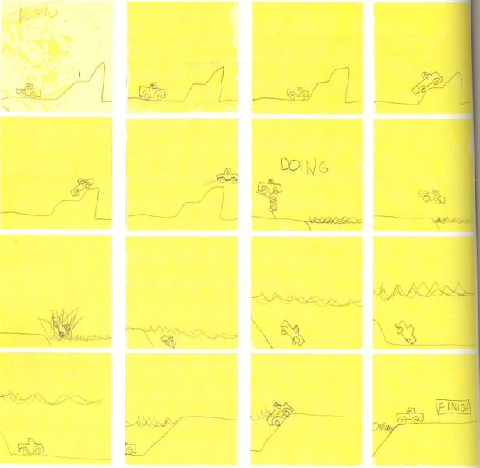
Bill Buxton Sketching User Experiences, Morgan Kaufman Figure 107

Slide 6
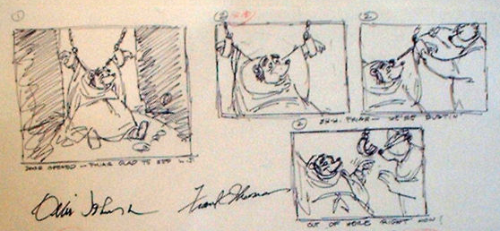
A Long Tradition – Animation
Image from: Disney’s Robin Hood storyboard, www.animaart.com/Cellar/disneyart/90robin%20storyboard.jpg.html

Slide 7

A Long Tradition – Comics
Image from: Creative Commons DC Comics: http://www.ntn24.com/news/news/muslim-arab-american-green-lan-16964,

Slide 8
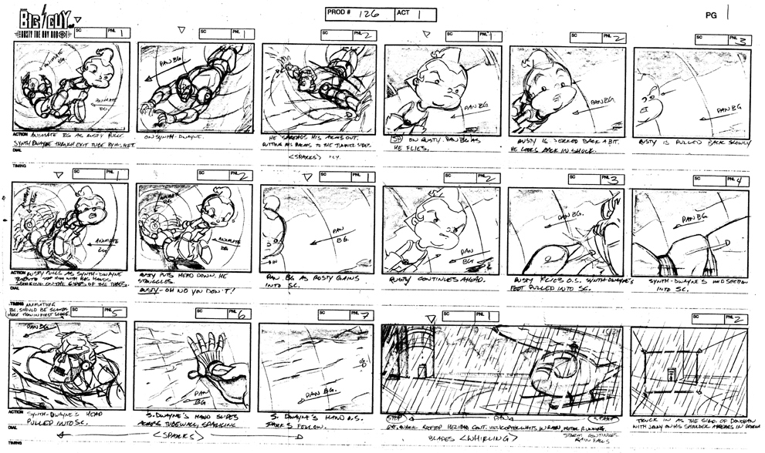
A Long Tradition – Animation
Image from: www.michaelborkowski.com/storyboards/images/big_bigguy1.gif

Slide 9
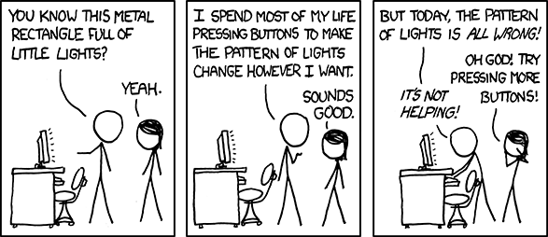
Key Elements: User Behaviours
Image from: http://www.palantir.com/tag/user-interface/ (XKCD comics, creative commons license)

Slide 10
Key Elements: Annotations
Image from: www.michaelborkowski.com/storyboards/images/big_bigguy1.gif

Slide 11
Key Elements: Annotations
Image from: www.michaelborkowski.com/storyboards/images/big_bigguy1.gif

Slide 12
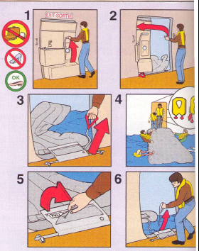
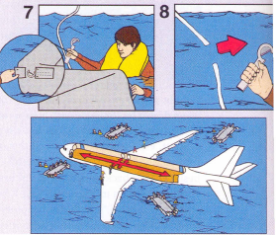
Key Elements: Annotated Actions
Image from:

Slide 13
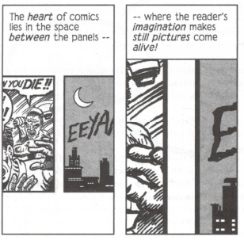
Key Elements: Transitions
Image from: Understanding Comics. Harper Collins (reproduced in Buxton, Sketching the User Interface)

Slide 14
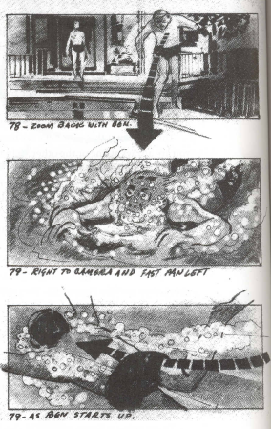
Key Elements: Transitions
Bill Buxton Sketching User Experiences, Morgan Kaufman Figure 4

Slide 15
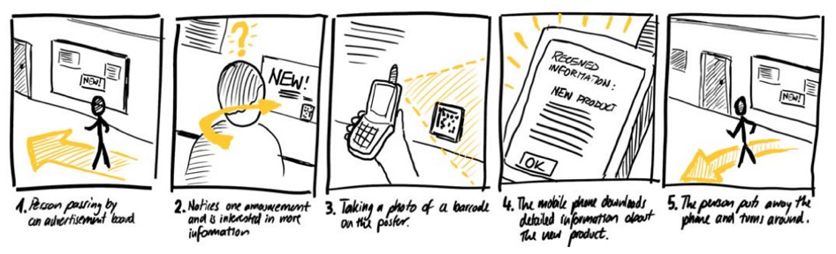

Slide 16
Exercise
Your cell phone
Create a storyboard of images only that
capture your phone’s interaction over time as
you enter a new name and number into the phone’s contact list

Slide 17
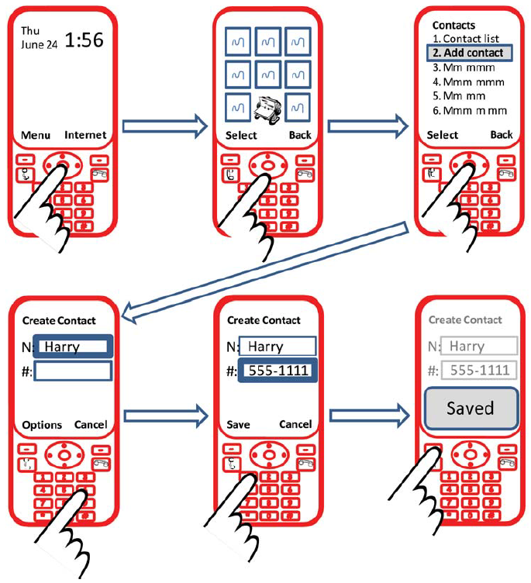

Slide 18
Key Decisions
Should I show the user in the scene?
What key frames should I use to create the sequence?
capture the essence of the story
people can ‘fill in’ the rest
What key transitions should I show?
actions to get from one frame to the next?
Bill Buxton Sketching User Experiences, Morgan Kaufman Figure 4

Slide 19
Key Decisions
How explicit do you need to be?
Depends on what you are trying to explain
are the missing parts important?
Depends on the audience
can your audience fill in the missing bits?

Slide 20
Exercise
Annotate your previous storyboard
label your phone’s state underneath each image
label each transition to explain user’s action

Slide 21
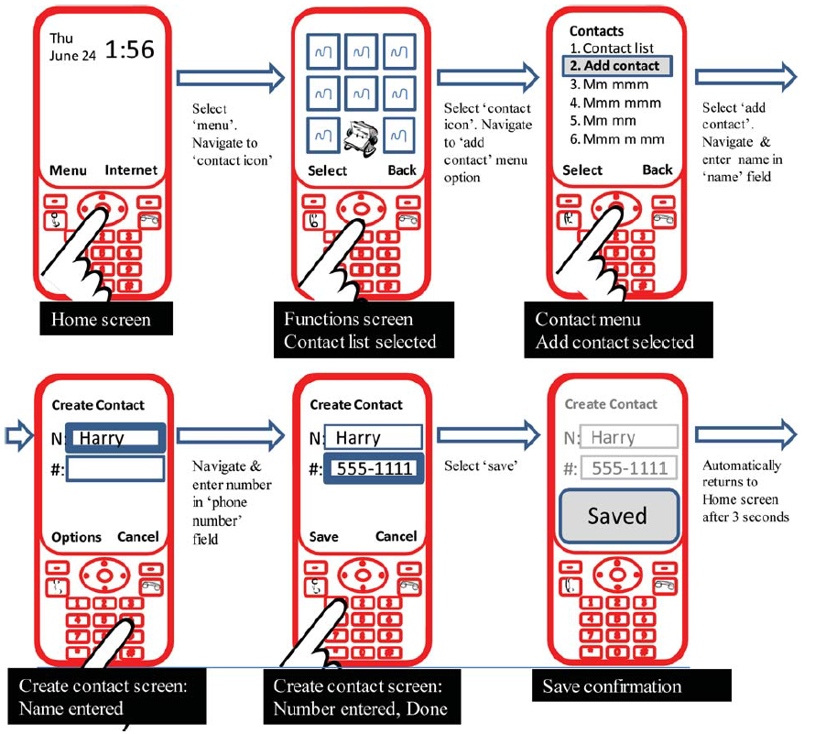

Slide 22
The Catalog Shopping System
Brick and mortar store
paper catalogs
scan in desired item(s) with bar code reader
see item on computer screen
complete and pay for order (which submits it)
print it and bring to sales clerk
sales clerk gives you item
Storyboard
buy a blue stroller

Slide 23
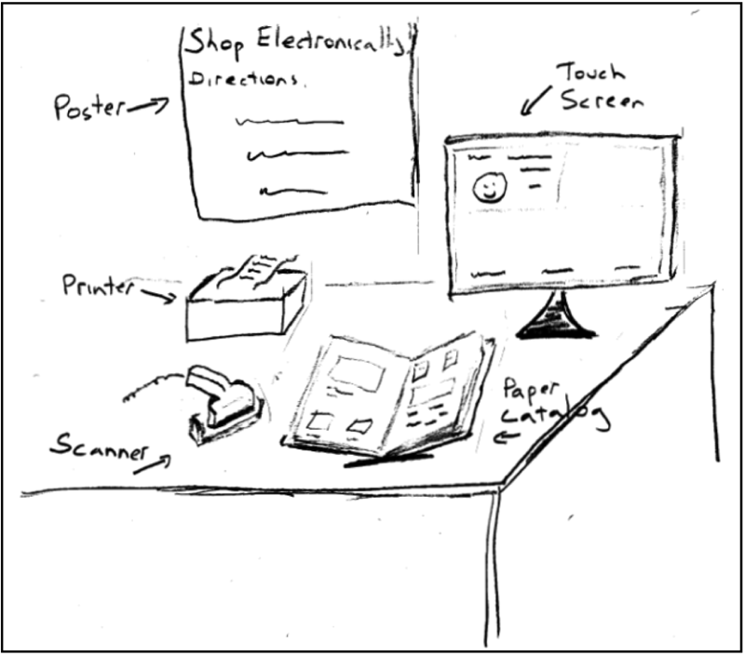

Slide 24
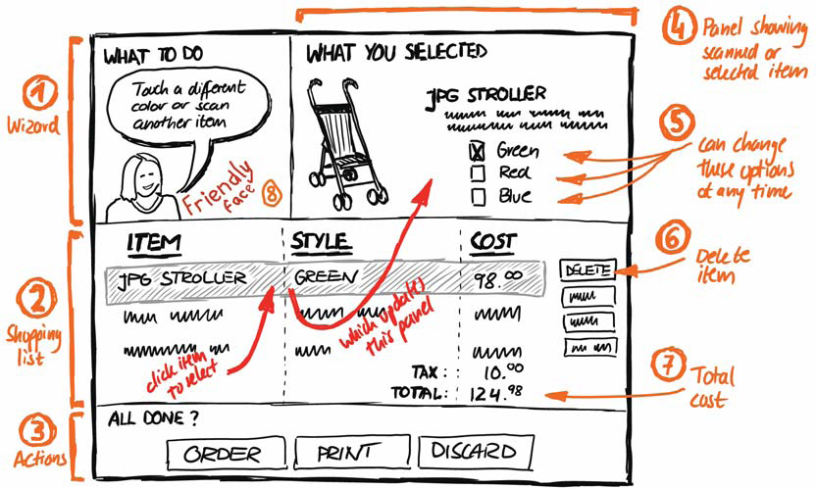
As a single sketch

Slide 25
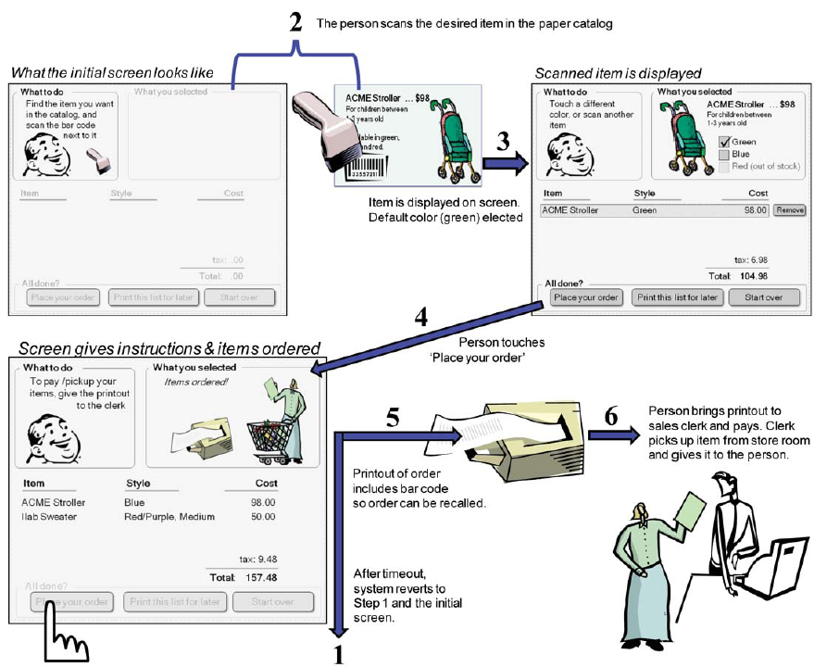

Slide 26
You Now Know
Sequential storyboard
a visual story of the user experience over time
Composed of
key frames
annotations

Slide 27



Permissions
You are free:
to Share — to copy, distribute and transmit the work
to Remix — to adapt the work
Under the following conditions:
Attribution — You must attribute the work in the manner specified by the author (but not in any way that suggests that they endorse you or your use of the work) by citing:
“from presentations accompanying the book ‘Sketching User Experiences, the Workbook’, by S. Greenberg, S. Carpendale, N. Marquardt and B. Buxton”
Noncommercial — You may not use this work for commercial purposes, except to assist one’s own teaching and training within commercial organizations.
Share Alike — If you alter, transform, or build upon this work, you may distribute the resulting work only under the same or similar license to this one.
With the understanding that:
Not all material have transferable rights — materials from other sources which are included here are cited
Waiver — Any of the above conditions can be waived if you get permission from the copyright holder.
Public Domain — Where the work or any of its elements is in the public domain under applicable law, that status is in no way affected by the license.
Other Rights — In no way are any of the following rights affected by the license:
Your fair dealing or fair use rights, or other applicable copyright exceptions and limitations;
The author's moral rights;
Rights other persons may have either in the work itself or in how the work is used, such as publicity or privacy rights.
Notice — For any reuse or distribution, you must make clear to others the license terms of this work. The best way to do this is with a link to this web page.

