Slide 1
Agenda
P3 +10 sketch critiques
Video, and why we should use them
Narrative storyboards
Tutorial: Kinect Gestures
HW: Narrative storyboard for P3
HW: Come up with a tutorial topic for Teddy (by Friday EOD)

Slide 2
Peek
What is happening in the video?
What is the system?

Slide 3
Peek
Document the “Acts” that you see
what is happening in the act
how is it being done
what shots are being used

Slide 4
Peek
How could it have been made even shorter?

Slide 5
Why make videos?

Slide 6
Why videos? – for audience
Low investment – high payoff
Easy to understand
Can be viewed any time
Can be replayed

Slide 7
Why videos? – for you
Forces you to focus on what’s important
Forces you to be concise
Brings your interface and system to life!
It is an archive!

Slide 9
How to develop great videos
Watch a lot of videos, and think about how they are telling the story
  What are the elements of the story?
  What scenes do they use to tell each element?
  What shots do they use to construct the scene?
Construct a narrative storyboard with a “sketching” mindset

Slide 10
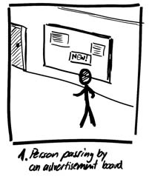
The Narrative Storyboard
Chapter 4.4 in Sketching User Experiences: The Workbook

Slide 11
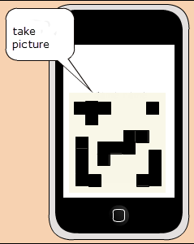

Interface vs. Narrative Storyboard

Slide 12
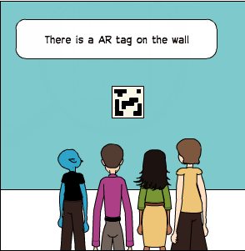
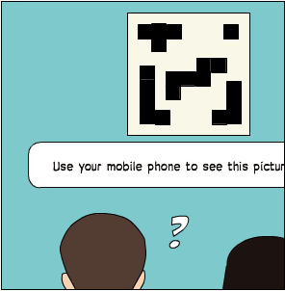
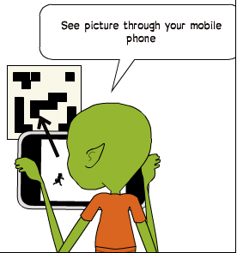
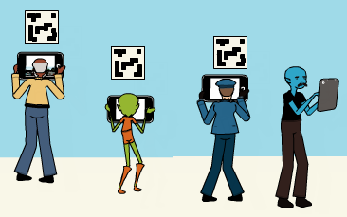
Image modified by S. Greenberg from: http://2012.idea9104.net/archives/1473 by yokoyokoyoko

Slide 13
A Narrative Tells a Story
The User Experience
  interface only part of the story
Narrative
  includes context of use
  a more complete story
Image modified by S. Greenberg from: http://2012.idea9104.net/archives/1473 by yokoyokoyoko

Slide 14
Narrative Storyboard
Primarily used to describe a scenario (i.e. one of the elements [may comprise multiple scenes])
Complete with annotations, the storyboard can exist on its own as a document
Can be used as a template for a video to document your system/interface

Slide 15
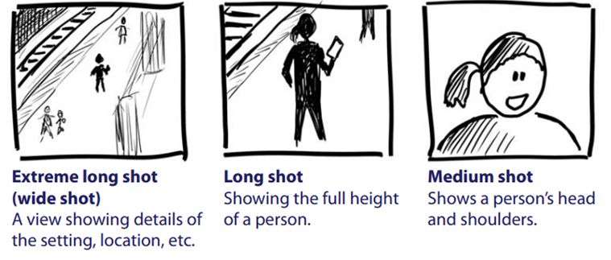
Vocabulary of Camera Shots

Slide 16




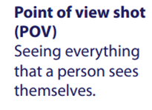
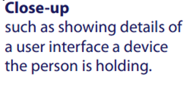
Vocabulary of Camera Shots
Image from:

Slide 17

1. Outline storyboard frames for scenario
5 boxes often suffice to illustrate one scenario
Image from:

Slide 18
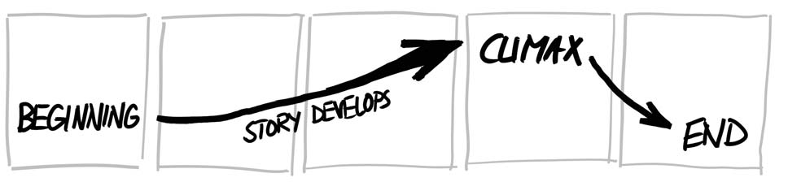
2. Develop the Storyline
Where does the interaction take place?
What is the problem?
What is the task a person is trying to do?
Which people are present / what are their actions?
What objects/devices do they use
What are the input / outputs?
How do their actions solve the problem?
Image from:

Slide 19
2. Develop the Storyline
establishing shot
story develops to climax
conclusion
Image from:

Slide 20
A Storyline
Fred passes by a public announcement board &
He is interested in more info about 1 announcement
He uses the phone to capture bar code next to display
He reads detailed info that appears on the phone
He walk away
Image from:

Slide 21
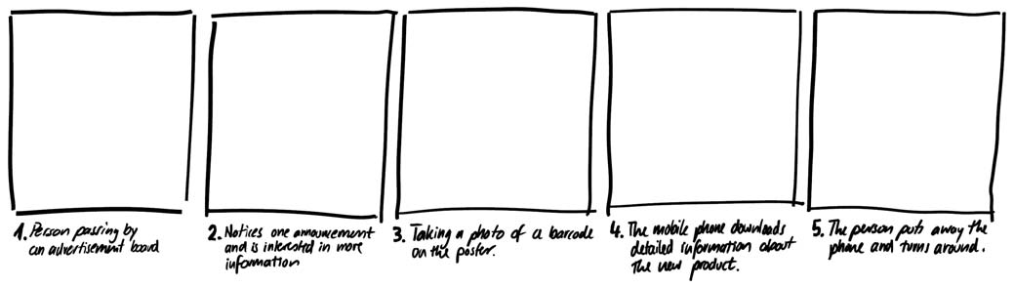
2. Develop the Storyline
1. A person passes by an advertisement board
3. Taking a photo of a barcode on the poster
5. Person puts phone away and turns around
2. Notices one advertisement and is interested in more information
4. Mobile phone downloads detailed info about that product
Image from:

Slide 22
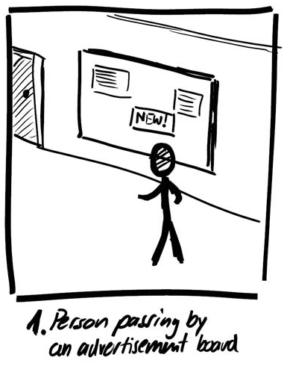
3. Sketch Establishing Shot
The introduction
  location where interaction
  takes place
  people involved
  setting
The shot
  long shot
Alternate shots OK
  hallway
  airport
  multiple people…
Image from:

Slide 23
3. Sketch Establishing Shot
Use appropriate shots
  extreme long shot
  emphasizes context
Image from:

Slide 24
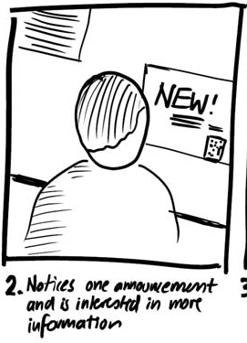
4. Continue storyline
Use appropriate shots
  over the shoulder
  emphasise person
  looking at something of
  interest
Image from:

Slide 25
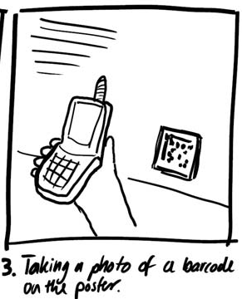
4. Continue storyline
Use appropriate shots
  point of view
  emphasises person’s
  action
Image from:

Slide 26
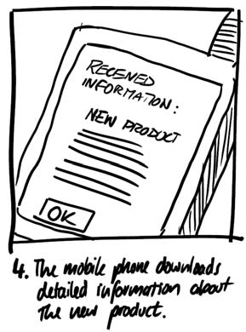
4. Continue storyline
Use appropriate shots
  close-up
  shows detail
The climax
Image from:

Slide 27
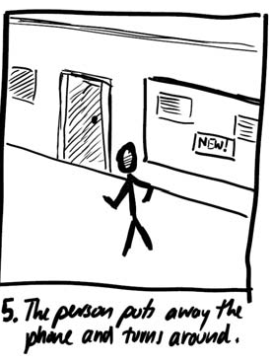
4. Continue storyline
Use appropriate shots
  extreme long shot
  shows context on
  completion
Conclusion
Image from:

Slide 28
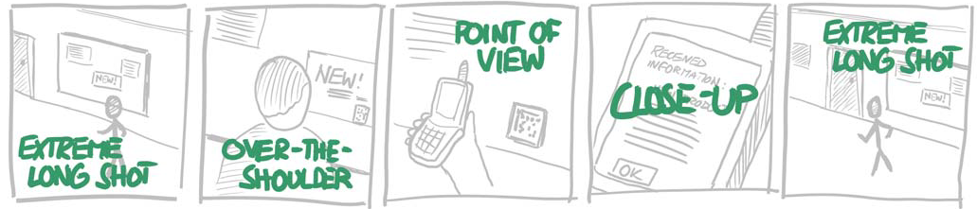
4. Continue storyline
Image from:

Slide 29
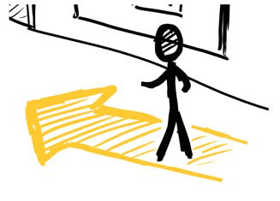
5. Emphasize Actions and Motions
Large arrow emphasises
a person walking by
Image from:

Slide 30
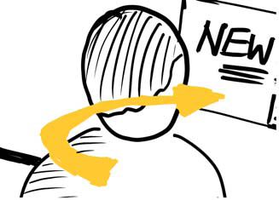

5. Emphasize Actions and Motions
Circling arrow emphasises
motion as he notices
something of interest
Question mark reveals emotions (interest)
Image from:

Slide 31
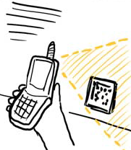
5. Emphasize Actions and Motions
Area emphasises
photo-taking action
Image from:

Slide 32

5. Emphasize Actions and Motions
Highlights emphasises
action of information received
Image from:

Slide 33
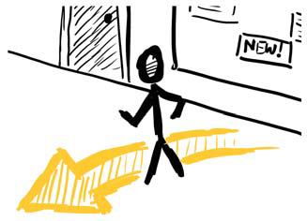
5. Emphasize Actions and Motions
Arrow emphasises
person walking away
Image from:

Slide 34
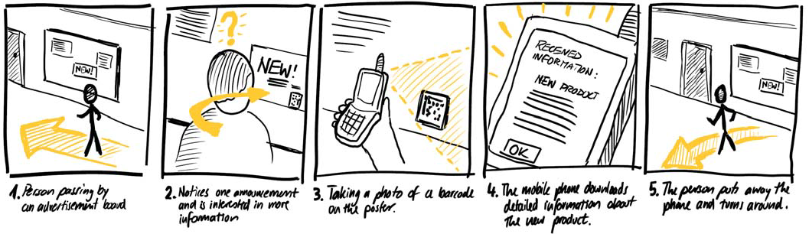
5. Emphasize Actions and Motions
Image from:

Slide 35
6. Demonstrate and Iterate
Show and get critique
  is it realistic?
  is the context plausible?
  are the person’s motivations plausible
  would they really do those actions?
Develop alternate scenarios
Image from:

Slide 36
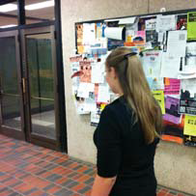
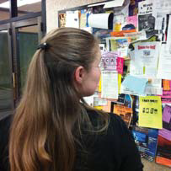
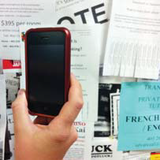
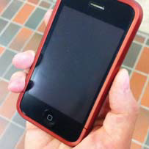

Alternate
Steps 3+4. Use Snapshots Instead
Tip: exaggerate poses

Slide 37
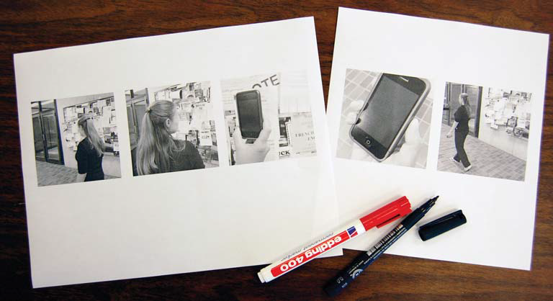
Alternate
Print Them
Tip: 4”x4” minimum / photo

Slide 38
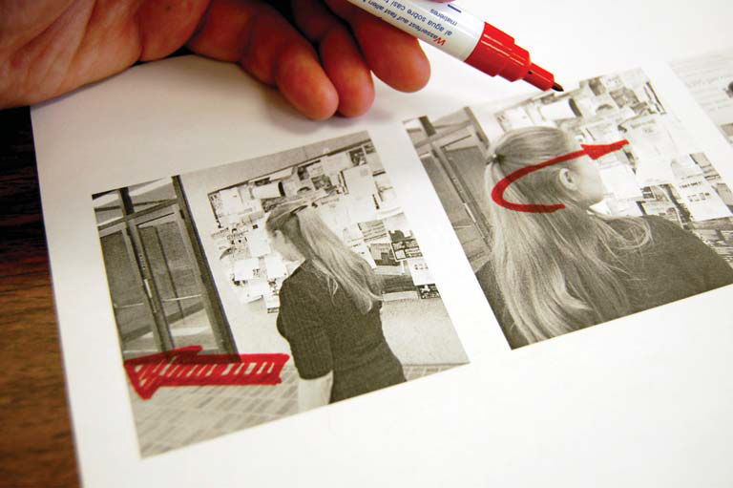
Alternate
Annotate Them
Tip: thick markers / tracing paper for alternates

Slide 39
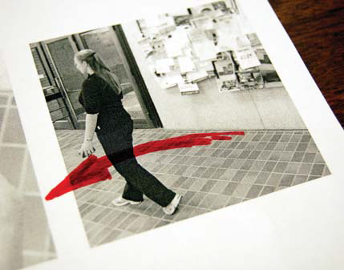
Alternate
Annotate Them
Tip: annotations an extend beyond boundaries

Slide 40

Alternate
Draw additional elements
Tip: Leave space on photos / white it out, or…

Slide 41
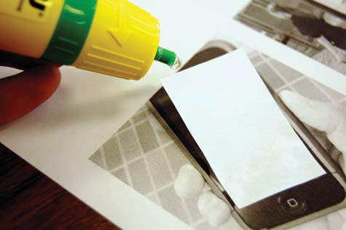

Alternate
Draw additional elements
Tip: Use office supplies to create overlays

Slide 42
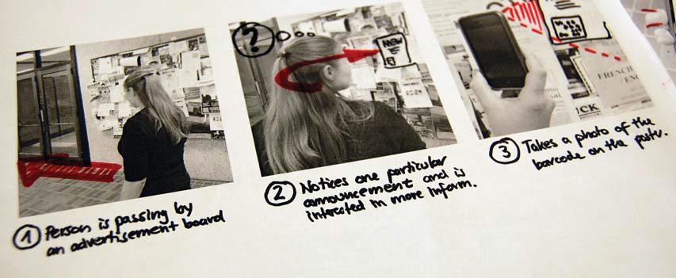
Alternate
Add Storyline

Slide 43
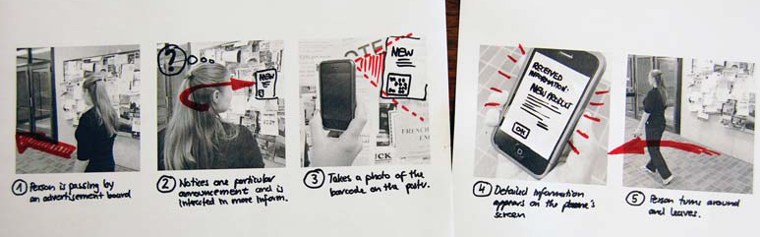
Alternate
Complete Narrative Storyboard

Slide 44
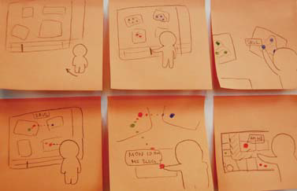
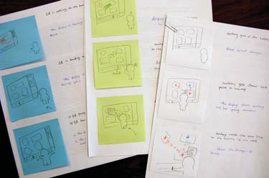
PROTIP
Use Sticky Notes for your Frames
Easier to
  add
  subtract
  modify
  alternatives

Slide 45
You now know
Vocabulary of shots
Narratives
  develop a story
  illustrate context of interaction
    from beginning to climax to conclusion
Narratives can be composed from
  sketches and/or photos
  annotations and explanatory notes

Slide 46



Permissions
You are free:
  to Share — to copy, distribute and transmit the work
  to Remix — to adapt the work
Under the following conditions:
Attribution — You must attribute the work in the manner specified by the author (but not in any way that suggests that they endorse you or your use of the work) by citing:
  “from presentations accompanying the book ‘Sketching User Experiences, the Workbook’, by S. Greenberg, S. Carpendale, N. Marquardt and B. Buxton”
Noncommercial — You may not use this work for commercial purposes, except to assist one’s own teaching and training within commercial organizations.
Share Alike — If you alter, transform, or build upon this work, you may distribute the resulting work only under the same or similar license to this one.
With the understanding that:
Not all material have transferable rights — materials from other sources which are included here are cited
Waiver — Any of the above conditions can be waived if you get permission from the copyright holder.
Public Domain — Where the work or any of its elements is in the public domain under applicable law, that status is in no way affected by the license.
Other Rights — In no way are any of the following rights affected by the license:
  Your fair dealing or fair use rights, or other applicable copyright exceptions and limitations;
  The author's moral rights;
  Rights other persons may have either in the work itself or in how the work is used, such as publicity or privacy rights.
Notice — For any reuse or distribution, you must make clear to others the license terms of this work. The best way to do this is with a link to this web page.

Slide 47
Agenda
P3 +10 sketch critiques
Video, and why we should use them
Narrative storyboards
Tutorial: Kinect Gestures
HW: Narrative storyboard for P3
HW: Come up with a tutorial topic for Teddy (by Friday EOD)

