Slide 1
Agenda
P2 Deliverables
Introduction to Proxemics & P3
Tutorial: Getting started with the Kinect

Slide 2
P2 Deliverables
Demonstrated in class
  Information Appliance {form factor, aesthetics, level of engagement, how well it fits its function/role}
  Cell Phone
  Interconnection
  Portfolio (visual project summary) incl/ video
Handed in (copied to a USB key):
  Digital copies of your personas (as PDFs)
  Digital copy of your final video

Slide 3
Proxemics and Interaction Design

Slide 4
Breaching Experiments
An experiment that seeks to examine people’s reactions to violations of commonly accepted social norms.
Staring at people in an elevator.
Wearing an enormous hat.
Trying to pay for things with a fictional currency and insisting that it is better than real money.
Yelling, reciting gibberish, singing badly and loudly in public.
Notes:
http://www.guzer.com/videos/elevator-psychology.php

Slide 5
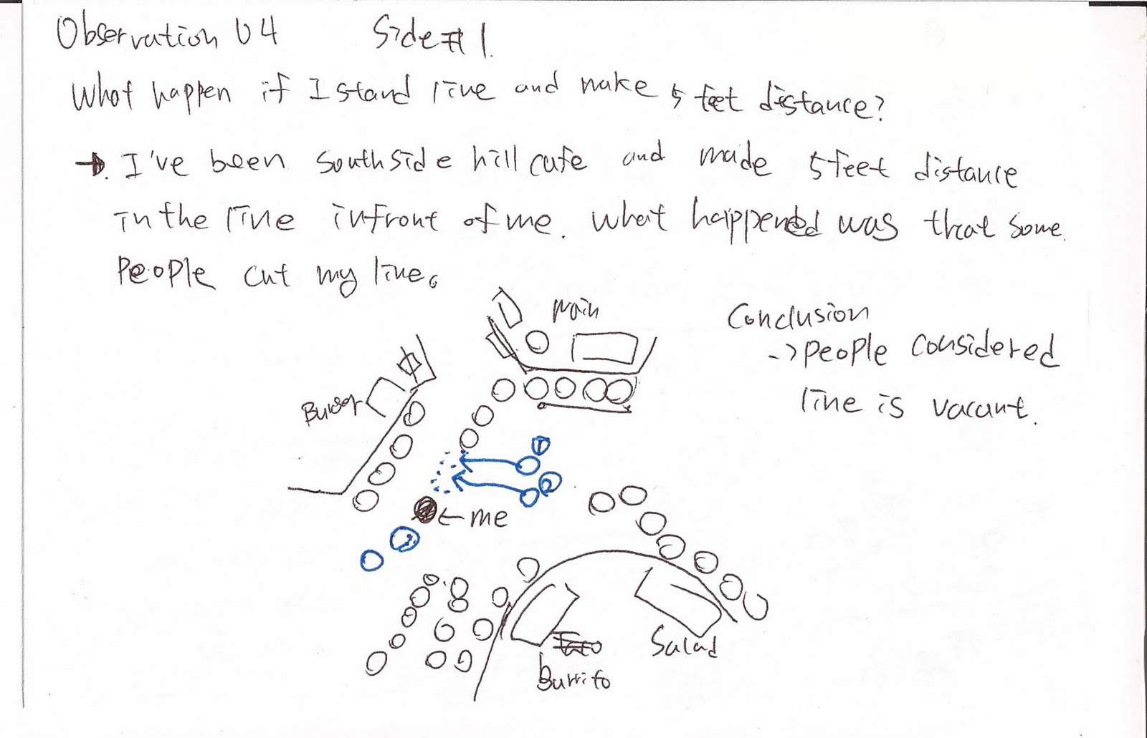
Notes:
http://wsu-interior-design-2015.blogspot.ca/2011/09/student-work-theory-of-territoriality.html

Slide 6
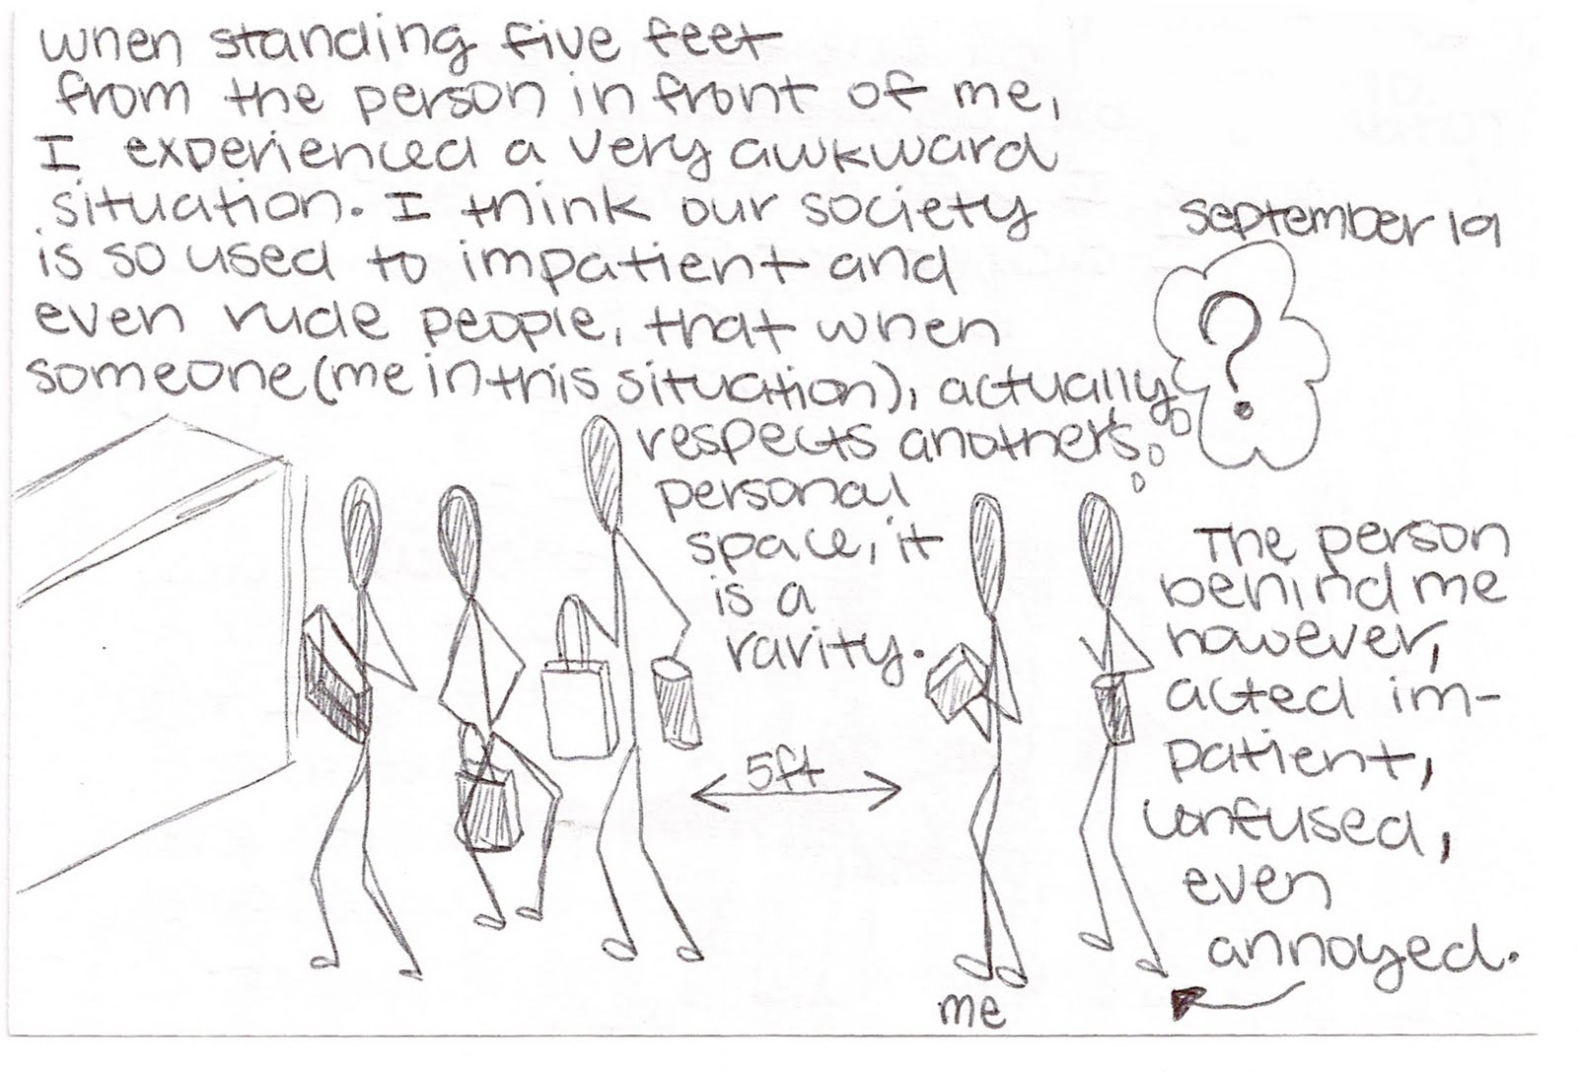

Slide 7
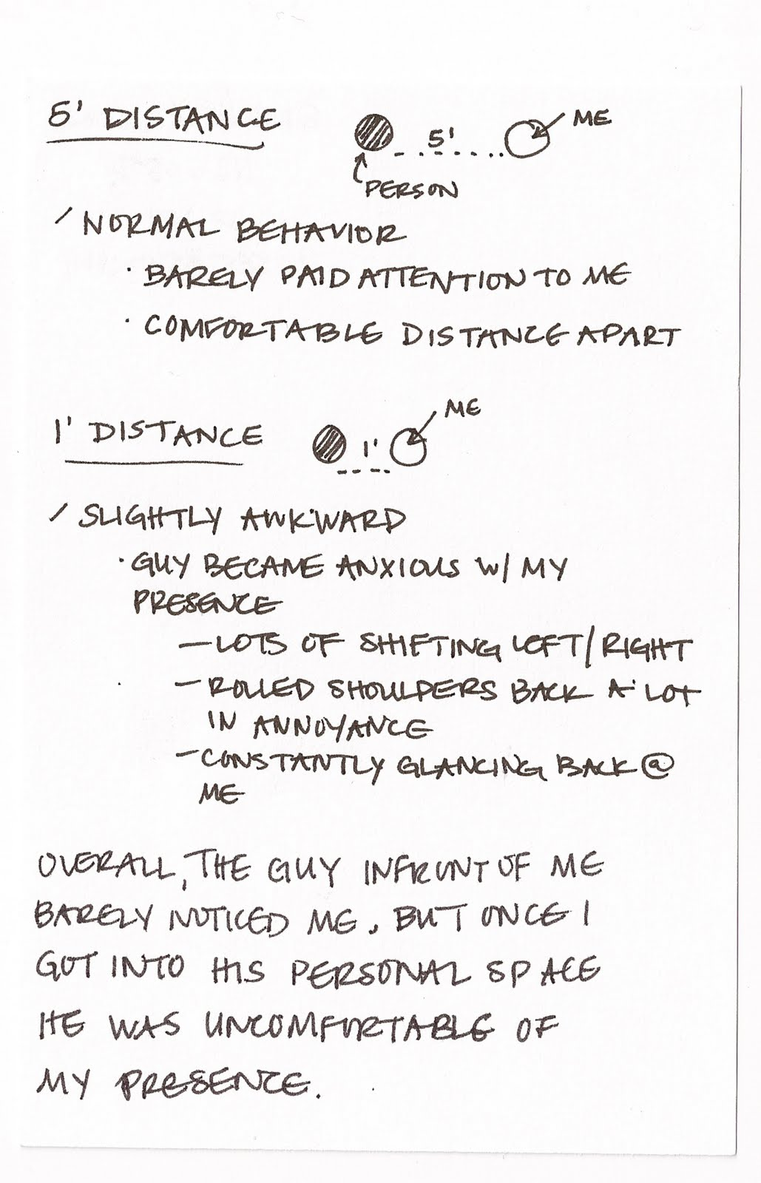

Slide 8
Edward Hall’s Proxemics (1963)
Impact of proxemic behaviour on interpersonal communication
  How close do you let your family get to you?
  How close do you let your close friends get to you?
  How close do you allow acquaintances get to you?
  How close do you allow random strangers get to you?

Slide 9
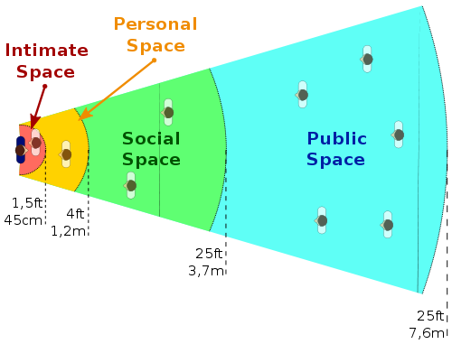
Edward Hall’s “Reaction Bubbles”
Notes:
http://en.wikipedia.org/wiki/Talk%3AProxemics
http://upload.wikimedia.org/wikipedia/commons/9/98/Personal_Spaces_in_Proxemics.svg

Slide 10
Close Talkers

Slide 11

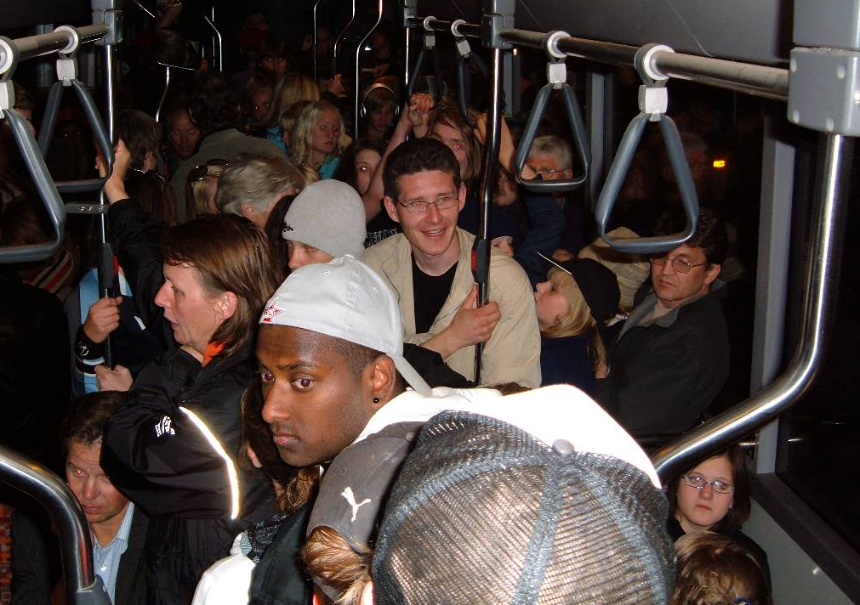
Proxemics, Culture and Context
Culture impacts what is considered “personal space” and “social space”
We also allow for temporary violations depending on context
Notes:
http://www.cs.unm.edu/~sheppard/proxemics.htm
http://www.rdillman.com/HFCL/TUTOR/Relation/relate1.html
Saudi Arabia: you would come away thinking he was pushy; and he would think you were stand-off-ish
Netherlands: way more personal space
Japan: people are literally pushed onto planes
http://www.lasvegas-injurylawyers.com/wp-content/uploads/2013/03/crowded_bus.jpg

Slide 12
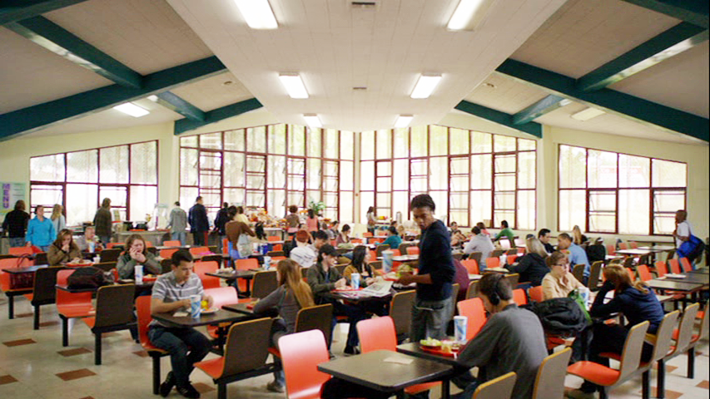
Implications of Proxemics
Main implication: design of architectural spaces
Notes:
http://community-sitcom.wikia.com/wiki/Cafeteria

Slide 13
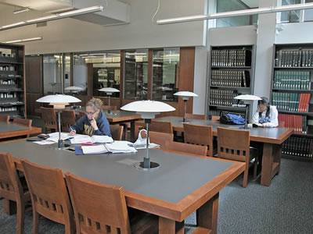
Architectural Spaces
Notes:
http://music.berkeley.edu/about/images/library-desks.jpg

Slide 14
Proxemics and Interpersonal Interaction
We modulate the volume of our speech, or our physical distance depending on how “far” someone is
We understand the role of physical orientation in determining attention
I WON’T YELL AT YOU WHEN WE ARE THIS CLOSE TO ONE ANOTHER

Slide 15
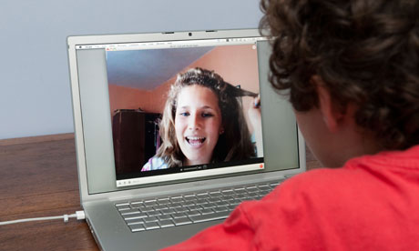
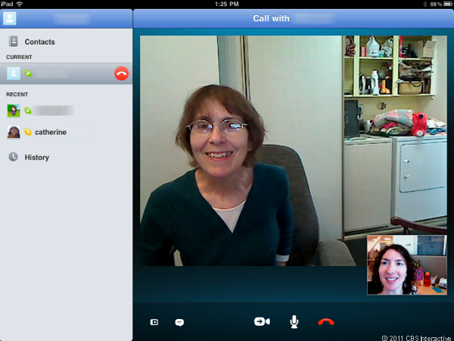
Video Conferencing
We haven’t gotten “it” right
Voice modulation
Head/gaze orientation
Notes:
http://www.theguardian.com/commentisfree/2012/jul/27/skype-encyption-methods-police-access
http://www.workformums.co.uk/job-interviews-via-skype/

Slide 16
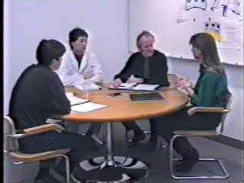
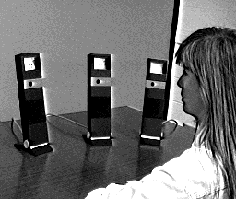
Spatial Cues and Video Conferencing
Notes:
http://www.billbuxton.com/hydra.html
http://www.billbuxton.com/hydraNarrative.htm

Slide 17
Computers don’t understand proxemics
Spatial relationships (orientation, proximity) directly impact human relationships (and interactions) with technology
Spatial relationships between pieces of technology can help constrain the set of possible interactions

Slide 18
Interactive Public Displays

Slide 19
Proxemics and the Media Centre

Slide 20
P3: Proxemic Display
Sketch, design, implement and document via a portfolio a display whose contents
  react to the proximity (distance) of a person from it
  can be manipulated by gestures appropriate to that distance
  the display will change its contents (as well as how people can interact with it) as a function of distance and orientation (see the papers and videos below for important examples).
Starting points
  advertisement display, home calendar, photo display, announcement board, video player, board to leave notes (e.g., use the windows phones), stock market overview, …

Slide 21
P3: Proxemic Display
HW (for 11/13): Find a real-life display. Study, and photograph people interacting with the display [as a function of proximity]. Create a “persona” for this display.
HW (for 11/18): First 10 sketches

