Slide 1
Agenda
Video pre-presentations
Digital sketches & photo traces
Templates

Slide 2
Digital vs. Paper Sketches
Most of the sketching we have done for this class has been on paper
ease
quickness
ubiquity
In practice, sketching and images/figures are often done digitally (or, they are represented digitally) – e.g. screenshots, pictures, etc. higher start up cost
expectations on quality
more detail than is appropriate

Slide 3
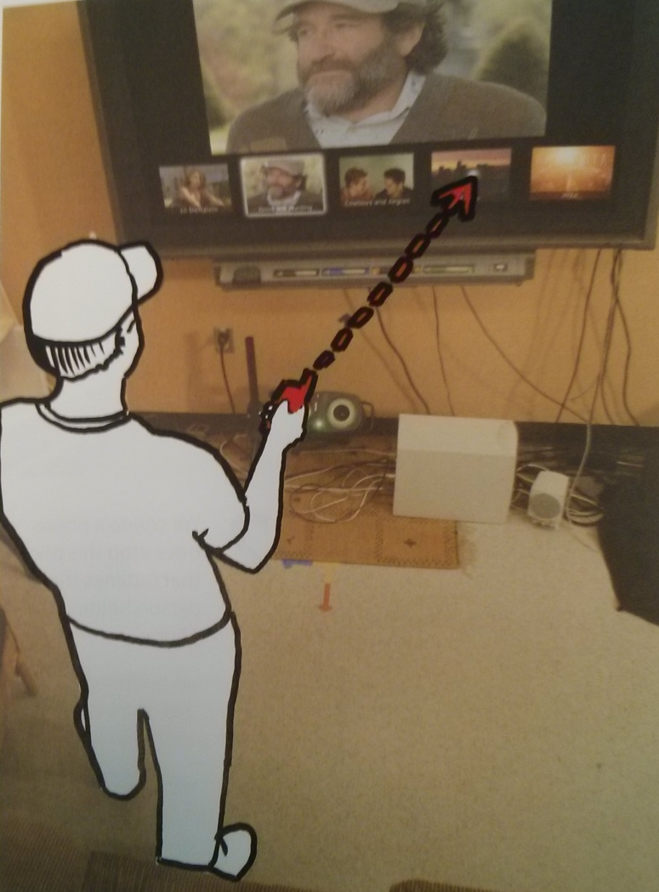
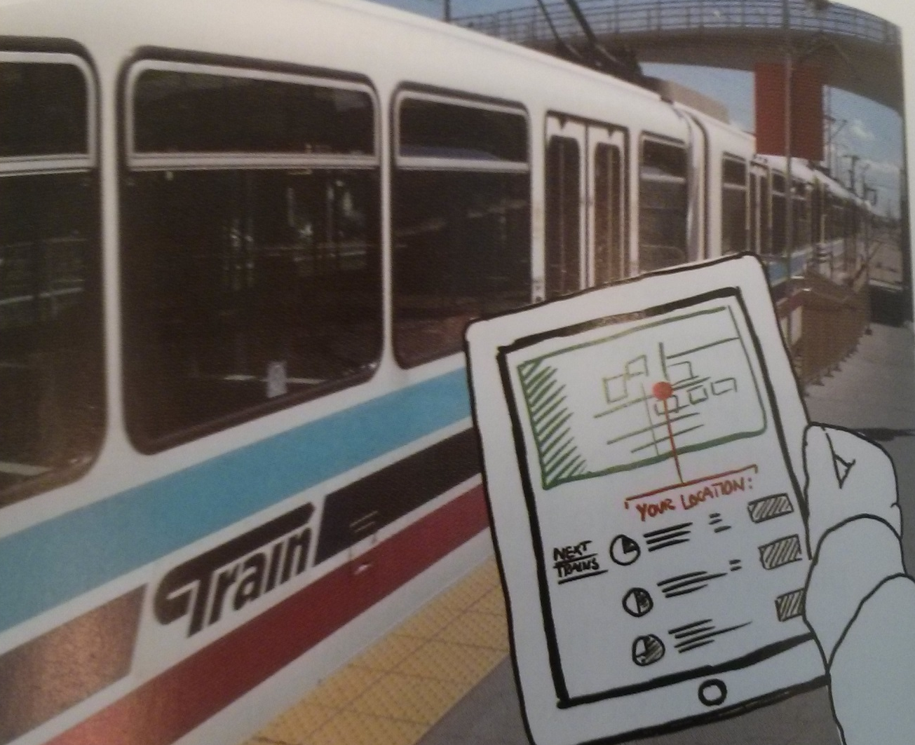
Digital Sketches
Affordances: ability to mix different kinds of styles and media as appropriate for the task

Slide 4
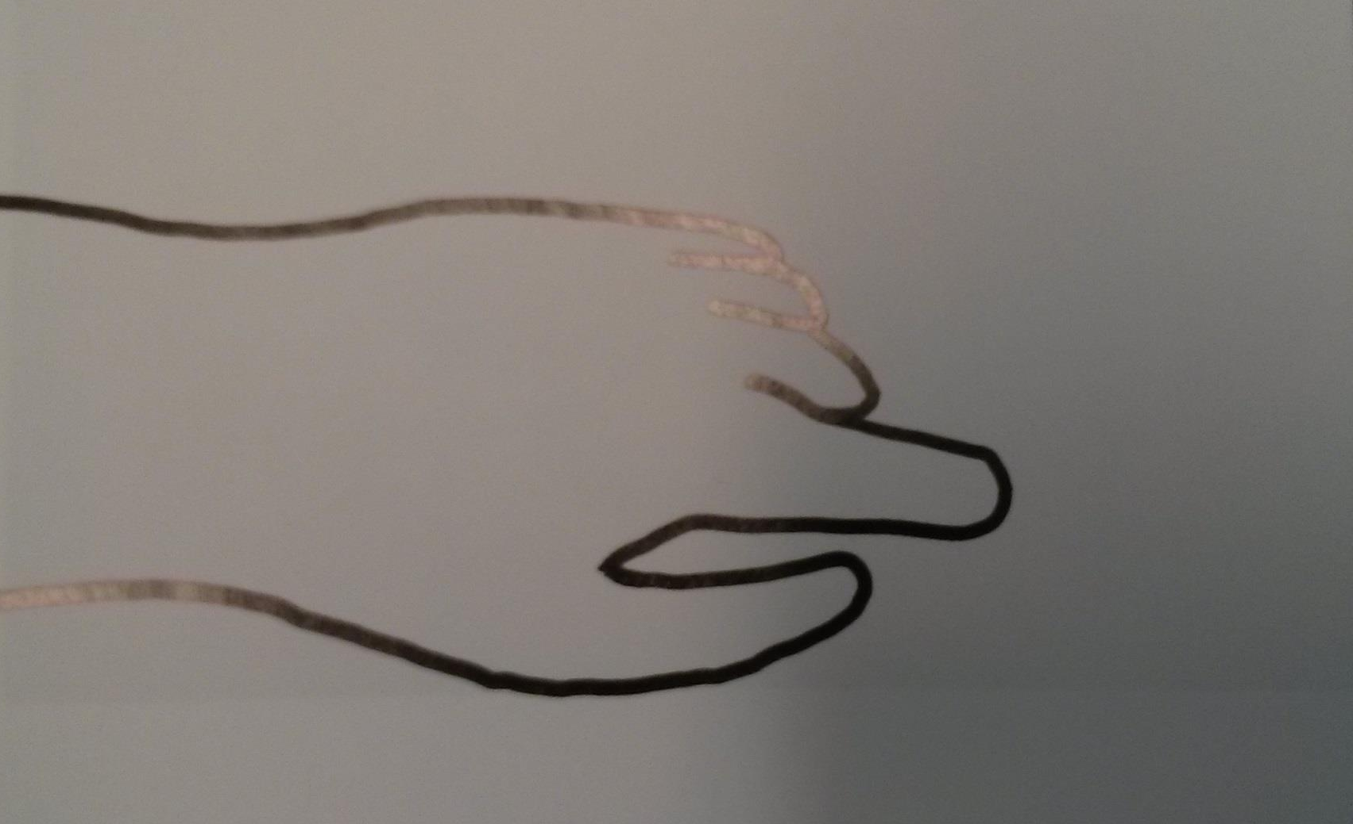
Photo Traces

Slide 5
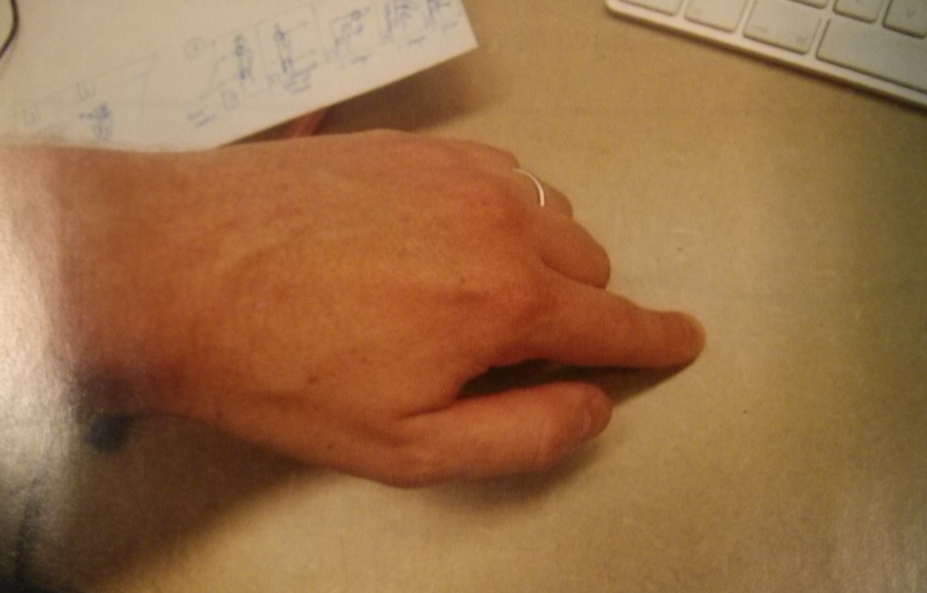
Photo Traces

Slide 6
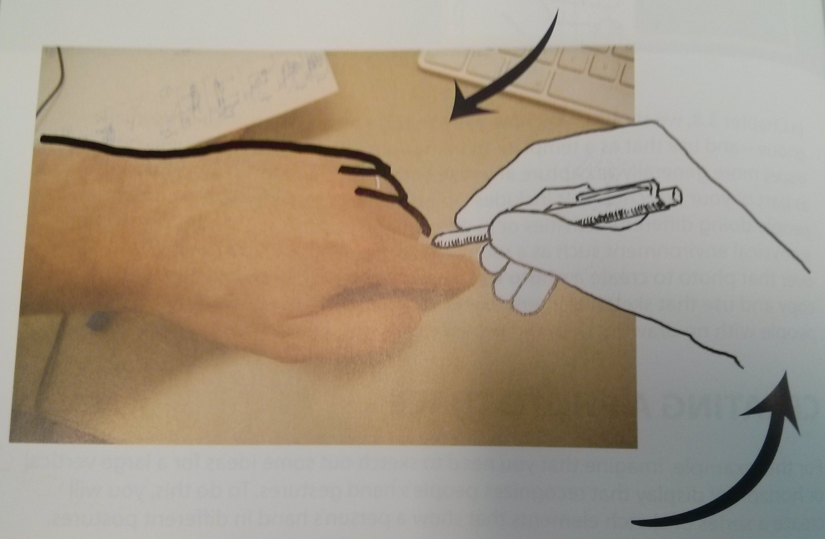
Photo Traces
Notes:
Note about using a fat ink rather than pixel-sized ink

Slide 7
Photo Traces

Slide 8
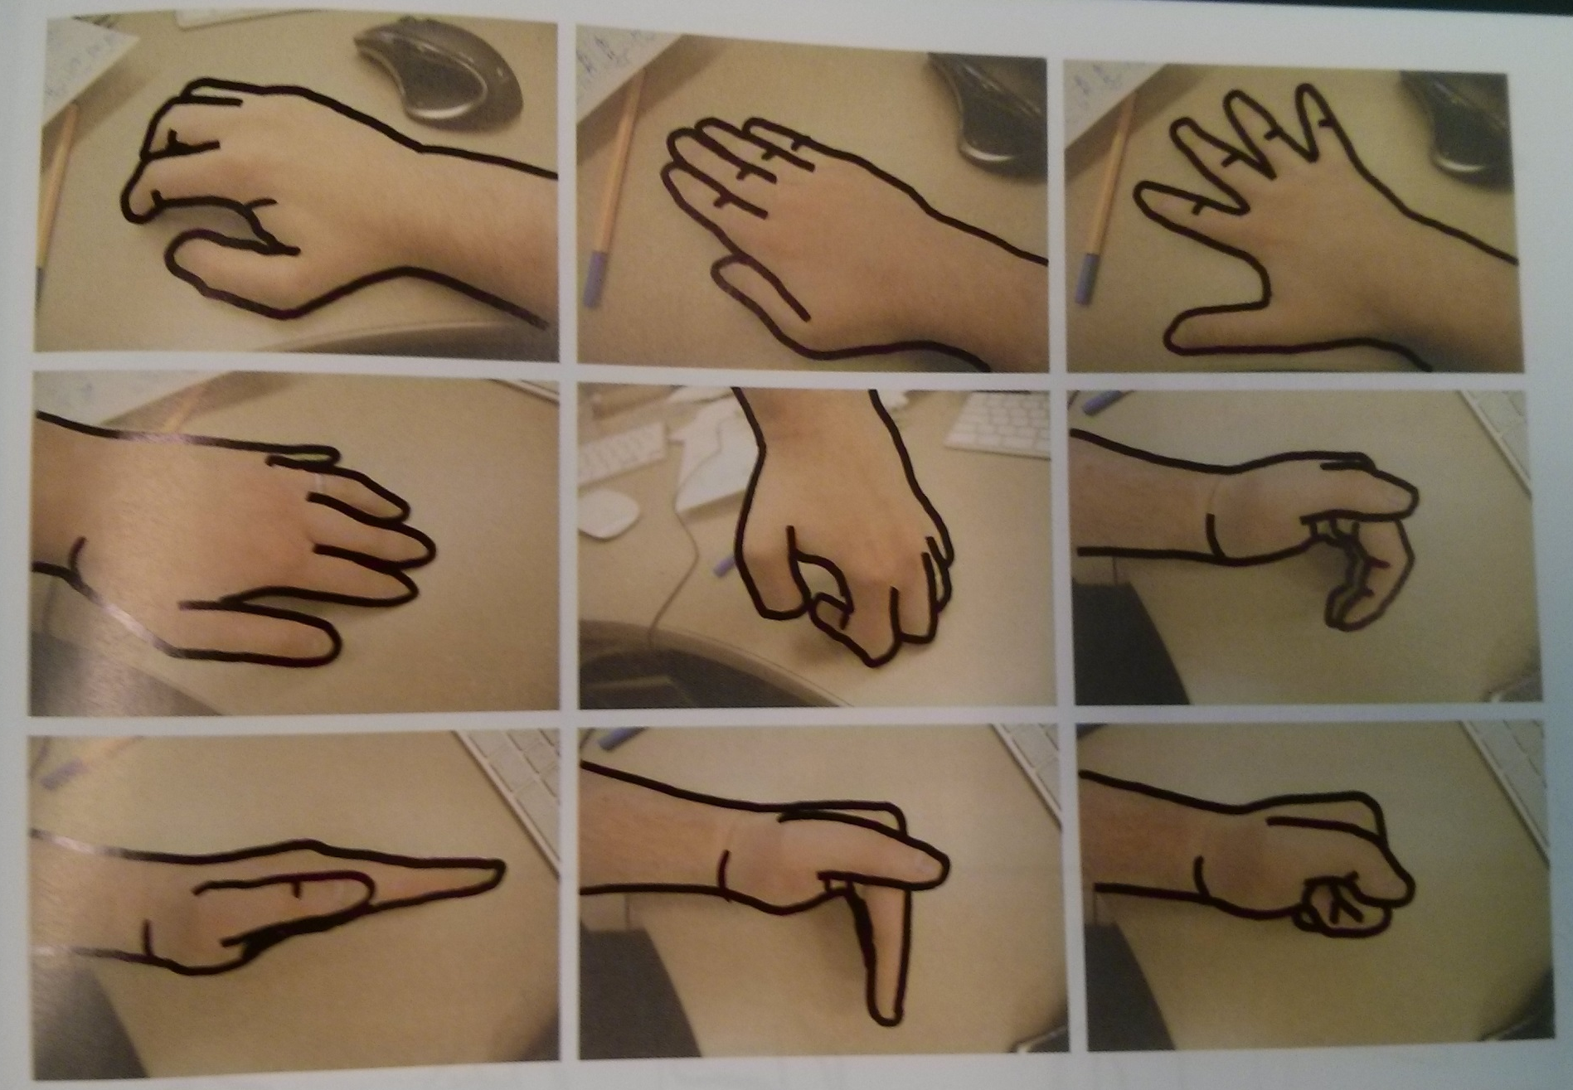
Other Poses

Slide 9
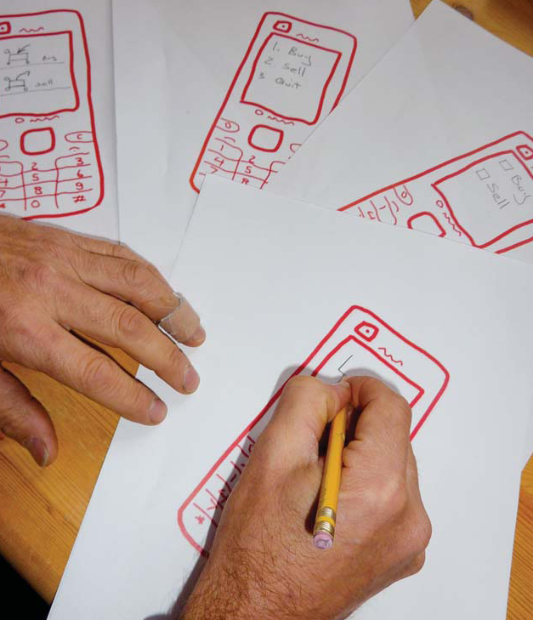
Templates
Chapter 3.8 in Sketching User Experiences: The Workbook

Slide 10
Parts of your Sketch are Constant
pre-determined contents
fixed locations
hardware
window appearance
standard controls
standard borders…

Slide 11
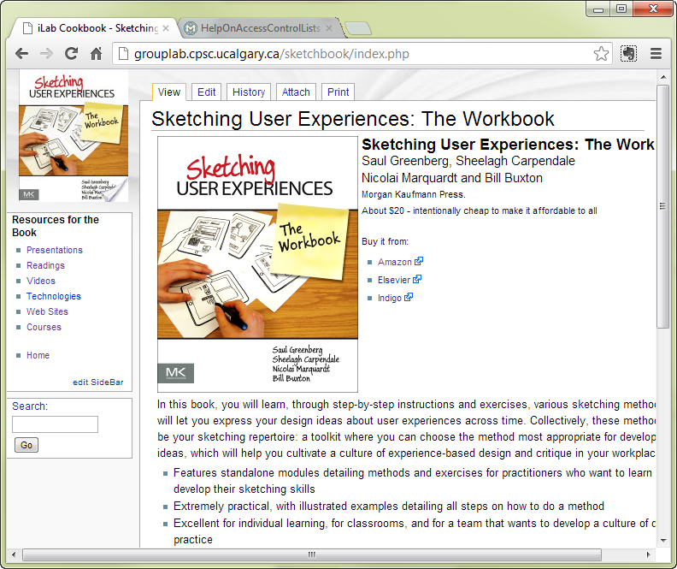
Parts of your Sketch are Constant

Slide 12
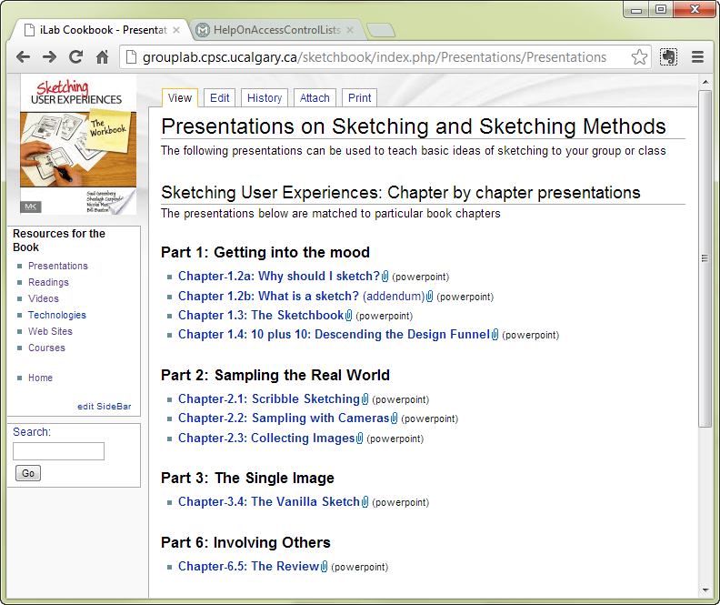
Parts of your Sketch are Constant

Slide 13
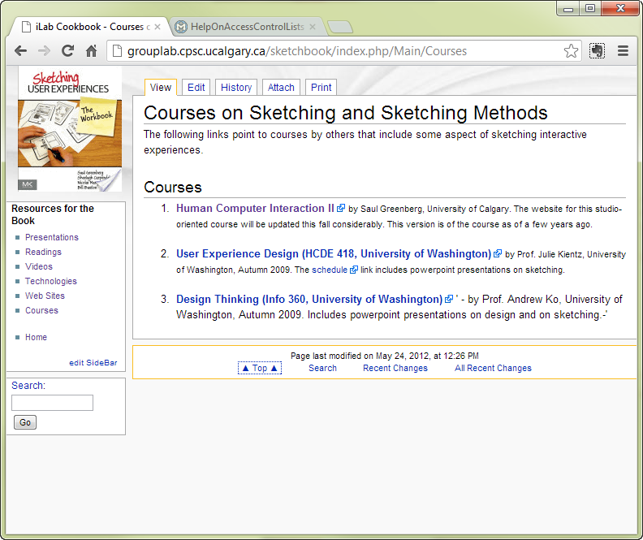
Parts of your Sketch are Constant

Slide 14
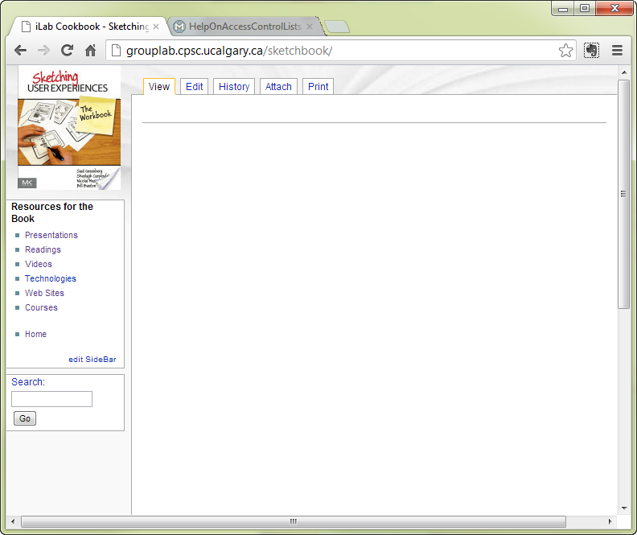
Parts of your Sketch are Constant

Slide 15
The Template
pre-draw the constant parts of your sketch
leave space for sketches, annotations & notes
make copies
sketch over those templates
Why?
focus on design aspects that change
faster to generate single drawing
faster to generate multiple ideas
imposes design constraints

Slide 16
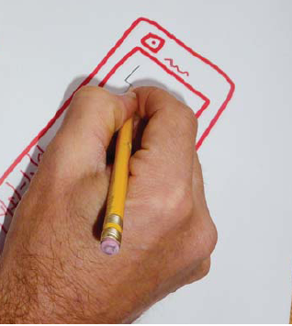
Making a Template – Paper method 1
Sketch the fixed parts
Photocopy or scan / print it

Slide 17
Making a Template – Paper method 1
Use those copies for your sketches

Slide 18
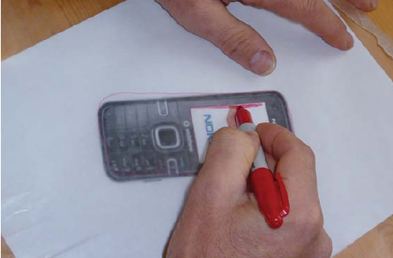
Making a Template – Paper method 2
If an image is available
trace over it
copy / print as before

Slide 19
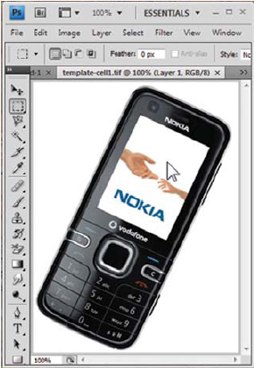
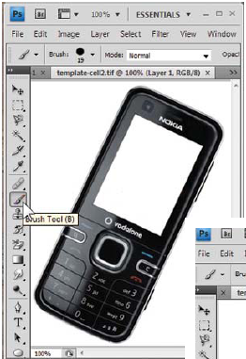
Making a Template – Digital method 1
Copy image into bitmap editor
Delete those portions that don’t change

Slide 20
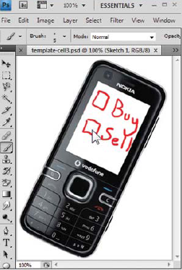
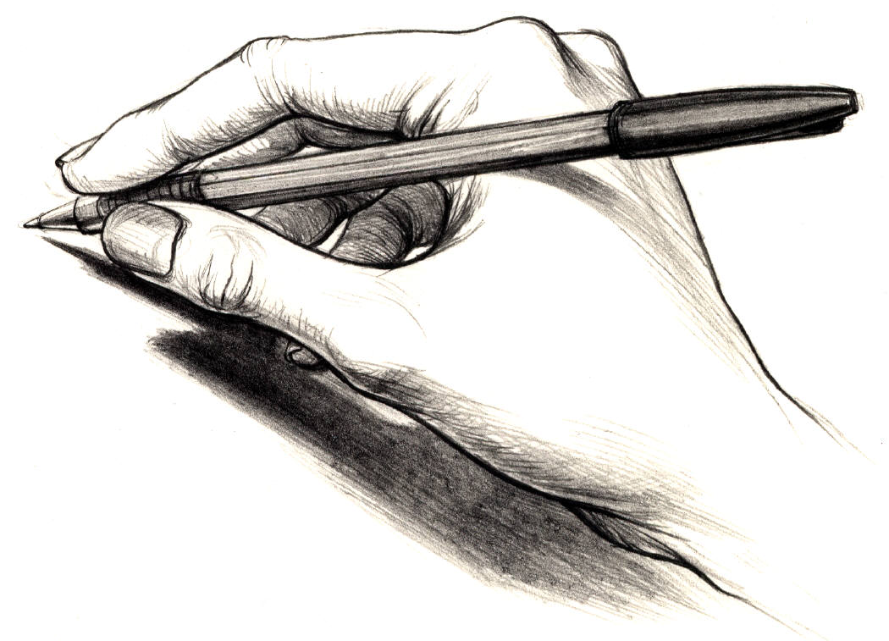
Making a Template – Digital method 1
print it and sketch on paper copies (very easy) or

Slide 21
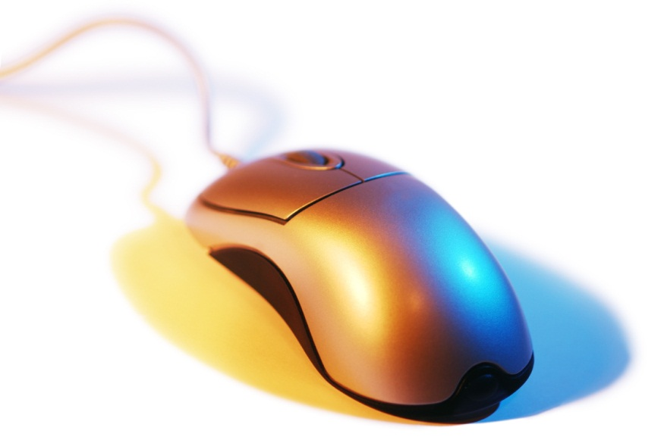
Making a Template – Digital method 1
Or sketch over this image using a drawing tool
drawing with a mouse is terrible

Slide 22
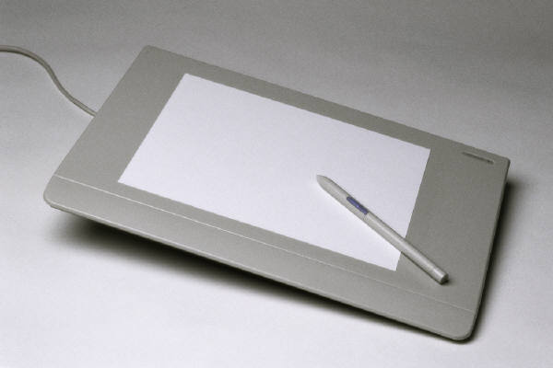
Making a Template – Digital method 1
sketch over this image using a drawing tool
digitizers are better,
tablets are best

Slide 23
Problem
strange juxtaposition of image fidelity

Slide 24
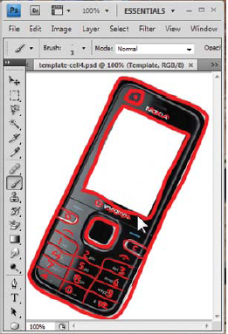
Making a Template – Digital method 2
copy image into layered editor (e.g., photoshop)
trace that image onto a layer

Slide 25
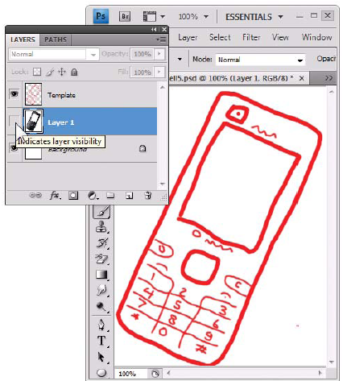
Making a Template – Digital method 2
hide the background layer

Slide 26
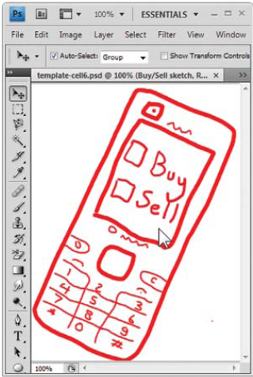
Making a Template – Digital method 2
sketch in another layer atop this layer

Slide 27
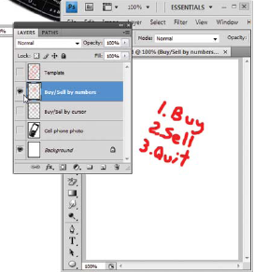
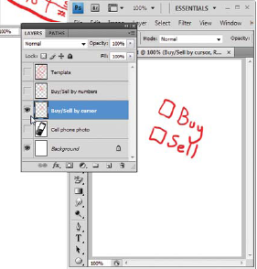
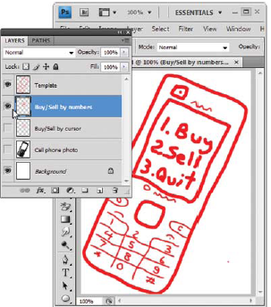
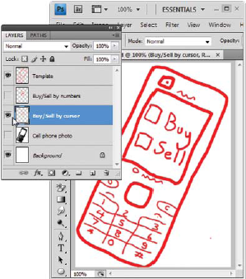
Making a Template – Digital method 2
can use multiple sketch layers to try alternate designs

Slide 28
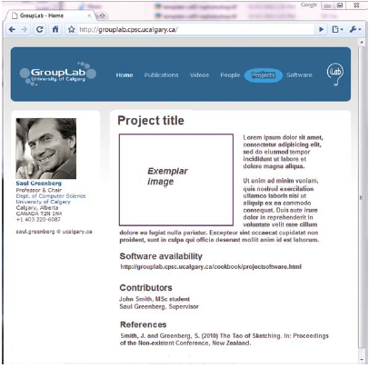
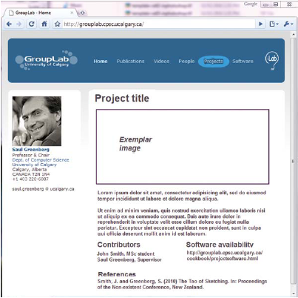
Template Fidelity Should Match
Two high fidelity layout designs in a template

Slide 29
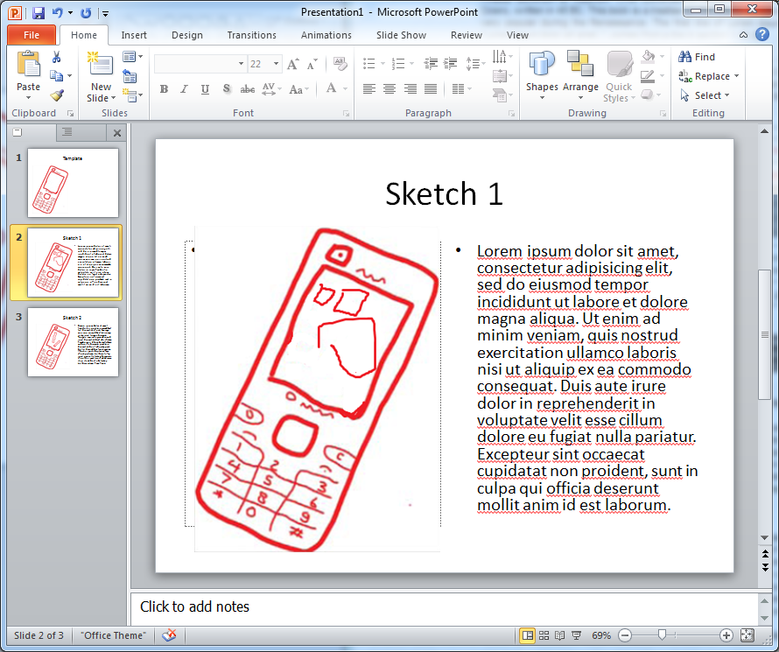
Making a Template – Digital method 3
Import the template into PowerPoint, and use the template across multiple slides to simulate layers. Alternately, do the trace in PowerPoint itself!

Slide 30
Exercise
  For each of the following methods: (paper trace, digital trace + powerpoint)
  make a template of a touch tablet of your choice
  use it to rapidly sketch out several ideas for a finger-painting application where a person can select
    different paints
    different textures

Slide 31
You now know
Templates
capture fixed parts of your interface
leave white space for drawings, annotations & notes
Template can be
drawn from scratch or
based on photos of existing interfaces or
based on traces over existing interfaces
Used in digital or paper form
Rapidly reused and built upon via layers

Slide 32



Permissions
You are free:
  to Share — to copy, distribute and transmit the work
  to Remix — to adapt the work
Under the following conditions:
Attribution — You must attribute the work in the manner specified by the author (but not in any way that suggests that they endorse you or your use of the work) by citing:
  “from presentations accompanying the book ‘Sketching User Experiences, the Workbook’, by S. Greenberg, S. Carpendale, N. Marquardt and B. Buxton”
Noncommercial — You may not use this work for commercial purposes, except to assist one’s own teaching and training within commercial organizations.
Share Alike — If you alter, transform, or build upon this work, you may distribute the resulting work only under the same or similar license to this one.
With the understanding that:
Not all material have transferable rights — materials from other sources which are included here are cited
Waiver — Any of the above conditions can be waived if you get permission from the copyright holder.
Public Domain — Where the work or any of its elements is in the public domain under applicable law, that status is in no way affected by the license.
Other Rights — In no way are any of the following rights affected by the license:
  Your fair dealing or fair use rights, or other applicable copyright exceptions and limitations;
  The author's moral rights;
  Rights other persons may have either in the work itself or in how the work is used, such as publicity or privacy rights.
Notice — For any reuse or distribution, you must make clear to others the license terms of this work. The best way to do this is with a link to this web page.

