Slide 1


Personas
Making the user real
Lecture /slide deck produced by Saul Greenberg and Anthony Tang, University of Calgary, Canada
vs
Image from http://3stepsbeyond.co.uk/2011/07/web-personas-this-is-what-weve-done/
Notice: some material in this deck is used from other sources without permission. Credit to the original source is given if it is known,

Slide 2

User Interface Design
User Centered Design
User Friendly
Human Computer Interaction…
focused on the user vs system

Slide 3
But who, exactly, is this user?
Image from http://3stepsbeyond.co.uk/2011/07/web-personas-this-is-what-weve-done/

Slide 4
Agenda
Challenge of Design w/ Engineers
Who is the user?
The Elastic user
Self-referential User
What are Personas?
Why Personas?
What constitutes a good persona?

Slide 5
Design a car
Imagine you are designing an automobile to please a wide spectrum of people. You can easily identify at least three subgroups: the soccer mom, the carpenter, and the junior executive. Take one minute with a partner to articulate:
What is it that each subgroup wants?
How is this best achieved with a vehicle?
Notes:
Example from “Inmates Running the Asylum, p. 124”

Slide 6
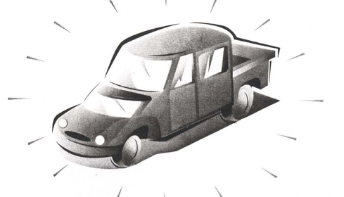
Design for everyone or design for one?
Notes:
When we design for everyone, we run into the problem that we annoy them a lot.
Now, a large population is 50% happy.
Whereas, if we took a different approach, where we came up with one car for one kind of user, then we would make them 100% happy, or even better 100% ecstatic.
So, it is often useful to think about designing “for one user”

Slide 7
Challenge of design with engineers
What is the nature of skill?
power users – computer-literate users – naïve users
➔ insufficiently nuanced
Rupak, network installer
Shannon, accountant
Dexter, VP of business development
Roberto, telemarketing rep
Notes:
Insufficiently nuanced.
Rupak – network installer who is very adept at getting things working, but has no real idea how things work. He relies on supersitition and lore
Shannon is accountant. Doesn’t know about web, email, networks, filesystem, but is a whiz at Excel.
Dexter VP of business development. Caries a pager, two cell phones, a computer, and wireless modem. Master of technology, but doesn’t have time to solve problems.
Roberto, telemarketing rep. Doesn’t know a thing about computers, but can follow complex instructions without difficulty. With a little bit of training, he can be a pro.
Example from Cooper, p131

Slide 8
Challenges of design with engineers
Feature debates
“What if the user wants to print this out?”
Programmers live and die by edge cases
Design is about the “center case”
Average person in Calgary has 2.3 kids
Who is the average?

Slide 9

The Elastic User
Can mean everyone and thus no one
  vague audience means unfocused design
  design defines user after the fact
  lack of specifics means its easy to rationalize any design
image from p.127, The Inmates are Running the Asylum
Notes:
It is imprecise
It doesn’t allow us to make decisions
Talking about “the user” gives programmers license basically to do whatever they want
“The User” is almost the only thing people talk about in this way. Think about the games you play. – v specific about what h/w and o/s it can run on.

Slide 10
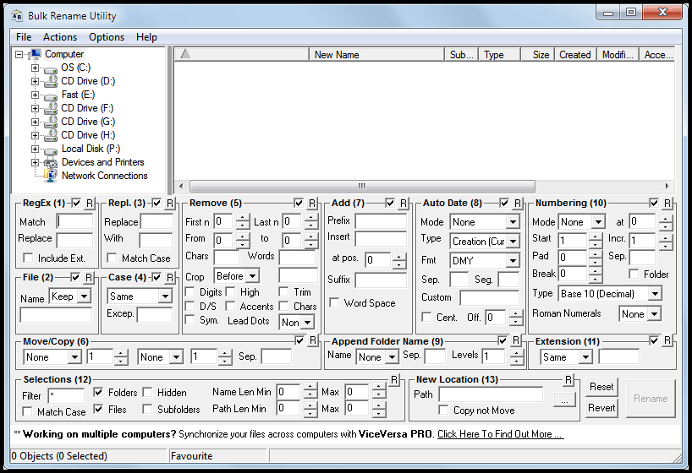
The Elastic User (defined after the fact)
An expert who wants plentiful renaming options
image from http://blog.ideaday.de/max/2010/11/example-for-a-bad-user-interface/

Slide 11
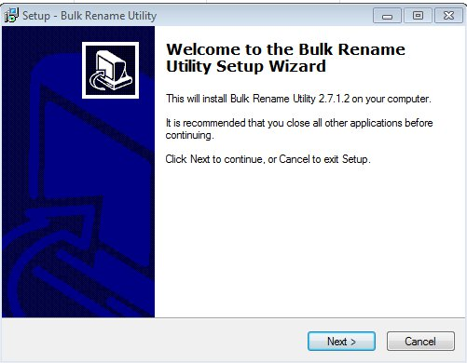
The Elastic User (defined after the fact)
Or a naïve user?
image from http://blog.ideaday.de/max/2010/11/example-for-a-bad-user-interface/

Slide 12

The Elastic User (self-referential)
The user is me (even if he or she isn’t)
image from http://blog.ideaday.de/max/2010/11/example-for-a-bad-user-interface/

Slide 13
Personas: a Design Strategy
Focus on the specific needs and goals of a single, archetype individual based on user research. The archetype should be specific and precise so that it can be used to make decisions when with regard to scope and design.
Designing for such an archetype allows us to do really well at making this person happy. Often, it results in something that ends up working well for others, too.
e.g. bags with wheels (commercial airline pilots; Post-It notes for hymns)

Slide 14
Example
G4K Company
Produces children’s educational and game software
Goal: make a corporate destination site for kids
  child-oriented entertainment
  news
  merchandise related to G4K software
This example and the following images are from: The Persona Lifecycle. John Pruitt and Tamara Adlin. Morgan Kaufmann (Elsevier), 2006

Slide 15
The Elastic User
I’ll gladly surf to your web site
I will love using it
I will buy your stuff
I’ll spend hours navigating your pages
I know how to download software
I have a credit card so I can pay
I am totally nto action games
I like dolls
Parents? What parents?
…

Slide 16
Making the User Real
do they have computers?
how do they use them?
what do they know?
what are their interests?
do they use the web?
what do they like doing online?
…
Captured as Personas
allows us to think about their goals
allows us to think about their usage contexts
allows us to think about their skills

Slide 17
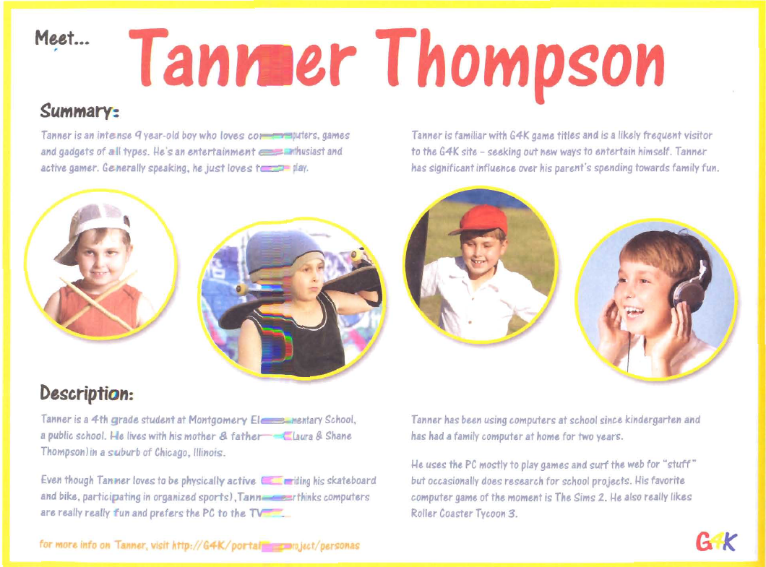

Slide 18
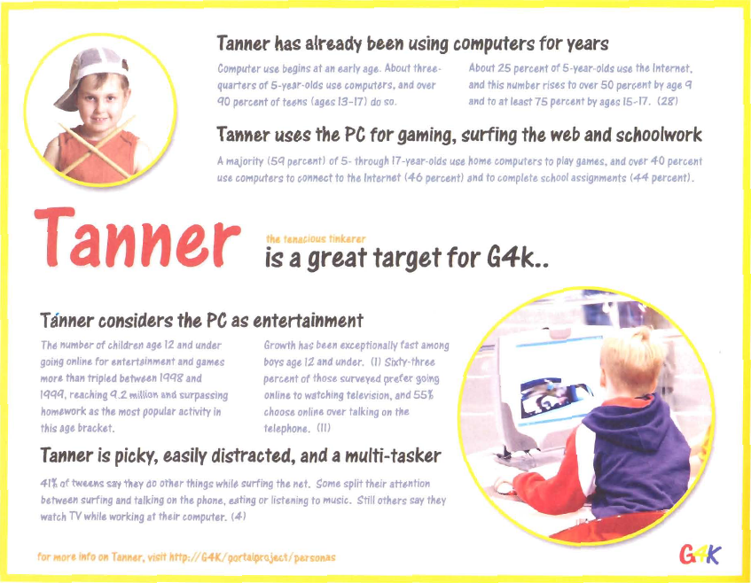

Slide 19
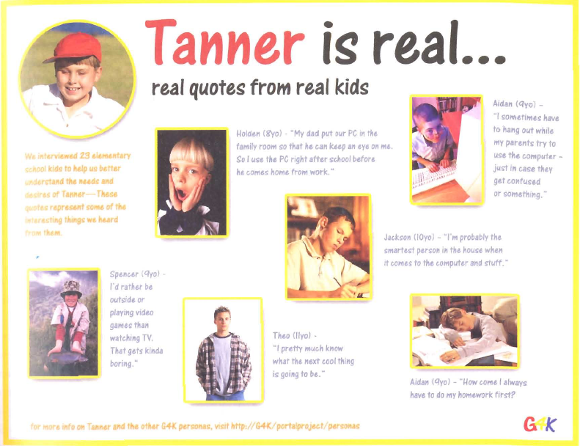

Slide 20
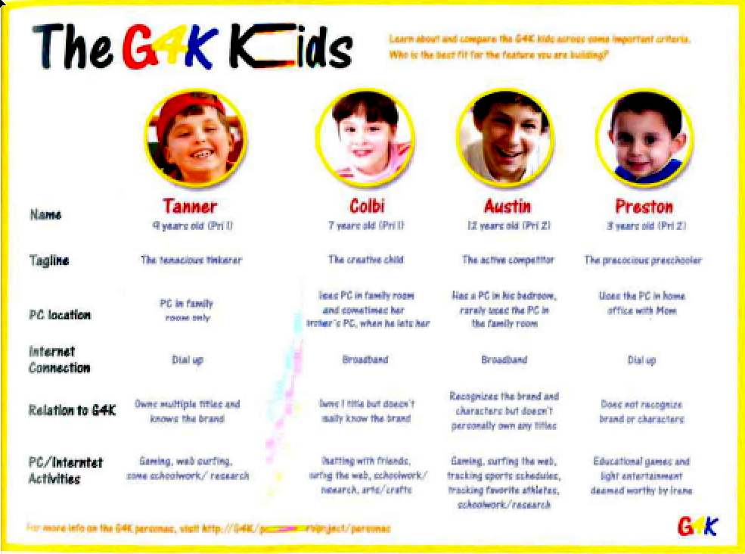

Slide 21
Making the User Real
User requirements analysis
Use Cases
Task centered system design
  provide specifics about particular user’s needs and tasks
  a good start, but can’t anticipate (nor inform) all design decisions

Slide 22
Making the User Real
User research
  gather data about intended audience
How?
  stakeholder interviews
    business and technical context surrounding the product
    preliminary product vision
    budget and schedule
    technical constraints and opportunities
    business driers
    stakeholders’ perception of the user
    …

Slide 23
Making the User Real
User research
  gather data about intended audience
How?
  customer interviews (customer may not be the user!)
    goals in purchasing the product
    frustrations with current solutions
    decision process for purchasing intended product
    role in product installation, maintenance, and management
    domain-related issues and vocabulary
    …

Slide 24
Making the User Real
User research
  gather data about intended audience
How?
  user interviews
    context of how product (or analogous system) fits in their lives or workflow
    their domain knowledge for this activity
    current tasks and activities: that the product is and isn’t supposed to support
    goals and motivations for using this product
    problems and frustrations with current products
    …

Slide 25
Making the User Real
User research
  gather data about intended audience
How?
  user observations
    non-obtrusive capture of specific activities
    how they get things done
  field studies
    capture broader activities
    how activities fit together in their ecosystem
  contextual inquiry
    master/apprentice model of learning
    observing and asking questions
  …

Slide 26
Making the User Real
User research
  gather data about intended audience
Issues?
  rich data, but
    un-integrated
    needs to be interpreted
    high learning curve to assimilate
    too much for ‘casual’ team members to use
    easy to forget over long project
    easy to forget big picture

Slide 27
Making the User Real
Personas
  a surrogate
  based on research
  pseudo-fictional character representing a user archetype
  a composite
  concrete descriptive model of intended user
  as a set, explores ranges of archetypes and behaviours

Slide 28
Personas
Why?
  Precise way of thinking about
    how users behave
    their motivations
    how they think
    what they wish to accomplish (goals)
    why they want to do what they do

Slide 29
Personas
Why?
  Within the team
    provides a shared understanding
    engage in empathy of design towards a target user
    helps communicate who you are building the product for
    helps determines what the product should and shouldn’t do
    serves as a stable reference point during the design process
    provides focus
    a stand-in for actual users
    testable via walkthroughs

Slide 30
Personas
Characteristics
  based on research
  archetypes represented as individual people
  not a real person, but a composite archetype
    each represents groups of users
As a set
  explores ranges of archetypes and behaviours

Slide 31
Persona
Basic structure
  specific narrative
  describes a specific usage pattern
  embodied in a specific fictional user
  by means of text and images
  and based on data
Includes
  name
  photo
  goals
and a mix of
  key characteristics
  motivations
  context
  activities
  narrative story
  representative quotes
  pain points…

Slide 32
Example 1 (by Robert Barlow-Busch)
From:
http://chopsticker.com/2007/06/08/download-an-example-persona-used-in-the-design-of-a-web-application/
ClickDox had an idea that people would be willing to pay for a
web application that lets them
send and receive confidential documents online
as opposed to sending them by courier (too slow and expensive) or as email attachments (too insecure).

Slide 33
Example 1 (by Robert Barlow-Busch)
Data Collection: User interviews
What are people’s overall job goals?
    By understanding what fundamentally motivates people in their jobs, we can design ClickDox’s web application so people feel it contributes to them achieving something important.
2. What’s the context in which they’d use ClickDox?
    By understanding the many factors that influence people on the job, we can design ClickDox so it feels like it was made just for them.
3. What are their current behaviors around document exchange?
    By understanding how people get things done today, we can design ClickDox to help them do it better.

Slide 34
Example 1 (by Robert Barlow-Busch)
Main Discoveries
Security was not as important as had been thought
2. People’s email client was a central tool in their jobs.
3. All struggled with large files that exceeded the mailer’s size limit
Result
Original strategy stressed security.
New result stressed ease of sending large files

Slide 35
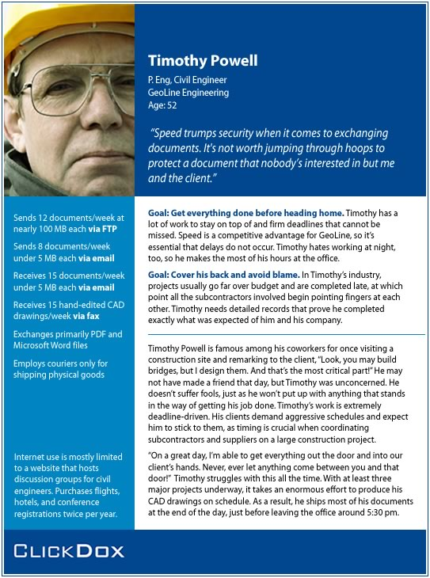

Slide 36
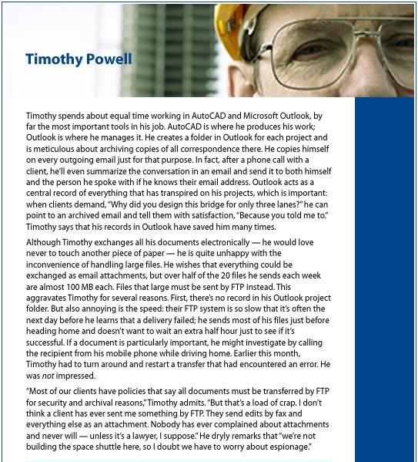

Slide 37
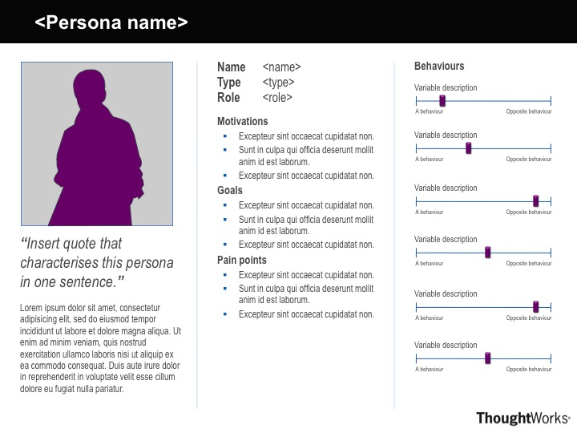
A Persona Template by Ben Melbourne from http://asinthecity.com/2011/05/13/explaining-personas-used-in-ux-design-%E2%80%93-part-2/

Slide 38
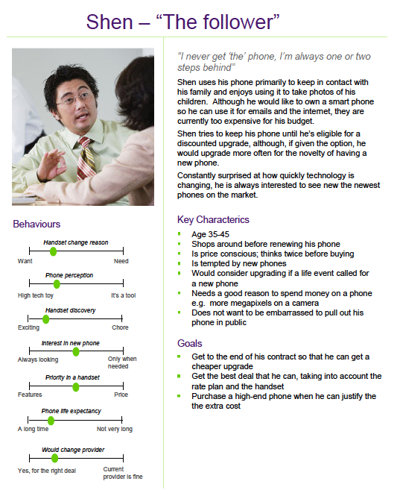
Handset upgrades
Persona Examples by Ben Melbourne
http://asinthecity.com/2011/05/13/explaining-personas-used-in-ux-design-%E2%80%93-part-2/

Slide 39
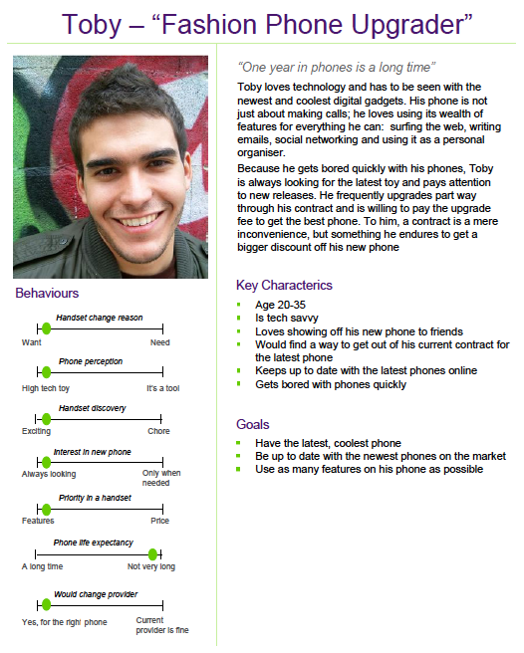
Handset upgrades
Persona Examples by Ben Melbourne
http://asinthecity.com/2011/05/13/explaining-personas-used-in-ux-design-%E2%80%93-part-2/

Slide 40
You now know
1. The Elastic User is problematic
2. Good Design requires Making the User Real
3. Personas define ‘real’ Archetype Users
4. Personas
  use the design funnel to develop ideas with
  the best ones considered for green/red light appraisal

Slide 41
Sources and Further References
The Inmates are Running the Asylum. Alan Cooper.
Sams, 1999 (Chapter 9)
About Face 3. Alan Cooper, Robert Reimann & David Cronin.
Wiley Publishing, 2007 (Chapters 4 & 5)
The Persona Lifecycle. John Pruitt and Tamara Adlin.
Morgan Kaufmann (Elsevier), 2006
Using Personas. Slide deck by Andrea Resmini:
http://www.slideshare.net/resmini/personas-5431493?from=share_email

Slide 42
Assignment (in relation to P2)
Create three personas:
2 persona that represents each of the individuals
1 “persona” that represents the relationship
For Wednesday, be prepared to present these personas as a small powerpoint deck (employ visuals, look at samples – see website).
Based on this feedback, iterate on both your personas, and your P2 sketches.

Slide 43



Permissions
You are free:
  to Share — to copy, distribute and transmit the work
  to Remix — to adapt the work
Under the following conditions:
Attribution — You must attribute the work in the manner specified by the author (but not in any way that suggests that they endorse you or your use of the work) by citing:
  “Lecture materials by Saul Greenberg, University of Calgary, AB, Canada. http://saul.cpsc.ucalgary.ca/saul/pmwiki.php/HCIResources/HCILectures”
Noncommercial — You may not use this work for commercial purposes, except to assist one’s own teaching and training within commercial organizations.
Share Alike — If you alter, transform, or build upon this work, you may distribute the resulting work only under the same or similar license to this one.
With the understanding that:
Not all material have transferable rights — materials from other sources which are included here are cited
Waiver — Any of the above conditions can be waived if you get permission from the copyright holder.
Public Domain — Where the work or any of its elements is in the public domain under applicable law, that status is in no way affected by the license.
Other Rights — In no way are any of the following rights affected by the license:
  Your fair dealing or fair use rights, or other applicable copyright exceptions and limitations;
  The author's moral rights;
  Rights other persons may have either in the work itself or in how the work is used, such as publicity or privacy rights.
Notice — For any reuse or distribution, you must make clear to others the license terms of this work. The best way to do this is with a link to this web page.

