Slide 1
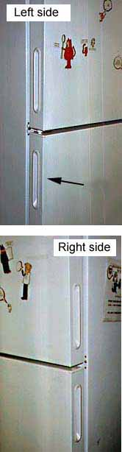
Open this refrigerator on the first try…
Notes:
http://www.baddesigns.com/fridge.html

Slide 2
Outline
What makes good interface?
What is design?
Why design is hard
Different kinds of error
What we need to be good designers

Slide 3
What makes a good interface?
CPSC 481: HCI I

Slide 4

What makes a good experience?

Slide 5
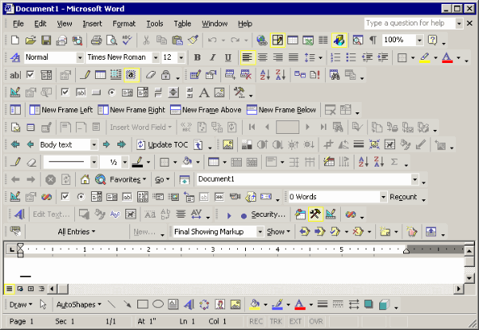
What makes a good experience?

Slide 6
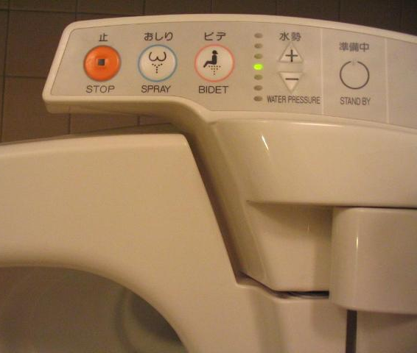
What makes a good experience?

Slide 7
Characteristics of a good interface…
… people feel satisfied when they use them
… people can complete their tasks error-free
… people can complete their tasks quickly*
… people can learn how to use the system (and its full functionality) quickly*
* Why the asterisks?

Slide 8
What is design?
Creative endeavor
Process of creating or shaping tools or artifacts for direct human use.
Outputs are things
people-centered concerns
Processes, methods

Slide 9

design vs. engineering
Engineering
  Make a mostly-known outcome possible
  Construct a sturdy bridge based on specifications
  Concerned with what can be done
  Reliance on well-established formulae
  Humans may or may not be directly “in the loop”
Design
  Envision new possibilities, new outcomes
  Determine what outcome should result among infinite possibilities
  Reliance on process over formulae
  Humans are central actors “in the loop”
  Context [cultural and temporal] matter

Slide 10
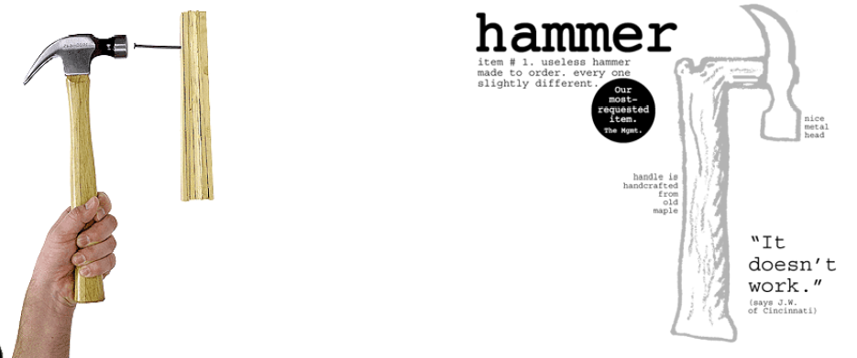
design vs. art
Design (as we regard it) concerns the creation of something useful and usable
Art does not bother with this restriction
  The test: how to deem what is “good”?

Slide 11
Why should we care?
Shift of attention in computer science:
Algorithms → People

Slide 12

Moore’s Law
Gordon Moore (Intel): 1965
“The complexity for minimum component costs has increased at a rate of roughly a factor of two per year... Certainly over the short term this rate can be expected to continue, if not to increase. Over the longer term, the rate of increase is a bit more uncertain, although there is no reason to believe it will not remain nearly constant for at least 10 years.”

Slide 13
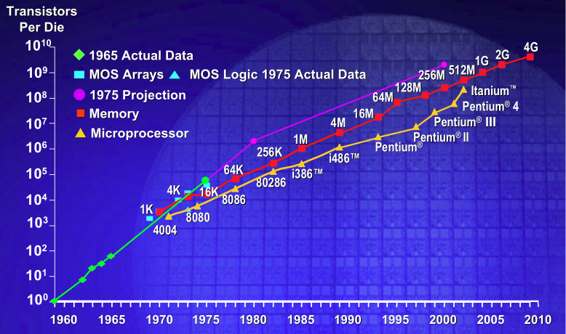
Moore’s Law… bang on so far

Slide 14
People stay the same smartness law…
Human cognitive ability
human
abilities
2000BC
1950
1990
2030

Slide 15
What is designed?
Anything consciously intended for human use is designed.
Notes:
But, what about our characteristics?

Slide 16
Characteristics of a good interface…
… people feel satisfied when they use them
… people can complete their tasks error-free
… people can complete their tasks quickly*
… people can learn how to use the system (and its full functionality) quickly*
* Why the asterisks?
Notes:
Why can’t these be used?

Slide 17
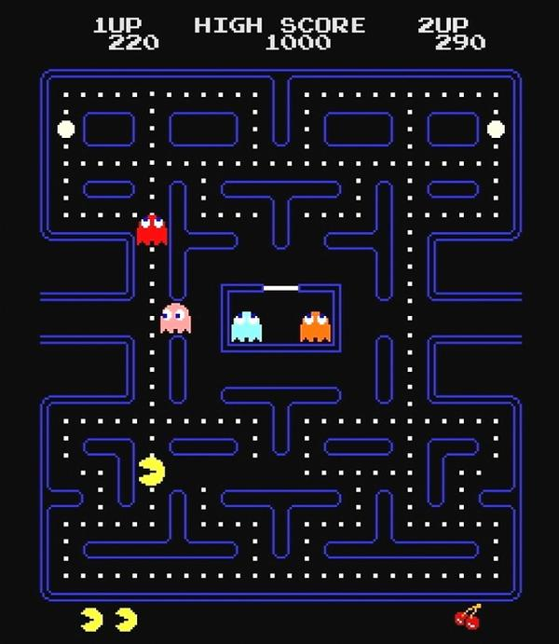
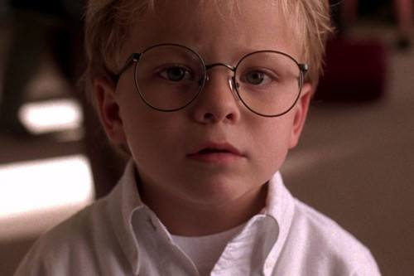



Why is design hard?
Notes:
Billy Mitchell
-=-=-=
Everyone is different… and in what ways?

Slide 18
Why is design hard?
Everyone is different
  Age, knowledge, skill, ability, background
People appropriate technology unexpectedly…
  Designer’s fallacy: that a designer can design into a technology, its purposes and uses
Contexts of use may differ than what we expect
  Smartphone app use in the early days, and now
Notes:
Billy Mitchell

Slide 19
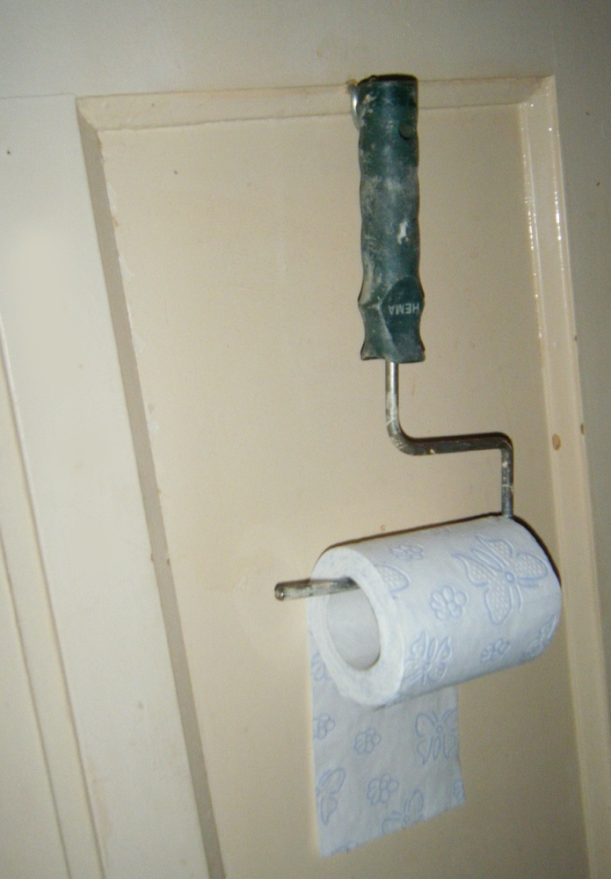
Appropriation
In action…
Notes:
http://www.museumofunintendeduse.com/

Slide 20


How are smartphones used?
Notes:
http://liveindia.tv/wp-content/uploads/2011/09/images/Texting-While-Walking_Gard-thumb-590x437-460481.jpg
http://static.guim.co.uk/sys-images/Guardian/Pix/commercial/2011/4/19/1303232872553/Woman-with-smartphone-lyi-007.jpg

Slide 21

Notes:
http://whitechristmassisters.blogspot.ca/2011/04/riding-bike-while-texting-really.html

Slide 22
Why is design hard?
Judging/predicting which designs will be successful is difficult
  Way more is possible than what is good
Design involves making trade-offs
Good designs are non-obvious

Slide 23
People make errors: two kinds…
People make errors
  slips: error in carrying out an action [e.g. motor action]
  mistakes: error in choosing an objective or action [e.g. cognitive goal]
Key: mistakes typically occur when a person misunderstands something in the system; a slip you could imagine to be a lapse in attention, or due to a change in typical circumstance
The distinction matters because as designers, we want to help users avoid mistakes. With careful design, we can help avoid slips, too.
Notes:
http://www.measuringusability.com/blog/errors-ux.php
http://www.interaction-design.org/encyclopedia/human_error_slips_and_mistakes.html

Slide 24

Slip vs. Mistake
Imagine you are using a mapping application wanted to find something, and clicked this icon.
Let’s pretend that in the application, the icon meant to magnify.
Is this a slip or a mistake?
Notes:
http://en.wikipedia.org/wiki/File:Magnifying_glass_Icon.png
How should we fix it?

Slide 25
Slip or mistake?
Exercise: classify these
  Mistyping an email address
  Clicking on a heading that isn’t clickable
  Clicking “Save” instead of “Open”
  Sending an email without remembering to add the attachment
  Typing both first and last name in the first name field
Notes:
http://www.measuringusability.com/blog/errors-ux.php
Slip
Mistake
Slip
Slip
Mistake

Slide 26
Core design skills
To synthesize a solution from all of the relevant constraints, understanding everything that will make a difference to the result
To frame, or reframe, the problem and objective
To create and envision alternatives.
To select from those alternatives, knowing intuitively how to choose the best approach.
To visualize and prototype the intended solution

Slide 27
“The user is not like me”
Familiarity with the interface problems being solved
Confidence
Designer’s setting vs. user’s setting
Designers have different skills (perceptual, cognitive, or domain)

Slide 28
You now know…
Some characteristics of a good interface
Design (vs. engineering; vs. art)
Motivation for design
Why design is hard
characteristics of people
randomness of people (appropriation)
unexpected contexts of use
Different kinds of error (slips vs. mistakes)
What we need to be good designers
Mantra: the user is not like me

