Slide 1
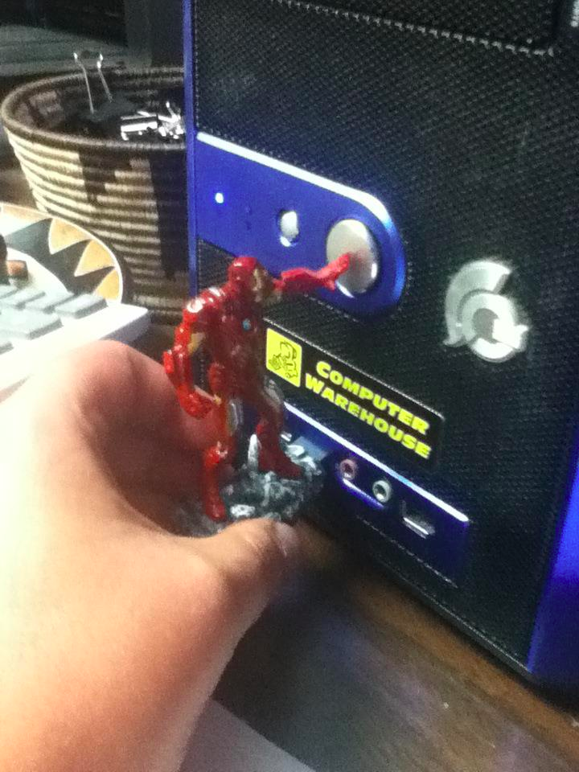
reddit.com
Notes:
http://www.reddit.com/r/funny/comments/10zcr2/i_just_got_trolled_by_the_iron_man_avengers_usb/

Slide 2
Interested in research/grad school?
I’m happy to chat
Grad school: get paid to go to school
If you’re interested, consider applying for the NSERC CGM. Deadline is Dec 1 (earlier Nov 14 deadline, too) -- $17.5k/y

Slide 3
Midterm – next Friday
Coverage: everything up to the end of Prototyping (today)
Focus: I am mainly interested that you are able to recall & understand the concepts, and can apply them in a logical way. You should be able to explain the main concepts and/or rationalize them.
How to study: review the “quiz” questions from each lecture; review notes from lecture; the readings that I have assigned you, as well as your assignments.
Exam: Closed book. Arrive early. Be concise. Mostly: short-answer questions.

Slide 4
481 – Prototyping Exercises

Slide 5
Questions
What are some reasons why we should use prototyping?
List some pros and cons of hi fidelity vs. lo fidelity prototyping
Explain the difference between a horizontal prototype vs. a vertical prototype
What are three ways prototyping can be integrated into an organization’s software engineering process?

Slide 6
Pros and Cons (lo-fi vs. hi-fi)
 | Lo-Fi | Hi-Fi
Pros | )* people are more likely to provide honest crtique (since it doesn’t look finished – they won’t hurt your feelings) Cheap and easy Often times faster to make Everyone can make one * because they’re faster to make, you can iterate more times * easy to throw them away You can have many of them Focus is on the functionality They aren’t specific to any hardware or software that exists | You can build on top of it (saactually iterate on the code itself More realsistic expectation of the output Requires little imagination on the part of the stakeholder Confidence (heads up on what it will look like) Stakeholders like it when it looks nice Shows extra detail than the lo fidentlity
Disadvantages | Not realistic Too cheap – stakeholderdeveloper may lose face Sunk cost (it’s sort of wasneeds to be discarded) | Take a longer time to make Has to be done by a developer (often) Optimizing the prototype (time is wasted) If it has to be discarded, then maybe you lose a lot
Notes:
Fill it in!

Slide 7
Hi-fi vs. Lo-fi: “From the experts…”
 | Lo-Fi | Hi-Fi
Advantages | » ***fast*** » cheap » easy – kindergarten skills! » can simulate actual product » great way to get feedback from stakeholders | » better sense of finished product » can judge aesthetic appeal » more realistic experience » can evaluate the experience better » probably more convincing for stakeholders
Disadvantages | » slow response time » can’t get feedback about aesthetics » user may question design quality | » users may focus on unnecessary details » takes a lot of time to make » users may lose track of big picture

Slide 8
Integrating Prototypes in Organizations
evolutionary
  » prototype is altered to incorporate design changes
  » eventually becomes the final product
2. modular (incremental)
  » product is built as separate components (modules)
  » each component is prototyped and tested, then added to final system
3. throwaway
  » prototype serves to reveal user reach, then discarded
  » creating prototype should be rapid, otherwise can be expensive
Notes:
-- Many large systems (e.g. Twitter/Facebook) can be considered to be built with an evolutionary approach (timeline feed): modern SCRUM techniques
-- On the other hand, many of the feature areas are often designed somewhat independently of one another (Ebay: automobiles site is independent of rest of site; Yahoo: cars, mail, calendar, etc.):: traditional SENG
-- Modular is suitable for very large products with a lot of component pieces. The downside is trying to come up with a unifying interaction metaphor or theme. The U of Calgary website (as a whole) is a good example. There are published guidelines, etc., but these are rarely followed.
-- HCI research often gets to take a throw-away approach. This is more suitable for products where the main learnings are in the process of development, rather than being the end-goal itself

Slide 9
Nordstrom video
What did you see?
Notes:
http://www.youtube.com/watch?v=szr0ezLyQHY
Prototyping and user feedback in a tight loop

Slide 10
Prototype of a prototyping environment
Illuminating light video
Notes:
https://vimeo.com/48600709

Slide 11
“Tangible Prototypes”
URP video
Notes:
This is obviously a very very slick prototype, and it works
What did you see in there?
What does the video show?
What are the key ideas that are there?
Going beyond exactly the application they showed, what are they trying to tell us?

Slide 12
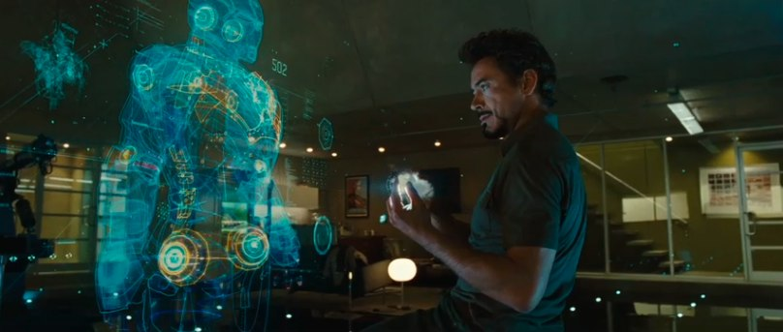
Cool video prototype
Notes:
Xkcd

Slide 13
For next week…
481 Class Site > Readings > Task Centered System Design
Sound files aren’t done yet: Sorry about this.
Monday: A2 is due. Questions?
Friday: Midterm – YAY!

