Slide 1
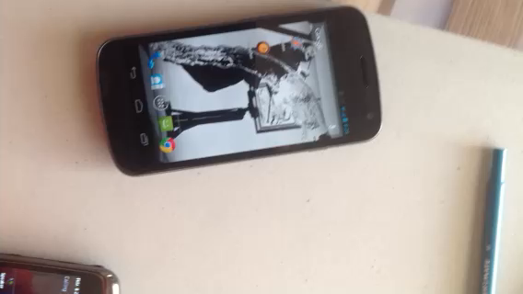

Slide 2
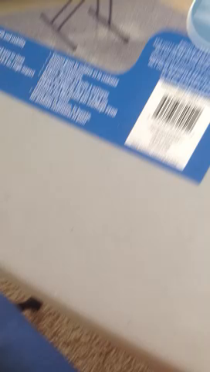

Slide 3
Thumb-meat example on phone
Main message: you don’t know who your users are, and often, you need to test your interface in the field to see if it’s going to work

Slide 4
Investigation…
CPSC 481: HCI I
Fall 2012
Anthony Tang, with acknowledgements to Julie Kientz, Saul Greenberg, Ehud Sharlin, Jake Wobbrock, Dave Hendry, Andy Ko, Jennifer Turns, & Mark Zachry

Slide 5
Think about my “thumb-meat” example…
What does it tell you?
  Breakdowns
  Opportunities for a new design
  Workarounds
  Mismatches between what users say and do
This is what observing people can help you discover

Slide 6
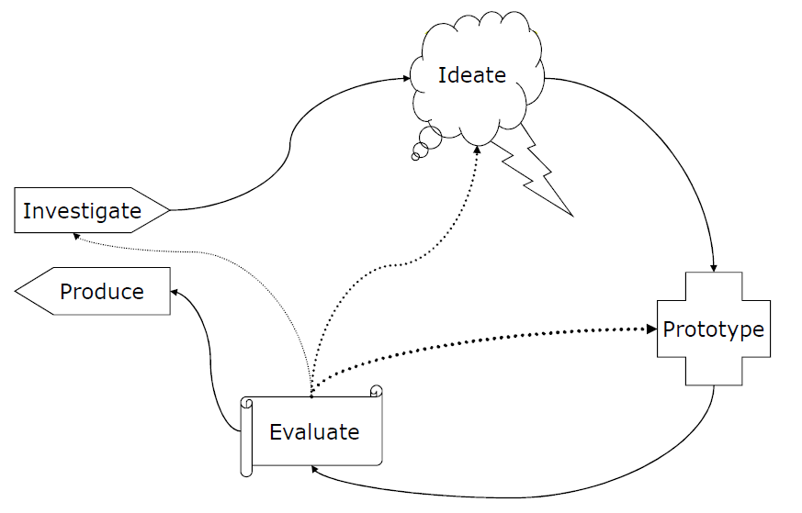
Notes:
Next few lectures, focus on the “investigate” thing

Slide 7
Investigate Phase Goals
Understand the state of the world, the state of our users, and what the problem is.
How can we go about doing this?

Slide 8
Imagine…
You are trying to design a better mop.
What do we need to find out?
How are we going to do that?

Slide 9
What people say…
Can we rely on what people say about what they want in a new design?
  Only kind of: people are really only good at framing their needs within the language of their current designs
  Henry Ford: “If I had asked my customers what they wanted, they would have said a faster horse.”
Often, people can’t see past their immediate problems to the possibilities

Slide 10
What people say…
How many hours did you sleep last night?
How many hours did you sleep last Monday night?
People have a bad memory

Slide 11
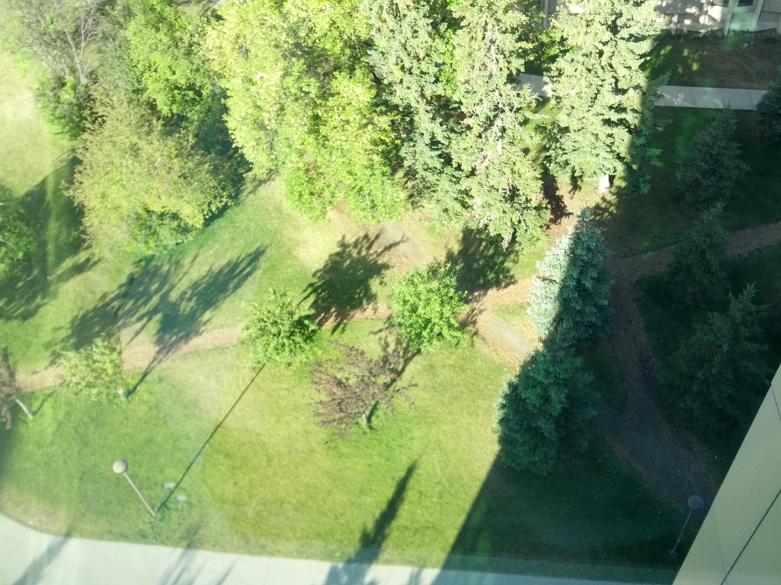
What people say…
Where do people need to walk around campus?

Slide 12
What people say…
12
Sometimes, people forget workarounds that they have already established to solve problems

Slide 13
What people say…
Where should we put the hand sanitizer?
Closer to the door, or on the other side of the light switch?

Slide 14
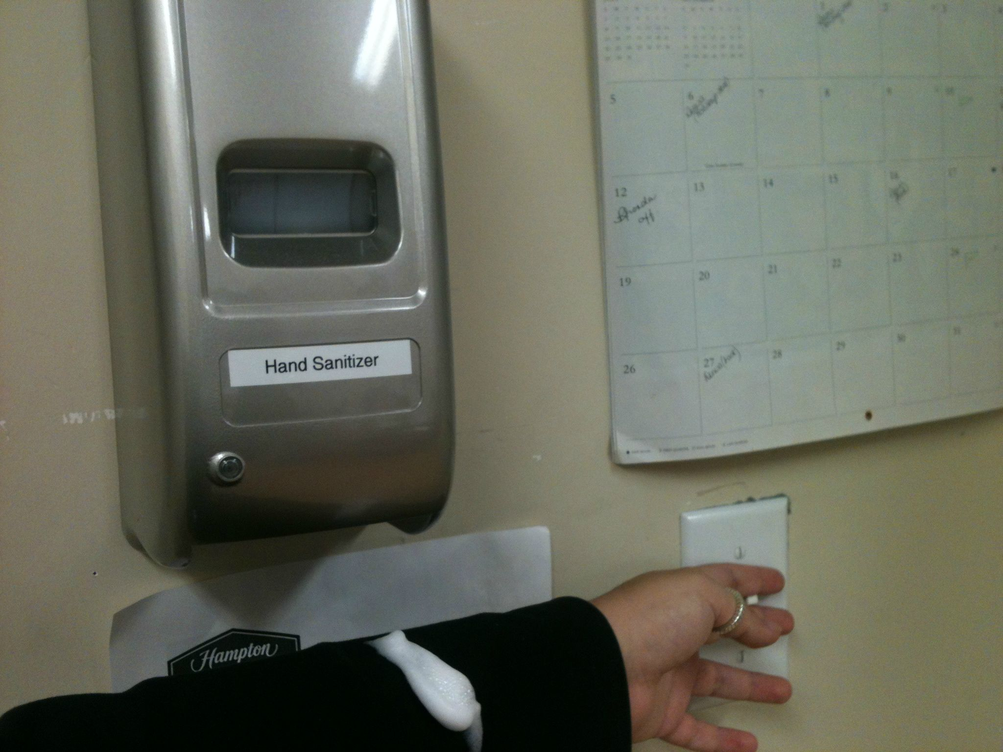
What people say…
People can be bad at predicting what they’d prefer if it is only hypothetical.

Slide 15
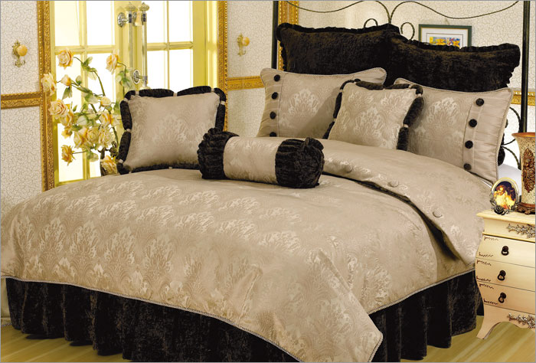
What people say…
Mismatches between what they say and do = GOLD
Notes:
Story about bloomingdales research
Trying to up the sales of bed sheets
Brought in focus groups, lined up a bunch of bed sheets: pick which ones you like the best
Only sold those for a while, but sales didn’t pick up
Brought them back in, and asked the same thing. At the end, they said to people, “So, we don’t need these any more, feel free to take one home with you.” They picked a different one.
Why?
Task asked: which do you like; task didn’t ask, “which would you use at home.”

Slide 16
What people say…
Jimmy Kimmel iPhone 5 first look
http://www.youtube.com/watch?v=rdIWKytq_q4
People can be unduly influenced by cultural context (hype), and what they think you expect them to say (this rocks!).

Slide 17
What people say…
People may lie—deliberately to save face (embarrassment)
People may lie—deliberately to save face (cultural / polite)
People may lie—their boss is around

Slide 18
Wait, are people completely useless?
People are really good at telling us a few things:
  What they are doing right now.
  How they are feeling right now.
  What their goal is right now.

Slide 19
Combine Interview with Observation
Watch people in their own environment
Watch people do everyday tasks
Opportunities for new designs arise from:
  Workarounds
  Breakdowns
  Unexpected uses of existing tools

Slide 20
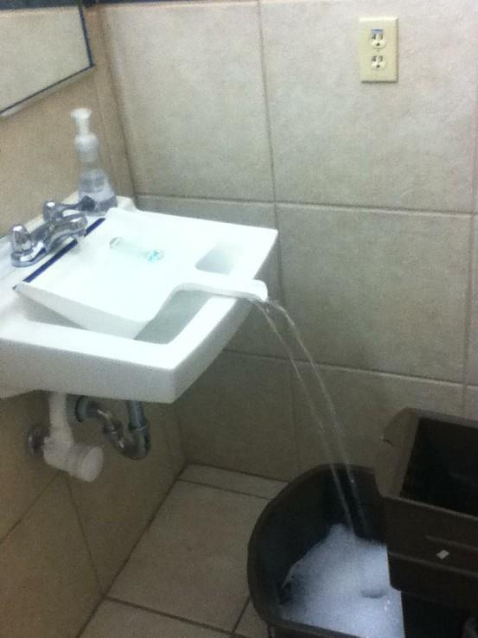
What people don’t say…
While this is extremely clever (I think), it’s unlikely that anyone would say this
This is something you’d have to go to see to know/understand
Notes:
http://lifehacker.com/5876167/use-a-dustpan-to-fill-containers-that-dont-fit-in-your-sink

Slide 21
Two Messages
Using a combination of what they are good at telling us, and observing them can tell us a lot → mismatches between what they say and what they do often lead to new designs
Your assumptions are likely to be wrong. To discover more, assume that your assumptions are always wrong.
Notes:
Example of the first one: bloomingdales thing

Slide 22
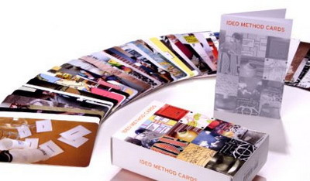
IDEO Method Cards: Course Site > Readings
Available from William Stout publishers ($49)

Slide 23
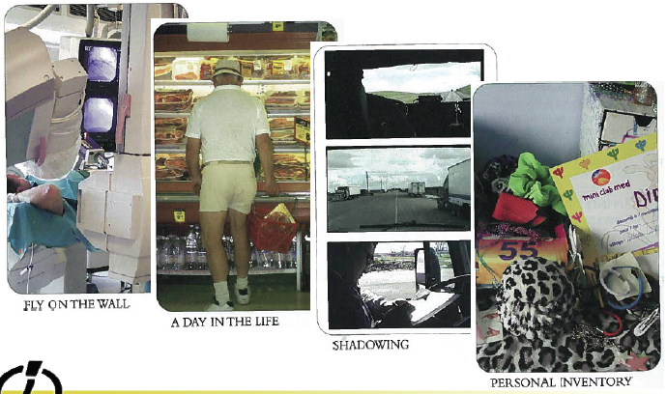
LOOK at what people really do

Slide 24
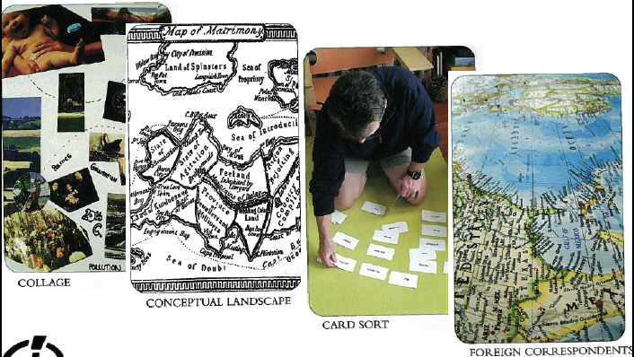
ASK users for help

Slide 25
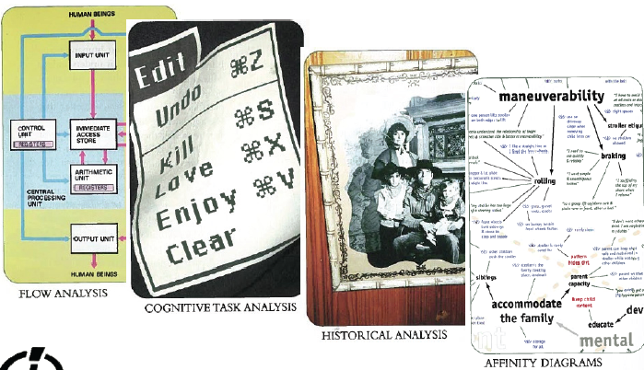
LEARN from the facts you gather

Slide 26
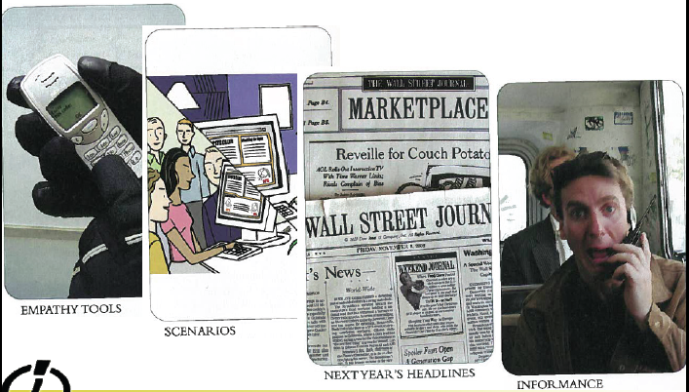
TRY it yourself

Slide 27
Assume you are wrong.

