Slide 1
Last Lecture
CPSC 481: HCI I
Winter 2014
Anthony Tang

Slide 2
Outline
Final exam
My thoughts and goals
Research in HCI

Slide 3
Final Exam
Saturday, April 19
8:00am – 10:00am
ST 147
Concepts over rote memorization
» understand the terms
» compare and contrast
Emphasis on latter half of course (post-midterm)
Revise your lecture notes
Revise your tutorial notes
Highlight and summarize important terms and concepts

Slide 4
Questions about final?

Slide 5
My Thoughts
Sensitivity
Spaces for possible designs
Motivating good design practices
Notes:
Sensitivity to good/bad design → things you “know”, but it wasn’t pointed out
Showing you that even with simple projects, there are a wide space of possible designs
--working in teams
--across teams, same project
--communication to users, but also about and of ourselves
When asked, there are no “right” answers. There are definite “wrong” answers. Goal: teach you to identify the tradeoffs in different possible designs
Motivating good design practices
-- helping you to identify these tradeoffs

Slide 6
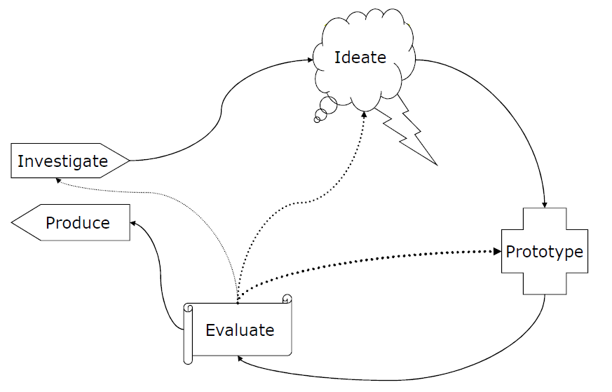
More Thoughts
Humbling you and your intuitions
Teaching a certain “logic” to design
Notes:
Showing that even your best efforts are sometimes not good enough
--Showing your interface to real users: what do they think?
Backing up the logic with foundation knowledge

Slide 7
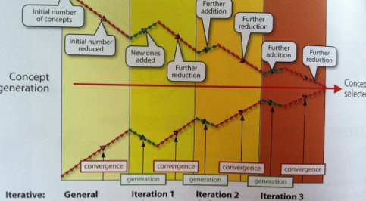
Another thought
Notes:
Design is as much about figuring out how to fit a set of features into a system as it is about reducing the feature set – not just visual feature set, but also which features to actually include

Slide 8
In the “real” world…
Identify and test assumptions about design/use
Design, even in little ways, with a deeper understanding of who your users may be
» not always “end-user” as in consumers

Slide 9
Questions about final?

Slide 10
Thoughts on Projects
P4 presentations were generally very good – awesome
Reflection was evident

