Slide 1
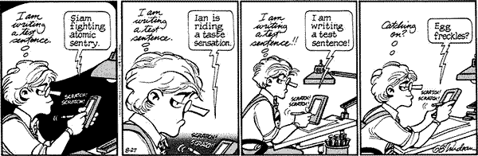
Robustness of handwriting recognition systems
Is this about gulf of execution or gulf of evaluation?
Notes:
http://images.ucomics.com/comics/db/1993/db930827.gif

Slide 2
What was all that direct manipulation mumbo-jumbo?
People invented GUIs
People liked GUIs
Researchers’ articulation/characterization of what it is about GUIs that make them likable/effective => “Direct manipulation”
Notes:
Carry these lessons forward, beyond particular instantiations

Slide 3
WIMP <==> GUI
Windows, Icons, Menus, Pointers
Main lesson:
Easier to find things (recognize) than it is to remember things (CLI)
Notes:
A window runs a self-contained program, isolated from other programs that (if in a multi-program operating system) run at the same time in other windows . Developed by Gene McDaniel at PARC
An icon acts as a shortcut to an action the computer performs (e.g., execute a program or task).
A menu is a text or icon-based selection systems that selects and executes programs or tasks.
The pointer is an onscreen symbol that represents movement of a physical device that the user controls to select icons, data elements, etc.
Pejorative use

Slide 4
Natural User Interfaces
CPSC 481: HCI I
Winter 2014
Anthony Tang
Notes:
Very little definitive on what’s going on here
There’s a lot of confusion right now in the research space, trying essentially to tease apart what has been brought on by the media in relation to specific devices, and in terms of what is really understood/postulated as the principles behind natural user interfaces
My goal today is to really give you a different way of thinking about interfaces

Slide 5
What is all this natural user interface mumbo-jumbo?
People invented {Kinect}* / {multi-touch}^
People like {Kinect}* / {multi-touch}^
Researchers’ articulation/characterization of what it is about these interfaces that make them likable/effective => “natural user interface”
* {Insert ‘physical’ game interface}
^ {Insert ‘direct touch’ interface}
Notes:
Carry these lessons forward, beyond particular instantiations

Slide 6
Learning Objectives
By the end of this lecture, you should be able to:
» Discuss “natural user interfaces” as a design philosophy
» Describe the "reality-based interface" design philosophy
» Identify and define the four core themes of the Reality-Based Interfaces philosophy
» Understand how RBI relates to various trade-offs in interface design

Slide 7
Natural User Interfaces
CPSC 481: HCI I
Fall 2012
Anthony Tang
Notes:
Very little definitive on what’s going on here
There’s a lot of confusion right now in the research space, trying essentially to tease apart what has been brought on by the media in relation to specific devices, and in terms of what is really understood/postulated as the principles behind natural user interfaces
My goal today is to really give you a different way of thinking about interfaces

Slide 8
Intuitive interface?
The only ‘intuitive’ interface is the nipple. After that, it’s all learned. – Bruce Ediger
Notes:
http://www.greenend.org.uk/rjk/misc/nipple.html

Slide 9
What does “natural” mean?
adjective
existing in or formed by nature (as opposed to artificial)
noun
a thing that is likely/certain to be suitable/successful in an endeavor without much training or difficulty

Slide 10
Thought experiment…
You make TonySoft Word. It is an exact replica of Microsoft Word. Every single feature is the exact same. UI is the exact same.
When you get a bunch of Microsoft Word users in to test TonySoft Word, they are able to do everything perfectly.
Notes:
What does this tell us about the effectiveness of this interface?
Did they have to learn anything?
Were they already good to go?
They already learned everything!

Slide 11
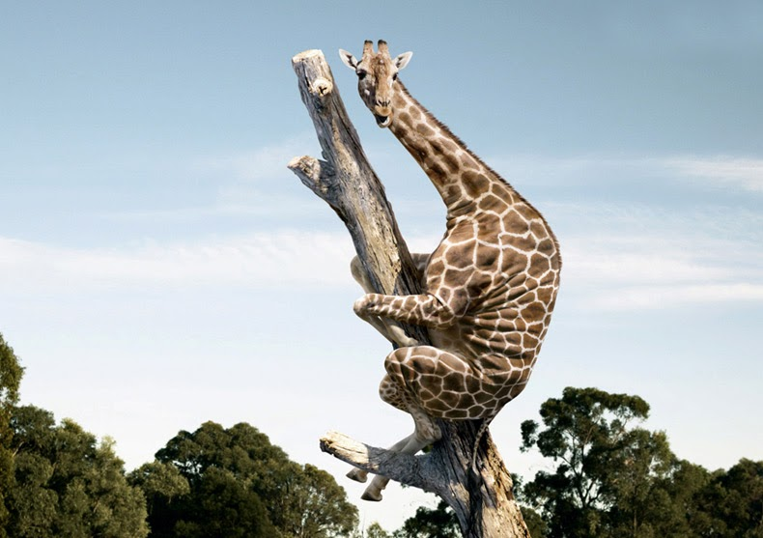
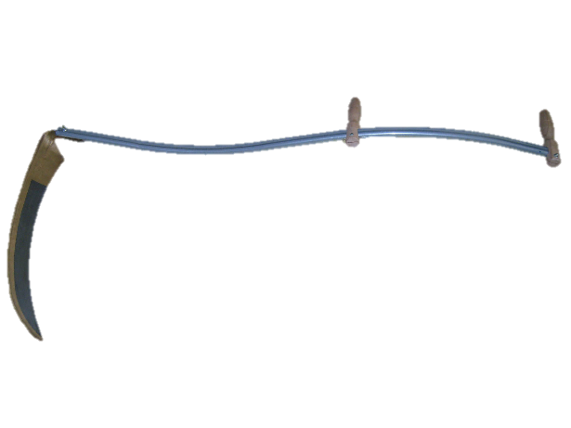
Natural User Interfaces
vs.
Natural User Interfaces
Notes:
"Everybody is a genius. But if you judge a fish by its ability to climb a tree, it will live its whole life believing that it is stupid."
NUIs have a set of strengths based on what they make easier
How they make things easier
How they shape the user’s interactions with technology
Which niches they fit into…
http://welcometothejiggle.blogspot.ca/2011/08/appropriate-expectations.html
“The way users interact with and feel while they are using a technology”
-- mirroring capabilities
-- meeting their needs
-- taking advantage of their capacities
-- fit their task and context demands

Slide 12
Scything
Notes:
http://www.youtube.com/watch?v=49NqwfaiMt8
http://www.youtube.com/watch?v=ns2Hbbw3RQE
Taking advantage of physical capabilities, naïve physics, understanding of the world
Allows

Slide 13
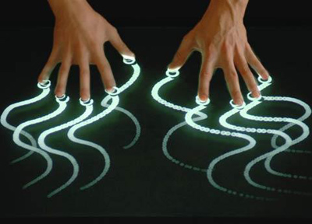
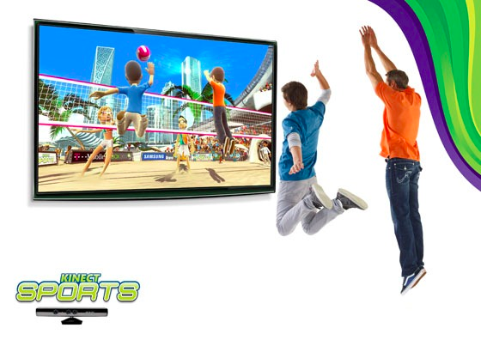
Input/Output Modalities
Provide us with the opportunity to make “NUIs”, but do not guarantee it => NUIs are not specifically input or output technologies
Notes:
Jeff Han

Slide 14
Natural User Interfaces
NUI = f(input / output capabilities, human capabilities)
NUI = feelings of efficacy

Slide 15
BumpTop
Notes:
http://www.ted.com/talks/anand_agarawala_demos_his_bumptop_desktop.html

Slide 16
Reality-Based Interfaces
One way of thinking about “Natural User Interfaces” -> ‘Reality-based interfaces’
  » Robert Jacob et al., 2008
In spite of the name, they are not advocating necessarily re-creating reality; instead, advocating leveraging our understanding of “reality” for design
Notes:
http://www.cs.tufts.edu/~jacob/papers/chi08.pdf

Slide 17
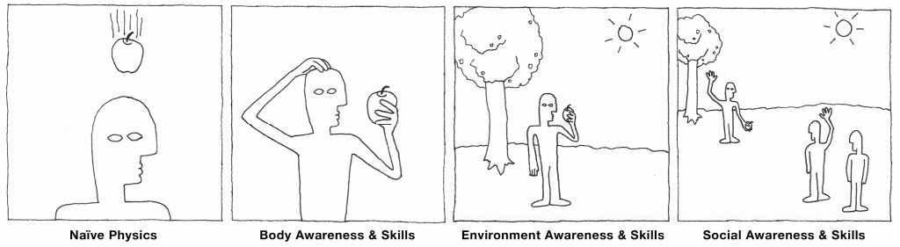
RBIs: Core Themes
Aspects of our understanding/capacities that have developed of/for the physical, non-digital world that can be leveraged for design

Slide 18
Naïve Physics
People’s common-sense knowledge about the physical world
  Friction, gravity, velocity, momentum, mass, etc.

Slide 19
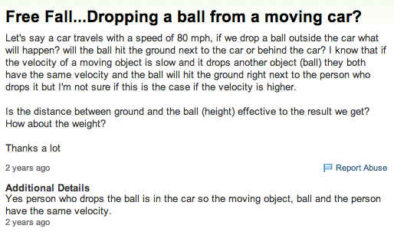
Naïve Physics…
Notes:
http://answers.yahoo.com/question/index?qid=20100914144031AAd9etH

Slide 20
Body Awareness and Skills
People have an awareness of their own physical bodies and possess skills for controlling and coordinating their bodies
  Proprioception (relative relation of limbs), range of motion.
  Coordinating body to walk, crawl, kick, throw a ball

Slide 21
Environmental Awareness and Skills
People have a sense of their surroundings and possess skills for negotiating, manipulating, and navigating within their environment
  Sense of orientation and spatial understanding
  Horizon, depth cues like shadow, lighting, etc.
  Manipulating things in the environment (positioning,altering, re-arranging objects)

Slide 22
Social Awareness and Skills
People are aware of others in the environment and have skills for interacting with them
  Verbal and non-verbal communication

Slide 23
Tradeoffs
Expressive Power: people can perform a variety of tasks in the application domain
Efficiency: users can perform a task quickly
Versatility: users can perform many tasks from different application domains
Ergonomics: users can perform a task without physical injury or fatigue
Accessibility: users with a variety of abilities can perform a task
Practicality: system is practical to develop and produce

Slide 24
Expressive Power vs. Reality
BumpTop
Cool, but limited by screen real-estate
Also limited in terms of capacity for trees of folders

Slide 25
Efficiency vs. Reality
Tangible Video Editor
Effective for a novice, but slows down an expert user
Notes:
http://www.youtube.com/watch?v=_auBtFb1WmE

Slide 26
Versatility vs. Reality
Tangible Video Editor
Only allows you to complete one type of task
Notes:
http://www.youtube.com/watch?v=_auBtFb1WmE

Slide 27
Case Studies
URP: Urban Resource Planner
Apple iPhone

Slide 28
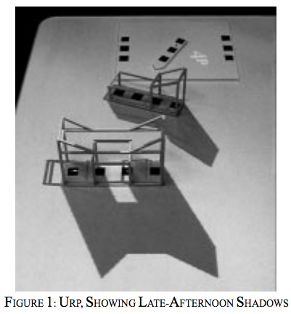
Urban Resource Planner
Makes use of naïve physics, and knowledge/understanding of environment and physical space
Moves body to change viewpoints
No need to share “a screen”, it is a physical workspace
Notes:
Trade-offs
Building material is manipualted with a wand – reality & expressive power trade off
Easy to change position, but difficult to change the shape of buildings (reality/practicality; reality/expressive power)

Slide 29
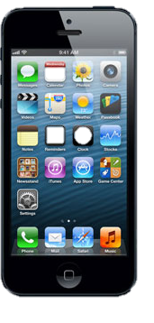
iPhone
Flicking photos (spatial metaphor)
Zoom and rubber surface (naïve physics)
Springiness/inertia – flicking contacts/ends of lists, etc. (naïve physics)
Notes:
Trade-off
Text entry keyboard – versatility over reality
Safari browser – reality over accessibility (render entire webpage

Slide 30
Learning Objectives
By the end of this lecture, you should be able to:
» Discuss “natural user interfaces” as a design philosophy
» Describe the "reality-based interface" design philosophy
» Identify and define the four core themes of the Reality-Based Interfaces philosophy
» Understand how RBI relates to various trade-offs in interface design

